Slide 1
Church and State, pt. 1

Slide 2
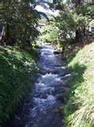
Render to Caesar
Some religious bigots came to Christ one day, hoping to trap Him with a question that truly perplexed them for which they felt there was no answer. All their lives, they had been taught that the church and the state were one. But in the case of Caesar?????

Slide 3
Shew Me a penny
“ And they watched him, and sent forth spies, which should feign themselves just men, that they might take hold of his words, that so they might deliver him unto the power and authority of the governor. And they asked him, saying, Master, we know that thou sayest and teachest rightly, neither acceptest thou the person of any, but teachest the way of God truly: Is it lawful for us to give tribute unto Caesar, or no? But he perceived their craftiness, and said unto them, Why tempt ye me? Shew me a penny. Whose image and superscription hath it? They answered and said, Caesar's. And he said unto them, Render therefore unto Caesar the things which be Caesar's, and unto God the things which be God's. And they could not take hold of his words before the people: and they marvelled at his answer, and held their peace.” LK. 20:20-26

Slide 4
The Answer
“The spies had expected Jesus to answer their question directly, in one way or the other. If He should say, It is unlawful to give tribute to Caesar, He would be reported to the Roman authorities and arrested for inciting rebellion. But in case He should pronounce it lawful to pay the tribute, they designed to accuse Him to the people as opposing the law of God. Now they felt themselves baffled and defeated. Their plans were disarranged. The summary manner in which their question had been settled left them nothing further to say.
Christ's reply was no evasion, but a candid answer to the question. Holding in His hand the Roman coin, upon which were stamped the name and image of Caesar, He declared that since they were living under the protection of the Roman power, they should render to that power the support it claimed, so long as this did not conflict with a higher duty. But while peaceably subject to the laws of the land, they should at all times give their first allegiance to God….

Slide 5
concluded
The Saviour's words, "Render . . . unto God the things that are God's," were a severe rebuke to the intriguing Jews. Had they faithfully fulfilled their obligations to God, they would not have become a broken nation, subject to a foreign power. No Roman ensign would have waved over Jerusalem, no Roman sentinel would have stood at her gates, no Roman governor would have ruled within her walls. The Jewish nation was then paying the penalty of its apostasy from God. When the Pharisees heard Christ's answer, "they marveled, and left Him, and went their way." He had rebuked their hypocrisy and presumption, and in doing this He had stated a great principle, a principle that clearly defines the limits of man's duty to the civil government and his duty to God. In many minds a vexed question had been settled. Ever after they held to the right principle. And although many went away dissatisfied, they saw that the principle underlying the question had been clearly set forth, and they marveled at Christ's far-seeing discernment. “ DA, pgs. 602,603

Slide 6
Perplexed?
How could a man be loyal to the state by paying taxes and, at the same time, be showing disloyalty to God? The Adventists of the 1st century believed that the two were one and couldn’t be separated. Christ spoke immortal truth, declaring man’s duty to government in civil things and man’s duty to his Maker in spiritual things!

Slide 7
To God
”Thou shalt have no other gods before me. Thou shalt not make unto thee any graven image, or any likeness of any thing that is in heaven above, or that is in the earth beneath, or that is in the water under the earth: Thou shalt not bow down thyself to them, nor serve them: for I the LORD thy God am a jealous God, visiting the iniquity of the fathers upon the children unto the third and fourth generation of them that hate me; And shewing mercy unto thousands of them that love me, and keep my commandments. Thou shalt not take the name of the LORD thy God in vain; for the LORD will not hold him guiltless that taketh his name in vain. Remember the sabbath day, to keep it holy. Six days shalt thou labour, and do all thy work: But the seventh day is the sabbath of the LORD thy God: in it thou shalt not do any work, thou, nor thy son, nor thy daughter, thy manservant, nor thy maidservant, nor thy cattle, nor thy stranger that is within thy gates: For in six days the LORD made heaven and earth, the sea, and all that in them is, and rested the seventh day: wherefore the LORD blessed the sabbath day, and hallowed it.” Exodus 20:3-11

Slide 8
Man’s Duty to Man
”Honour thy father and thy mother: that thy days may be long upon the land which the LORD thy God giveth thee. Thou shalt not kill. Thou shalt not commit adultery. Thou shalt not steal. Thou shalt not bear false witness against thy neighbour. Thou shalt not covet thy neighbour's house, thou shalt not covet thy neighbour's wife, nor his manservant, nor his maidservant, nor his ox, nor his ass, nor any thing that is thy neighbour's.” Exodus 20:12-17

Slide 9
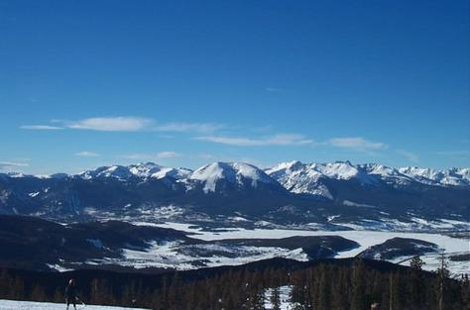
A Theocracy
Through much of Old Testament times, Israel was a theocracy. This means that God was the King in both civil and religious matters. His will and purposes were made known through the voice of His prophets. He was the sole voice in civil matters and object of their worship. However, as His people departed from Him and the voice of the prophet was no longer desired, the clear duties to government and to God become very cloudy and undefined.

Slide 10
Foggy Lines
Should the men of Israel obey the king when he tells them to kill the priests of Nob?
“And the king said unto the footmen that stood about him, Turn, and slay the priests of the LORD; because their hand also is with David, and because they knew when he fled, and did not shew it to me. But the servants of the king would not put forth their hand to fall upon the priests of the LORD.” 1Samuel 22:17
How far does one go in obeying the king? How about Joab? “ And it came to pass, when Joab observed the city, that he assigned Uriah unto a place where he knew that valiant men were. And the men of the city went out, and fought with Joab: and there fell some of the people of the servants of David; and Uriah the Hittite died also.” @Samuel 11:16,17

Slide 11
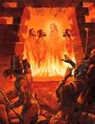
A ‘Sacral’ Mindset!
In heathen lands, the king was god in civil and religious matters. Whatever the king demanded in worship or otherwise, had to be obeyed. Each king/pharaoh would select their deity and all of society was bound together by their reverence of the king’s deity. Everyone became one in their religious devotion. The society was held together by a common religion to which all the members of society were committed. The common people had really no choice. It was obey and live or disobey and die!

Slide 12
The Sacral Way
Nebuchadnezzar was the god/king. His word was law. All society was bound together by whatever the king desired to worship. He decreed the worship of a gigantic statue and almost everyone obeyed. For those who didn’t, to the flames!
“Then a herald cried aloud, To you it is commanded, O people, nations, and languages, that at what time ye hear the sound of the cornet, flute, harp, sackbut, psaltery, dulcimer, and all kinds of music, ye fall down and worship the golden image that Nebuchadnezzar the king hath set up: and whoso falleth not down and worshippeth shall the same hour be cast into the midst of a burning fiery furnace. Therefore at that time, when all the people heard the sound of the cornet, flute, harp, sackbut, psaltery, and all kinds of music, all the people, the nations, and the languages, fell down and worshipped the golden image that Nebuchadnezzar the king had set up.” Daniel 3:4-7

Slide 13
Drawing the Line
“If it be so, our God whom we serve is able to deliver us from the burning fiery furnace, and he will deliver us out of thine hand, O king. But if not, be it known unto thee, O king, that we will not serve thy gods, nor worship the golden image which thou hast set up. Then was Nebuchadnezzar full of fury, and the form of his visage was changed against Shadrach, Meshach, and Abednego: therefore he spake, and commanded that they should heat the furnace one seven times more than it was wont to be heated.” Daniel 3:17-19
This is how sacral society works. The god/king decrees and everyone obeys. The three Hebrew young men understood clearly their duties to the king and to their God. In civil matters, they were willing and obedient subjects of the king. In religious matters, God alone was to be obeyed! The king had crossed the line and nothing, not even the flames, could get the young men to change their minds. The line had been drawn, violations had occurred, and they wouldn’t budge!!

Slide 14
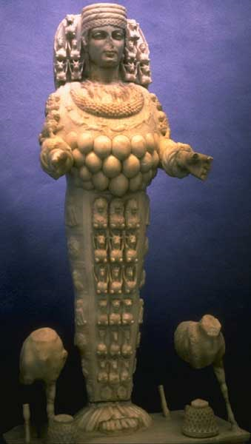
Great is Diana!
“For a certain man named Demetrius-us, a silversmith, which made silver shrines for Diana, brought no small gain unto the craftsmen; whom he called together with the workmen of like occupation, and said, Sirs, ye know that by this craft we have our wealth. Moreover ye see and hear, that not alone at Ephesus, but almost throughout all Asia, this Paul hath persuaded and turned away much people, saying that they be no gods, which are made with hands: so that not only this our craft is in danger to be set at nought; but also that the temple of the great goddess Diana should be despised, and her magnificence should be destroyed, whom all Asia and the world worshippeth. And when they heard these sayings, they were full of wrath, and cried out, saying, Great is Diana of the Ephesians.” Acts 19:24-28

Slide 15
Sacral Society
“But when they knew that he was a Jew, all with one voice about the space of two hours cried out, Great is Diana of the Ephesians. And when the town clerk had appeased the people, he said, Ye men of Ephesus, what man is there that knoweth not how that the city of the Ephesians is a worshipper of the great goddess Diana, and of the image which fell down from Jupiter?” Acts 19:34,35
Demetrius and the silversmiths made big money off of this heathen vestal. However, the one object of worship in Ephesus and throughout the Asian world was Diana! She was the center/sum/ and substance of Ephesian worship and everyone was to conform. All Ephesus was bound together in their devotion to her! This is a sacral society. This was the mindset of the ancient world. Those who didn’t obey were in trouble!

Slide 16
Roman Society the Same
Persecution over religious belief is always the ultimate result of a sacral society. Everyone is expected to follow the king’s word and honor his deity. The Roman Empire had an object of worship; everyone was to conform. Interestingly enough, the primitive church had their supreme object of worship as well- the man Jesus Christ. However, the early church never fought for the exaltation of their Deity- even though He was the right One! True Christianity never seeks to compel by force the worship of another!

Slide 17
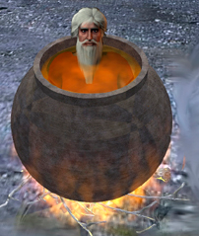
Domitian the god/king
“ Also unlike his brother and father, Domitian adopted an autocratic style coupled with what might be regarded as egomaniacal behavior. Having himself referred to as Dominus et Dues (master and god), renaming the month of September to Germanicus to commemorate his supposed military victories, and renaming October to Domitianus was a constant reminder to the rest of Rome that the eternal city was not a veiled Republic but truly was an empire at the whims of a single man.” http://www.unrv.com/early-empire/reign-of-terror.php

Slide 18
John the Revelator
“The emperor Domitian was filled with rage. He could neither dispute the reasoning of Christ's faithful advocate, nor match the power that attended his utterance of truth; yet he determined that he would silence his voice. John was cast into a caldron of boiling oil; but the Lord preserved the life of His faithful servant, even as He preserved the three Hebrews in the fiery furnace. As the words were spoken, Thus perish all who believe in that deceiver, Jesus Christ of Nazareth, John declared, My Master patiently submitted to all that Satan and his angels could devise to humiliate and torture Him. He gave His life to save the world. I am honored in being permitted to suffer for His sake. I am a weak, sinful man. Christ was holy, harmless, undefiled. He did no sin, neither was guile found in His mouth.” AA, pg. 569,570

Slide 19
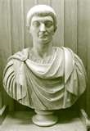
The War Raged
For the first three centuries of the Christian church, a sacral, Roman society squared off with apostolic Christianity. Apostolic Christianity grew and prospered as adherents came into the church by the thousands. The blood of the Christians was seed. Since sacralism couldn’t be used to destroy the early church, the devil created something new, something startling, something still with us today!!

Slide 20
Constantine!
“Little by little, at first in stealth and silence, and then more openly as it increased in strength and gained control of the minds of men, "the mystery of iniquity" carried forward its deceptive and blasphemous work. Almost imperceptibly the customs of heathenism found their way into the Christian church. The spirit of compromise and conformity was restrained for a time by the fierce persecutions which the church endured under paganism. But as persecution ceased, and Christianity entered the courts and palaces of kings, she laid aside the humble simplicity of Christ and His apostles for the pomp and pride of pagan priests and rulers; and in place of the requirements of God, she substituted human theories and traditions. The nominal conversion of Constantine, in the early part of the fourth century, caused great rejoicing; and the world, cloaked with a form of righteousness, walked into the church.” GC, pg. 49,50

