Slide 1
The Golden Rule
The One Who Has the Gold Makes the Rules

Slide 2
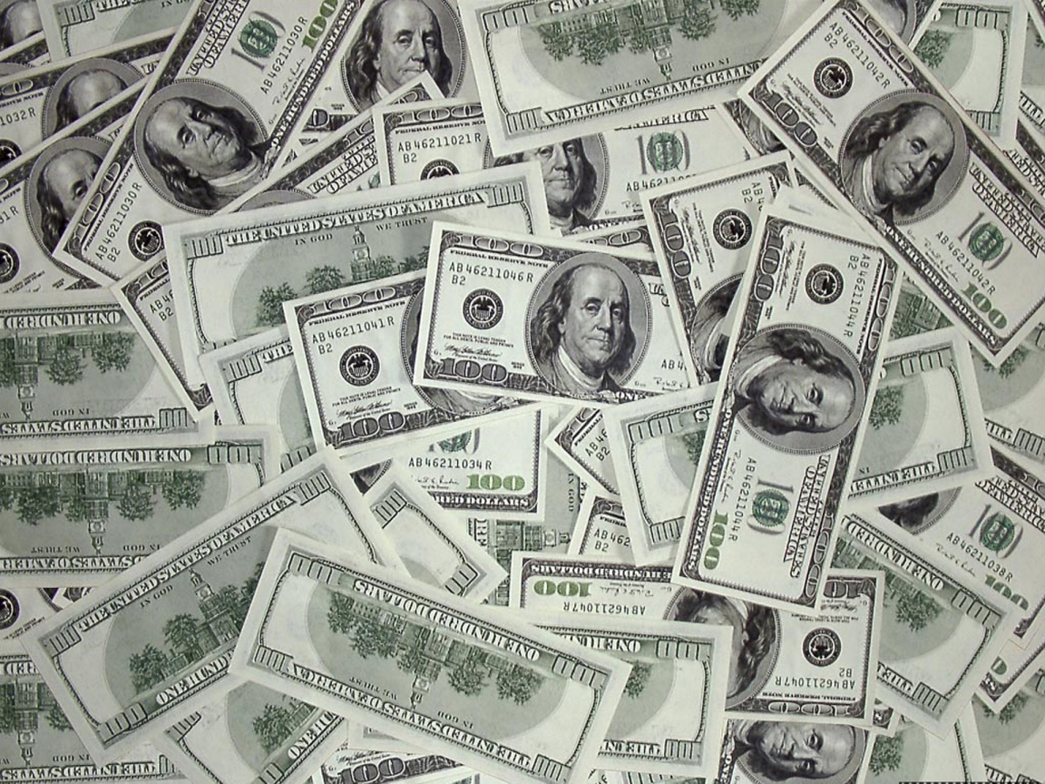
Money Control
“And he causeth all, both small and great, rich and poor, free and bond, to receive a mark in their right hand, or in their foreheads: And that no man might buy or sell, save he that had the mark, or the name of the beast, or the number of his name.” Revelation 13:16,17

Slide 3
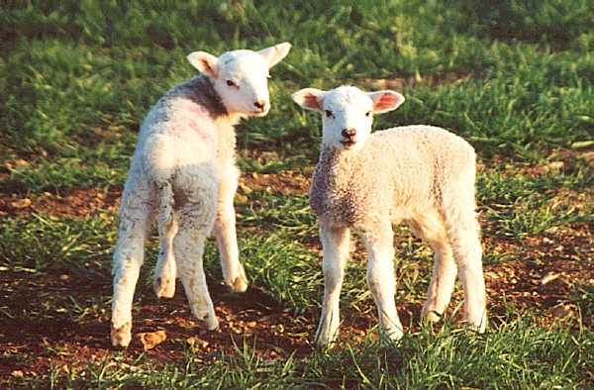
Who Would Do Such a Thing?
“And I beheld another beast coming up out of the earth; and he had two horns like a lamb, and he spake as a dragon. And he exerciseth all the power of the first beast before him, and causeth the earth and them which dwell therein to worship the first beast, whose deadly wound was healed.” Revelation13:11,12 This lamb-like power will use a money system to enforce religious conformity.

Slide 4
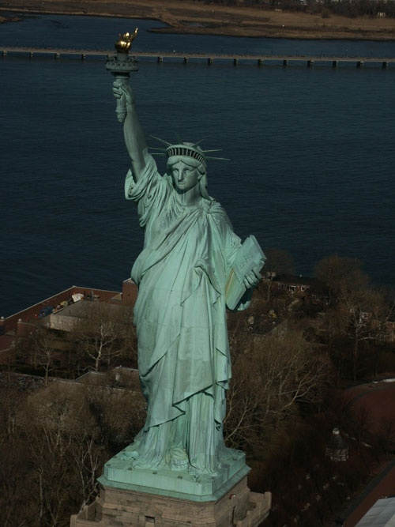
The Bible Says
1. It is a beast. In Bible prophecy, a beast represents a nation or world power. (Daniel 7:17,23
2. It starts off with Christ-like principles of government. Christ is the Lamb of God. (John 1:29)
3. Christ-like principles of government would be: a. total separation of the church and state. (Luke 20:25)
B. Where the people can worship God as they chose.
C. Where the people are granted certain inalienable rights.
D. Where the power of government rests with the people.
This lamb-like beast can be only one nation on the earth today……………………..

Slide 5
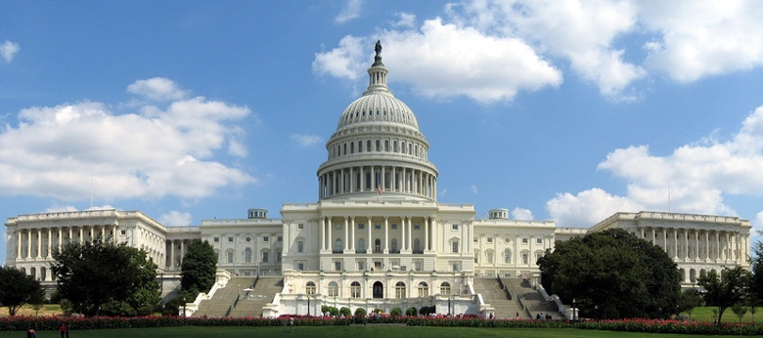
The Lamb-Like Beast is……….America!
Only America started off with the church and state separate. Only America started off with a government where the power rested with the people. Only America started off with basic freedoms for the people as its cornerstone of prosperity and power. Only America has the wealth and power to force worship on the world.

Slide 6
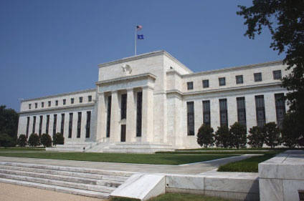
It Takes Time
To gain such control over the American financial fabric takes time. In order to do this, one must gain full control of the banking system of America. A central bank or a Federal Reserve System must be in place to gain such control.

Slide 7
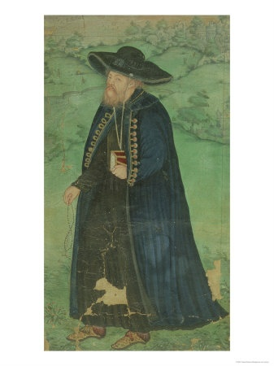
Surprise!!!!
Repeated attempts have been made to have a central bank in America. 1. Before Lexington and Concord, an attempt was made by Robert Morris.
2. This attempt failed and Alexander Hamilton tried a central bank in 1791. It too, failed.
3. Then, Nicholas Biddle tried one around the 1820’s. Andrew Jackson stopped this one.
4. Finally, in 1913, Woodrow Wilson and Edward Mandel House got one through and the monster has been with us ever since.

Slide 8
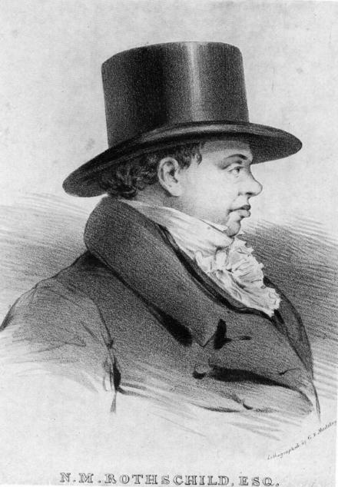
Who Has Been Pulling the Strings?
“The blunt reality is that the Rothschild banking dynasty in Europe was the dominant force, both financially and politically, in the formation of the Bank of the United States.— G. Edward Griffin, The Creature from Jekyll Island, American Opinion Publishing, p. 331..
The Rothschild's long had a powerful influence in dictating American financial laws. The law records show that they were the power in the old Bank of the United States. —Gustavus Myers, History of the Great American Fortunes, Random House, p. 556.

Slide 9
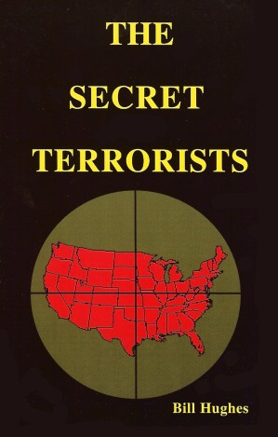
“Aware that the Rothschilds are an important Jewish family, I looked them up in Encyclopedia Judaica and discovered that they bear the title ‘Guardians of the Vatican Treasury’…. The appointment of Rothschild gave the black papacy absolute financial privacy and secrecy. Who would ever search a family of orthodox Jews for the key to the wealth of the Roman Catholic Church? — F. Tupper Saussy, Rulers of Evil, Harper Collins, page 160, 161

Slide 10
Jesuit Controlled Money System
“Throughout Christendom, Protestantism was menaced by formidable foes. The first triumphs of the Reformation past, Rome summoned new forces, hoping to accomplish its destruction. At this time the order of the Jesuits was created, the most cruel, unscrupulous, and powerful of all the champions of popery. Cut off from earthly ties and human interests, dead to the claims of natural affection, reason and conscience wholly silenced, they knew no rule, no tie, but that of their order, and no duty but to extend its power. (See Appendix.) The gospel of Christ had enabled its adherents to meet danger and endure suffering, undismayed by cold, hunger, toil, and poverty, to uphold the banner of truth in face of the rack, the dungeon, and the stake. To combat these forces, Jesuitism inspired its followers with a fanaticism that enabled them to endure like dangers, and to oppose to the power of truth all the weapons of deception. There was no crime too great for them to commit, no deception too base for them to practice, no disguise too difficult for them to assume. Vowed to perpetual poverty and humility, it was their studied aim to secure wealth and power, to be devoted to the overthrow of Protestantism, and the re-establishment of the papal supremacy….

Slide 11
Continued
When appearing as members of their order, they wore a garb of sanctity, visiting prisons and hospitals, ministering to the sick and the poor, professing to have renounced the world, and bearing the sacred name of Jesus, who went about doing good. But under this blameless exterior the most criminal and deadly purposes were often concealed. It was a fundamental principle of the order that the end justifies the means. By this code, lying, theft, perjury, assassination, were not only pardonable but commendable, when they served the interests of the church. Under various disguises the Jesuits worked their way into offices of state, climbing up to be the counselors of kings, and shaping the policy of nations. They became servants to act as spies upon their masters… All the outward pomp and display of the Romish worship was brought to bear to confuse the mind and dazzle and captivate the imagination, and thus the liberty for which the fathers had toiled and bled was betrayed by the sons. The Jesuits rapidly spread themselves over Europe, and wherever they went, there followed a revival of popery.” GC, pg 234,235

Slide 12
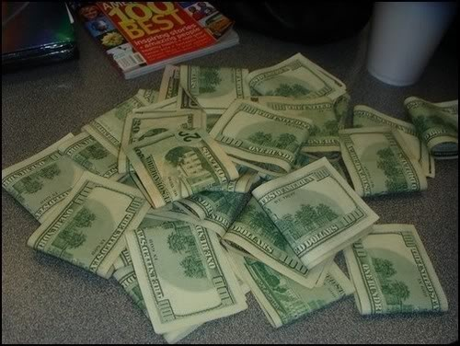
Centuries Old Battle
For over 200 years, the Jesuit Order and the Catholic Church, via the Rothschild’s and a central bank in America, have sought to create a situation whereby Protestantism can be overthrown in America and the papacy can reign supreme. Remember, the one who has the gold makes the rules. Anyone who has resisted their plan has been killed, or attempts have been made on their lives, or wars have been fought.

Slide 13
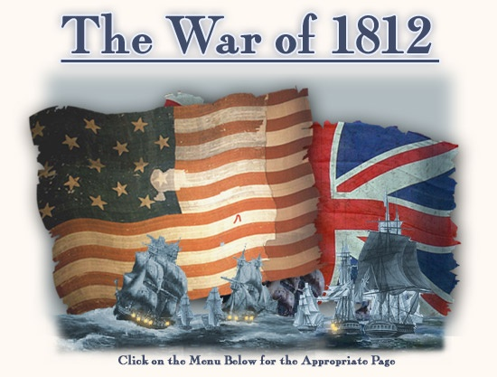
Threads of U.S. History
People, presidents, assassinations, and wars, that appear to be random events, seemingly disjointed and totally unrelated, are actually all apart of a consistent unfolding of events leading toward the same goal. The goal is ultimate and complete control of the financial fabric of this country.

Slide 14
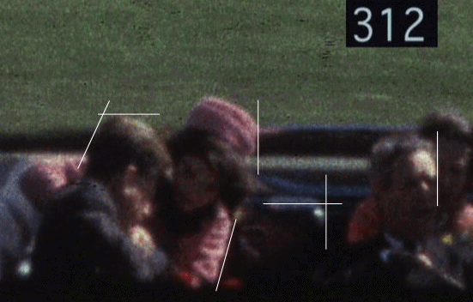
They Opposed the Central Bank
1. James Madison
2. Andrew Jackson
3. Abraham Lincoln
4. John Jacob Astor, Benjamin Guggenheim, Isador Strauss
5. Louis McFadden
6. John Kennedy
They all had attempts made on their lives.

Slide 15
Madison and Jackson
As the charter for Hamilton’s bank would expire around 1811, Nathan Rothschild issued a warning to America if the charter wasn’t renewed. The private banking charter for the First Bank of the United States expired in 1811. Its renewal was refused by Congress. The arguments concerning this "private bank" had been going on since its creation in 1792.
After the refusal to renew the charter, the United States suddenly found themselves in the War of 1812. This "war" was punishment for America refusing to do business on the International Banking families House of Rothschild's terms, with the first Bank of the United States.
“The President had earned the undying hatred of monetary scientists, both in America and abroad. [The Jesuits were furious.] It is not surprising, therefore, that on January 30,1835, an assassination attempt was made against him. Miraculously, both pistols of the assailant misfired, and Jackson was spared by a quirk of fate. It was the first such attempt to be made against the life of a President of the United States. The would-be assassin was Richard Lawrence who either was truly insane or who pretended to be insane to escape harsh punishment. At any rate, Lawrence was found not guilty due to insanity. However, he did spend the rest of his life confined to a mental institution. Later, he boasted to friends that he had been in touch with powerful people in Europe who had promised to protect him from punishment should he be caught.” Ibid. p. 357. Griffin, Creature from Jekyll Island.

Slide 16
Lincoln and Kennedy
“The division of the United States into federations of equal force was decided long before the Civil War by the high financial powers of Europe. These bankers were afraid that the United States, if they remained in one block and as one nation, would attain economic and financial independence, which would upset their financial domination over Europe and the world. Of course, in the ‘inner circle’ of Finance, the voice of the Rothschild’s prevailed. They saw an opportunity for prodigious booty if they could substitute two feeble democracies, burdened with debt to the financiers…. Therefore, they sent their emissaries into the field to exploit the question of slavery and to drive a wedge between the two parts of the.” Statement by German Chancellor, Otto von Bismarck. Found CFJI, GE Griffin. Page 374
“When Kennedy called for a return of America’s currency to the gold standard, and the dismantling of the Federal Reserve System — he actually minted non-debt money that does not bear the mark of the Federal Reserve; when he dared to actually exercise the leadership authority granted to him by the U.S. Constitution…Kennedy prepared his own death warrant. It was time for him to go. — Colonel James Gritz, Called to Serve: Profiles in Conspiracy from John F. Kennedy to George Bush, Lazarus Publishing, pp 511,512

Slide 17
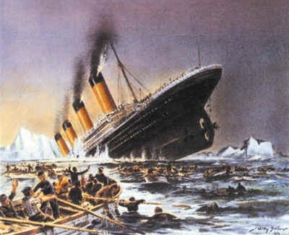
The Titanic
Benjamin Guggenheim, along with Isador Strauss and John Jacob Astor were among
the many wealthy that
died on the maiden
voyage of the Titanic.
They all opposed the setting up of the Federal Reserve Bank.

Slide 18
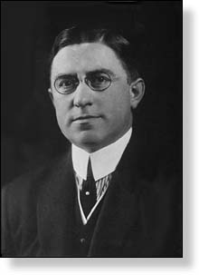
Louis T. McFadden
"Mr. Chairman, we have in this Country one of the most corrupt institutions the world has ever known. I refer to the Federal Reserve Board and the Federal Reserve Banks, hereinafter called the Fed. The Fed has cheated the Government of these United States and the people of the United States out of enough money to pay the Nation's debt. The depredations and iniquities of the Fed has cost enough money to pay the National debt several times over.
"This evil institution has impoverished and ruined the people of these United States, has bankrupted itself, and has practically bankrupted our Government. It has done this through the defects of the law under which it operates, through the maladministration of that law by the Fed and through the corrupt practices of the moneyed vultures who control it.”
Louis McFadden, Chairman on Finance, 1920-1931

Slide 19

McFadden: One more Casualty
There were two attempts on McFadden's life, a failed shooting and an apparent poisoning that made him "violently ill" after attending a political banquet in Washington. He was murdered in 1936 on a visit to New York City,

Slide 20
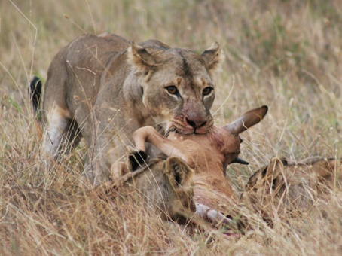
Total Control
A central bank is crucial in the final formation of papal re-dominance in this world. The Vatican is using America today to create a financial crisis worldwide that will lead to a time when no man can buy or sell save those who have embraced the papacy’s mark of authority in this world.

Slide 21
The Mark of the Beast
Protestants... accept Sunday rather than Saturday as the day for public worship after the Catholic Church made the change.... But the Protestant mind does not seem to realize that...in observing the Sunday, they are accepting the authority of the spokesman for the church, the Pope. — Our Sunday Visitor, February 5, 1950.
It is well to remind the Presbyterians, Baptists, Methodists, and all other Christians, that the Bible does not support them anywhere in their observance of Sunday. Sunday is an institution of the Roman Catholic Church, and those who observe the day observe a commandment of the Catholic Church. — Priest Brady, in an address, reported in the Elizabeth, N.J. “News,” March 18, 1903.
The mark of Catholic Church authority in the world is Sunday observance. This is a tradition that has no place in the Bible. It originated in Rome, and when we honor the Sunday tradition, we are paying homage to the papacy. Sunday goes directly contrary to the plain teaching of the fourth commandment,…

Slide 22
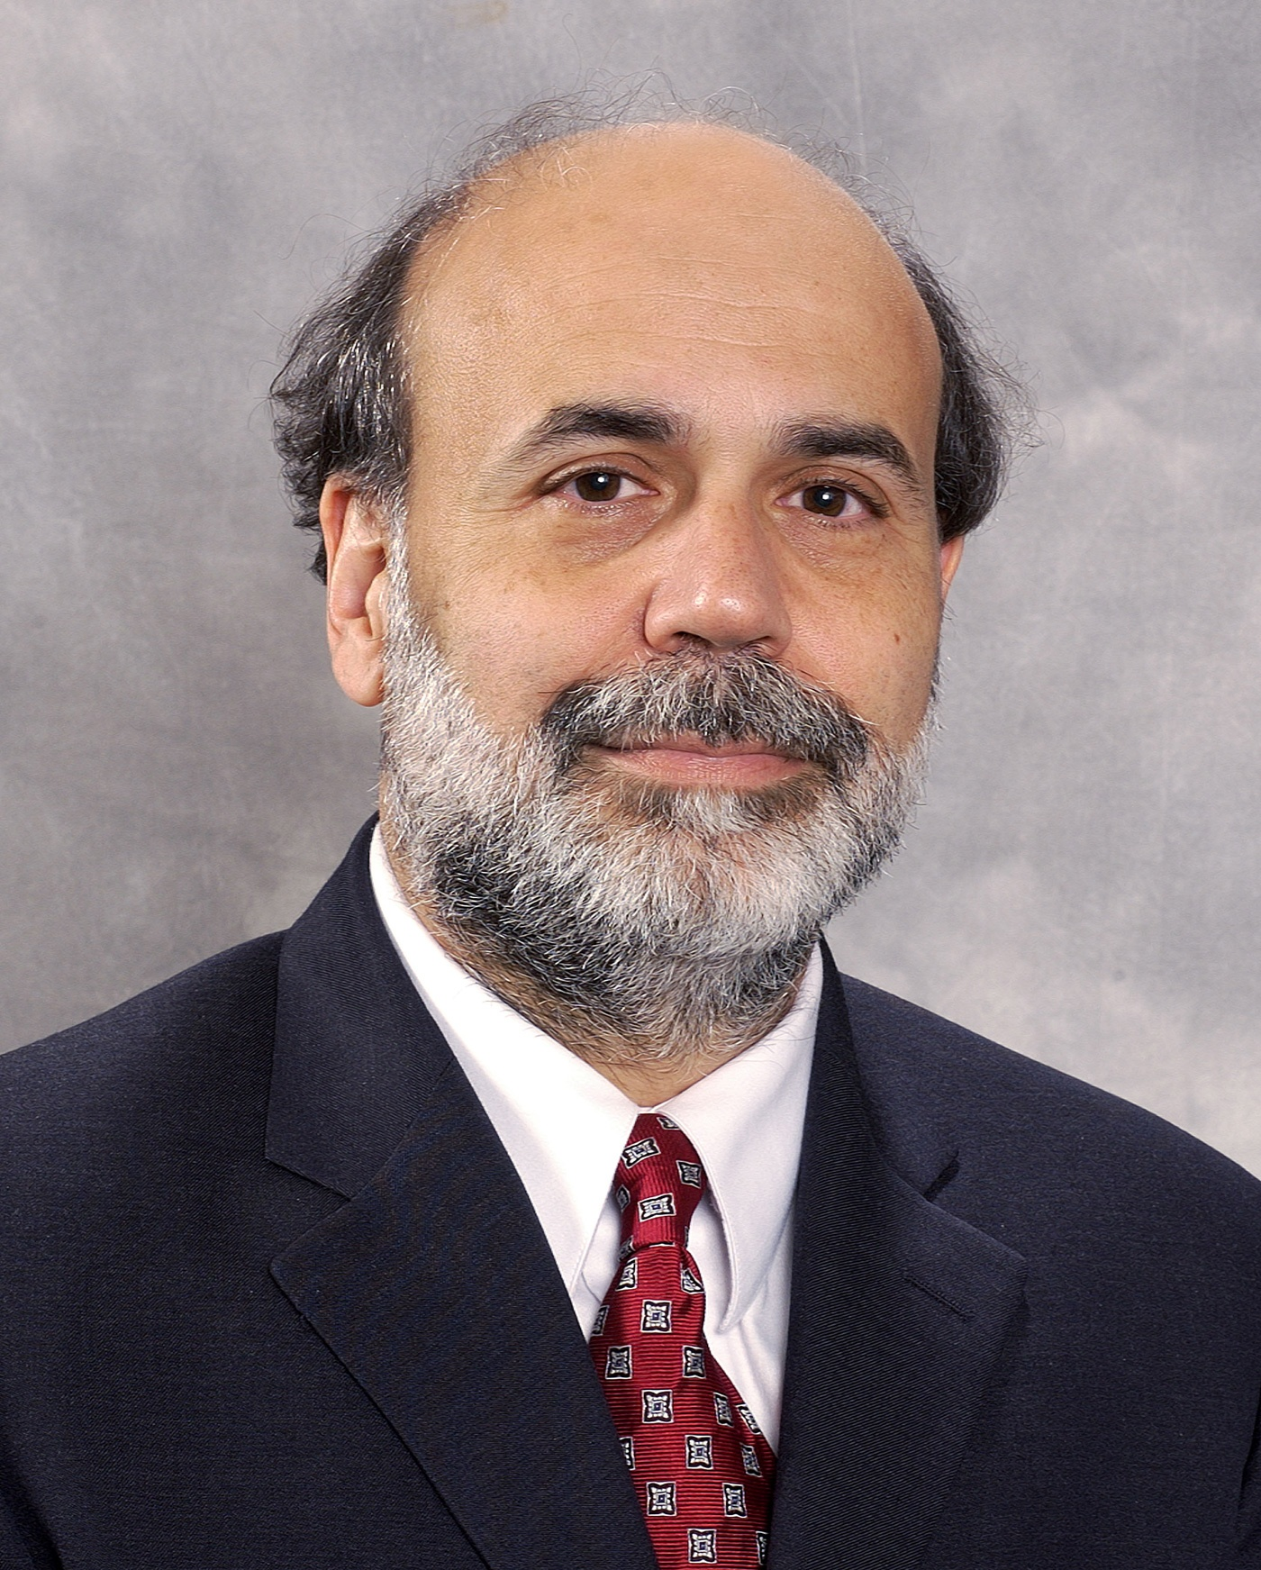
A Long Time Coming
“And he causeth all, both small and great, rich and poor, free and bond, to receive a mark in their right hand, or in their foreheads: And that no man might buy or sell, save he that had the mark, or the name of the beast, or the number of his name.” Revelation 13:16,17

