Slide 1
501(c)3
And Setting Up the Image of the Beast

Slide 2
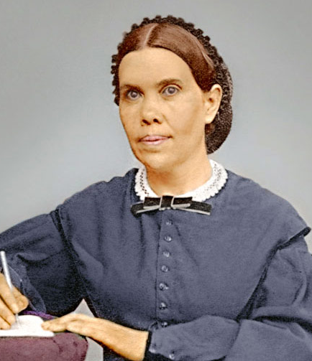
A Warning From Ellen White
“The people of the United States have been a favored people; but when they restrict religious liberty, surrender Protestantism, and give countenance to popery, the measure of their guilt will be full, and "national apostasy" will be registered in the books of heaven. The result of this apostasy will be national ruin. . . When Protestantism shall stretch her hand across the gulf to grasp the hand of the Roman power, when she shall reach over the abyss to clasp hands with spiritualism, when, under the influence of this threefold union, our country shall repudiate every principle of its Constitution as a Protestant and republican government” Maranatha, p. 216

Slide 3
Compromise with the Government!
Many Christians and Seventh-day Adventists for years have argued that becoming a 501(c)3 tax-exempt ministry is compromising with the Government—further, putting your church and flock under the jurisdiction of the state, surrendering your God-given rights to religious liberty protected by the 1st Amendment, and as a legal corporate entity becoming beholden to the State: “a corporation is a creature of the State” (Hale v. Henkel, 201 U.S. 43 (1906)). By this, they say, you are setting up the image of the Beast and are a false church!

Slide 4
The Compromise: 503(c)1 Guidelines

Slide 5
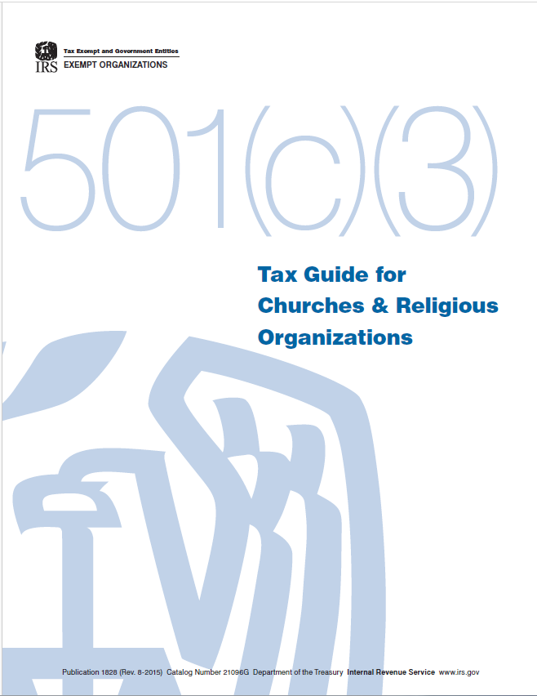
From the Tax Code: IRS 1828

Slide 6
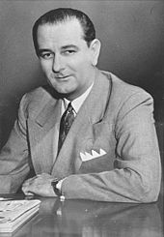
The Johnson Amendment 1954
“The Johnson Amendment is a provision in the U.S. tax code, since 1954, that prohibits all 501(c)(3) non-profit organizations from endorsing or opposing political candidates. Section 501(c)(3) organizations are the most common type of nonprofit organization in the United States, ranging from charitable foundations to universities and churches. The amendment is named for then-Senator Lyndon B. Johnson of Texas, who introduced it in a preliminary draft of the law in July 1954.” (Johnson Amendment, Wikipedia)

Slide 7
501(c)3--Political Clause
“To be tax-exempt under section 501(c)(3) of the Internal Revenue Code, an organization must be organized and operated exclusively for exempt purposes set forth in section 501(c)(3), and none of its earnings may inure [take effect/private benefit] to any private shareholder or individual. In addition, it may not be an action organization, i.e., it may not attempt to influence legislation as a substantial part of its activities and it may not participate in any campaign activity for or against political candidates. Organizations described in section 501(c)(3) are commonly referred to as charitable organizations. Organizations described in section 501(c)(3), other than testing for public safety organizations, are eligible to receive tax-deductible contributions in accordance with Code section 170.” IRS.gov, Exemption Requirements - 501(c)(3) Organizations

Slide 8
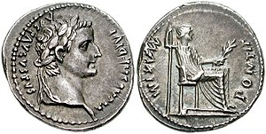
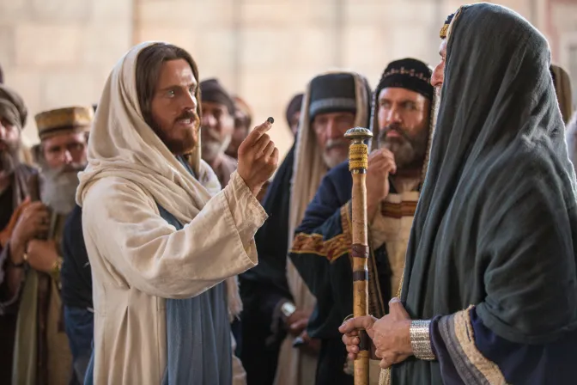
Is This Request Biblical???
Matt. 22:17-22 “Tell us therefore, What thinkest thou? Is it lawful to give tribute unto Caesar, or not? But Jesus perceived their wickedness, and said, Why tempt ye me, ye hypocrites? Shew me the tribute money. And they brought unto him a penny. And he saith unto them, Whose is this image and superscription? They say unto him, Caesar's. Then saith he unto them, Render therefore unto Caesar the things which are Caesar's; and unto God the things that are God's. When they had heard these words, they marvelled, and left him, and went their way.”

Slide 9
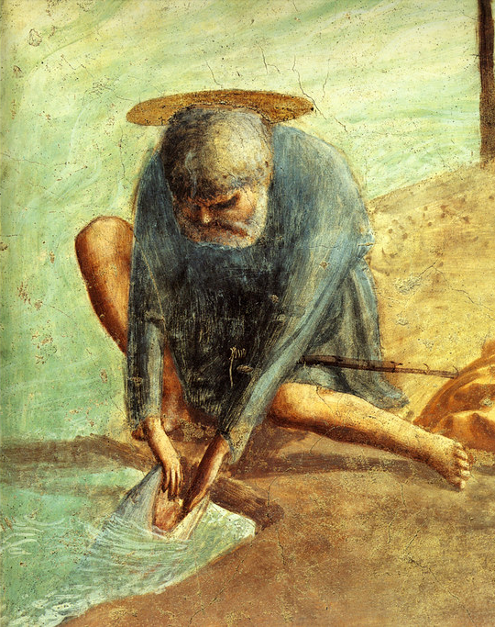
I Don’t Agree Personally, But It’s the Law
Matt. 17:24-27 “And when they were come to Capernaum, they that received tribute money came to Peter, and said, Doth not your master pay tribute? He saith, Yes. And when he was come into the house, Jesus prevented him, saying, What thinkest thou, Simon? of whom do the kings of the earth take custom or tribute? of their own children, or of strangers? Peter saith unto him, Of strangers. Jesus saith unto him, Then are the children free. Notwithstanding, lest we should offend them, go thou to the sea, and cast an hook, and take up the fish that first cometh up; and when thou hast opened his mouth, thou shalt find a piece of money: that take, and give unto them for me and thee.”

Slide 10
The Apostle Paul Chimes In…
Rom. 13:1-7 “Let every soul be subject unto the higher powers. For there is no power but of God: the powers that be are ordained of God. Whosoever therefore resisteth the power, resisteth the ordinance of God: and they that resist shall receive to themselves damnation. For rulers are not a terror to good works, but to the evil. Wilt thou then not be afraid of the power? do that which is good, and thou shalt have praise of the same: For he is the minister of God to thee for good. But if thou do that which is evil, be afraid; for he beareth not the sword in vain: for he is the minister of God, a revenger to execute wrath upon him that doeth evil. Wherefore ye must needs be subject, not only for wrath, but also for conscience sake. For for this cause pay ye tribute also: for they are God's ministers, attending continually upon this very thing. Render therefore to all their dues: tribute to whom tribute is due; custom to whom custom; fear to whom fear; honour to whom honour.”

Slide 11
An Old Testament 501(c)3???
Ezra 7:24-26 “Also we certify you, that touching any of the priests and Levites, singers, porters, Nethinims, or ministers of this house of God, it shall not be lawful to impose toll, tribute, or custom, upon them. And thou, Ezra, after the wisdom of thy God, that is in thine hand, set magistrates and judges, which may judge all the people that are beyond the river, all such as know the laws of thy God; and teach ye them that know them not. And whosoever will not do the law of thy God, and the law of the king, let judgment be executed speedily upon him, whether it be unto death, or to banishment, or to confiscation of goods, or to imprisonment.”

Slide 12
What About the SOP?
“Those who have charge of our institutions and our schools should guard themselves diligently, lest by their words and sentiments they lead the students into false paths. Those who teach the Bible in our churches and in our schools are not at liberty to unite in making apparent their prejudices for or against political men or measures, because by so doing they stir up the minds of others, leading each to advocate his favorite theory. There are among those professing to believe present truth some who will thus be stirred up to express their sentiments and political preferences, so that division will be brought into the church. The Lord would have His people bury political questions. On these themes silence is eloquence. Christ calls upon His followers to come into unity on the pure gospel principles which are plainly revealed in the word of God. We cannot with safety vote for political parties; for we do not know whom we are voting for. We cannot with safety take part in any political schemes. We cannot labor to please men who will use their influence to repress religious liberty, and to set in operation oppressive measures to lead or compel their fellow men to keep Sunday as the Sabbath. The first day of the week is not a day to be reverenced. It is a spurious sabbath, and the members of the Lord’s family cannot participate with the men who exalt this day, and violate the law of God by trampling upon His Sabbath. The people of God are not to vote to place such men in office; for when they do this, they are partakers with them of the sins which they commit while in office.”—(Fundamentals of Christian Education, p. 475)

Slide 13
It Goes Further… The Political Clause Doesn’t Go Far Enough!
“What are we to do, then?—Let political questions alone. “Be ye not unequally yoked together with unbelievers: for what fellowship hath righteousness with unrighteousness? and what communion hath light with darkness? and what concord hath Christ with Belial? Or what part hath he that believeth with an infidel?” [2 Cor. 6:14-15] What can there be in common between these parties? There can be no fellowship, no Communion” (Fundamentals of Christian Education, p. 476)

Slide 14
Politicizing Teachers Should Be Removed!
“Those teachers in the church or in the school who distinguish themselves by their zeal in politics, should be relieved of their work and responsibilities without delay; for the Lord will not co-operate with them. The tithe should not be used to pay any one for speechifying on political questions. Every teacher, minister, or leader in our ranks who is stirred with a desire to ventilate his opinions on political questions, should be converted by a belief in the truth, or give up his work. His influence must tell as a laborer together with God in winning souls to Christ, or his credentials must be taken from him. If he does not change, he will do harm, and only harm. In the name of the Lord I would say to the teachers in our schools, Attend to your appointed work. You are not called upon by God to engage in politics” (Fundamentals of Christian Education, p. 477)

Slide 15
Politics ARE A NO! in God’s Church!
“I call upon my brethren who are appointed to educate, to change their course of action. It is a mistake for you to link your interests with any political party, to cast your vote with them or for them. Those who stand as educators, as ministers, as laborers together with God in any line, have no battles to fight in the political world. . . . The questions at issue in the world are not to be the theme of our conversation. We are to call upon the world to behold an uplifted Saviour, through whom we are made necessary to one another and to God(Fundamentals of Christian Education, p. 478-479)

Slide 16
God Will Condemn Those Who Turn Their Ministries into Legislative Lobbies!
“The Lord speaks of those who claim to believe the truth for this time, yet see nothing inconsistent in their taking part in politics, mingling with the contending elements of these last days, as the circumcised who mingle with the uncircumcised, and He declares that He will destroy both classes together without distinction. They are doing a work that God has not set them to do. They dishonor God by their party spirit and contention, and He will condemn both alike. The question may be asked, Are we to have no union whatever with the world? The word of the Lord is to be our guide. Any connection with infidels and unbelievers which would identify us with them is forbidden by the word. We are to come out from them and be separate. In no case are we to link ourselves with them in their plans or work. But we are not to live reclusive lives. We are to do worldlings all the good we possibly can.” Ibid., 482

Slide 17
Is it Clear Yet?
“There is a large vineyard to be cultivated; but while Christians are to work among unbelievers, they are not to appear like worldlings. They are not to spend their time talking politics or acting as politicians; for by so doing, they give the enemy opportunity to come in and cause variance and discord. Those in the ministry who desire to stand as politicians should have their credentials taken from them; for this work God has not given to high or low among His people. God calls upon all who minister in doctrine to give the trumpet a certain sound. All who have received Christ, ministers and lay members, are to arise and shine; for great peril is right upon us. Satan is stirring the powers of earth. Everything in the world is in confusion. God calls upon His people to hold aloft the banner bearing the message of the third angel. We are not to go to Christ through any human being, but through Christ we are to understand the work He has given us to do for others. God calls to His people, saying, “Come out from among them, and be ye separate.” He asks that the love which He has shown for them may be reciprocated and revealed by willing obedience to His commandments. His children are to separate themselves from politics, from any alliance with unbelievers. They are not to link their interests with the interests of the world” (ibid., p. 484)

Slide 18
Is There Another Way to Be Tax-Exempt????
In 1969, 15 years after the Johnson Amendment to the 501(c)3 Tax Code, the Tax Code was again revised to expand 501(c)3 parameters to allow for the protection of tax-exempt status’ for certain organizations, including “churches” (not ministries/religious organizations) in the Tax Reform Act of 1969. In that Act Section 508 was enacted and codified into tax law to allow those certain exceptions, like “churches” to operate as a nonprofit tax-exempt organization and function without notifying the government of their existence by (1) becoming incorporated/acknowledged/approved by the government under 508(c)1A or by applying for 501(c)3

Slide 19
The Other Option: 26 US Code 508 – Special rules with respect to section 501(c)3 organizations
“(a)New organizations must notify Secretary that they are applying for recognition of section 501(c)(3) statusExcept as provided in subsection (c), an organization organized after October 9, 1969, shall not be treated as an organization described in section 501(c)(3)—(1)unless it has given notice to the Secretary in such manner as the Secretary may by regulations prescribe, that it is applying for recognition of such status, or(2)for any period before the giving of such notice, if such notice is given after the time prescribed by the Secretary by regulations for giving notice under this subsection.
(b)Presumption that organizations are private foundationsExcept as provided in subsection (c), any organization (including an organization in existence on October 9, 1969) which is described in section 501(c)(3) and which does not notify the Secretary, at such time and in such manner as the Secretary may by regulations prescribe, that it is not a private foundation shall be presumed to be a private foundation.
(c)Exceptions(1)Mandatory exceptionsSubsections (a) and (b) shall not apply to—(A)churches, their integrated auxiliaries, and conventions or associations of churches, or (B)any organization which is not a private foundation (as defined in section 509(a)) and the gross receipts of which in each taxable year are normally not more than $5,000. (26 U.S. Code 508 – Special rules with respect to section 501(c)3 organizations)”—(Legal Information Institute, https://www.law.cornell.edu/uscode/text/26/508)

Slide 20
According to 508(c)1A, IRS What is a “Church”?

Slide 22
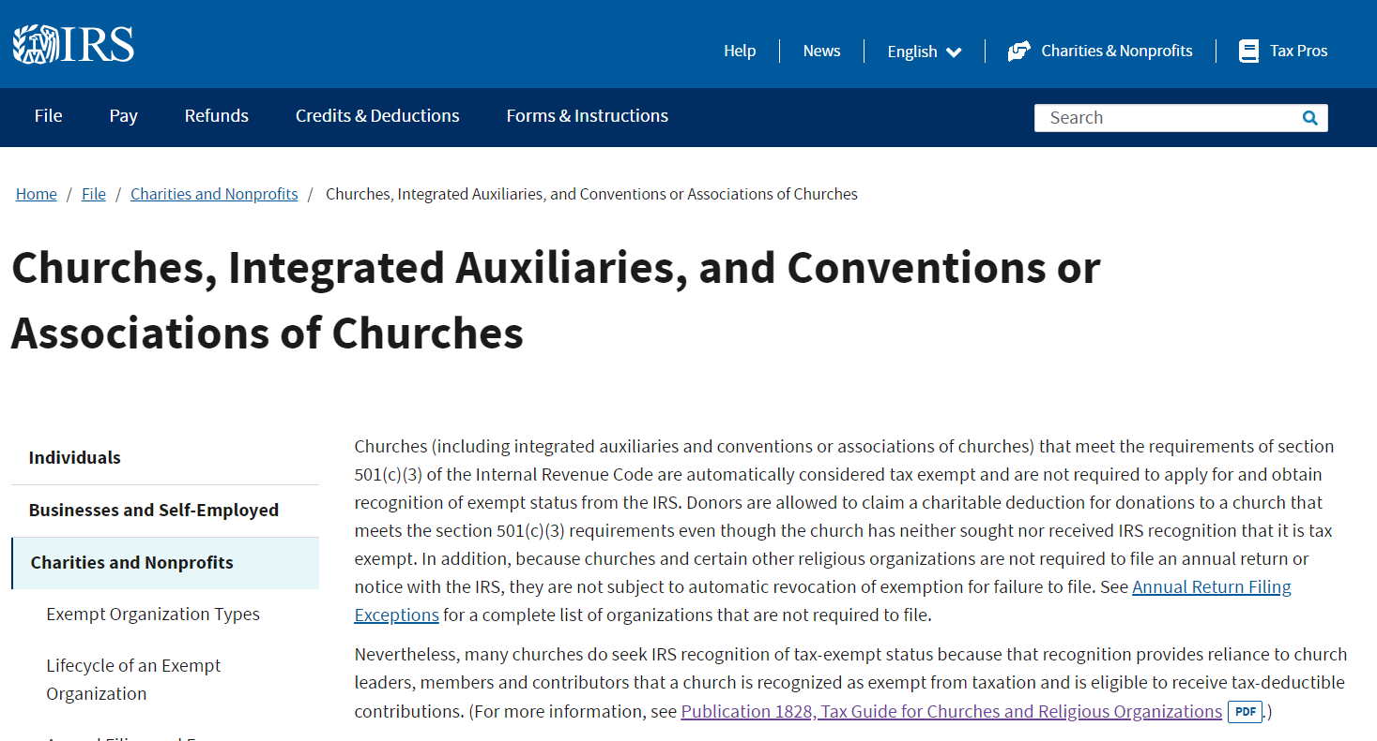
Which “Churches” Qualify for the exemption under 508(c)1A???

Slide 23
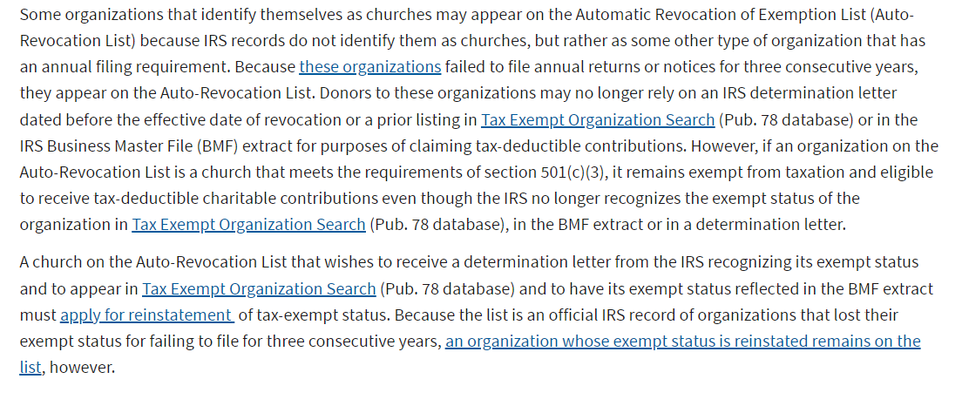
508(c)1A “Churches” (NOT Ministries or FBOs) ONLY qualify under this exemption IF they follow 501(c)3!
Churches, Integrated Auxiliaries, and Conventions or Associations of Churches | Internal Revenue Service (irs.gov)

Slide 24
Legally Speaking—You Are Still a 501(c)3!
“What is the difference between 501(c)(3) and 508(c)(1)(A)?
Section 501(c)(3) of the Tax Code is the section that describes charitable organizations that are exempt from paying federal income tax, including churches. Section 508 of the Code, which is entitled "Special rules with respect to section 501(c)(3) organizations," requires any organization created after October 9, 1969 that seeks 501(c)(3) charitable exemption to notify the Internal Revenue Service and apply to obtain an official recognition, but exempts those organizations described in Section 508(c) from the filing requirement.
Section 508(c)(1)(A) exempts churches, their integrated auxiliaries, and conventions or associations of churches, while subsection (B) exempts charities that are not private foundations and normally have gross receipts of not more than $5000 a year. Basically everybody who wants 501(c)(3) status, except churches, has to file a Form 1023 or 1023-EZ to be recognized as a 501(c)(3) charity by the IRS.
The religious organizations mentioned in (A) are also exempt from filing an annual Form 990 series tax information return. The small nonprofits that don’t have to file for recognition of exemption under 508(c)(1)(B) nevertheless have to file a tax information return, normally the Form 990-N electronic postcard. They will automatically lose their exempt status (even though the IRS may not know that they exist) if they fail to file for three consecutive years.” (Don Kramer’s Nonprofit Issues, What is the difference between 501(c)(3) and 508(c)(1)(A)? | Nonprofit Issues)

Slide 25
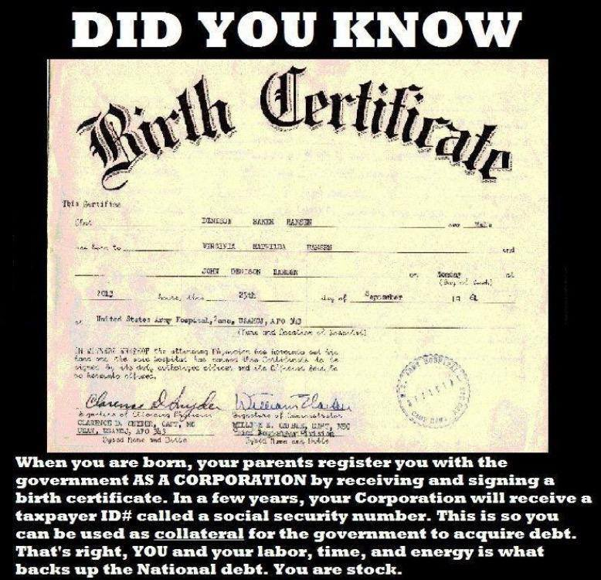
Similar Fanaticisms
Don’t get a marriage license because then your marriage is under the state and not under God! “When you marry with a marriage license, you grant the State jurisdiction over your marriage. . . . When you marry with a marriage license, you place yourself under a body of law which is immoral. . . . The marriage license invades and removes God-given parental authority.” 5 Reasons Why Christians Should Not Obtain a State Marriage License (christianbaptistliving.com)
Don’t get a Birth Certificate for your children because then they get a state-filing number, barcode, and their Birth Certificate constitutes a Bank Note, which makes them incorporated—”a creature of the State”!

Slide 26
Despicable Things Ministries to Avoid being a 501(c)3
Write receipts that they cannot guarantee are not fraudulent
Tell their donors to say “it’s a gift” instead of “tithe” or “offering”—that’s lying!
Ignore the law and wait and hope that the Government doesn’t come knocking and sue the pants off them if they are deemed in violation
Pay PMA advisors to set your church up to fall under the 508(c)1A, removing valuable privileges under 501(c)3 and leaving your ministry wide open to audits, IRS infractions, and court proceedings
If suspected to be in violation of any part of the IRS code 501(c)3, a ministry will be forced to devote time, energy and money to defend themselves in court and deal with the IRS investigations rather than giving the 3rd Angel’s Messages—WOW!!!

Slide 27
Other Problems… Which Are Totally Avoidable
“Applying for 501(c)(3) status is optional for churches, but to not do so might cause problems for donors. If a donor to a church is audited, he/she must establish or prove that the organization meets the requirements of a church (Taylor v. Commissioner, 2000). This makes donating to a church without 501(c)(3) status much less appealing for a donor, especially when it comes to appreciated assets. If a donor is audited later and cannot establish that the organization is a church, the donor may be liable for taxes. For this reason, many donors may choose not to donate to organizations without 501(c)(3) approval. Although a 508(c)(1)(a) church can also receive tax deductible donations, the process can be more difficult in certain situations. For instance, if a donor wants to give appreciated stock through their stock broker, there is no process for a 508(c)(1)(a) church to receive such stock. Only a 501(c)(3) organization that is on the approved “list” is eligible to receive a direct transfer from the broker. The alternative would be for the donor to sell the appreciated stock and donate the proceeds to a 508(c)(1)(a) church, but that would trigger a capital gains tax for the donor, reducing the amount of the donation.” (What is a 508(c)(1)(a) Church? A history of the 508(c)(1)(a) exception, Project Phoenix - What is a 508c1a church?)

Slide 28
Snake Oil Salesmen and Wolves in Sheep’s Clothing
“You can practice almost anything without a license within your properly formed Private Membership Association of private members!!! The only exception is if your association practices, proposes or promotes a clear and present danger of substantive evil. Also, the private domain is referred to as a “sanctuary from unjustified interference by the State” in Pierce v. Society of Sisters, 268 U.S. 510 at 534-535. And as a “constitutional shelter” in Roberts v. United States, 82 L.Ed.2d 462 at 472. And again as a “shield” in Roberts v. United States, supra at 474” (pmapower.org, PMA Power – Power You Didn't Know You Have)

Slide 29
Charlatans Take Advantage
“The only exception is if your association practices, proposes or promotes a clear and present danger of substantive evil. Also, the private domain is referred to as a “sanctuary from unjustified interference by the State” in Pierce v. Society of Sisters, 268 U.S. 510 at 534-535. And as a “constitutional shelter” in Roberts v. United States, 82 L.Ed.2d 462 at 472. And again as a “shield” in Roberts v. United States, supra at 474.” (A PMA Synopsis (getyourpma.com))

Slide 30
Parrots?
“The private domain is referred to as a “sanctuary from unjustified interference by the State” in Pierce v. Society of Sisters, 268 U.S. 510 at 534-535. And as a “constitutional shelter” in Roberts v. United States, 82 L.Ed.2d 462 at 472. And again, as a “shield” in Roberts v. United States, supra at 474.” Why is Veritas Healthy Community a PMA? - Veritas Medical

Slide 31
Is This Plagiarism?
“Also, the private domain is referred to as a “sanctuary from unjustified interference by the State” in Pierce v. Society of Sisters, 268 U.S. 510 at 534-535. And as a “constitutional shelter” in Roberts v. United States, 82 L.Ed.2d 462 at 472. And again as a “shield” in Roberts v. United States, supra at 474.” (Medical Practitioner's Legal Defense - ProAdvocate Group PMA)

Slide 32
And On and On and On….
That being said, you can practice almost anything without a license within your properly formed Private Membership Association of private members!!!
The only exception is if your association practices, proposes or promotes a transparent and/or present danger of substantive evil.
The private domain is referred to as a "sanctuary from unjustified interference by the State" in Pierce v. Society of Sisters, 268 U.S. 510 at 534-535. And as a "constitutional shelter" in Roberts v. United States, 82 L.Ed.2d 462 at 472. And again as a "shield" in Roberts v. United States, supra at 474. (Private Membership Associations (freedomsphoenix.com))

Slide 33
And On and On…..
Also, the private domain is referred to as a “sanctuary from unjustified interference by the State” in Pierce v. Society of Sisters, 268 U.S. 510 at 534-535. And as a “constitutional shelter” in Roberts v. United States, 82 L.Ed.2d 462 at 472 (Articles of Association | KOL Wellness)

Slide 34
The Facts Paint a Different Picture…
Pierce v. Society of Sisters, 268 U.S. 510 (1925) is misquoted in all of these articles—nowhere is the phrase “sanctuary from unjustified interference by the State”—it’s misquoted and then parroted over and over and over again by these organizations which stand to gain by changing your 501(c)3 into a PMA seeking protection under 508(c)1A. This court case is actually about private Catholic schools suing the state after “The Oregon Compulsory Education Act (Oreg. Ls., § 5259) which, with certain exemptions, requires every parent, guardian or other person having control of a child between the ages of eight and sixteen years to send him to the public school in the district where he resides”—They are not a PMA nor advocating for PMAs, they are a corporation—a private school challenging a new law which is causing financial losses for the private school sector. This was their grievance: “But where corporations owning and conducting schools are threatened with destruction of their business and property through the improper and unconstitutional compulsion exercised by this statute upon parents and guardians, their interest is direct and immediate, and entitles them to protection by injunction” and they did win this case
Roberts v. United States Jaycees 468 U.S. 609 (1984) is actually where all these quotes come from, but the misquote is even more dubious in the second case. The Jaycees was a Private Member Association that offered membership ONLY to men ages 18-35. However, one of their chapters began offering membership to women, which caused the practice of discrimination to be challenged legally in court. The quotes mentioned by the PMA advocates appear to be saying that the court ruling is acknowledging the rights of PMAs, but it’s totally out of context—this case ruled against the private rights and liberties of the PMA in favor of state interests. The only concession that is made in this case is that Constitutional rights are to be fully acknowledged and protected by the State when related to: “intimate personal relationships”, defined in the case as: “The personal affiliations that exemplify these considerations, and that therefore suggest some relevant limitations on the relationships that might be entitled to this sort of constitutional protection, are those that attend the creation and sustenance of a family--marriage, childbirth, the raising and education of children, and cohabitation with one's relatives”. However when it came to the “rights” of the PMA vs the interests of the State, the opinion declared: “The right to associate for expressive purposes is not, however, absolute. Infringements on that right may be justified by regulations adopted to serve compelling state interests, unrelated to the suppression of ideas, that cannot be achieved through a means significantly less restrictive of associational freedoms. We are persuaded that Minnesota's compelling interest in eradicating discrimination against its female citizens justifies the impact that application of the statute to the Jaycees may have on the male members' associational freedoms”—this case proves that PMAs rights are NOT absolute, even though these pseudo-legal PMA advocates quote it as if it provides legal precedent establishing protection for PMAs—it does the opposite!!

Slide 35
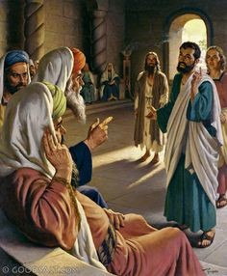
Closing Bible Quotes
Eph. 4:14 “That we henceforth be no more children, tossed to and fro, and carried about with every wind of doctrine, by the sleight of men, and cunning craftiness, whereby they lie in wait to deceive”
But What About the Sunday Law?
Acts 5:29 “Then Peter and the other apostles answered and said, We ought to obey God rather than men.”

Slide 36
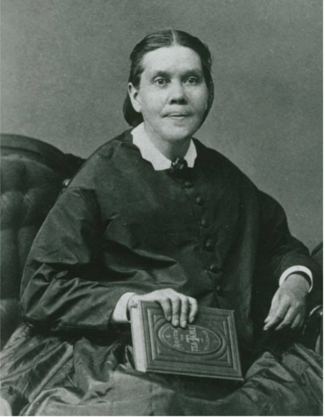
Let’s Give the 3rd Angel’s Message!
“Let nothing lessen the force of the truth for this time. The present truth is to be our burden. The third angel's message must do its work of separating from the churches a people who will take their stand on the platform of eternal truth.” EGW, 6T, p. 61

