Slide 1
Hebrews 9
‘A Greater Tabernacle’

Slide 2
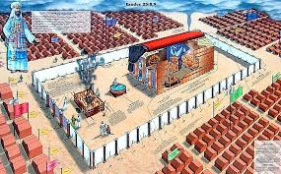
Paul Comes Back
As we wrapped up Hebrews 8, Paul had diverted from discussing the earthly sanctuary as a copy of the heavenly one, and had drifted into a brief discussion of the two covenants.
Now, as Hebrews 9 opens, Paul returns to the subject of the 2 tabernacles.

Slide 3
Hebrews 8
“Now of the things which we have spoken this is the sum: We have such an high priest, who is set on the right hand of the throne of the Majesty in the heavens; A minister of the sanctuary, and of the true tabernacle, which the Lord pitched, and not man. For every high priest is ordained to offer gifts and sacrifices: wherefore it is of necessity that this man have somewhat also to offer. For if he were on earth, he should not be a priest, seeing that there are priests that offer gifts according to the law: Who serve unto the example and shadow of heavenly things, as Moses was admonished of God when he was about to make the tabernacle: for, See, saith he, that thou make all things according to the pattern shewed to thee in the mount. But now hath he obtained a more excellent ministry, by how much also he is the mediator of a better covenant, which was established upon better promises.” Hebrews 8:1-6

Slide 4
“ For if that first covenant had been faultless, then should no place have been sought for the second. For finding fault with them, he saith, Behold, the days come, saith the Lord, when I will make a new covenant with the house of Israel and with the house of Judah: Not according to the covenant that I made with their fathers in the day when I took them by the hand to lead them out of the land of Egypt; because they continued not in my covenant, and I regarded them not, saith the Lord. For this is the covenant that I will make with the house of Israel after those days, saith the Lord; I will put my laws into their mind, and write them in their hearts: and I will be to them a God, and they shall be to me a people: And they shall not teach every man his neighbour, and every man his brother, saying, Know the Lord: for all shall know me, from the least to the greatest. For I will be merciful to their unrighteousness, and their sins and their iniquities will I remember no more. In that he saith, A new covenant, he hath made the first old. Now that which decayeth and waxeth old is ready to vanish away.” Hebrews 8:7-13

Slide 5
Paul is Ready to start again!
“Then verily the first covenant had also ordinances of divine service, and a worldly sanctuary. For there was a tabernacle made; the first, wherein was the candlestick, and the table, and the shewbread; which is called the sanctuary. And after the second veil, the tabernacle which is called the Holiest of all; Which had the golden censer, and the ark of the covenant overlaid round about with gold, wherein was the golden pot that had manna, and Aaron's rod that budded, and the tables of the covenant; And over it the cherubims of glory shadowing the mercy seat; of which we cannot now speak particularly.” Hebrews 9:1-5

Slide 6
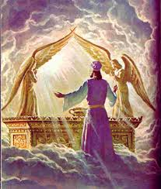
Paul restates what he said in chapter 8. The sanctuary on earth, in the Old Testament, was a pattern of the Heavenly Temple. The temple on earth is a replica of the Heavenly temple. The earthly had an ark in the Most Holy Place. So does the heavenly. “And the temple of God was opened in heaven, and there was seen in his temple the ark of his testament: and there were lightnings, and voices, and thunderings, and an earthquake, and great hail.” Rev. 11:19

Slide 7
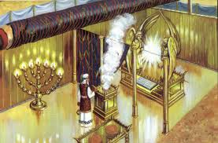
Paul’s Whole Argument in Chapter 9
“The voice of the LORD maketh the hinds to calve, and discovereth the forests: and in his temple doth every one speak of his glory.” Ps. 29:9
Everything in the sanctuary revealed the character , ministries, and sacrifice of Christ. The services were to lead people to utter self abasement and total dependence on Jesus!

Slide 8
The Sanctuary in Summary!
“The only defense against evil is the indwelling of Christ in the heart through faith in His righteousness. Unless we become vitally connected with God, we can never resist the unhallowed effects of self-love, self-indulgence, and temptation to sin. We may leave off many bad habits, for the time we may part company with Satan; but without a vital connection with God, through the surrender of ourselves to Him moment by moment, we shall be overcome. Without a personal acquaintance with Christ, and a continual communion, we are at the mercy of the enemy, and shall do his bidding in the end.” DA, pg. 324

Slide 9
“Now when these things were thus ordained, the priests went always into the first tabernacle, accomplishing the service of God. But into the second went the high priest alone once every year, not without blood, which he offered for himself, and for the errors of the people: The Holy Ghost this signifying, that the way into the holiest of all was not yet made manifest, while as the first tabernacle was yet standing: Which was a figure for the time then present, in which were offered both gifts and sacrifices, that could not make him that did the service perfect, as pertaining to the conscience; Which stood only in meats and drinks, and divers washings, and carnal ordinances, imposed on them until the time of reformation. But Christ being come an high priest of good things to come, by a greater and more perfect tabernacle, not made with hands, that is to say, not of this building; Neither by the blood of goats and calves, but by his own blood he entered in once into the holy place, having obtained eternal redemption for us.” Heb. 9:6-12

Slide 10
“The matchless splendor of the earthly tabernacle reflected to human vision the glories of that heavenly temple where Christ our forerunner ministers for us before the throne of God. The abiding place of the King of kings, where thousand thousands minister unto Him, and ten thousand times ten thousand stand before Him (Daniel 7:10); that temple, filled with the glory of the eternal throne, where seraphim, its shining guardians, veil their faces in adoration, could find, in the most magnificent structure ever reared by human hands, but a faint reflection of its vastness and glory. Yet important truths concerning the heavenly sanctuary and the great work there carried forward for man's redemption were taught by the earthly sanctuary and its services. The holy places of the sanctuary in heaven are represented by the two apartments in the sanctuary on earth. As in vision the apostle John was granted a view of the temple of God in heaven, he beheld there "seven lamps of fire burning before the throne." Revelation 4:5. He saw an angel "having a golden censer; and there was given unto him much incense, that he should offer it with the prayers of all saints upon the golden altar which was before the throne." Revelation 8:3. Here the prophet was permitted to behold the first apartment of the sanctuary in heaven; and he saw there the "seven lamps of fire" and "the golden altar," represented by the golden candlestick and the altar of incense in the sanctuary on earth. Again, "the temple of God was opened" (Revelation 11:19), and he looked within the inner veil, upon the holy of holies. Here he beheld "the ark of His testament," represented by the sacred chest constructed by Moses to contain the law of God.” GC, pgs. 414, 415

Slide 11
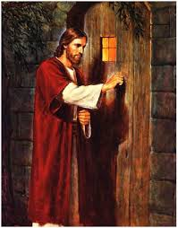
The sanctuary was Christ is All!
Christ was:
1. The Lamb.
2.The priests.
3. As Christ was everything in the temple, so He wants to be everything for us today!
“And let them make me a sanctuary; that I may dwell among them.” Ex. 25:8
“And the Word was made flesh, and dwelt among us, (and we beheld his glory, the glory as of the only begotten of the Father,) full of grace and truth.” John 1:14

Slide 12
Hebrews 9:13-20
“For if the blood of bulls and of goats, and the ashes of an heifer sprinkling the unclean, sanctifieth to the purifying of the flesh: How much more shall the blood of Christ, who through the eternal Spirit offered himself without spot to God, purge your conscience from dead works to serve the living God? And for this cause he is the mediator of the new testament, that by means of death, for the redemption of the transgressions that were under the first testament, they which are called might receive the promise of eternal inheritance. For where a testament is, there must also of necessity be the death of the testator. For a testament is of force after men are dead: otherwise it is of no strength at all while the testator liveth. Whereupon neither the first testament was dedicated without blood. For when Moses had spoken every precept to all the people according to the law, he took the blood of calves and of goats, with water, and scarlet wool, and hyssop, and sprinkled both the book, and all the people, Saying, This is the blood of the testament which God hath enjoined unto you.” Heb. 9:13-20

Slide 13
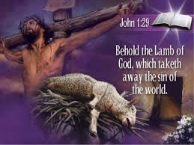
Christ’s death made possible life for every child of humanity. How very, very few will avail themselves of this wondrous offering. As the lambs died in the Old Testament, so Christ , the lamb of God, died that we may have life. Only thru Christ do we have life!

Slide 14
For you and Me
“The spotless Son of God hung upon the cross, His flesh lacerated with stripes; those hands so often reached out in blessing, nailed to the wooden bars; those feet so tireless on ministries of love, spiked to the tree; that royal head pierced by the crown of thorns; those quivering lips shaped to the cry of woe. And all that He endured--the blood drops that flowed from His head, His hands, His feet, the agony that racked His frame, and the unutterable anguish that filled His soul at the hiding of His Father's face--speaks to each child of humanity, declaring, It is for thee that the Son of God consents to bear this burden of guilt; for thee He spoils the domain of death, and opens the gates of Paradise. He who stilled the angry waves and walked the foam-capped billows, who made devils tremble and disease flee, who opened blind eyes and called forth the dead to life,--offers Himself upon the cross as a sacrifice, and this from love to thee.” DA, pg. 755

Slide 15
Hijacked by the Little horn/1st Beast of Rev. 13
Why are these things so foreign to us today. The Bible foretold a hijacking of these awesome truths by the little horn in Daniel 8.
“Yea, he magnified himself even to the prince of the host, and by him the daily sacrifice was taken away, and the place of his sanctuary was cast down.” Daniel 8:11
“And he opened his mouth in blasphemy against God, to blaspheme his name, and his tabernacle, and them that dwell in heaven. And it was given unto him to make war with the saints, and to overcome them: and power was given him over all kindreds, and tongues, and nations.” Rev. 13:6,7

Slide 16
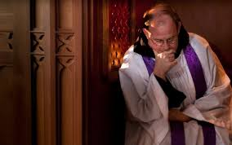
Annihilated……………but Restored!!!!
“Then I heard one saint speaking, and another saint said unto that certain saint which spake, How long shall be the vision concerning the daily sacrifice, and the transgression of desolation, to give both the sanctuary and the host to be trodden under foot? And he said unto me, Unto two thousand and three hundred days; then shall the sanctuary be cleansed.” Dan. 8:13,14
Since 1844, the Lord has been restoring the sanctuary message in the earth!!

Slide 17
The Sacrifice and the Priest
“Moreover he sprinkled with blood both the tabernacle, and all the vessels of the ministry. And almost all things are by the law purged with blood; and without shedding of blood is no remission. It was therefore necessary that the patterns of things in the heavens should be purified with these; but the heavenly things themselves with better sacrifices than these. For Christ is not entered into the holy places made with hands, which are the figures of the true; but into heaven itself, now to appear in the presence of God for us:” Heb. 9:21-24

Slide 18
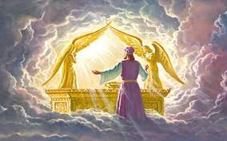
Christ beckons us today to renounce all self dependence and to lean on Him, to surrender to Him, and to allow Him to be King of our hearts and Lord of our minds. “Behold, I stand at the door, and knock: if any man hear my voice, and open the door, I will come in to him, and will sup with him, and he with me. To him that overcometh will I grant to sit with me in my throne, even as I also overcame, and am set down with my Father in his throne.” Rev. 3:20,21

