Slide 1
Unity at All Cost!
Unity at What Cost?

Slide 2
Many Voices
Stay in the organized church! If you don’t, you are lost!
In Germany—’P. Bill, you are following the devil if you do not join up the denomination.’
The church is Babylon; have nothing to do with it!
Self-supporting/independent vs. conference/organized church!
What should we do?

Slide 3
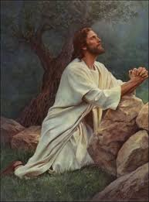
Christ Prayed for Unity
“Holy Father, keep through thine own name those whom thou hast given me, that they may be one, as we are…. That they all may be one; as thou, Father, art in me, and I in thee, that they also may be one in us: that the world may believe that thou hast sent me. And the glory which thou gavest me I have given them; that they may be one, even as we are one:” John 17:11,21, 22

Slide 4
Christ’s Desire
Christ’s prayer for unity among His children was based in two things and they are both found in John 17. “I pray not that thou shouldest take them out of the world, but that thou shouldest keep them from the evil. They are not of the world, even as I am not of the world. Sanctify them through thy truth: thy word is truth.” John 17:15-17
Christ wanted His children to be kept from the evil of this world.
Christ wanted His children to be purified through the truth as it is found in His word.
Thus, true unity can only be found in a community of believers who are seeking to live in submission to the truth and they are being purified by it. This only comes through submission to God’s truth!!

Slide 5
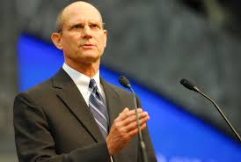
Ted Wilson’s Plea
“To independent groups or ministries who have found themselves somewhat distant from official church connection and have accepted tithe for support. Contact your local church and local conference and return to a warm and appropriate relationship, refusing to accept tithe and encouraging members to return their tithe through the storehouse of the local church. Remember your name!” Sermon, Ted Wilson, October 9, 2010

Slide 6
Should We Obey This?
Ted Wilson declared that independent groups should:
1. return to a warm and appropriate relationship with the brethren.
2. Refuse to accept tithe.
3. Encourage those who give you tithe to return it to the conference.

Slide 7

10 Reasons Why
I would like to look at 10 reasons why this is absolutely impossible. There is absolutely NO WAY that a reconciliation can occur between the self-supporting ministries/churches and the denomination unless there is genuine repentance on the part of the denomination.

Slide 8
The Nature of Christ
Carnal, Sinful Flesh
Perfect, Pre-Fall, Exempt
”It would have been an almost infinite humiliation for the Son of God to take man's nature, even when Adam stood in his innocence in Eden. But Jesus accepted humanity when the race had been weakened by four thousand years of sin. Like every child of Adam He accepted the results of the working of the great law of heredity. What these results were is shown in the history of His earthly ancestors. He came with such a heredity to share our sorrows and temptations, and to give us the example of a sinless life.” DA, pg. 48, 49
In the book ‘Questions on Doctrine, Froom declared “Although born in the flesh, He was nevertheless God, and was exempt from the inherited passions and pollutions that corrupt the natural descendants of Adam. “ QOD, pg. 383

Slide 9
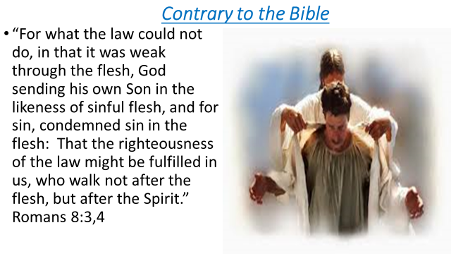

Slide 10
The Atonement
Going on in Heaven Today
Finished at the Cross
“So when Christ entered the holy of holies to perform the closing work of the atonement, He ceased His ministration in the first apartment. But when the ministration in the first apartment ended, the ministration in the second apartment began. When in the typical service the high priest left the holy on the Day of Atonement, he went in before God to present the blood of the sin offering in behalf of all Israel who truly repented of their sins. So Christ had only completed one part of His work as our intercessor, to enter upon another portion of the work, and He still pleaded His blood before the Father in behalf of sinners. This subject was not understood by Adventists in 1844.” GC. Pgs. 428, 429
Since the writing of the book Questions on Doctrine in the 1950’s, SDA’s have been ashamed of this teaching and speak very rarely of this doctrine. Many SDA’s today believe that the atonement of Christ was finished at the cross. On these eternal issues of Bible truth, can people with opposing views be in harmony over these? “Can two walk together except they be agreed?” Amos 3:3

Slide 11
Sanctification
Victory over Sin
Salvation in Sin/Just accept Jesus
While it formerly denounced Christ and the Bible, it now professes to accept both. But the Bible is interpreted in a manner that is pleasing to the unrenewed heart, while its solemn and vital truths are made of no effect. Love is dwelt upon as the chief attribute of God, but it is degraded to a weak sentimentalism, making little distinction between good and evil. God's justice, His denunciations of sin, the requirements of His holy law, are all kept out of sight. The people are taught to regard the Decalogue as a dead letter. Pleasing, bewitching fables captivate the senses and lead men to reject the Bible as the foundation of their faith. Christ is as verily denied as before; but Satan has so blinded the eyes of the people that the deception is not discerned.” GC, pg. 558
“He that overcometh, the same shall be clothed in white raiment; and I will not blot out his name out of the book of life, but I will confess his name before my Father, and before his angels.” Revelation 3:5

Slide 12
The Anti-Christ
The Papacy
The Pope is a Christian/our Brother
“And I stood upon the sand of the sea, and saw a beast rise up out of the sea, having seven heads and ten horns, and upon his horns ten crowns, and upon his heads the name of blasphemy. And the beast which I saw was like unto a leopard, and his feet were as the feet of a bear, and his mouth as the mouth of a lion: and the dragon gave him his power, and his seat, and great authority. And I saw one of his heads as it were wounded to death; and his deadly wound was healed: and all the world wondered after the beast. And they worshipped the dragon which gave power unto the beast: and they worshipped the beast, saying, Who is like unto the beast? who is able to make war with him?”
William Johnson-Editor-Adventist Review-1994,1995 ‘Saints Victory in the End-time’ “To interpret the sea monster of Revelation 13 as the papacy seems somewhat out of keeping with the spirit of the times. In an age when Christianity in general faces the onslaughts of secularism and when among Christians ecumenism has become popular, the interpretation smacks of narrowness and bigotry.” Shocking………………………………………

Slide 13
Widmer
Associate Editor of the Review, Myron Widmer “I was surprised and delighted to learn that the Bible is the sole textbook during the pope’s visit and the World Youth Day activities. What a wonderful opportunity for so many young people to hear the gospel message straight from God’s Word…Or might a better understanding be that God is working through this pope to open doors for Catholics to the great truths of Scripture concerning salvation by faith in Christ?”…I can only wonder if in these last days He is using some very unexpected sources to encourage many individuals (especially Catholics) in search for truth.” Review and Herald, September 9,23,and 30, 1993

Slide 14
Mark of the Beast
Sunday
Any Day but Sabbath
“Prove to me from the Bible alone that I am bound to keep Sunday holy. There is no such law in the Bible. It is a law of the holy Catholic Church alone. The Bible says ‘Remember the Sabbath day to keep it holy.’ The Catholic Church says, No. By my divine power I abolish the Sabbath day and command you to keep holy the first day of the week. And lo! The entire civilized world bows down in reverent obedience to the command of the Holy Catholic Church. — Thomas Enright, CSSR, President, Redemptorist College (Roman Catholic), Kansas City, MO., February 18, 1884.
"The Mark of the Beast, which is the observance of any day other than the seventh-day Sabbath, is an institution that clearly sets forth the authority of the Beast because the Sabbath is God's mark of his authority," Wilson said. Given at ASI, 8-9-14 in Grand Rapids, MI Are we suppose to support this?

Slide 15
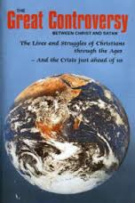
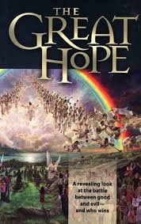
Great Controversy or Great Hoax
700 pages of Great Truth
92 pages of devotional material

Slide 16
The Prophet
Like the Prophets of Old
Good for devotional material only/ not for doctrine
Ellen White was as inspired as all the prophets of old. Her writings are good for doctrine, reproof, instruction in righteousness, and not just for devotional thoughts. When sharing with non-Adventists, we should use the Bible to explain our faith for no teaching of Adventism is based in Ellen White. The SOP only sheds light on what is already in the Bible!
The denomination has for 60 years been denigrating the influence of the SOP. This is in fulfillment of 1 SM, pg. 48 “Satan is ... constantly pressing in the spurious—to lead away from the truth. The very last deception of Satan will be to make of none effect the testimony of the Spirit of God. “Where there is no vision, the people perish” (Proverbs 29:18). Satan will work ingeniously, in different ways and through different agencies, to unsettle the confidence of God's remnant people in the true testimony.—Letter 12, 1890.

Slide 17
Bible Translations, Spiritual Formation
The great thrust amongst us has been to utilize other translations of the bible other than the King James Version. The New International Version, the New King James, and a host of other translations have come in amongst us.
Spiritual Formation was brought in 2001. “‘The Adventist world church created the International Board of Ministerial and Theological Education in September 2001, designed to provide overall guidance and standards to the professional training of pastors, evangelists, theologians, teachers, chaplains, and other denominational employees involved in ministerial and religious formation, or spiritual formation, in each of the church’s 13 regions around the world.’ (ANN News, 2-3-2004, www.Adventist.org.
“Malachi Martin says that after going through the rigors of the Spiritual Exercises, ‘Each man emerged from that weeks long regimen as a spiritual fighter completely won over to warfare…an entirely obedient servant of the pope.’ “ quote form Omega II by Lewis Walton, pgs. 150,151

Slide 18
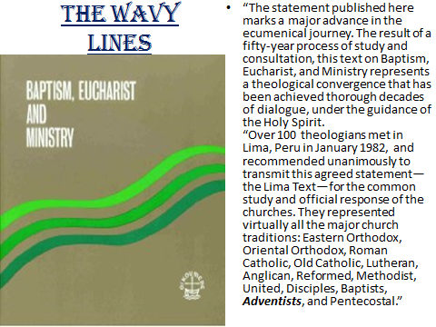

Slide 19
Support This? Unify with This?
“ But there is no union between the Prince of light and the prince of darkness, and there can be no union between their followers. When Christians consented to unite with those who were but half converted from paganism, they entered upon a path which led further and further from the truth. Satan exulted that he had succeeded in deceiving so large a number of the followers of Christ. He then brought his power to bear more fully upon these, and inspired them to persecute those who remained true to God. None understood so well how to oppose the true Christian faith as did those who had once been its defenders; and these apostate Christians, uniting with their half-pagan companions, directed their warfare against the most essential features of the doctrines of Christ. It required a desperate struggle for those who would be faithful to stand firm against the deceptions and abominations which were disguised in sacerdotal garments and introduced into the church. The Bible was not accepted as the standard of faith. The doctrine of religious freedom was termed heresy, and its upholders were hated and proscribed. After a long and severe conflict, the faithful few decided to dissolve all union with the apostate church if she still refused to free herself from falsehood and idolatry. They saw that separation was an absolute necessity if they would obey the word of God. They dared not tolerate errors fatal to their own souls, and set an example which would imperil the faith of their children and children's children. To secure peace and unity they were ready to make any concession consistent with fidelity to God; but they felt that even peace would be too dearly purchased at the sacrifice of principle. If unity could be secured only by the compromise of truth and righteousness, then let there be difference, and even war.” GC, pg. 45

