Slide 1
The Right Arm, pt. 3 “Sleep-Rest”

Slide 2
Peter’s Ladder
“And beside this, giving all diligence, add to your faith virtue; and to virtue knowledge; And to knowledge temperance; and to temperance patience; and to patience godliness; And to godliness brotherly kindness; and to brotherly kindness charity.” 2 Peter1 :5-7

Slide 3
None More Clear than Rest!
It is virtually impossible to be self controlled, and patient if we are not getting enough sleep at night! Peter’s ladder goes in steps. The ones following temperance are patience, godliness, brotherly kindness, and charity. These are impossible when we are not getting enough sleep.

Slide 4
“During the day, the chief work of the body is done, but during the night, the body is revived, the muscles are built up, the brain tissue is restored, and the nerves are recharged. For growth and health, a sufficient amount of leisure and rest is essential. When the body is deprived of sleep, it is unable to rebuild and recharge itself adequately. There is an increase in irritability, while creativity, concentration, and efficiency suffer. Sleep deprivation impairs judgment, causing values and priorities to change. Continued loss of sleep can result in exhaustion, depression, delusions, paranoia, and hallucinations. Losing as little three hours of sleep in a single night can cut the effectiveness of your immune system in half. Slowed reaction time and decreased concentration lead to an increase in car accidents. As many a 30% of fatal automobile accidents are caused by a driver falling asleep at the wheel. In a classic health study, it was found that people who regularly slept seven to eight hours each night had a lower death rate than those who slept less than that. Do you nod off whenever you're not active, need an alarm clock to wake up, or sleep longer on your days off? If so, you are probably not getting enough sleep.” Amazing Discoveries

Slide 5
Science has discovered how the human body works in a daily 24-hour cycle. The body lets go of hormones at certain times of the day. This supports a statement made by Ellen G. White: “Sleep is worth far more before than after midnight. Two hours’ good sleep before twelve o’ clock is worth more than four hours after twelve o’ clock.” - MR. vol. 7 p. 224

Slide 6
Sleep With Empty Stomach
"I know that from the testimonies given me from time to time, for brain workers, that sleep is worth far more before than after midnight. Two hours good sleep before 12 o'clock is worth more than four hours after 12 o'clock...(Ellen White)
"Give yourself proper time to sleep. They who sleep give nature time to build up and repair the weary waste of the organs." (Ellen White).
"The number of hours of sleep generally needed varies with circumstances The average is seven to nine. In general one should sleep when sleepy and not try to sleep more. Growing children require more sleep than grown-ups." (Ellen White).
"Ones best sleep is with the stomach practically empty. It is true that food puts one to sleep at first, by diverting blood from the head; but it disturbs sleep later. Water, unless it induces bladder-action during the night, or even fruit, may be taken without injury before retiring. If one goes to bed with an empty stomach, he can often get along well with six or seen hours sleep, but if he goes to bed soon after a hearty meal, he usually needs from eight to ten hours sleep...It has already been pointed out that sleeping outdoors is more restful than sleeping indoors." How to Live, pg. 120-121. (Ellen White).

Slide 7
“No Night Eating: Don’t eat meals close to bedtime and avoid evening and late night snacking. If your body is churning through a big meal, it’s certainly not going to get the rest it needs. And if you’re overweight or prone to digestion problems, you’re likely to experience painful heartburn and reflux if you binge too close to bedtime.” NY Times, How to Sleep Better.

Slide 8
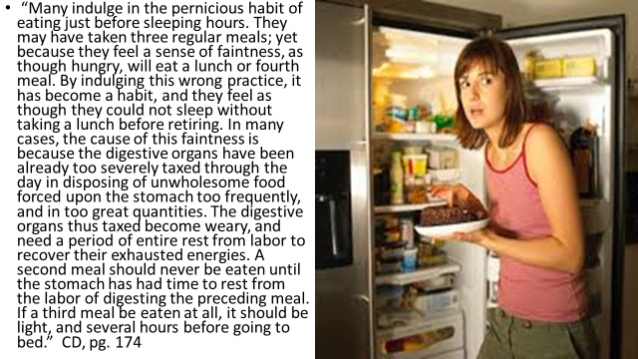

Slide 9
"The stomach, when we lie down to rest, should have its work done, that it may enjoy rest, as well as other portions of the body. The work of digestion should not be carried on through any period of the sleeping hours."—Ellen G. White, Healthful Living, p. 84

Slide 10
Regularity
“In most cases two meals a day are preferable to three. Supper, when taken at an early hour, interferes with the digestion of the previous meal. When taken later, it is not itself digested before bedtime. Thus the stomach fails of securing proper rest. The sleep is disturbed, the brain and nerves are wearied, the appetite for breakfast is impaired, the whole system is unrefreshed and is unready for the day's duties.
The importance of regularity in the time for eating and sleeping should not be overlooked. Since the work of building up the body takes place during the hours of rest, it is essential, especially in youth, that sleep should be regular and abundant.” Education, pg. 206

Slide 11
Be Regular!
“Stick to a sleep schedule of the same bedtime and wake up time, even on the weekends. This helps to regulate your body's clock and could help you fall asleep and stay asleep for the night.
Practice a relaxing bedtime ritual. A relaxing, routine activity right before bedtime conducted away from bright lights helps separate your sleep time from activities that can cause excitement, stress or anxiety which can make it more difficult to fall asleep, get sound and deep sleep or remain asleep.
If you have trouble sleeping, avoid naps, especially in the afternoon. Power napping may help you get through the day, but if you find that you can't fall asleep at bedtime, eliminating even short catnaps may help.
Exercise daily. Vigorous exercise is best, but even light exercise is better than no activity. Exercise at any time of day, but not at the expense of your sleep.” National Sleep Foundation

Slide 12
Ellen White's Counsel to Her Secretaries Regarding Proper Rest .—” It is a very bad habit to let work drag and drive one. Drive the work, and then you will not become discouraged. It is a bad plan to give way to impulse. If you see a book you would like to read, and sit down in the midst of your work and read during the precious hours of the day, when there is work that needs to be done, then the work is neglected. Make it habit not to sit up after nine o'clock. Every light should be extinguished. This turning night into day is a wretched, health-destroying habit, and this reading much by brain workers, up to the sleeping hours, is very injurious to health. It calls the blood to the brain and then there is restlessness and wakefulness, and the precious sleep, which should rest the body, does not come when desired. It is needful to take care of the body and to study its needs and preserve it from unnecessary exposure. It is a sin to be ignorant of how to care for the wants of this habitation God has given us. Especially should brain workers begin to be soothed and not in any way excited as they draw nigh their hours for sleep. Let the blood be attracted from the brain by some kind of exercise, if need be. Let not the brain be taxed even to read, and, of course, not to put forth literary effort. You shall, Marian [Davis] and Fannie [Bolton], have one or two hours, as will best please you, in the daytime, and you will not feel so starved for intellectual food that you will partake of it in the night hours. God designed that the night shall be given to sleep. . . .Wake up in the mornings. Set your hour to rise early, and bring yourself to it, then retire at an early hour, and you will see that you will overcome many painful disorders which distress the mind, cause gloomy feelings, discouragement, and unhappy friction, and disqualify you for doing anything without great taxation.-- Letter 76, 1888, pp. 3-5. (To Brother and Sister Lockwood, Marian Davis, Fannie Bolton, and May Walling, May 24, 1888.)

Slide 13
By 9:30 pm
“In regulating the hours for sleep, there should be no haphazard work. Students should not form the habit of burning the midnight oil and taking the hours of the day for sleep. If they have been accustomed to doing this at home, they should correct the habit, going to bed at a seasonable hour. They will then rise in the morning refreshed for the duties of the day. In our schools the lights should be put out at half past nine.” Counsels to Teachers, pg. 297

Slide 14
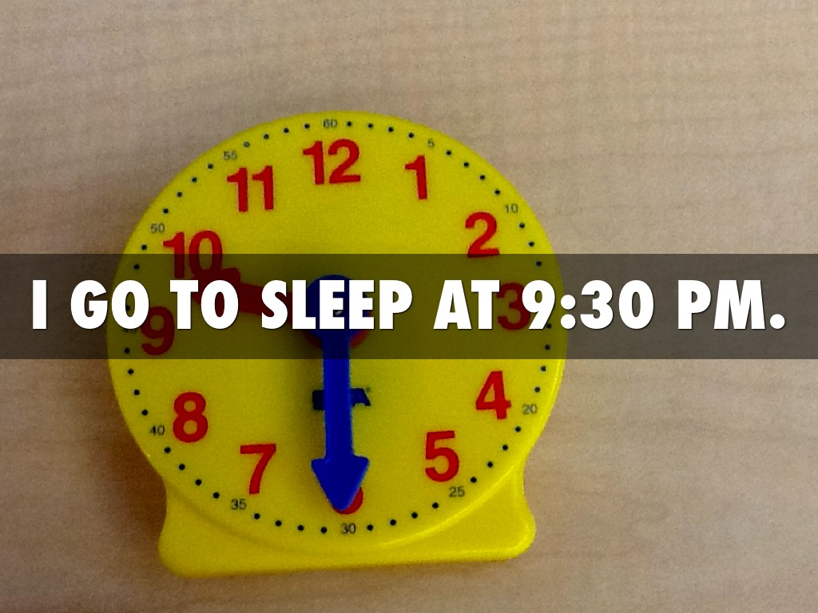
9:00 to 9:30 at night best bedtime
Ellen White’s council to college aged young people was that 9:30 pm should be bedtime. Huge decisions are being made at that time in a person's life; a career choice and a lifelong mate. How critical that the mind is clear for making right decisions. In this time of investigative judgment, how much more important that we get good sleep!

Slide 15
Restfulness
"Keep the Sabbath day to sanctify it, as the LORD thy God hath commanded thee. Six days thou shalt labour, and do all thy work: But the seventh day [is] the Sabbath of the LORD thy God: [in it] thou shalt not do any work, thou, nor thy son, nor thy daughter, nor thy manservant, nor thy maidservant, nor thine ox, nor thine ass, nor any of thy cattle, nor thy stranger that [is] within thy gates; that thy manservant and thy maidservant may rest as well as thou. And remember that thou wast a servant in the land of Egypt, and [that] the LORD thy God brought thee out thence through a mighty hand and by a stretched out arm: therefore the LORD thy God commanded thee to keep the Sabbath day." Deut. 5:12-15
"A life in Christ is a life of restfulness. There may be no ecstasy of feeling, but there should be an abiding peaceful trust. Your hope is not in yourself; it is in Christ. Your weakness is united to His strength, your ignorance to His wisdom, your frailty to His enduring might....Let the mind dwell upon His love, upon the beauty, the perfection of His character.."—Ellen G. White, Steps to Christ, p. 70

Slide 16
Sabbath-Time for Service/Not Idleness
“Let none come to the place of worship to take a nap. There should be no sleeping in the house of God. You do not fall asleep when engaged in your temporal business, because you have an interest in your work. Shall we allow the service which involves eternal interests to be placed on a lower level than the temporal affairs of life? When we do this we miss the blessing which the Lord designs us to have. The Sabbath is not to be a day of useless idleness. Both in the home and in the church a spirit of service is to be manifested. He who gave us six days for our temporal work has blessed and sanctified the seventh day and set it apart for Himself. On this day He will in a special manner bless all who consecrate themselves to His service.” 6T, pg. 361

Slide 17
The Sabbath- Restful Usefulness
True rest can only be found in Christ and in living a life in submission to Him! Even in seeking to practice regularity, getting to bed by 9:30, not eating near bedtime; all of these are very important. However, none of us will find perfect rest or sleep unless our mind is at rest in submission to Christ’s authority. There is no rest found outside of this communion!!
“Come unto me, all ye that labour and are heavy laden, and I will give you rest. Take my yoke upon you, and learn of me; for I am meek and lowly in heart: and ye shall find rest unto your souls. For my yoke is easy, and my burden is light.” Matthew 11:28-30

