Slide 2
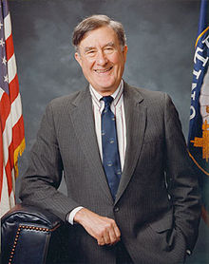
Senator John Chaffee

Slide 6
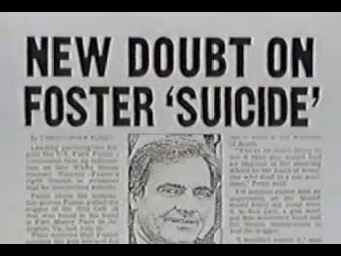
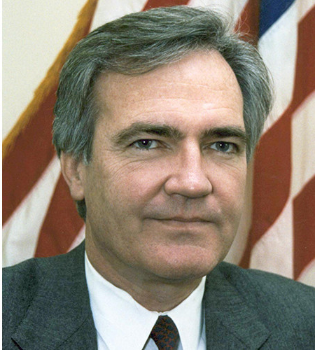
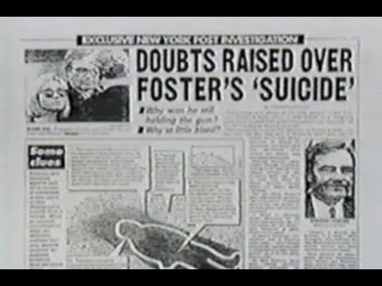
Vince Foster

Slide 7
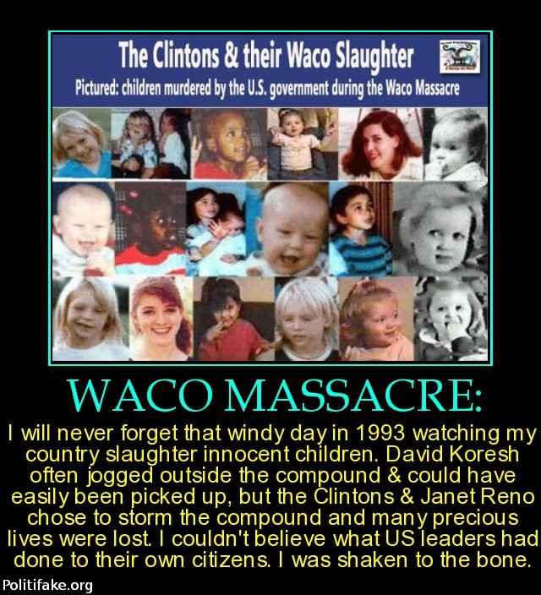

Slide 8
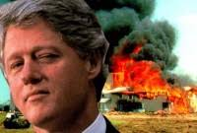
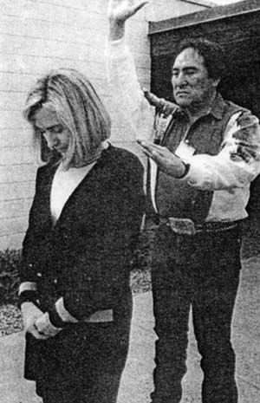

Slide 9
The Message is Clear! Stay in the Mainstream Churches or suffer the fate of the Branch Davidians. Do not be apart of independent, self-supporting ministries. Just put your money in the till and keep you mouths shut. Do not speak about the Second Coming of Christ, the Law of God, the Papacy, or the 3 Angels Messages. I you want to worship God according to the dictates of the Bible you will be deemed a “fundamentalist” and treated as a terrorist in the coming conflict. Will you stand with Christ and receive the Seal of God. We are not called to revolution, but to preach the Word of God, the straight testimony of truth, and to tell the world of the 3 Angels Messages of Revelation 14 until it swells into a Loud Cry that will be heard across the world!

Slide 10
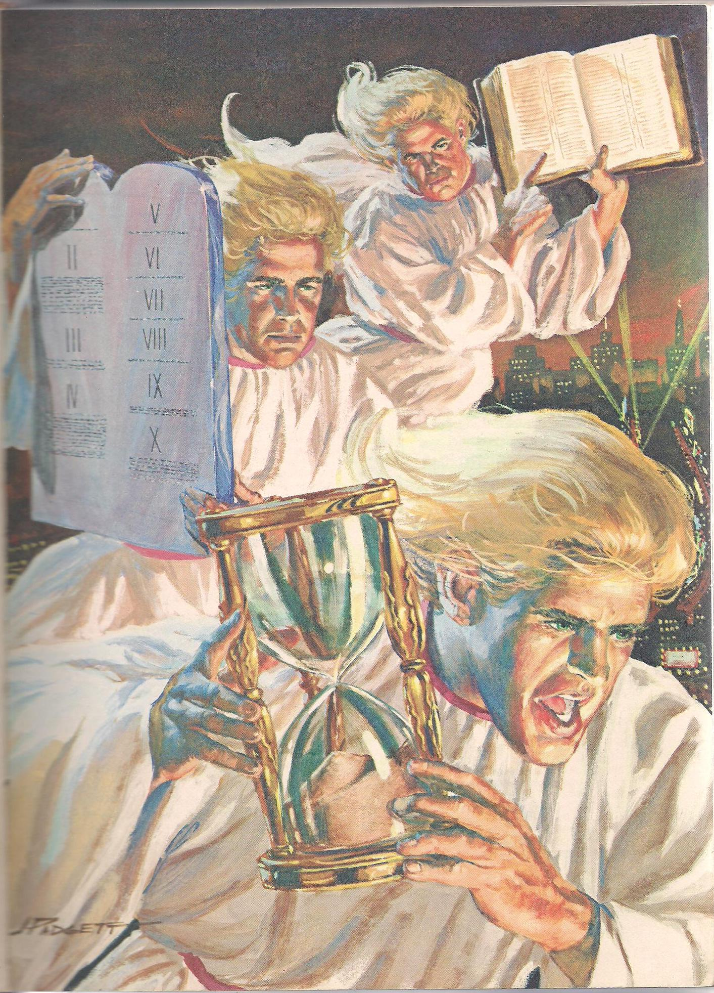

Slide 11
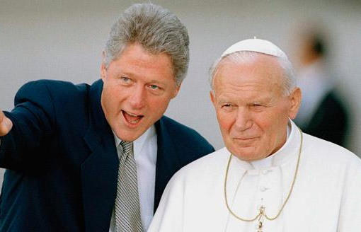
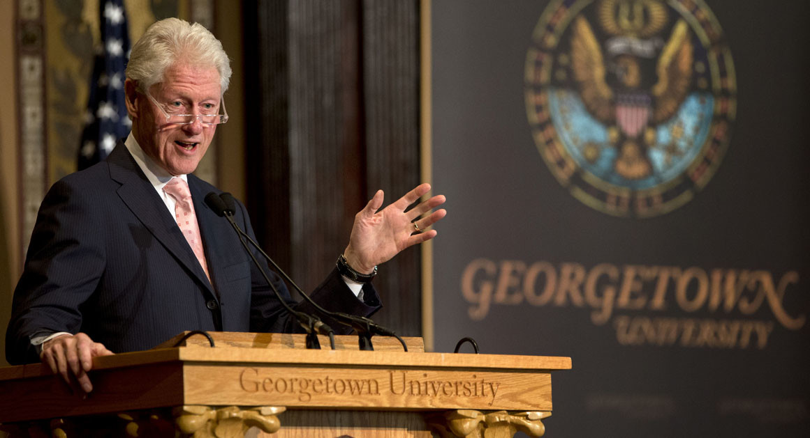
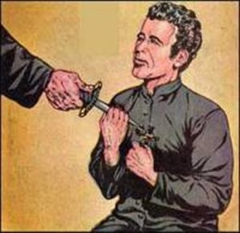
Bill Clinton. Jesuit-trained at Jesuit School “Georgetown”, adamant supporter of Pope John Paul II, and implicated in the deaths of Christian self-supporting SDAs

Slide 12
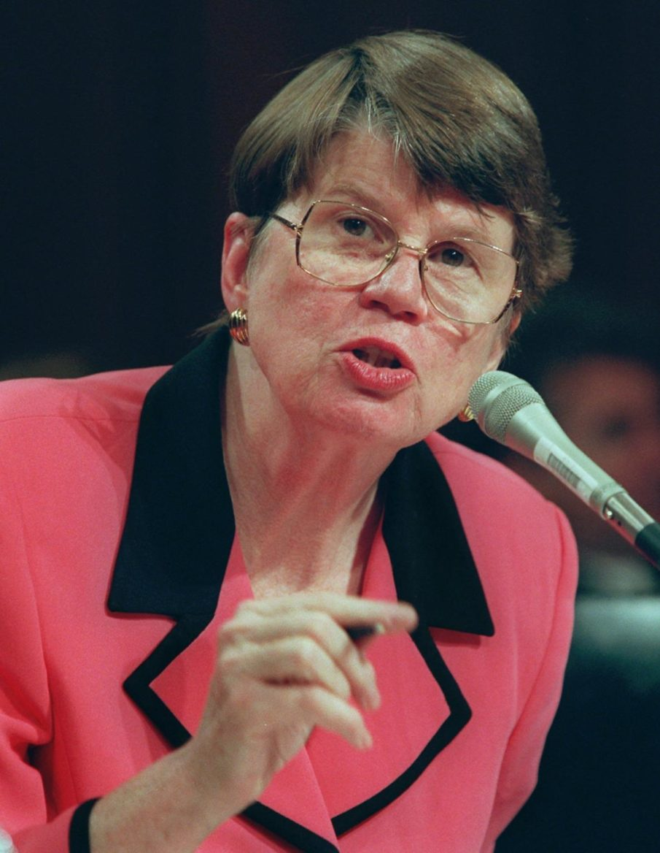
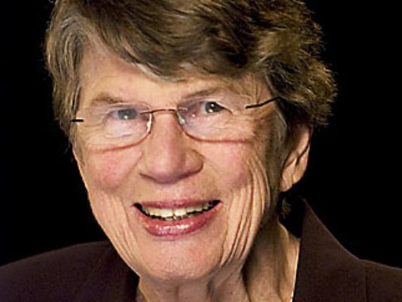
Attorney General Janet Reno

Slide 13
Janet Reno: What is a Cultist (Member of a cult)?
Strong belief in the Bible
Strong belief in Second Coming of Christ
Frequent attendance at Bible Studies
Gives high levels of finances to Christian cause (say like 10% Tithe maybe?)
Homeschools children
Accumulated survival food
Strong belief in the Second Amendment
Who also distrusts Big Government
How do you stack up???
If you are more than one of these than according to the then Attorney General you are a THREAT, qualified for government interference! Liberty of conscience wholly silenced, religious liberty struck down!

Slide 14
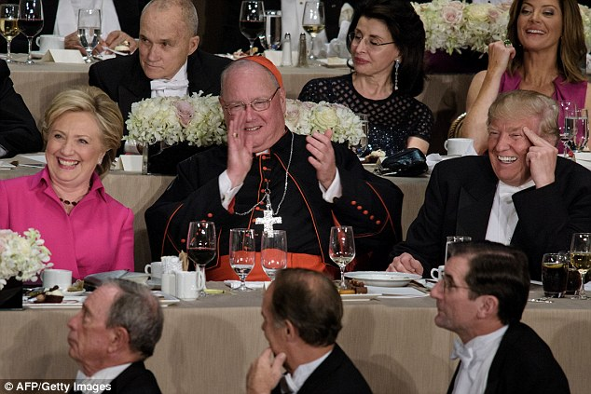
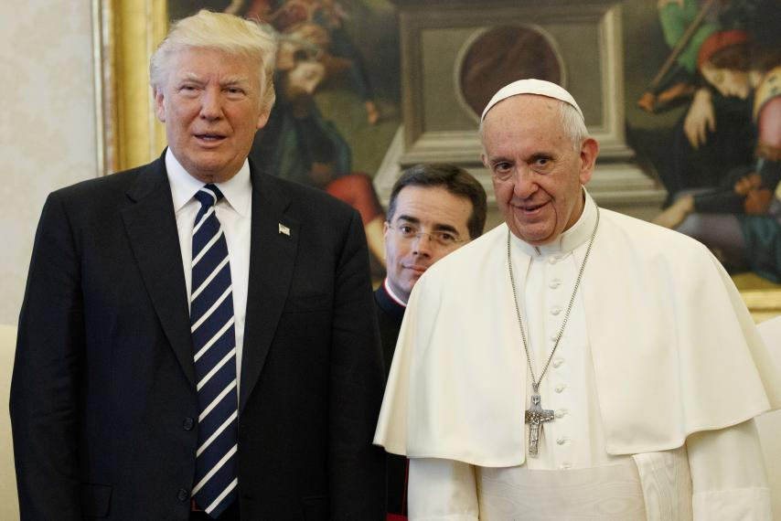
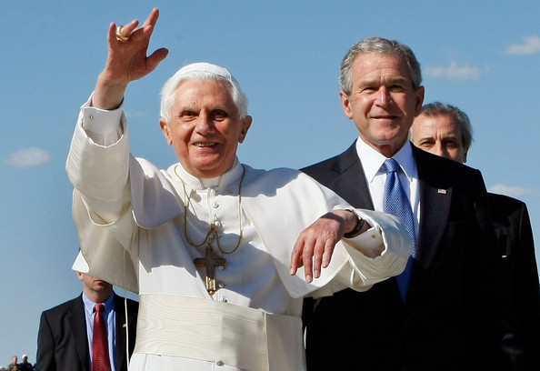
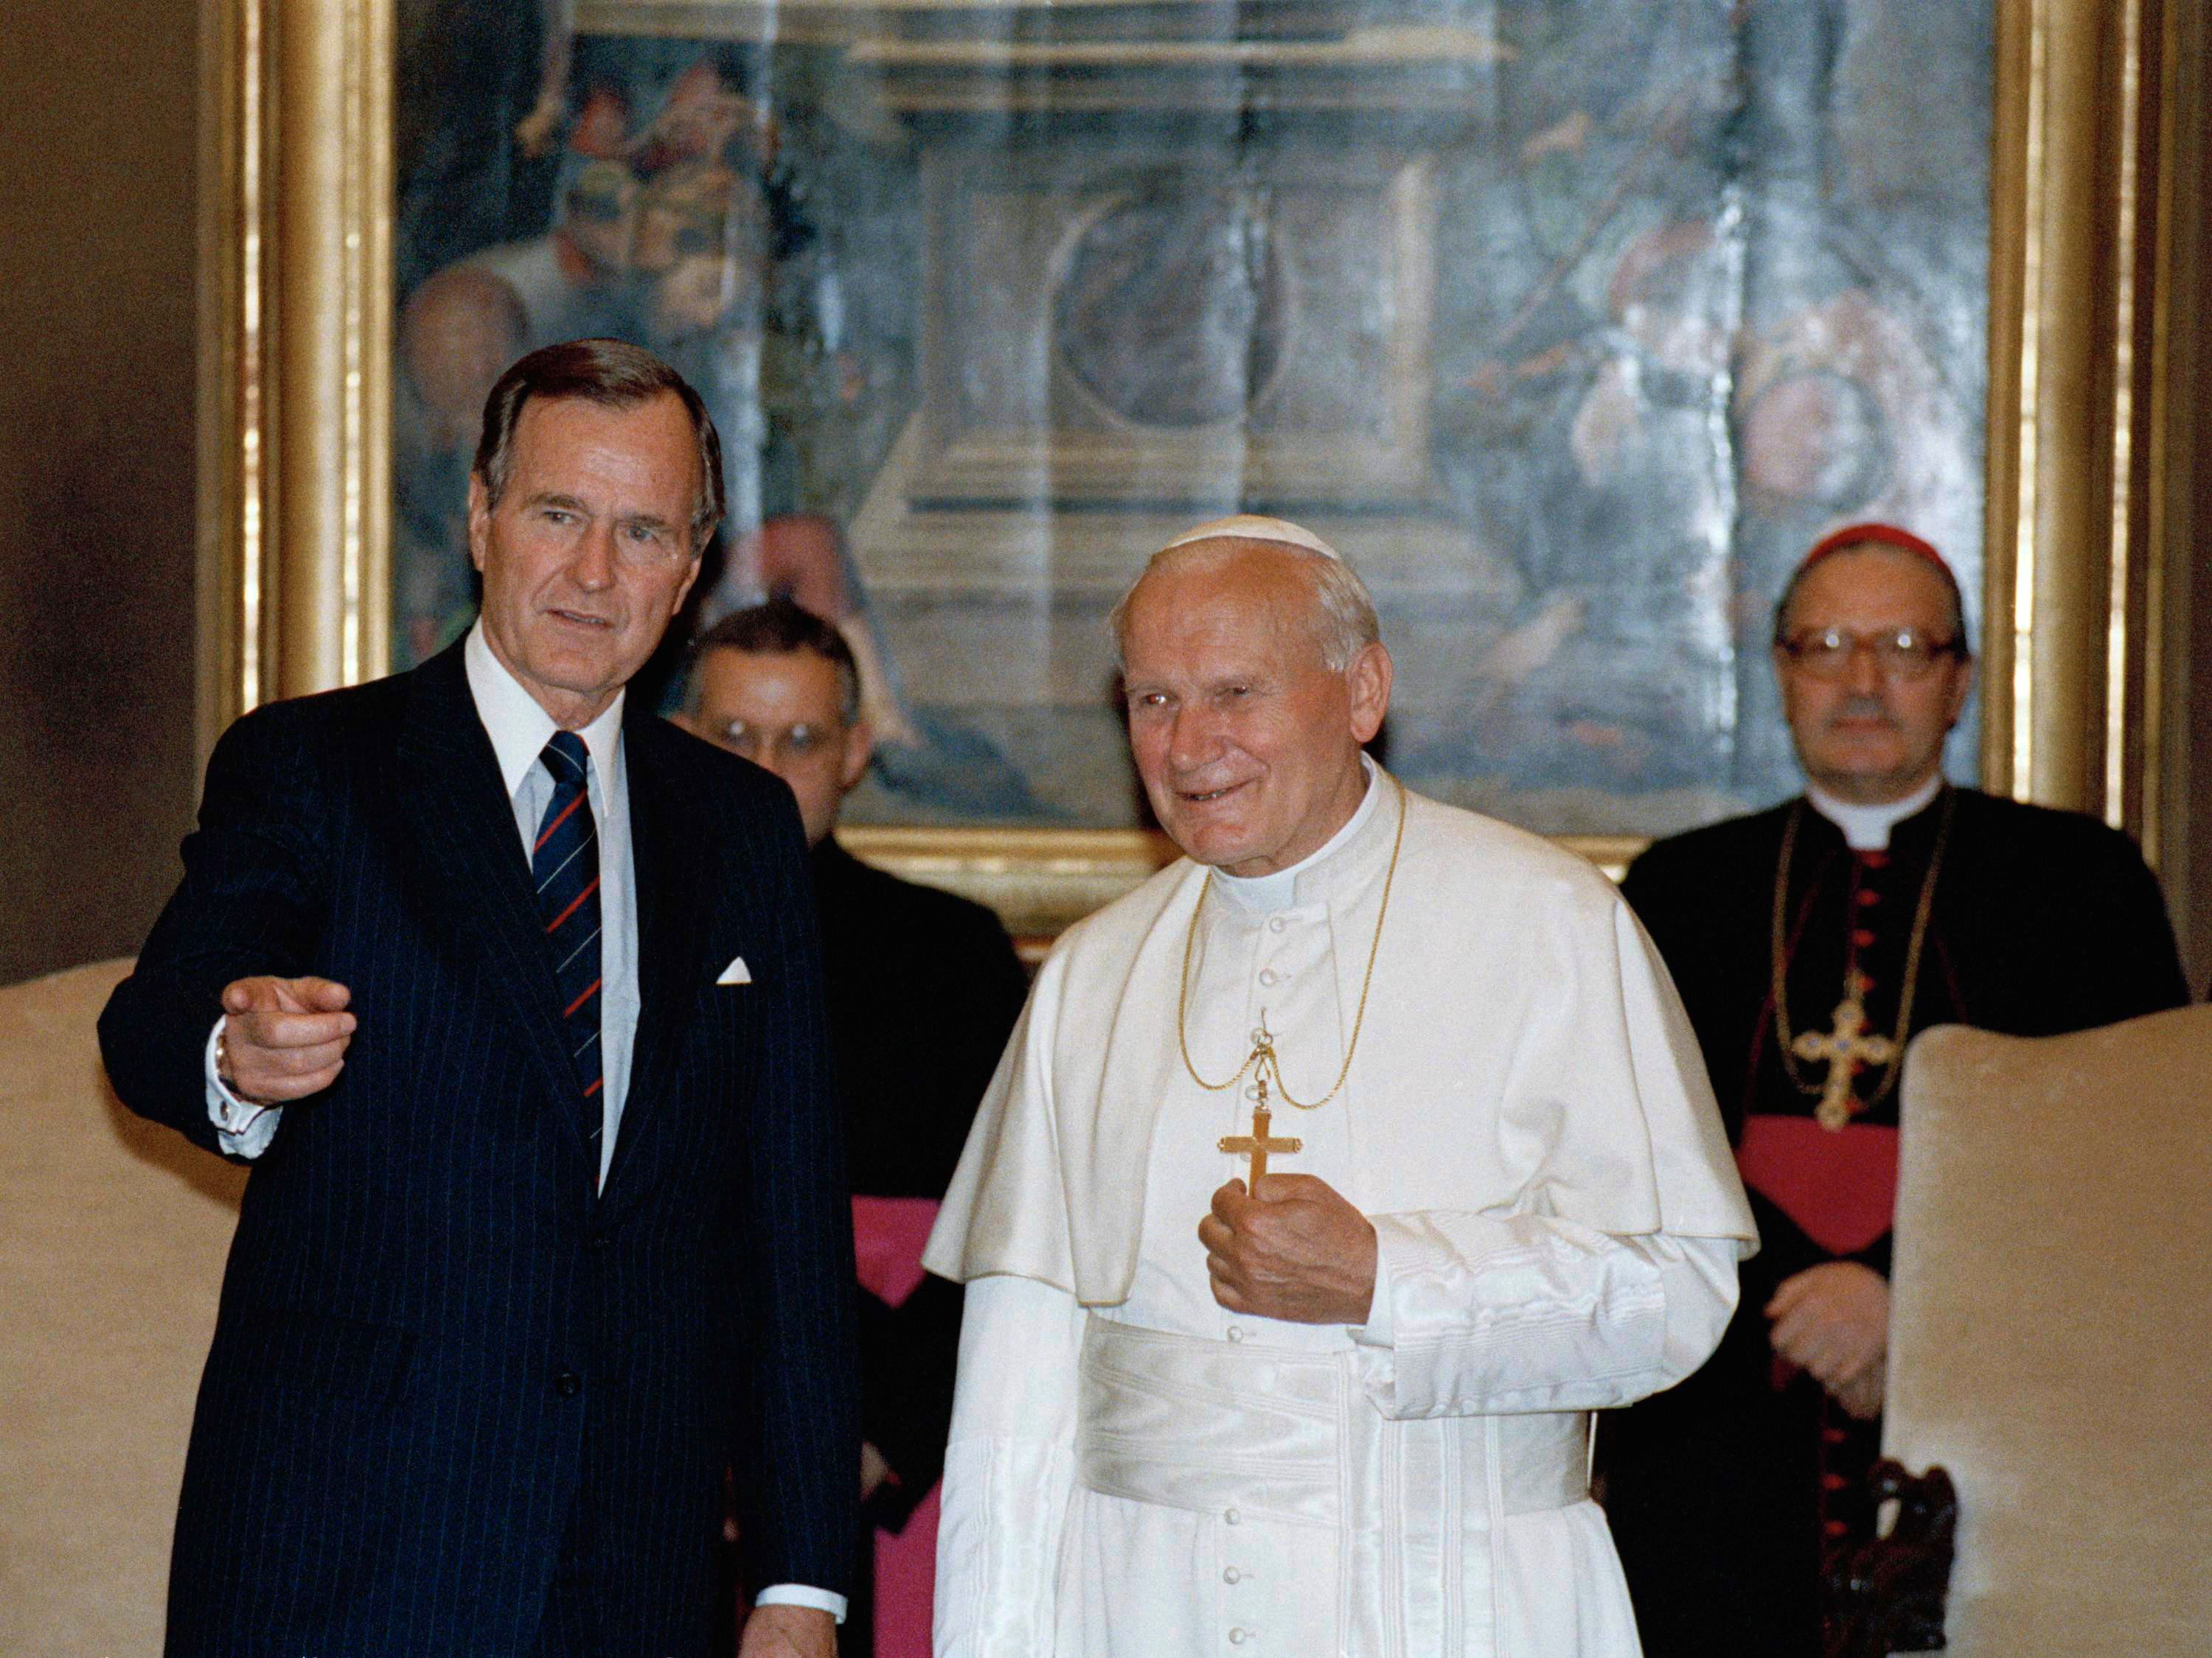
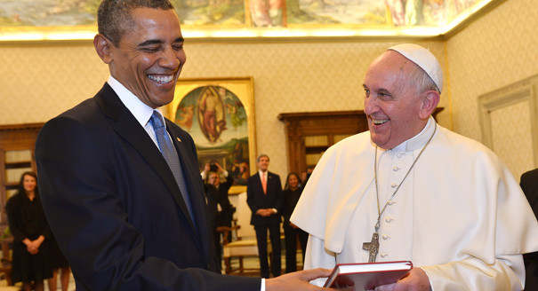
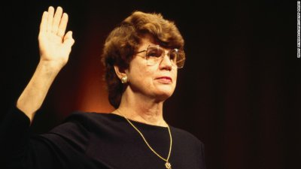
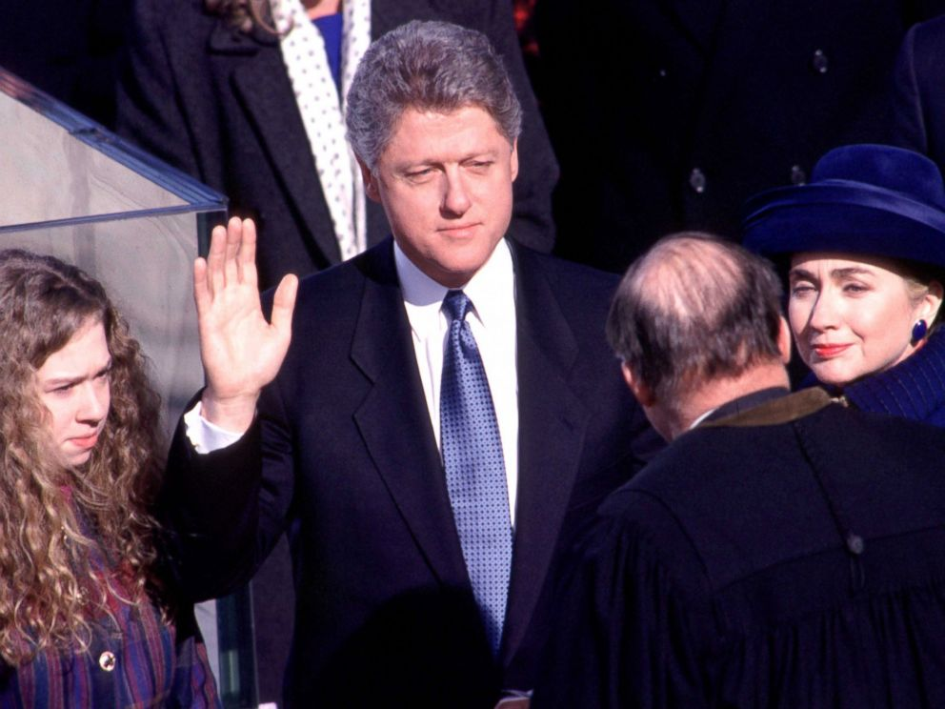
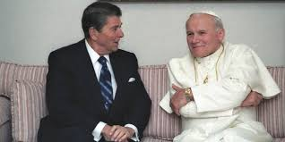
Republican or Democrat? Doesn’t matter, these people may take the oath, but they are all working for Rome. If they weren’t they would suffer the same fate as JFK, Abraham Lincoln, William Henry Harrison, and any all whistle blowers since then. Don’t be deceived! If they aren’t towing the line for Rome, they will not be permitted to stand long. Will you stand with Christ and spread the 3 Angels Messages??

Slide 15
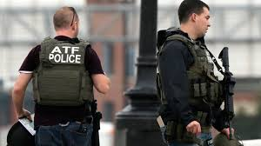
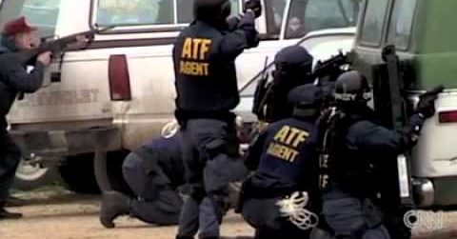
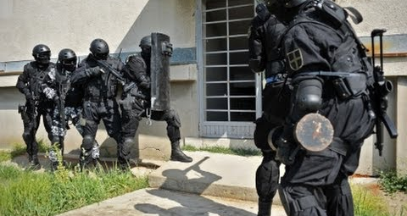
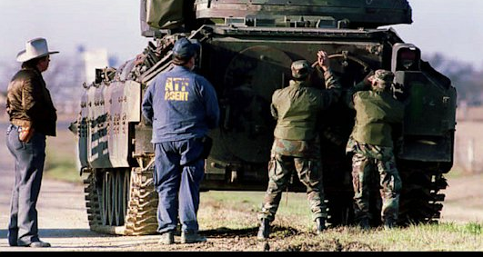

Slide 16
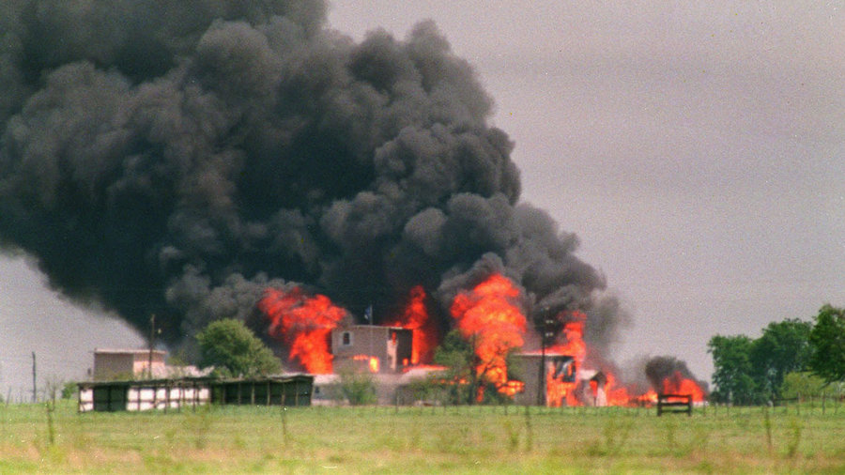

Slide 17
Friend? Foe? Infiltrated? Following Christ? Or Following the Ecumenical movement? You Decide. Are you hearing the Old Foundational Truths that make us a Separate people. Have we become more Christlike or worldlike in the last decades?

Slide 19
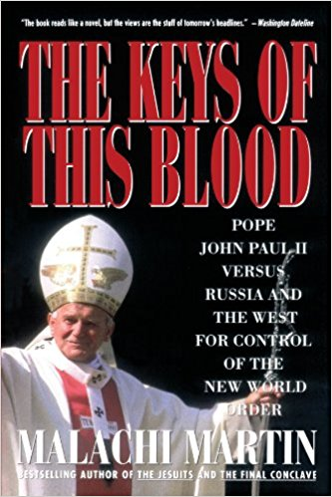

Slide 20
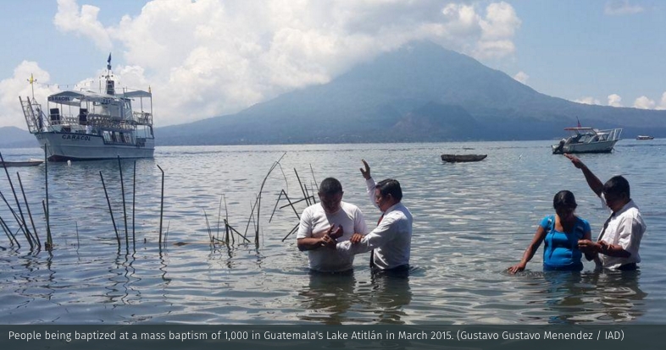

Slide 21
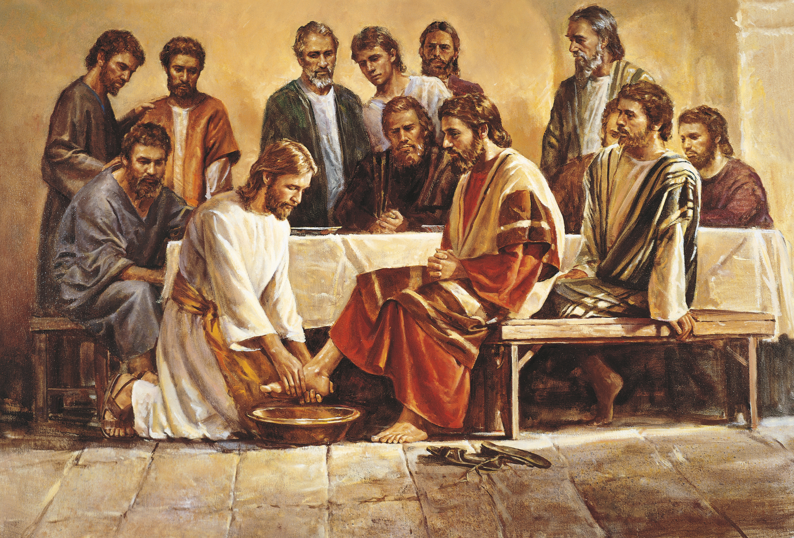

Slide 22
By the decree enforcing the institution of the papacy in violation of the law of God, our nation [the United States] will disconnect herself fully from righteousness. When Protestantism shall stretch her hand across the gulf to grasp the hand of the Roman power, when she shall reach over the abyss to clasp hands with spiritualism, when, under the influence of this threefold union, our country shall repudiate every principle of its Constitution as a Protestant and republican government, and shall make provision for the propagation of papal falsehoods and delusions, then we may know that the time has come for the marvelous working of Satan and that the end is near.—Ellen White, Testimonies for the Church Volume 5, p, 451

