Slide 1
What is the Big Deal?!?
Come On!!!!

Slide 2
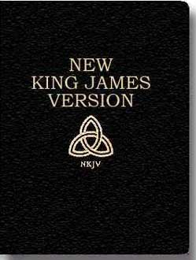
A Bible is a Bible!
It doesn’t make any difference what Bible you use! You can use the NIV, the Good News, the New American Standard, or the New King James. Take your pick; they are all the same!
Well, you are right; these are all the same!

Slide 3
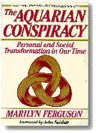
Symbolism-Very important
The symbolism of the Aquarian conspiracy and the NKJV is identical. This Bible, along with all the others, save one, are based around corrupted manuscripts that are steeped in allegory, mysticism, and corruption of the pure Word of God. Only the King James Bible is based on the Textus Receptus; the only solid base for translation!!!

Slide 4
One Bible
“Listen carefully; the only version of the Bible, out of the 100 versions on the market, that is founded on the Textus Receptus (Greek) is the King James Version, and this Greek text agrees with over 5,000 extant Greek manuscripts in the world today of the New Testament in part or nearly in whole, in between 90% and 95%, while the Westcott and Hort Greek text (on which all of the modern versions are founded) disagrees with this same 5,000 Greek manuscripts in the same percentage, 90% to 95%!... What was wrong with the Revised Version of 1881 where all the mischief began? It was based upon the Westcott & Hort Greek Text and that was based upon two of the worst manuscripts ever discovered: Codex Vaticanus and Codex Sinaiticus. Vaticanus or B, is in the Vatican museum in Rome. All of Revelation is missing in the manuscript, 46 chapters of Genesis, 30 Psalms, all of the pastoral epistles, and Hebrews 9 thru 13.” A Position Paper on the Versions of the Bible
By David Otis Fuller, D.D.

Slide 5
Destroy the KJV
“In 1825, some eleven years after the revival of the Jesuit Order, a secret meeting of leading Jesuits was held at their College of Chieri near Turin, in Northern Italy. At that gathering, plans were discussed for the advancement of Papal power, world-wide, for the destabilizing of governments who stood in the way and for the crushing of all opposition to Jesuit schemes and ambitions… “What we aim at, is the Empire of the World…
“We must give them [the great men of earth] to understand that the cause of evil, the bad leaven, will remain as long as Protestantism shall exist, that Protestantism must therefore be utterly abolished… Heretics are the enemies that we are bound to exterminate…
“Then the Bible that serpent which with head erect and eyes flashing threatens us with its venom while it trails along the ground, shall be changed into a rod as soon as we are able to seize it.” — Hector Macpherson, The Jesuits in History, Ozark Book Publishers, 1997, appendix.

Slide 6
It Makes no Difference how I Dress!
Low cut dresses, mini-skirts, bare backs, tight pants, you name it; we have compromised so far in our dress that it stinks!! It is important how we dress!!!
“In like manner also, that women adorn themselves in modest apparel, with shamefacedness and sobriety; not with broided hair, or gold, or pearls, or costly array;
But (which becometh women professing godliness) with good works.” 1 Timothy 2:9,10
“Whose adorning let it not be that outward [adorning] of plaiting the hair, and of wearing of gold, or of putting on of apparel;
But [let it be] the hidden man of the heart, in that which is not corruptible, [even the ornament] of a meek and quiet spirit, which is in the sight of God of great price.” 1 Peter 3:3,4

Slide 7
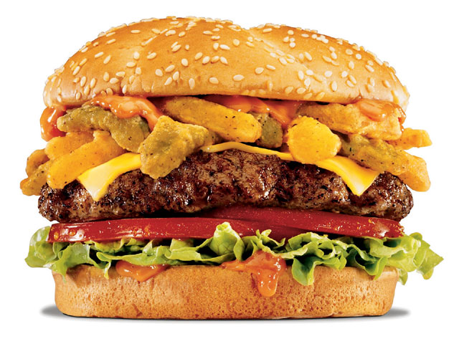
It is Important what ,when ,and how much we eat, sleep, and exercise ,etc.
Eat what I want, eat when I want, and sleep all hours of the night; it doesn’t make any difference at all. Stop meddling and stick to preaching!!

Slide 8
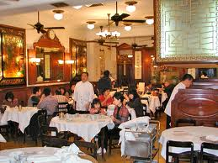
I Can Do What I Want on the Sabbath
“ If thou turn away thy foot from the sabbath, [from] doing thy pleasure on my holy day; and call the sabbath a delight, the holy of the LORD, honourable; and shalt honour him, not doing thine own ways, nor finding thine own pleasure, nor speaking [thine own] words: Then shalt thou delight thyself in the LORD; and I will cause thee to ride upon the high places of the earth, and feed thee with the heritage of Jacob thy father: for the mouth of the LORD hath spoken it.” Isaiah 58:13,14

Slide 9
Watching Games on Sabbath
Whatever happened to:
1. talking walks in nature and communing with God?
2. doing missionary work in your area?
3. visiting shut-ins, the elderly, or the sickly?
4. spending time in extra prayer or Bible study?
5. holding services at rest homes for the infirmed?

Slide 10
Bacchiochi
“In the light of this symbolic interpretation of the three and half year as the time of the domination and persecution of the Antichrist during which God's people will be protected, this identifying mark of the Little Horn applies equally well to the Papacy and Islam. Both powers have attempted to wear out the saints of the Most High, but during the times of persecution many believers have been empowered and protected by God.
The preceding analysis of the identifying marks of the prophetic Antichrist, represented in Daniel 7 by the imagery of the Little Horn and in Revelation 13 by the symbol of a Beast, has shown that both the Papacy and Islam fulfill the qualifying marks of this prophetic power.” End time Issues, #86 Disgusting!

Slide 11
Wilson
"Although it is true that there was a period in the life of the Seventh-day Adventist Church when the denomination took a distinctly anti-Roman Catholic viewpoint...that attitude on the church's part was nothing more than a manifestation of widespread anti-popery among conservative Protestant denominations in the early part of this century and the latter part of the last, and which has now been consigned to the historical trash heap so far as the Seventh-day Adventist Church is concerned." (Neal C. Wilson, past president of the Seventh-day Adventist General Conference, Court Transcript of United States vs the Seventh-day Adventist Church, Equal Employment Opportunity Commission vs the Pacific Press Publishing Association and the General Conference, Reply Brief for Defendants, p 4, Civil Case #74-2025 CBR, presided over by Judge Charles B. Renfrew, U.S. District Court, San Francisco, California, 1974-1975.)

Slide 12
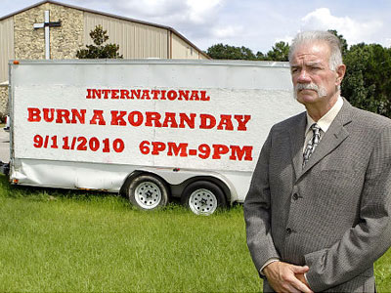
Everywhere!!!
Everyone knows that the great, sinister power today that is the antichrist, is Islam!! We, here in the west, need to unite together, to resist the common enemy-Islam! Islam is the fulfillment of all the Bible verses that refer to antichrist!!! This has nothing to do with the Christian church we know as Roman Catholicism!!!

Slide 13
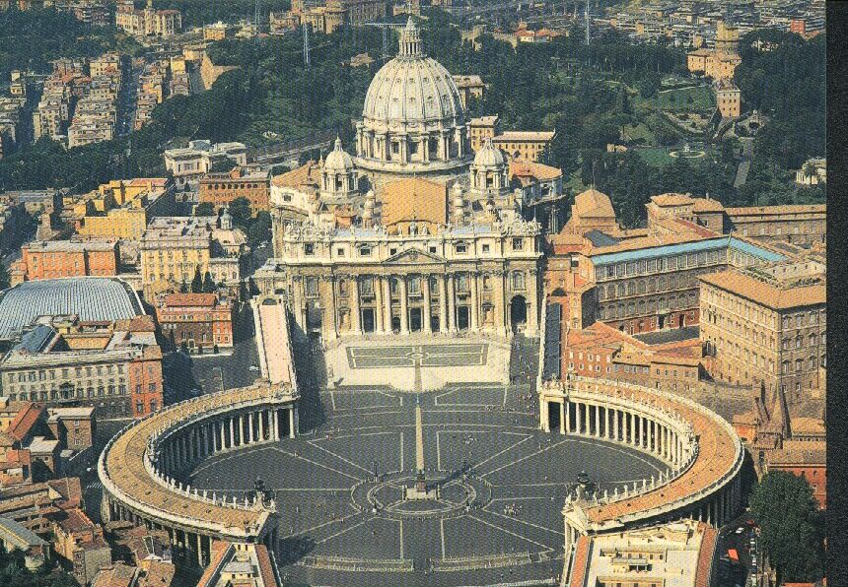
The Antichrist power of Scripture!
From the:
1. little horn in Daniel 7
2. the king of the north in Daniel 11
3. the man of sin of 2Thessalonians 2
4. Jezebel in Revelation 2
5. the first beast of Revelation 13
6. the harlot of Revelation 17
These all identify the same antichrist power-PAPACY!!!!

Slide 14
How Hateful the Bible is?!?!?
Who is so hateful/vicious/cunning/ and treacherous?
1. Those who originated Communism that has murdered billions of people.
2. Those who create wars for their ends.
3. Those who assassinate presidents/leaders who stand in her way.
4. Those who destroy business competition that dares to try and make a living.
THIS IS HATE!!!! This has been and is the Papacy’s plan always!!!

Slide 15
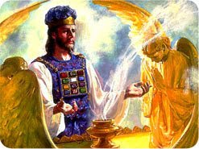
No Judgment Began in 1844
God already knows who will be saved and lost; there is no need for a judgment in 1844.
Hey, I’ve accepted Christ. I passed from needing judgment.
No scholar believes that foolishness.
Christ never taught such ridiculous stuff!!

Slide 16
Christ taught the judgment in 1844!
“ And when the king came in to see the guests, he saw there a man which had not on a wedding garment: And he saith unto him, Friend, how camest thou in hither not having a wedding garment? And he was speechless. Then said the king to the servants, Bind him hand and foot, and take him away, and cast him into outer darkness; there shall be weeping and gnashing of teeth. For many are called, but few are chosen.” Matthew 22:11-14

Slide 17
Confirmed
“By the king's examination of the guests at the feast is represented a work of judgment. The guests at the gospel feast are those who profess to serve God, those whose names are written in the book of life. But not all who profess to be Christians are true disciples. Before the final reward is given, it must be decided who are fitted to share the inheritance of the righteous. This decision must be made prior to the second coming of Christ in the clouds of heaven; for when He comes, His reward is with Him, "to give every man according as his work shall be." Rev. 22:12. Before His coming, then, the character of every man's work will have been determined, and to every one of Christ's followers the reward will have been apportioned according to his deeds.
It is while men are still dwelling upon the earth that the work of investigative judgment takes place in the courts of heaven. The lives of all His professed followers pass in review before God. All are examined according to the record of the books of heaven, and according to his deeds the destiny of each is forever fixed.” COL, pg. 310

Slide 18
The Churches of Today
Are the churches of today:
Our brethren in Christ?
Those who are following the same God we are?
Those who preach the same message we do?
Those who we should invite into our pulpits?
Those who we should encourage to stay in their churches because we are all the same?

