Slide 1
Final Scenes
Supper at Simon’s House

Slide 2
A Thoughtful Hour
It would be well for us to spend a thoughtful hour each day in contemplation of the life of Christ. We should take it point by point, and let the imagination grasp each scene, especially the closing ones. As we thus dwell upon His great sacrifice for us, our confidence in Him will be more constant, our love will be quickened, and we shall be more deeply imbued with His spirit. If we would be saved at last, we must learn the lesson of penitence and humiliation at the foot of the cross.” Desire of Ages, pg. 83

Slide 3
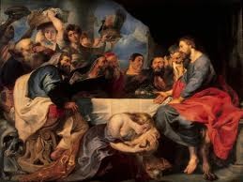
Supper Anyone?
“Then Jesus six days before the pass over came to Bethany, where Lazarus was which had been dead, whom he raised from the dead. There they made him a supper; and Martha served: but Lazarus was one of them that sat at the table with him. Then took Mary a pound of ointment of spikenard, very costly, and anointed the feet of Jesus, and wiped his feet with her hair: and the house was filled with the odour of the ointment.” Jn. 12:1-3

Slide 4
What an Occasion!
1. Jesus would eat a Sabbath meal at Simon’s. (DA, pg. 557)
2. This was 6 days before His death on Passover Friday.
3. The great test for the disciples was just before them. DA, pg. 394 “Compassionate Redeemer, who in the full knowledge of the doom that awaited Him, tenderly smoothed the way for the disciples, prepared them for their crowning trial, and strengthened them for the final test!” Their test-the cross. Our test-Sunday.

Slide 5
What a Cast of Characters!
Simon- had been cured by Christ of leprosy, but hadn’t surrendered his life to Christ. “He acknowledged Jesus as a teacher, and hoped that He might be the Messiah, but he had not accepted Him as a Saviour. His character was not transformed; his principles were unchanged.
Simon had been healed of the leprosy, and it was this that had drawn him to Jesus.” DA, pg. 557
“Simon had led into sin the woman he now despised. She had been deeply wronged by him.” DA, pg. 566

Slide 6
The Forgiven One!
Mary-She heard Jesus say He would die soon, so she wanted to pour out her love while He was still alive. She gave all to Him who had given all for her. “Christ delighted in the earnest desire of Mary to do the will of her Lord. He accepted the wealth of pure affection which His disciples did not, would not, understand. The desire that Mary had to do this service for her Lord was of more value to Christ than all the precious ointment in the world, because it expressed her appreciation of the world's Redeemer. It was the love of Christ that constrained her. The matchless excellence of the character of Christ filled her soul. That ointment was a symbol of the heart of the giver. It was the outward demonstration of a love fed by heavenly streams until it overflowed.” DA, pg. 564

Slide 7
The Resurrected One!
Lazarus-recently brought back from the dead. People wanted to hear his stories of life beyond the tomb, but he had nothing to say. “For the living know that they shall die: but the dead know not any thing, neither have they any more a reward; for the memory of them is forgotten.” Eccl. 9:5 “With assurance and power he declared that Jesus was the Son of God.” DA, pg. 558

Slide 8
The Heart Shredder!
Judas-With an air of concern for the poor, he tore into Mary! The thief coveted the money to spend on himself! “Judas had no heart for the poor. Had Mary's ointment been sold, and the proceeds fallen into his possession, the poor would have received no benefit.
Judas had a high opinion of his own executive ability. As a financier he thought himself greatly superior to his fellow disciples, and he had led them to regard him in the same light. He had gained their confidence, and had a strong influence over them. His professed sympathy for the poor deceived them, and his artful insinuation caused them to look distrustfully upon Mary's devotion. The murmur passed round the table, "To what purpose is this waste? For this ointment might have been sold for much, and given to the poor.“ DA, pgs. 559,560
“Then saith one of his disciples, Judas Iscariot, Simon's [son], which should betray him, Why was not this ointment sold for three hundred pence, and given to the poor? This he said, not that he cared for the poor; but because he was a thief, and had the bag, and bare what was put therein.” Jn. 12:4-6

Slide 9
Eaters of Gossip!
The disciples sucked up Judas’ comments. They listened to the evil arguments of Judas and didn’t defend the right. How important it is that we don’t allow evil words and unkind comments to slide! How many would have not been crushed by cruel words and gossip!

Slide 10
Someone else was there too!
We were all there at the feast. Whose shoes are we wearing?
1. Simon- the unforgiven
2. Lazarus- the one walking in newness of life
3. Mary- the forgiven
4. Judas- harboring greed and selfishness
5. the disciples- listening to cruel words said about others

Slide 11
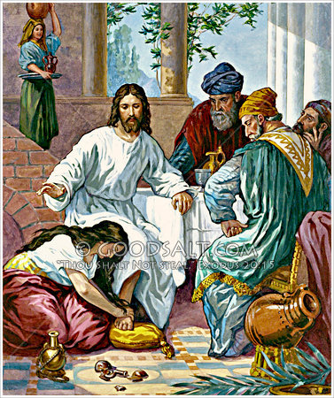
Mary Gives her All!
“Then took Mary a pound of ointment of spikenard, very costly, and anointed the feet of Jesus, and wiped his feet with her hair: and the house was filled with the odor of the ointment.” Jn. 12:3
With Mary’s act, everyone gets into the action.

Slide 12
Always at Jesus' feet
“Jesus saith unto her, Mary. She turned herself, and saith unto him, Rabboni; which is to say, Master.” Jn. 20:16 “But now in His own familiar voice Jesus said to her, "Mary." Now she knew that it was not a stranger who was addressing her, and turning she saw before her the living Christ. In her joy she forgot that He had been crucified. Springing toward Him, as if to embrace His feet, she said, "Rabboni." But Christ raised His hand, saying, Detain Me not; "for I am not yet ascended to My Father:” DA, pg. 790
“And she had a sister called Mary, which also sat at Jesus' feet, and heard his word.” Luke 10:39
“Then when Mary was come where Jesus was, and saw him, she fell down at his feet, saying unto him, Lord, if thou hadst been here, my brother had not died.” John 11:32

Slide 13
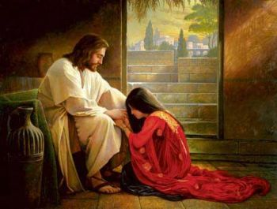
Power at the feet of Jesus!
“Her heart was melted, and she cast herself at the feet of Jesus, sobbing out her grateful love, and with bitter tears confessing her sins.
This was to her the beginning of a new life, a life of purity and peace, devoted to the service of God. In the uplifting of this fallen soul, Jesus performed a greater miracle than in healing the most grievous physical disease; He cured the spiritual malady which is unto death everlasting. This penitent woman became one of His most steadfast followers. With self-sacrificing love and devotion she repaid His forgiving mercy.” DA, pg. 462

Slide 14
A Story for Simon
“Simon the host had been influenced by the criticism of Judas upon Mary's gift, and he was surprised at the conduct of Jesus. His Pharisaic pride was offended. He knew that many of his guests were looking upon Christ with distrust and displeasure. Simon said in his heart, "This Man, if He were a prophet, would have known who and what manner of woman this is that toucheth Him: for she is a sinner."
By curing Simon of leprosy, Christ had saved him from a living death. But now Simon questioned whether the Saviour were a prophet. Because Christ allowed this woman to approach Him, because He did not indignantly spurn her as one whose sins were too great to be forgiven, because He did not show that He realized she had fallen, Simon was tempted to think that He was not a prophet. Jesus knows nothing of this woman who is so free in her demonstrations, he thought, or He would not allow her to touch Him.
But it was Simon's ignorance of God and of Christ that led him to think as he did. He did not realize that God's Son must act in God's way, with compassion, tenderness, and mercy. Simon's way was to take no notice of Mary's penitent service. Her act of kissing Christ's feet and anointing them with ointment was exasperating to his hardheartedness. He thought that if Christ were a prophet, He would recognize sinners and rebuke them.”
DA, pg. 566

Slide 15
Simon, what say you?
“And Jesus answering said unto him, Simon, I have somewhat to say unto thee. And he saith, Master, say on. There was a certain creditor which had two debtors: the one owed five hundred pence, and the other fifty. And when they had nothing to pay, he frankly forgave them both. Tell me therefore, which of them will love him most? Simon answered and said, I suppose that he, to whom he forgave most. And he said unto him, Thou hast rightly judged. And he turned to the woman, and said unto Simon, Seest thou this woman? I entered into thine house, thou gavest me no water for my feet: but she hath washed my feet with tears, and wiped [them] with the hairs of her head. Thou gavest me no kiss: but this woman since the time I came in hath not ceased to kiss my feet. My head with oil thou didst not anoint: but this woman hath anointed my feet with ointment. Wherefore I say unto thee, Her sins, which are many, are forgiven; for she loved much: but to whom little is forgiven, the same loveth little.” LK. 7:40-47

Slide 16
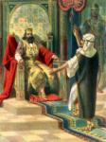
Forgiven Much
Mary had been forgiven much and she showed the greatest appreciation. Simon had been saved from living death-leprosy- but it had called forth little appreciation.
Christ read Simon like an opened book. He rebuked him gently!

Slide 17
Christ Didn’t expose him
“As did Nathan with David, Christ concealed His home thrust under the veil of a parable. He threw upon His host the burden of pronouncing sentence upon himself. Simon had led into sin the woman he now despised. She had been deeply wronged by him. By the two debtors of the parable, Simon and the woman were represented. Jesus did not design to teach that different degrees of obligation should be felt by the two persons, for each owed a debt of gratitude that never could be repaid…Simon was touched by the kindness of Jesus in not openly rebuking him before the guests. He had not been treated as he desired Mary to be treated. He saw that Jesus did not wish to expose his guilt to others, but sought by a true statement of the case to convince his mind, and by pitying kindness to subdue his heart. Stern denunciation would have hardened Simon against repentance, but patient admonition convinced him of his error. He saw the magnitude of the debt which he owed his Lord. His pride was humbled, he repented, and the proud Pharisee became a lowly, self-sacrificing disciple.” DA, pgs. 566-568

Slide 18
Which one are WE?
Are we the forgiven one, manifesting compassion towards others and service to our Lord everyday? Or, are we picking to find fault with others; even with those who are doing the Lord’s service? By our hardness toward others, we reveal that Christ is still at arms length!!

