Slide 1
Judges, pt. 2 “More Unknowns”
Ehud Who????

Slide 2
Eglon, the sword of God’s punishment
“And the children of Israel did evil again in the sight of the LORD: and the LORD strengthened Eglon the king of Moab against Israel, because they had done evil in the sight of the LORD. And he gathered unto him the children of Ammon and Amalek, and went and smote Israel, and possessed the city of palm trees. So the children of Israel served Eglon the king of Moab eighteen years. But when the children of Israel cried unto the LORD, the LORD raised them up a deliverer, Ehud the son of Gera, a Benjamite, a man left-handed: and by him the children of Israel sent a present unto Eglon the king of Moab.” Judges 3:12-15

Slide 3
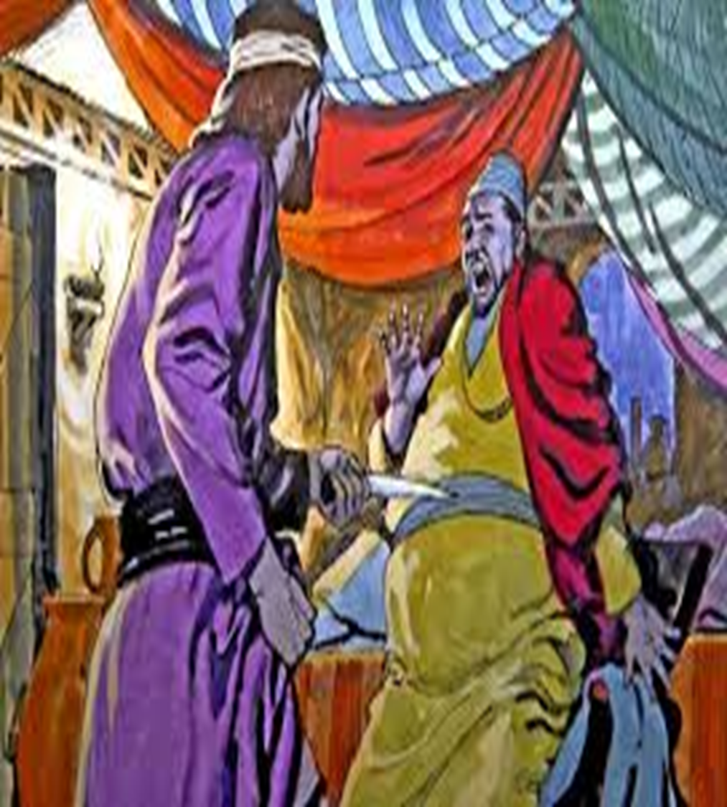
Ehud, the Deliverer!
What a gift! It was time for deliverance. Eglon had oppressed God’s people for 18 years. “So the children of Israel served Eglon the king of Moab eighteen years.” verse 14 The Lord found a man He could use. He realized he was nothing and that the Lord was everything. He realized that all he had to offer was a broken and contrite spirit; he recognized his need for Jesus. His name was Ehud!

Slide 4
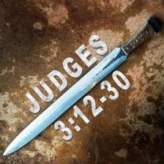
Ehud’s Gift to Eglon
“But Ehud made him a dagger which had two edges, of a cubit length; and he did gird it under his raiment upon his right thigh. And he brought the present unto Eglon king of Moab: and Eglon was a very fat man. And when he had made an end to offer the present, he sent away the people that bare the present. But he himself turned again from the quarries that were by Gilgal, and said, I have a secret errand unto thee, O king: who said, Keep silence. And all that stood by him went out from him. And Ehud came unto him; and he was sitting in a summer parlour, which he had for himself alone. And Ehud said, I have a message from God unto thee. And he arose out of his seat.” Judges 3:16-20

Slide 5
The Trap Was Being Set!
The conspiracy against Eglon was well planned. Ehud placed himself at the head of a deputation charged to bring Eglon “a present,” or, more probably, the regular tribute, as we gather from the similar use of the word in 2 Samuel 8:2, 6; 17:3, 4. But Ehud carried under his raiment a two-edged dagger, a cubit long; according to the LXX translation, about three-quarters of a foot. The tribute was delivered, no doubt with many protestations of humility and allegiance on the part of Ehud, and the deputation graciously dismissed.

Slide 6
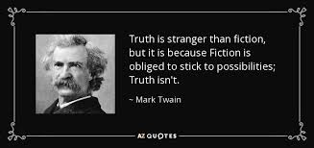
Bizarre!!!
1. Through the gift of tribute/tax, Ehud gains the king’s confidence.
2. Ehud goes into the enemy’s territory.
3. The king allows an enemy into his chamber without any soldiers standing guard.
4. In approaching the king, surely the soldiers would check him for a concealed weapon, BUT they did not check him AT ALL.
5. Sooo many things could have easily destroyed Ehud’s plan, BUT none did.
6. The Lord was on his side and NOTHING would get in the way!!!!!

Slide 7
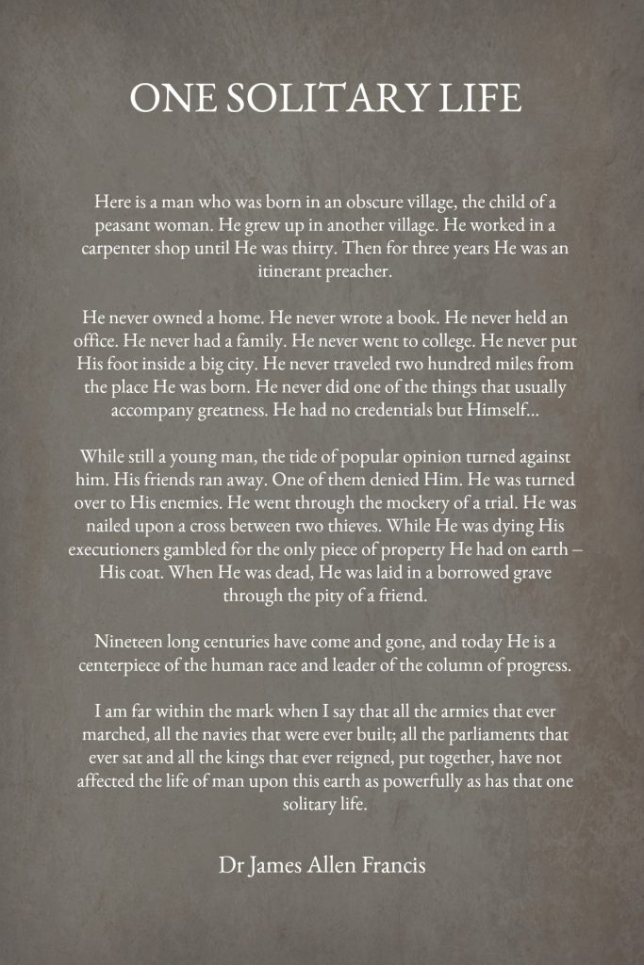
One With God!
Ehud was a man on A MISSION AND NOTHING WOULD TURN HIM AWAY FROM THIS!!! When someone has the Lord on his side; then nothing can resist him; nothing can turn him aside from the path God has laid in front of him! Whether it be Jonathan and his armor bearer; David in the valley, the lone Man on Calvary’s hill; it takes one with God and the majority stands there!!!

Slide 8
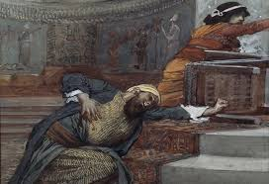
“And Ehud put forth his left hand, and took the dagger from his right thigh, and thrust it into his belly: And the haft also went in after the blade; and the fat closed upon the blade, so that he could not draw the dagger out of his belly; and the dirt came out.” Judges 3:21,22

Slide 9
The Dagger/Sword of the Spirit
“Wherefore take unto you the whole armour of God, that ye may be able to withstand in the evil day, and having done all, to stand. Stand therefore, having your loins girt about with truth, and having on the breastplate of righteousness; And your feet shod with the preparation of the gospel of peace; Above all, taking the shield of faith, wherewith ye shall be able to quench all the fiery darts of the wicked. And take the helmet of salvation, and the sword of the Spirit, which is the word of God:” Ephesians 6:13-17

Slide 10

Nothing Can Stand!!!
“God had revealed to Abraham the bondage of Israel in Egypt, and had declared that the time of their sojourning should be four hundred years. "Afterward," He said, "shall they come out with great substance." Genesis 15:14. Against that word, all the power of Pharaoh's proud empire battled in vain. On "the self-same day" appointed in the divine promise, "it came to pass, that all the hosts of the Lord went out from the land of Egypt." Exodus 12:41. So in heaven's council the hour for the coming of Christ had been determined. When the great clock of time pointed to that hour, Jesus was born in Bethlehem.” DA, pg. 32,33

Slide 11
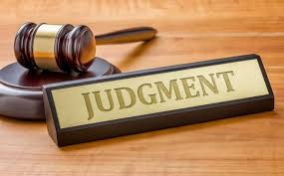
Judgment from Heaven
Alone with the king, Ehud saith, in a manner not uncommon in the East: “I have a message from God unto thee,” on which Eglon, in token of reverence, rises from his seat. This is the favorable moment, and, in an instant, Ehud has plunged his dagger up to the hilt into the lower part of his body, with such force that the blade came out behind. Not pausing for a moment, Ehud retires, closes and locks the doors upon the murdered king, and escapes beyond the boundary.

Slide 12
The Wondering Servants!
“Then Ehud went forth through the porch, and shut the doors of the parlour upon him, and locked them. When he was gone out, his servants came; and when they saw that, behold, the doors of the parlour were locked, they said, Surely he covereth his feet in his summer chamber. And they tarried till they were ashamed: and, behold, he opened not the doors of the parlour; therefore they took a key, and opened them: and, behold, their lord was fallen down dead on the earth. And Ehud escaped while they tarried, and passed beyond the quarries, and escaped unto Seirath.” Judges 3 :23-26

Slide 13
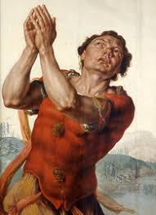
Meanwhile the king’s attendants, finding the room locked, have waited, till, at last, they deem it necessary to break open the doors. The horror and confusion consequent upon the discovery of the murder have given Ehud still further time. And now the preconcerted signal is heard.

Slide 14
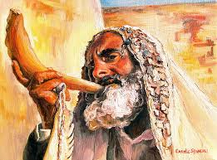

Slide 15
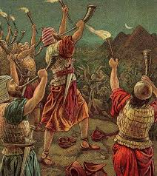
Trumpet Blast!
“And it came to pass, when he was come, that he blew a trumpet in the mountain of Ephraim, and the children of Israel went down with him from the mount, and he before them. And he said unto them, Follow after me: for the LORD hath delivered your enemies the Moabites into your hand. And they went down after him, and took the fords of Jordan toward Moab, and suffered not a man to pass over.” Judges 3:27,28

Slide 16
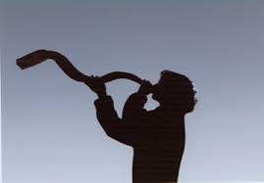
The shrill blast of the trumpet in Seirath (perhaps the “hairy” or “wooded”) wakes the echoes of Mount Ephraim. The first object is to haste back towards Jericho and take the fords of Jordan, so as to allow neither help to come, nor fugitives to escape; the next to destroy the garrison of Moab. In both, Israel is successful, and, “at that time”—of course, not on that precise day—10,000 of Moab are slain, all of them, as we should say, fine men and brave soldiers. “And the land had rest fourscore years.”

Slide 17
The Trumpets Significance
The trumpet was deeply significant in Israel. It ALWAYS was a warning that judgment was coming primarily through war. Note:
“Speak unto the children of Israel, saying, In the seventh month, in the first day of the month, shall ye have a Sabbath, a memorial of blowing of trumpets, an holy convocation… Also on the tenth day of this seventh month there shall be a day of atonement: it shall be an holy convocation unto you; and ye shall afflict your souls, and offer an offering made by fire unto the LORD.” Lev. 23:24,27
“And seven priests shall bear before the ark seven trumpets of rams' horns: and the seventh day ye shall compass the city seven times, and the priests shall blow with the trumpets. And it shall come to pass, that when they make a long blast with the ram's horn, and when ye hear the sound of the trumpet, all the people shall shout with a great shout; and the wall of the city shall fall down flat, and the people shall ascend up every man straight before him.” Joshua 6:4,5
This is very important in understanding Revelation 8 and 9.

Slide 18
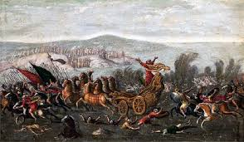
When the people of God are walking in submission to Heaven’s authority, there is NOONE or NOTHING that can stand before them. A little man or army becomes unconquerable before the mighty power of the God of Israel!! “A little one shall become a thousand, and a small one a strong nation: I the LORD will hasten it in his time.” Isa. 60:22

