Slide 1
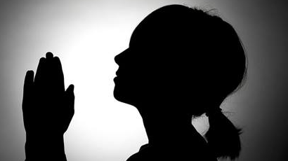

Slide 2
Behind the Door pt 17:
Are the Jesuits in Your Church?

Slide 4
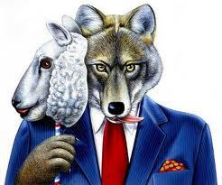

Slide 5
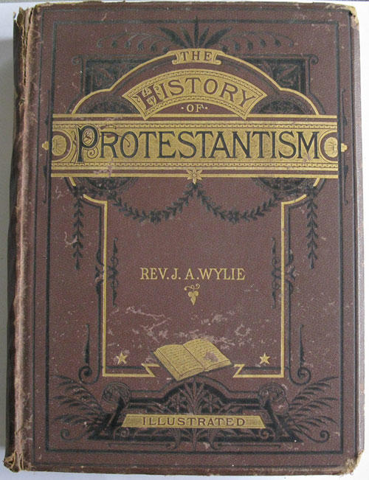
“There was no disguise they could not assume, and therefore there was no place into which they could not penetrate. They enter unheard the closet of the monarch, or the cabinet of the stateman. They could sit unseen in Convocation or General Assembly, and mingle unsuspected in the deliberations and debates. There was no tongue they could not speak, no creed they could not profess, and thus there was no people among whom they might not sojourn, and no Church whose membership they might not enter, and whose functions they might not discharge. They could execrate the Pope with the Lutheran, and swear the Solemn League with the Covenanter.”—J.A. Wylie, History of Protestantism, Vol. 2, p. 412

Slide 6
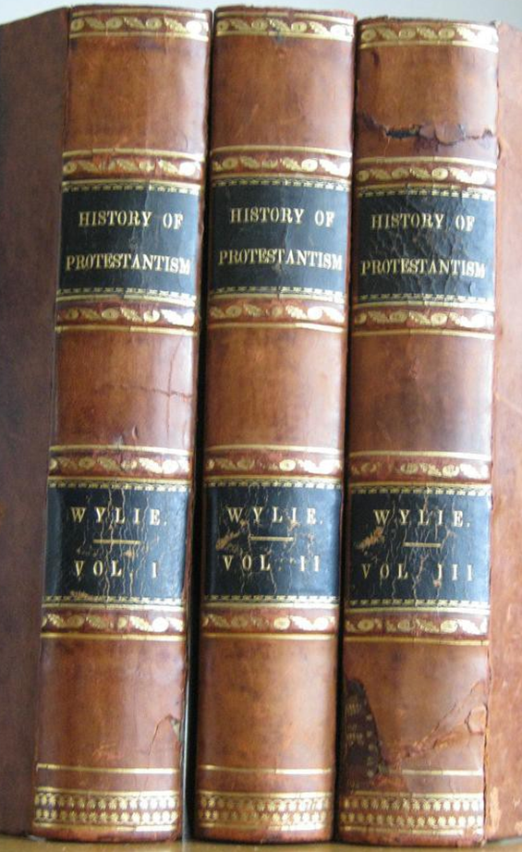
“They could execrate the Pope with the Lutheran, and swear the Solemn League with the Covenanter.”—J.A. Wylie, History of Protestantism, Vol. 2, p. 412
To combat these forces, Jesuitism inspired its followers with a fanaticism that enabled them to endure like dangers, and to oppose to the power of truth all the weapons of deception.

Slide 7
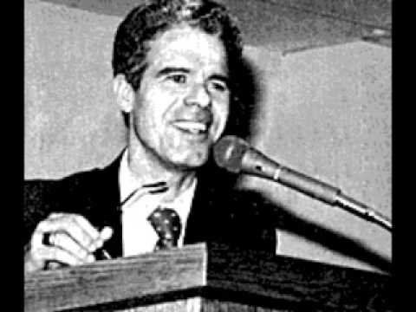
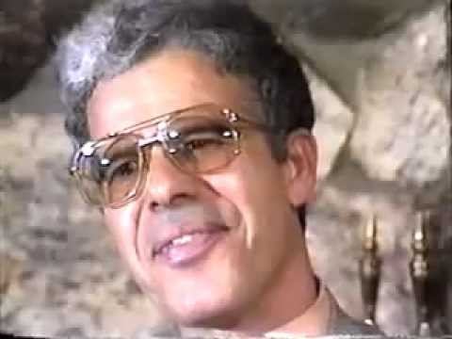
Former Jesuit, Alberto Rivera was a priest in Spain, before leaving Catholicism to embrace Christ. Books about him include: “Is Alberto for Real?-Sidney Hunter, and The Alberto Rivera series by Jack Chick. He was also interviewed by Seventh-day Adventist James Arabito.

Slide 8
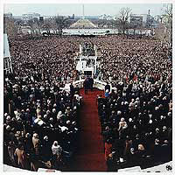
“Dr. Rivera explained that when he was under the extreme oath of the Jesuits, he was told that a secret sign was to be given to the Jesuits worldwide when the ecumenical movement had successfully wiped out Protestantism, in preparation for the signing of a concordat between the Vatican and the U.S.
The sign was to be when a president of the U.S. took his oath of office facing an obelisk.”--Jack Chick quoting Alberto Rivera in ‘The Godfathers: Alberto Part Three,’ p. 26
Photo from: Time Magazine, Feb. 2, 1981
This event was also recorded in Newsweek, Jan. 26, 1981, p. 32

Slide 9
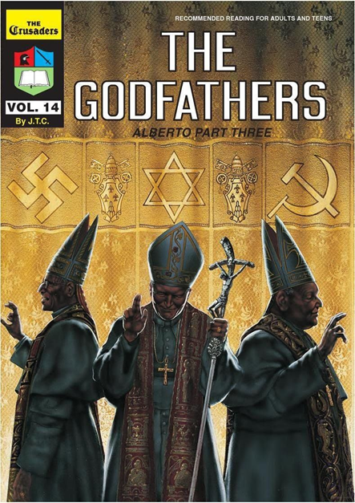
“The sign was to be when a president of the U.S. took his oath of office facing an obelisk. For the first time in U.S. history, the swearing in ceremonies were moved the West front of the Capitol, and President Reagan faced the Washington Monument. This happened January 20, 1981.”—Jack Chick quoting Alberto Rivera in ‘The Godfathers: Alberto Part Three,’ p. 26

Slide 10
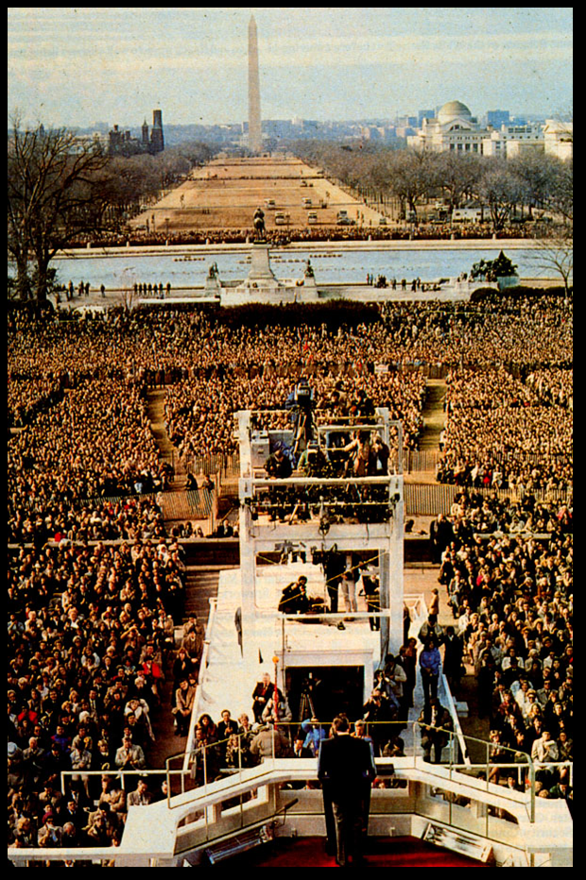
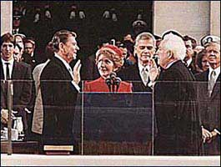
If Alberto Rivera is correct, and ALL mainstream churches have been infiltrated and are now fully controlled by the Jesuit Order and the Catholic Church since Reagan in 1981, How much more so are they in the hands of Rome now???

Slide 11
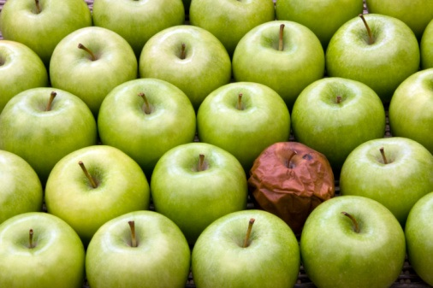
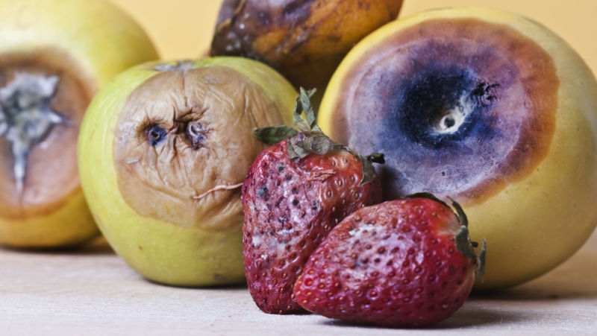
How do we know if any of this is true? Where is our surety for discernment and truth?
Jesus said: “Ye shall know them by their fruits. Do men gather grapes of thorns, or figs of thistles? Even so every good tree bringeth forth good fruit; but a corrupt tree bringeth forth evil fruit.

Slide 12
“A good tree cannot bring forth evil fruit, neither can a corrupt tree bring forth good fruit. Every tree that bringeth not forth good fruit is hewn down, and cast into the fire. Wherefore by their fruits ye shall know them.” Matthew 7:16-20
The Jesuits aim has always been destruction of Protestantism, they founded as an evil tree, therefore this is their destiny according to Christ:
Hewn Down
Cast into the Lake of Fire

Slide 13
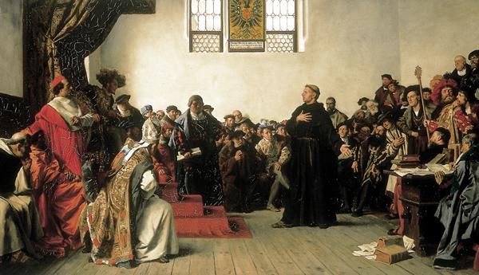

Slide 14
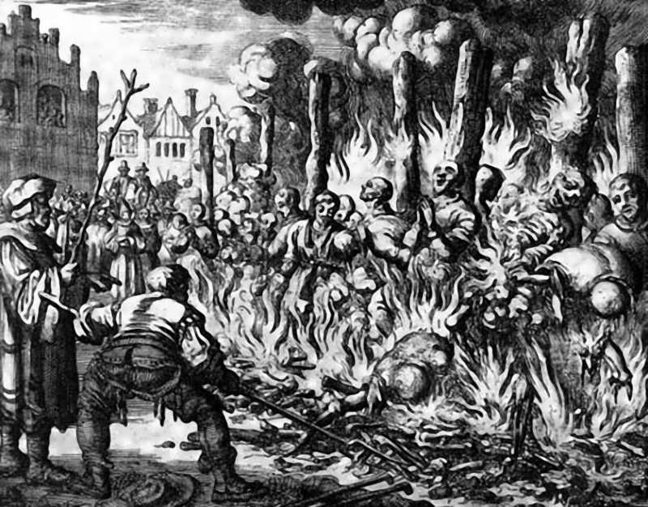
History shows time and time again, that Rome’s Jesuits have been instrumental in the destruction of Protestantism everywhere from: Inquisitions in France, Spain, and abroad Europe, religious and political wars, overthrow of pro-Protestant legislation, and assassinations of pro-Protestant leaders from Henry IV of France to Abraham Lincoln. No one is safe; when Pope Clement XIV was pressured to suppress the Jesuits in his Dominus ac Redemptor Noster in 1773, he was poisoned shortly afterword. The Jesuits have produced much fruits for all to examine.

Slide 15
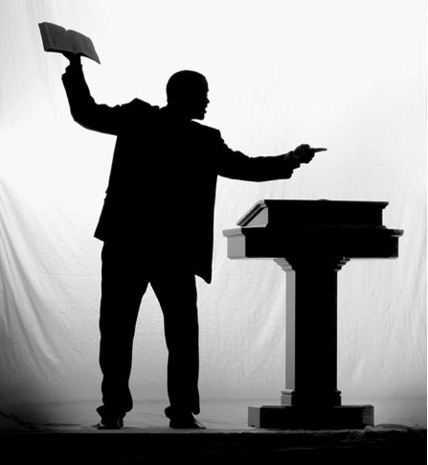
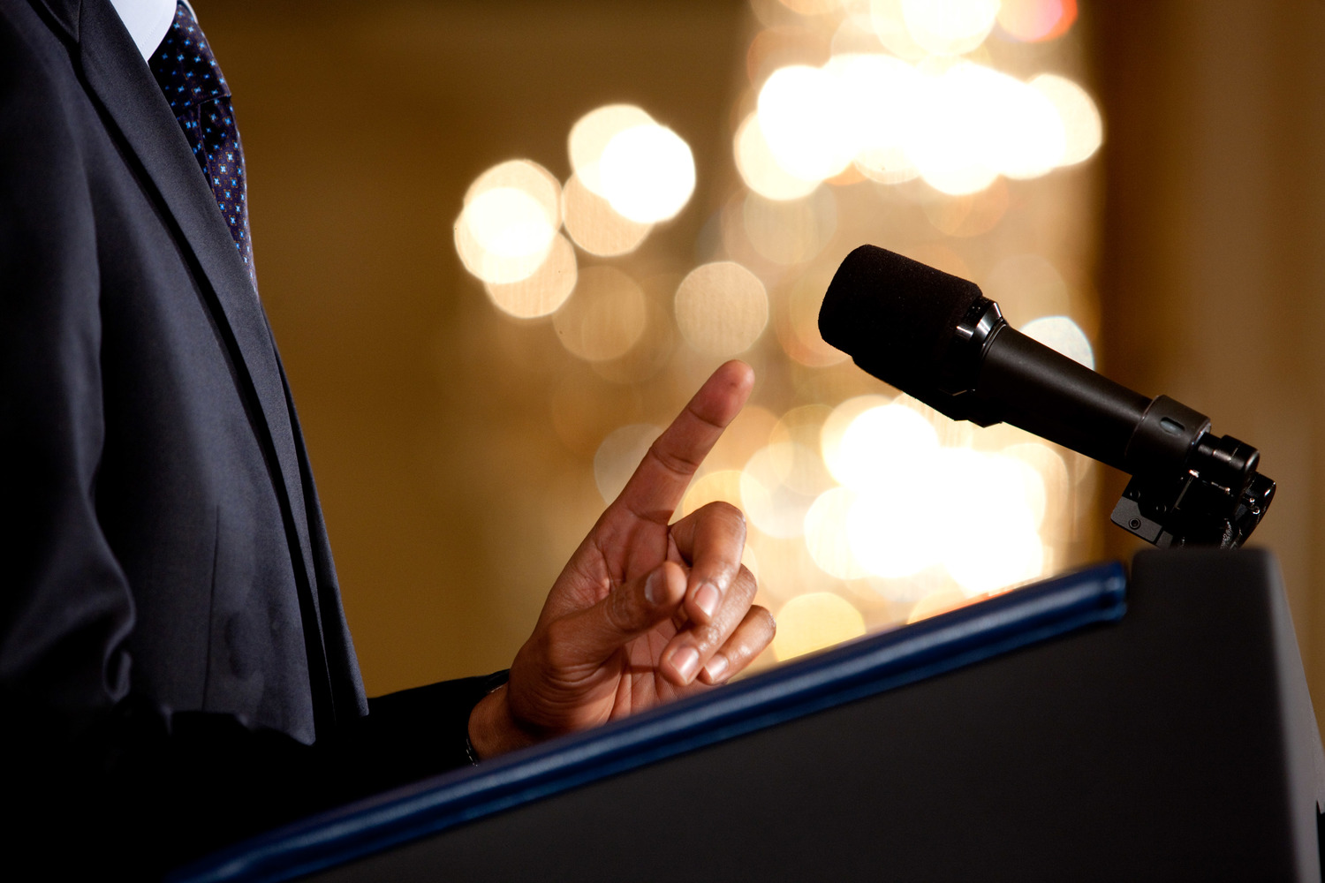
Fruits (Signs) of an Infiltrated Protestant Church:
1. They will stop Protesting against Rome’s heresies and unbiblical doctrines
2. Instead of preaching that Catholicism is the harlot of Revelation 17, churches will focus almost entirely on God’s love (foundational doctrines will become unimportant or irrelevant)
3. Roman Catholicism will be embraced and nice things will be spoken concerning this institution
4. The Antichrist will no longer be the Papacy, but an individual in the future or in the past
5. The church will become extremely ecumenical
6. Individuals within these churches that do continue to protest will deemed “divisive”, “crazy”, “radical”, “bigoted” or “angry” and “un-Christlike”. These individuals will be silenced, phased out, put somewhere where their message will be ineffective, fired or disfellowshipped, untimely death, and/or their reputation will be destroyed

Slide 16
2 Cor. 6:14-17 “Be ye not unequally yoked together with unbelievers: for what fellowship hath righteousness with unrighteousness? and what communion hath light with darkness? And what concord hath Christ with Belial? or what part hath he that believeth with an infidel? And what agreement hath the temple of God with idols? for ye are the temple of the living God; as God hath said, I will dwell in them, and walk in them; and I will be their God, and they shall be my people. Wherefore come out from among them, and be ye separate, saith the Lord, and touch not the unclean thing; and I will receive you.
Eph. 5:11 “And have no fellowship with the unfruitful works of darkness, but rather reprove them.”
Rev. 18:4 “And I heard another voice from heaven, saying, Come out of her, my people, that ye be not partakers of her sins, and that ye receive not of her plagues.”
Amos 3:3 “Can two walk together, except they be agreed?”

Slide 17
Fruits (Signs) of an Infiltrated Protestant Church:
1. They will stop Protesting against Rome’s heresies and unbiblical doctrines
2. Instead of preaching that Catholicism is the harlot of Revelation 17, churches will focus almost entirely on God’s love (foundational doctrines will become unimportant or irrelevant)
3. Roman Catholicism will be embraced and nice things will be spoken concerning this institution
4. The Antichrist will no longer be the Papacy, but an individual in the future or in the past
5. The church will become extremely ecumenical
6. Individuals within these churches that do continue to protest will deemed “divisive”, “crazy”, “radical”, “bigoted” or “angry” and “un-Christlike”. These individuals will be silenced, phased out, put somewhere where their message will be ineffective, fired or disfellowshipped, untimely death, and/or their reputation will be destroyed

Slide 18
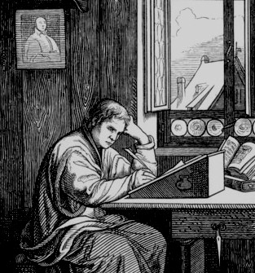
“Luther was as yet but partially converted from the errors of Romanism. But as he compared the Holy Oracles with the papal decrees and constitutions, he was filled with wonder. "I am reading," he wrote, "the decrees of the pontiffs, and . . . I do not know whether the pope is antichrist himself, or his apostle, so greatly is Christ misrepresented and crucified in them.“—Ellen White, Great Controversy, p. 139 quoting from J.H. Merle D’Aubigne, “History of the Reformation of the Sixteenth Century,” b. 5, ch. 1”
Martin Luther (1483-1546) In 1517 he nailed his 95 Theses to the door of the Wittenberg Chapel, thus beginning the Protestant Reformation

Slide 19
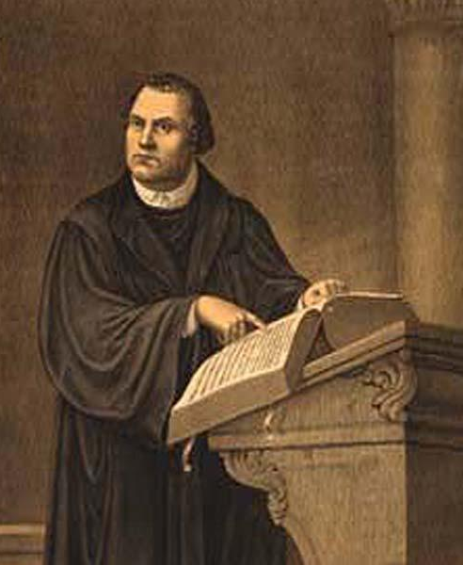
With a martyr's faith and courage he wrote: "What is about to happen I know not, nor do I care to know. . . . Let the blow light where it may, I am without fear. Not so much as a leaf falls, without the will of our Father. How much rather will He care for us! It is a light thing to die for the Word, since the Word which was made flesh hath Himself died.”—Great Controversy, p. 141 quoting D’Aubigne, History of the Reformation of the Sixteenth Century, b. 6, ch 9.

Slide 20
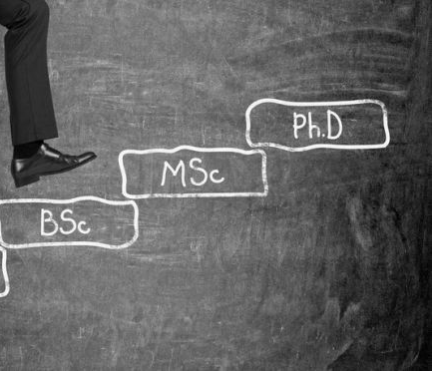
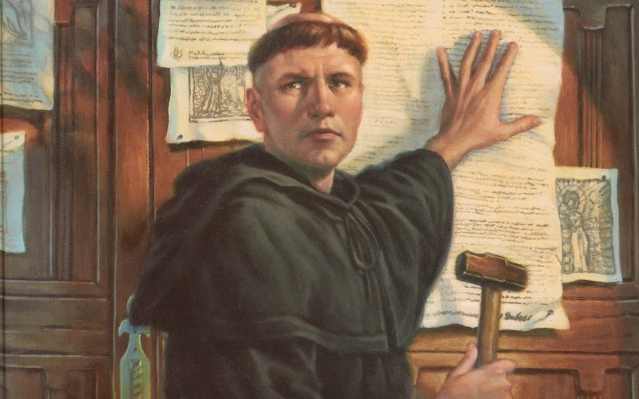
Fruits (Signs) of an Infiltrated Protestant Church:
7. The Word of God or proven inspired writings would no longer be the foundation of faith, but traditions, confusing interpretations, festivities, and pagan holidays would be incorporated into the church dogmas and procedures.
8. Scholarly works of modern PhDs and theologians would supersede former church founders, and it would be the modern PhDs and theologians doctrines and theories that would be taught and encouraged in schools
9. Because of the new scholarly movements, former teachings and writings of great founding Protestants would be set aside as “no longer relevant” or incorrect
10. The Bible would be questioned and distrusted, claiming to have extensive errors and not infallible—the many criticisms would highly regarded and doubt of the Bible would abound
JEDP, Source Criticism, Literary Criticism, Textual Criticism, Multiple Theories/Interpretations simultaneously claimed as valid, Narrative, Reduction, etc.

Slide 21
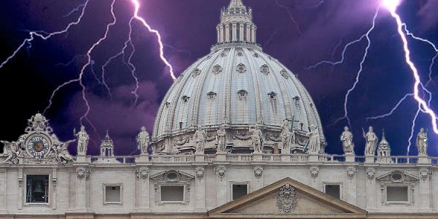
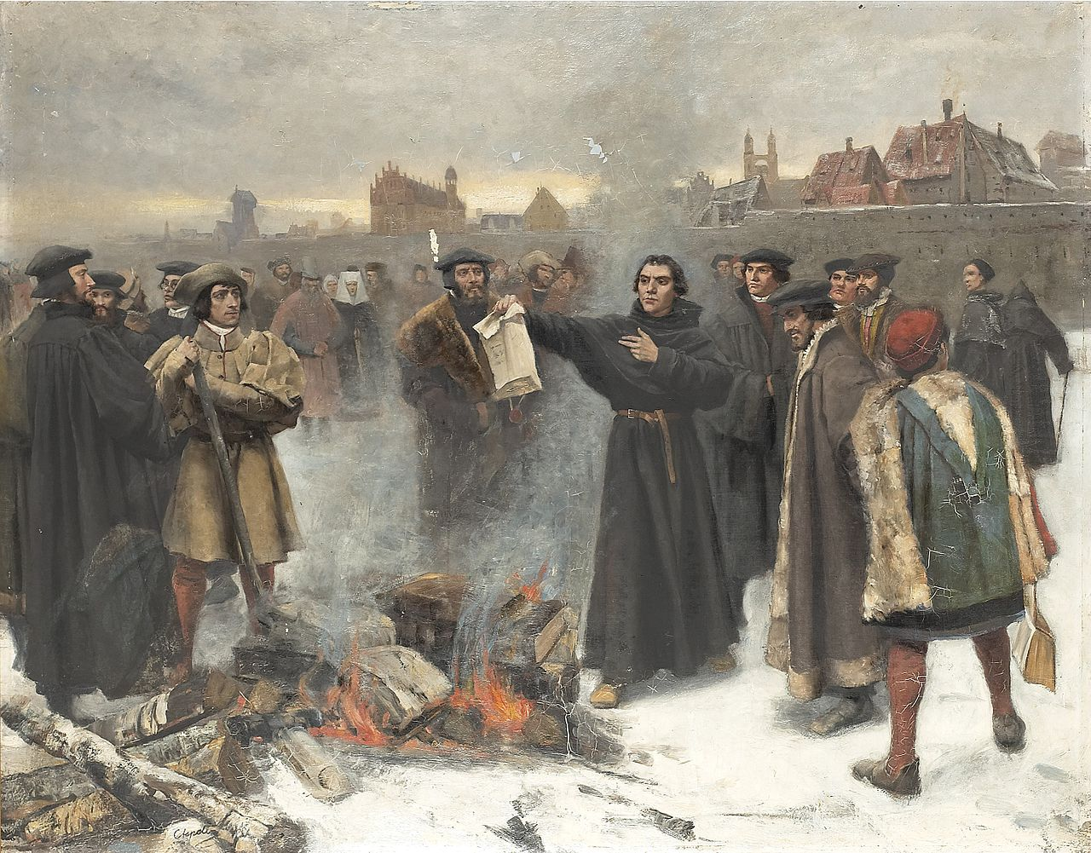
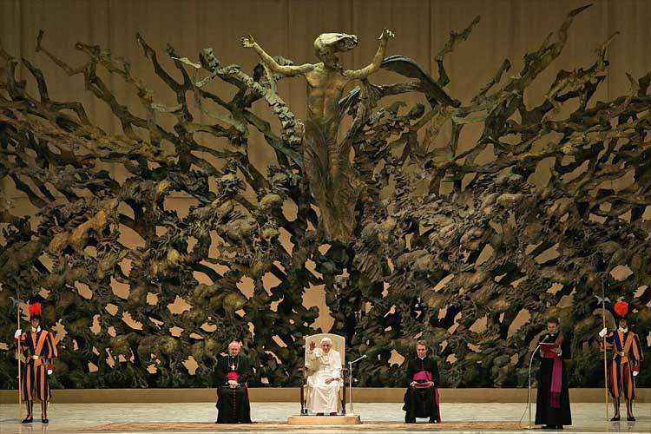
“Already I feel greater liberty in my heart; for at last I know that the pope is antichrist, and that his throne is that of Satan himself”—Great Controversy, p. 142 quoting D’Aubigne, History of the Reformation of the Sixteenth Century, b. 6, ch. 9

Slide 22
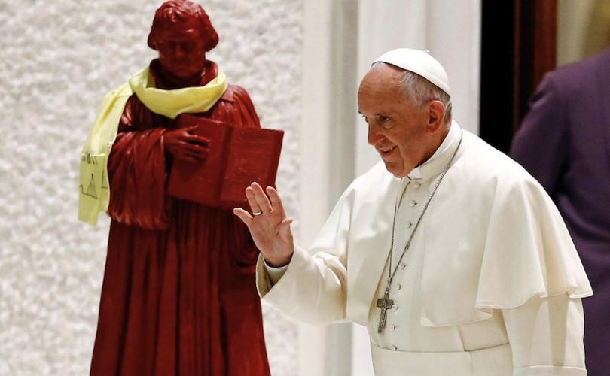
What Would Luther Think???
“This fall in Augsburg, Germany Catholics and Lutherans will officially declare their differences resolved. The two churches will abandon the anathemas they hurled at one another in the 1500s. The signing of their joint-declaration together will take place on October 31, 1999, the anniversary of the day Luther nailed his 95 Theses to the door of Wittenberg Cathedral.”—The National Catholic Reporter, Sept. 10, 1999
Does this Statement match Dr. Alberto Rivera’s claim that all mainstream Protestant churches have been infiltrated???

Slide 23
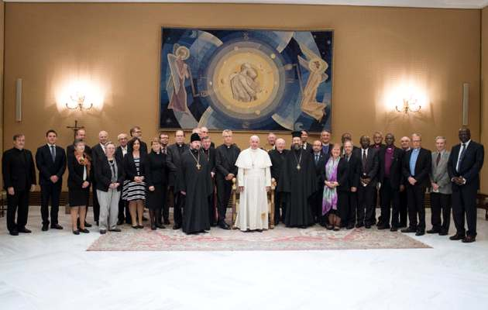
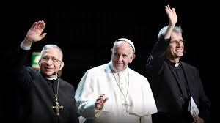
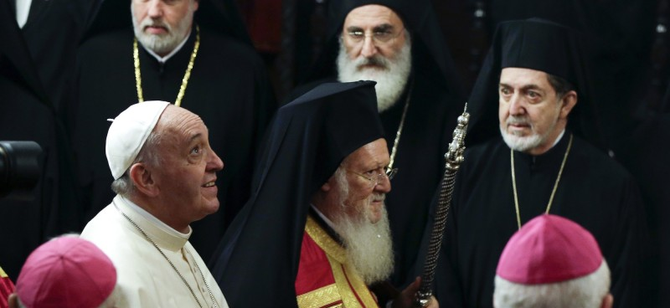
Today the Vatican is fighting a new type of Crusade: It’s Called “Ecumenism”
“The Vatican said it welcomed the statement by Lutherans that the sixteenth century condemnations of Roman Catholicism by Protestant Reformers no longer applies ”—The National Catholic Reporter, Jul. 17, 1998

Slide 24
Protestantism has changed, not the Bible or it’s prophecies concerning the Antichrist as the Papacy in Daniel 7, 8, 9, 11, 2 Thessalonians 2, and Revelation 13, 17, 18

Slide 25
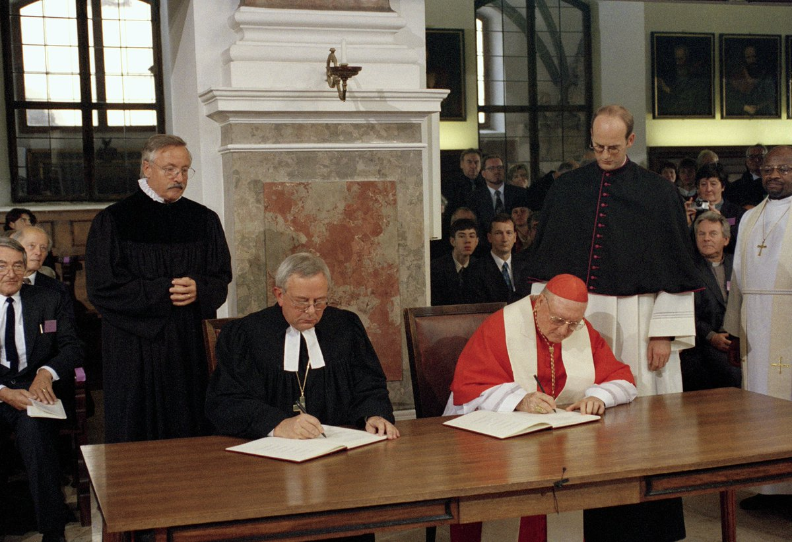
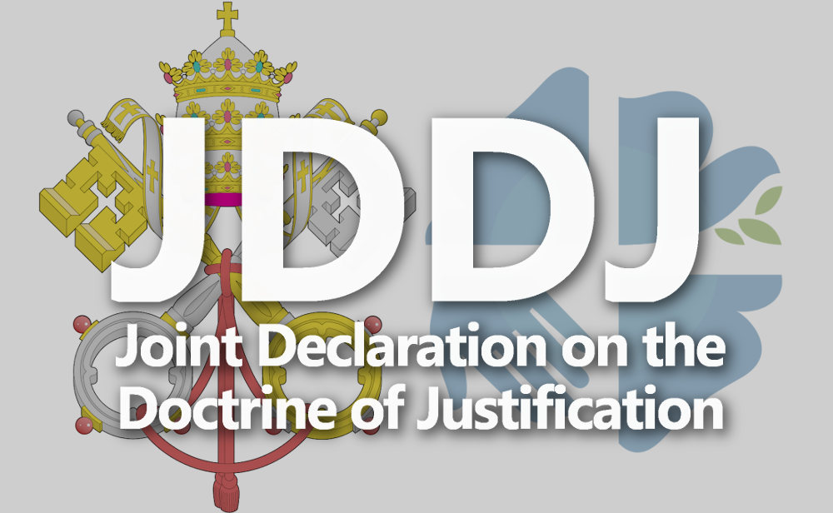
“On October 31, 1999, Reformation Sunday, official representatives of the Roman Catholic Church and the churches of the Lutheran World Federation signed a joint-declaration on the doctrine of justification in Augsburg, Germany. That historic occasion means that the first step has been taken toward unity and faith and worship between Lutherans and Catholics to heal the rift that has existed between them since the 16th century”—The National Catholic Reporter, Feb. 19, 2000

Slide 26
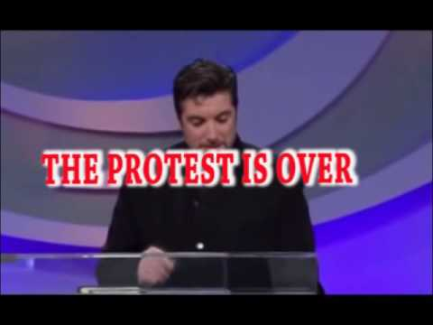
Does a Protestant Church claiming that the Reformation is irrelevant line up with Dr. Rivera’s Claims that the mainstream churches are being controlled by the Jesuits? If you see things like this in your church, what does that tell you???

Slide 27
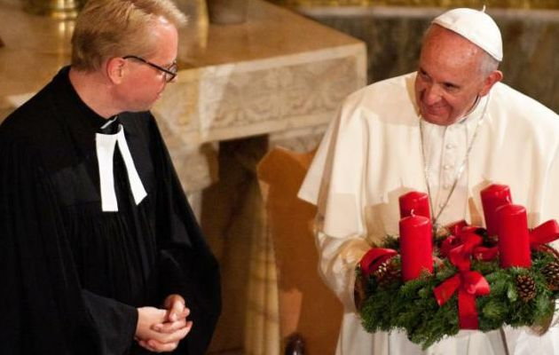
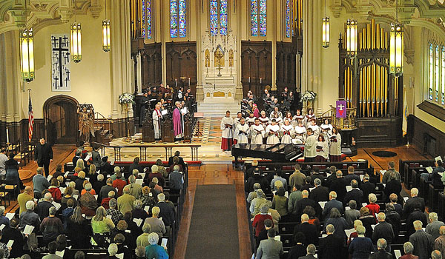
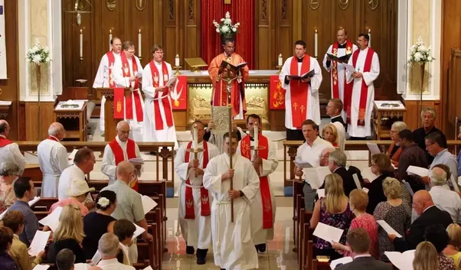
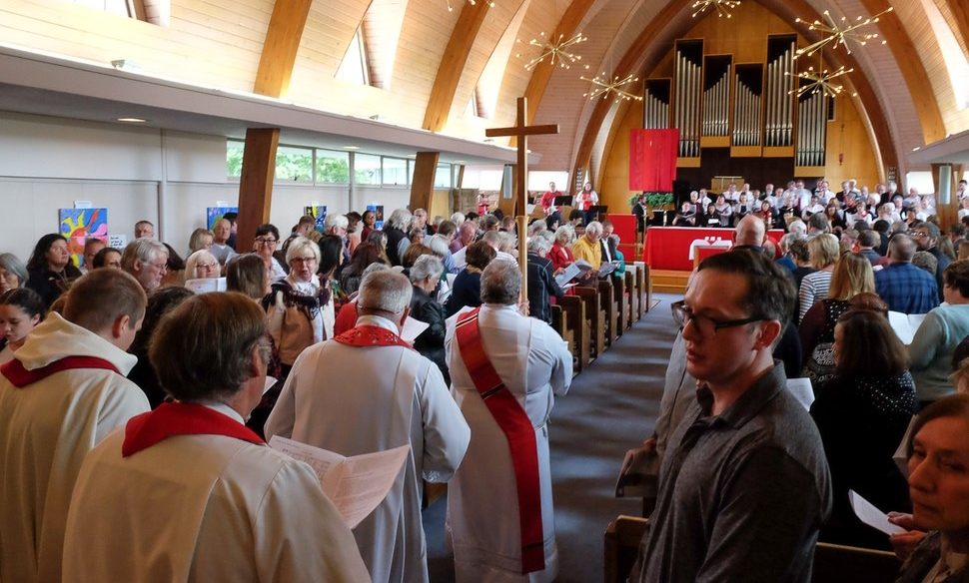

Slide 28
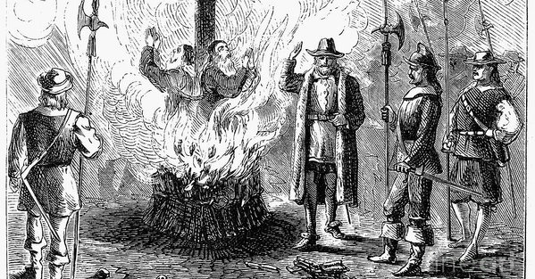
If the Reformation is irrelevant and does not deserve our attention, did Jan Huss, William Tyndale, John Wycliffe, Berquin, Cranmer, and countless millions of others die in vain???

Slide 29
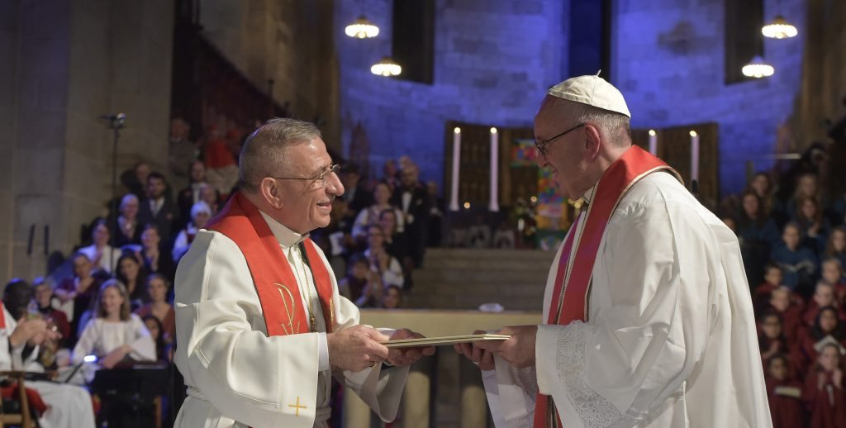
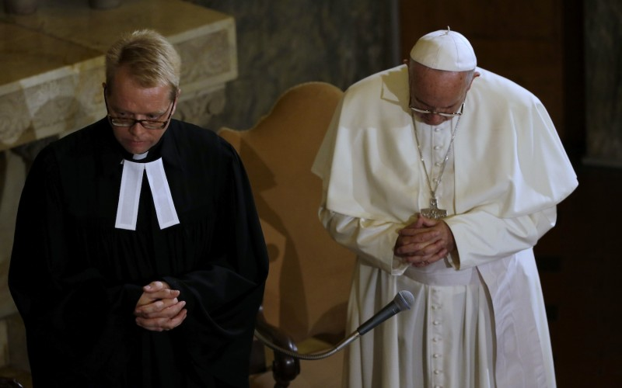
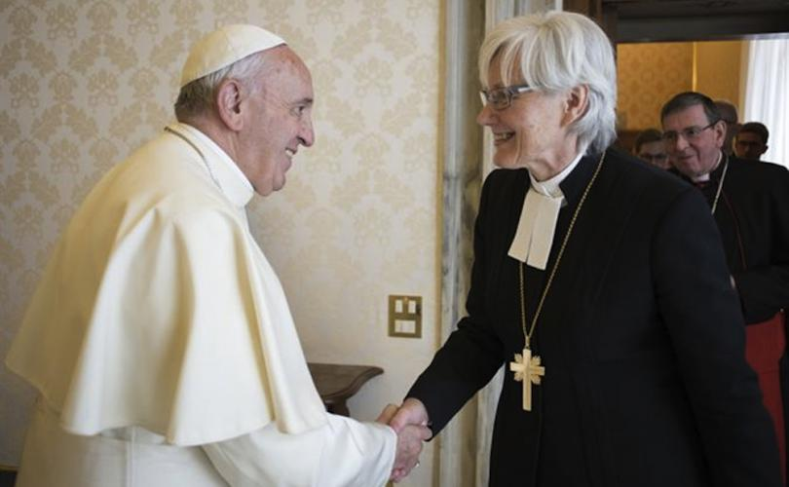
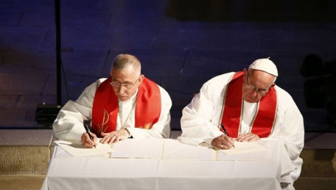

Slide 30
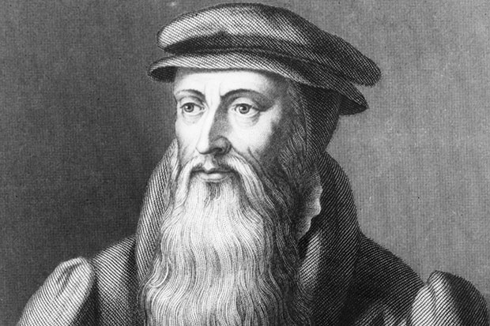
John Knox had turned away from the traditions and mysticisms of the church, to feed upon the truths of God's word; and the teaching of Wishart had confirmed his determination to forsake the communion of Rome and join himself to the persecuted Reformers.—Ellen White, Great Controversy, p. 250
John Knox (1513-1572)

Slide 31
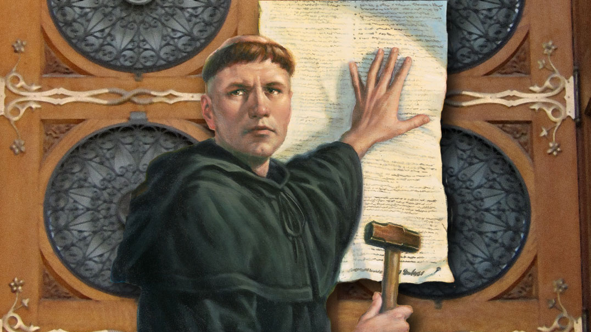
Which “Protestant” Denomination is still protesting Roman error?
Answer: Not one mainstream Protestant or Evangelical Church

Slide 32
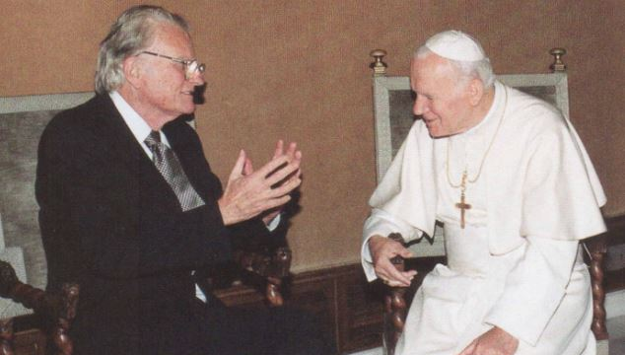
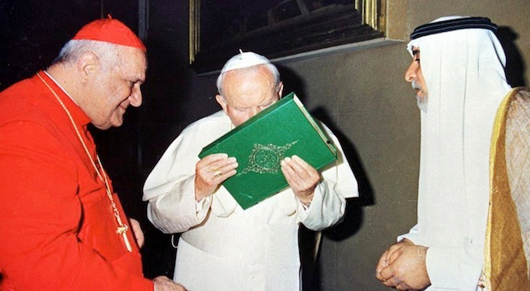
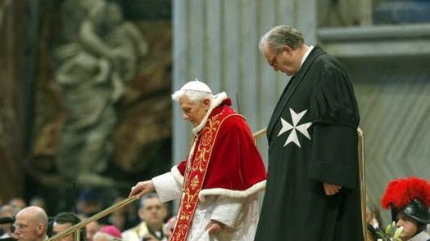
Rome has been busy bringing the Protestant Churches back under it’s wing. Who will continue the Reformation? Who will cry aloud and spare not?

Slide 33
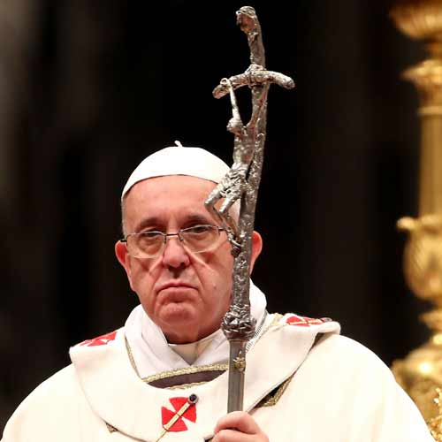
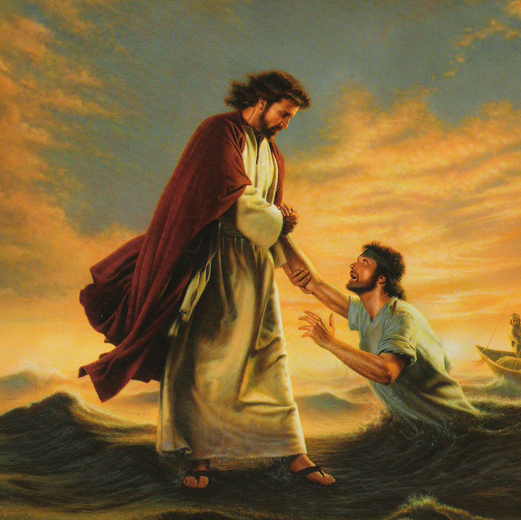
OR

