Slide 1
Free Robe
Best Yet!

Slide 2
A Story
“ And Jesus answered and spake unto them again by parables, and said, The kingdom of heaven is like unto a certain king, which made a marriage for his son, And sent forth his servants to call them that were bidden to the wedding: and they would not come. Again, he sent forth other servants, saying, Tell them which are bidden, Behold, I have prepared my dinner: my oxen and [my] fatlings are killed, and all things are ready: come unto the marriage. But they made light of [it], and went their ways, one to his farm, another to his merchandise: And the remnant took his servants, and entreated [them] spitefully, and slew them But when the king heard [thereof], he was wroth: and he sent forth his armies, and destroyed those murderers, and burned up their city. Then saith he to his servants, The wedding is ready, but they which were bidden were not worthy. Go ye therefore into the highways, and as many as ye shall find, bid to the marriage. So those servants went out into the highways, and gathered together all as many as they found, both bad and good: and the wedding was furnished with guests. And when the king came in to see the guests, he saw there a man which had not on a wedding garment: And he saith unto him, Friend, how camest thou in hither not having a wedding garment? And he was speechless. Then said the king to the servants, Bind him hand and foot, and take him away, and cast him into outer darkness; there shall be weeping and gnashing of teeth. For many are called, but few [are] chosen.” Matthew 22:1-14

Slide 3
Full of Meaning
1. The gospel invitation to the Jews.
2. Their rejection and ultimate destruction of their city.
3. The gospel invitation to the Gentiles.
4. The investigative judgment of 1844 foretold here.

Slide 4
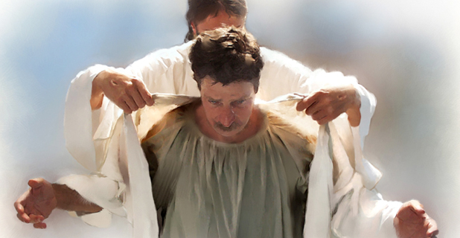
Most Important
”And when the king came in to see the guests, he saw there a man which had not on a wedding garment: And he saith unto him, Friend, how camest thou in hither not having a wedding garment? And he was speechless. Then said the king to the servants, Bind him hand and foot, and take him away, and cast him into outer darkness; there shall be weeping and gnashing of teeth. For many are called, but few are chosen.” Matthew 22:11-14

Slide 5
A Gift
“This garment was a gift from the king. By wearing it the guests showed their respect for the giver of the feast. But one man was clothed in his common citizen dress. He had refused to make the preparation required by the king. The garment provided for him at great cost he disdained to wear. Thus he insulted his lord. To the king's demand, "How camest thou in hither not having a wedding garment?" he could answer nothing. He was self-condemned. Then the king said, "Bind him hand and foot, and take him away, and cast him into outer darkness.“ Col, pg. 309

Slide 6
A Gift from Christ
“By the wedding garment in the parable is represented the pure, spotless character which Christ's true followers will possess. To the church it is given "that she should be arrayed in fine linen, clean and white," "not having spot, or wrinkle, or any such thing." Eph. 5:27. The fine linen, says the Scripture, "is the righteousness of saints." Rev. 19:8. It is the righteousness of Christ, His own unblemished character, that through faith is imparted to all who receive Him as their personal Saviour.” COL, pg. 310

Slide 7
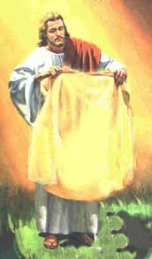
Christ’s Righteousness
“In his days Judah shall be saved, and Israel shall dwell safely: and this [is] his name whereby he shall be called, THE LORD OUR RIGHTEOUSNESS.” Jer. 23:6
“I will go in the strength of the Lord GOD: I will make mention of thy righteousness, even of thine only.” Ps. 71:16

Slide 8
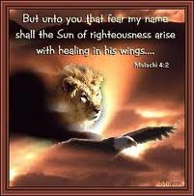
We Have None
“But we are all as an unclean thing, and all our righteousnesses are as filthy rags; and we all do fade as a leaf; and our iniquities, like the wind, have taken us away.” Isaiah 64:6
“Surely, shall one say, in the LORD have I righteousness and strength: even to him shall men come; and all that are incensed against him shall be ashamed.” Isaiah 45:24

Slide 9
What is it?
“Only the covering which Christ Himself has provided can make us meet to appear in God's presence. This covering, the robe of His own righteousness, Christ will put upon every repenting, believing soul. "I counsel thee," He says, "to buy of Me . . . white raiment, that thou mayest be clothed, and that the shame of thy nakedness do not appear." Rev. 3:18.
This robe, woven in the loom of heaven, has in it not one thread of human devising. Christ in His humanity wrought out a perfect character, and this character He offers to impart to us. "All our righteousness are as filthy rags." Isa. 64:6. Everything that we of ourselves can do is defiled by sin. But the Son of God "was manifested to take away our sins; and in Him is no sin." Sin is defined to be "the transgression of the law." 1 John 3:5, 4.” COL, pg. 311

Slide 10
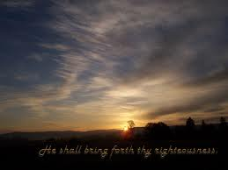
For Naked Laodicea
”Because thou sayest, I am rich, and increased with goods, and have need of nothing; and knowest not that thou art wretched, and miserable, and poor, and blind, and naked: I counsel thee to buy of me gold tried in the fire, that thou mayest be rich; and white raiment, that thou mayest be clothed, and that the shame of thy nakedness do not appear; and anoint thine eyes with eyesalve, that thou mayest see. As many as I love, I rebuke and chasten: be zealous therefore, and repent.” Rev. 3:17,18

Slide 11
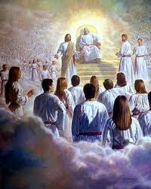
Given to the Redeemed
“And round about the throne were four and twenty seats: and upon the seats I saw four and twenty elders sitting, clothed in white raiment; and they had on their heads crowns of gold.” Rev. 4:4

Slide 12
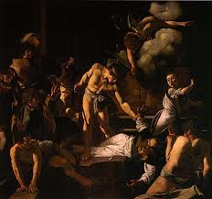
Promised to the Persecuted
”And when he had opened the fifth seal, I saw under the altar the souls of them that were slain for the word of God, and for the testimony which they held: And they cried with a loud voice, saying, How long, O Lord, holy and true, dost thou not judge and avenge our blood on them that dwell on the earth? And white robes were given unto every one of them; and it was said unto them, that they should rest yet for a little season, until their fellow servants also and their brethren, that should be killed as they were, should be fulfilled.” Rev. 6:9-11

Slide 13
Made Pure by Suffering
“And one of the elders answered, saying unto me, What are these which are arrayed in white robes? and whence came they? And I said unto him, Sir, thou knowest. And he said to me, These are they which came out of great tribulation, and have washed their robes, and made them white in the blood of the Lamb. Therefore are they before the throne of God, and serve him day and night in his temple: and he that sitteth on the throne shall dwell among them.” Rev. 7:13-15

Slide 14
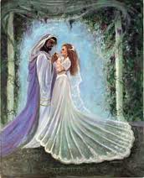
Final Manifestation
“Let us be glad and rejoice, and give honour to him: for the marriage of the Lamb is come, and his wife hath made herself ready. And to her was granted that she should be arrayed in fine linen, clean and white: for the fine linen is the righteousness of saints.” Revelation 19:7,8

Slide 15
Clothed and Ready
By His perfect obedience He has made it possible for every human being to obey God's commandments. When we submit ourselves to Christ, the heart is united with His heart, the will is merged in His will, the mind becomes one with His mind, the thoughts are brought into captivity to Him; we live His life. This is what it means to be clothed with the garment of His righteousness. Then as the Lord looks upon us He sees, not the fig-leaf garment, not the nakedness and deformity of sin, but His own robe of righteousness, which is perfect obedience to the law of Jehovah. The guests at the marriage feast were inspected by the king. Only those were accepted who had obeyed his requirements and put on the wedding garment. So it is with the guests at the gospel feast. All must pass the scrutiny of the great King, and only those are received who have put on the robe of Christ's righteousness.” COL, pg. 312

Slide 16
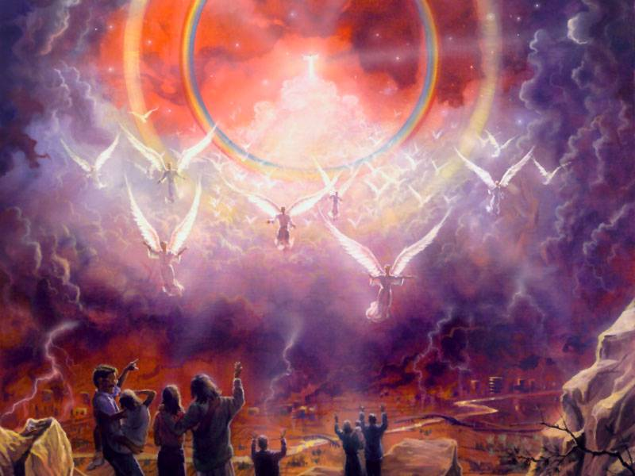
Revelation’s Message
1, His church rejected His righteousness.
2. Political powers refused His righteousness and crumbled.
3. Christ has always had a people and He will at the end of time. These ones will be clothed in His righteousness. They will reveal His character!

