Slide 1
Romans, pt.19
Christ is the end of the Law

Slide 2
Review of Romans 9:17-33
1. God intended that all men be saved. The fact that so few will be saved is because of our perversity.
2. The potter hopes that all his vessels of craft will be beautiful, but some pieces are not.
3. Israel/Adventism had every opportunity but failed because they felt they had a righteousness that was good enough.
4. The Gentiles, that were saved, embraced Christ, Who alone is righteousness.

Slide 3

How Sad!
Romans 10:1 “Brethren, my heart’s desire and prayer to God for Israel is, that they might be saved.”
Paul wanted so much for his brethren to be saved, but it wouldn’t be.
“That I have great heaviness and continual sorrow in my heart. For I could wish that myself were accursed from Christ for my brethren, my kinsmen according to the flesh:” Romans 9:2,3

Slide 4
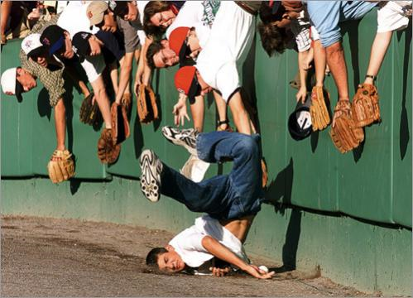
Zeal without knowledge
“For I bear them record that they have a zeal of God, but not according to knowledge.” Romans 10:2
One may very zealously want to go to New York from Florida, but will never get there by travelling south. Zeal is nullified by ignorance.
“My people are destroyed for lack of knowledge: because thou hast rejected knowledge, I will also reject thee, that thou shalt be no priest to me: seeing thou hast forgotten the law of thy God, I will also forget thy children.” Hosea 4:6

Slide 5

No Submission
“For they being ignorant of God’s righteousness, and going about to establish their own righteousness, have not submitted themselves unto the righteousness of God.” Romans 10:3
Jews/Adventism, with the highest of profession, claiming to be following God, were utterly ignorant of God and His requirements. They didn’t need God’s righteousness, because their ignorance claimed their righteousness sufficient to gain heaven!

Slide 6
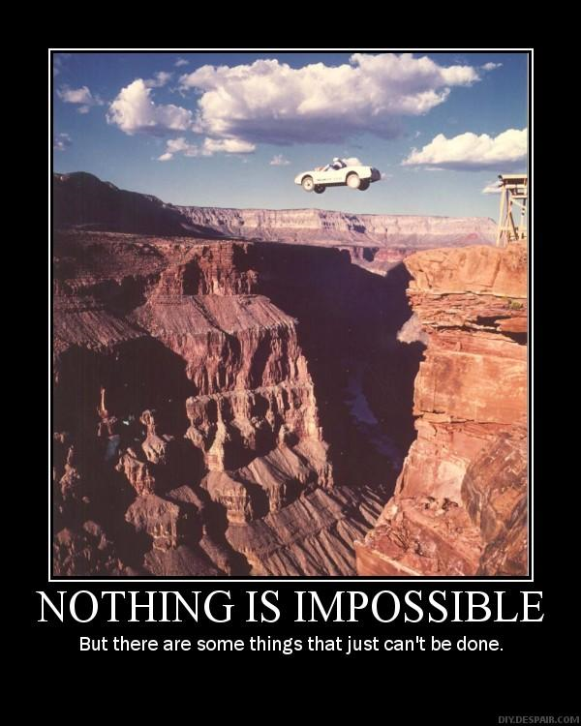
Impossible
Jews/Adventism expect God to submit to them and what they think is right. God is to accept their righteousness in their way. From Sinai, Israel believed they could establish obedience because they knew better than God.
“And all the people answered together, and said, All that the LORD hath spoken we will do.”

Slide 7
Christ and the Law
“When the law was proclaimed from Sinai, God made known to men the holiness of His character, that by contrast they might see the sinfulness of their own. The law was given to convict them of sin, and reveal their need of a Saviour. It would do this as its principles were applied to the heart by the Holy Spirit. This work it is still to do. In the life of Christ the principles of the law are made plain; and as the Holy Spirit of God touches the heart, as the light of Christ reveals to men their need of His cleansing blood and His justifying righteousness, the law is still an agent in bringing us to Christ, that we may be justified by faith. "The law of the Lord is perfect, converting the soul." Ps. 19:7.
"Till heaven and earth pass," said Jesus, "one jot or one tittle shall in nowise pass from the law, till all be fulfilled." The sun shining in the heavens, the solid earth upon which you dwell, are God's witnesses that His law is changeless and eternal. Though they may pass away, the divine precepts shall endure. "It is easier for heaven and earth to pass, than one tittle of the law to fail." Luke 16:17. The system of types that pointed to Jesus as the Lamb of God was to be abolished at His death; but the precepts of the Decalogue are as immutable as the throne of God.”
DA, pg. 308

Slide 8

Christ- the end of the law?
“For Christ is the end of the law for righteousness to every one that believeth.” Romans 10:4
Many would like this verse to mean that Christ put an end to the law. Matthew 5:18 is clear- “For verily I say unto you, Till heaven and earth pass, one jot or one tittle shall in no wise pass from the law, till all be fulfilled.”

Slide 9
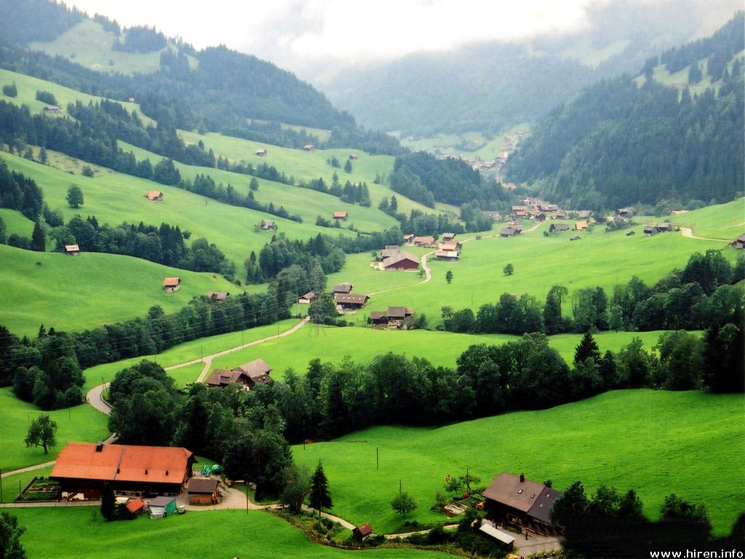
The Law is Eternal
If this verse doesn’t mean that the law is abolished, then what does it mean? In context, Paul is talking about the attempts of the Jews/Adventists to keep the law apart from Christ. Paul’s comment is that Christ is the only way to keep the law. The verse, in context, means Christ is the end of the law as a means to righteousness for everyone who has faith. For those who have faith, they recognize that by themselves obedience is impossible and that only through faith can the law be obeyed.

Slide 10

Contrasting Principles
“For Moses describeth the righteousness which is of the law, That the man which doeth those things shall live by them. But the righteousness which is of faith speaketh on this wise, Say not in thine heart, Who shall ascend into heaven? (that is, to bring Christ down from above:) Or, Who shall descend into the deep? (that is, to bring up Christ again from the dead.) But what saith it? The word is nigh thee, even in thy mouth, and in thy heart: that is, the word of faith, which we preach;” Romans 10:5-8

Slide 11

Which way are WE?
Paul continues his argument. There are two ways whereby a man can seek righteousness or obedience to God’s law. One way is through his own efforts; the other way is through faith in the power of Jesus Christ. Through his own efforts, man will find failure as did the Jews/Adventists. The only true way is through faith in Jesus Christ.

Slide 12
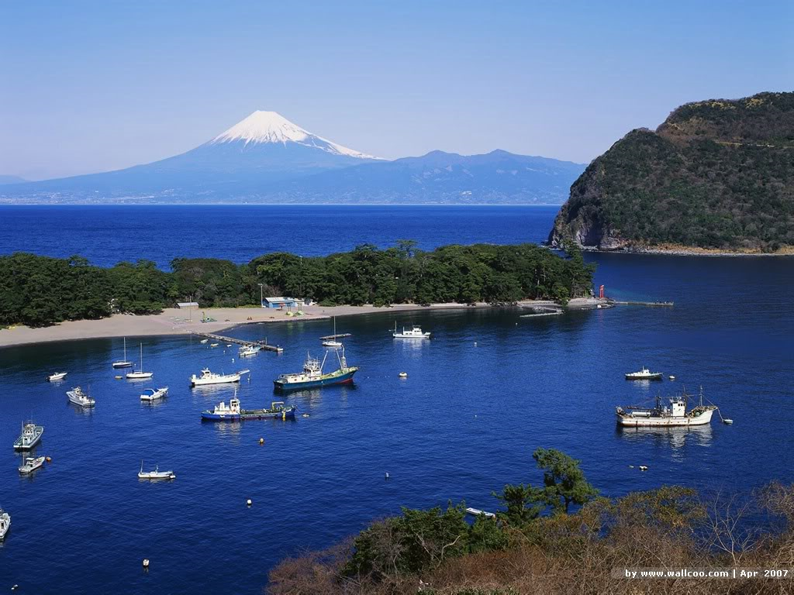
The Word
Paul declares the sole source of power for helpless humanity. “The word is nigh thee, even in thy mouth, and in thy heart: that is, the word of faith, which we preach;” Romans 10:8
So long as we are united to Him by faith, sin has no more dominion over us. God reaches for the hand of faith in us to direct it to lay fast hold upon the divinity of Christ, that we may attain to perfection of character.
And how this is accomplished, Christ has shown us. By what means did He overcome in the conflict with Satan? By the word of God. Only by the word could He resist temptation. "It is written," He said. And unto us are given "exceeding great and precious promises: that by these ye might be partakers of the divine nature, having escaped the corruption that is in the world through lust." 2 Peter 1:4. Every promise in God's word is ours. "By every word that proceedeth out of the mouth of God" are we to live. When assailed by temptation, look not to circumstances or to the weakness of self, but to the power of the word. All its strength is yours. "Thy word," says the psalmist, "have I hid in mine heart, that I might not sin against Thee." "By the word of Thy lips I have kept me from the paths of the destroyer." Ps. 119:11; 17:4.

Slide 13
Righteousness by Faith
“The woman had not comprehended the words of Christ, but she felt their solemn import. Her light, bantering manner began to change. Supposing that Jesus spoke of the well before them, she said, "Sir, Thou hast nothing to draw with, and the well is deep: from whence then hast Thou that living water? Art Thou greater than our father Jacob, which gave us the well, and drank thereof himself?" She saw before her only a thirsty traveler, wayworn and dusty. In her mind she compared Him with the honored patriarch Jacob. She cherished the feeling, which is so natural, that no other well could be equal to that provided by the fathers. She was looking backward to the fathers, forward to the Messiah's coming, while the Hope of the fathers, the Messiah Himself, was beside her, and she knew Him not. How many thirsting souls are today close by the living fountain, yet looking far away for the wellsprings of life! "Say not in thine heart, Who shall ascend into heaven? (that is, to bring Christ down from above:) or, Who shall descend into the deep? (that is, to bring up Christ again from the dead.) . . . The word is nigh thee, even in thy mouth, and in thy heart: . . . if thou shalt confess with thy mouth the Lord Jesus, and shalt believe in thine heart that God hath raised Him from the dead, thou shalt be saved." Rom. 10:6-9. DA, pg. 184

Slide 14

Believing involves action
“That if thou shalt confess with thy mouth the Lord Jesus, and shalt believe in thine heart that God hath raised him from the dead, thou shalt be saved. For with the heart man believeth unto righteousness; and with the mouth confession is made unto salvation.” Romans 10:9,10

Slide 15
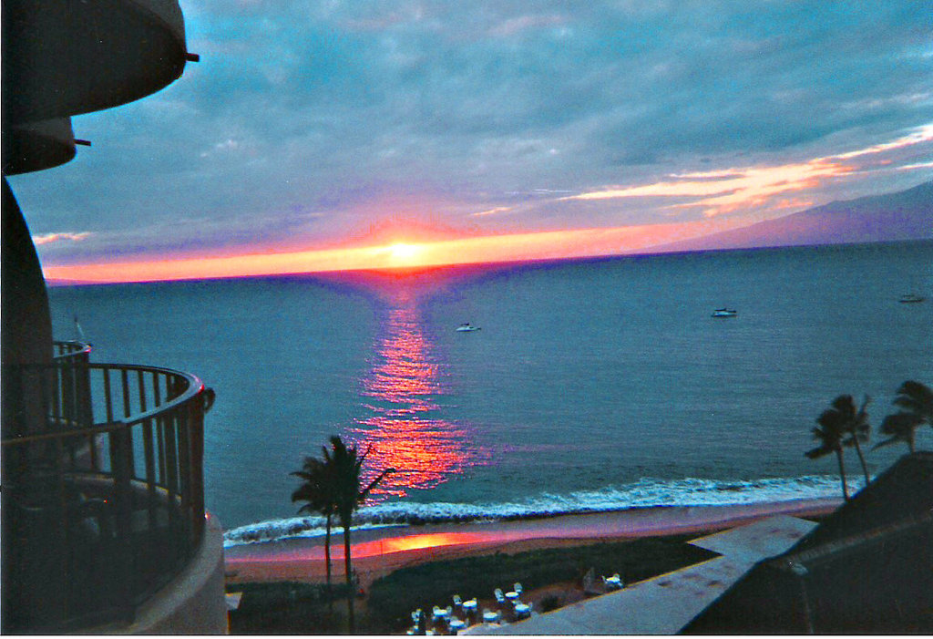
Devils Believe
“Even so faith, if it hath not works, is dead, being alone.
Yea, a man may say, Thou hast faith, and I have works: shew me thy faith without thy works, and I will shew thee my faith by my works.
Thou believest that there is one God; thou doest well: the devils also believe, and tremble. But wilt thou know, O vain man, that faith without works is dead?” James 2:17-20

Slide 16
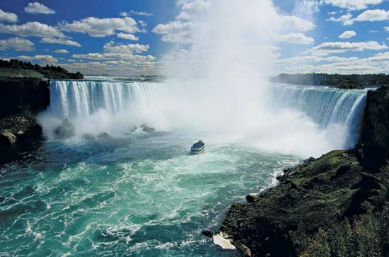
Going Across
The story is told of the tightrope walker who walked across the Niagara Falls. The crowd roared their approval. The walker proceeded to a microphone and asked, “How many of you believe I can wheel someone across the tightrope in a wheel barrel?” Everyone roared again, stating they felt he could. When he asked for volunteers, there were no takers. They didn’t really believe!

Slide 17
True Faith
“True faith, which relies wholly upon Christ, will be manifested by obedience to all the requirements of God. From Adam's day to the present time the great controversy has been concerning obedience to God's law. In all ages there have been those who claimed a right to the favor of God even while they were disregarding some of His commands. But the Scriptures declare that by works is "faith made perfect;" and that, without the works of obedience, faith "is dead." James 2:22, 17. He that professes to know God, "and keepeth not His commandments, is a liar, and the truth is not in him." 1 John 2:4.”
“There are many who fail to understand the relation of faith and works. They say, "Only believe in Christ, and you are safe. You have nothing to do with keeping the law." But genuine faith will be manifest in obedience. Said Christ to the unbelieving Jews, "If ye were Abraham's children, ye would do the works of Abraham." John 8:39. And concerning the father of the faithful the Lord declares, "Abraham obeyed My voice, and kept My charge, My commandments, My statutes, and My laws." Genesis 26:5. Says the apostle James, "Faith, if it hath not works, is dead, being alone." James 2:17. And John, who dwells so fully upon love, tells us, "This is the love of God, that we keep His commandments." 1 John 5:3.” PP, pg. 73,153,154,

Slide 18
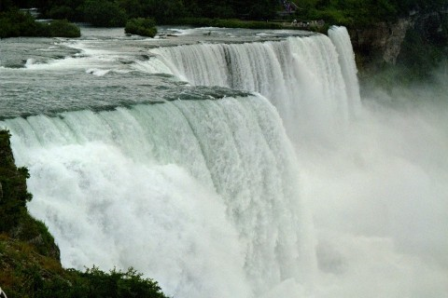
Would You Walk the Rope?
“For the scripture saith, Whosoever believeth on him shall not be ashamed. For there is no difference between the Jew and the Greek: for the same Lord over all is rich unto all that call upon him. For whosoever shall call upon the name of the Lord shall be saved.” Romans 10:11-13

Slide 19
The Message Must Go!
“How then shall they call on him in whom they have not believed? and how shall they believe in him of whom they have not heard? and how shall they hear without a preacher? And how shall they preach, except they be sent? as it is written, How beautiful are the feet of them that preach the gospel of peace, and bring glad tidings of good things! But they have not all obeyed the gospel. For Esaias saith, Lord, who hath believed our report? So then faith cometh by hearing, and hearing by the word of God.” Romans 10:14-17
Everyone must hear the message. It rests upon God’s people to share the truth as far and wide as possible.
“And this gospel of the kingdom shall be preached in all the world for a witness unto all nations; and then shall the end come.” Matthew 24:15
“The message of salvation is communicated to men through human agencies. But the Jews had sought to make a monopoly of the truth which is eternal life. They had hoarded the living manna, and it had turned to corruption. The religion which they tried to shut up to themselves became an offense. They robbed God of His glory, and defrauded the world by a counterfeit of the gospel. They had refused to surrender themselves to God for the salvation of the world, and they became agents of Satan for its destruction.
The people whom God had called to be the pillar and ground of the truth had become representatives of Satan. They were doing the work that he desired them to do, taking a course to misrepresent the character of God, and cause the world to look upon Him as a tyrant.” DA, pg. 36

Slide 20
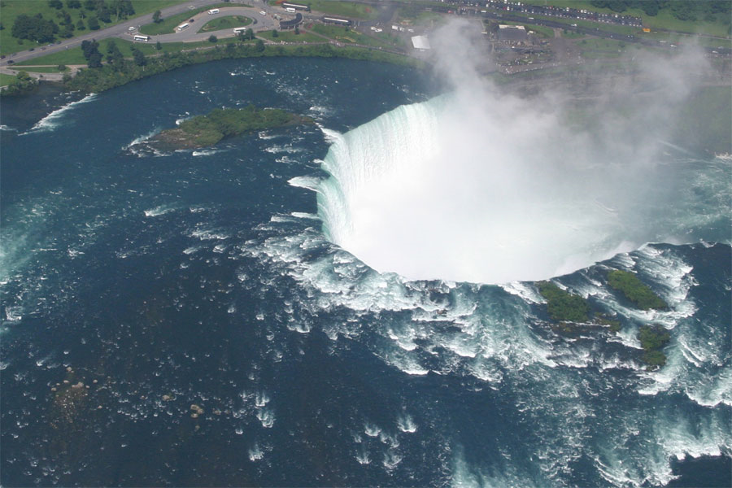
Every Creature
“But I say, Have they not heard? Yes verily, their sound went into all the earth, and their words unto the ends of the world. But I say, Did not Israel know? First Moses saith, I will provoke you to jealousy by them that are no people, and by a foolish nation I will anger you. But Esaias is very bold, and saith, I was found of them that sought me not; I was made manifest unto them that asked not after me. But to Israel he saith, All day long I have stretched forth my hands unto a disobedient and gainsaying people.” Romans 10:18-21

