Slide 1
Unity?

Slide 2
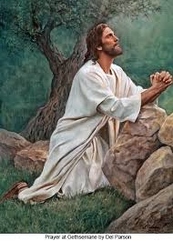
Christ’s Prayer
The burden of Christ at the end of His life was not Gethsemane, or the cruel machinations of the Adventist leadership in uniting with Rome! It wasn’t even Calvary. It was unity!!! Christ longed for His children to be untied together in bonds of genuine love and unity! It finally did occur and it will happen again! Let us look at the prayer of Jesus this morning and what finally brought about the unity of His children and what will bring it again!

Slide 3
The Introduction
These words spake Jesus, and lifted up his eyes to heaven, and said, Father, the hour is come; glorify thy Son, that thy Son also may glorify thee: As thou hast given him power over all flesh, that he should give eternal life to as many as thou hast given him. And this is life eternal, that they might know thee the only true God, and Jesus Christ, whom thou hast sent. I have glorified thee on the earth: I have finished the work which thou gavest me to do. And now, O Father, glorify thou me with thine own self with the glory which I had with thee before the world was. I have manifested thy name unto the men which thou gavest me out of the world: thine they were, and thou gavest them me; and they have kept thy word. Now they have known that all things whatsoever thou hast given me are of thee. For I have given unto them the words which thou gavest me; and they have received them, and have known surely that I came out from thee, and they have believed that thou didst send me. pray for them: I pray not for the world, but for them which thou hast given me; for they are thine. And all mine are thine, and thine are mine; and I am glorified in them. And now I am no more in the world, but these are in the world, and I come to thee. Holy Father, keep through thine own name those whom thou hast given me, that they may be one, as we are.” John 17:1-10

Slide 4
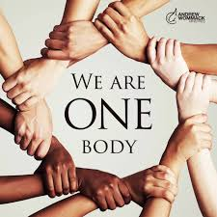
Glorified in Their Oneness
“In this prayer He further goes on to state what is comprehended by the work which He has accomplished, and which has given Him all those who believe on His name. He values this recompense so highly that He forgets the anguish it has cost Him to redeem fallen man. He declares Himself glorified in those who believe on Him. The church, in His name, is to carry to glorious perfection the work which He has commenced; and when that church shall be finally ransomed in the Paradise of God, He will look upon the travail of His soul and be satisfied. Through all eternity the ransomed host will be His chief glory (The Spirit of Prophecy 3:260, 261).”

Slide 5
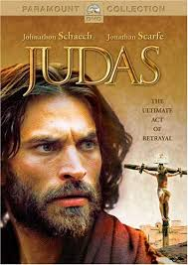
Disruptor of Unity
“While I was with them in the world, I kept them in thy name: those that thou gavest me I have kept, and none of them is lost, but the son of perdition; that the scripture might be fulfilled. And now come I to thee; and these things I speak in the world, that they might have my joy fulfilled in themselves. I have given them thy word; and the world hath hated them, because they are not of the world, even as I am not of the world.” John 17:12-14

Slide 6
Judas Sought to Thwart Unity!
From that time he expressed doubts that confused the disciples. He introduced controversies and misleading sentiments, repeating the arguments urged by the scribes and Pharisees against the claims of Christ. All the little and large troubles and crosses, the difficulties and the apparent hindrances to the advancement of the gospel, Judas interpreted as evidences against its truthfulness. He would introduce texts of Scripture that had no connection with the truths Christ was presenting. These texts, separated from their connection, perplexed the disciples, and increased the discouragement that was constantly pressing upon them. Yet all this was done by Judas in such a way as to make it appear that he was conscientious. And while the disciples were searching for evidence to confirm the words of the Great Teacher, Judas would lead them almost imperceptibly on another track. Thus in a very religious, and apparently wise, way he was presenting matters in a different light from that in which Jesus had given them, and attaching to His words a meaning that He had not conveyed. His suggestions were constantly exciting an ambitious desire for temporal preferment, and thus turning the disciples from the important things they should have considered. The dissension as to which of them should be greatest was generally excited by Judas.” DA, pg. 719

Slide 7
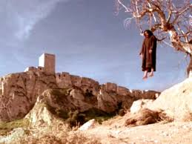
What Motivates/Moves YOU!?!
While one in their midst was prompted by money and greed of gain, THERE could be no unity! While one wanted position and power and would pervert the truth to achieve his secret goal, THERE could be no unity! While one would betray sacred trust for greed of gain, THERE could be no unity?
“The history of Judas presents the sad ending of a life that might have been honored of God. Had Judas died before his last journey to Jerusalem he would have been regarded as a man worthy of a place among the twelve, and one who would be greatly missed. The abhorrence which has followed him through the centuries would not have existed but for the attributes revealed at the close of his history. But it was for a purpose that his character was laid open to the world. It was to be a warning to all who, like him, should betray sacred trusts.” DA, pg. 716

Slide 8
Unity Only in the Truth!
“I pray not that thou shouldest take them out of the world, but that thou shouldest keep them from the evil. They are not of the world, even as I am not of the world. Sanctify them through thy truth: thy word is truth. As thou hast sent me into the world, even so have I also sent them into the world. And for their sakes I sanctify myself, that they also might be sanctified through the truth. Neither pray I for these alone, but for them also which shall believe on me through their word; That they all may be one; as thou, Father, art in me, and I in thee, that they also may be one in us: that the world may believe that thou hast sent me. And the glory which thou gavest me I have given them; that they may be one, even as we are one:” John 17:15-22

Slide 10
Basis of All Unity
Truth remains the basis of all unity. When people are committed to the truth and love the truth above ALL else, THEN and only then can there be unity. The sanctifying power of the truth binds people’s hearts together in bonds that CAN NEVER be broken. There is a sweet communion, a striving for the same thing; even the spreading of the 3 Angel’s messages around this globe! Unfortunately, we have so many things that block unity today: false teaching, love of the world/money; the desire for praise and power; jealousy; these rip the heart out of unity!

Slide 11
When Unity Occurred!
“And when the day of Pentecost was fully come, they were all with one accord in one place. And suddenly there came a sound from heaven as of a rushing mighty wind, and it filled all the house where they were sitting. And there appeared unto them cloven tongues like as of fire, and it sat upon each of them. And they were all filled with the Holy Ghost, and began to speak with other tongues, as the Spirit gave them utterance.” Acts 2:1-4

Slide 12
Unity NOT Before the test of Crucifixion
“When Jesus presented the testing truth that caused so many of His disciples to turn back, He knew what would be the result of His words; but He had a purpose of mercy to fulfill. He foresaw that in the hour of temptation every one of His beloved disciples would be severely tested. His agony in Gethsemane, His betrayal and crucifixion, would be to them a most trying ordeal. Had no previous test been given, many who were actuated by merely selfish motives would have been connected with them. When their Lord was condemned in the judgment hall; when the multitude who had hailed Him as their king hissed at Him and reviled Him; when the jeering crowd cried, “Crucify Him!”—when their worldly ambitions were disappointed, these self-seeking ones would, by renouncing their allegiance to Jesus, have brought upon the disciples a bitter, heart-burdening sorrow, in addition to their grief and disappointment in the ruin of their fondest hopes. In that hour of darkness, the example of those who turned from Him might have carried others with them. But Jesus brought about this crisis while by His personal presence He could still strengthen the faith of His true followers.
Compassionate Redeemer, who in the full knowledge of the doom that awaited Him, tenderly smoothed the way for the disciples, prepared them for their crowning trial, and strengthened them for the final test!” DA, pg. 394

Slide 13
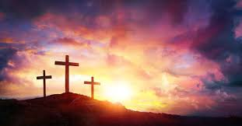
Disciples Final Test!
The disciples final test was the cross. Christ allowed the great shaking in Galilee because He knew those who were shaken out would only hurt the disciples at the cross if they were still around!
Christ allows a shaking to remove those who are hindering the work and causing disunity. The shaking kept up until the cross. After the test, there was unity.

Slide 14
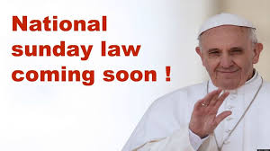
What About Us?
The final test for us is the National Sunday Law! Prior to that, there is and will continue to be a great shaking! The Lord wants to see if we are pure gold or base metal. We are all being challenged to see how much we love the Lord and His truth!
Those who are walking in the light and following the Lord, come what may, will be sealed and then, there will be unity!

Slide 15
After the Cross, UNITY!
“As the disciples waited for the fulfillment of the promise, they humbled their hearts in true repentance and confessed their unbelief. As they called to remembrance the words that Christ had spoken to them before His death they understood more fully their meaning. Truths which had passed from their memory were again brought to their minds, and these they repeated to one another. They reproached themselves for their misapprehension of the Saviour. Like a procession, scene after scene of His wonderful life passed before them. As they meditated upon His pure, holy life they felt that no toil would be too hard, no sacrifice too great, if only they could bear witness in their lives to the loveliness of Christ's character. Oh, if they could but have the past three years to live over, they thought, how differently they would act! If they could only see the Master again, how earnestly they would strive to show Him how deeply they loved Him, and how sincerely they sorrowed for having ever grieved Him by a word or an act of unbelief! But they were comforted by the thought that they were forgiven. And they determined that, so far as possible, they would atone for their unbelief by bravely confessing Him before the world.” AA, pg. 36

Slide 16
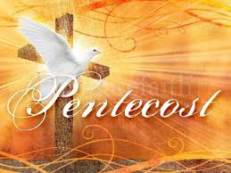
Put Away Differences!
“The disciples prayed with intense earnestness for a fitness to meet men and in their daily intercourse to speak words that would lead sinners to Christ. Putting away all differences, all desire for the supremacy, they came close together in Christian fellowship. They drew nearer and nearer to God, and as they did this they realized what a privilege had been theirs in being permitted to associate so closely with Christ. Sadness filled their hearts as they thought of how many times they had grieved Him by their slowness of comprehension, their failure to understand the lessons that, for their good, He was trying to teach them. These days of preparation were days of deep heart searching. The disciples felt their spiritual need and cried to the Lord for the holy unction that was to fit them for the work of soul saving. They did not ask for a blessing for themselves merely. They were weighted with the burden of the salvation of souls. They realized that the gospel was to be carried to the world, and they claimed the power that Christ had promised.” AA, pg. 37

Slide 17
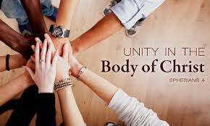
Unity!
1. true repentance.
2. admitted their unbelief.
3. put away all differences.
4. put away all desire for supremacy.
5. felt their spiritual need.
Filled with power and were of one accord!
UNITY!!!

Slide 18
Turned the World Upside Down
“But the Jews which believed not, moved with envy, took unto them certain lewd fellows of the baser sort, and gathered a company, and set all the city on an uproar, and assaulted the house of Jason, and sought to bring them out to the people. And when they found them not, they drew Jason and certain brethren unto the rulers of the city, crying, These that have turned the world upside down are come hither also;” Acts 17:5,6

