Slide 1
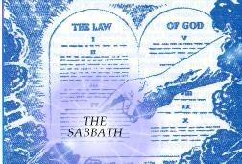
The Spirit of the Sabbath

Slide 2
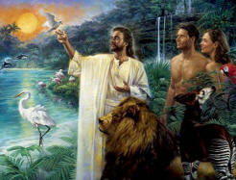
Given at Creation
Gen. 2:1-3 “Thus the heavens and the earth were finished, and all the host of them. And on the seventh day God ended his work which he had made; and he rested on the seventh day from all his work which he had made. And God blessed the seventh day, and sanctified it: because that in it he had rested from all his work which God created and made.”

Slide 3
Satan’s Plan for the Sabbath
“During the Christian dispensation, the great enemy of man's happiness has made the Sabbath of the fourth commandment an object of special attack. Satan says, ‘I will work at cross purposes with God. I will empower my followers to set aside God's memorial, the seventh-day Sabbath. . . I will place in its stead a day that does not bear the credentials of God, a day that cannot be a sign between God and His people. I will lead those who accept this day to place upon it the sanctity that God placed upon the seventh day. Through my vicegerent, I will exalt myself. The first day will be extolled, and the Protestant world will receive this spurious sabbath as genuine. Through the nonobservance of the Sabbath that God instituted, I will bring His law into contempt. The words, 'A sign between Me and you throughout your generations,' I will make to serve on the side of my sabbath. Thus the world will become mine. I will be the ruler of the earth, the prince of the world. I will so control the minds under my power that God's Sabbath shall be a special object of contempt. A sign? I will make the observance of the seventh day a sign of disloyalty to the authorities of earth. Human laws will be made so stringent that men and women will not dare to observe the seventh-day Sabbath. For fear of wanting food and clothing, they will join with the world in transgressing God's law. The earth will be wholly under my dominion.’”—PK, 183-184

Slide 4
Two Reasonings Given in the Law!!!
Exodus 20:8-11 “Remember the sabbath day, to keep it holy. Six days shalt thou labour, and do all thy work: But the seventh day is the sabbath of the Lord thy God: in it thou shalt not do any work, thou, nor thy son, nor thy daughter, thy manservant, nor thy maidservant, nor thy cattle, nor thy stranger that is within thy gates: For in six days the Lord made heaven and earth, the sea, and all that in them is, and rested the seventh day: wherefore the Lord blessed the sabbath day, and hallowed it.”
Deuteronomy 5:12-15 “Keep the sabbath day to sanctify it, as the Lord thy God hath commanded thee. Six days thou shalt labour, and do all thy work: But the seventh day is the sabbath of the Lord thy God: in it thou shalt not do any work, thou, nor thy son, nor thy daughter, nor thy manservant, nor thy maidservant, nor thine ox, nor thine ass, nor any of thy cattle, nor thy stranger that is within thy gates; that thy manservant and thy maidservant may rest as well as thou. And remember that thou wast a servant in the land of Egypt, and that the Lord thy God brought thee out thence through a mighty hand and by a stretched out arm: therefore the Lord thy God commanded thee to keep the sabbath day.”

Slide 5
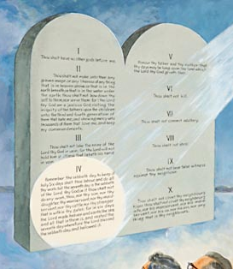
The Sabbath is the Path of Sanctification
Ezekiel 20:12 “Moreover also I gave them my sabbaths, to be a sign between me and them, that they might know that I am the Lord that sanctify them.”

Slide 6
Jealous For His Sabbath
Exodus 31:13-17 “Speak thou also unto the children of Israel, saying, Verily my sabbaths ye shall keep: for it is a sign between me and you throughout your generations; that ye may know that I am the Lord that doth sanctify you. Ye shall keep the sabbath therefore; for it is holy unto you: every one that defileth it shall surely be put to death: for whosoever doeth any work therein, that soul shall be cut off from among his people. Six days may work be done; but in the seventh is the sabbath of rest, holy to the Lord: whosoever doeth any work in the sabbath day, he shall surely be put to death. Wherefore the children of Israel shall keep the sabbath, to observe the sabbath throughout their generations, for a perpetual covenant. It is a sign between me and the children of Israel for ever: for in six days the Lord made heaven and earth, and on the seventh day he rested, and was refreshed.”

Slide 7
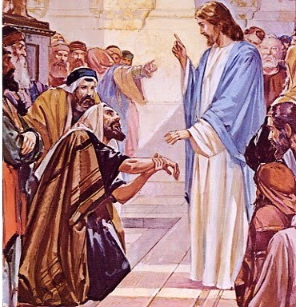
No Work At All???
Matt. 12:10-13 “And, behold, there was a man which had his hand withered. And they asked him, saying, Is it lawful to heal on the sabbath days? that they might accuse him. And he said unto them, What man shall there be among you, that shall have one sheep, and if it fall into a pit on the sabbath day, will he not lay hold on it, and lift it out? How much then is a man better than a sheep? Wherefore it is lawful to do well on the sabbath days. Then saith he to the man, Stretch forth thine hand. And he stretched it forth; and it was restored whole, like as the other.”

Slide 8
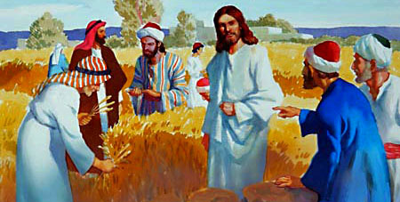
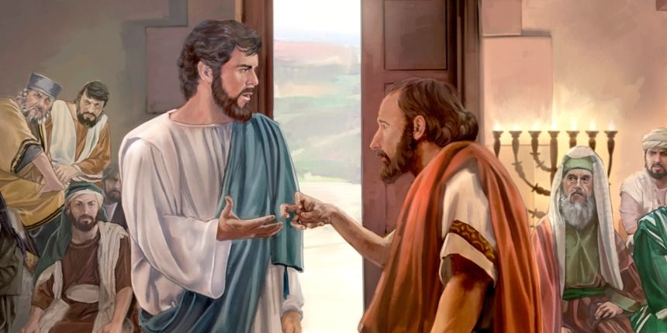
No Selfish or Secular Work….
“When Jesus turned upon the Pharisees with the question whether it was lawful on the Sabbath day to do good or to do evil, to save life or to kill, He confronted them with their own wicked purposes. They were hunting His life with bitter hatred, while He was saving life and bringing happiness to multitudes. Was it better to slay upon the Sabbath, as they were planning to do, than to heal the afflicted, as He had done? Was it more righteous to have murder in the heart upon God's holy day than love to all men, which finds expression in deeds of mercy? In the healing of the withered hand, Jesus condemned the custom of the Jews, and left the fourth commandment standing as God had given it. "It is lawful to do well on the Sabbath days," He declared. By sweeping away the senseless restrictions of the Jews, Christ honored the Sabbath, while those who complained of Him were dishonoring God's holy day.”—DA, 287

Slide 9
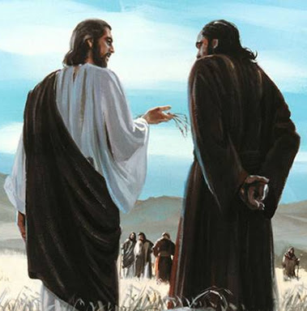
The Lord of the Sabbath
Christ, during His earthly ministry, emphasized the binding claims of the Sabbath; in all His teaching He showed reverence for the institution He Himself had given. In His days the Sabbath had become so perverted that its observance reflected the character of selfish and arbitrary men rather than the character of God. Christ set aside the false teaching by which those who claimed to know God had misrepresented Him. Although followed with merciless hostility by the rabbis, He did not even appear to conform to their requirements, but went straight forward keeping the Sabbath according to the law of God.—PK, 183

Slide 10
That Means No Buying or Selling Either!
Nehemiah 13:15-22 “In those days saw I in Judah some treading wine presses on the sabbath, and bringing in sheaves, and lading asses; as also wine, grapes, and figs, and all manner of burdens, which they brought into Jerusalem on the sabbath day: and I testified against them in the day wherein they sold victuals. There dwelt men of Tyre also therein, which brought fish, and all manner of ware, and sold on the sabbath unto the children of Judah, and in Jerusalem. Then I contended with the nobles of Judah, and said unto them, What evil thing is this that ye do, and profane the sabbath day? Did not your fathers thus, and did not our God bring all this evil upon us, and upon this city? yet ye bring more wrath upon Israel by profaning the sabbath. And it came to pass, that when the gates of Jerusalem began to be dark before the sabbath, I commanded that the gates should be shut, and charged that they should not be opened till after the sabbath: and some of my servants set I at the gates, that there should no burden be brought in on the sabbath day. So the merchants and sellers of all kind of ware lodged without Jerusalem once or twice. Then I testified against them, and said unto them, Why lodge ye about the wall? if ye do so again, I will lay hands on you. From that time forth came they no more on the sabbath.

Slide 11
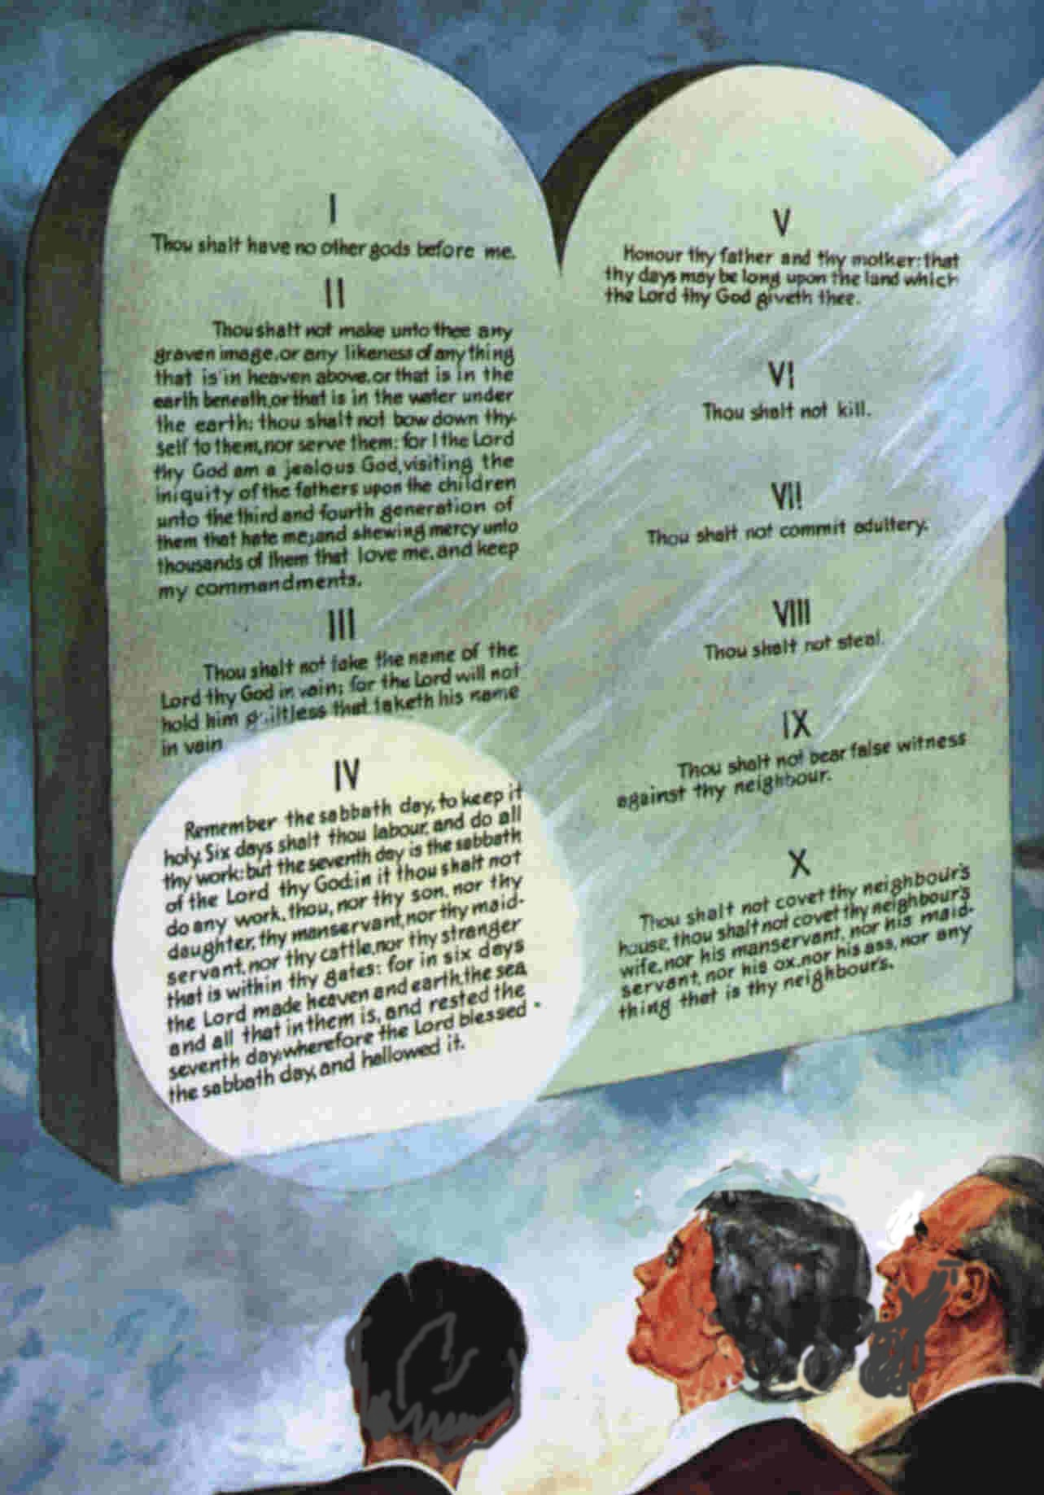
The Highest of Commandments
“I beheld the tables of stone on which the Ten Commandments were written. I was amazed as I saw the fourth commandment in the very center of the ten precepts with a soft halo of light encircling it. Said the angel, 'It is the only one of the ten which defines the living God who created the heavens and the earth and all things that are there­in.“--Life Sketches of Ellen G. White, Pages 95-96

Slide 12
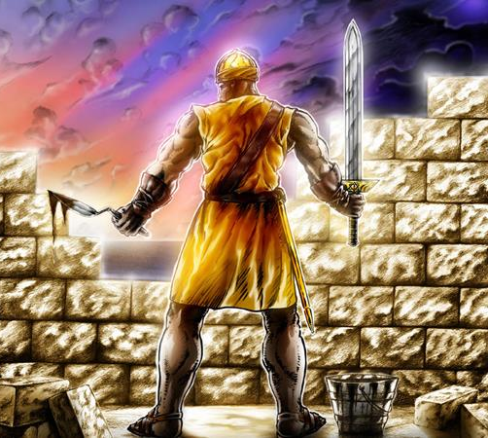
Keeping the Sabbath in Spirit and Truth
Isaiah 58:12:13 “And they that shall be of thee shall build the old waste places: thou shalt raise up the foundations of many generations; and thou shalt be called, The repairer of the breach, The restorer of paths to dwell in. If thou turn away thy foot from the sabbath, from doing thy pleasure on my holy day; and call the sabbath a delight, the holy of the Lord, honourable; and shalt honour him, not doing thine own ways, nor finding thine own pleasure, nor speaking thine own words”

Slide 13
No Low Talk
This spirit of jesting and joking, of lightness and trifling, is a stumbling block to sinners and a worse stumbling block to those who give way to the inclination of the unsanc­tified heart. The fact that some have allowed this trait to develop and strengthen until jest­ing is as natural as their breath, does not lessen its evil effects. When anyone can point to one trifling word spoken by our Lord, or to any lightness seen in His character, he may feel that lightness and jesting are excusable in himself. This spirit is unchristian; for to be a Christian is to be Christlike. Jesus is a perfect pattern, and we must imitate His ex­ample. A Christian is the highest type of man, a representative of Christ. Some who are given to jesting, and to light and trifling remarks, may appear in the sacred desk with becoming dignity. They may be able to pass at once to the contemplation of serious subjects, and present to their hearers the most important, testing truths ever committed to mortals; but perhaps their fellow laborers, whom they have influenced, and who have joined with them in the careless jest, cannot change the current of their thoughts so readily. They feel condemned, their minds are con­fused; and they are unfitted to enter upon the contemplation of heavenly themes.—RH, June 10, 1884

Slide 14
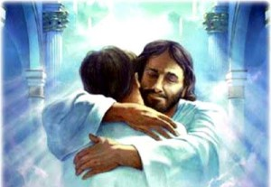
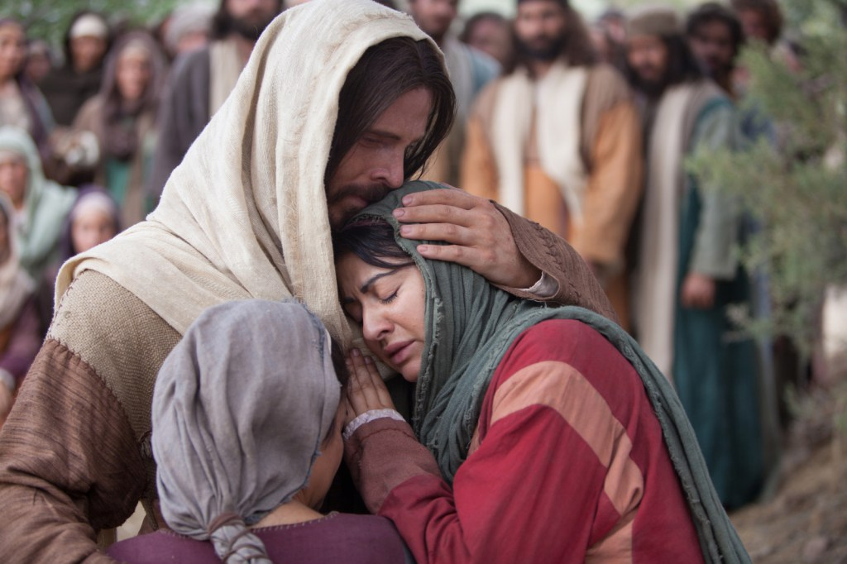
We Keep the Sabbath His Way Because We Love Him
“As I realize how much has been done for us to keep us right, I am led to exclaim, Oh, what love, what wondrous love, hath the Son of God for us poor sinners! Should we be stupid and careless while everything is being done for our salvation that can be done? All heaven is interested for us. We should be alive and awake to honor, glorify, and adore the high and lofty One. Our hearts should flow out in love and gratitude to Him who has been so full of love and compassion to us. With our lives we should honor Him, and with pure and holy conversation show that we are born from above, that this world is not our home, but that we are pilgrims and strangers here, traveling to a better country.”—EW, 113

