Slide 1
What is the Difference Between Mormons, Jehovah’s Witnesses, and Seventh-day Adventists? pt 1

Slide 2
“Are You a Mormon or Jehovah’s Witness?”
So often when passing out literature, doing evangelism, or even discussing Jesus in public, the question arises? “Are you Jehovah’s Witnesses?” or “Are you guys Mormons?”—many folks quite often judge your efforts to evangelize based on the issues they have had with these previous religions by subconsciously lumping you together. Confusion arises even more when potential students begin doing their own research, but have mistaken the literature and you for one of these other entities. These issues and more are the reason for this study.

Slide 3
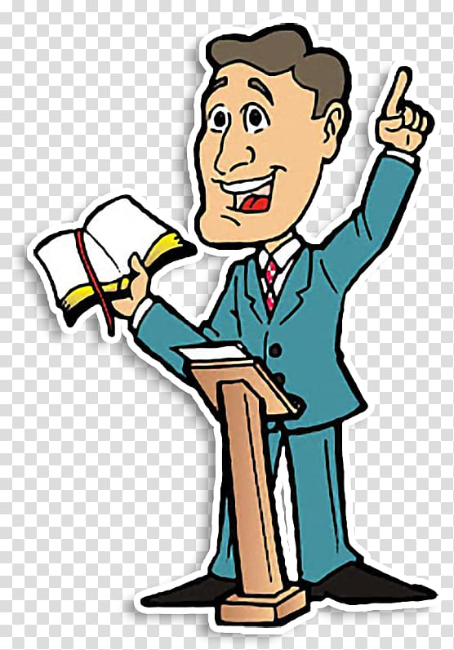
Same or Different?
The Jehovah’s Witnesses, Latter-Day Saints and Seventh-day Adventists have some obvious things in common. They all claim to be God’s true remnant last day church on earth, They all claim to have a special message and mission for the world different than other Christian Churches, and they all sprang up about the same time in history. So today as we study, we are going to unpack the differences between these entities.

Slide 4
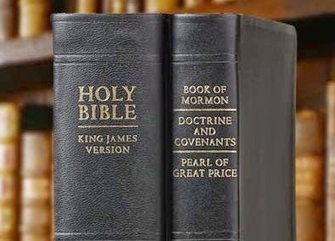
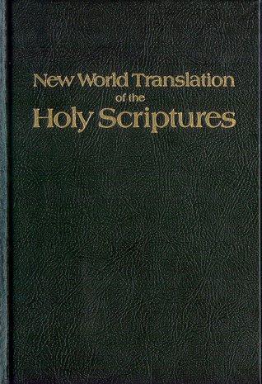
What We Will Study….
Origins of the Religion
Their Authorities and/or Authoritative Texts
Their Doctrinal Differences
Their Message to the World

Slide 5
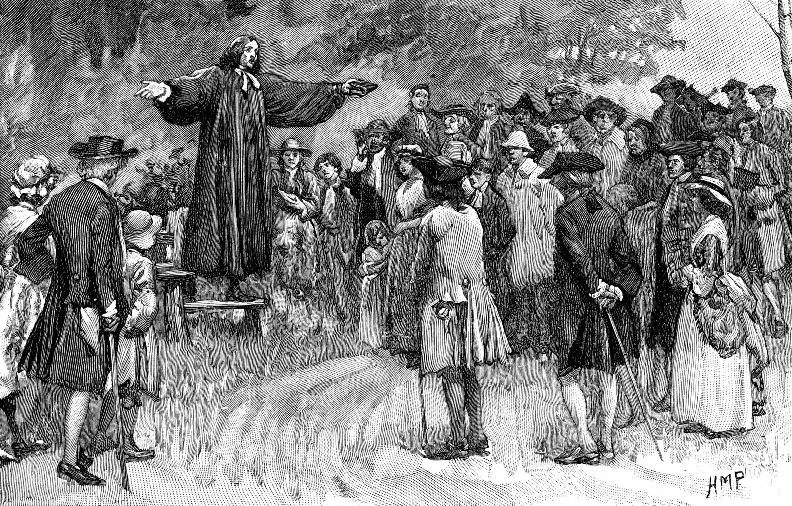
The Backdrop: The Great Awakening
“The Great Awakening came to an end sometime during the 1740s. In the 1790s, another religious revival, which became known as the Second Great Awakening, began in New England. This movement is typically regarded as less emotionally charged than the First Great Awakening. It led to the founding of several colleges, seminaries and mission societies. A Third Great Awakening was said to span from the late 1850s to the early 20th century. Some scholars, however, disagree that this movement was ever a significant event.” History.com, Great Awakening, Sept. 2019

Slide 6
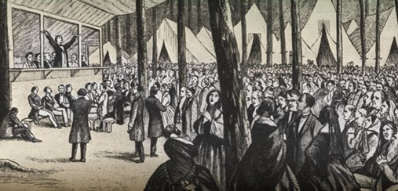
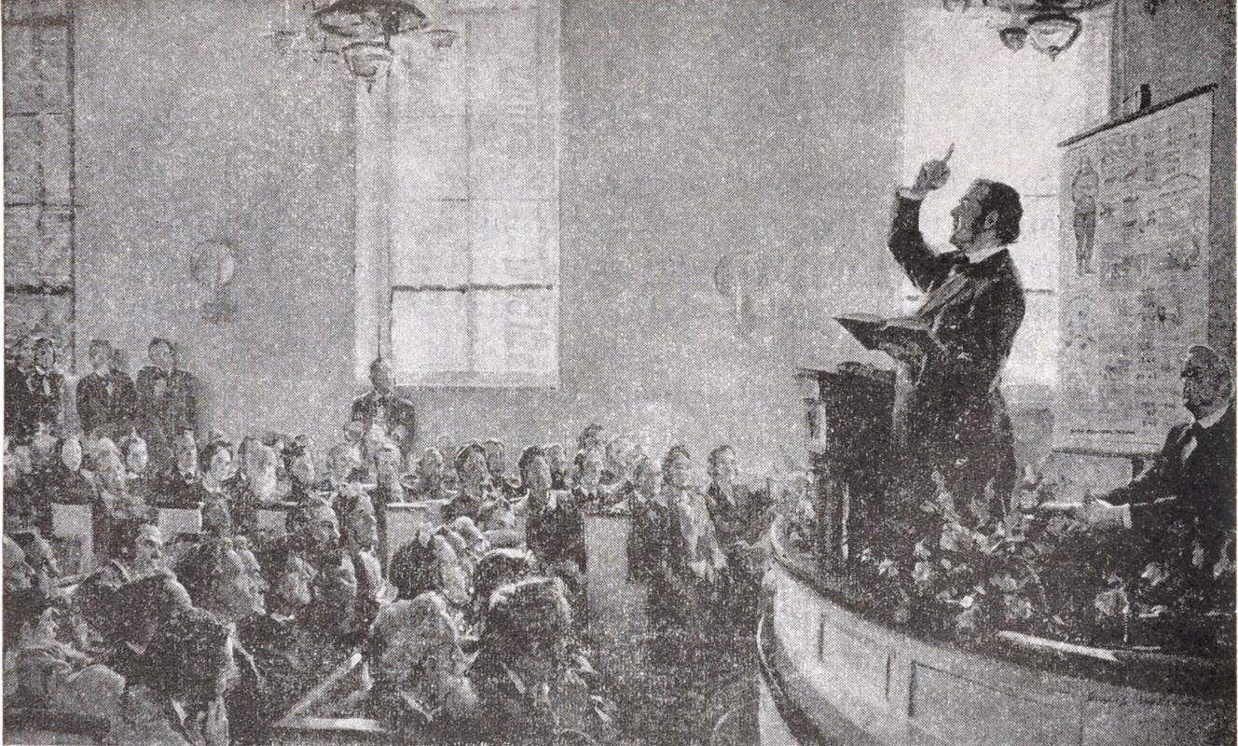
Encyclopedia Britannica
“Second Great Awakening, Protestant religious revival in the United States from about 1795 to 1835. During this revival, meetings were held in small towns and large cities throughout the country, and the unique frontier institution known as the camp meeting began. Many churches experienced a great increase in membership, particularly among Methodist and Baptist churches. The Second Great Awakening made soul-winning the primary function of ministry and stimulated several moral and philanthropic reforms, including temperance and the emancipation of women. Generally considered less emotional than the Great Awakening of the early 18th century, the second wave of evangelical revivalism led to the founding of numerous colleges and seminaries and to the organization of mission societies across the country.”—Encyclopedia Britannica Online, The Second Great Awakening

Slide 7
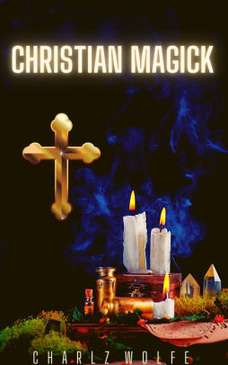
Origins of Mormonism (Latter-day Saints)
Joseph Smith (December 23, 1805-June 27, 1844) was born in Vermont. “Joseph Smith's family was typical of many early Americans who practiced various forms of Christian folk magic.”--Quinn, D. Michael (1998). Early Mormonism and the Magic World View (2nd ed.), p. 30-31. According to Wikipedia, Cunning folk magic within the Latter Day Saints is described as follows “Cunning folk traditions, sometimes referred to as folk magic, were intertwined with the early culture and practice of the Latter Day Saint movement. These traditions were widespread in unorganized religion in the parts of Europe and America where the Latter Day Saint movement began in the 1820s and 1830s. Practices of the culture included folk healing, folk medicine, folk magic, and divination, remnants of which have been incorporated or rejected to varying degrees into the liturgy, culture, and practice of modern Latter Day Saints.”

Slide 8
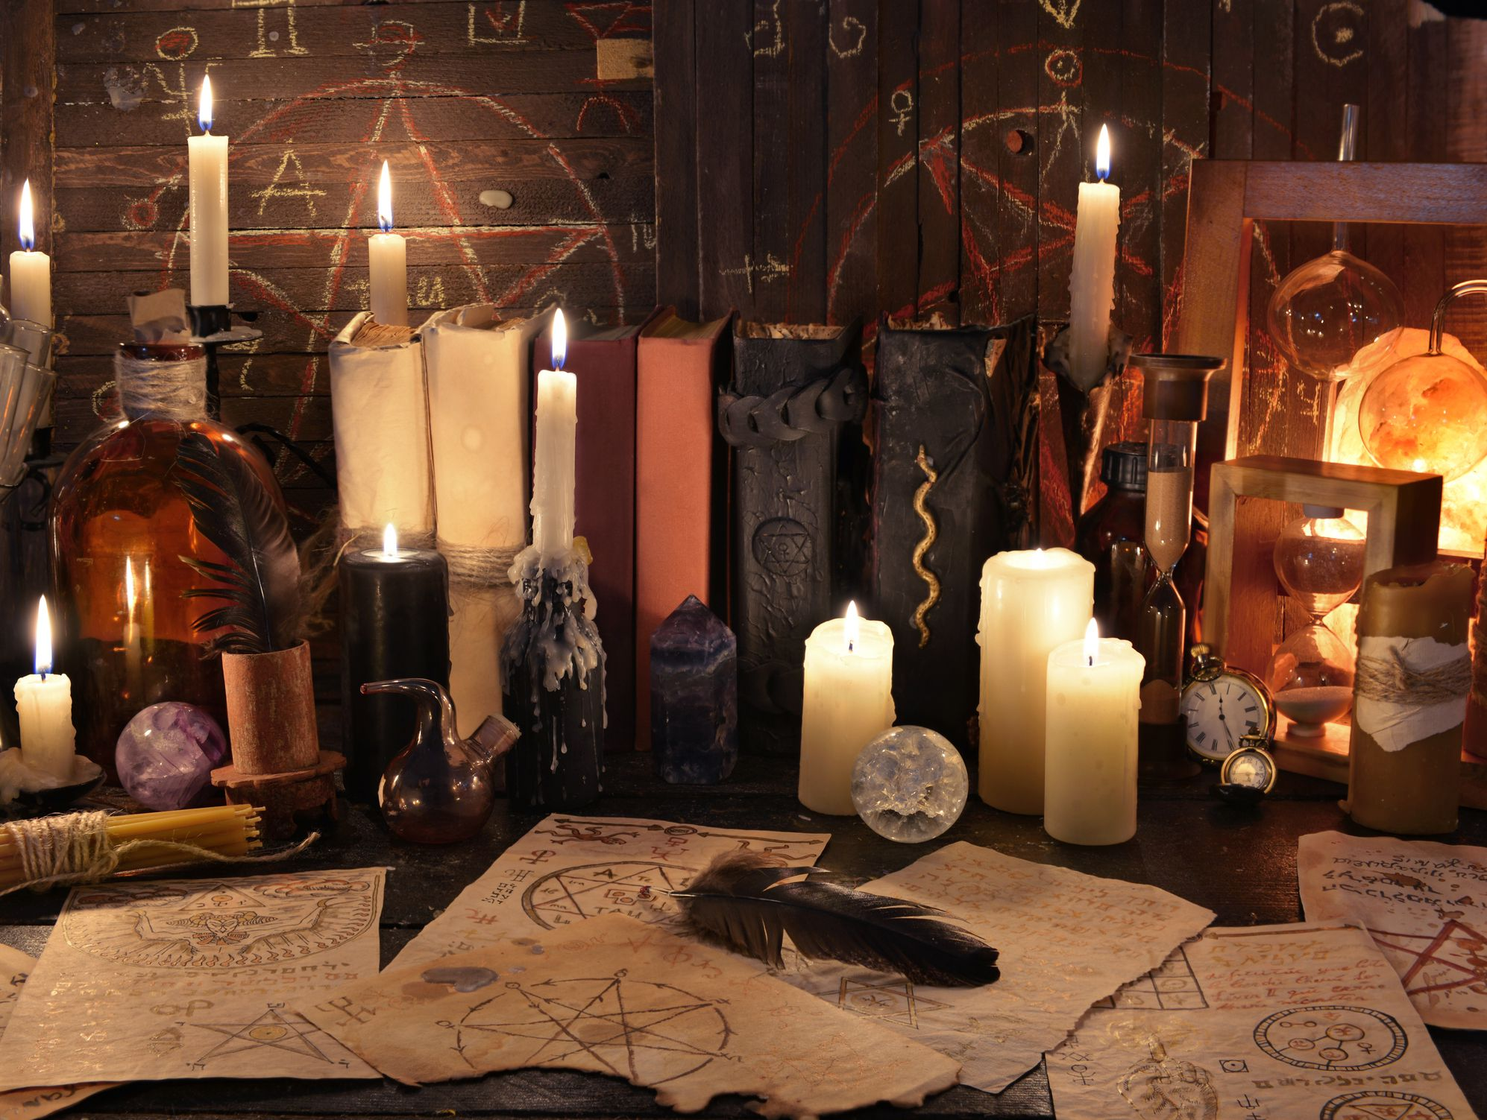
What Does the Bible Say About Practicing Folk Magic?
Deut. 18:10-14 “There shall not be found among you any one that maketh his son or his daughter to pass through the fire, or that useth divination, or an observer of times, or an enchanter, or a witch. Or a charmer, or a consulter with familiar spirits, or a wizard, or a necromancer. For all that do these things are an abomination unto the Lord: and because of these abominations the Lord thy God doth drive them out from before thee. Thou shalt be perfect with the Lord thy God. For these nations, which thou shalt possess, hearkened unto observers of times, and unto diviners: but as for thee, the Lord thy God hath not suffered thee so to do.”

Slide 9
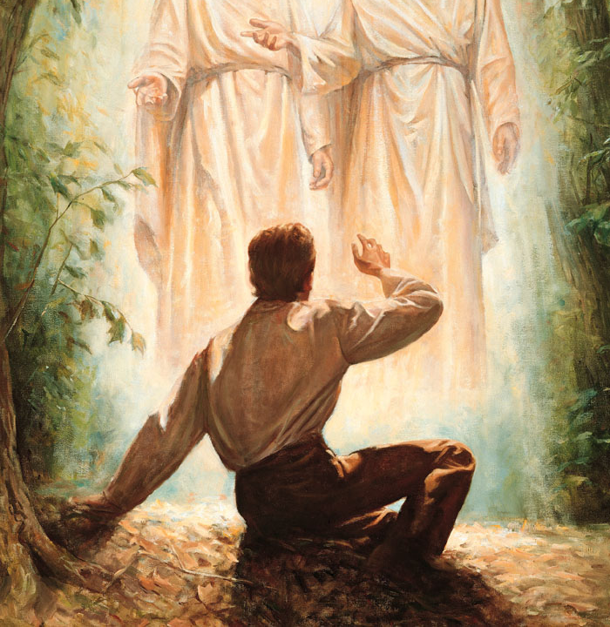
The Vision of 1820
His family was caught up in the revival movements of the day. While praying one day, in the woods, Joseph Smith received a vision of God the Father and Jesus Christ who spoke with him directly and assured him that his sins were forgiven and also told him that all contemporary churches had turned away from the Gospel. According to his testimony, he related the vision to a Methodist minister but was not believed so he kept to himself until many years later. (See Remini, Robert V. (2002). Joseph Smith, p. 37-38)

Slide 10
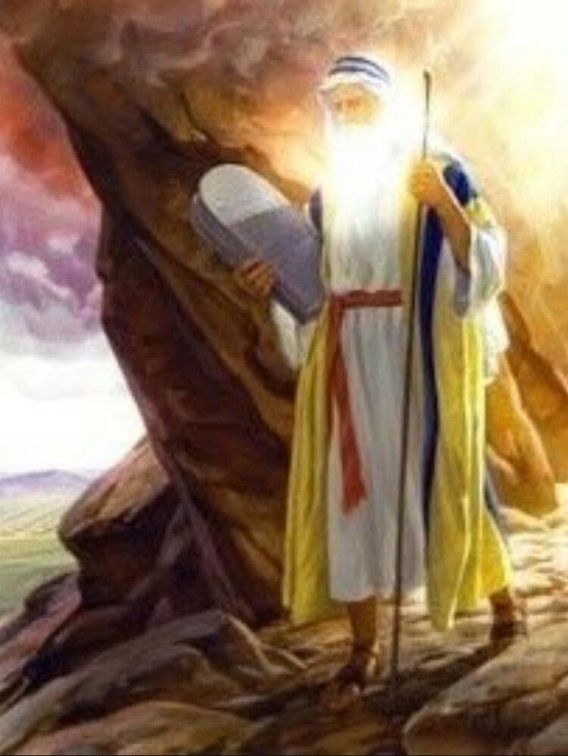
OT and NT Agree—You Cannot See God
John 1:18 “No man hath seen God at any time, the only begotten Son, which is in the bosom of the Father, he hath declared him.”
John 6:45-46 “It is written in the prophets, And they shall be all taught of God. Every man therefore that hath heard, and hath learned of the Father, cometh unto me. Not that any man hath seen the Father, save he which is of God, he hath seen the Father.
Ex. 33:17-20 “And the Lord said unto Moses, I will do this thing also that thou hast spoken: for thou hast found grace in my sight, and I know thee by name. And he said, I beseech thee, shew me thy glory. And he said, I will make all my goodness pass before thee, and I will proclaim the name of the Lord before thee; and will be gracious to whom I will be gracious, and will shew mercy on whom I will shew mercy. And he said, Thou canst not see my face: for there shall no man see me, and live.”

Slide 11
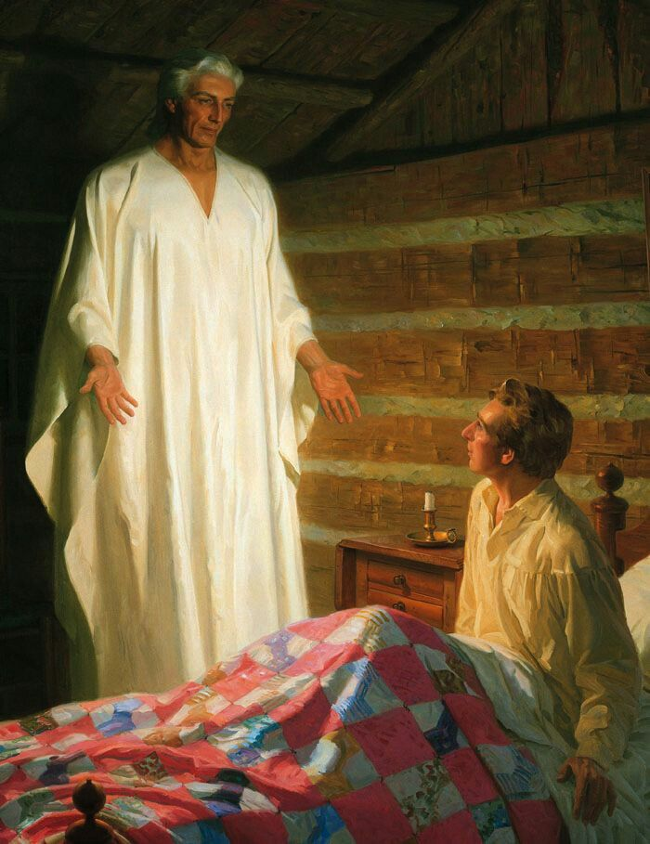
The Vision of 1823
In 1823, Joseph Smith had a strange dream where an angel appeared in his presence, named Moroni, who disclosed the location of a buried book of golden plates and other artifacts, including a breastplate and seer stones, which could be used to interpret the book made of golden plates. According to an interview with Joseph Smith’s father Joseph Smith Sr., the visitor in the vision was not an angel but all, but an old man in bloody clothes, and the name was Nephi, then later Moroni. (See Fayette Lapham, “Interview with the Father of Joseph Smith, the Mormon Prophet, Forty Years Ago. His Account of the Finding of the Sacred Plates” Historical Magazine [2nd Series] 7 (May 1870): 305-309). It wasn’t until 4 years later that he finally retrieved the golden plates.

Slide 12
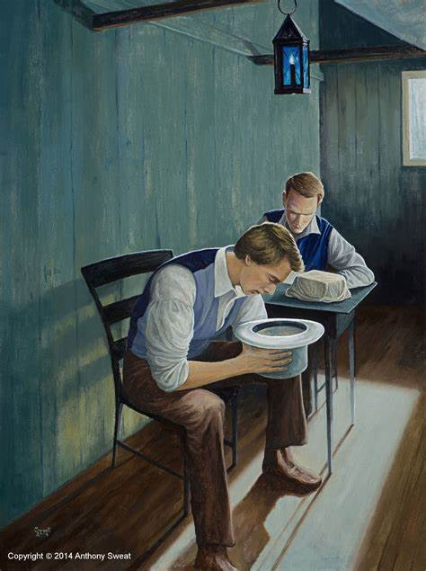
1826 Supernatural Treasure Hunter
In 1826, Joseph Smith had to try to supplement his income to help the family after the death of his brother Alvin. “Family members supplemented their meager farm income by hiring out for odd jobs and working as treasure seekers, a type of magical supernaturalism common during the period. Smith was said to have an ability to locate lost items by looking into a seer stone, which he also used in treasure hunting, including, beginning in 1825, several unsuccessful attempts to find buried treasure sponsored by Josiah Stowell, a wealthy farmer in Chenango County, New York. . . Smith was brought before a Chenango County court for "glass-looking", or pretending to find lost treasure; Stowell's relatives accused Smith of tricking Stowell and faking an ability to perceive hidden treasure” Wikipedia, Joseph Smith

Slide 13
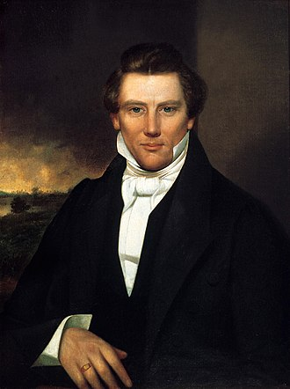
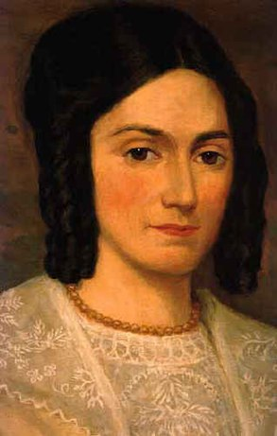
He Finally Gets the Golden Plates
“Smith made his last visit to the hill shortly after midnight on September 22, 1827, taking Emma with him. This time, he said he successfully retrieved the plates. He said the angel commanded him not to show the plates to anyone else, but to translate them and publish their translation. Smith said the plates were a religious record of Middle-Eastern indigenous Americans and were engraved in an unknown language, called reformed Egyptian. He also told associates that he was capable of reading and translating them.” Wikipedia, Joseph Smith

Slide 14
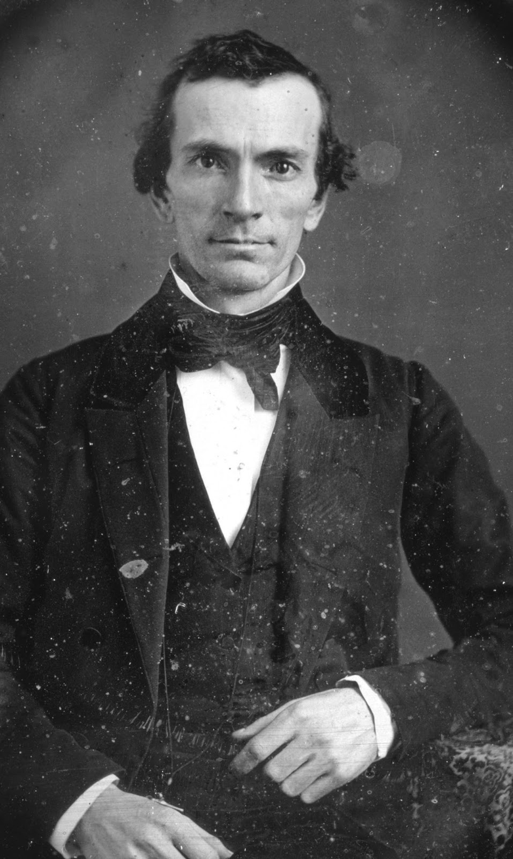
Problems for Smith
After initial hardships with the translation of the golden plates, Joseph Smith met Oliver Cowdery in 1828, who also practiced folk magic and treasure hunting. It was with him that he completed the translation of the golden plates before they were taken away by the angel Moroni. The only other “witnesses” of the plates with other followers with sworn testimony, totaling 11 (3 then 8). The translation called for baptism and an institutional church, in which Smith and Cowdery baptized each other. The completed translation called “The Book of Mormon” was published in 1830 along with the formation of “The Church of Christ”. Mob violence was kindled against both Smith and Cowdery because of his past as a fraudulent treasure hunter, and he was forced to flee New York shortly after the formation of the church. He also claimed to have had a vision of Peter, James and John at this time calling himself and Cowdery to a higher priesthood.

Slide 15
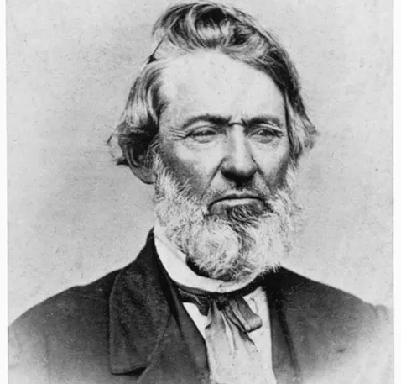
Joseph Smith: Prophet and Sole Authority
Some of Smith’s followers and fellow leaders claimed that they had received special revelations and visions, including Hiram Page and Oliver Cowdery. Shortly after, Smith received a revelation stating: “No one shall be appointed to receive commandments and revelations in this church, excepting my servant Joseph, for he receiveth them even as Moses.” (Bushman, Richard Lyman (2005). Joseph Smith: Rough Stone Rolling, p. 121)
From there, Cowdery and others were sent to be missionaries to Native Americans and to locate their “New Jerusalem”, where Cowdery met Sidney Rigdon, who was converted in Ohio along with hundreds of his followers

Slide 16
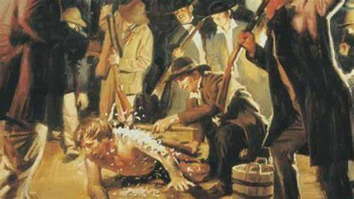
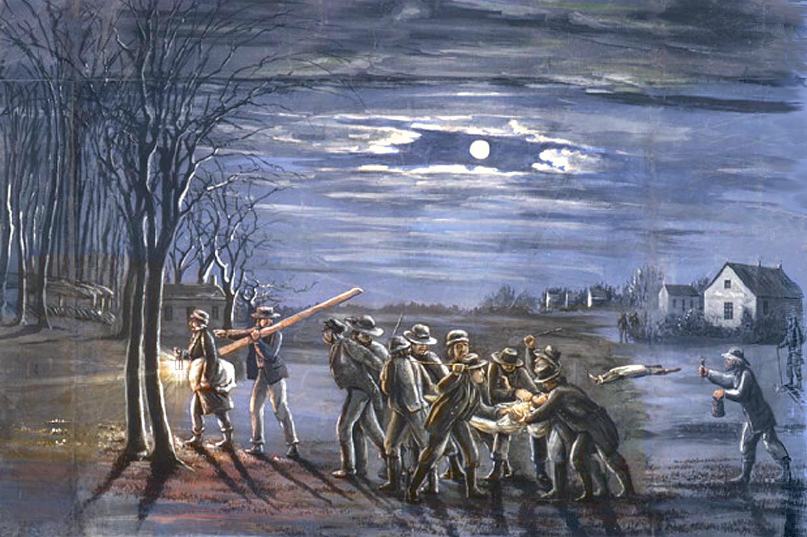
More Problems for Smith in Ohio 1831-1838
Due to the issues in New York, Joseph Smith called his followers to move together to Kritland Ohio, along with the new followers from Sidney Rigdon, which were known for extreme manifestations of spiritual gifts like speaking in tongues, going into trances and rolling on the ground. They were also communalists, which is the religious form of communism. Cowdery found the “New Jerusalem” in Jackson County, Missouri and Smith approved in 1831. However, the large numbers of Mormons in Kirtland excited more mob violence, and Smith and Rigdon were beaten, tarred and feathered and left for dead in 1832. (see Bushman (2005, pp. 178–80).

Slide 17
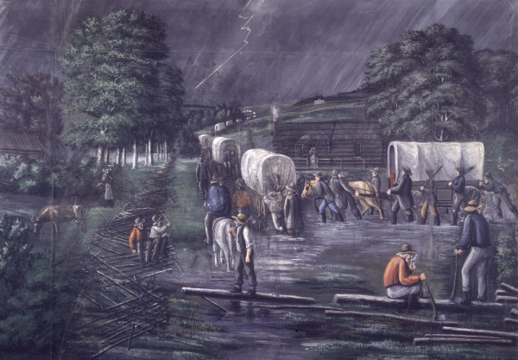
Problems in Missouri for Smith
Due to political and religious differences, the residents of Jackson County eventually became violent as well. The Mormons were expelled and their property burned. Smith responded by telling the Missouri Mormons to first bear the abuse patiently, then to take up arms. He supported their conflict by creating “Zion’s Camp” which failed in successfully defeating the Jackson County residents in their skirmishes, a cholera outbreak occurred among the Mormons at this time as well. After this, more emphasis was placed on the Kirtland Temple, but the church was greatly in debt, and internal struggles became more prominent. Cowdery accused Smith of having a sexual relationship with a teenage servant in his home named Fanny Alger (who later became one of Smith’s plural wives). (see Bushman, 2005, p. 247-328)

Slide 18
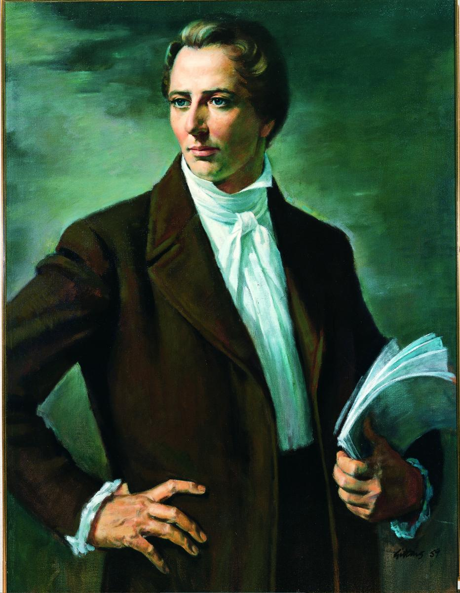
Back to Old Tricks!
In 1837, Smith and others went to Salem, Massachusetts on a treasure hunting excursion to combat their great debt, where Smith received a revelation from God that He had “much treasure in this city” (Bushman, 2005, p. 328), though he returned to Ohio empty-handed.
Deut. 18:22 “When a prophet speaketh in the name of the Lord, if the thing follow not, nor come to pass, that is the thing which the Lord hath not spoken, but the prophet hath spoken it presumptuously: thou shalt not be afraid of him.”

Slide 19
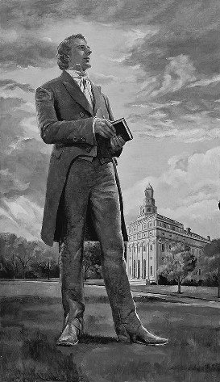
Fraudulent Bankers
“In January 1837, Smith and other church leaders created a joint stock company, called the Kirtland Safety Society Anti-Banking Company, to act as a quasi-bank; the company issued banknotes partly capitalized by real estate. Smith encouraged the Latter Day Saints to buy the notes, in which he invested heavily himself. The bank failed within a month. As a result, Latter Day Saints in Kirtland suffered extreme price volatility and intense pressure from debt collectors. Smith was held responsible for the failure, and there were widespread defections from the church, including many of Smith's closest advisers. After a warrant was issued for Smith's arrest on a charge of banking fraud, Smith and Rigdon fled Kirtland for Missouri in January 1838.” Wikipedia, Joseph Smith

Slide 20
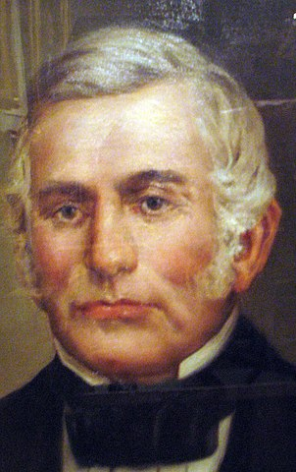
More Extreme, More Violence
By 1838, the Mormons had moved back to Missouri, but this time much further west. At this time, their name was changed to “The Church of Jesus Christ of Latter Day Saints”. Internal dissenters were removed including Cowdery, and other older members. They became known as “Dissenters”. Sampson Avard formed an internal group called the Danites, who were tasked with intimidating Mormon members who were seen to be out of line with the church or Smith and willing to take up arms against anti-Mormon groups. Hostilities broke out between the Missourians and the Mormons called the “1838 Mormon War”. By accident, the Mormons and Danites attacked a Missouri State Militia and caused the Governor Lilburn Boggs ordered that the Mormons be “exterminated or driven from the state”. Missourians surprised and killed 17 Mormons in what was later called “Haun’s Mill Massacre”. Eventually, the Mormons surrendered to 2,500 Missouri Militia (see Bushman, 2005, p. 300-365)

Slide 21
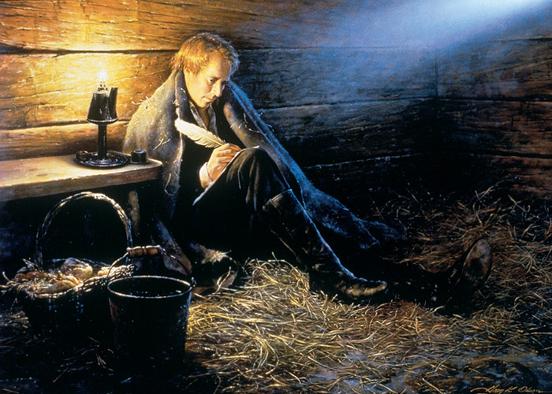
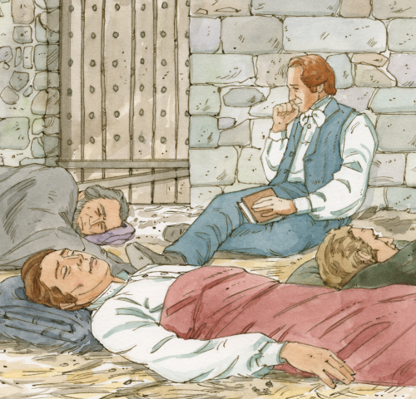
On The Run From the Law
Smith was tried with treason and sentenced to death, but was granted a hearing by the state, but charged with treason when “dissenters” testified against him. He was then held in the Liberty, Missouri Jail for 4 months. At this time, he repented of his endorsement of the Danites, and now counseled his followers to avoid hostilities with non-Mormons. Meanwhile, Brigham Young rose to prominence when he successfully moved 14,000 Mormons to Illinois and Iowa. In April of 1839, after a Grand Jury hearing in Davis County, Smith escaped from custody. It is widely believed he did this by bribing the guards with whiskey and money (Bushman, 2005, p. 375)

Slide 22
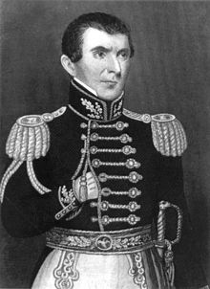
At it Again!
Life in Nauvoo, Illinois was better at first because of the disgust of parts of the nation with the event at Haun’s Mill Massacre. Illinois accepted the Mormons as residents. Smith unsuccessfully petitioned the federal government for reparations for their mistreatment. The summer of 1839 saw a malaria epidemic in Nauvoo while Brigham Young led a successful mission trip to Europe. In Illinois, Smith converted John C. Bennett, the Illinois quartermaster, who gave Smith and the Mormons city autonomy, habeas corpus control of Nauvoo, and allowed them to form a militia. Which found Bennett and Smith as its Generals, commanding the largest military force in Illinois. Bennett also became a leading official in the church and the first mayor of Nauvoo (see Bushman, 2005, p. 360-411)

Slide 23
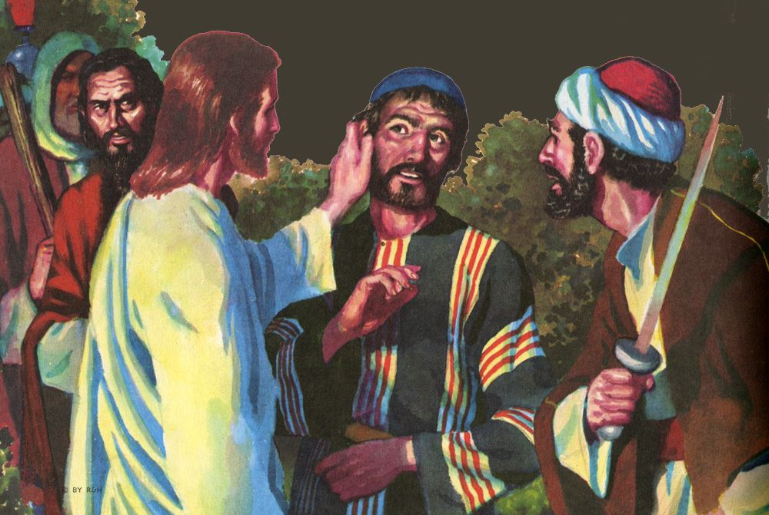
Had They Never Read?
Matt. 26:50-52 “And Jesus said unto him, Friend, wherefore art thou come? Then came they, and laid hands on Jesus and took him. And, behold, one of them which were with Jesus stretched out his hand, and drew his sword, and struck a servant of the high priest's, and smote off his ear. Then said Jesus unto him, Put up again thy sword into his place: for all they that take the sword shall perish with the sword.”

Slide 24
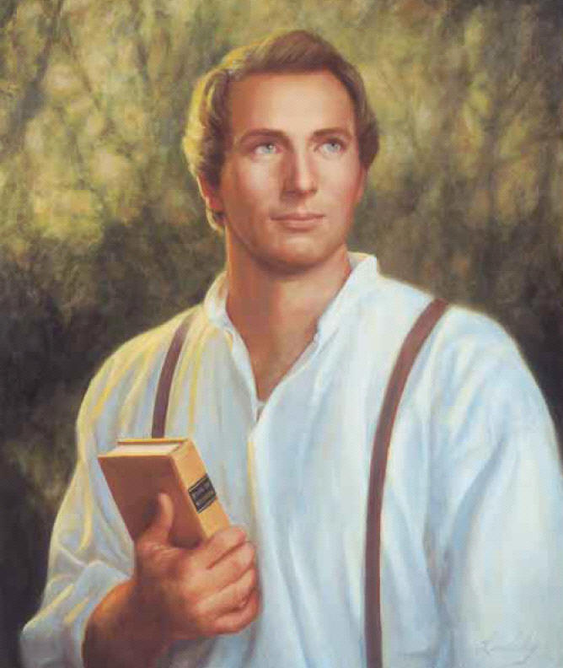
The 2nd Muhammad?
“With their backing [the Danites], this powerful force gave “The Prophet” the courage to flex his muscles. He became fierce with pride and boldness. He actually said: ‘If the people will let us alone, we will preach the gospel in peace. But if they come upon us to molest us, we will establish our religion with the sword. We will trample down our enemies and make it one gore of blood . . . From the Rocky Mountains to the Atlantic Ocean. I will be to this generation a 2nd Muhammad, whose motto in treating for peace was ‘the Al-Qur’an or the sword’ So shall it eventually be with us—’Joseph Smith or the sword!’ (see History of the Church, Vol. 3, p. 167)” Jack Chick, The Enchanter, p. 23

Slide 25
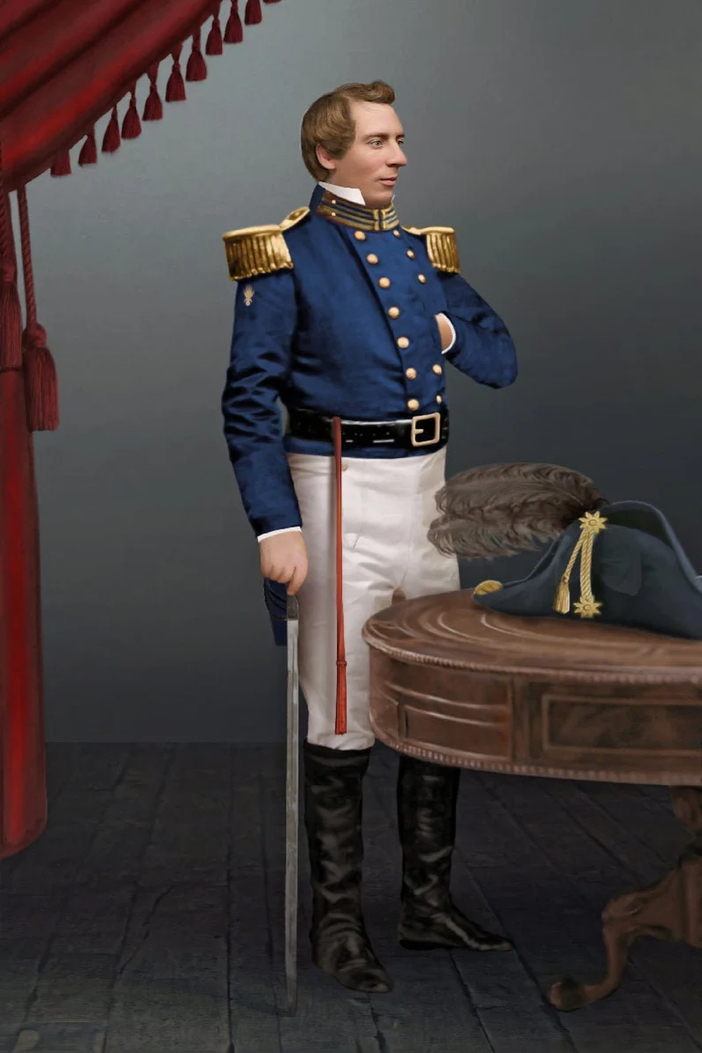
New Doctrines for Nauvoo
It was in Nauvoo that new doctrines were introduced, starting in 1840, with “Baptism for the dead”, the Nauvoo Temple, in May 1842 Smith created the “first anointing” or endowment, which was a ceremony designed to prepare Christians to be kings and queens, priests and priestesses in heaven. It highly resembled the Freemason rite of “at sight” which he had recently took 2 months prior in the Nauvoo Masonic Lodge. “At sight” is when a non-Mason is initiated into Freemasonry and immediately promoted to Master Mason by the power of a Grand Master. Moreover, Zion was no longer to be built in a specific place but all of North and South America was to be the New Zion, with each local church representing a tent “stake” in that region (see Bushman, 2005, 350-410)

Slide 26
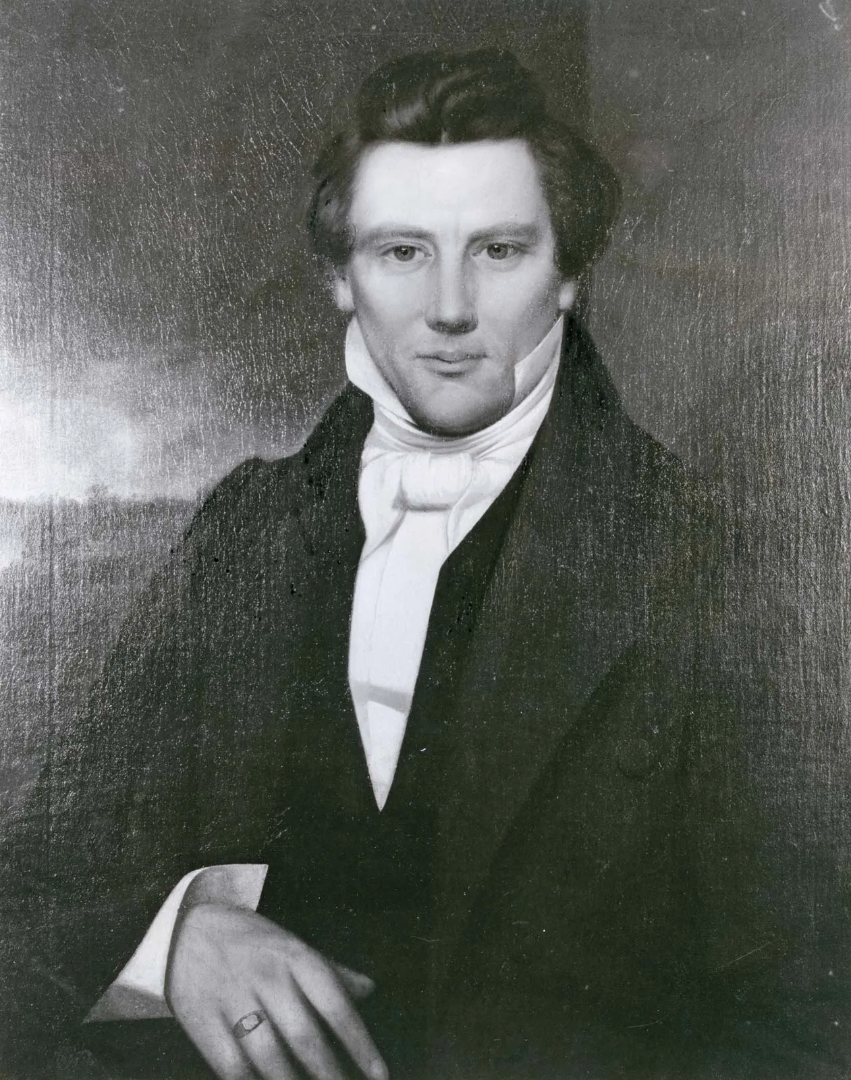
Freemasonry and Protestantism??
Eph. 5:11 “And have no fellowship with the unfruitful works of darkness, but rather reprove them.”
2 Cor. 6:14-17 “Be ye not unequally yoked together with unbelievers: for what fellowship hath righteousness with unrighteousness? and what communion hath light with darkness? And what concord hath Christ with Belial? or what part hath he that believeth with an infidel? And what agreement hath the temple of God with idols? for ye are the temple of the living God; as God hath said, I will dwell in them, and walk in them; and I will be their God, and they shall be my people. Wherefore come out from among them, and be ye separate, saith the Lord, and touch not the unclean thing; and I will receive you.”

Slide 27
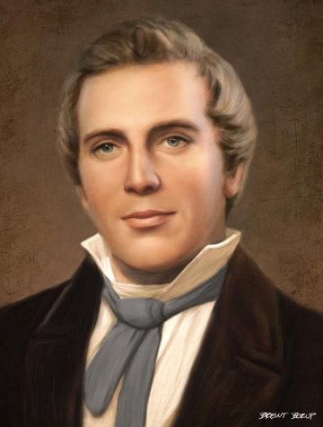
More Insanity
In Summer 1842, he revealed plans to establish Theocratic rule over the earth, setting us God’s Millennial Kingdom. He also married many additional wives during this time, called “plural marriage”. In the beginning, he kept the doctrine secret, except to John Bennett, who called it spiritual wifery. However, when polygamy rumors went abroad, Smith forced Bennett to resign as mayor of Nauvoo, which made Bennett his open enemy. Eventually, Mormon hatred became prevalent again, and an assassination attempt against Missouri Governor Boggs, led to the order to extradite Smith, which failed, but later old charges of treason which were never resolved rekindled the extradition order. Smith was handed over by Illinois Governor Thomas Ford in 1843 but intercepted by Mormons before he could get back to Missouri (see Bushman, 2005, p. 400-508)

Slide 28
Smith for President
In 1843, Smith petitioned Congress to make Illinois a territory with the right to call out federal troops to its defense, which was denied. Smith then petitioned Presidential candidates for commitments to protect the Mormons, but when he received negative comments back, he announced his independent bid to run for President of the United States! He suspended proselytizing and sent Mormons as political missionaries. By 1844, a rift between Smith and his two powerful followers William Law and Robert Foster occurred when it was discovered that Smith had allegedly attempted to seduce their wives and add them to his plural marriage companions. He promptly excommunicated them on April 18, 1844 (see Ostling, Richard; Ostling, Joan K. (1999). Mormon America: The Power and the Promise, p. 14)

Slide 29
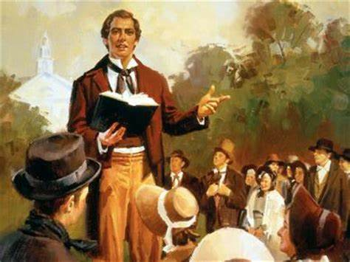
Joseph Strikes Back!
“Scandal broke out! It was Joseph Smith against the men whose wives he had abused. (He called those men “Apostates”). In an explosive sermon he bragged: ‘I’m the only man that has been able to keep a whole Church together since the days of Adam! I boast that no man ever did such as I. The followers of Jesus ran away from Him . . . But the Latter Day Saints never ran away from me . . . Yet!’ (see History of the Church, Vol. 6 p. 408-409)” Jack Chick, The Enchanter, p. 27

Slide 30
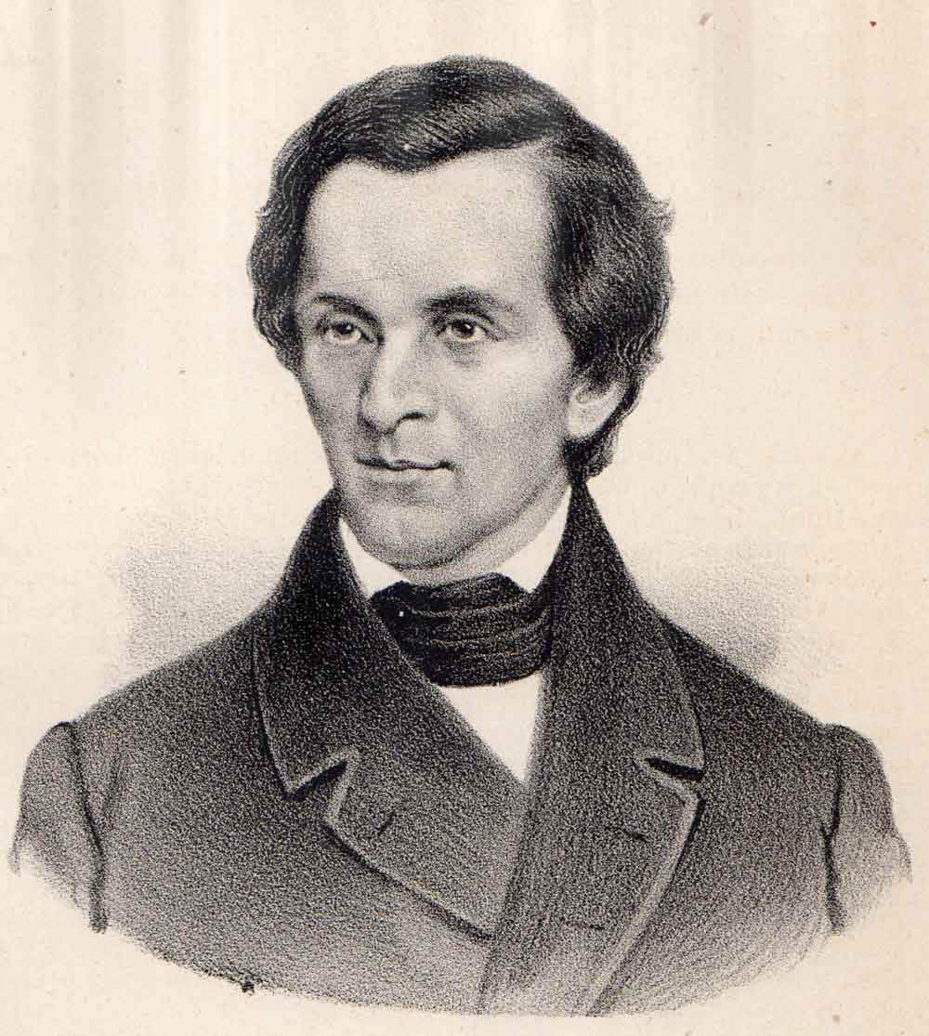
The End…
By June of 1844, The Dissenters published the Nauvoo Expositor calling for reforms within the church but also requesting political assistance from non-Mormons in the area to repeal the Nauvoo Charter, making void the political stranglehold that Mormons had in Nauvoo. The Nauvoo Legion (the autonomous militia of Nauvoo) was ordered at the direction of Smith to destroy the press, making freedom of the press effectively illegal in Nauvoo. This act, brought a call to arms from a critic of Joseph Smith, and as a result the Nauvoo Legion was mobilized and martial law declared in Nauvoo. This caused the state militia under Governor Thomas Ford to force Smith and the Nauvoo council to surrender, which after initially fleeing they eventually did (see Ostling, Richard; Ostling, Joan K. (1999). Mormon America: The Power and the Promise, p. 16)

Slide 31
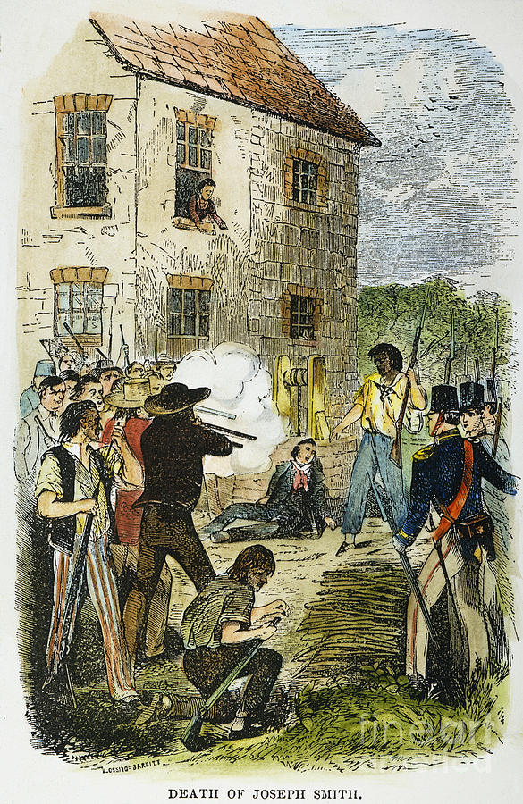
By the Sword…
On June 25th 1844, Joseph Smith, his brother Hyrum, and other willing followers were in custody of Carthage, Illinois. On June 27, 1844 a mob with blackened faces stormed Carthage Jail, and shot Hyrum in the face, and shot Joseph Smith as he fell out of a window, where he was shot more once he hit the ground before the mob dispersed. He was screaming ‘Oh Lord, my God!’ before he hit the ground. 5 men were charged with his murder but all were acquitted due to identification factors. At that point, Brigham Young became the new Mormon leader, expanding LDS doctrines, and making new settlements in Salt Lake Valley in Utah. Other groups who did not agree with Young as the appointment splintered into smaller Mormon groups, some went with Sidney Rigdon and James J Strang, others went to Texas with Lyman Wight (see Bushman 2005, p. 500-600

Slide 32
Very Successful
Overland Monthly, January 1910 p. 130: "As a writer, Mr. Russell's books have enjoyed a larger circulation than any English work ... Of his work entitled 'Studies in the Scriptures,' the average output is two thousand three hundred copies for each working day. We regret the records of 1909 are not yet complete, but in 1908 seven hundred and twenty-eight thousand, four hundred and seventy-four volumes were sold. Since publication, three million five hundred and thirty-four thousand volumes have been circulated. Last year, in addition to these there were three hundred and eight million pages of his tracts circulated. In all literature the Bible is about the only book that has had a larger circulation ... In the literature of the world, the order would probably be as follows: The Bible, the Chinese Almanac, the 'Studies in the Scriptures,' 'Don Quixote,' 'Uncle Tom's Cabin' and Hubbard's 'Message to Garcia.'"

Slide 33
End of the World in 1914
Be not surprised, then, when in subsequent chapters we present proofs that the setting up of the Kingdom of God is already begun, that it is pointed out in prophecy as due to begin the exercise of power in A. D. 1878, and that the < < battle of the great day of God Almighty'' (Rev. 16:14.), which will end in A. D. 1914 with the complete overthrow of earth's present rulership, is already commenced. The gathering of the armies is plainly visible from the standpoint of God's Word.” Russell, The Time is at Hand, p. 101

Slide 34
2520 is the Basis!
The Bible evidence is clear and strong that the "Times of the Gentiles'' is a period of 2520 years, from the year B. C. 606 to and including A. D. 1914. This lease of universal dominion to Gentile governments, as we have already seen, began with Nebuchadnezzar—not when his reign began, but when the typical kingdom of the Lord passed away, and the dominion of the whole world was left in the hands of the Gentiles.

Slide 35
No Gospel Preached to the Jews!?
In 1910 Pastor Russell received a letter from a committee of Jewish leaders:
"Dear Sir: Your Sympathetic interest in the Jewish people for years past has not escaped our notice. Your denunciation of the atrocities perpetrated against our race in the name of Christianity has added to our conviction that you are a sincere friend," wrote the committee members.
"Your discourse on “Jerusalem and Jewish Hopes” has struck a responsive chord in the hearts of many of our people. Still we doubted for a time if any Christian minister could really be interested in a Jew as a Jew and merely from a hope of proselyting him…You may well understand how surprised we are to find a Christian minister acknowledging that there are prophecies of the Bible still fulfilled, which belong to the Jew and not to the Christian…
"These things, Pastor Russell, have led to the formation of a Jewish Mass Meeting Committee, which by this letter, request you to give a public discourse," they concluded.
The pastor acceded and on October 9, 1910 gave a talk titled “Zionism in Prophecy” before an audience of about 4,000 Jews at the Hippodrome, New York's largest and finest auditorium at the time.
As The New York American reported on that day, “The unusual spectacle of 4,000 Hebrews enthusiastically applauding a Gentile preacher, after having listened to a sermon he addressed to them concerning their own religion…where Pastor Russell, the famous head of the Brooklyn Tabernacle conducted a most unusual service. It was not long before all reserve, and all possible doubt of Pastor Russell’s entire sincerity and friendliness were worn away. Then the mention of the name of a great leader [Herzl] who, the speaker declared, had been raised by God for the cause -- brought a burst of applause."
Russell held similar mass meetings in Chicago, Philadelphia, St. Louis, Kansas City and Cincinnati. In England he addressed 4,600 Jews in London's Royal Albert Hall, following which he appeared in Glasgow and Manchester, then gave talks in other European cities with large Jewish populations, including Vienna, Berlin, Krakow and Budapest.” HAARETZ.com, Before Herzl, There Was Pastor Russell: A Neglected Chapter of Zionism, Philippe Bohstrom, Aug. 22, 2018

Slide 36
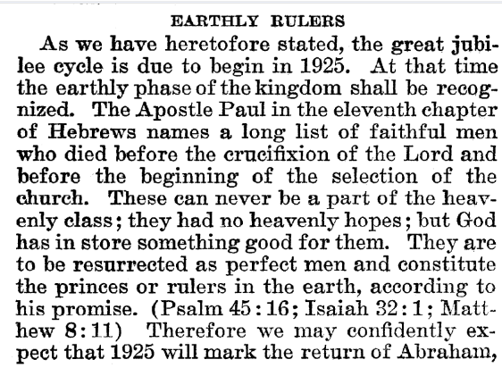
Rutherford Predicts Return of Abraham
Joseph F. Rutherford, (1920): Millions Now Living Will Never Die! p. 89-90

Slide 37
Time-setting Again! 1975
"Choosing the Best Way of Life". The Watchtower. March 15, 1980. pp. 17–18. With the appearance of the book Life Everlasting—in Freedom of the Sons of God, ... considerable expectation was aroused regarding the year 1975. ... there were other statements published that implied that such realization of hopes by that year was more of a probability than a mere possibility. It is to be regretted that these latter statements apparently overshadowed the cautionary ones and contributed to a buildup of the expectation already initiated. ... persons having to do with the publication of the information ... contributed to the buildup of hopes centered on that date.
"What will the 1970's Bring?". Awake!. Watch Tower Society. October 8, 1968. p. 14. Does this mean that the above evidence positively points to 1975 as the complete end of this system of things? Since the Bible does not specifically state this, no man can say... If the 1970s should see intervention by Jehovah God to bring an end to a corrupt world drifting toward ultimate disintegration, that should surely not surprise us.
"How Are You Using Your Life?". Our Kingdom Ministry. May 1, 1974. p. 63. Reports are heard of brothers selling their homes and property and planning to finish out the rest of their days in this old system in the pioneer service. Certainly, this is a fine way to spend the short time remaining before the wicked world's end.

Slide 38
Decline of the Watch Tower After Death
Chicago Daily Tribune October 30, 1949 pg 18: "Pastor Russell died in 1916. In the 33 years since, the methods of this sect have deviated completely from those of Pastor Russell and his manner of teaching."

