Slide 1
Daniel, chapter 4
‘Conversion of a Crazy King’

Slide 2
“Study Nebuchadnezzar’s dream as recorded in the fourth chapter of Daniel. The king saw a lofty tree planted in the earth. Flocks and herds from the mountains and hills enjoyed its shelter, and the birds of the air built their nests in its branches. Thus were represented Nebuchadnezzar’s greatness and prosperity. Nations were gathered under his sovereignty. His kingdom was firmly established in the hearts of his loyal subjects.
The king saw his prosperity, and because of it he was lifted up. Notwithstanding the warnings that God had given him, he did the very things which the Lord had told him not to do. He looked upon his kingdom with pride and exclaimed: “Is not this great Babylon, that I have built for the house of the kingdom by the might of my power, and for the honor of my majesty?” Daniel 4:30. The instant that the words were uttered, the sentence of judgment was pronounced. The king’s reason was taken away. The judgment that he had thought so perfect, the wisdom that he had prided himself on possessing, were removed. The jewel of the mind, that which elevates man above the beasts, he no longer retained.” 8T 126

Slide 3
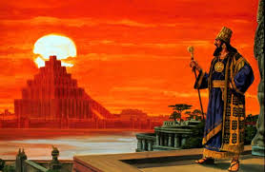
Nebuchadnezzar
Nebuchadnezzar is quite a study. The Bible elucidates many of his qualities.
1. conqueror (Dan. 1:1,2)
2. highly intelligent (Dan. 1:18-20)
3. opulently wealthy (Isa. 13:19; Isa. 14:4)
4. builder, engineer (Dan. 4:30)

Slide 4
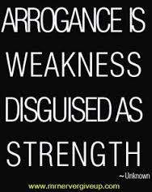
A Proud Man!
Nebuchadnezzar had so much going for him. All of these things were used by the devil to exalt himself in his own mind! We know the king became utterly arrogant and boastful. “The king spake, and said, Is not this great Babylon, that I have built for the house of the kingdom by the might of my power, and for the honour of my majesty?” Dan. 4:30

Slide 5
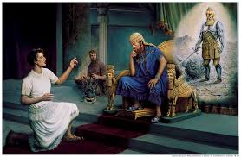
The Lord Tries
For 34 years! “And in the second year of the reign of Nebuchadnezzar dreamed..” “The king answered unto Daniel, and said, Of a truth it is, that your God is a God of gods, and a Lord of kings, and a revealer of secrets, seeing thou couldest reveal this secret.” Dan. 2:47
God speaks, but he says ‘your God’.

Slide 6
For a While
“The king had acknowledged the power of God, saying to Daniel, "Of a truth it is, that your God is a God of gods, . . . and a revealer of secrets." Verse 47. For a time afterward, Nebuchadnezzar was influenced by the fear of God; but his heart was not yet cleansed from worldly ambition and a desire for self-exaltation. The prosperity attending his reign filled him with pride. In time he ceased to honor God, and resumed his idol worship with increased zeal and bigotry. The words, "Thou art this head of gold," had made a deep impression upon the ruler's mind.” PK, pgs. 503, 504

Slide 7
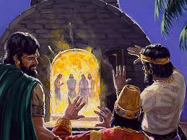
Again!
“Then Nebuchadnezzar spake, and said, Blessed be the God of Shadrach, Meshach, and Abednego, who hath sent his angel, and delivered his servants that trusted in him, and have changed the king's word, and yielded their bodies, that they might not serve nor worship any god, except their own God.” Dan. 3: 28

Slide 8
Impressed, but not Committed!
“An idolater by birth and training, and at the head of an idolatrous people, he had nevertheless an innate sense of justice and right, and God was able to use him as an instrument for the punishment of the rebellious and for the fulfillment of the divine purpose. "The terrible of the nations" (Ezekiel 28:7), it was given Nebuchadnezzar, after years of patient and wearing labor, to conquer Tyre; Egypt also fell a prey to his victorious armies; and as he added nation after nation to the Babylonian realm, he added more and more to his fame as the greatest ruler of the age. It is not surprising that the successful monarch, so ambitious and so proud-spirited, should be tempted to turn aside from the path of humility, which alone leads to true greatness. In the intervals between his wars of conquest he gave much thought to the strengthening and beautifying of his capital, until at length the city of Babylon became the chief glory of his kingdom, "the golden city," "the praise of the whole earth." His passion as a builder, and his signal success in making Babylon one of the wonders of the world, ministered to his pride, until he was in grave danger of spoiling his record as a wise ruler whom God could continue to use as an instrument for the carrying out of the divine purpose. “ PK, pgs. 514, 515

Slide 9
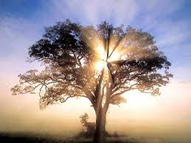
A Final Warning
God loved the king and wanted to save him from himself. He had done some amazing things for him, but the king was very proud and self-satisfied. God would speak to him again!

Slide 10
Cast Aside the Warning!
“In the providence of God, Nebuchadnezzar was given ample opportunity to ascribe to the Lord the glory for the splendor of his reign. And for a time after the vision of the great image, he acknowledged God as supreme. Falling back into idolatrous habits, he was again, by the miraculous deliverance of the three Hebrews from the fiery furnace, led to acknowledge that God’s “kingdom is an everlasting kingdom, and his dominion is from generation to generation.” But once more the king perverted the warnings God had given him, and turned aside from the path of humility to follow the imaginations of his naturally proud heart. Thinking that his kingdom should be more extensive and powerful than any that would follow, he made great additions to the city of Babylon, and gave himself up to a life of pleasure and self-glorification. Of this time he himself says: “I Nebuchadnezzar was at rest in mine house, and flourishing in my palace.” (YI October 11, 1904)

Slide 11
Warning!
“Thus were the visions of mine head in my bed; I saw, and behold a tree in the midst of the earth, and the height thereof was great. The tree grew, and was strong, and the height thereof reached unto heaven, and the sight thereof to the end of all the earth: The leaves thereof were fair, and the fruit thereof much, and in it was meat for all: the beasts of the field had shadow under it, and the fowls of the heaven dwelt in the boughs thereof, and all flesh was fed of it. I saw in the visions of my head upon my bed, and, behold, a watcher and an holy one came down from heaven; He cried aloud, and said thus, Hew down the tree, and cut off his branches, shake off his leaves, and scatter his fruit: let the beasts get away from under it, and the fowls from his branches: Nevertheless leave the stump of his roots in the earth, even with a band of iron and brass, in the tender grass of the field; and let it be wet with the dew of heaven, and let his portion be with the beasts in the grass of the earth: Let his heart be changed from man's, and let a beast's heart be given unto him; and let seven times pass over him. This matter is by the decree of the watchers, and the demand by the word of the holy ones: to the intent that the living may know that the most High ruleth in the kingdom of men, and giveth it to whomsoever he will, and setteth up over it the basest of men.” Daniel 4:10-17

Slide 12
God Loved Him
“ Wherefore, O king, let my counsel be acceptable unto thee, and break off thy sins by righteousness, and thine iniquities by shewing mercy to the poor; if it may be a lengthening of thy tranquillity.” Dan. 4:27

Slide 13
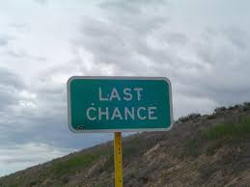
One Last Time!
Truly amazing how many times the Lord sought to reach the king! We saw in Dan. 2, Daniel 3, and now in Daniel 4. 3 powerful attempts to reach the king have been put into operation. God seeks to save him from himself!

Slide 14
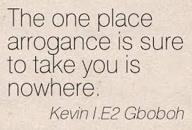
Arrogance Took Nebuchadnezzar down!
The king spake, and said, Is not this great Babylon, that I have built for the house of the kingdom by the might of my power, and for the honour of my majesty? While the word was in the king's mouth, there fell a voice from heaven, saying, O king Nebuchadnezzar, to thee it is spoken; The kingdom is departed from thee. And they shall drive thee from men, and thy dwelling shall be with the beasts of the field: they shall make thee to eat grass as oxen, and seven times shall pass over thee, until thou know that the most High ruleth in the kingdom of men, and giveth it to whomsoever he will.” Daniel 4:30-32

Slide 15
“Let men become lifted up in pride, and the Lord will not sustain them and keep them from falling. Let a church become proud and boastful, not depending on God, not exalting His power, and that church will surely be left by the Lord, to be brought down to the ground. Let a people glory in wealth, intellect, knowledge, or in anything but Christ, and they will soon be brought to confusion.” 8T 127

Slide 16
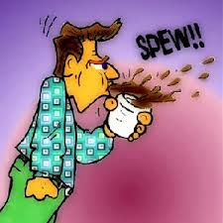
Nebuchadnezzar is Laodicea
“I know thy works, that thou art neither cold nor hot: I would thou wert cold or hot. So then because thou art lukewarm, and neither cold nor hot, I will spue thee out of my mouth. Because thou sayest, I am rich, and increased with goods, and have need of nothing; and knowest not that thou art wretched, and miserable, and poor, and blind, and naked:” Rev. 3:15-17

Slide 17
Victory
“And at the end of the days I Nebuchadnezzar lifted up mine eyes unto heaven, and mine understanding returned unto me, and I blessed the most High, and I praised and honoured him that liveth for ever, whose dominion is an everlasting dominion, and his kingdom is from generation to generation:…At the same time my reason returned unto me; and for the glory of my kingdom, mine honour and brightness returned unto me; and my counsellors and my lords sought unto me; and I was established in my kingdom, and excellent majesty was added unto me. Now I Nebuchadnezzar praise and extol and honour the King of heaven, all whose works are truth, and his ways judgment: and those that walk in pride he is able to abase.” Dan. 4:34-37

Slide 18
Saved at Last!
“The once proud monarch had become a humble child of God; the tyrannical, overbearing ruler, a wise and compassionate king. He who had defied and blasphemed the God of heaven, now acknowledged the power of the Most High and earnestly sought to promote the fear of Jehovah and the happiness of his subjects. Under the rebuke of Him who is King of kings and Lord of lords, Nebuchadnezzar had learned at last the lesson which all rulers need to learn—that true greatness consists in true goodness. He acknowledged Jehovah as the living God, saying, “I Nebuchadnezzar praise and extol and honor the King of heaven, all whose works are truth, and His ways judgment: and those that walk in pride He is able to abase.” PK 521

