Slide 1
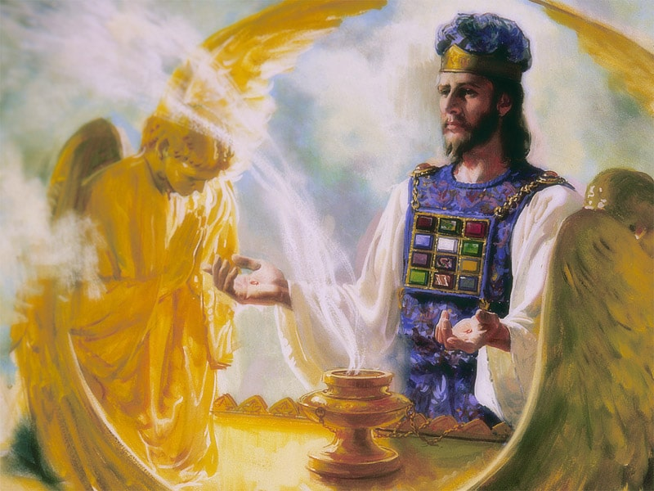
The Sanctuary pt 70: The Day of Atonement 17: The Third Coming and Final Punishment

Slide 2
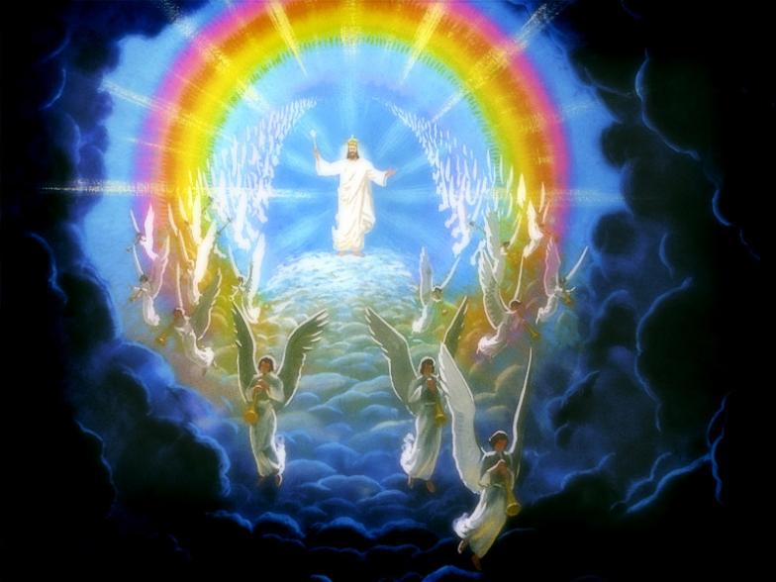
The Third Coming…
Zech. 14:1-4 “Behold, the day of the Lord cometh, and thy spoil shall be divided in the midst of thee. For I will gather all nations against Jerusalem to battle; and the city shall be taken, and the houses rifled, and the women ravished; and half of the city shall go forth into captivity, and the residue of the people shall not be cut off from the city. Then shall the Lord go forth, and fight against those nations, as when he fought in the day of battle. And his feet shall stand in that day upon the mount of Olives, which is before Jerusalem on the east, and the mount of Olives shall cleave in the midst thereof toward the east and toward the west, and there shall be a very great valley; and half of the mountain shall remove toward the north, and half of it toward the south.”

Slide 3
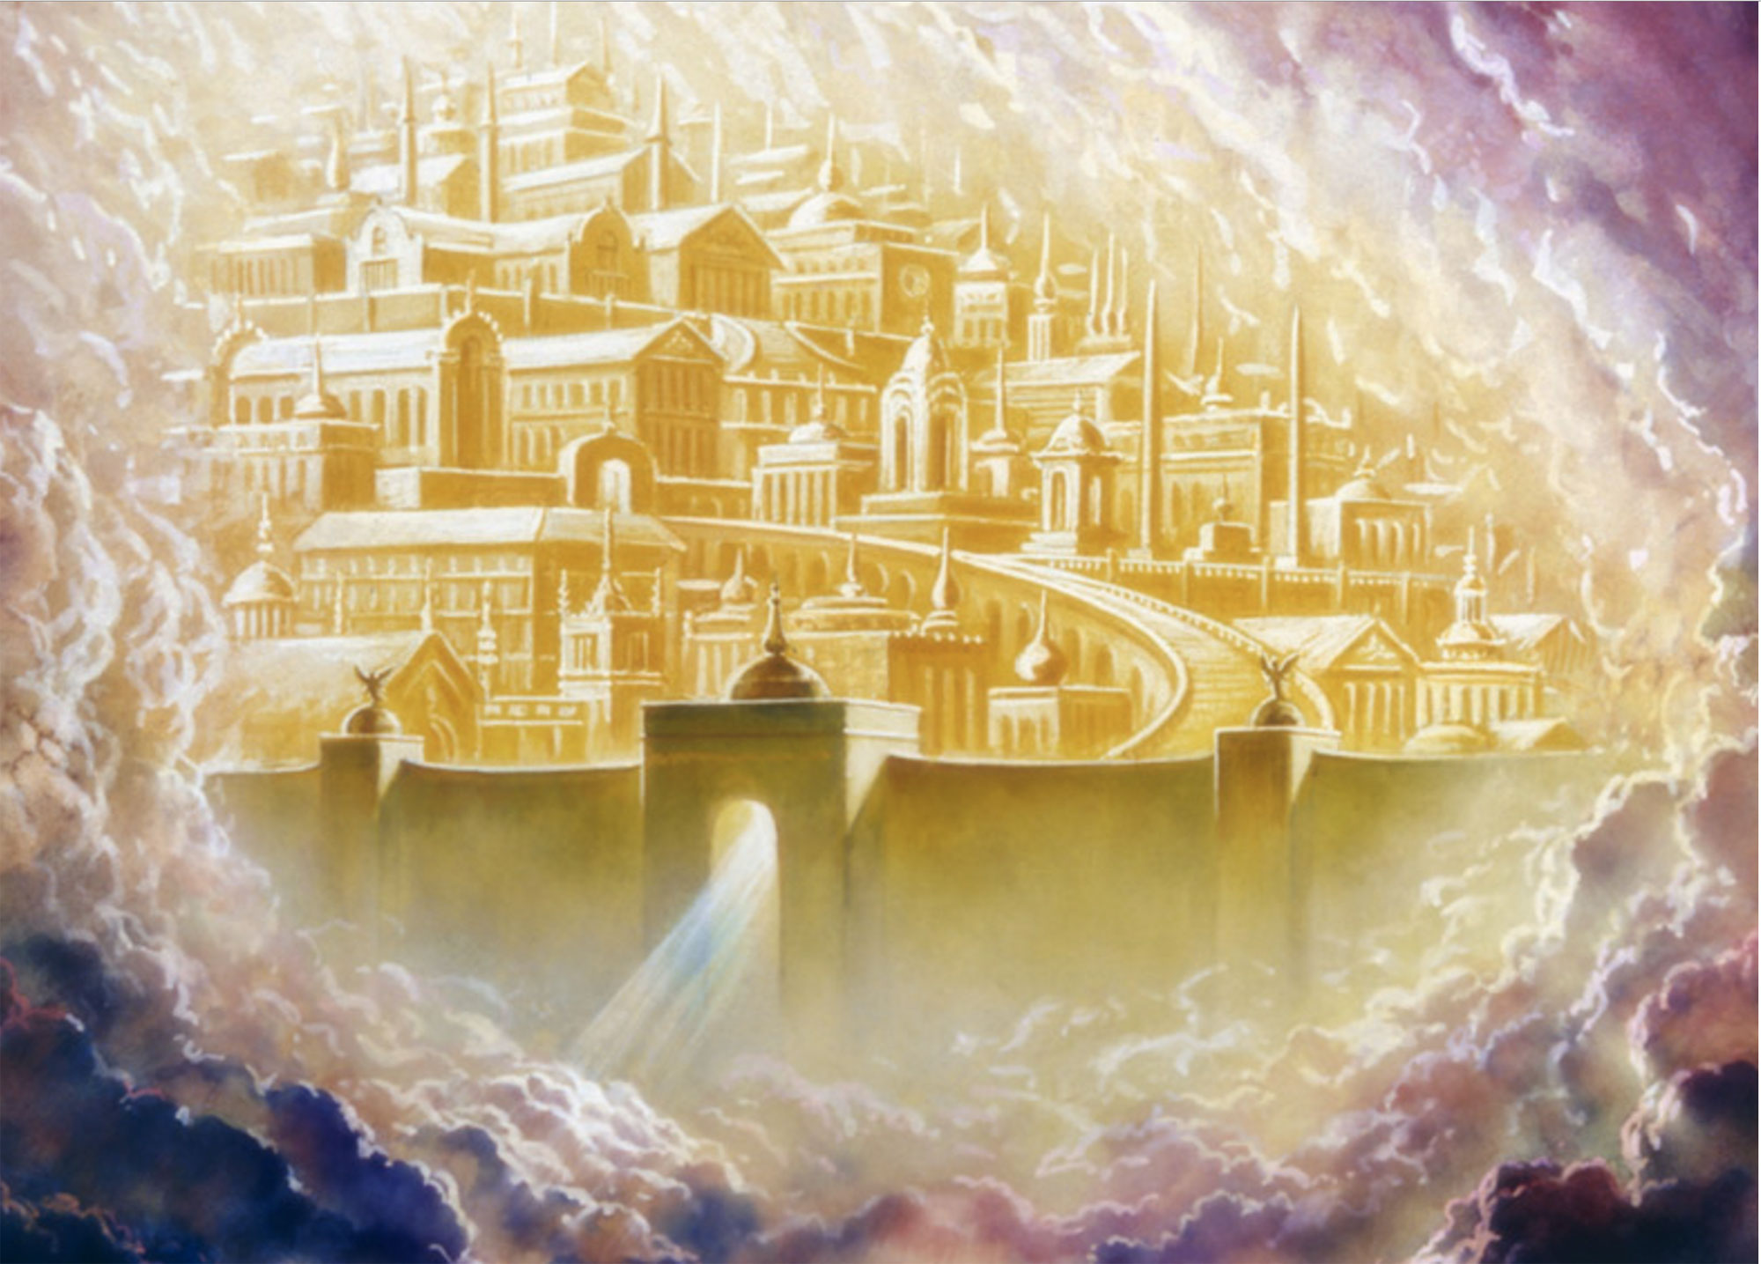
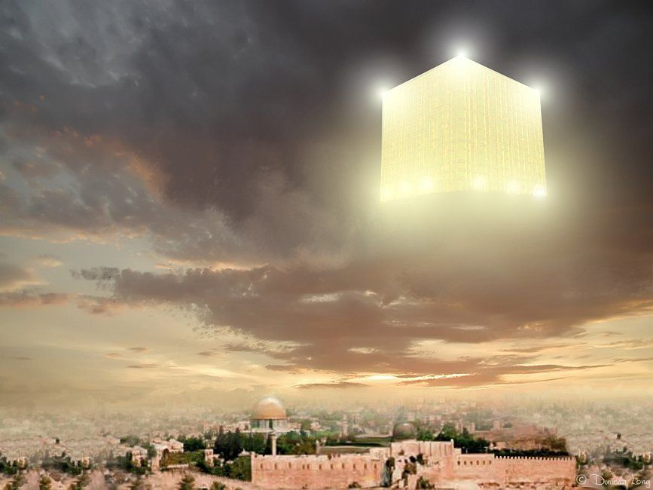
New Jerusalem Comes Down
Zech 14:11-12 “And men shall dwell in it, and there shall be no more utter destruction; but Jerusalem shall be safely inhabited. And this shall be the plague wherewith the Lord will smite all the people that have fought against Jerusalem; Their flesh shall consume away while they stand upon their feet, and their eyes shall consume away in their holes, and their tongue shall consume away in their mouth.
Rev 21:1-2 “And I saw a new heaven and a new earth: for the first heaven and the first earth were passed away; and there was no more sea. And I John saw the holy city, new Jerusalem, coming down from God out of heaven, prepared as a bride adorned for her husband.”

Slide 4
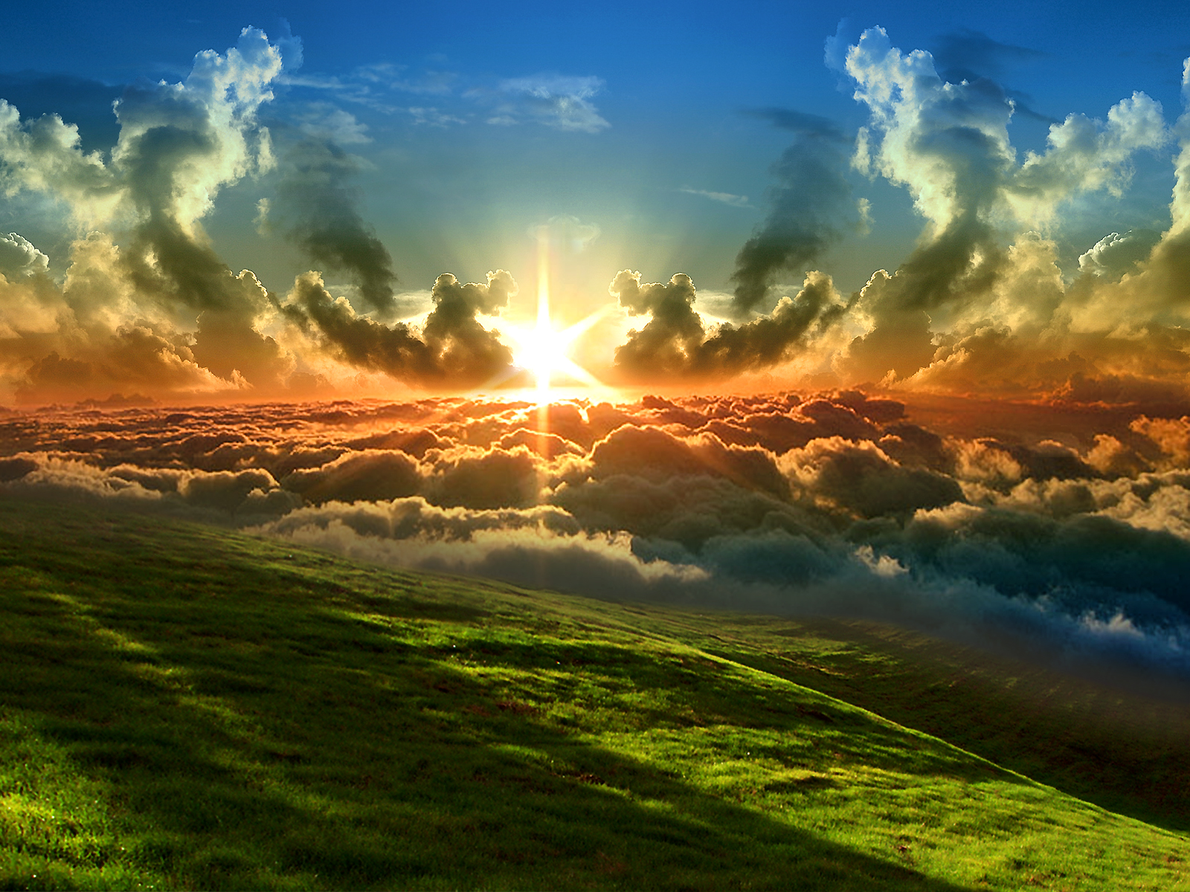
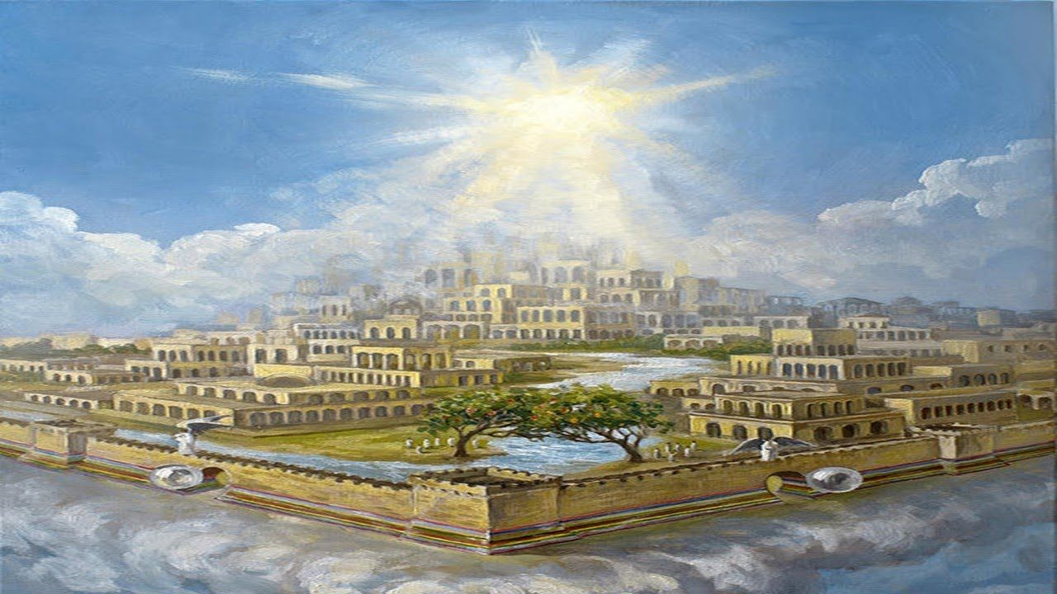
Early Writings Describes the New Jerusalem
“With Jesus at our head we all descended from the city down to this earth, on a great and mighty mountain, which could not bear Jesus up, and it parted asunder, and there was a mighty plain. Then we looked up and saw the great city, with twelve foundations, and twelve gates, three on each side, and an angel at each gate. We all cried out, “The city, the great city, it’s coming, it’s coming down from God out of heaven,” and it came and settled on the place where we stood. Then we began to look at the glorious things outside of the city. There I saw most glorious houses, that had the appearance of silver, supported by four pillars set with pearls most glorious to behold. These were to be inhabited by the saints. In each was a golden shelf. I saw many of the saints go into the houses, take off their glittering crowns and lay them on the shelf, then go out into the field by the houses to do something with the earth; not as we have to do with the earth here; no, no. A glorious light shone all about their heads, and they were continually shouting and offering praises to God” EW, p. 17-18

Slide 5
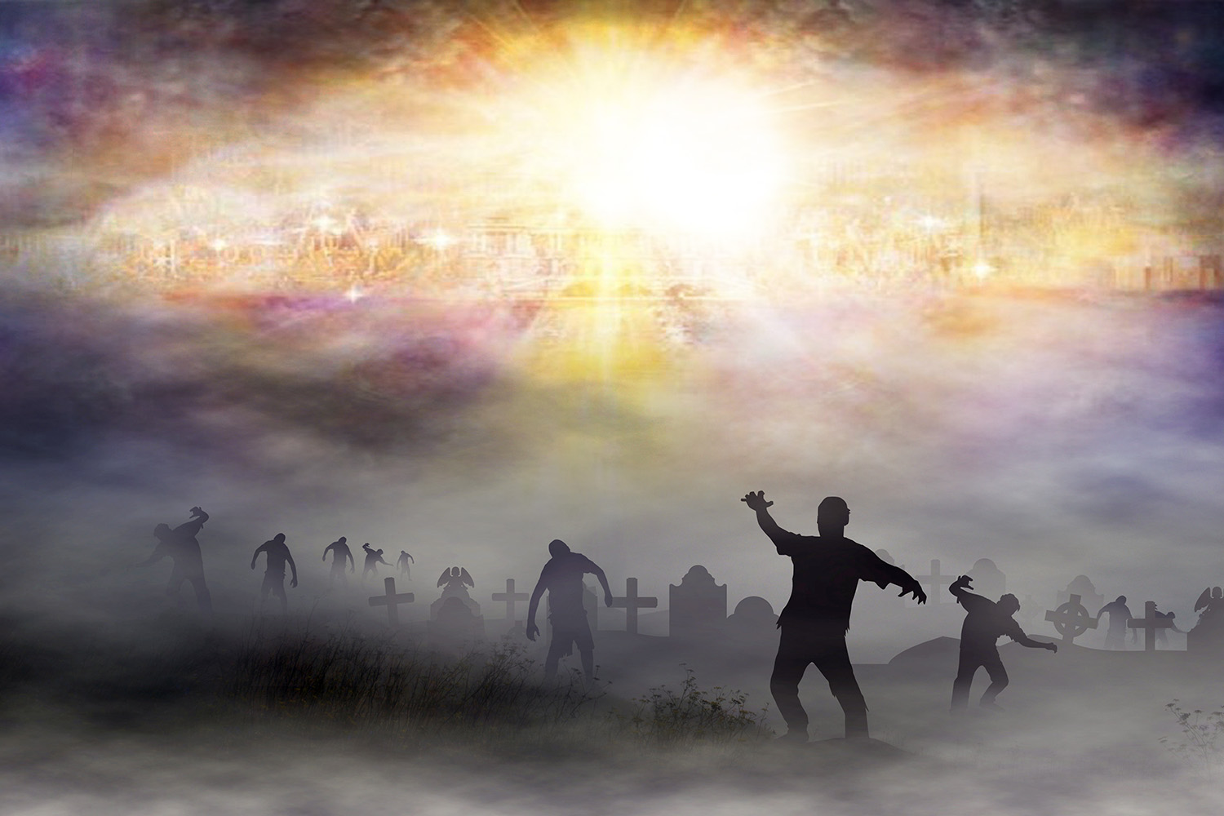
A Frightful Picture…
Rev. 20:11-14 “And I saw a great white throne, and him that sat on it, from whose face the earth and the heaven fled away; and there was found no place for them. And I saw the dead, small and great, stand before God; and the books were opened: and another book was opened, which is the book of life: and the dead were judged out of those things which were written in the books, according to their works. And the sea gave up the dead which were in it; and death and hell delivered up the dead which were in them: and they were judged every man according to their works. And death and hell were cast into the lake of fire. This is the second death.”

Slide 6
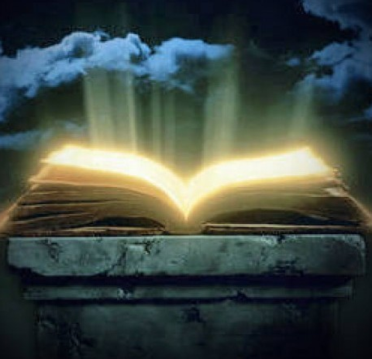
Judged By the Books of their Characters
“Remember, your character is being daguerreotyped [photographed] by the great Master Artist in the record books of heaven, as minutely as the face is reproduced upon the polished plate of the artist. What do the books of heaven say in your case? Are you conforming your character to the Pattern, Jesus Christ? Are you washing your robes of character and making them white in the blood of the Lamb?” Testimonies on Sexual Behavior, Adultery and Divorce, p. 62
“If the thoughts are wrong, the feelings will be wrong; and the thoughts and feelings combined make up the moral character.” In Heavenly Places, p. 164

Slide 7
The Final Judgment
Jesus called forth the wicked dead; and they came up with the same feeble, sickly bodies that went into the grave. What a spectacle! What a scene! At the first resurrection all came forth in immortal bloom, but at the second the marks of the curse are visible on all. The kings and noblemen of the earth, the mean and low, the learned and unlearned, come forth together. All behold the Son of man; and those very men who despised and mocked Him, who put the crown of thorns upon His sacred brow and smote Him with the reed, behold Him in all His kingly majesty . . . And they know that He is the very one whom they crucified and derided in His expiring agony. And then there arises one long protracted wail of agony, as they flee to hide from the presence of the King of kings and Lord of lords. All are seeking to hide in the rocks, to shield themselves from the terrible glory of Him whom they once despised. And, overwhelmed and pained with His majesty and exceeding glory, they with one accord raise their voices, and with terrible distinctness exclaim, "Blessed is He that cometh in the name of the Lord!“—Story of Redemption, p. 418-419

Slide 8
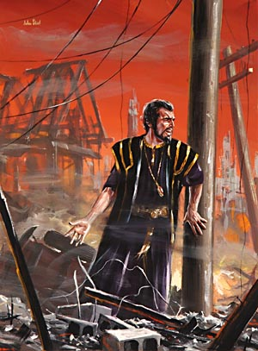
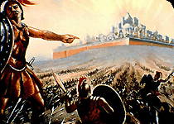

Slide 9
Now Satan prepares for a last mighty struggle for the supremacy. . . as the wicked dead are raised and he sees the vast multitudes upon his side, his hopes revive, and he determines not to yield the great controversy. He will marshal all the armies of the lost under his banner and through them endeavor to execute his plans. The wicked are Satan's captives. In rejecting Christ they have accepted the rule of the rebel leader. They are ready to receive his suggestions and to do his bidding. Yet, true to his early cunning, he does not acknowledge himself to be Satan. He claims to be the prince who is the rightful owner of the world and whose inheritance has been unlawfully wrested from him. He represents himself to his deluded subjects as a redeemer, assuring them that his power has brought them forth from their graves and that he is about to rescue them from the most cruel tyranny. The presence of Christ having been removed, Satan works wonders to support his claims. He makes the weak strong and inspires all with his own spirit and energy. He proposes to lead them against the camp of the saints and to take possession of the City of God. With fiendish exultation he points to the unnumbered millions who have been raised from the dead and declares that as their leader he is well able to overthrow the city and regain his throne and his kingdom.—GC, p. 662

Slide 10
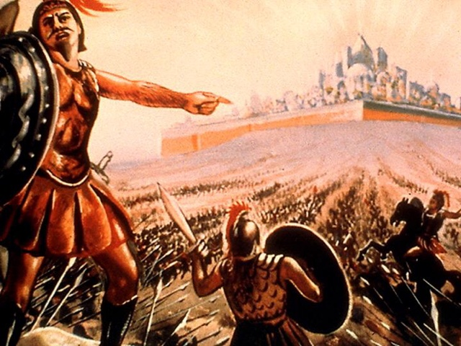
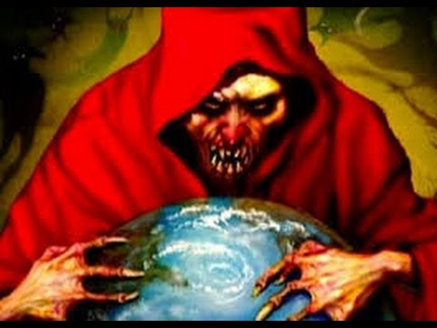

Slide 11
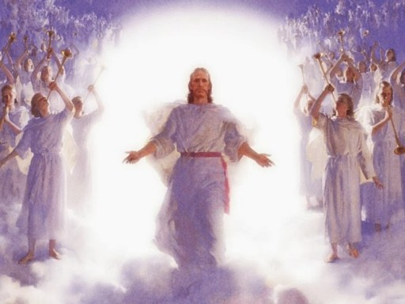
By command of Jesus, the gates of the New Jerusalem are closed, and the armies of Satan surround the city and make ready for the onset. Now Christ again appears to the view of His enemies. Far above the city, upon a foundation of burnished gold, is a throne, high and lifted up. Upon this throne sits the Son of God, and around Him are the subjects of His kingdom. The power and majesty of Christ no language can describe, no pen portray.—GC, p. 664-665

Slide 12
As soon as the books of record are opened, and the eye of Jesus looks upon the wicked, they are conscious of every sin which they have ever committed. They see just where their feet diverged from the path of purity and holiness, just how far pride and rebellion have carried them in the violation of the law of God. The seductive temptations which they encouraged by indulgence in sin, the blessings perverted, the messengers of God despised, the warnings rejected, the waves of mercy beaten back by the stubborn, unrepentant heart--all appear as if written in letters of fire. Above the throne is revealed the cross; and like a panoramic view appear the scenes of Adam's temptation and fall, and the successive steps in the great plan of redemption. The Saviour's lowly birth; His early life of simplicity and obedience; His baptism in Jordan; the fast and temptation in the wilderness; His public ministry, unfolding to men heaven's most precious blessings; the days crowded with deeds of love and mercy, the nights of prayer and watching in the solitude of the mountains; the plottings of envy, hate, and malice which repaid His benefits; the awful, mysterious agony in Gethsemane beneath the crushing weight of the sins of the whole world; His betrayal into the hands of the murderous mob—GC, 666-667

Slide 13
There are papist priests and prelates, who claimed to be Christ's ambassadors, yet employed the rack, the dungeon, and the stake to control the consciences of His people. There are the proud pontiffs who exalted themselves above God and presumed to change the law of the Most High. Those pretended fathers of the church have an account to render to God from which they would fain be excused. Too late they are made to see that the Omniscient One is jealous of His law and that He will in no wise clear the guilty. They learn now that Christ identifies His interest with that of His suffering people; and they feel the force of His own words: "Inasmuch as ye have done it unto one of the least of these My brethren, ye have done it unto Me." Matthew 25:40. The whole wicked world stand arraigned at the bar of God on the charge of high treason against the government of heaven. They have none to plead their cause; they are without excuse; and the sentence of eternal death is pronounced against them.—GC, 668

Slide 14
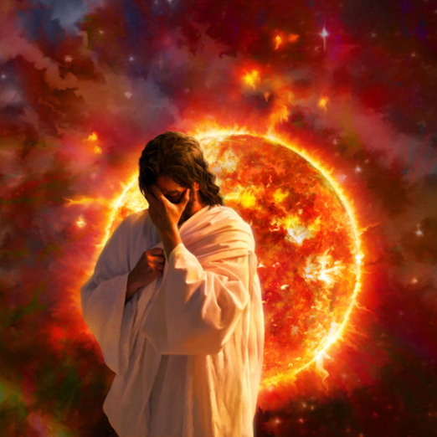
His Strange Act…
Is. 28:21 “For the Lord shall rise up as in mount Perazim, he shall be wroth as in the valley of Gibeon, that he may do his work, his strange work; and bring to pass his act, his strange act.”
Ez. 18:32 “For I have no pleasure in the death of him that dieth, saith the Lord God: wherefore turn yourselves, and live ye.”

Slide 15
It is now evident to all that the wages of sin is not noble independence and eternal life, but slavery, ruin, and death. The wicked see what they have forfeited by their life of rebellion. The far more exceeding and eternal weight of glory was despised when offered them; but how desirable it now appears. "All this," cries the lost soul, "I might have had, but I chose to put these things far from me. Oh, strange infatuation! I have exchanged peace, happiness, and honor for wretchedness, infamy, and despair.“—SR, p. 425
Notwithstanding Satan has been constrained to acknowledge God's justice, and to bow to the supremacy of Christ, his character remains unchanged. The spirit of rebellion, like a mighty torrent, against bursts forth. Filled with frenzy, he determines not to yield the great controversy. The time has come for a last desperate struggle against the King of heaven. He rushes into the midst of his subjects and endeavors to inspire them with his own fury and arouse them to instant battle. But of all the countless millions whom he has allured into rebellion, there are none now to acknowledge his supremacy. His power is at an end. The wicked are filled with the same hatred of God that inspires Satan; but they see that their case is hopeless, that they cannot prevail against Jehovah. Their rage is kindled against Satan and those who have been his agents in deception. With the fury of demons they turn upon them, and there follows a scene of universal strife. –SR, 427-428

Slide 16
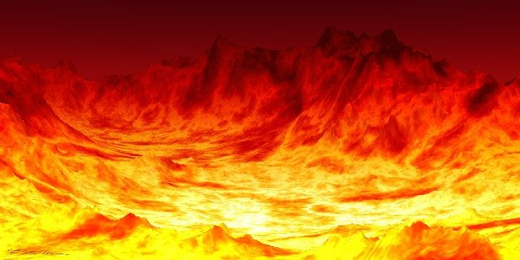
Fire comes down from God out of heaven. The earth is broken up. The weapons concealed in its depths are drawn forth. Devouring flames burst from every yawning chasm. The very rocks are on fire. The day has come that "shall burn as an oven." Mal. 4:1. The elements melt with fervent heat, the earth also and the works that are therein are burned up. (2 Peter 3:10.) . . . Some are destroyed as in a moment, while others suffer many days. All are punished according to their deeds. The sins of the righteous have been transferred to Satan, the originator of evil, who must bear their penalty. Thus he is made to suffer, not only for his own rebellion, but for all the sins which he has caused God's people to commit. His punishment is to be far greater than that of those whom he has deceived—SR 428,429

Slide 17
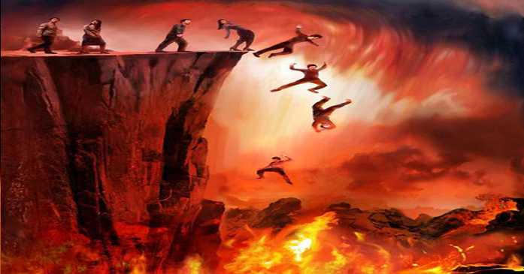
Destroyed NOT Tortured Forever
Rev. 20:9-10 “And they went up on the breadth of the earth, and compassed the camp of the saints about, and the beloved city: and fire came down from God out of heaven, and devoured them. And the devil that deceived them was cast into the lake of fire and brimstone, where the beast and the false prophet are, and shall be tormented day and night for ever and ever.”
Ez. 28:18-19 “Thou hast defiled thy sanctuaries by the multitude of thine iniquities, by the iniquity of thy traffick; therefore will I bring forth a fire from the midst of thee, it shall devour thee, and I will bring thee to ashes upon the earth in the sight of all them that behold thee. All they that know thee among the people shall be astonished at thee: thou shalt be a terror, and never shalt thou be any more.”

