Slide 1
The Quarry: Chiseling Necessary!

Slide 2
Backdrop
The story of the 12 tribes of Jacob is fascinating and it starts with Jacob himself. He married women that were old enough to be his grandchildren and he, their grandfather. Let me explain. Jacob tells us when he stood before Pharaoh, “, The days of the years of my pilgrimage are an hundred and thirty years:” Gen. 47:9. At this point, Joseph was 39. Joseph was 30 when he became the prime minister (41:46), then had followed 7 years of plenty (41:53), and then 2 years of famine when Joseph was reunited with his family. (Gen. 45:6) Jacob, therefore was 91 when Joseph was born.

Slide 3
In Haran!
Jacob was 91 when Joseph was born. Joseph was born when Jacob had been in Haran for 14 years. Remember, once Jacob arrived, he worked 7 years for Rachel, (Gen. 29:20) then served another 7 (Gen. 29:27) and then, he wanted to leave when Joseph was born. (Gen. 30:25) He served Laban after Joseph’s birth 6 more years. He was in Haran for 20 years. (Gen. 31:38) Jacob was 77 when he arrived in Haran!

Slide 4
Timeline
Jacob arrives in Haran- 77 years old
Joseph’s birth- Jacob is 91 years old
Jacob leaves 20 years later- 97 years old
Joseph is sold at 17, Jacob is 108 years old.
Joseph is Prime minister at 30, Jacob is 121 years old.
7 years of plenty, 2 of famine- Joseph is 39, Jacob is 130.
Jacob dies at 147, Joseph is 56.

Slide 5
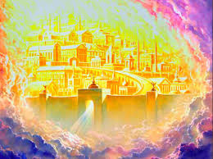
In this majestic and solemn, yet joyous place, there are conspicuously written the names of 12 men. How they got there we must ponder for a time! It is nothing short of a miracle of God that their names are written there!

Slide 6
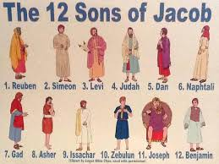
“And he carried me away in the spirit to a great and high mountain, and shewed me that great city, the holy Jerusalem, descending out of heaven from God, Having the glory of God: and her light was like unto a stone most precious, even like a jasper stone, clear as crystal; And had a wall great and high, and had twelve gates, and at the gates twelve angels, and names written thereon, which are the names of the twelve tribes of the children of Israel: On the east three gates; on the north three gates; on the south three gates; and on the west three gates.” Rev. 21:10-13

Slide 7
The Motley Crew
Within the names mentioned, even one of them doesn’t belong there. In the final role in Revelation 7, the tribe of Dan is missing and is replaced by Manasseh!
“And I heard the number of them which were sealed: and there were sealed an hundred and forty and four thousand of all the tribes of the children of Israel. Of the tribe of Juda were sealed twelve thousand. Of the tribe of Reuben were sealed twelve thousand. Of the tribe of Gad were sealed twelve thousand. Of the tribe of Aser were sealed twelve thousand. Of the tribe of Nepthalim were sealed twelve thousand. Of the tribe of Manasseh were sealed twelve thousand. Of the tribe of Simeon were sealed twelve thousand. Of the tribe of Levi were sealed twelve thousand. Of the tribe of Issachar were sealed twelve thousand. Of the tribe of Zabulon were sealed twelve thousand. Of the tribe of Joseph were sealed twelve thousand. Of the tribe of Benjamin were sealed twelve thousand.” Revelation 7:4-8

Slide 8

They Had it All! Everything Bad!
What this family had, and what they became is cause for hope for every family and individual!
1. Their patriarch was called of God to represent Him in the earth!
2. One son became the prime minister of Egypt.
3. Mixed in was every filthy, horrible thing that man can invent. Hatred, immorality, cruelty, indifference, and smoldering pain!

Slide 9
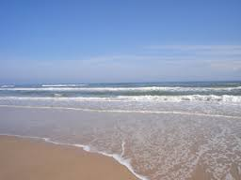
The Lord Chose Imperfection
If God had chose a perfect family, then the devil would have cried foul, so the Lord chose a family full of troubles that they might be trophies of His grace and revealers of His glory!
The Lord showed that cultivated weaknesses, bad traits of character can be transformed into the divine image by His amazing grace!

Slide 10
Keep Digging!
“ Inspiration faithfully records the faults of good men, those who were distinguished by the favor of God; indeed, their faults are more fully presented than their virtues. This has been a subject of wonder to many, and has given the infidel occasion to scoff at the Bible. But it is one of the strongest evidences of the truth of Scripture, that facts are not glossed over, nor the sins of its chief characters suppressed. The minds of men are so subject to prejudice that it is not possible for human histories to be absolutely impartial. Had the Bible been written by uninspired persons, it would no doubt have presented the character of its honored men in a more flattering light. But as it is, we have a correct record of their experiences.
Men whom God favored, and to whom He entrusted great responsibilities, were sometimes overcome by temptation and committed sin, even as we at the present day strive, waver, and frequently fall into error. Their lives, with all their faults and follies, are open before us, both for our encouragement and warning. If they had been represented as without fault, we, with our sinful nature, might despair at our own mistakes and failures. But seeing where others struggled through discouragements like our own, where they fell under temptations as we have done, and yet took heart again and conquered through the grace of God, we are encouraged in our striving after righteousness. As they, though sometimes beaten back, recovered their ground, and were blessed of God, so we too may be overcomers in the strength of Jesus. On the other hand, the record of their lives may serve as a warning to us. It shows that God will by no means clear the guilty. He sees sin in His most favored ones, and He deals with it in them even more strictly than in those who have less light and responsibility. “ PP, pg. 238

Slide 11
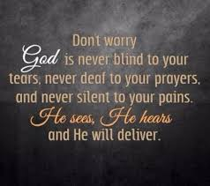
The Lord Understands!
“I will make mention of Rahab and Babylon to them that know me: behold Philistia, and Tyre, with Ethiopia; this man was born there. And of Zion it shall be said, This and that man was born in her: and the highest himself shall establish her. The LORD shall count, when he writeth up the people, that this man was born there. Selah.” Ps. 87:4-6

Slide 12
Before Rueben Was Ever Born!
Horrible influences were already ready to destroy the home before the first child screamed! Jacob had agreed to work 7 years for the hand of Rachel, his cousin. Of course, Rachel was the younger daughter of Jacob’s Uncle Laban and custom said that the eldest daughter, Leah, less attractive and vivacious as her sister, should be married first. Laban devised a cunning plan, to which Leah agreed, to marry her to Jacob! This resulted in such tragedy, cold indifference, and sorrow. From this horrible beginning would come the 12 tribes of Jacob! Wow!!!!!

Slide 13
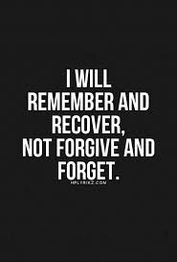
Never Forgiven, Never Acknowledged!
AS cold indifference ate away at the household of Jacob, as bitter jealousy and cruel heartache never abated, the sons of Jacob learned such terrible lessons from their parents. Tragically, this never let up either. As the last lingering shadows began to overtake the great patriarch Israel, even then he could not and would not acknowledge Leah!

Slide 14
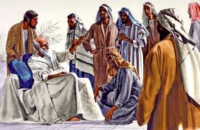
“And he charged them, and said unto them, I am to be gathered unto my people: bury me with my fathers in the cave that is in the field of Ephron the Hittite, In the cave that is in the field of Machpelah, which is before Mamre, in the land of Canaan, which Abraham bought with the field of Ephron the Hittite for a possession of a burying place. There they buried Abraham and Sarah his wife; there they buried Isaac and Rebekah his wife; and there I buried Leah.” Gen. 49:29-31

Slide 15
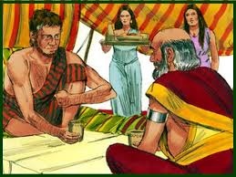
She Had 6 Children
“And Leah conceived, and bare a son, and she called his name Reuben: for she said, Surely the LORD hath looked upon my affliction; now therefore my husband will love me. And she conceived again, and bare a son; and said, Because the LORD hath heard that I was hated, he hath therefore given me this son also: and she called his name Simeon. And she conceived again, and bare a son; and said, Now this time will my husband be joined unto me, because I have born him three sons: therefore was his name called Levi. And she conceived again, and bare a son: and she said, Now will I praise the LORD: therefore she called his name Judah; and left bearing.” Gen. 29:32-35

Slide 16
Rachel Cannot Bear!!
“And Reuben went in the days of wheat harvest, and found mandrakes in the field, and brought them unto his mother Leah. Then Rachel said to Leah, Give me, I pray thee, of thy son's mandrakes. And she said unto her, Is it a small matter that thou hast taken my husband? and wouldest thou take away my son's mandrakes also? And Rachel said, Therefore he shall lie with thee to night for thy son's mandrakes. And Jacob came out of the field in the evening, and Leah went out to meet him, and said, Thou must come in unto me; for surely I have hired thee with my son's mandrakes. And he lay with her that night.” Gen. 30:14-16

Slide 17

Leah Can, Rachel Can’t!
Leah has 6, Rachel can’t bear. Bring on the servant wives; throw in some mandrakes and Jacob IS PROSTITUTED FOR A NIGHT!
Throw in a coat of many colors for the beloved, finally, son of Rachel, have the angry, unloved brothers sell him as a slave, and you have a recipe for disaster!

Slide 18
There they Are!
“And I heard the number of them which were sealed: and there were sealed an hundred and forty and four thousand of all the tribes of the children of Israel. Of the tribe of Juda were sealed twelve thousand. Of the tribe of Reuben were sealed twelve thousand. Of the tribe of Gad were sealed twelve thousand. Of the tribe of Aser were sealed twelve thousand. Of the tribe of Nepthalim were sealed twelve thousand. Of the tribe of Manasseh were sealed twelve thousand. Of the tribe of Simeon were sealed twelve thousand. Of the tribe of Levi were sealed twelve thousand. Of the tribe of Issachar were sealed twelve thousand. Of the tribe of Zabulon were sealed twelve thousand. Of the tribe of Joseph were sealed twelve thousand. Of the tribe of Benjamin were sealed twelve thousand.” Rev. 7:4-8

Slide 19
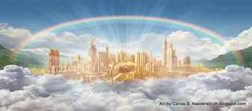
And There they ARE!!!
“And he carried me away in the spirit to a great and high mountain, and shewed me that great city, the holy Jerusalem, descending out of heaven from God, Having the glory of God: and her light was like unto a stone most precious, even like a jasper stone, clear as crystal; And had a wall great and high, and had twelve gates, and at the gates twelve angels, and names written thereon, which are the names of the twelve tribes of the children of Israel:” Rev. 21:10-12

Slide 20
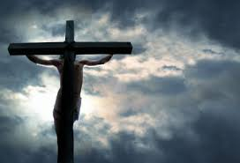
There Is a Song!
“And they sung a new song, saying, Thou art worthy to take the book, and to open the seals thereof: for thou wast slain, and hast redeemed us to God by thy blood out of every kindred, and tongue, and people, and nation; And hast made us unto our God kings and priests: and we shall reign on the earth. And I beheld, and I heard the voice of many angels round about the throne and the beasts and the elders: and the number of them was ten thousand times ten thousand, and thousands of thousands; Saying with a loud voice, Worthy is the Lamb that was slain to receive power, and riches, and wisdom, and strength, and honour, and glory, and blessing.” Rev. 5:9-12

