Slide 1
Daniel, chapter 1
“Young Man vs. the World”

Slide 2
Not Much Worse
First, it was the screaming. Then, it was the site of blood. Watching family and friends die was almost too much. Right before their eyes, the temple was being pilfered, the city was taken over, and then a long, dusty, weary march to Babylon. Never again seeing family or home was reaching the breaking point for them. What would come next?

Slide 3
They Were Chosen
“In the third year of the reign of Jehoiakim king of Judah came Nebuchadnezzar king of Babylon unto Jerusalem, and besieged it. And the Lord gave Jehoiakim king of Judah into his hand, with part of the vessels of the house of God: which he carried into the land of Shinar to the house of his god; and he brought the vessels into the treasure house of his god. And the king spake unto Ashpenaz the master of his eunuchs, that he should bring certain of the children of Israel, and of the king's seed, and of the princes;” Daniel 1:1-3

Slide 4
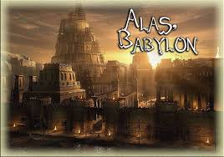
The old prophet Jeremiah had predicted this. Now, in 605 BC, the city is taken and we will be in Babylon for 70 years! What will happen to us? Evil and wickedness lurk at every corner in this pagan culture. Lord , help us be true………

Slide 5
Part of the Elite of Babylon
“Children in whom was no blemish, but well favoured, and skilful in all wisdom, and cunning in knowledge, and understanding science, and such as had ability in them to stand in the king's palace, and whom they might teach the learning and the tongue of the Chaldeans. And the king appointed them a daily provision of the king's meat, and of the wine which he drank: so nourishing them three years, that at the end thereof they might stand before the king. Now among these were of the children of Judah, Daniel, Hananiah, Mishael, and Azariah: Unto whom the prince of the eunuchs gave names: for he gave unto Daniel the name of Belteshazzar; and to Hananiah, of Shadrach; and to Mishael, of Meshach; and to Azariah, of Abednego.” Daniel 1:4-7

Slide 6
True as Steel!
“Among the children of Israel who were carried captive to Babylon at the beginning of the seventy years' captivity were Christian patriots, men who were as true as steel to principle, who would not be corrupted by selfishness, but who would honor God at the loss of all things. In the land of their captivity these men were to carry out God's purpose by giving to heathen nations the blessings that come through a knowledge of Jehovah. They were to be His representatives. Never were they to compromise with idolaters; their faith and their name as worshipers of the living God they were to bear as a high honor. And this they did. In prosperity and adversity they honored God, and God honored them. The fact that these men, worshipers of Jehovah, were captives in Babylon, and that the vessels of God's house had been placed in the Temple of the Babylonish gods, was boastfully cited by the victors as evidence that their religion and customs were superior to the religion and customs of the Hebrews. Yet through the very humiliations that Israel's departure from Him had invited, God gave Babylon evidence of His supremacy. ” PK, pgs. 479,480

Slide 7
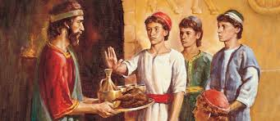
The Test!
“But Daniel purposed in his heart that he would not defile himself with the portion of the king's meat, nor with the wine which he drank: therefore he requested of the prince of the eunuchs that he might not defile himself. Now God had brought Daniel into favour and tender love with the prince of the eunuchs.” Daniel 1:8,9

Slide 8
Let the War Begin!
“At the very outset of their career there came to them a decisive test of character. It was provided that they should eat of the food and drink of the wine that came from the king's table. In this the king thought to give them an expression of his favor and of his solicitude for their welfare. But a portion having been offered to idols, the food from the king's table was consecrated to idolatry; and one partaking of it would be regarded as offering homage to the gods of Babylon. In such homage, loyalty to Jehovah forbade Daniel and his companions to join. Even a mere pretense of eating the food or drinking the wine would be a denial of their faith. To do this would be to array themselves with heathenism and to dishonor the principles of the law of God. Nor dared they risk the enervating effect of luxury and dissipation on physical, mental, and spiritual development. They were acquainted with the history of Nadab and Abihu, the record of whose intemperance and its results had been preserved in the parchments of the Pentateuch; and they knew that their own physical and mental power would be injuriously affected by the use of wine. Daniel and his associates had been trained by their parents to habits of strict temperance. They had been taught that God would hold them accountable for their capabilities, and that they must never dwarf or enfeeble their powers. This education was to Daniel and his companions the means of their preservation amidst the demoralizing influences of the court of Babylon. Strong were the temptations surrounding them in that corrupt and luxurious court, but they remained uncontaminated. No power, no influence, could sway them from the principles they had learned in early life by a study of the word and works of God.” PK, pgs. 481,482

Slide 9
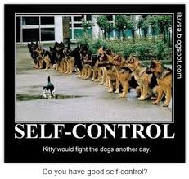
Is Temperance still Important?
“And beside this, giving all diligence, add to your faith virtue; and to virtue knowledge; And to knowledge temperance; and to temperance patience; and to patience godliness; And to godliness brotherly kindness; and to brotherly kindness charity.” 2 Peter 1:5-7

Slide 10
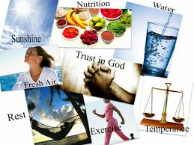
Temperance in what?
Temperance in all things must be our motto! It is not just about one aspect of health to the exclusion of the others. We need to be mindful of health in all its spheres. Daniel’s passing this test made possible the remaining 11 chapters of this book!!!

Slide 11
Too Narrow!
“There are many among professed Christians today who would decide that Daniel was too particular, and would pronounce him narrow and bigoted. They consider the matter of eating and drinking as of too little consequence to require such a decided stand--one involving the probable sacrifice of every earthly advantage. But those who reason thus will find in the day of judgement that they turned from God's express requirements and set up their own opinion as a standard of right and wrong. They will find that what seemed to them unimportant was not so regarded of God. His requirements should be sacredly obeyed. Those who accept and obey one of His precepts because it is convenient to do so, while they reject another because its observance would require a sacrifice, lower the standard of right and by their example lead others to lightly regard the holy law of God. "Thus saith the Lord" is to be our rule in all things.” Sanctified Life, pgs. 5,6

Slide 12
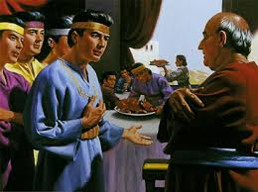
10 Day Trial
“Then said Daniel to Melzar, whom the prince of the eunuchs had set over Daniel, Hananiah, Mishael, and Azariah, Prove thy servants, I beseech thee, ten days; and let them give us pulse to eat, and water to drink. Then let our countenances be looked upon before thee, and the countenance of the children that eat of the portion of the king's meat: and as thou seest, deal with thy servants. So he consented to them in this matter, and proved them ten days.” Daniel 1:10-14

Slide 13
God Blessed Them!
“At the end of the ten days the result was found to be quite the opposite of Melzar's expectations. Not only in personal appearance, but in physical activity and mental vigour, those who had been temperate in their habits exhibited a marked superiority over their companions who had indulged appetite. As a result of this trial, Daniel and his associates were permitted to continue their simple diet during the whole course of their training for the duties of the kingdom.
The Lord regarded with approval the firmness and self-denial of these Hebrew youth, and His blessing attended them. He "gave them knowledge and skill in all learning and wisdom: and Daniel had understanding in all visions and dreams" (Dan. 1:17). At the expiration of the three years of training, when their ability and acquirements were tested by the king, he "found none like Daniel, Hananiah, Mishael, and Azariah: therefore stood they before the king. And in all matters of wisdom and understanding, that the king enquired of them, he found them ten times better than all the magicians and astrologers that were in all his realm" (verse 20).” SL, pg. 7

Slide 14
“And at the end of ten days their countenances appeared fairer and fatter in flesh than all the children which did eat the portion of the king's meat. Thus Melzar took away the portion of their meat, and the wine that they should drink; and gave them pulse. As for these four children, God gave them knowledge and skill in all learning and wisdom: and Daniel had understanding in all visions and dreams.” Daniel 1:15-17

Slide 15
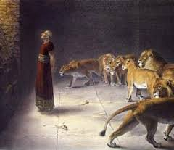
Daniel’s Blessing
Daniel’s example of temperance and taking care of his body effects us today. If he had failed that test, the book that bears his name would never have been written. The prophecies and triumphs that fill his book remain an encouragement still today!!

Slide 16
His Stand!
1. Daniel could stand erect before kings because he lived a life of temperance.
2. Daniel could walk in lion’s dens because he lived a life of temperance.
3. Daniel could be used by Heaven to share great truth with the world because he lived a life of temperance.
4. Daniel still blesses the world today because he lived a life of temperance.

Slide 17
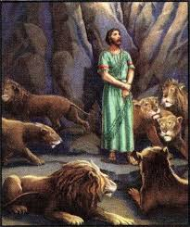
Daniel is victorious!
“Now at the end of the days that the king had said he should bring them in, then the prince of the eunuchs brought them in before Nebuchadnezzar. And the king communed with them; and among them all was found none like Daniel, Hananiah, Mishael, and Azariah: therefore stood they before the king. And in all matters of wisdom and understanding, that the king enquired of them, he found them ten times better than all the magicians and astrologers that were in all his realm. And Daniel continued even unto the first year of king Cyrus.” Daniel 1:18-21

Slide 18
“What if Daniel and his companions had made a compromise with those heathen officers and had yielded to the pressure of the occasion by eating and drinking as was customary with the Babylonians? That single instance of departure from principle would have weakened their sense of right and their abhorrence of wrong. Indulgence of appetite would have involved the sacrifice of physical vigour, clearness of intellect, and spiritual power. One wrong step would probably have led to others, until, their connection with Heaven being severed, they would have been swept away by temptation.
God has said, "Them that honour me I will honour" (1 Sam. 2:30). While Daniel clung to his God with unwavering trust, the Spirit of prophetic power came upon him. While he was instructed of man in the duties of court life, he was taught of God to read the mysteries of future ages and to present to coming generations, through figures and similitudes, the wonderful things that would come to pass in the last days.” SL, pg. 7

Slide 19
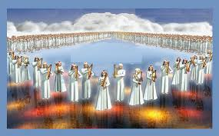
Victory
The faithful Children of God---1
Babylon the Great---0

