Slide 1
Church and State, pt. 2
Constantine’s Christianity

Slide 2
The Early Church
The early church was made up of people who had responded to the call of Christ. “Then said Jesus unto his disciples, If any man will come after me, let him deny himself, and take up his cross, and follow me.” Matthew 16:24 To display their conversion to Christ and His truth, the people were then baptized by immersion. This ordinance was only done by those of understanding. The early church was a community of believers within the Roman Empire. However toward the end of the 3rd century, an apostate, pagan ‘Christian’ named Origen declared, “If now, the entire Roman Empire should unite in the adoration of the true God, then the Lord would fight for her.” Origen, Contra Celsum, volume 8, pg. 69
If this occurred, then the whole society, the whole empire, would become ‘Christian’. Anyone who didn’t go along with this would be considered a heretic. The church would become the state and the state the church. The community of believers would no longer exist. In place of baptism for the believer in the community, baptism would be done at birth to ensure that the newborn was part of the Christian society. This is Christian sacralism at its finest!!!

Slide 3
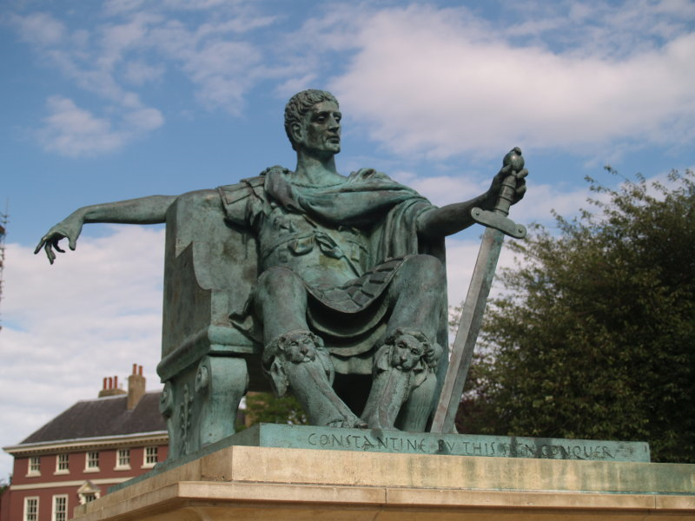
Along Came a Man
His goals were not religious at all. His goals were purely political; he wanted to go down in history as the greatest emperor who had united the Roman Empire when it was collapsing at the seams. He couldn’t sleep at night. How could he bring together his vast realms? How could he stabilize his great empire? Then, Constantine had his ‘vision’.

Slide 4
Changed the face of the World
We still live with the mindset of this man today!
He turned the history of the politics and religion into one flowing stream.
He used the church to gain uniformity throughout his empire.
Anyone who didn’t go along with his church was persecuted
Constantine would allow no one to disagree with him!
Christ allowed people to disagree with Him.
Christ loved humanity too much to not allow them free choice.
Christ never coerced anyone to agree with Him.
Christ’s gospel had nothing to do with the state and everything to do with individual choice.
Christ taught that everyone had the right to be wrong!

Slide 5
His mother, pagan Christianity, and the sign
Constantine’s mother, Helena, who was instrumental in finding wrong sites for Mt. Sinai and the Red Sea crossing, among others, had a great influence over her son. “Constantius divorced Helena at some time before 289, when he married Theodora, Maximian's daughter.^{[18]} Helena and her son were dispatched to the court of Diocletian at Nicomedia, where Constantine grew to be a member of the austus' inner circle. Helena never remarried and lived for a time in obscurity, though close to her only son, who had a deep regard and affection for her.”

Slide 6
The Vision
“Constantine with his army was marching (Eusebius does not specify the actual location of the event, but it clearly is not in the camp at Rome), when he looked up to the sun and saw a cross of light above it, and with it the Greek words "Εν Τούτῳ Νίκα". The Latin translation is in hoc signo vinces—"In this sign, you shall conquer". At first he was unsure of the meaning of the apparition, but in the following night he had a dream in which Christ explained to him that he should use the sign against his enemies.” Wikipedia

Slide 7
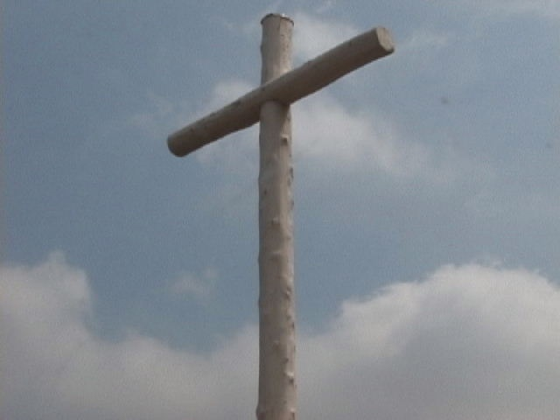
The Cross a Sign?
Because of Constantine’s impact on history, past and present, one must ask, 1. “Where did the vision come from?”
2. Does Christ give a vision of His cross and tell people to kill in His name?
3. The society Constantine created was totally contrary to the Bible. The vision came not from the God of heaven, but from the god of this world. “Again, the devil taketh him up into an exceeding high mountain, and sheweth him all the kingdoms of the world, and the glory of them;
And saith unto him, All these things will I give thee, if thou wilt fall down and worship me.

Slide 8
The Christian Faith
“Then Simon Peter having a sword drew it, and smote the high priest's servant, and cut off his right ear. The servant's name was Malchus. Then said Jesus unto Peter, Put up thy sword into the sheath: the cup which my Father hath given me, shall I not drink it?” Jn. 18:10,11 When, where, in the Bible does one find the promotion and spreading of the Christian
Faith through arms? Christ told Peter to put away the sword; Christianity was never spread or upheld by swords and weapons!
Constantine would use the cross of Christ and make Christianity the religion of the empire. He would create a Christian, sacral society and everyone would unite under the religion of Constantine. No one would dare disobey! This mentality would continue for centuries!

Slide 9
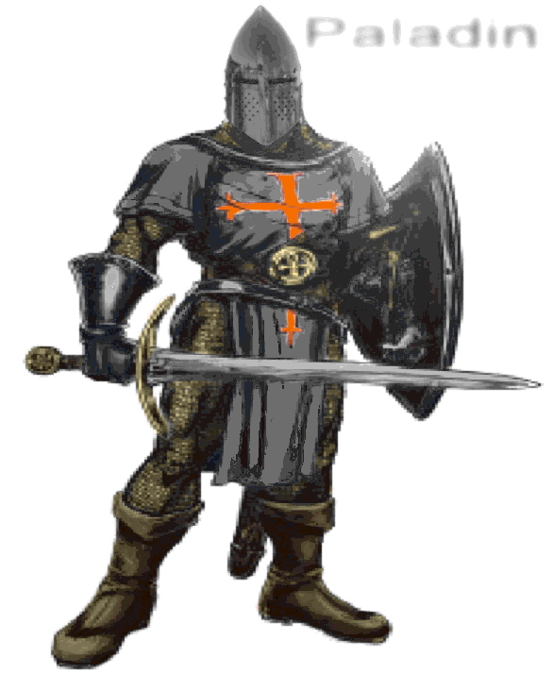
Compel Them
Two verses that Constantine, Eusebius, and Augustine used to back up their “Arms for Christ” battle cry were these. “And the lord said unto the servant, Go out into the highways and hedges, and compel them to come in, that my house may be filled.” Luke 14:23 “Then said he unto them, But now, he that hath a purse, let him take it, and likewise his scrip: and he that hath no sword, let him sell his garment, and buy one.
”For I say unto you, that this that is written must yet be accomplished in me, And he was reckoned among the transgressors: for the things concerning me have an end. And they said, Lord, behold, here are two swords. And he said unto them, It is enough.” Luke 22:36-38

Slide 10
Augustine and Eusebius
Augustine, a Latin church father, is one of the most important figures in the development of Western Christianity…He believed that the grace of Christ was indispensable to human freedom, and he framed the concepts of original sin and just war…
Eusebius “a political propagandist, a good courtier, the shrewd and worldly adviser of the Emperor Constantine, the great publicist of the first Christian emperor, the first in a long succession of ecclesiastical politicians, the herald of Byzantinism, a political theologian, a political metaphysician, and a caesaropapist. Much traditional scholarship, sometimes with barely suppressed disdain, has regarded Eusebius as one who risked his orthodoxy and perhaps his character because of his zeal for the Constantinian establishment.

Slide 11

The Essence of the Gospel
The word ‘compel’ in the Greek means to urgently entreat. It most certainly has nothing to do with forcing someone to convert to Christianity by the sword. The other passage about swords was interpreted to mean ‘convert people by the religious arm’ and by ‘the secular arm’. Thus, two swords. The verses are referencing the fact that Christ’s followers never lacked for anything.

Slide 12

Free to Choose
“Our first parents, though created innocent and holy, were not placed beyond the possibility of wrongdoing. God made them free moral agents, capable of appreciating the wisdom and benevolence of His character and the justice of His requirements, and with full liberty to yield or to withhold obedience. They were to enjoy communion with God and with holy angels; but before they could be rendered eternally secure, their loyalty must be tested. At the very beginning of man's existence a check was placed upon the desire for self-indulgence, the fatal passion that lay at the foundation of Satan's fall.” PP, pg. 48

Slide 13
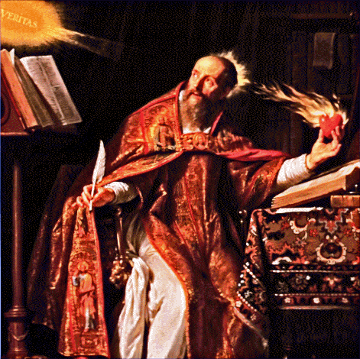
Augustine’s Insanity
“And so if you were strolling quietly outside the feast of eternal salvation and the unity of the holy church then we would overtake you on the highways; but now that you verily by many injuries and cruelties which you perpetrate upon our people, are full of thorns and spines, now we come upon you in your hedges to compel you. The sheep which is compelled is coerced while it is unwilling, but after it has been brought in it may graze as its own volition wills.” Augustine’s letter to Donatus, #173 , Volume 1, Phillip Schaff

Slide 14
Amazing
“The Truth leaves you no choice; you must agree that the magistracy has the authority to coerce his subjects to the gospel. And if you say, ‘Yes, but with admonition and well chosen words but not by force” then would I answer that to get people to the services with fine words and admonitions is the preacher’s duty, but to keep them there with recourse to force if need be and to frighten them away from error is the proper function of the rulers….” Quellen Hesse, pg. 102f

Slide 15
Shocking
“When Amandus came to Flanders, early in the 7th century, he began his ‘missionary’ efforts with a visit to the local king, Dagobert II. His request fro aid granted, to the extent of coercion by the king’s sword, he went to his task, carrying papers on which it was stated for all to know that the king’s orders were: “If anyone does not of his own accord have himself regenerated by baptism he shall be coerced to it by the king.” This Amandus a little later complained to his superiors in Rome that he had once and again been obliged to pick himself out of the Schelde River- the explanation for this not very kind reception seems to be that this was the way the natives sought to pay him back in kind, replying to his forced baptisms by a forced baptism of their own.” The Reformers and Their Stepchildren, Louis Verdun, pg. 69

Slide 16
A ‘New’ Church
Constantine set up a unified state and church. The state would use the church to bring unity throughout the empire. The church would use the state to enforce her beliefs and to establish a world church. Everyone would be part of it. The words of Christ would be thrown away. “And he said unto them, Render therefore unto Caesar the things which be Caesar's, and unto God the things which be God's.” Luke 20:25 “Jesus answered, My kingdom is not of this world: if my kingdom were of this world, then would my servants fight, that I should not be delivered to the Jews: but now is my kingdom not from hence.” Jn. 18:36

Slide 17
They Dared to Disagree
There were those who rejected this monolith of paganism mixed with some Bible concepts. There were those who refused this universal church. They refused to accept a ‘catholic’ church. Catholic simply means ‘embracing all’. Constantine’s plan never embraced everyone. There was always a voice of dissent. The voice at that time came from the Donatists. Here began the use of the word heretic to be used to describe those who didn’t go along with the universal, sacral church. The Donatists simply rejected the idea that the church embraced everyone. They believed the church was made up of believers in the Bible and the Christian faith.

Slide 18
A Horrible Fall
“In the eyes of the Donatists, the church had fallen in the days of Constantine, with a fall as calamitous and as fraught with evil consequences as the fall in Eden. This fall had made a fallen creature of the church, one dead in trespasses and sins. And just as the catastrophe in Eden had made a rebirth necessary, so did the fall of the fourth century require a new creation.” Verduin, Reformers and their Stepchildren, pg. 40

Slide 19
Commentary
“Christians were forced to choose either to yield their integrity and accept the papal ceremonies and worship, or to wear away their lives in dungeons or suffer death by the rack, the fagot, or the headsman's ax. Now were fulfilled the words of Jesus: "Ye shall be betrayed both by parents, and brethren, and kinsfolks, and friends; and some of you shall they cause to be put to death. And ye shall be hated of all men for My name's sake." Luke 21:16, 17. Persecution opened upon the faithful with greater fury than ever before, and the world became a vast battlefield. For hundreds of years the church of Christ found refuge in seclusion and obscurity. Thus says the prophet: "The woman fled into the wilderness, where she hath a place prepared of God, that they should feed her there a thousand two hundred and three-score days." Revelation 12:6. GC, pgs. 54,55
                “Christians were forced to choose either to yield their integrity and accept the papal ceremonies and worship, or to wear

Slide 20
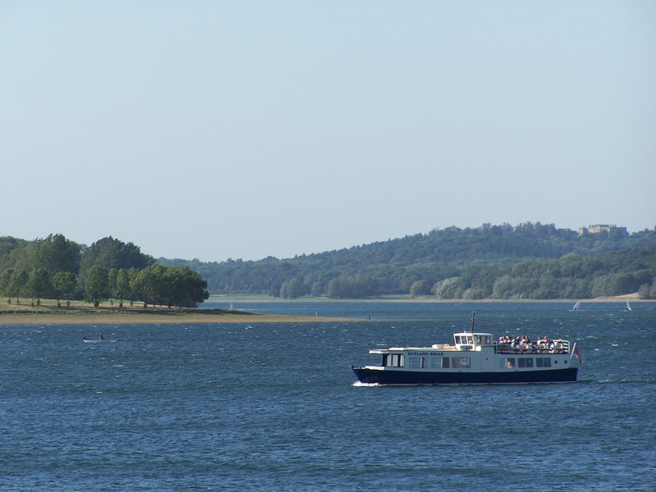
Right to be wrong?
Does a person have the right to be wrong in their worship of God without be prosecuted? Constantine and his child- the papacy- said no! Even the Creator of the universe gives men this right, but this arrogant, blasphemous, and devilish people demanded people to worship God their way. This went on for over a thousand years. Then, along came the Reformation and things would change or would they?

