Slide 1
Jesus Life, pt. 10 ‘Do it’
What He Says, DO IT!

Slide 2
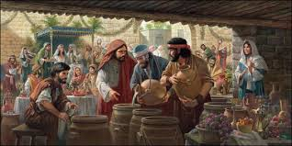
Of All Places
In the Garden of Eden, Jesus bequeathed to the human family two sacred institutions; the Sabbath and the marriage. How fitting then that His first miracle on earth would be performed at a marriage in Cana of Galilee!

Slide 3
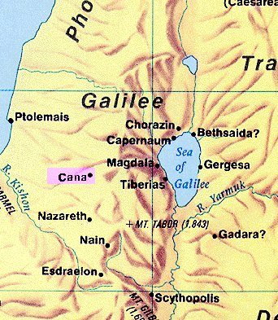
Obscure Cana
“And the third day there was a marriage in Cana of Galilee; and the mother of Jesus was there: And both Jesus was called, and his disciples, to the marriage. And when they wanted wine, the mother of Jesus saith unto him, They have no wine. Jesus saith unto her, Woman, what have I to do with thee? mine hour is not yet come.” John 2:1-4

Slide 4
In Sympathy with Men!
“Jesus did not begin His ministry by some great work before the Sanhedrin at Jerusalem. At a household gathering in a little Galilean village His power was put forth to add to the joy of a wedding feast. Thus He showed His sympathy with men, and His desire to minister to their happiness. In the wilderness of temptation He Himself had drunk the cup of woe. He came forth to give to men the cup of blessing, by His benediction to hallow the relations of human life.…At the marriage feast she meets Him, the same tender, dutiful son. Yet He is not the same. His countenance is changed. It bears the traces of His conflict in the wilderness, and a new expression of dignity and power gives evidence of His heavenly mission. With Him is a group of young men, whose eyes follow Him with reverence, and who call Him Master. These companions recount to Mary what they have seen and heard at the baptism and elsewhere. They conclude by declaring, “We have found Him, of whom Moses in the law, and the prophets, did write.” DA, pgs. 144,145

Slide 5
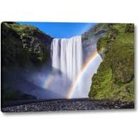
Jesus Speaks respectfully
“This answer, abrupt as it seems to us, expressed no coldness or discourtesy. The Saviour's form of address to His mother was in accordance with Oriental custom. It was used toward persons to whom it was desired to show respect. Every act of Christ's earthly life was in harmony with the precept He Himself had given, “Honor thy father and thy mother.” Exodus 20:12. On the cross, in His last act of tenderness toward His mother, Jesus again addressed her in the same way, as He committed her to the care of His best-loved disciple. Both at the marriage feast and upon the cross, the love expressed in tone and look and manner interpreted His words.”

Slide 6

Jesus spoke with the utmost respect to Mary. However, there was nothing in what He said to denote them being equals. He understood exactly who He was, the Savior of the world, and who Mary was. She was His mother and He was also her Savior. Mary, like everyone else, had to accept Christ as her Savior!! This is very recognizable from this passage!

Slide 7
Salvation in Jesus Alone!
“There was danger that Mary would regard her relationship to Jesus as giving her a special claim upon Him, and the right, in some degree, to direct Him in His mission. For thirty years He had been to her a loving and obedient son, and His love was unchanged; but He must now go about His Father's work. As Son of the Most High, and Saviour of the world, no earthly ties must hold Him from His mission, or influence His conduct. He must stand free to do the will of God. This lesson is also for us. The claims of God are paramount even to the ties of human relationship. No earthly attraction should turn our feet from the path in which He bids us walk. The only hope of redemption for our fallen race is in Christ; Mary could find salvation only through the Lamb of God. In herself she possessed no merit. Her connection with Jesus placed her in no different spiritual relation to Him from that of any other human soul. This is indicated in the Saviour's words. He makes clear the distinction between His relation to her as the Son of man and as the Son of God. The tie of kinship between them in no way placed her on an equality with Him.” DA, pgs. 146,147

Slide 8
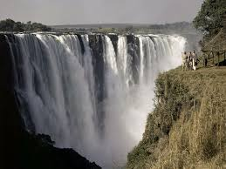
“His mother saith unto the servants, Whatsoever he saith unto you, do it.” John 2:5 In the first story of Mary, we find a similar position. With Gabriel, she said, “And Mary said, Behold the handmaid of the Lord; be it unto me according to thy word. And the angel departed from her.” Luke 1:38 Mary recognized in herself that she was nothing and that the Word of God was everything. She told the servants to follow whatever Jesus said. This would be the key to success then and now!

Slide 9
keynote of her Life
Before any of us will ever get to that point in our lives, we must realize that all we have inside us are as filthy rags and all our outward acts that appear good to men are as fecal material. When we renounce the outward ‘righteous deeds’ , admit that all we can produce inside is tainted with selfishness and uncleanness, THEN, and only then, will we depend on, cling to, and experience what Mary said, “Whatsoever He says unto you, DO IT!”
This was the experience of the apostle Paul when he declared, “But what things were gain to me, those I counted loss for Christ. Yea doubtless, and I count all things but loss for the excellency of the knowledge of Christ Jesus my Lord: for whom I have suffered the loss of all things, and do count them but dung, that I may win Christ, And be found in him, not having mine own righteousness, which is of the law, but that which is through the faith of Christ, the righteousness which is of God by faith: That I may know him, and the power of his resurrection, and the fellowship of his sufferings, being made conformable unto his death;” Philippians 3:7-10

Slide 10
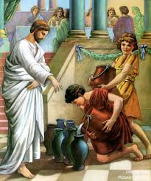
“And there were set there six waterpots of stone, after the manner of the purifying of the Jews, containing two or three firkins apiece. Jesus saith unto them, Fill the waterpots with water. And they filled them up to the brim. And he saith unto them, Draw out now, and bear unto the governor of the feast. And they bare it.” John 2:6-8

Slide 11
The Best for Those that Wait
“Beside the doorway stood six large stone water jars, and Jesus bade the servants fill these with water. It was done. Then as the wine was wanted for immediate use, He said, “Draw out now, and bear unto the governor of the feast.” Instead of the water with which the vessels had been filled, there flowed forth wine. Neither the ruler of the feast nor the guests generally were aware that the supply of wine had failed. Upon tasting that which the servants brought, the ruler found it superior to any he had ever before drunk, and very different from that served at the beginning of the feast. Turning to the bridegroom, he said, “Every man at the beginning doth set forth good wine; and when men have well drunk, then that which is worse: but thou hast kept the good wine until now.” DA, pg. 148

Slide 12
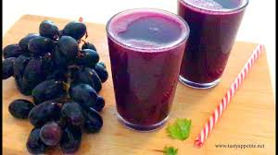
Oriental weddings always brought out the best first and then at the end served the diluted stuff. This was not the case with Christ’s juice. It was the best possible and it highly impressed the ruler in attendance!

Slide 13
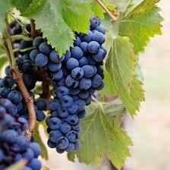
“The wine which Christ provided for the feast, and that which He gave to the disciples as a symbol of His own blood, was the pure juice of the grape. To this the prophet Isaiah refers when he speaks of the new wine “in the cluster,” and says, “Destroy it not; for a blessing is in it.” Isaiah 65:8. It was Christ who in the Old Testament gave the warning to Israel, “Wine is a mocker, strong drink is raging: and whosoever is deceived thereby is not wise.” Proverbs 20:1. And He Himself provided no such beverage. Satan tempts men to indulgence that will becloud reason and benumb the spiritual perceptions, but Christ teaches us to bring the lower nature into subjection. His whole life was an example of self-denial. In order to break the power of appetite, He suffered in our behalf the severest test that humanity could endure.” DA, pg. 149

Slide 14
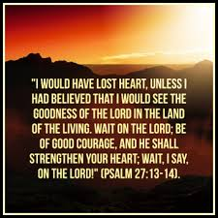
In order to taste of God’s goodness and faithfulness, we need to learn to wait for Him to work. This is a critical lesson we ALL need to learn. “To wait patiently, to trust when everything looks dark, is the lesson that the leaders in God’s work need to learn. Heaven will not fail them in their day of adversity. Nothing is apparently more helpless, yet really more invincible, than the soul that feels its nothingness and relies wholly on God . . .” PK. Pg. 174, 175

Slide 15
“As men set forth the best wine first, then afterward that which is worse, so does the world with its gifts. That which it offers may please the eye and fascinate the senses, but it proves to be unsatisfying. The wine turns to bitterness, the gaiety to gloom. That which was begun with songs and mirth ends in weariness and disgust. But the gifts of Jesus are ever fresh and new. The feast that He provides for the soul never fails to give satisfaction and joy. Each new gift increases the capacity of the receiver to appreciate and enjoy the blessings of the Lord. He gives grace for grace. There can be no failure of supply. If you abide in Him, the fact that you receive a rich gift today insures the reception of a richer gift tomorrow. The words of Jesus to Nathanael express the law of God's dealing with the children of faith. With every fresh revelation of His love, He declares to the receptive heart, “Believest thou? thou shalt see greater things than these.” John 1:50.” DA, pg. 148

Slide 16

“It is of the LORD'S mercies that we are not consumed, because his compassions fail not. They are new every morning: great is thy faithfulness. The LORD is my portion, saith my soul; therefore will I hope in him. The LORD is good unto them that wait for him, to the soul that seeketh him. It is good that a man should both hope and quietly wait for the salvation of the LORD.” Lamentations 3:22-26

Slide 17

“Jesus reproved self-indulgence in all its forms, yet He was social in His nature. He accepted the hospitality of all classes, visiting the homes [151] of the rich and the poor, the learned and the ignorant, and seeking to elevate their thoughts from questions of commonplace life to those things that are spiritual and eternal. He gave no license to dissipation, and no shadow of worldly levity marred His conduct; yet He found pleasure in scenes of innocent happiness, and by His presence sanctioned the social gathering. A Jewish marriage was an impressive occasion, and its joy was not displeasing to the Son of man.” DA, pg. 150, 151

