Slide 1
Balaam
`An Ass Spoke to Him!’

Slide 2
Had it All!
“Balaam was once a good man and a prophet of God; but he had apostatized, and had given up to covetousness; yet he still professed to be a servant of the Most High. He was not ignorant of God's work in behalf of Israel; and when the messengers announced their errand, he well knew that it was his duty to refuse the rewards of Balak and to dismiss the ambassadors. But he ventured to dally with temptation, and urged the messengers to tarry with him that night, declaring that he could give no decided answer till he had asked counsel of the Lord. Balaam knew that his curse could not harm Israel. God was on their side, and so long as they were true to Him no adverse power of earth or hell could prevail against them. But his pride was flattered by the words of the ambassadors, "He whom thou blessest is blessed, and he whom thou cursest is cursed” PP. pg. 439

Slide 3
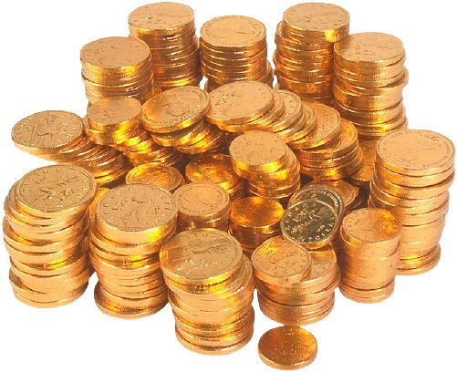
Wanted More Than ALL!!
" The bribe of costly gifts and prospective exaltation excited his covetousness. He greedily accepted the offered treasures, and then, while professing strict obedience to the will of God, he tried to comply with the desires of Balak.” PP, 439

Slide 4

A Mad Man!
“Which have forsaken the right way, and are gone astray, following the way of Balaam the son of Bosor, who loved the wages of unrighteousness; But was rebuked for his iniquity: the dumb ass speaking with man's voice forbad the madness of the prophet.” 2Peter 2:15,16

Slide 5
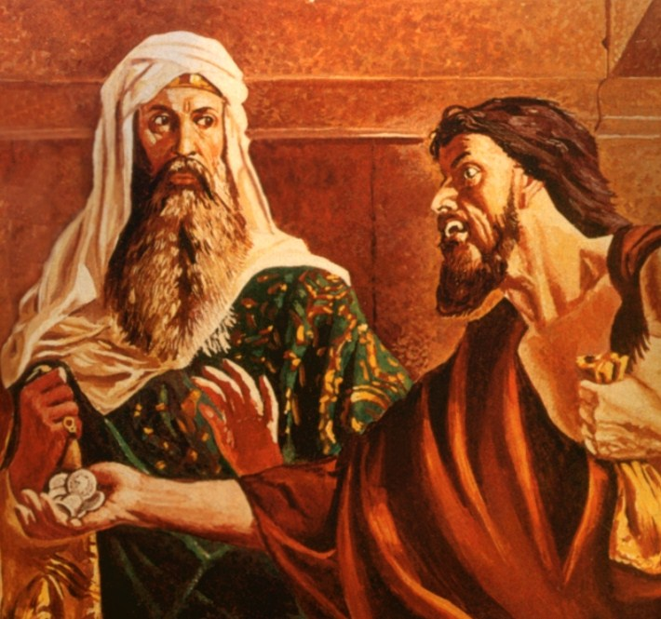
Destruction
“Judas had naturally a strong love for money; but he had not always been corrupt enough to do such a deed as this. He had fostered the evil spirit of avarice until it had become the ruling motive of his life. The love of mammon overbalanced his love for Christ. Through becoming the slave of one vice he gave himself to Satan, to be driven to any lengths in sin.” Desire of Ages, pg. 716

Slide 6
The Visit
“He sent messengers therefore unto Balaam the son of Beor to Pethor, which is by the river of the land of the children of his people, to call him, saying, Behold, there is a people come out from Egypt: behold, they cover the face of the earth, and they abide over against me: Come now therefore, I pray thee, curse me this people; for they are too mighty for me: peradventure I shall prevail, that we may smite them,” Numbers 22:5,6
“The hosts of Bashan had yielded before the mysterious power enshrouded in the cloudy pillar, and the giant strongholds were occupied by the Hebrews. The Moabites dared not risk an attack upon them; an appeal to arms was hopeless in face of the supernatural agencies that wrought in their behalf. But they determined, as Pharaoh had done, to enlist the power of sorcery to counteract the work of God. They would bring a curse upon Israel.” PP, 438

Slide 7
Balaam
“And Balaam rose up in the morning, and said unto the princes of Balak, Get you into your land: for the LORD refuseth to give me leave to go with you. And the princes of Moab rose up, and they went unto Balak, and said, Balaam refuseth to come with us. And Balak sent yet again princes, more, and more honourable than they. And they came to Balaam, and said to him, Thus saith Balak the son of Zippor, Let nothing, I pray thee, hinder thee from coming unto me: For I will promote thee unto very great honour, and I will do whatsoever thou sayest unto me: come therefore, I pray thee, curse me this people. And Balaam answered and said unto the servants of Balak, If Balak would give me his house full of silver and gold, I cannot go beyond the word of the LORD my God, to do less or more. Now therefore, I pray you, tarry ye also here this night, that I may know what the LORD will say unto me more. And God came unto Balaam at night, and said unto him, If the men come to call thee, rise up, [and] go with them; but yet the word which I shall say unto thee, that shalt thou do.” Numbers 22:13-20

Slide 8
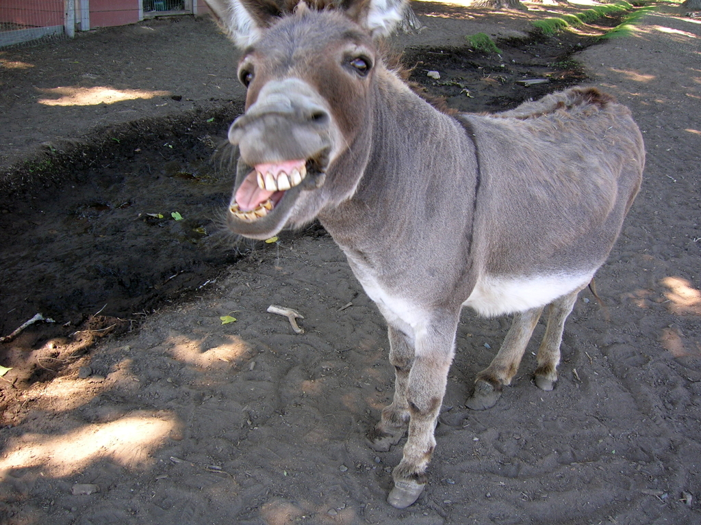
Talking Donkey
“Balaam owed the preservation of his life to the poor animal that he had treated so cruelly. The man who claimed to be a prophet of the Lord, who declared that his eyes were open, and he saw the "vision of the Almighty," was so blinded by covetousness and ambition that he could not discern the angel of God visible to his beast. "The god of this world hath blinded the minds of them which believe not." 2 Corinthians 4:4. How many are thus blinded! They rush on in forbidden paths, transgressing the divine law, and cannot discern that God and His angels are against them. Like Balaam they are angry at those who would prevent their ruin.” PP, 442

Slide 9
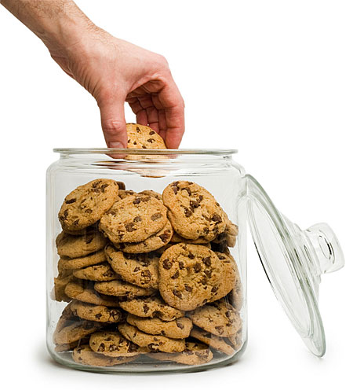
Balaam’s Response
“And the ass saw me, and turned from me these three times: unless she had turned from me, surely now also I had slain thee, and saved her alive. And Balaam said unto the angel of the LORD, I have sinned; for I knew not that thou stoodest in the way against me: now therefore, if it displease thee, I will get me back again. And the angel of the LORD said unto Balaam, Go with the men: but only the word that I shall speak unto thee, that thou shalt speak. So Balaam went with the princes of Balak.” Numbers 22:33-35

Slide 10
Sorry?!?!?
Repentance includes sorrow for sin and a turning away from it. We shall not renounce sin unless we see its sinfulness; until we turn away from it in heart, there will be no real change in the life. There are many who fail to understand the true nature of repentance. Multitudes sorrow that they have sinned and even make an outward reformation because they fear that their wrongdoing will bring suffering upon themselves. But this is not repentance in the Bible sense. They lament the suffering rather than the sin. Such was the grief of Esau when he saw that the birthright was lost to him forever. Balaam, terrified by the angel standing in his pathway with drawn sword, acknowledged his guilt lest he should lose his life; but there was no genuine repentance for sin, no conversion of purpose, no abhorrence of evil. Judas Iscariot, after betraying his Lord, exclaimed, "I have sinned in that I have betrayed the innocent blood." Matthew 27:4. The confession was forced from his guilty soul by an awful sense of condemnation and a fearful looking for of judgment. The consequences that were to result to him filled him with terror, but there was no deep, heartbreaking grief in his soul, that he had betrayed the spotless Son of God and denied the Holy One of Israel.” Steps to Christ, pgs. 23,24

Slide 11
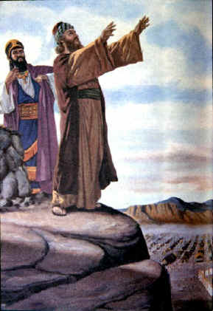
Balaam Blesses
“How shall I curse, whom God hath not cursed? or how shall I defy, whom the LORD hath not defied? For from the top of the rocks I see him, and from the hills I behold him: lo, the people shall dwell alone, and shall not be reckoned among the nations. Who can count the dust of Jacob, and the number of the fourth [part] of Israel? Let me die the death of the righteous, and let my last end be like his!” Numbers 23:8-10

Slide 12

Someone Was Watching
“And he took up his parable, and said, Balaam the son of Beor hath said, and the man whose eyes are open hath said: He hath said, which heard the words of God, which saw the vision of the Almighty, falling into a trance, but having his eyes open: How goodly are thy tents, O Jacob, and thy tabernacles, O Israel!” Numbers 24:3-5

Slide 13
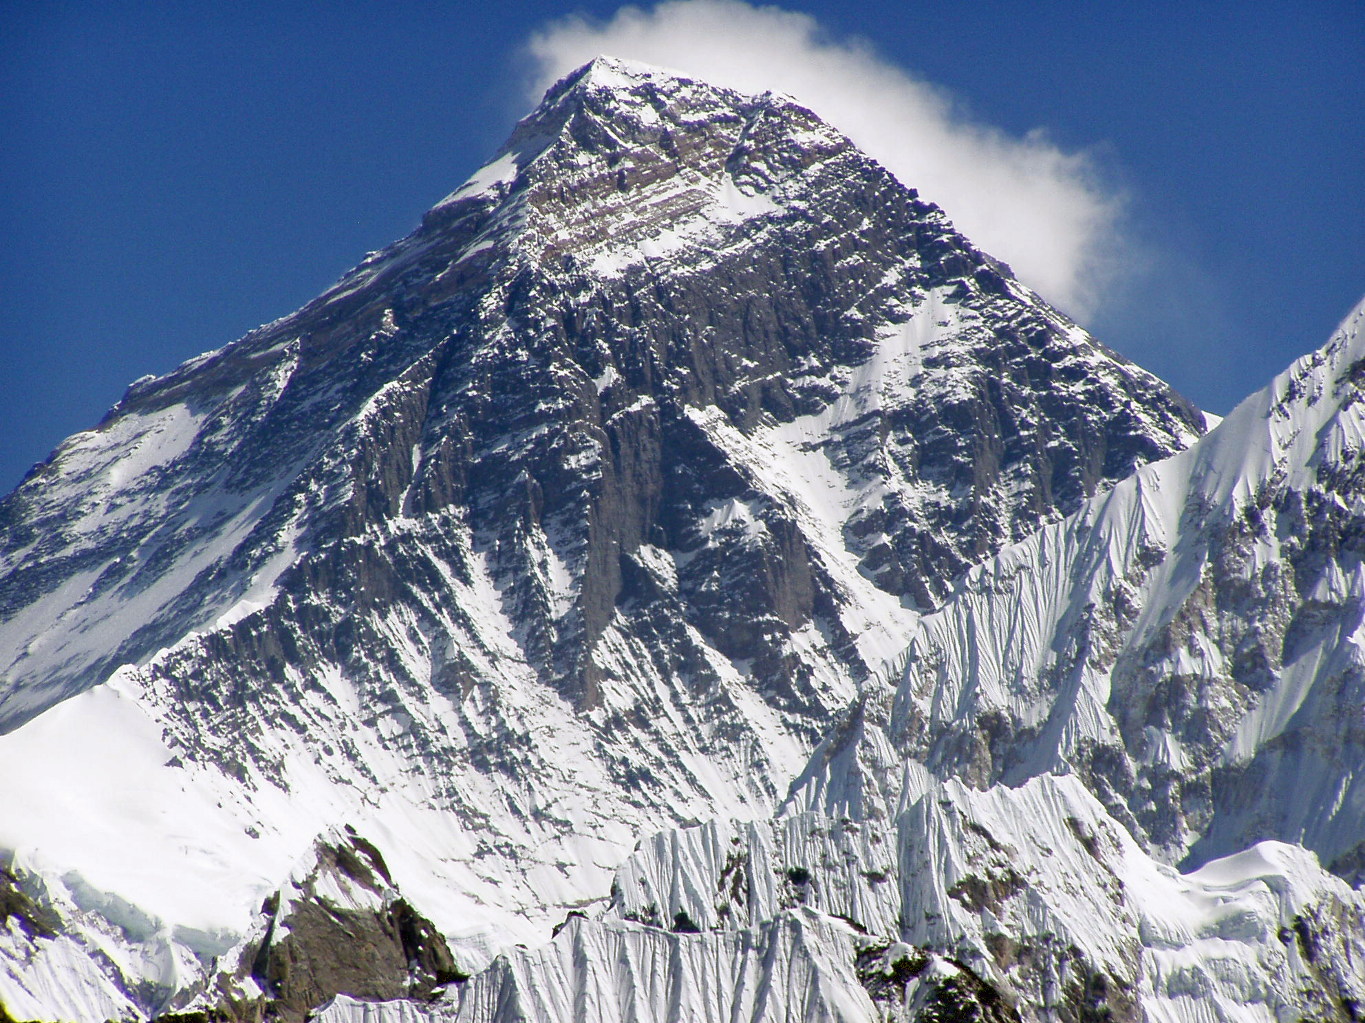
El Shaddai
“He hath said, which heard the words of God, and knew the knowledge of the most High, which saw the vision of the Almighty, falling into a trance, but having his eyes open: I shall see him, but not now: I shall behold him, but not nigh: there shall come a Star out of Jacob, and a Sceptre shall rise out of Israel, and shall smite the corners of Moab, and destroy all the children of Sheth.” Numbers 24:16,17

Slide 14
Mighty and Tender
El Shaddai has as its base the Hebrew word shad. Shad denotes a mother’s breast! From Leslie Hardinge’s book, “His Name is Wonderful”, “This idea of almightiness, illustrated by a mother’s breasts, is colored by her unique relationship to her infant… The mother loves her newborn because he is totally helpless, completely dependant and utterly vulnerable, and so she continues to give him everything she has and seeks to anticipate all his needs... She is able to provide his mental, physical, psychological, emotional, and social needs at her breasts.” Pg.56&57

Slide 15
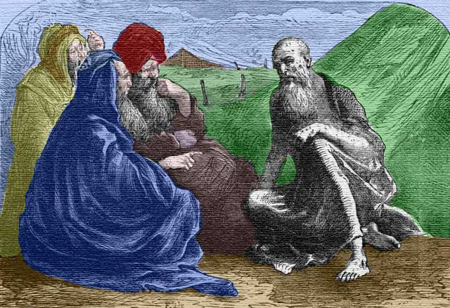
31 out of 46
Of the 46 times in the Old Testament where God is referred to as El Shaddai, 31 of them are mentioned in the book of Job. Job needed to know that El Shaddai was there, nurturing and comforting His child. El Shaddai saw His people on the shores of Canaan. He guards His children still!!!

Slide 16
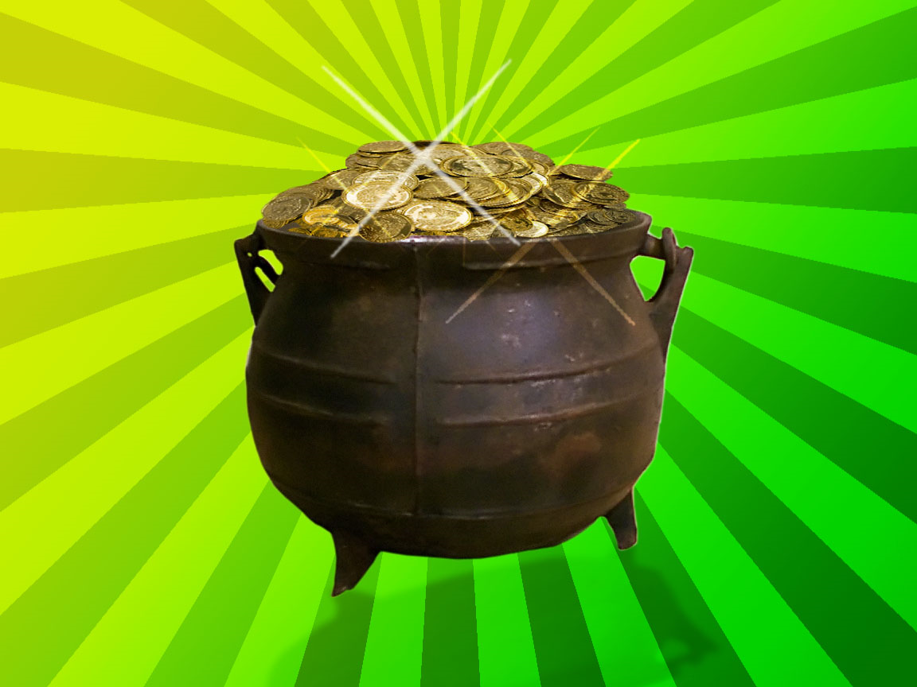
He couldn’t do it!!!
“And Balaam rose up, and went and returned to his place: and Balak also went his way.” Numbers 24:25
Balaam was furious and angry; he didn’t get what he wanted!
He wasn’t finished. His covetousness knew no bounds; he would get his way!!

Slide 17
The Result
“And Israel abode in Shittim, and the people began to commit whoredom with the daughters of Moab. And they called the people unto the sacrifices of their gods: and the people did eat, and bowed down to their gods. And Israel joined himself unto Baalpeor: and the anger of the LORD was kindled against Israel… And Moses said unto the judges of Israel, Slay ye every one his men that were joined unto Baalpeor. And, behold, one of the children of Israel came and brought unto his brethren a Midianitish woman in the sight of Moses, and in the sight of all the congregation of the children of Israel, who [were] weeping [before] the door of the tabernacle of the congregation. And when Phinehas, the son of Eleazar, the son of Aaron the priest, saw [it], he rose up from among the congregation, and took a javelin in his hand; And he went after the man of Israel into the tent, and thrust both of them through, the man of Israel, and the woman through her belly. So the plague was stayed from the children of Israel. And those that died in the plague were twenty and four thousand.” Numbers 25:1-9

Slide 18
Balaam’s Plan
“… after a time Midianitish women began to steal into the camp. Their appearance excited no alarm, and so quietly were their plans conducted that the attention of Moses was not called to the matter. It was the object of these women, in their association with the Hebrews, to seduce them into transgression of the law of God, to draw their attention to heathen rites and customs, and lead them into idolatry. These motives were studiously concealed under the garb of friendship, so that they were not suspected, even by the guardians of the people. At Balaam's suggestion, a grand festival in honor of their gods was appointed by the king of Moab, and it was secretly arranged that Balaam should induce the Israelites to attend. He was regarded by them as a prophet of God, and hence had little difficulty in accomplishing his purpose. Great numbers of the people joined him in witnessing the festivities. They ventured upon the forbidden ground, and were entangled in the snare of Satan. Beguiled with music and dancing, and allured by the beauty of heathen vestals, they cast off their fealty to Jehovah.” PP, pg. 454

Slide 19
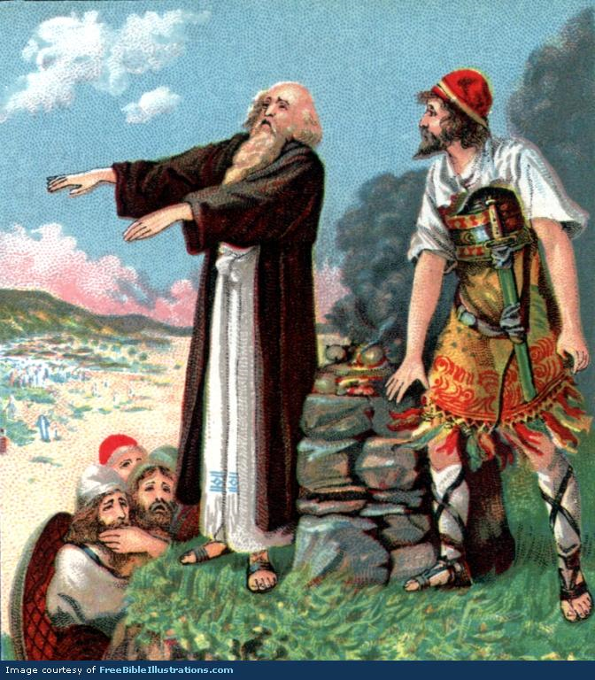
The Culprit
“And they slew the kings of Midian, beside the rest of them that were slain; namely, Evi, and Rekem, and Zur, and Hur, and Reba, five kings of Midian: Balaam also the son of Beor they slew with the sword…
Behold, these caused the children of Israel, through the counsel of Balaam, to commit trespass against the LORD in the matter of Peor, and there was a plague among the congregation of the LORD.” Numbers 31:8,16

