Slide 1
Atonement ABC’s
Atonement in Pictures

Slide 2
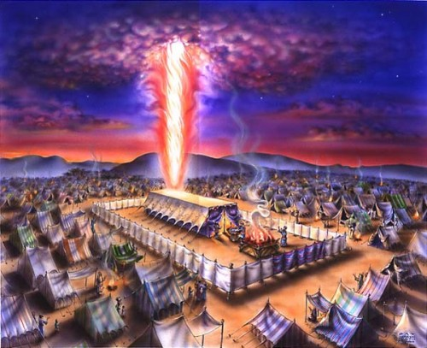
The Picture

Slide 3
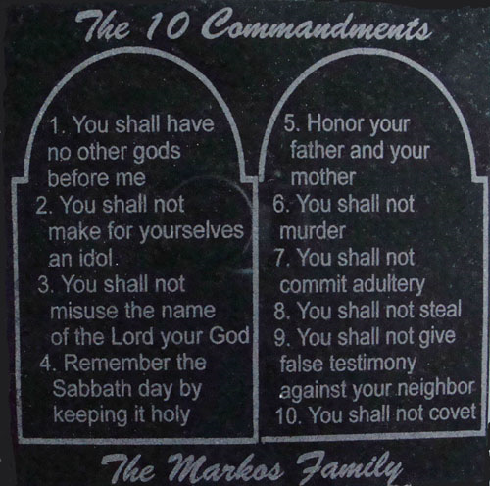
The Process
“And if any one of the common people sin through ignorance, while he doeth somewhat against any of the commandments of the LORD concerning things which ought not to be done, and be guilty;” Leviticus 4:27
The law of God, the ten commandments, revealed sin.

Slide 4
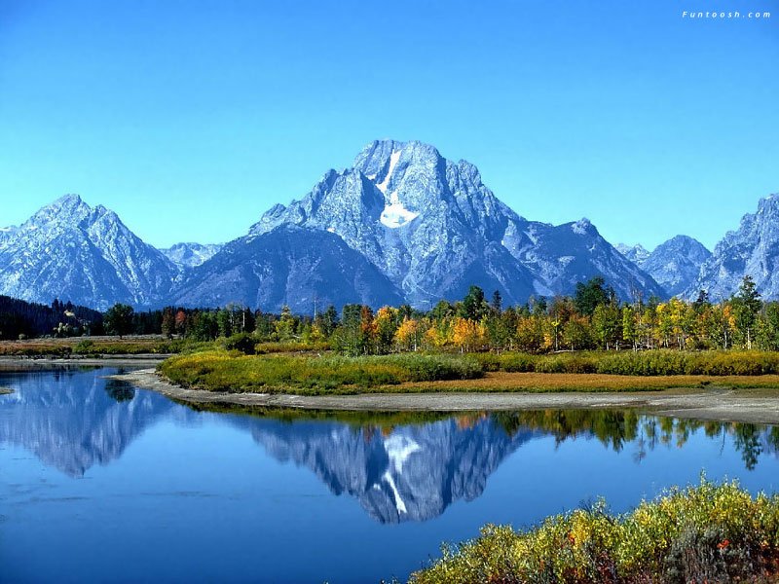
Definition for sin
The law reveals sin. It can’t save; it can’t give life; it can’t give anything but condemnation to the human being.
“What shall we say then? Is the law sin? God forbid. Nay, I had not known sin, but by the law: for I had not known lust, except the law had said, Thou shalt not covet.” Romans 7:7

Slide 5
The Schoolmaster
“ Is the law then against the promises of God? God forbid: for if there had been a law given which could have given life, verily righteousness should have been by the law. But the scripture hath concluded all under sin, that the promise by faith of Jesus Christ might be given to them that believe. But before faith came, we were kept under the law, shut up unto the faith which should afterwards be revealed. Wherefore the law was our schoolmaster to bring us unto Christ, that we might be justified by faith. But after that faith is come, we are no longer under a schoolmaster.” Galatians 3:21-25

Slide 6
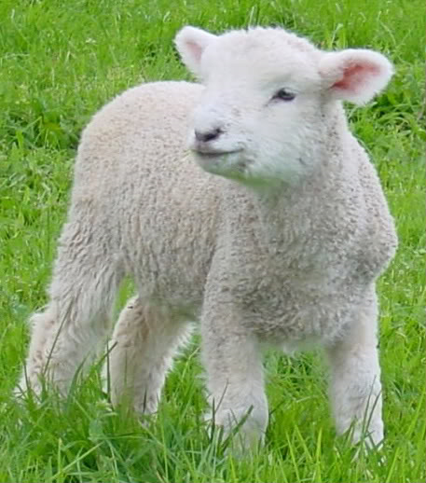
The answer comes from without
“Or if his sin, which he hath sinned, come to his knowledge: then he shall bring his offering, a kid of the goats, a female without blemish, for his sin which he hath sinned.” Leviticus 4:28
The sinner had nothing in himself that could satisfy the righteous claims of the law of God. He stands utterly condemned and without hope unless Someone could be found to satisfy the claims of that law.

Slide 7
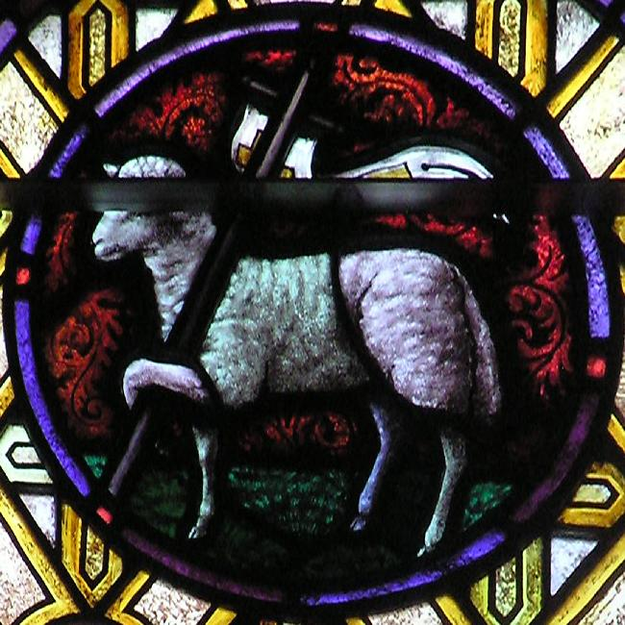
One Had to pay the penalty
Innocent, pure, and utterly willing, the lamb went to His death.
“ All we like sheep have gone astray; we have turned every one to his own way; and the LORD hath laid on him the iniquity of us all. He was oppressed, and he was afflicted, yet he opened not his mouth: he is brought as a lamb to the slaughter, and as a sheep before her shearers is dumb, so he openeth not his mouth.” Isaiah 53:6,7
“The next day John seeth Jesus coming unto him, and saith, Behold the Lamb of God, which taketh away the sin of the world.” John 1:29

Slide 8
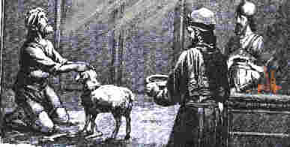
Confession
“And he shall lay his hand upon the head of the sin offering, and slay the sin offering in the place of the burnt offering.” Leviticus 4:29
By laying his hand upon the innocent lamb, the individual was confessing his sin. This was to teach the person that is was his sin that caused the death of the innocent. It was designed to teach how heinous sin is in the sight of a holy God and that it will have a punishment.
Included in the confession was to be a sorrow for the act that bruised the heart of God and would one day kill His Son! As the person realized what his sin had caused, hopefully, it would lead him to pray, “Create in me a clean heart, O God; and renew a right spirit within me.” Ps. 51:10
Without this heartache for sin and its results, it could lead one to believe that God loves the sight of blood or we can do whatever we want and then say we are sorry and its all right too. The confessional!!

Slide 9

Confess and Forsake
“"He that covereth his sins shall not prosper: but whoso confesseth and forsaketh them shall have mercy." Proverbs 28:13.
The conditions of obtaining mercy of God are simple and just and reasonable. The Lord does not require us to do some grievous thing in order that we may have the forgiveness of sin. We need not make long and wearisome pilgrimages, or perform painful penances, to commend our souls to the God of heaven or to expiate our transgression; but he that confesseth and forsaketh his sin shall have mercy.” Steps to Christ, pg. 37

Slide 10
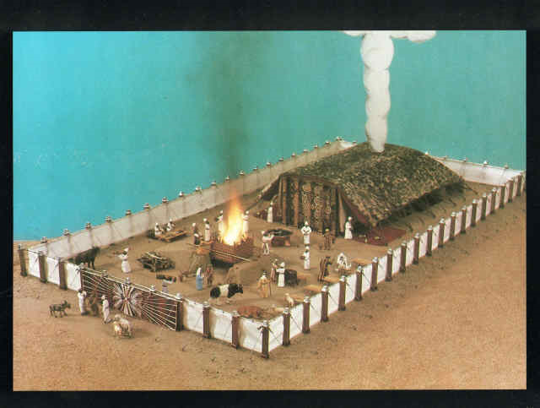
Death of Sacrifice Not Enough!!
As great as the sacrifice of Jesus Christ was for the sins of humanity, it was not the end of the plan of salvation. When the sacrifice was slain, the Bible does not say, at that point, that the person’s sins were forgiven, nor that the atonement was made!!

Slide 11
Priestly Intervention
“And the priest shall take of the blood thereof with his finger, and put [it] upon the horns of the altar of burnt offering, and shall pour out all the blood thereof at the bottom of the altar. And he shall take away all the fat thereof, as the fat is taken away from off the sacrifice of peace offerings; and the priest shall burn [it] upon the altar for a sweet savour unto the LORD; and the priest shall make an atonement for him, and it shall be forgiven him.” Leviticus 4:30,31

Slide 12
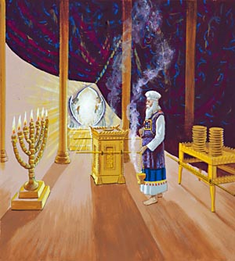
Vital in the plan of salvation
The work of the priest was just as much a part of atonement as was the sacrifice. The sin problem was not dealt with until the priest had mediated the blood. From this, we see that atonement has to do with anything that deals with the sin problem!! Once the priest mediated the blood , there was forgiveness. Atonement was not complete at the cross!

Slide 13
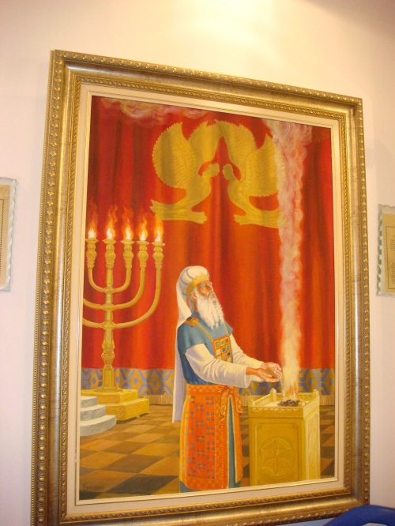
Essential
“The intercession of Christ in man's behalf in the sanctuary above is as essential to the plan of salvation as was His death upon the cross. By His death He began that work which after His resurrection He ascended to complete in heaven. We must by faith enter within the veil, "whither the forerunner is for us entered." Hebrews 6:20. There the light from the cross of Calvary is reflected. There we may gain a clearer insight into the mysteries of redemption. The salvation of man is accomplished at an infinite expense to heaven; the sacrifice made is equal to the broadest demands of the broken law of God. Jesus has opened the way to the Father's throne, and through His mediation the sincere desire of all who come to Him in faith may be presented before God.” GC, pg. 489

Slide 14

Some Wrong Answers
1. Legal forgiveness is all that matters.
2. Once you accept Christ, you are saved no matter what you may do.
3. Some are destined to be saved and others to be lost. If you are in the elect, don’t worry.
4. Because of Christ’s death, all mankind is saved.

Slide 15
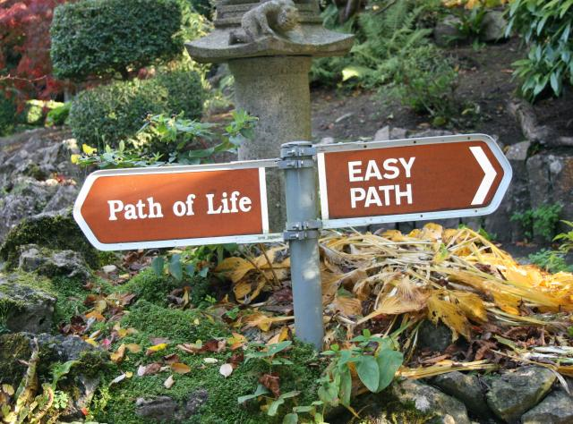
God Doesn’t Take away the power of Choice
Once we accept Christ’s forgiveness and are legally forgiven by God, we do not stop making choices. We do not become robots. We can choose to step away from the forgiveness of Christ and we can choose our own way. The Day of Atonement answers a simple question; is the person, who once embraced the forgiveness and love of God, still choosing to follow Christ when the Day of Atonement comes or at the end of his life? Am I still claiming Christ in my life when my name comes up in the judgment?

Slide 16
An Attorney Speaks
“But is that gift of life irrevocable, or is it contingent? To put it another way, by believing in Jesus does one thereby lose the freedom to change one’s mind? Evidently not; a great number of backsliders makes that point all too evident. The gift of life is bestowed with the condition of accepting Christ-with all that implies, including accepting Him as part of one’s own life. The relationship is more than a one-time contact; it is an ongoing connection, and to lose it brings tragic consequences…While belief in Christ calls into being the legal right to live forever, that gift cannot be granted irrevocably until there is no possibility that a person will change his mind and return to sin…God is confronted by persons stating a request that He cannot deny-eternal life in the name of Jesus. But He is also dealing with human beings, whose freedom of choice gives them the ability to change their minds.” Walton, Decision at the Jordan, pg. 67

Slide 17
Oh yes you are!
The investigative judgment is the only logical, legal, and lawful answer to the plan of salvation. God grants legal forgiveness for anyone who comes to Him. However, God also realizes that people can change their mind after accepting Him as their Savior. He therefore enters, as Western law defines it, an interlocutory judgment on behalf of those who have accepted Him. When we accept Christ as our Savior, this ices the fact that we will come up in the judgment. “For the time [is come] that judgment must begin at the house of God: and if [it] first [begin] at us, what shall the end [be] of them that obey not the gospel of God?” 1 Peter 4:17
This entitles a person everything God has promised, but also takes note of one’s free choice. For those at the end of their probationary time, who are still choosing Christ as their Savior and Lord, they will be granted everything to which the plan of salvation entitles them; even eternal life!

Slide 18
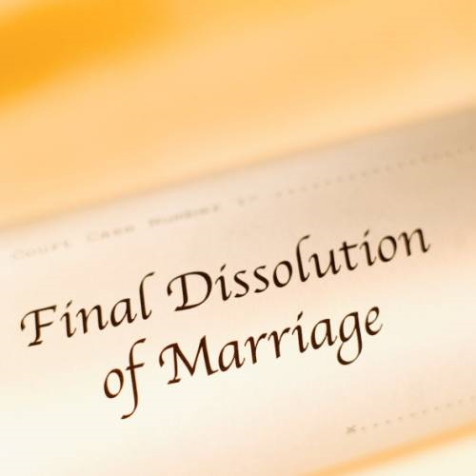
An interlocutory judgment?!?
When someone comes to the judge requesting a divorce, the grieving indivual has every right to get one. However, the judge doesn’t grant it immediately because he recognizes that the person could change his/her mind. Therefore, he enters an interlocutory judgment. This means that the person is legally entitled to the divorce, but will have to wait for a time, to see if that is what the person really wantsd. If, after a certain time, the person returns to court, still requesting for the divorce, then the judge, based on the firm decision that time has made strong, grants his/her request.
Some way in the plan of salvation!! We are human beings with free choice, ready to change our mind. God grants us time to reveal our true desires; whether we want to follow Him, or go back to worldly things! If at the end of our probation, we are still choosing Christ, then we are given the gift of eternal life!!!

Slide 19
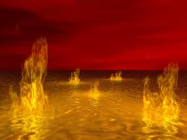
Atonement Goes On….
“And the LORD spake unto Moses, saying, Phinehas, the son of Eleazar, the son of Aaron the priest, hath turned my wrath away from the children of Israel, while he was zealous for my sake among them, that I consumed not the children of Israel in my jealousy. Wherefore say, Behold, I give unto him my covenant of peace: And he shall have it, and his seed after him, [even] the covenant of an everlasting priesthood; because he was zealous for his God, and made an atonement for the children of Israel.” Numbers 25:10-13

Slide 20

All Over
Atonement involves anything that takes care of the sin problem. That includes sacrifice, mediation, and even Phinehas slaying those people in open sin in Israel. Atonement will go for the universe until sin is cast into the lake of fire. Ultimately, sin, then, will be eradicated from the universe and atonement will be complete!
Praise God!!

