Slide 1

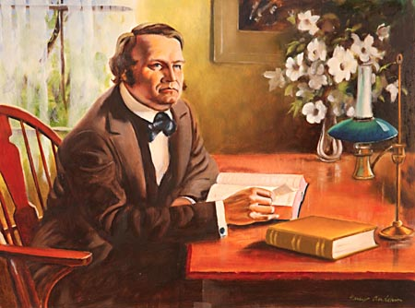
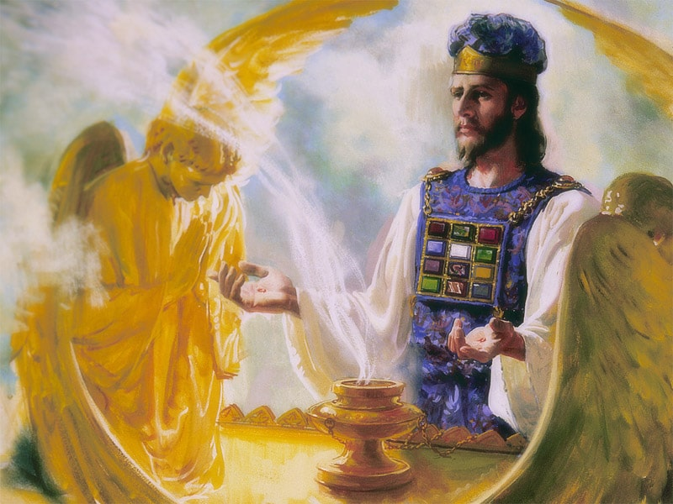
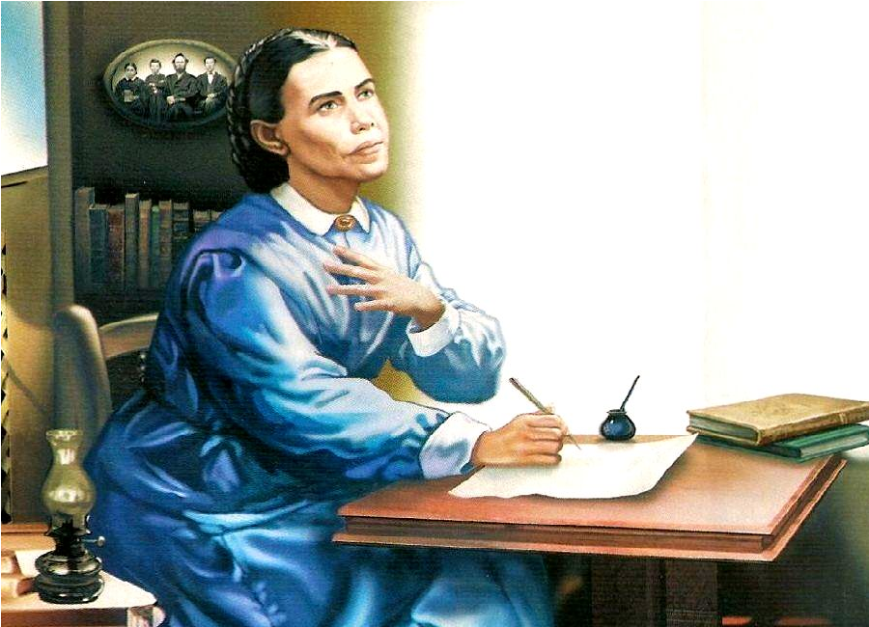

The 2300 Days

Slide 2
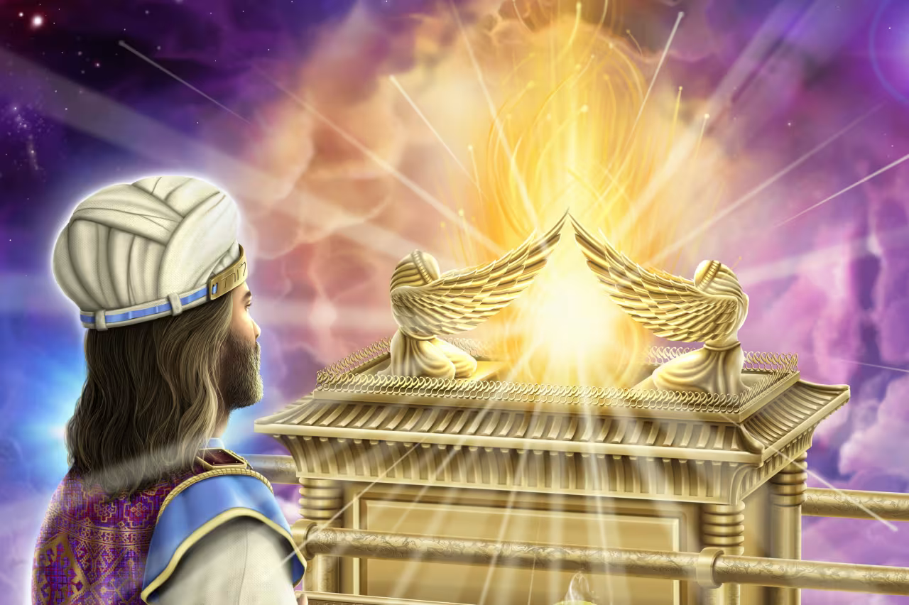
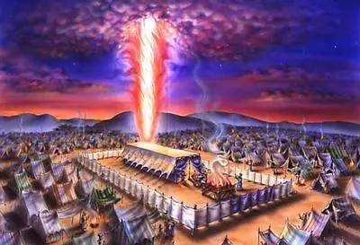
Recap…
We have now seen unequivocally that the Millerite Movement was the event that Daniel 8:14 was pointing towards. 457BC – 1844AD was the mark of the 2300 year prophecy. Needing a correction based on the improper calendar, and again with Samuel Snow’s 7-month message. Pagan/Papal Rome destroyed the sanctuary doctrine and the daily—the Reformation began rebuilding the fallen Sanctuary doctrines, which culminated in the ultimate restoration of the yearly—this occurred on the Antitypical Day of Atonement October 22, 1844; the sanctuary was restored after the Great Disappointment pushed 50 Millerites to their Bibles—Hiram Edson saw a vision in the cornfields as he walked seeing Jesus entering into the most holy place (which is what the true meaning of “then shall the sanctuary be cleansed” intended).

Slide 3
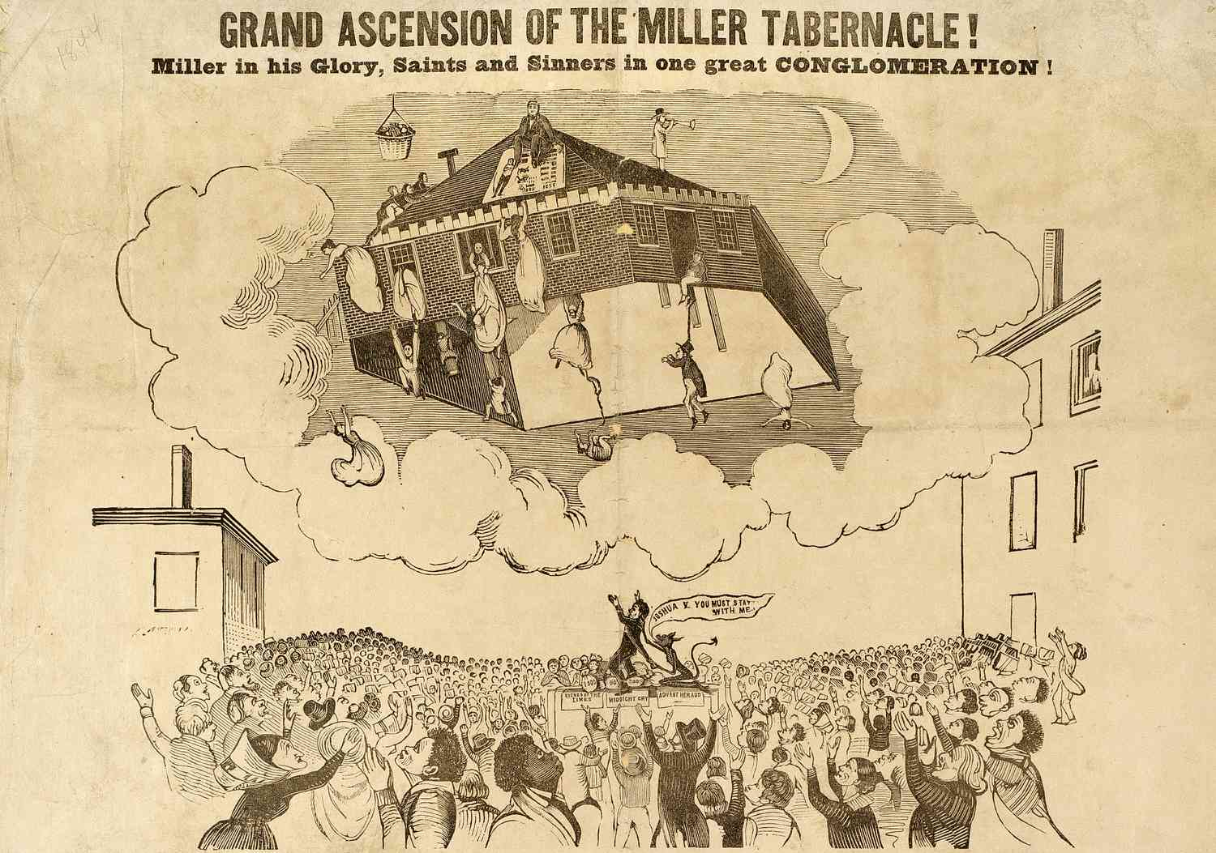
Recap Continued…
The Millerite Movement stands on the stage of earth without a peer. This is the only movement that occurred at the correct time [1844], on the correct day [Day of Atonement Oct. 22,1844], restored the sanctuary doctrine [yearly] and there is literally nothing else that comes close. It was a worldwide message, based on Scripture, highlighted a prophecy but misunderstood the event (Just like the Great Disappoint of the Disciples), but is there any more evidence from the Bible and history that the Millerite Movement is the only movement that fits prophecy?

Slide 4
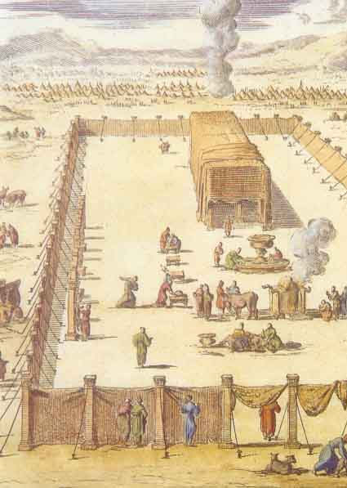
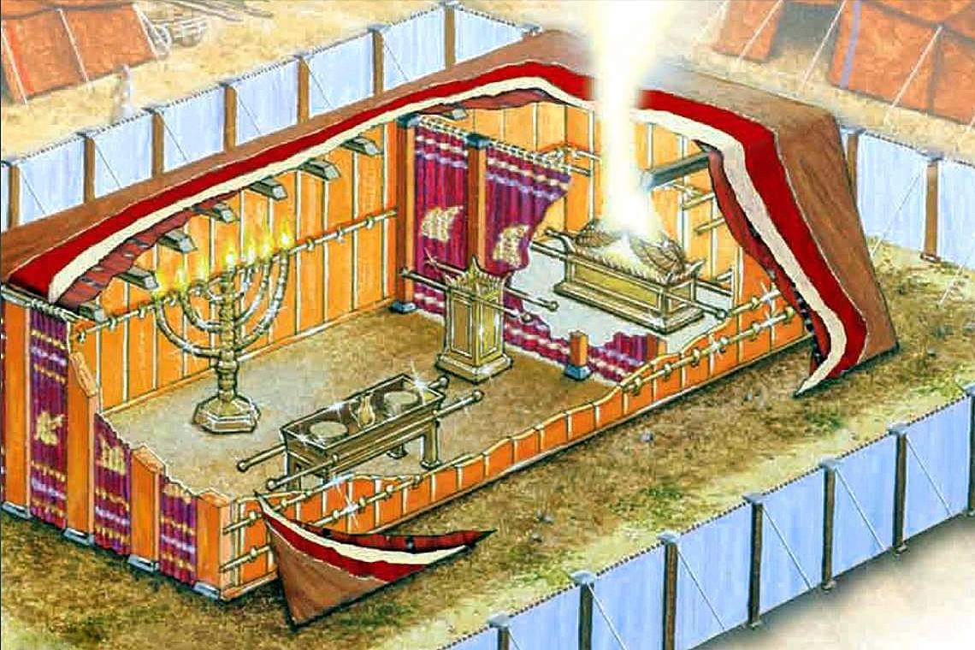
Daniel 8 Revisited…
Dan. 8:11-14 “Yea, he magnified himself even to the prince of the host, and by him the daily sacrifice was taken away, and the place of the sanctuary was cast down. And an host was given him against the daily sacrifice by reason of transgression, and it cast down the truth to the ground; and it practised, and prospered. Then I heard one saint speaking, and another saint said unto that certain saint which spake, How long shall be the vision concerning the daily sacrifice, and the transgression of desolation, to give both the sanctuary and the host to be trodden under foot? And he said unto me, Unto two thousand and three hundred days; then shall the sanctuary be cleansed.”

Slide 5
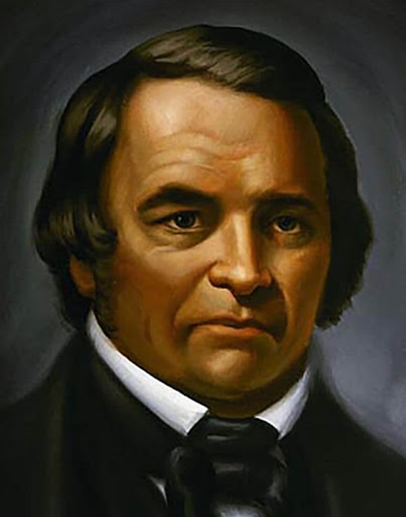
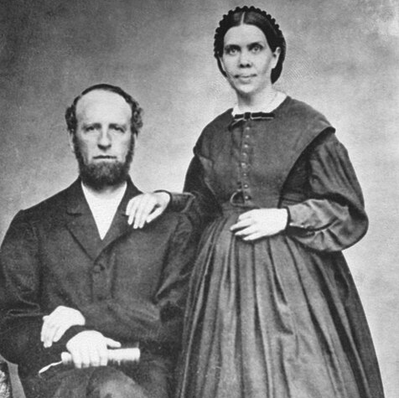
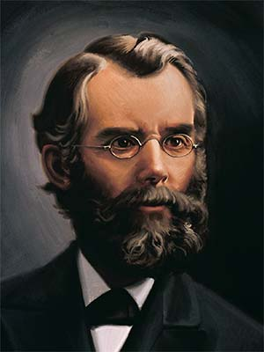
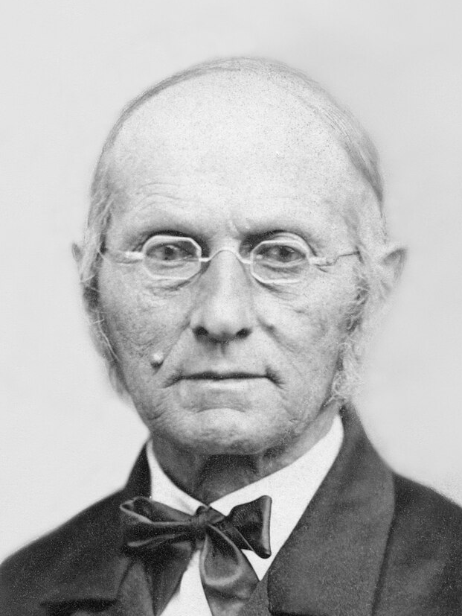
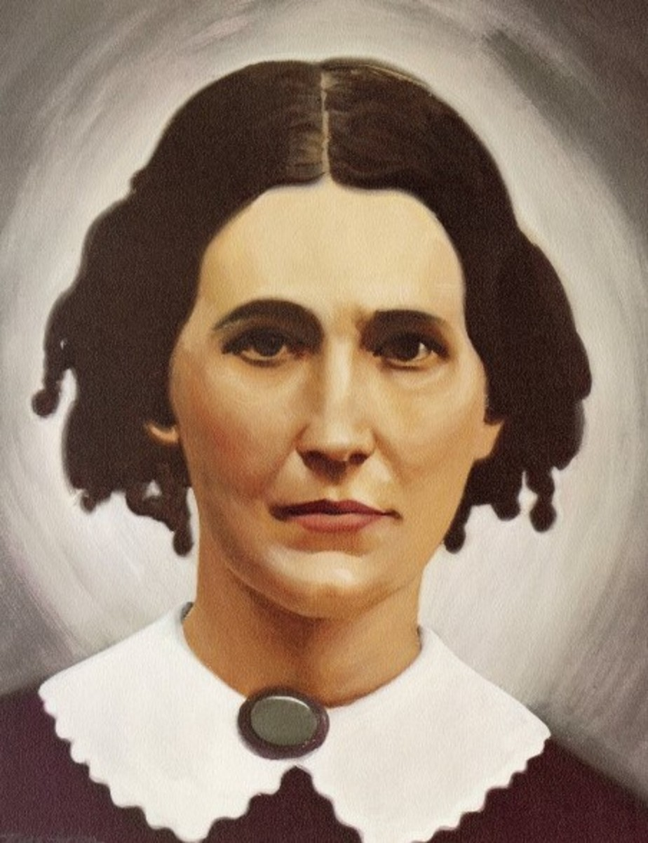
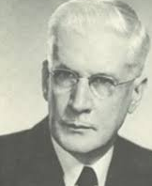
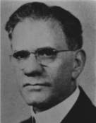
The Fruits Testify…
William Miller’s Millerite Movement bore massive fruits. Picking up where the Reformation stalled, the Millerites began studying the Bible like never before and rediscovered important Bible truths like: The State of the Dead, Prophecies of Daniel and Revelation, The Sabbath, The Investigative Judgment, The Sanctuary, Atonement, Health Principles, Binding Claims of the Law of God, Righteousness by Faith, Importance of Evangelism, Prayer, and Reading, Devotion Time, The Literal Second Coming of Christ, the Remnant, Present Truth, and more. The gift of the Spirit of Prophecy was given to Ellen White to guide this rediscovery. James and Ellen White [top right] devoted their lives to the proclamation of the 3rd Angel’s Message; Joseph Bates and Rachel Oaks [middle right] worked to reestablish the 7th Day Sabbath; John N. Andrews [middle left] was the 1st missionary to Europe and wrote the book The History of the Sabbath; Francis Nichol [bottom left] was an editor, sanitarium official, and apologetics author who wrote many works defending Adventism; Benjamin Wilkinson [bottom right] was a university professor and authored Truth Triumphant. Other names worthy of note include: JN Loughborough, Spalding & Magan, Stephen Haskell, Hyram Edson, Sylvester Bliss, ML Andreason, and many more…

Slide 6
Daniel 12 and the Millerite Movement
Dan. 12:1-13 “And at that time shall Michael stand up, the great prince which standeth for the children of thy people: and there shall be a time of trouble, such as never was since there was a nation even to that same time: and at that time thy people shall be delivered, every one that shall be found written in the book. And many of them that sleep in the dust of the earth shall awake, some to everlasting life, and some to shame and everlasting contempt. And they that be wise shall shine as the brightness of the firmament; and they that turn many to righteousness as the stars for ever and ever. But thou, O Daniel, shut up the words, and seal the book, even to the time of the end: many shall run to and fro, and knowledge shall be increased. Then I Daniel looked, and, behold, there stood other two, the one on this side of the bank of the river, and the other on that side of the bank of the river. And one said to the man clothed in linen, which was upon the waters of the river, How long shall it be to the end of these wonders? And I heard the man clothed in linen, which was upon the waters of the river, when he held up his right hand and his left hand unto heaven, and sware by him that liveth for ever that it shall be for a time, times, and an half; and when he shall have accomplished to scatter the power of the holy people, all these things shall be finished. And I heard, but I understood not: then said I, O my Lord, what shall be the end of these things? And he said, Go thy way, Daniel: for the words are closed up and sealed till the time of the end. Many shall be purified, and made white, and tried; but the wicked shall do wickedly: and none of the wicked shall understand; but the wise shall understand. And from the time that the daily sacrifice shall be taken away, and the abomination that maketh desolate set up, there shall be a thousand two hundred and ninety days. Blessed is he that waiteth, and cometh to the thousand three hundred and five and thirty days. But go thou thy way till the end be: for thou shalt rest, and stand in thy lot at the end of the days.”

Slide 7
Seal the Book until the Time of the End!
Dan. 12:4 “But thou, O Daniel, shut up the words, and seal the book, even to the time of the end: many shall run to and fro, and knowledge shall be increased.”
Dan. 8:17 “So he came near where I stood: and when he came, I was afraid, and fell upon my face: but he said unto me, Understand, O son of man: for at the time of the end shall be the vision.”
Dan. 8:27-28 “And the vision of the evening and the morning which was told is true: wherefore shut thou up the vision; for it shall be for many days. And I Daniel fainted, and was sick certain days; afterward I rose up, and did the king's business; and I was astonished at the vision, but none understood it.”

Slide 8
Daniel Pleads With God…
Daniel 10:1-5, “In the third year of Cyrus king of Persia a thing was revealed unto Daniel, whose name was called Belteshazzar; and the thing was true, but the time appointed was long: and he understood the thing, and had understanding of the vision. In those days I Daniel was mourning three full weeks. I ate no pleasant bread, neither came flesh nor wine in my mouth, neither did I anoint myself at all, till three whole weeks were fulfilled. And in the four and twentieth day of the first month, as I was by the side of the great river, which is Hiddekel; Then I lifted up mine eyes, and looked, and behold a certain man clothed in linen, whose loins were girded with fine gold of Uphaz:”
Daniel 10:12-14 “Then said he unto me, Fear not, Daniel: for from the first day that thou didst set thine heart to understand, and to chasten thyself before thy God, thy words were heard, and I am come for thy words. But the prince of the kingdom of Persia withstood me one and twenty days: but, lo, Michael, one of the chief princes, came to help me; and I remained there with the kings of Persia. Now I am come to make thee understand what shall befall thy people in the latter days: for yet the vision is for many days.”

Slide 9
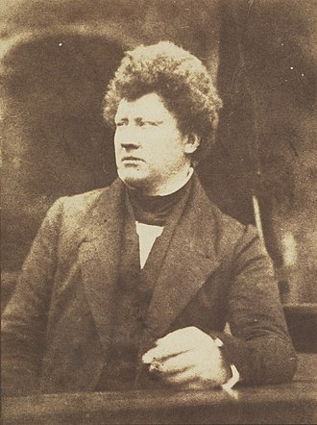
Knowledge shall increase, at the time of the end….
After 1798, the prophecies of Daniel started to spark an interest throughout the world, especially the time prophecies given in Daniel 8, 9, and 12. Here is just a few examples of people that began to predict the Second Coming, Judgment of God, and the End of the World:
-Johann Phillipp (1718-1792) from Germany, Christ must Return around 1847
-William Cunningham (1805-1861) D.D., President of New College, Edinburgh, England wrote a number of books on the Second Coming, which would occur in 1843
-James Frere (1779-1866) said Christ would Return between 1822-1867
-Peter Roberts (1760-1819) Anglican writer “The Manual of Prophecy” (1818), said the Lord would Return in 1843

Slide 10
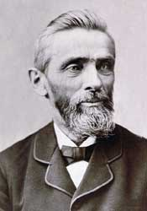
Many Shall Run To and Fro
“We here with present a list of twenty different parties who discovered the truth concerning the close of the twenty-three hundred days, not by communication with each other, but as the result of diligent searching of the Scriptures, led by the influence of the Spirit of God. Heading this list we place William Miller of the State of New York; then follow A. J. Krupp, of Philadelphia, Pa.; David McGregor, of Falmouth, Maine; Edward Irving, of England; Archibald Mason, of Scotland; W. E. Davis, of South Carolina; Joseph Wolff, who labored in various parts of Asia; Alexander Campbell, in his debate with Robert Dale Owen, in 1829; Captain A. Landers, of Liverpool, England; Leonard Heinrich Kelber, of Stuttgart, Germany; Laucunza, of Spain; Hentzepeter, of The Hague, Holland; Dr. Capadose, of Amsterdam, Holland; Rau, of Bavaria; priests of Tartary, in 1821; Bible students of Yemen, in their book called “Seera;” Hengstenberg, in another part of Germany; Russians on the Caspian Sea; Molokaners on the shores of the Baltic”—The Great Advent Movement, JN Loughborough, p. 86

Slide 11
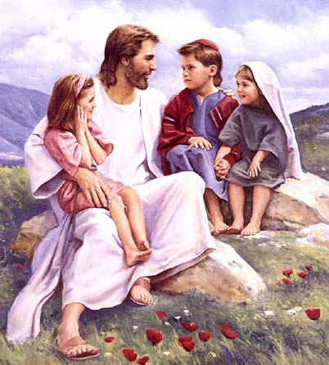
Children Preached Too?
“Sweden was one of those countries. There the Lord used little children to introduce the work. The first of this manifestation was in the summer of 1843, in Eksjo, southern Sweden. A little girl, only five years of age, who had never learned to read or sing, one day, in a most solemn manner, sang correctly a long Lutheran hymn, and then with great power proclaimed “the hour of his judgement is come,” and exhorted the family to get ready to meet the Lord; for he was soon coming. The unconverted in the family called upon God for mercy, and found pardon. This movement spread from town to town, other children proclaiming the message. The same movement among children was manifest to some extent in Norway and Germany.”—The Great Advent Movement, JN Loughborough, p. 140

Slide 12
Joseph Wolff
“During the twenty-four years from 1821 to 1845, Wolff traveled extensively: in Africa, visiting Egypt and Abyssinia; in Asia, traversing Palestine, Syria, Persia, Bokhara, and India. He also visited the United States, on the journey thither preaching on the island of Saint Helena. He arrived in New York in August, 1837; and, after speaking in that city, he preached in Philadelphia and Baltimore, and finally proceeded to Washington. Here, he says, "on a motion brought forward by the ex-President, John Quincy Adams, in one of the houses of Congress, the House unanimously granted to me the use of the Congress Hall for a lecture, which I delivered on a Saturday, honored with the presence of all the members of Congress, and also of the bishop of Virginia, and of the clergy and citizens of Washington. The same honor was granted to me by the members of the government of New Jersey and Pennsylvania, in whose presence I delivered lectures on my researches in Asia, and also on the personal reign of Jesus Christ."—Ibid., pages 398, 399. Dr. Wolff traveled in the most barbarous countries without the protection of any European authority, enduring many hardships and surrounded with countless perils. He was bastinadoed and starved, sold as a slave, and three times condemned to death. He was beset by robbers, and sometimes nearly perished from thirst. Once he was stripped of all that he possessed and left to travel hundreds of miles on foot through the mountains, the snow beating in his face and his naked feet benumbed by contact with the frozen ground. When warned against going unarmed among savage and hostile tribes, he declared himself "provided with arms"— "prayer, zeal for Christ, and confidence in His help." "I am also," he said, "provided with the love of God and my neighbor in my heart, and the Bible is in my hand.“”—GC, 360-361

Slide 13
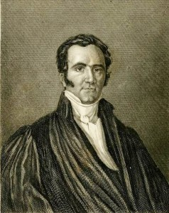
How is this all possible?
“Germany did not communicate the truth to Switzerland, nor Switzerland to France, nor France to England. All these countries received it from God, just as one part of the world does not transmit the light to another part; but the same shining globe communicates it directly to all the earth. Christ, the day spring from on high, infinitely exalted above all mankind, was, at the period of the Reformation, as at the establishment of Christianity, the divine fire which gave life to the world. In the sixteenth century, one and the same doctrine was at once established in the homes and churches of the most distant and diversified nations. The reason is, that the same Spirit was everywhere at work producing the same faith. “The Reformation of Germany and that of Switzerland demonstrate this truth. Zwingle had no intercourse with Luther. There was, no doubt, a link between these two men; but we must search for it above the earth. He who from heaven gave the truth to Luther, gave it to Zwingle. God was the medium of communication between them. ‘I began to preach the gospel,’ says Zwingle, ‘in the year of grace 1516, in other words, at a time when the name of Luther had never been heard of in our country. I did not learn the doctrine of Christ from Luther, but from the word of God. If Luther preaches Christ, he does what I do; that is all.’”—Merle D’Aubigne, History of the Reformation, Book viii, chap. i, pars. ii, iii.

Slide 14
Continuing in Daniel 12….
1290 days
=
1290 literal years
Daniel 12:11 “And from the time that the daily sacrifice shall be taken away, and the abomination that maketh desolate set up, there shall be a thousand two hundred and ninety days.”

Slide 15
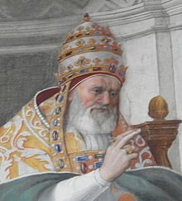
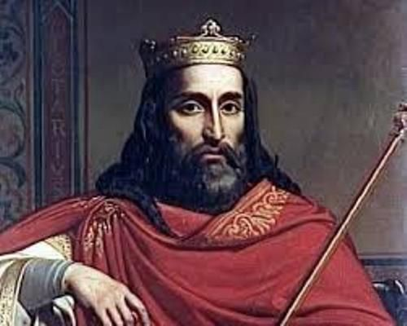
Back to Daniel 11…
Daniel 11:31 “And arms shall stand on his part, and they shall pollute the sanctuary of strength, and shall take away the daily sacrifice, and they shall place the abomination that maketh desolate.”

Slide 16
When to Start the Prophecy?
Option 1: At the Beginning of the 1260 day prophecy…
538AD+1290=1828 What happened?
Answer: Nothing Obvious
Option 2: At the End of the 1260 day prophecy and Work Backwards so as to stay in the proper time period…
1798-1290=508AD What Happened?
Union with King Clovis
Fully Ratified

Slide 17
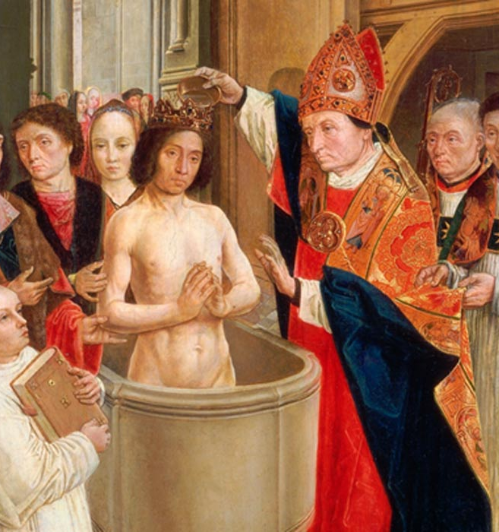
King Clovis (466-511): Rome’s Champion!
“Clovis became by his conversion the object of hope and attachment to such a party [Catholic] in almost every country on the continent of Europe. He had the powerful support of the whole body of the Catholic clergy, in whose hearts the interests of their church far out-weighed all other considerations. . . . He had, indeed, without the slightest provocation, deprived a noble and peaceable neighbour of his power and life. He had treacherously murdered his royal kindred, and deprived their children of their birthright. He had on all occasions shown himself the heartless ruffian, the greedy conqueror, the blood-thirsty tyrant; but by his conversion he had led the way to the triumph of Catholicism ; he had saved the Roman Catholic Church from the Scylla and Charybdis of heresy and PAGANISM, planted it on a rock in the very centre of Europe, and fixed its doctrines and traditions in the hearts of the conquerors of the West.”—Historian’s History of the World, Vol. VII, p. 471, 477

Slide 18
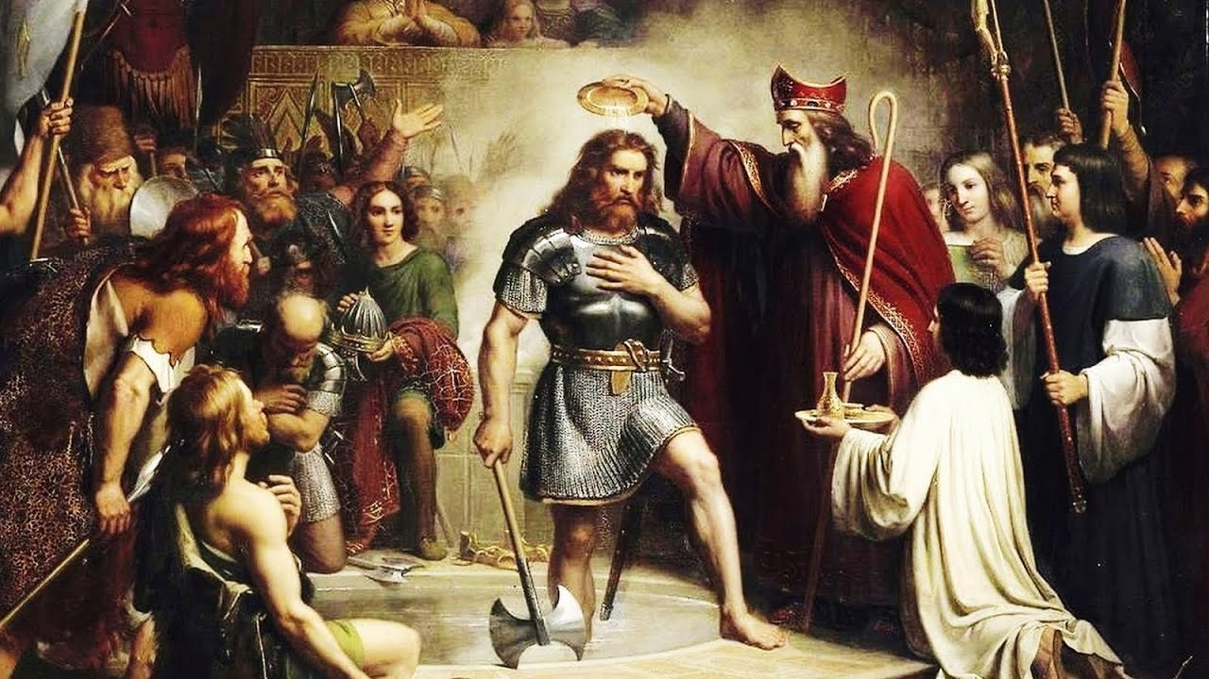
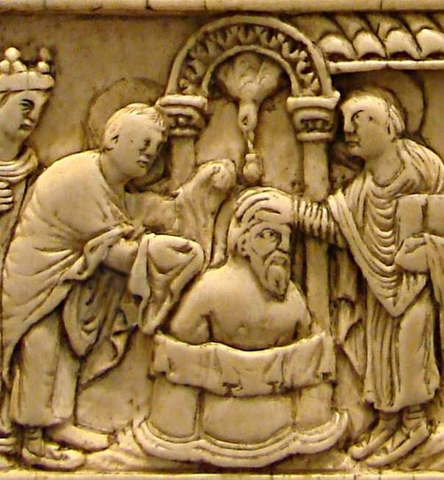
In 503, The “Power” was given to the Pope…
By 503, an ecclesiastical council held in Rome declared: “the pope was judge as God’s vicar, and could himself be judged by no one”—Hadouin’s Councils, vol. 2, p. 983
Catholicism enforceable and being enforced in 508 by King Clovis! “It was decided that the Franks, and not the Goths, were to direct the future destinies of Gaul and Germany, and that the Catholic faith, and not Arianism, was to be the religion of these great realms”—Richard W. Church, The Beginning of the Middle Ages, p. 38-39

Slide 19
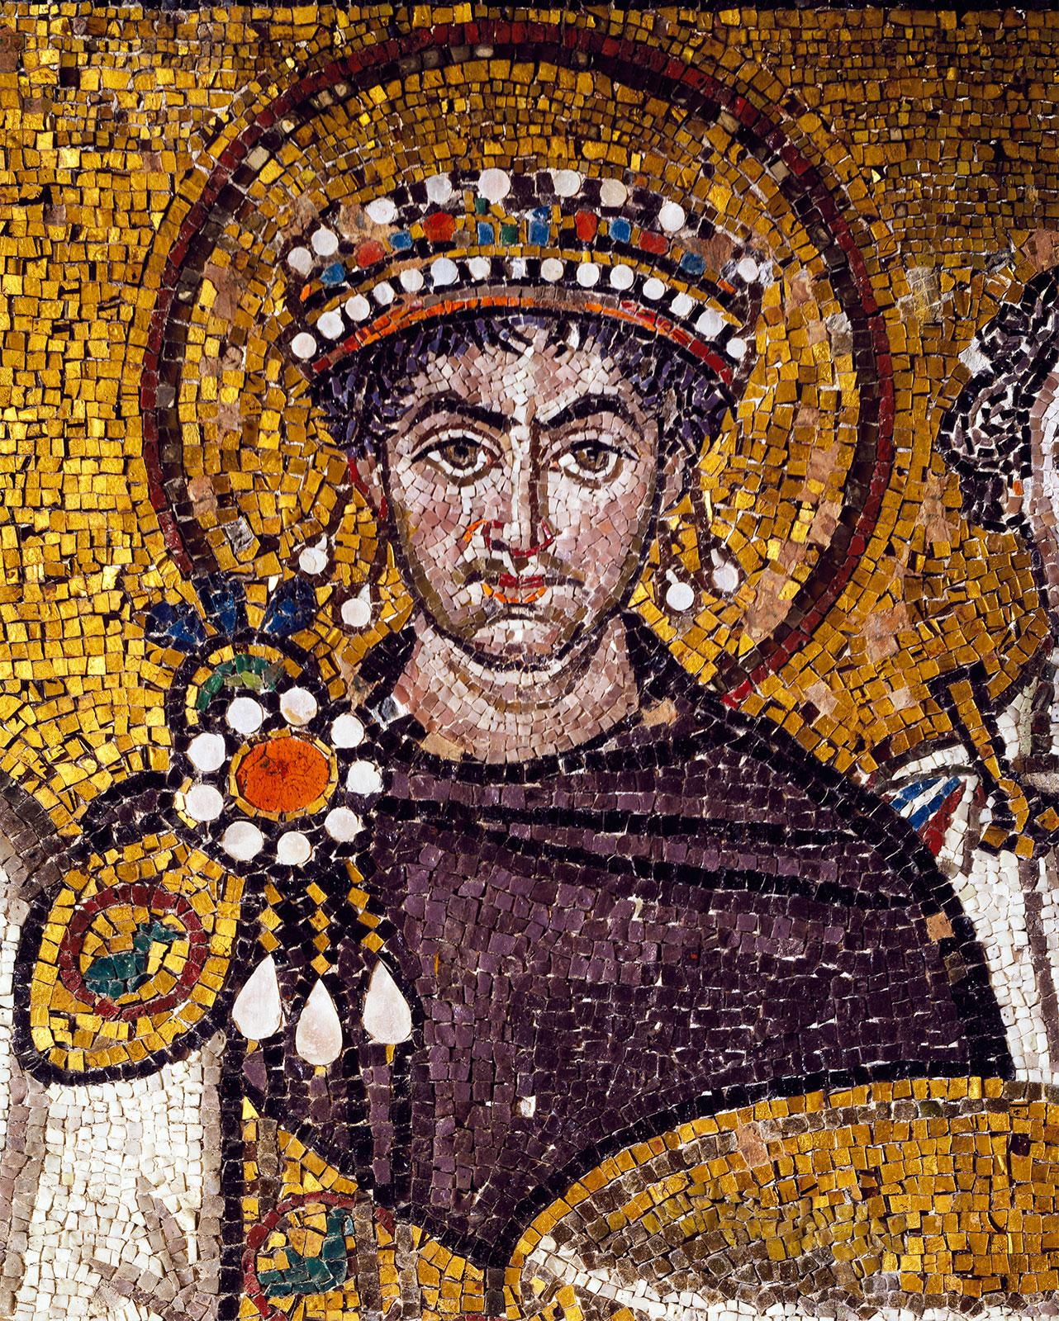
Similar to Another Prophecy…
Like the 508 prophecy, where there was a special blasphemous decree given 5 years prior (in 503)—which was all but unenforceable until King Clovis I, the Frankish King made it possible to enforce.
Likewise, the 538 prophecy was preceded with another blasphemous decree, but this one was not from the corrupt ecclesiastical powers, but from the highest state authority at that time: Byzantium Emperor Justinian. This decree was also given 5 years prior in 533 and stated that the Pope was to be addressed as “head of all the churches” (Code of Justinian, lib. I, title I.) and “that all affairs touching the church shall be referred to the pope, ‘Head of all bishops and true and corrector of heretics.’” Again, this decree was not enforceable until General Belisarius defeated the Ostrogoths in 538 and took back Rome for the Pope.

Slide 20
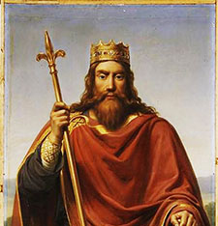
By 508 Clovis Accomplished…
United the Franks, Establishing Paris, and acknowledged as the ruler of Gaul (modern France) by the Byzantine Emperor Anastasius—Clovis then received 100 warships from Emperor Anastasius
Fought and won the decisive Battle of Poiters, defeating Alarac—King of the Goths
Sent the treaty gifts offered by Emperor Anastasius, including a golden crown, to the Papal treasury
Greatly favored and enriched the Roman Catholic religion
Solidified the Papacy as a legitimate power in the west, and gaining the ascendency over Arianism
Modeled the role of the subservient temporal king (Clovis) towards his superior and spiritual lord (the Pope)—This model was followed by almost every monarch thereafter until the fall of the Papacy in 1798
“Clovis eventually converted to Catholicism following the Battle of Tolbiac on Christmas Day 508”—Wikipedia, King Clovis I

Slide 21
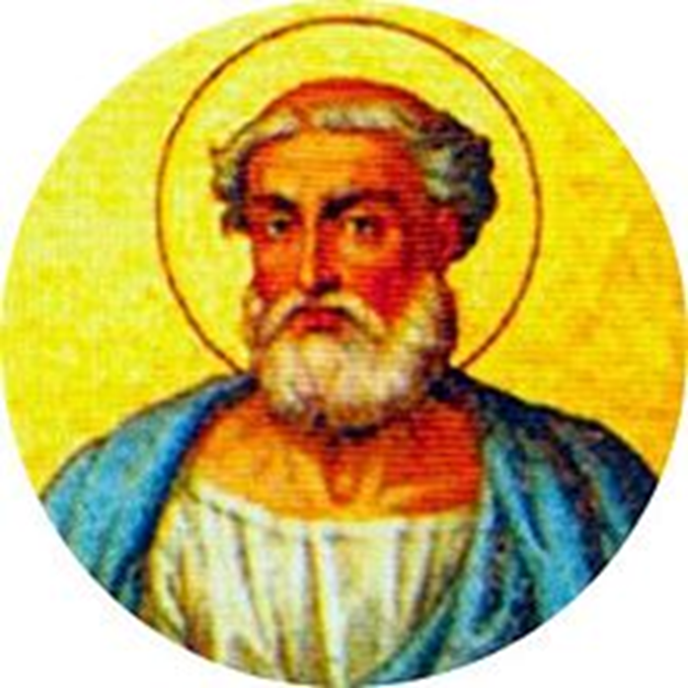
Clovis Made it Possible to Take Away the Daily and Set up the Abomination of Desolation
“Pope Sylvester [314-335 AD] first among the Romans ordered that the names of the days . . . But he ordered to call the Sabbath by the ancient term of the law, the first feria the "Lord's day," because on it the Lord rose, Moreover, the same pope decreed that the rest of the Sabbath should be transferred rather to the Lord's day, in order that on that day we should rest from worldly works for the praise of God.”—Rabanus Maurus [776-856], De Clericorum Institutione (Concerning the Instruction of the Clergymen), Book II, Chap. XLVI, as translated by the writer from the Latin text in Migne's Patrologia Latina, Vol. CVII, col. 361.

Slide 22
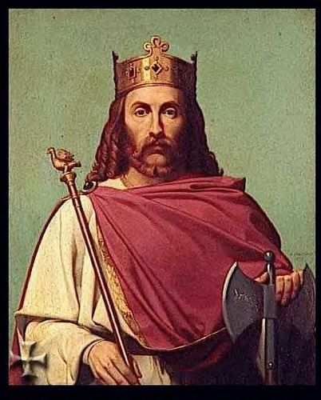
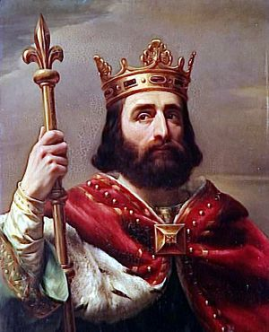
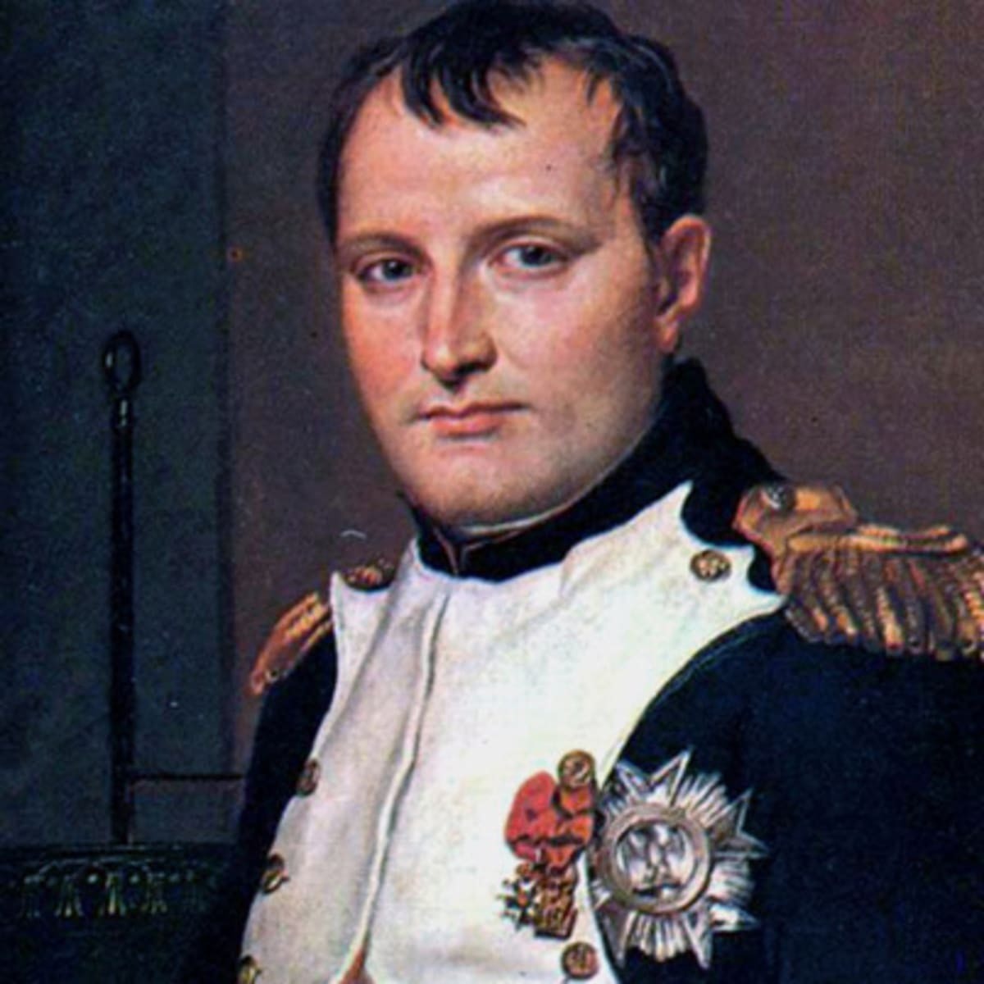
The French Prophecy
Because of King Clovis I, France is called “the oldest daughter of the Roman Catholic Church” or “eldest son of the papacy”
Anastasius I, Byzantine Emperor “conferred upon Clovis the title and insignia of consul in 508”—Encyclopedia Americana, Int. Ed., 1998, article “Clovis I”
Do you think that it ironic, that France, the power that established Papal supremacy in 508, were the very same power to take it away in 1798?

Slide 23
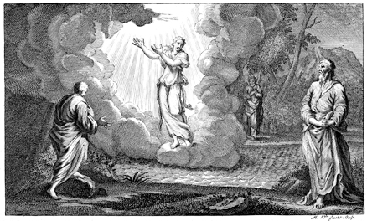
Another Time Added…
Daniel 12:12-13 “Blessed is he that waiteth, and cometh to the thousand three hundred and five and thirty days. But go thou thy way till the end be: for thou shalt rest, and stand in thy lot at the end of the days.”

Slide 24
508+1335=
1843

Slide 25
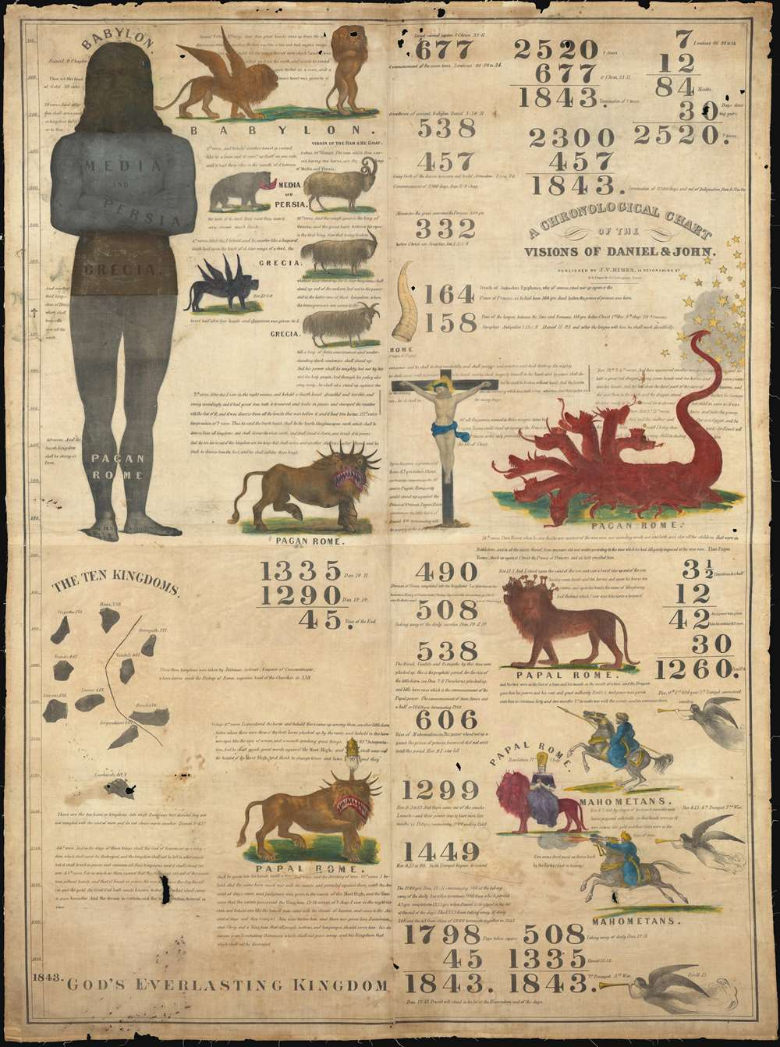
The Seventh-day Adventist Faith
Only the Seventh-day Adventists can claim the to be the “blessed” that make it the 1335 days/years. It was through the preaching of William Miller and others that the warning cry was given to the world—that the Return of Christ was to be in 1843. After the time came and went, they realized there was a miscalculation which pushed the time period back to 1844. Isn’t interesting that Daniel 8 identifies perfectly that the Sanctuary was to be cleansed in 1844, and that Daniel 12 identifies those who were blessed of the LORD in 1843—Both years are given credibility in the prophecies, making it unmistakable who God’s people are in the last days: The true Seventh-day Adventists. Shortly, after the 1844 time came and went, the Sanctuary was reestablished (the yearly), the Sabbath, Righteousness by Faith, Law of God, State of the Dead, etc—all great Bible truths restored by the early Seventh-day Adventists

Slide 26
Explain the time of the end and the Reformation, restoring the Sanctuary
Elijah and the restoration of the altar
Explain the Millerite movement and the 2300 days as the only ones who understood the significance of this passage
Walk through the events and the errors, highlight the importance of the sanctuary throughout
Loughborough’s account, etc.
3 Angel’s Messages—the worldwide message, the Second Great Awakening, Great Disappointment of the disciples

