Slide 1
Behind the Door pt 12:
World War II

Slide 2
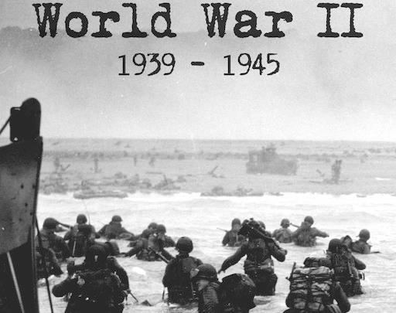
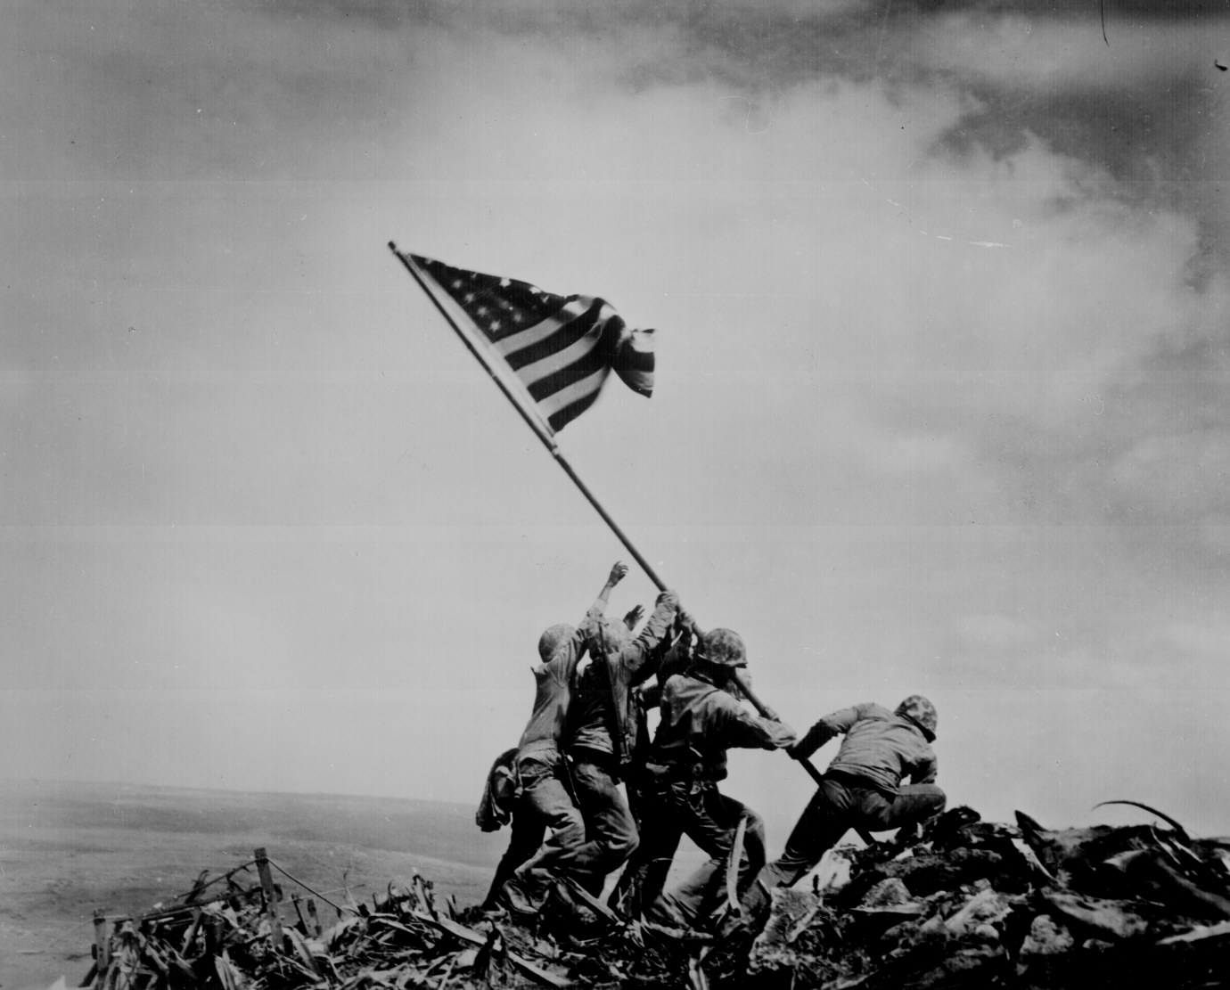

Slide 4
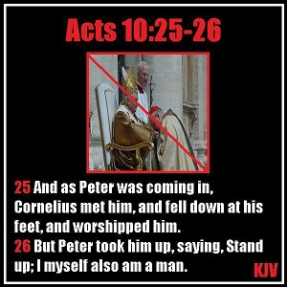

Slide 5
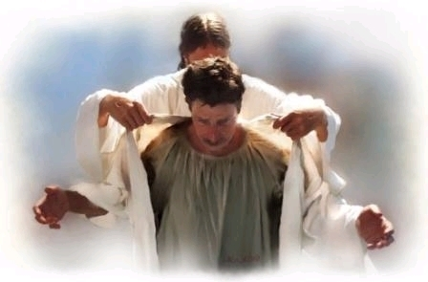
The white robe of righteousness is the FREE gift of Christ. “These are they which came out of great tribulation, and have washed their robes, and made them white in the blood of the Lamb” Revelation 7:14 KJV

Slide 6
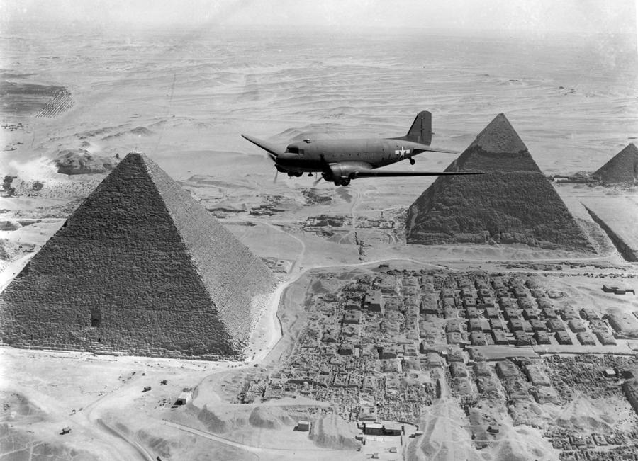
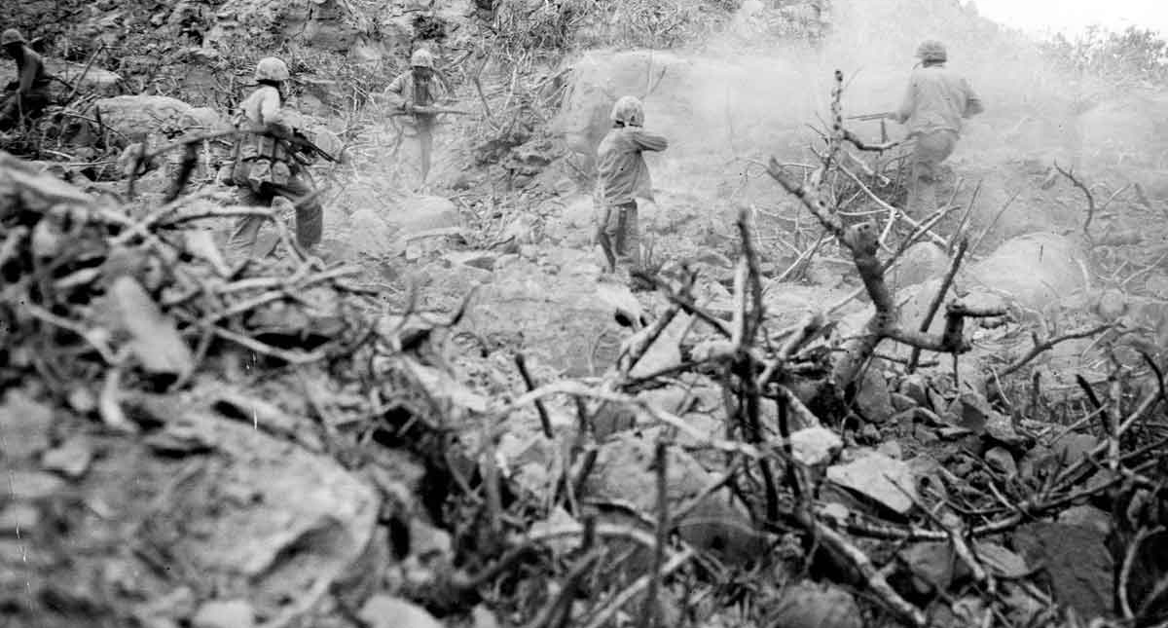
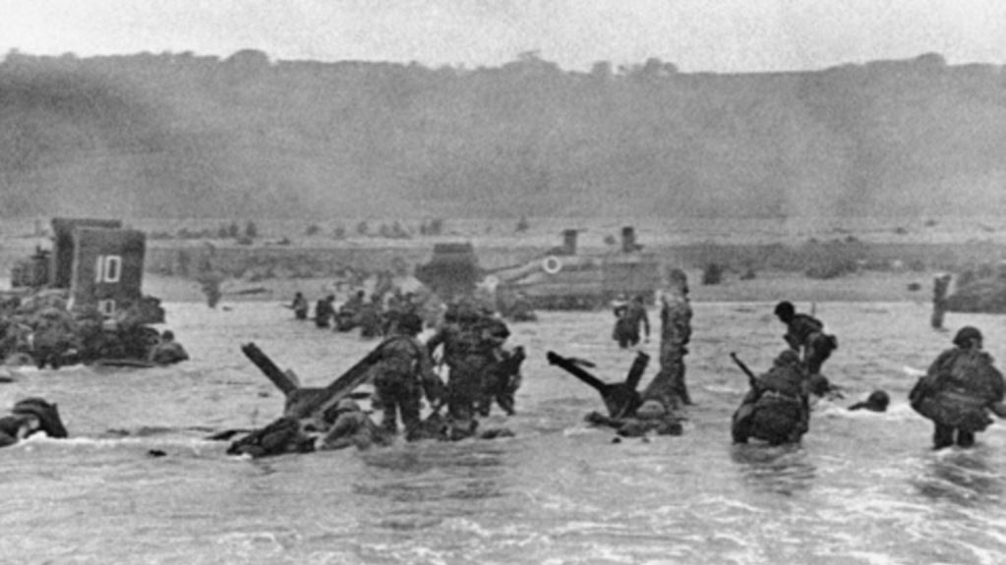
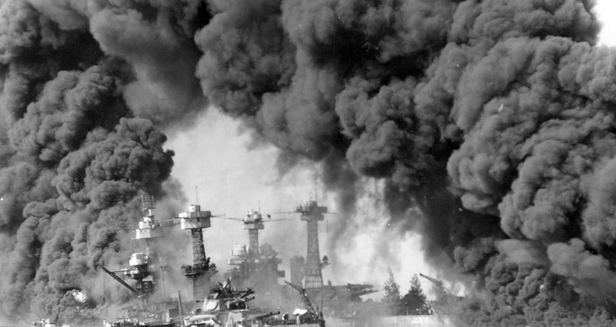
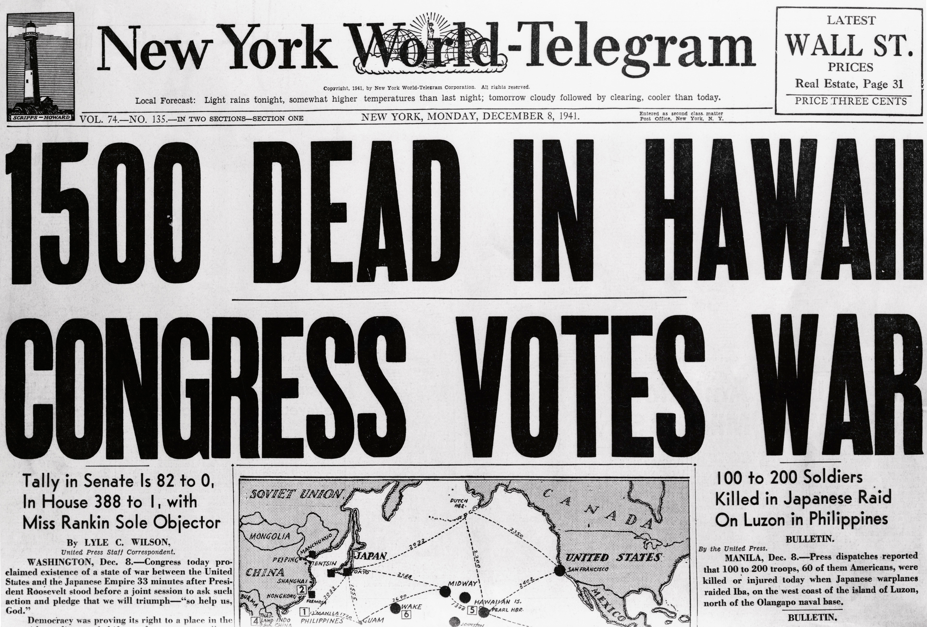
North African Campaign
Iwo Jima-Allies v. Japan-war in the Pacific
June 6, 1944 D-Day: Normandy, France Invasion
Pearl Harbor Aftermath-Dec. 7, 1941

Slide 7
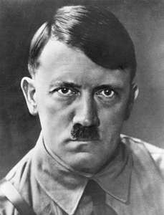
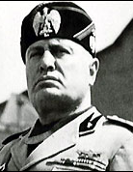
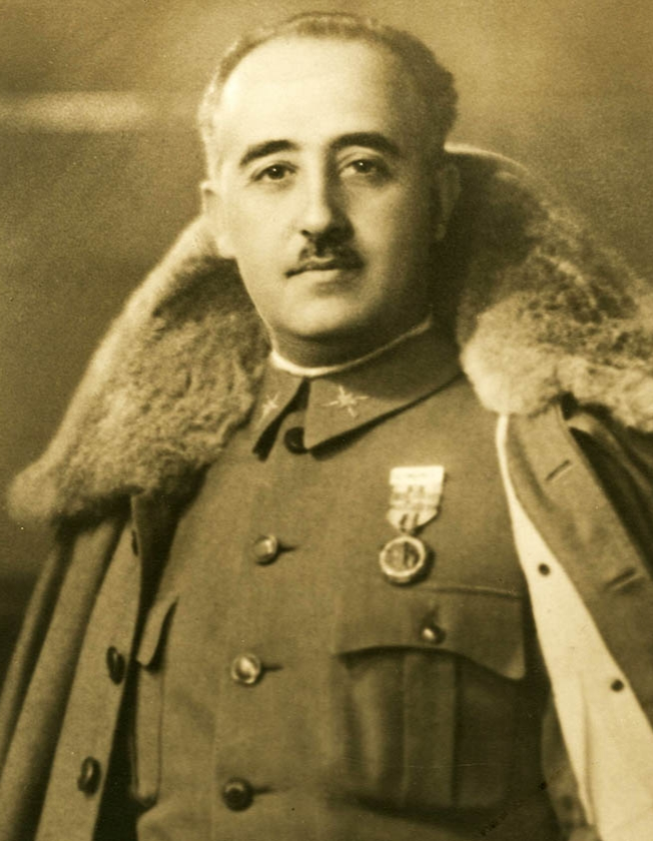
Chancellor of Germany and Fhurer (Leader) of Nazi Germany-Adolf Hitler
Spanish Dictator-Francisco Franco
Prime Minister of Italy-Benito Mussolini

Slide 8
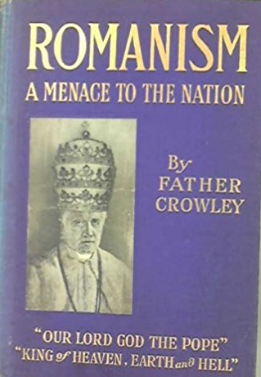

Slide 9
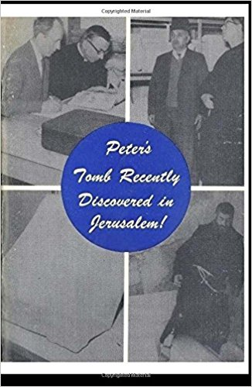
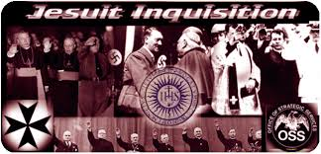
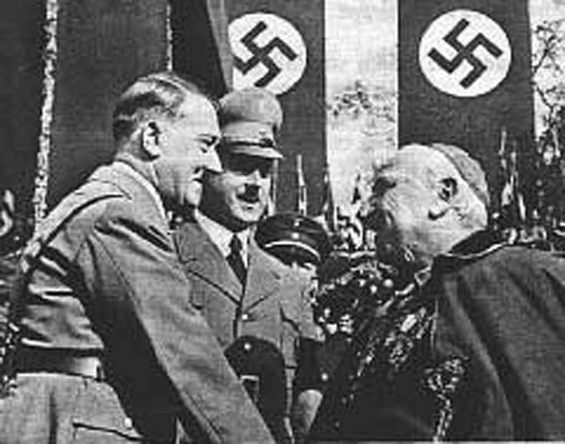

Slide 10
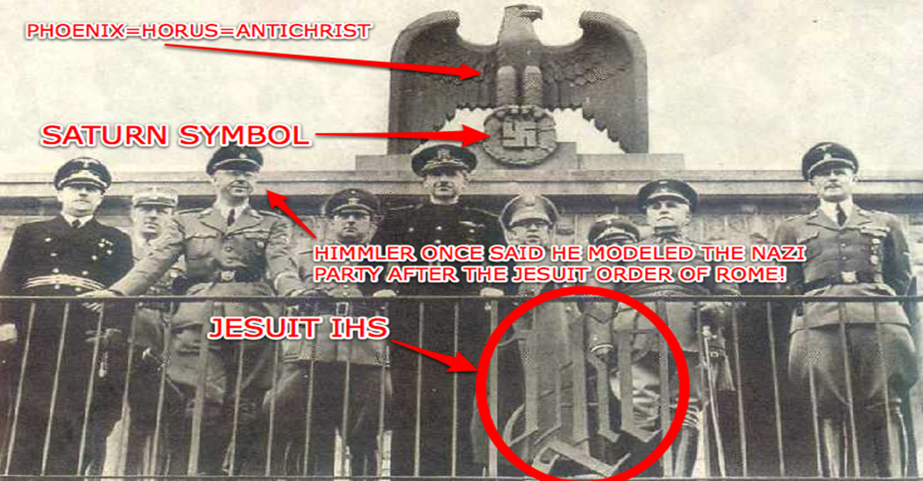

Slide 11
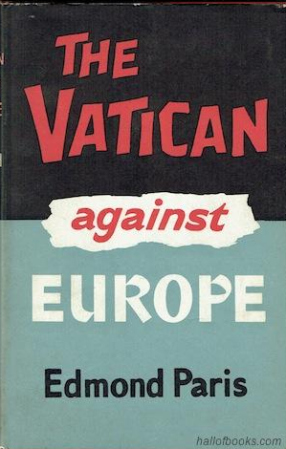
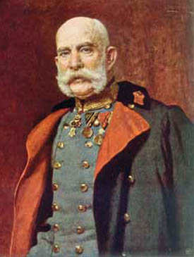
Franz Joseph-Emperor of Austria-Hunagary (1848-1916)

Slide 12
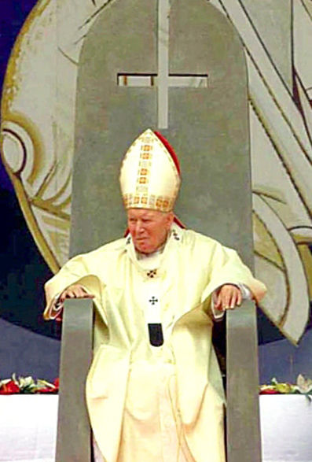
“Violence never again! War never again! Terrorism never again!” John Paul II

Slide 13
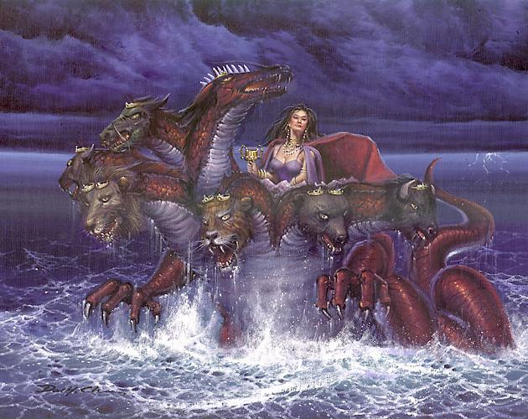
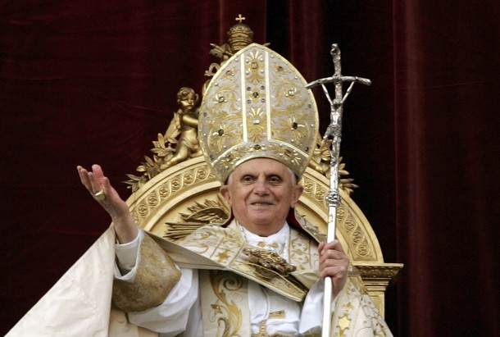
And in her was found the blood of prophets, and of saints, and of all that were slain upon the earth—Rev. 18:24

Slide 14
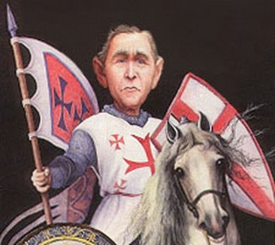

Slide 15
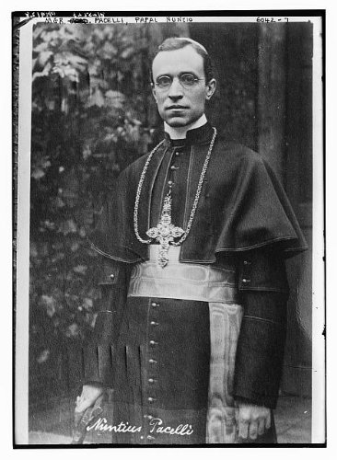
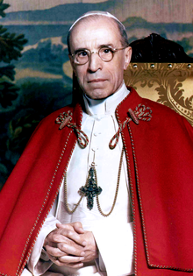
Monsignor Pacelli
Pope Pius XII (1939-1958)

Slide 16
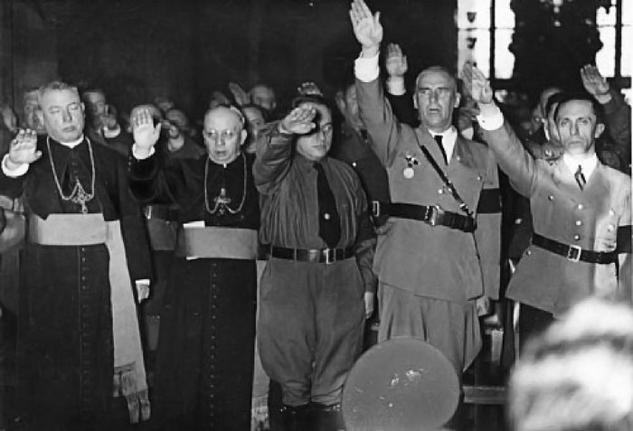
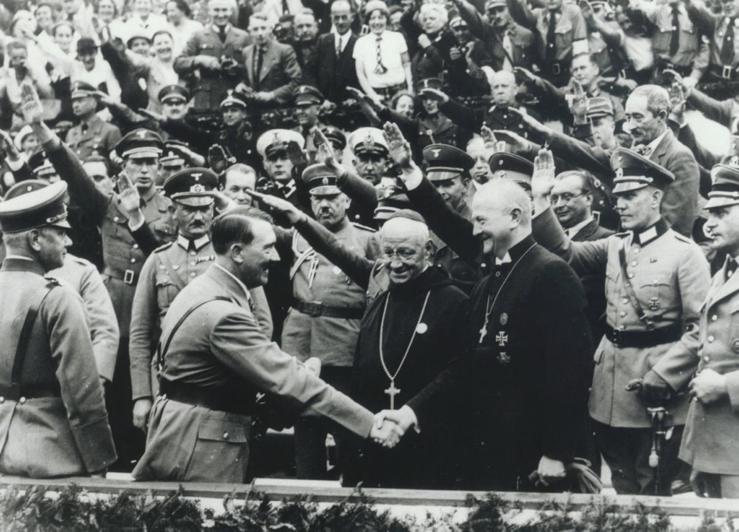
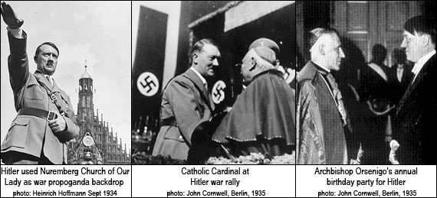

Slide 17
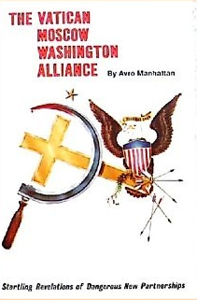
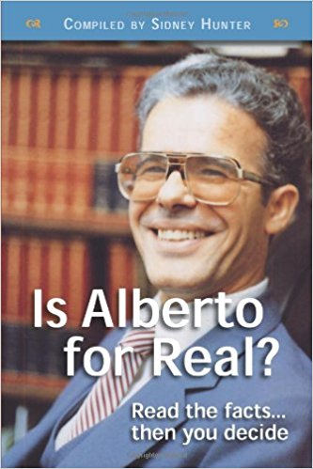

Slide 18
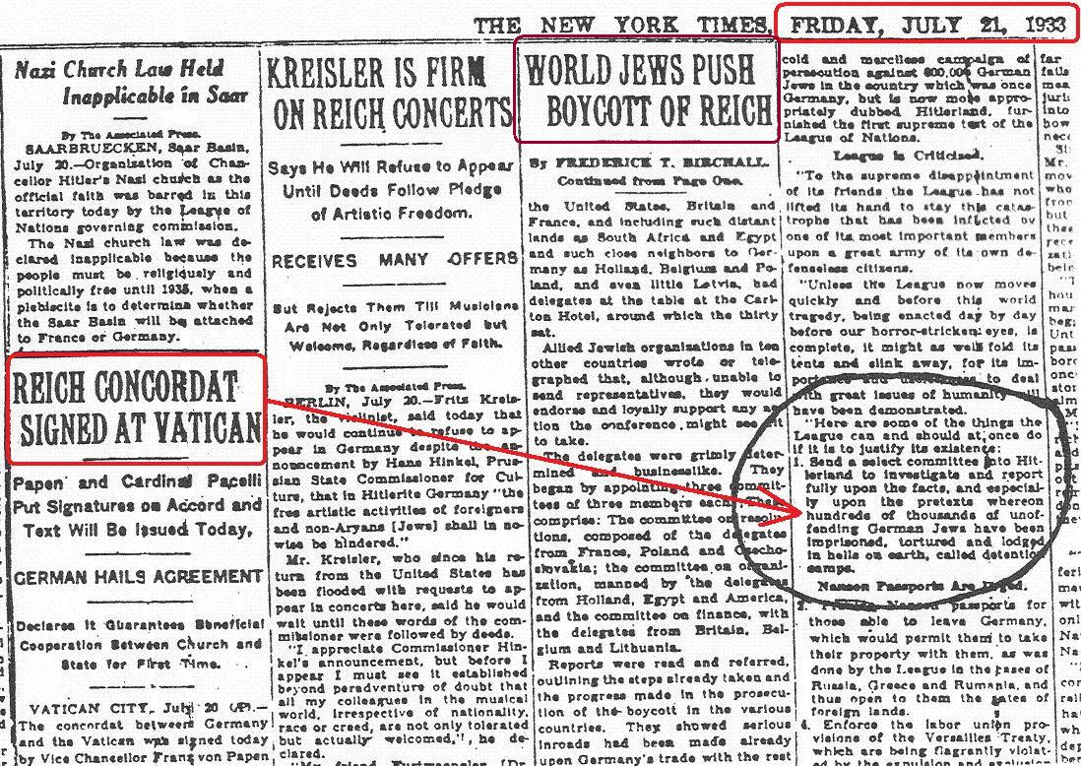
The “Reichskonkordat” (Reich Concordat) between the Vatican and Nazi Germany July 20, 1933

Slide 19
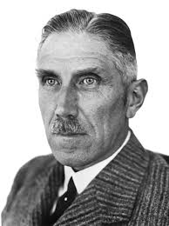
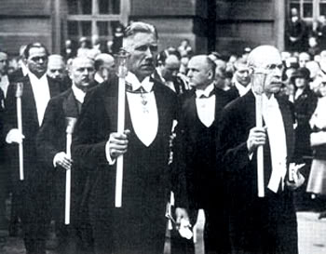
“The Third Reich was the first power that not only recognized, but put into practice the high principles of the Papacy”
Franz von Papen
Franz von Papen heading Catholic mass

Slide 20
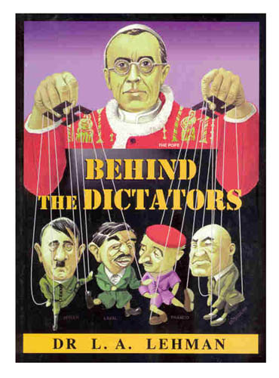
“Hitler himself admits he was helped by the methods of the Jesuit Counter Reformation to carry on his ideological war. . . We have witnessed Catholicism’s open support of every step taken by Nazi fascism to impose authoritarian regimes upon all peoples—Lehman, Behind the Dictators, p. 36, 38

Slide 21
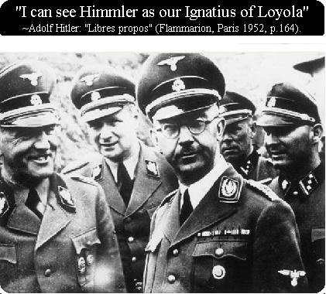

Slide 23
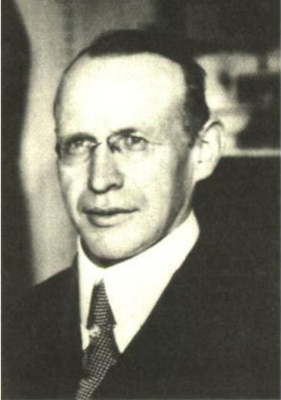
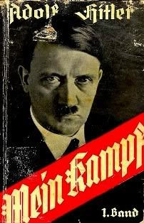
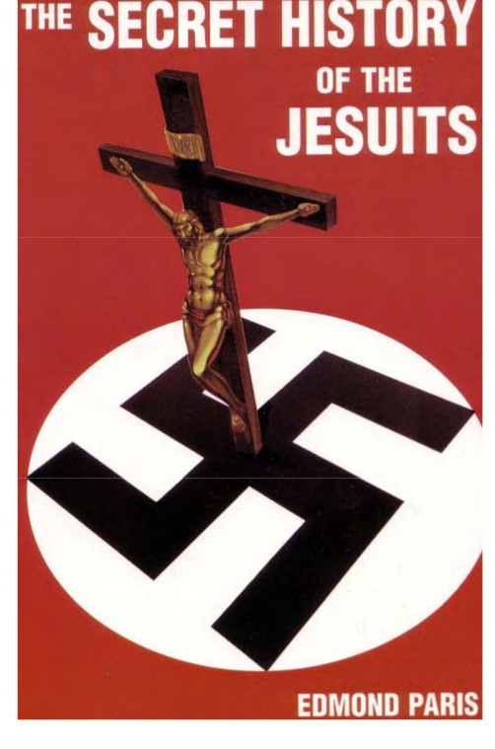
"The Fuhrer had come to power, thanks to the votes of the Catholic Zentrum, only five years before, but most of the objectives cynically revealed in 'Mein Kampf were already realized; this book, an insolent challenge to the western democracies, was written by the Jesuit Father Staempfle and signed by Hitler. For—as so many ignore the fact—it was the Society of Jesus which perfected the famous Pan-German programme as laid out in this book, and the Fuhrer endorsed it." The Secret History of the Jesuits Page 138
Jesuit Priest Bernhard Stempfle (1882-1934)

Slide 24
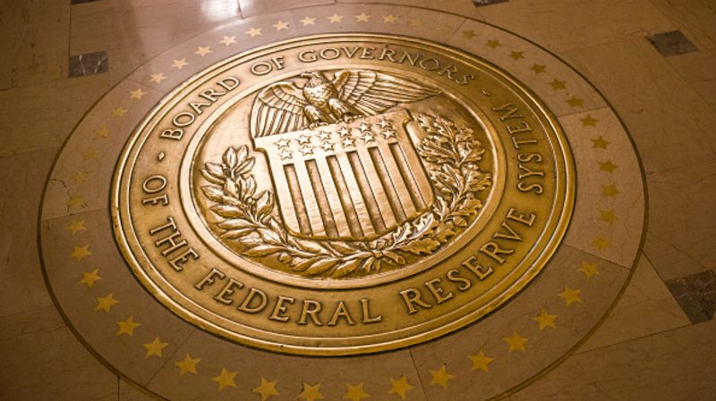

Slide 27
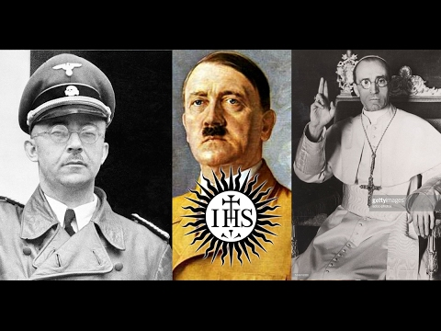

Slide 28
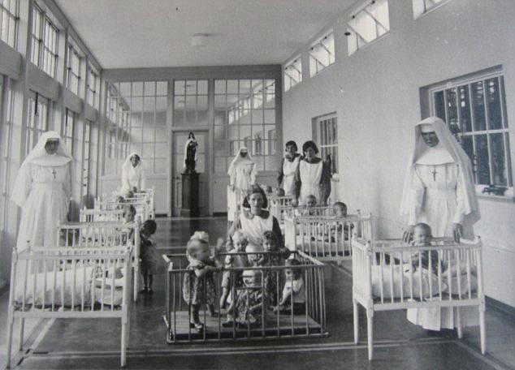
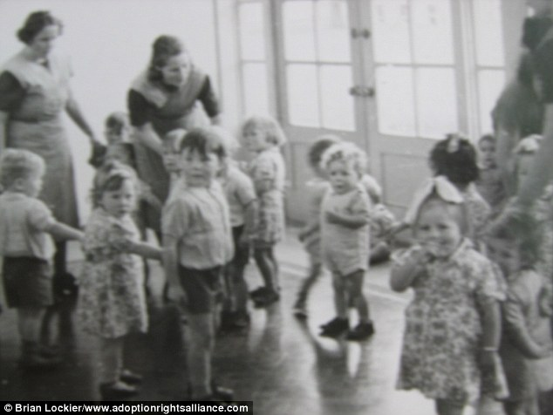
Discovery of mass baby grave, consisting of 800 children found in a Catholic orphanage in Tuam, Ireland from the 1950s and earlier. They were discovered in the sewage tank, which was subdivided into 20 sections—this was intended. This grievous crime is not an isolated event for Spain only-; there are many many more incidents of this caliber occurring in other countries, other times.

Slide 29
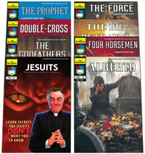
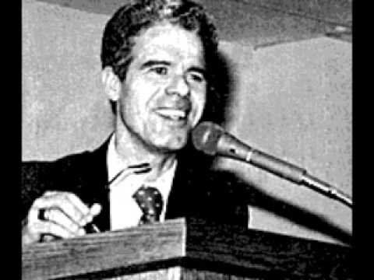
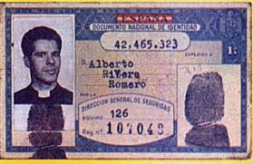
Alberto Rivera Ex-Jesuit Priest

Slide 30
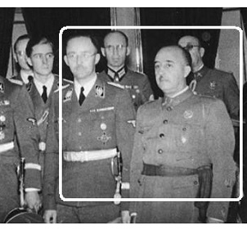
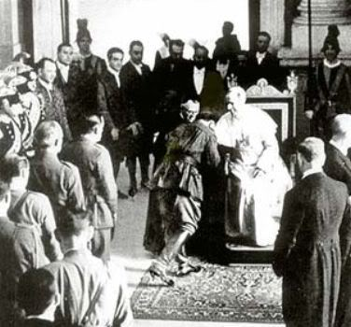
Francisco kisses the Pope Puis XII’s ring—full submission to Rome!
Francisco Franco with Heinrich Himmler

Slide 31
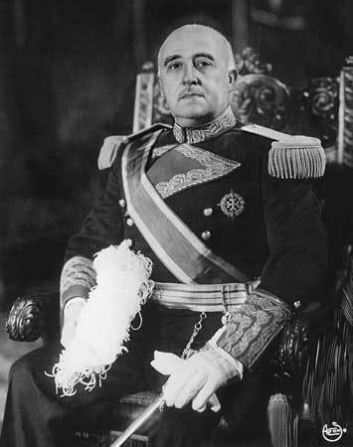
"Adolf Hitler, son of the Catholic Church, died while defending Christianity. It is therefore understandable that words cannot be found to lament over his death, when so many were found to exalt his life. Over his mortal remains stands his victorious moral figure. With the palm of the martyr, God gives Hitler the laurels of Victory". -Spanish dictator (Francisco Franco, Knight of the Order of Christ) published on the 3rd of May 1945, the day of Hitler's death. ("Reforme", 21st of July 1945.)

Slide 32
