Slide 1
Order out of Chaos
In order to achieve one’s objectives, one must create enough trouble in order to reach the ultimate goal.

Slide 2
Hegel and his ideas
Georg Wilhelm Friedrich Hegel was born in Germany in 1770 and died in 1831. He was a German philosopher who has left for us a philosophy of history that is used heavily today. It is known as the Hegelian dialectic, or as order out of chaos.
Hegel’s ideas are also known as:
1. thesis
2. antithesis
3. synthesis
How this process has been used is quite apparent in our world and is being used to create a climate for Sunday laws!

Slide 3
Answers out of Problems?
Hegel’s ideas are very simple. You have an objective or something you want to accomplish. The way to achieve it is to create trouble bad enough so that people will start looking for a solution. When the troubles get bad enough, then you start offering the solution that you had in mind all along. Thus, you get what you want and the people have no idea that was what you wanted in the first place. The people are the pawns, moving exactly the way planned by the mastermind! Watch it work……………………..

Slide 4
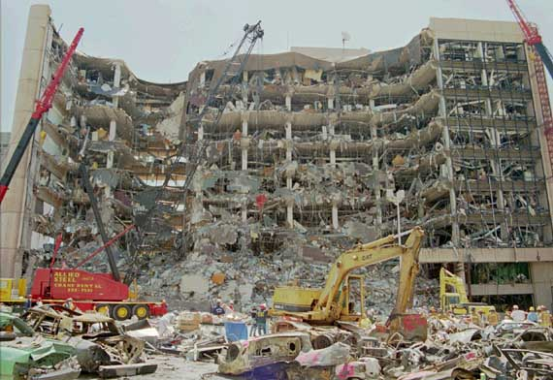
The Murrah Building in Oklahoma City

Slide 5
Watch Hegel’s Ideas in Action
WATCH- Jesuit trained and educated, Bill Clinton, was told to get some anti-terrorism legislation passed through Congress. This legislation would seriously gut individual freedom in America. Here comes Hegel!
Thesis- Create Terror
Anti-Thesis= Blame Right wing weirdo’s
Synthesis= Legislation passed through
Mission Accomplished

Slide 6
Order out of Chaos
The Omnibus Counter Terrorism Act of 1995 was on a slow track in Congress and the subject of a lively debate as to whether it would violate some fundamental civil liberties, including the right to confront one’s accuser. Now, after the Oklahoma City bombing, there are few surer legislative bets in Washington. Democrats and Republicans issued news releases Thursday calling for the bill’s quick passage. — Terror in the Heartland: Terrorism Bill Moves Very Fast, Orlando Sentinel, April 21st, 1995 (emphasis supplied).
President Clinton prodded Congress on Friday to move swiftly on his anti-terrorism legislation and avoid political ‘endless quibbling’ over details. ‘We must not doddle or delay. Congress must act, and act promptly.’ His 1.25 billion anti-terrorism package would expand law enforcement’s investigative and enforcement powers and toughen penalties for certain crimes. Republicans have reacted favorably to the proposals Clinton put forward on Wednesday, one week after the Oklahoma City bombing. — Clinton Urges Swift Action on Anti-terrorism Legislation, Orlando Sentinel, April 29th, 1995.

Slide 7
Liberty Gutted
“One of the laws considered for passage after the Oklahoma City bombing was the gross destruction of the First Amendment advocated in Charles Schumer’s bill, HR 2580. In this bill, a five-year prison sentence would be given for publicly engaging in unseemly speculation and publishing or transmitting by wire or electronic means baseless conspiracy theories regarding the federal government of the United States.
We have seen that in the aftermath of the Oklahoma City bombing, several liberty-restricting laws were passed by Congress very quickly. The bombing created a climate of fear in America. In this setting, laws passed with few dissenting voices. In the midst of the hysteria, the unconstitutional laws could be quickly passed. The people want comfort and security, and they did not object to the passing of these laws. These laws seriously eroded the constitutional liberties that have been the cornerstone of American prosperity for over 200 years. It is amazing how quickly a normally slow and cumbersome Congress can act when the agenda is all set.” Secret Terrorists, chapter 10

Slide 8
The Real Terrorists
Most of us understand "terrorism" to have a particular meaning, generally involving violent attacks on government officials or innocent civilians in order to make a political point and calculated to instill fear and shock in the general population. But when representatives of the power elite use the word "terrorism" nowadays, they often mean something quite different. "Terrorism" has in fact has become a code word used by "superterrorists"[30] to demonize, marginalize, and criminalize domestic opposition.[31] Bush, Ashcroft, and the FBI have all explicitly declared their determination to focus on critics of the status quo as part of the "antiterror" campaign.
Ashcroft revealed in early December that the war on terrorism would involve extensive targeting of "domestic religious and political groups." Even though the Afghan war was still raging and Osama bin Laden remained at large, Ashcroft felt so secure of success in the campaign against al-Qaeda that he announced plans for a new national offensive.
International Socialist Review Issue 22, March-April 2002 The assault on civil liberties
By Candace Cohn

Slide 9
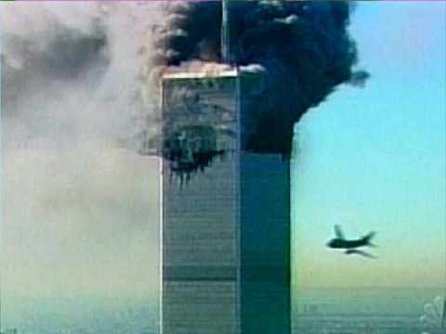
Would Hegel be used again?

Slide 10
Rome’s Mortal Enemies
Rome/ the Jesuits hate the Protestant West and Fundamental Islam. They hate Protestant liberty in the Constitution.
“The Vatican condemned the Declaration of Independence as wickedness and called the Constitution of the United States a Satanic Document.” — Avro Manhattan, The Dollar and the Vatican, Ozark Book Publishers, 1988, p. 26. They also want to rule the world from Jerusalem.

Slide 11
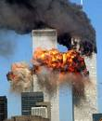
FOUR Birds with one stone
1. Destroy Protestant Liberty
2. Destroy Fundamental Islam
3.Rule the World from Jerusalem.
4. Keep Drug Money flowing from Afghanistan.
Here are the objectives. What chaos do you create to reach these goals?

Slide 12
Bingo!!
1. Fundamental Islam is being ravaged in the Middle East. The most powerful Middle East leader is removed from his throne. A message has been sent…………………………………
2. As things continue to deteriorate in the Middle East, there will be a cry for a peacemaker to come to the region to bring peace. HMM- who could that be?
3. Drug money is flowing from Afghanistan.
4. The Constitution is in shambles!

Slide 13
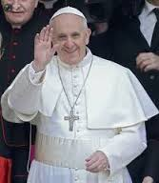
Time Magazine’s Man of Peace

Slide 14
Protestant Liberty Assaulted
Experts, however, say there is much work to be done. And it will involve much more spending and planning, hardening of key facilities and, perhaps, higher taxes and forfeiture of some personal freedoms. — Tighter Security Means Less Freedom, Orlando Sentinel, Wednesday, September 12th, (emphasis supplied).
As the United States faces a new war against uncertain and hidden enemies, the temptation to sacrifice our freedom in the hopes of protecting ourselves from harm is powerful.
The danger is that we will end up neither safe nor free.
The constitutional protections of speech and privacy that Americans value so highly reflect a balance between individual liberty and state security. Just how those lines are drawn, history teaches, is directly affected by the perceived threats to our country’s security….
We’re faced with real threats to national security. The challenge is to meet those threats without endangering our constitutional character or undermining the freedom and liberty that are the source of our power. — USA Today, Thursday, Sept. 13, 2001 (emphasis supplied).
Freedom or safety? Anti terrorism measures may mean forfeiture of some personal freedoms. — Orlando Sentinel, Wednesday, September 12th, (emphasis supplied).

Slide 15
New Patriot Act
There has been an onslaught of media articles and statements suggesting the giving up of certain civil liberties just as the Jesuit agenda requires. On October 26, 2001, George Bush signed the misnamed USA Patriot Act of 2001, which was proposed five days after the tragedy. Just six weeks after the World Trade Center was destroyed, this bill was passed. This is truly amazing. It is virtually impossible for a bill to be conceived, written, debated, and passed this quickly. You see, they already had the bill written before the tragedy occurred.
”The bill enhances the ability of federal authorities to tap phones, share intelligence information, track Internet usage, e-mails and cell phones and protect U.S. borders.” — Bush Signs Sweeping New Laws to Combat Terrorism, Reuters News Service, October 26, 2001.
Lawmakers upset with some of the administrations anti-terrorism actions will question Attorney General John Ashcroft on the matter.
[Certain Congressmen] say the administration’s actions have gone too far in infringing on civil liberties. — USA Today, November 26, 2001, (emphasis supplied).
In the same paper, on the same day, there’s a cartoon of two children, decorating a Christmas tree. One sings, “He sees you when you are sleeping, He knows when you are awake, He knows if you have been bad or good….” The other child says, “Enough about Attorney General Ashcroft already!”

Slide 16
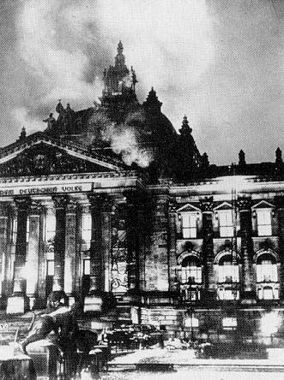
It Happened Before
The Reichstag Fire-1933
“On the day following the fire, February 28, [Hitler] prevailed on President Hindenburg to sign a decree “for the Protection of the People and the State” suspending seven sections of the constitution which guaranteed individual and civil liberties. Described as a “defensive measure against Communist acts of violence endangering the state, the decree laid down that: Restrictions on personal liberty, on the right of free expression of opinion, including freedom of the press, on the rights of assembly and association; and violations of the privacy of postal, telegraphic and phone communications; and warrants for house searches on property, …

Slide 17
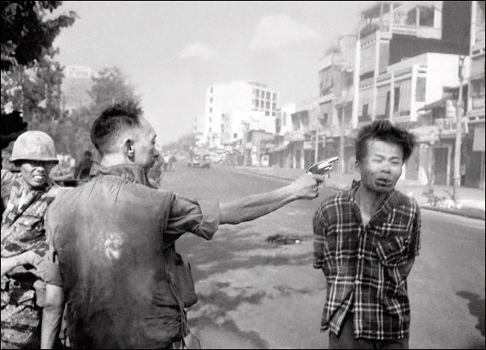
Hitler, Clinton, and Bush-Same Technique!?!
Oh, by the way…………….
Diem did the same thing in south Vietnam ‘The next year, October 26, 1956, he promulgated a new Constitution. Imitating Mussolini, Hitler, and also Ante Pavelich of Catholic Croatia, (not to mention Franco of Catholic Spain, and Salazar of Catholic Portugal,) he inserted an article, Article 98, which gave him full dictatorial powers. The article read in part as follows: "During the first legislative term, the president (that is Diem) may decree a temporary suspension of . . . (there followed almost all the civil liberties of the nation) to meet the legitimate demands of public security, etc." The article should have expired in April, 1961, but it was maintained indefinitely.…’ Vietnam:Why Did We Go? Manhattan, pg. 77

Slide 18
Smell the Roses-It is Happening Again! How can this be?!
Hitler- Reichstag-1933
Diem-South Vietnam-1950’s and 1960’s
Clinton-Oklahoma City-1995
Bush-World Trade Center-2001
Nearly 70 years separating these people, on three continents; is there a common denominator?

Slide 19
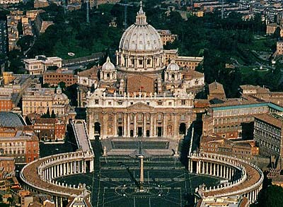
The Common Denominator is……….
Revelation 17:18 “And the woman which thou sawest is that great city, which reigneth over the kings of the earth.”
“The pope is the ruler of the world. All the emperors, all the kings, all the princes, all the presidents of the world are as these altar boys of mine.” — Priest D. S. Phelan, Western Watchman, June 27, 1912

Slide 20
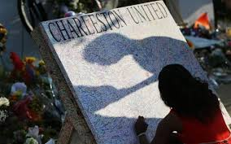
Order From Chaos NOW!
People gunned down in a Charleston, SC church. The smoldering flames of race surface again.
The president calls for stricter gun control laws.
In order to be safe, we must give up our guns!

Slide 21
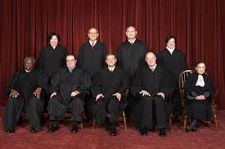
Supreme Court Does It!
June 26, 2015 “ The Supreme Court declared Friday that same-sex couples have a right to marry anywhere in the United States, a historic culmination of decades of litigation over gay marriage and gay rights generally.
Gay and lesbian couples already could marry in 36 states and the District of Columbia. The court's 5-4 ruling means the remaining 14 states, in the South and Midwest, will have to stop enforcing their bans on same-sex marriage.” Associated Press

Slide 22
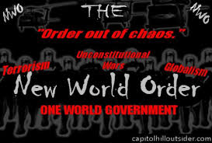
Creating the Chaos
Creating chaos! Encouraging racial violence and then using it to take away people’s rights to have guns! Creating a filthy climate that will lead to judgments upon this land and then bringing a solution! We are repeating history. The world has no solutions. The Lord Jesus Christ is the solution!!!!!

Slide 23
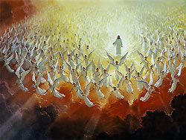
Hegel and Babylon missed the Boat
This isn’t the answer
This is!!
“Yet this very class put forth the claim that the fast-spreading corruption is largely attributable to the desecration of the so-called "Christian sabbath," and that the enforcement of Sunday observance would greatly improve the morals of society. This claim is especially urged in America, where the doctrine of the true Sabbath has been most widely preached.” GC, pg. 587

