Slide 1
What is the Difference Between Mormons, Jehovah’s Witnesses, and Seventh-day Adventists? pt 30

Slide 2
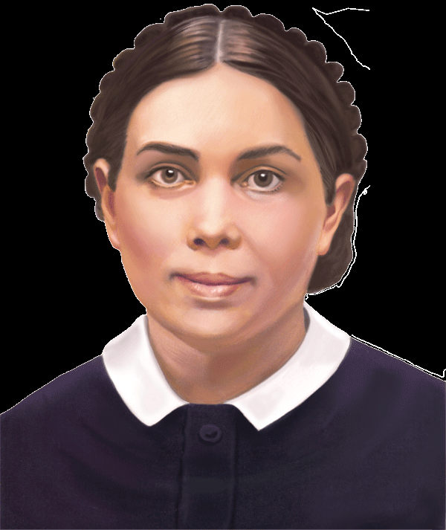
Principle over the letter of the law!
"I present these matters [health reform] before the people, dwelling upon general principles" (Manuscript 29, 1897)
I left off these things from principle. I took my stand on health reform from principle . . . I moved out from principle, not from impulse. I have advanced nothing but what I stand to today" (2T 372).
“It is reported by some that I have not followed the principles of health reform as I have advocated them with my pen; but I can say that I have been a faithful health reformer. Those who have been members of my family know that this is true” (9T 159).

Slide 3
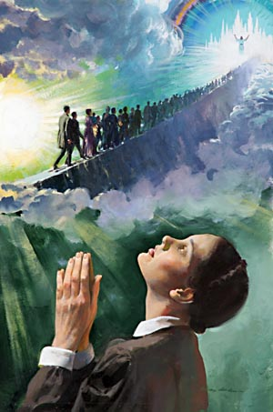
Charge: Contradiction--No Time Setting?
“Time has not been a test since 1844, and it will never again be a test. The Lord has shown me that the message of the third angel must go, and be proclaimed to the scattered children of the Lord, but it must not be hung on time. I saw that some were getting a false excitement, arising from preaching time; but the third angel's message is stronger than time can be” EW, p. 74
“Then Jesus would encourage them by raising His glorious right arm, and from His arm came a light which waved over the Advent band, and they shouted, “Alleluia!” Others rashly denied the light behind them and said that it was not God that had led them out so far. The light behind them went out, leaving their feet in perfect darkness, and they stumbled and lost sight of the mark and of Jesus, and fell off the path down into the dark and wicked world below. Soon we heard the voice of God like many waters, which gave us the day and hour of Jesus’ coming. The living saints, 144,000 in number, knew and understood the voice, while the wicked thought it was thunder and an earthquake.” EW, p. 14-15

Slide 4
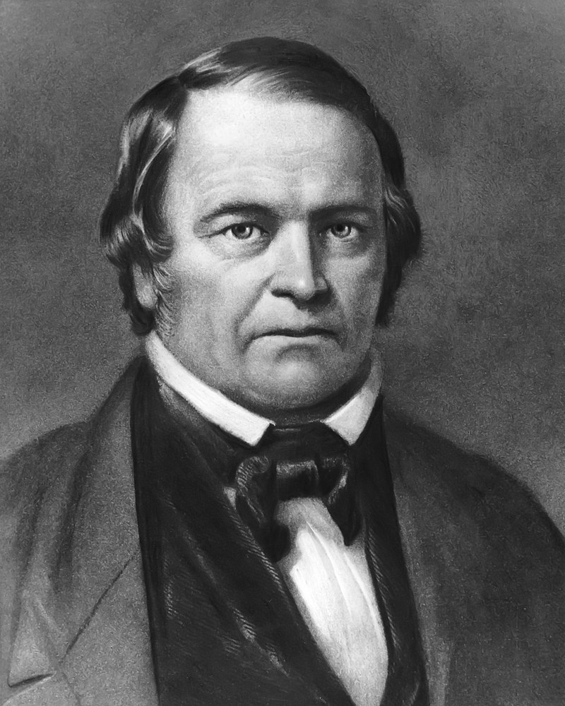
“I confess my error and acknowledge my disappointment; yet I still believe that the day of the Lord is near, even at the door; and I exhort you, my brethren, to be watchful and not let that day come upon you unawares. The wicked, the proud, and the bigot, will exult over us. I will try to be patient. God will deliver the godly out of temptation, and will reserve the unjust to be punished at Christ’s appearing.” Sketches of the Christian Life and Public Labors of William Miller, Sylvester Bliss, p. 282
David Gates Lied About 2018 and the Pope, starting the date from the 2015 visit of Pope Francis correlated to the flee of Cestius Gallus 3-1/2 years prior. Now he’s using the 6,000 year cycle to calculate new times. But he insists he’s not “time-setting” because he’s not selecting a specific day, but he has recently mentioned March 2024, 2027 and/or 2031—THIS IS EVIL!!!

Slide 5
Memory Lane
Clips From Even at the Doors

Slide 6
Today
David Gates Message on February 3, 2024

Slide 7
Charge: Ridiculous—Bicycles?
"There were some who were striving for the mastery, each trying to excel the other in the swift running of their bicycles. There was a spirit of strife and contention among them as to which should be the greatest. The spirit was similar to that manifested in the baseball games on the college ground. Said my Guide: 'These things are an offense to God. Both near and afar off souls are perishing for the bread of life and the water of salvation.' When Satan is defeated in one line, he will be all ready with other schemes and plans which will appear attractive and needful, and which will absorb money and thought, and encourage selfishness, so that he can overcome those who are so easily led into a false and selfish indulgence. The question arises: What burden do these persons carry for the advancement of the work of God? Wherein do they realize the importance of the work for this time? Christ said to His disciples: ‘Ye are the light of the world . . . . Let your light so shine before men, that they may see your good works, and glorify your Father which is in heaven’ Matthew 5:14-16. Is this investment of means and this spinning of bicycles through the streets of Battle Creek giving evidence of the genuineness of your faith in the last solemn warning to be given to human beings standing on the very verge of the eternal world?" (Testimonies for the Church, vol. 8, pp. 51, 52).

Slide 8
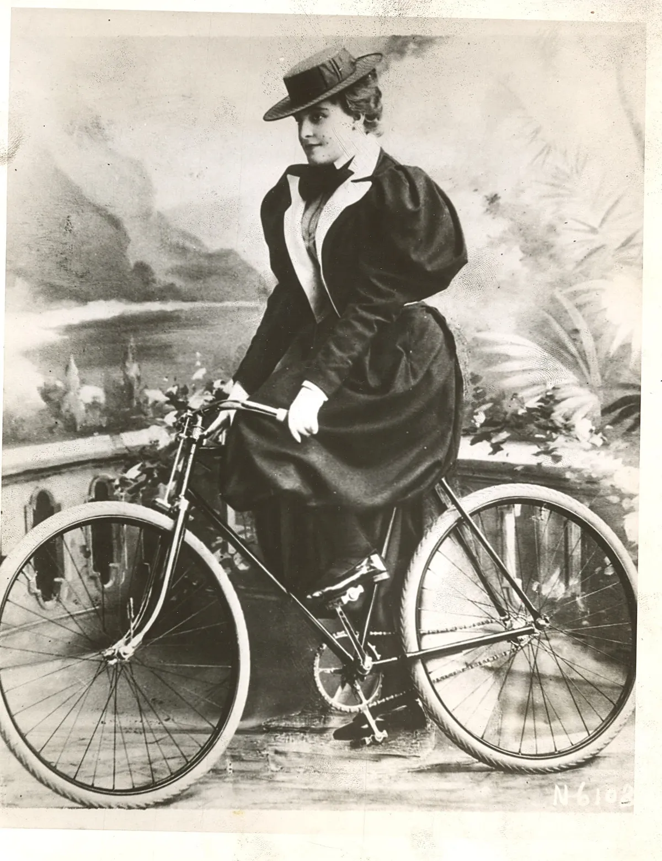
Bicycles Were Expensive
“Toward the end of the last century, the American people were swept with a consuming passion which left them with little time or money for anything else. . . . What was this big new distraction? For an answer the merchants had only to look out the window and watch their erstwhile customers go whizzing by. America had discovered the bicycle, and everybody was making the most of the new freedom it brought. . . . The bicycle began as a rich man's toy. Society and celebrity went awheel. The best early bicycle cost $150, an investment comparable to the cost of an automobile today. . . . Every member of the family wanted a 'wheel,' and entire family savings often were used up in supplying the demand" (When All the World Went Wheeling, Reader's Digest, December 1951).

Slide 9
Charge: Mistake on “The Seal of God”?
“This is the message given by God to be sounded forth in the loud cry of the third angel. The sign or seal of God is the observance of the seventh-day Sabbath, and the Lord's memorial of his work of creation. "The Lord spake unto Moses saying, Speak thou also unto the children of Israel, saying, Verily my Sabbaths ye shall keep: for it is a sign between me and you throughout your generations; that ye may know that I am Lord that doth sanctify you." Here the Sabbath is clearly defined as a sign between God and his people. Pamphlets, p. 866, Special Testimony to Battle Creek Church, 1898
“If the light of truth has been presented to you, revealing the Sabbath of the fourth commandment, and showing that there is no foundation in the Word of God for Sunday observance, and yet you still cling to the false sabbath, refusing to keep holy the Sabbath which God calls "My holy day," you receive the mark of the beast. When does this take place? When you obey the decree that commands you to cease from labor on Sunday and worship God, while you know that there is not a word in the Bible showing Sunday to be other than a common working day, you consent to receive the mark of the beast, and refuse the seal of God.”--Review and Herald, July 13, 1897

Slide 10
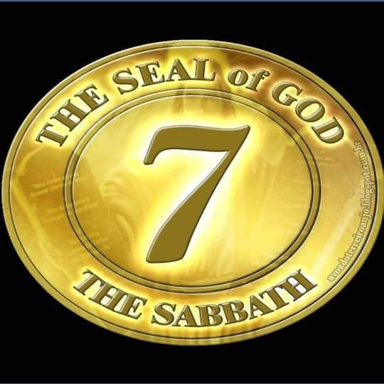
Sabbath-keepers Receive the Seal of God
“The Sabbath will be the great test of loyalty; for it is the point of truth especially controverted. When the final test shall be brought to bear upon men, then the line of distinction will be drawn between those who serve God and those who serve him not. While the observance of the false sabbath in compliance with the law of the State, contrary to the fourth commandment, will be an avowal of allegiance to a power that is in opposition to God, the keeping of the true Sabbath, in obedience to God's law, is an evidence of loyalty to the Creator. While one class, by accepting the sign of submission to earthly powers, receive the mark of the beast, the other, choosing the token of allegiance to divine authority, receive the seal of God.” GC88, 605

Slide 11
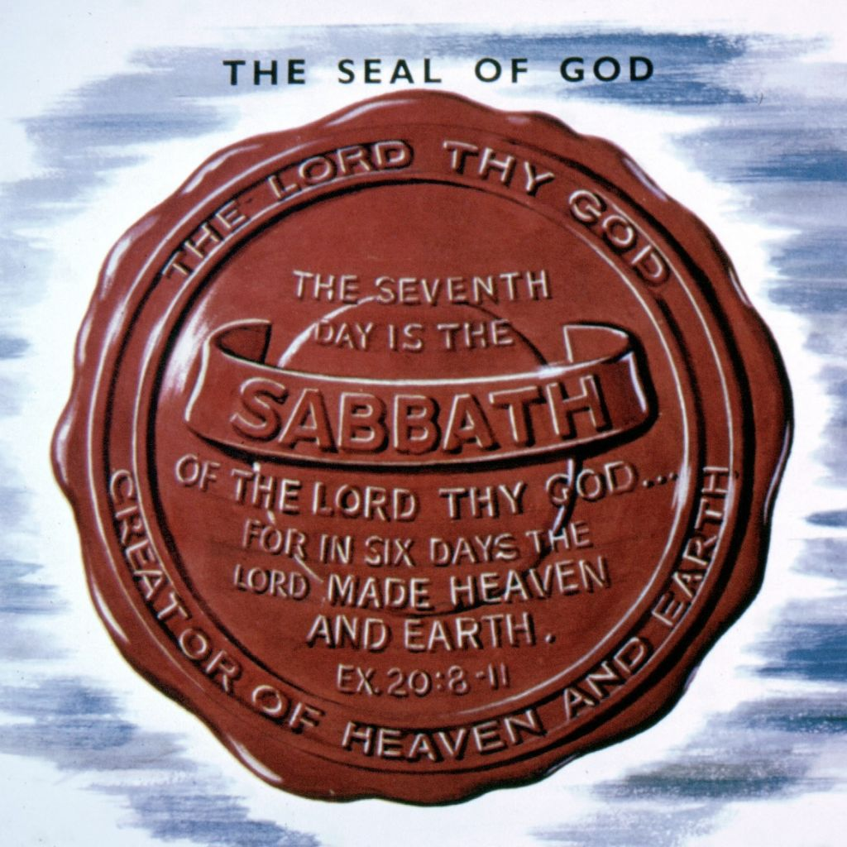
More Powerful Quotes
“The sign, or seal, of God is revealed in the observance of the seventh-day Sabbath, the Lord's memorial of creation. . . . The mark of the beast is the opposite of this--the observance of the first day of the week.”--8T 117
“The seal of God’s law is found in the fourth commandment. This only, of all the ten, brings to view both the name and the title of the Lawgiver. It declares Him to be the Creator of the heavens and the earth, and thus shows His claim to reverence and worship above all others. Aside from this precept, there is nothing in the Decalogue to show by whose authority the law is given.” Our Father Cares, p. 83

Slide 12
Bible Contradiction with EGW?
2 Cor. 1:21-22 “Now he which stablisheth us with you in Christ, and hath anointed us, is God; Who hath also sealed us, and given the earnest of the Spirit in our hearts.”
Eph. 1:13 “In whom ye also trusted, after that ye heard the word of truth, the gospel of your salvation: in whom also after that ye believed, ye were sealed with that holy Spirit of promise.”
Eph. 4:29-30 “Let no corrupt communication proceed out of your mouth, but that which is good to the use of edifying, that it may minister grace unto the hearers. And grieve not the holy Spirit of God, whereby ye are sealed unto the day of redemption.”

Slide 13
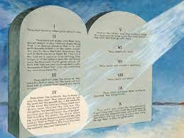
Thoughts on the Seal of God
The Bible does NOT say that the Holy Spirit is the “Seal of God”—as in the genuine article, but that we are sealed by/with the Holy Spirit, meaning it is His work. The Bible could just as easily say Jesus has sealed us, or the Father has sealed us, or the Law has sealed us depending on the context. The Seal of God officially is the Sabbath, the forgotten 4th Commandment of God. Like other official seals, the 4th Commandment contains God’s Name, Title, and Jurisdiction. This Law was spoken by God’s own mouth, in Person, and written by His own finger. There is not other portion of the Law or the Testimonies which contain these identifying characteristics and simultaneously proclaimed by the highest authority in the universe. Unofficially speaking, the “seal of God” could be many things. Any portion of the Law of God which is being ignored will contain a sealing element. Belief in Jesus is the seal, perfection is the seal, obedience is the seal, baptism is the seal, etc. context matters!

Slide 14
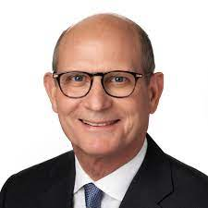
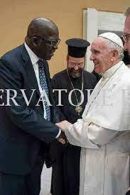
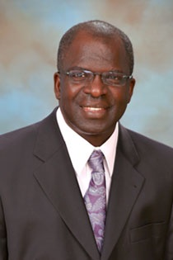
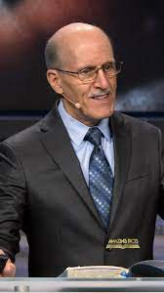
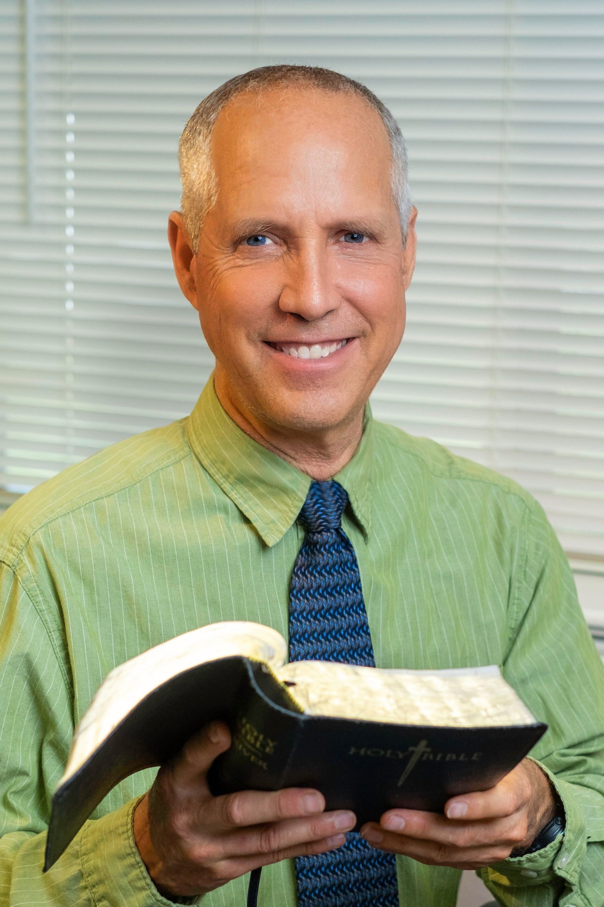
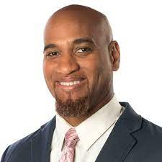
Other Contexts
“The day of God's vengeance is just upon us. The seal of God will be placed upon the foreheads of those only who sigh and cry for the abominations done in the land. Those who link in sympathy with the world are eating and drinking with the drunken, and will surely be destroyed with the workers of iniquity. ‘The eyes of the Lord are upon the righteous, and His ears are open unto their cry;’ but ‘the face of the Lord is against them that do evil.’” Christian Experience and Teachings of Ellen White, p. 187
Ganoune Diop: Director For Public Affairs and Religious Liberty

Slide 15
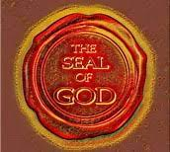
“This was to be an evidence that the priests could not misinterpret. This was the reason of His delay in going to Bethany. This crowning miracle, the raising of Lazarus, was to set the seal of God on His work and on His claim to divinity.” DA, p. 529
“The work that is done to the honor and glory of God will bear the seal of God. Christ will endorse the work of those who will do their best. And as they continue to do their best, they will increase in knowledge, and the character of their work will be improved.”--Letter 153, 1903

Slide 16
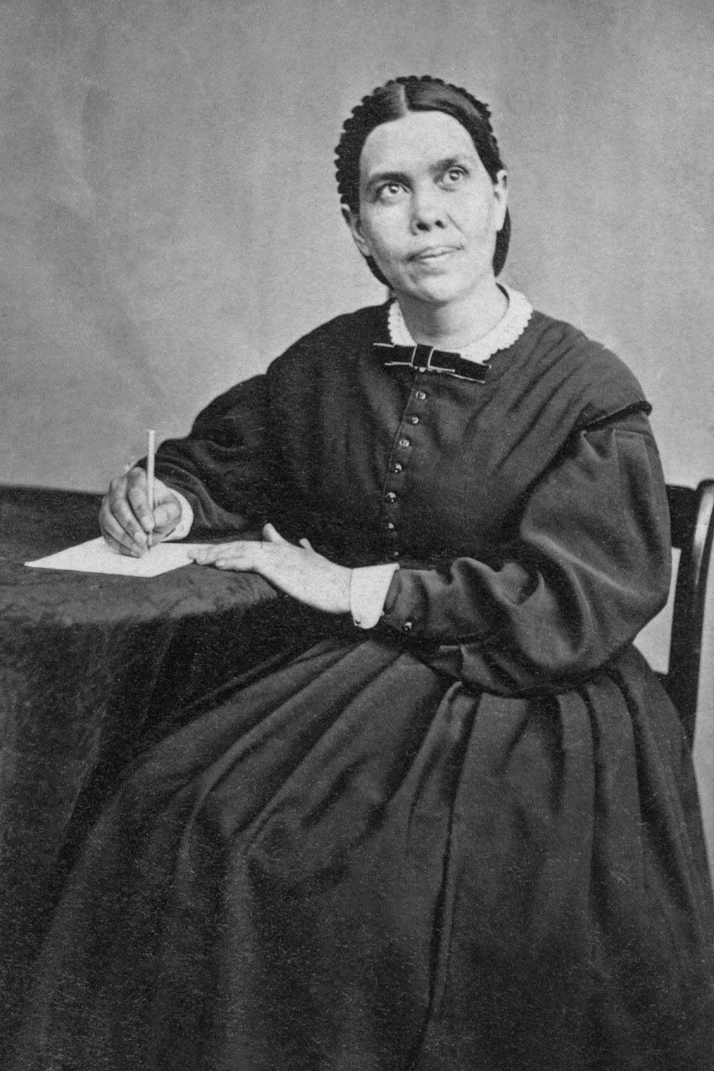
“Not one of us will ever receive the seal of God while our characters have one spot or stain upon them. It is left with us to remedy the defects in our characters, to cleanse the soul-temple of every defilement. Then the latter rain will fall upon us as the early rain fell upon the disciples on the day of Pentecost.” Christian Experience and Teachings of Ellen White, p. 189
“Thus the distinction is drawn between the loyal and the disloyal. Those who desire to have the seal of God in their foreheads must keep the Sabbath of the Fourth Commandment. Thus they are distinguished from the disloyal, who have accepted a man-made institution in place of the true Sabbath. The observance of God's rest-day is a mark of distinction between him that serveth God and him that serveth Him not.” RH, April 23, 1901

Slide 17
Final Thoughts
There are many terms/phrases which can be used in a direct or loose way—like ‘types’ if you will. For example
“The Sunday Law is the Mark of the Beast” vs “Sunday is the Mark of the Beast”
“The Church-State hierarchy formed at the Sunday Law is the Image of the Beast” vs “Sunday is the Image of the Beast”
“The Gospel is Righteousness by Faith” vs “Jesus is the Gospel” vs “Forgiveness is the Gospel” vs “Grace through Faith is the Gospel”
Again, we must focus on the principles not the letter. Ellen White’s teachings on the “Seal of God” in no way contradicts the Bible. In fact, she clarifies a very important and lost truth—the 4th Commandment contains God’s Name, Title, and Jurisdiction; it literally is “The Seal of God”—the Bible clarifies, how do you know you are saved, you will be sealed by/with the Holy Spirit--are you receiving strength to overcome sin? Are you conquering? Are you obedient? Are your garments white? Or spotted with self and sin?

