Slide 1
Ezekiel, pt. 7/ chapters 12 and 13
‘The Leaky Fence’

Slide 2
Summary so Far
1. The Glory of God. Ezekiel. Ch. 1
2. The Call. Ezekiel. Ch. 2,3
3. The Warning Ezekiel. Ch. 4,5
4. The Remnant Ezekiel. Ch. 6,7
5. The Mark Ezekiel. Ch. 8,9
6. The Departing Ezekiel Ch. 10, 11
7. Today Ezekiel Ch. 12 repetition
Ch. 13 ‘The Leaky Fence’

Slide 3
Ch. 12 Highlights
“The word of the LORD also came unto me, saying, Son of man, thou dwellest in the midst of a rebellious house, which have eyes to see, and see not; they have ears to hear, and hear not: for they are a rebellious house. Therefore, thou son of man, prepare thee stuff for removing, and remove by day in their sight; and thou shalt remove from thy place to another place in their sight: it may be they will consider, though they be a rebellious house. Then shalt thou bring forth thy stuff by day in their sight, as stuff for removing: and thou shalt go forth at even in their sight, as they that go forth into captivity. Dig thou through the wall in their sight, and carry out thereby. In their sight shalt thou bear it upon thy shoulders, and carry it forth in the twilight: thou shalt cover thy face, that thou see not the ground: for I have set thee for a sign unto the house of Israel. And I did so as I was commanded: I brought forth my stuff by day, as stuff for captivity, and in the even I digged through the wall with mine hand; I brought it forth in the twilight, and I bare it upon my shoulder in their sight….

Slide 4
Zedekiah Goes Down
“…And in the morning came the word of the LORD unto me, saying, Son of man, hath not the house of Israel, the rebellious house, said unto thee, What doest thou? Say thou unto them, Thus saith the Lord GOD; This burden concerneth the prince in Jerusalem, and all the house of Israel that are among them. Say, I am your sign: like as I have done, so shall it be done unto them: they shall remove and go into captivity. And the prince that is among them shall bear upon his shoulder in the twilight, and shall go forth: they shall dig through the wall to carry out thereby: he shall cover his face, that he see not the ground with his eyes. My net also will I spread upon him, and he shall be taken in my snare: and I will bring him to Babylon to the land of the Chaldeans; yet shall he not see it, though he shall die there.” Ezekiel 12:1-13

Slide 5
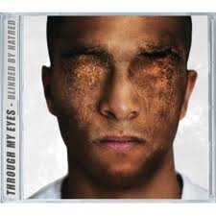
De-Eyed
Jer. 39:4-8 “ And it came to pass, that when Zedekiah the king of Judah saw them, and all the men of war, then they fled, and went forth out of the city by night, by the way of the king's garden, by the gate betwixt the two walls: and he went out the way of the plain. But the Chaldeans' army pursued after them, and overtook Zedekiah in the plains of Jericho: and when they had taken him, they brought him up to Nebuchadnezzar king of Babylon to Riblah in the land of Hamath, where he gave judgment upon him. Then the king of Babylon slew the sons of Zedekiah in Riblah before his eyes: also the king of Babylon slew all the nobles of Judah. Moreover he put out Zedekiah's eyes, and bound him with chains, to carry him to Babylon. And the Chaldeans burned the king's house, and the houses of the people, with fire, and brake down the walls of Jerusalem.”

Slide 6
Ezekiel 12:14-20
“And I will scatter toward every wind all that are about him to help him, and all his bands; and I will draw out the sword after them. And they shall know that I am the LORD, when I shall scatter them among the nations, and disperse them in the countries. But I will leave a few men of them from the sword, from the famine, and from the pestilence; that they may declare all their abominations among the heathen whither they come; and they shall know that I am the LORD. Moreover the word of the LORD came to me, saying, Son of man, eat thy bread with quaking, and drink thy water with trembling and with carefulness; And say unto the people of the land, Thus saith the Lord GOD of the inhabitants of Jerusalem, and of the land of Israel; They shall eat their bread with carefulness, and drink their water with astonishment, that her land may be desolate from all that is therein, because of the violence of all them that dwell therein. And the cities that are inhabited shall be laid waste, and the land shall be desolate; and ye shall know that I am the LORD. And the word of the LORD came unto me, saying,”…

Slide 7
Concluded
“Son of man, what is that proverb that ye have in the land of Israel, saying, The days are prolonged, and every vision faileth? Tell them therefore, Thus saith the Lord GOD; I will make this proverb to cease, and they shall no more use it as a proverb in Israel; but say unto them, The days are at hand, and the effect of every vision. For there shall be no more any vain vision nor flattering divination within the house of Israel. For I am the LORD: I will speak, and the word that I shall speak shall come to pass; it shall be no more prolonged: for in your days, O rebellious house, will I say the word, and will perform it, saith the Lord GOD. Again the word of the LORD came to me, saying, Son of man, behold, they of the house of Israel say, The vision that he seeth is for many days to come, and he prophesieth of the times that are far off. Therefore say unto them, Thus saith the Lord GOD; There shall none of my words be prolonged any more, but the word which I have spoken shall be done, saith the Lord GOD.” Ezek. 12:14-28

Slide 8
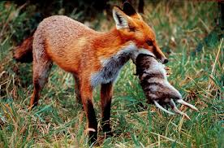
Ruthless False Teachers
“Son of man, prophesy against the prophets of Israel that prophesy, and say thou unto them that prophesy out of their own hearts, Hear ye the word of the LORD; Thus saith the Lord GOD; Woe unto the foolish prophets, that follow their own spirit, and have seen nothing! O Israel, thy prophets are like the foxes in the deserts. Ye have not gone up into the gaps, neither made up the hedge for the house of Israel to stand in the battle in the day of the LORD.” Ezek. 13:2-5

Slide 9
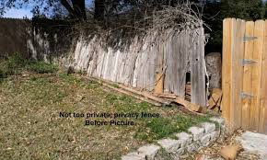
Hedge/Fence Broken
In Ezekiel 13, we find a hedge that is in ill-repair. It is of such paramount importance that God’s people will not be able to stand in the battle in the day of the Lord! This battle is just ahead. What is this hedge/fence that is of vital import for the people of God?

Slide 10
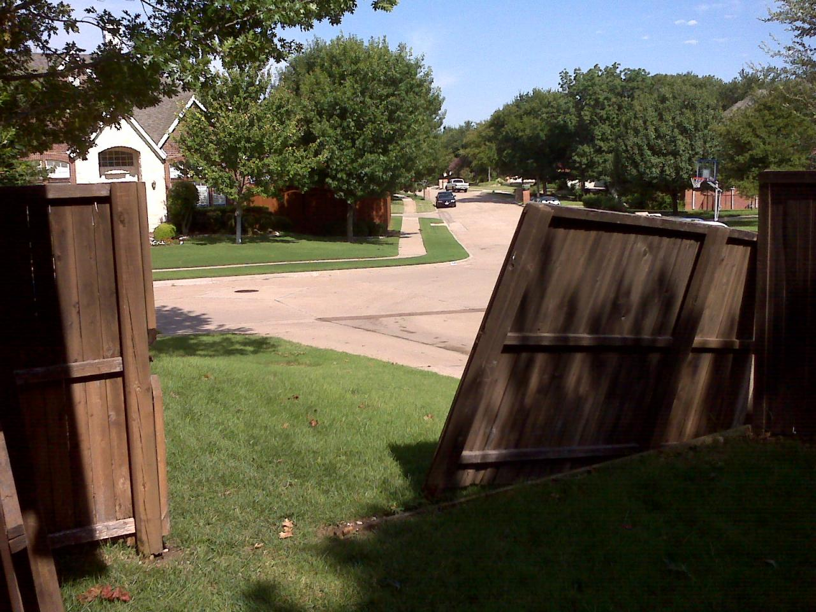
The Hedge is Broken Down
“Hear another parable: There was a certain householder, which planted a vineyard, and hedged it round about, and digged a winepress in it, and built a tower, and let it out to husbandmen, and went into a far country.” Matthew 21:33

Slide 11
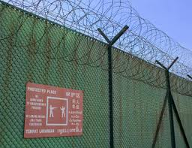
Protection
““The speakers had not at first perceived the application of the parable, but they now saw that they had pronounced their own condemnation. In the parable the householder represented God, the vineyard the Jewish nation, and the hedge the divine law which was their protection. The tower was a symbol of the temple. The lord of the vineyard had done everything needful for its prosperity. "What could have been done more to my vineyard," he says, "that I have not done in it." Isa. 5:4. Thus was represented God's unwearied care for Israel.” DA, pgs. 596

Slide 12
Divine Protector
“ There is not a commandment of the law that is not for the good and happiness of man, both in this life and in the life to come. In obedience to God's law, man is surrounded as with a hedge and kept from the evil. He who breaks down this divinely erected barrier at one point has destroyed its power to protect him; for he has opened a way by which the enemy can enter to waste and ruin.” Reflecting Christ, pg. 69

Slide 13
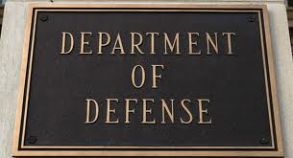
Only way to Obedience
“We must inevitably be under the control of the one or the other of the two great powers that are contending for the supremacy of the world. It is not necessary for us deliberately to choose the service of the kingdom of darkness in order to come under its dominion. We have only to neglect to ally ourselves with the kingdom of light. If we do not co-operate with the heavenly agencies, Satan will take possession of the heart, and will make it his abiding place. The only defense against evil is the indwelling of Christ in the heart through faith in His righteousness. Unless we become vitally connected with God, we can never resist the unhallowed effects of self-love, self-indulgence, and temptation to sin.” DA, pg. 324

Slide 14
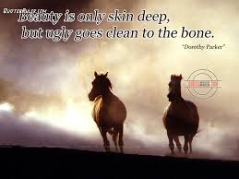
Only to Outward Acts
“For I say unto you, That except your righteousness shall exceed the righteousness of the scribes and Pharisees, ye shall in no case enter into the kingdom of heaven.” Matthew 5:20

Slide 15
Righteousness All the Way
“The greatest deception of the human mind in Christ's day was that a mere assent to the truth constitutes righteousness. In all human experience a theoretical knowledge of the truth has been proved to be insufficient for the saving of the soul. It does not bring forth the fruits of righteousness. A jealous regard for what is termed theological truth often accompanies a hatred of genuine truth as made manifest in life. The darkest chapters of history are burdened with the record of crimes committed by bigoted religionists. The Pharisees claimed to be children of Abraham, and boasted of their possession of the oracles of God; yet these advantages did not preserve them from selfishness, malignity, greed for gain, and the basest hypocrisy. ..

Slide 16
Truth Inside!
“They thought themselves the greatest religionists of the world, but their so-called orthodoxy led them to crucify the Lord of glory. The same danger still exists. Many take it for granted that they are Christians, simply because they subscribe to certain theological tenets. But they have not brought the truth into practical life. They have not believed and loved it, therefore they have not received the power and grace that come through sanctification of the truth. Men may profess faith in the truth; but if it does not make them sincere, kind, patient, forbearing, heavenly-minded, it is a curse to its possessors, and through their influence it is a curse to the world.” DA, pgs. 309,310

Slide 17
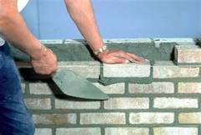
Untempered Morter
” And mine hand shall be upon the prophets that see vanity, and that divine lies: they shall not be in the assembly of my people, neither shall they be written in the writing of the house of Israel, neither shall they enter into the land of Israel; and ye shall know that I am the Lord GOD. Because, even because they have seduced my people, saying, Peace; and there was no peace; and one built up a wall, and, lo, others daubed it with untempered morter:” Ezek. 13:9,10

Slide 18
Untempered Mortar
The wall "daubed with untempered mortar" of (Ezekiel 13:10) was perhaps a sort of cob-wall of mud or clay without lime, which would give way under heavy rain. Untempered mortar was the Hebrew equivalent for empty foolishness. It was a picture of someone who built a stone wall with water and sand as mortar and then covered it over with white wash. To them, there was nothing more foolish than a wall which couldn’t stand up against the elements or hold back the enemy armies that often laid siege against their cities.

Slide 19
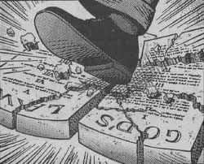
Changed God’s Law
Done So Many Ways
1. just smashing it.
2. only applying it to our outward lives.
3. believing I can be saved in disobedience to that law. Believing I can be saved in my sins.

Slide 20
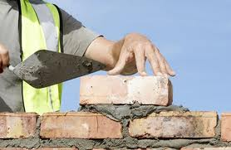
Collapsing Wall!!
A wall built with untempered mortar will not survive. It will collapse under any kind of pressure. The leaders in Israel were building by substituting their words for God’s Word. They were replacing God’s law with man made laws! This is happening today!

Slide 21
Hailstones!!
“Say unto them which daub it with untempered mortar, that it shall fall: there shall be an overflowing shower; and ye, O great hailstones, shall fall; and a stormy wind shall rend it. Lo, when the wall is fallen, shall it not be said unto you, Where is the daubing wherewith ye have daubed it? Therefore thus saith the Lord GOD; I will even rend it with a stormy wind in my fury; and there shall be an overflowing shower in mine anger, and great hailstones in my fury to consume it. So will I break down the wall that ye have daubed with untempered mortar, and bring it down to the ground, so that the foundation thereof shall be discovered, and it shall fall, and ye shall be consumed in the midst thereof: and ye shall know that I am the LORD.” Ezekiel 13:11-14

Slide 22
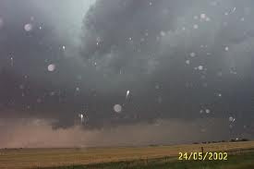
A Talent in Weight
“And there fell upon men a great hail out of heaven, every stone about the weight of a talent: and men blasphemed God because of the plague of the hail; for the plague thereof was exceeding great.” Rev. 16:21

Slide 23
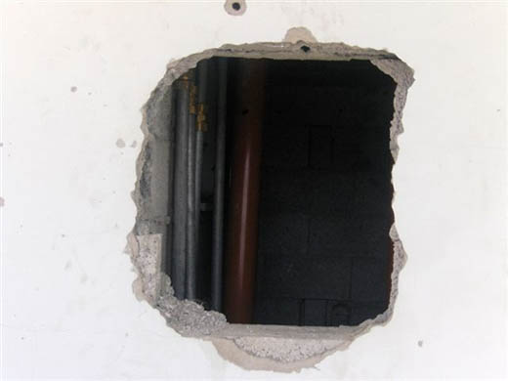
75 Pounds!
The hailstones will weigh 75 lbs! God will show His ultimate displeasure toward those who have substituted man made law for His law; for changing the Sabbath to Sunday; for teaching/preaching that disobedience to God’s law is OK!!

Slide 24
Satan’s Great Goal
“From the very beginning of the great controversy in heaven it has been Satan's purpose to overthrow the law of God. It was to accomplish this that he entered upon his rebellion against the Creator, and though he was cast out of heaven he has continued the same warfare upon the earth. To deceive men, and thus lead them to transgress God's law, is the object which he has steadfastly pursued. Whether this be accomplished by casting aside the law altogether, or by rejecting one of its precepts, the result will be ultimately the same. He that offends "in one point," manifests contempt for the whole law; his influence and example are on the side of transgression; he becomes "guilty of all." James 2:10.” GC, pg. 582

Slide 25
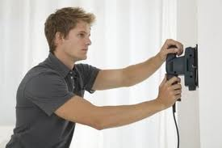
Repairer’s of the Breach!
”And they that shall be of thee shall build the old waste places: thou shalt raise up the foundations of many generations; and thou shalt be called, The repairer of the breach, The restorer of paths to dwell in.” Isaiah 58:12

