Slide 1

The Holy Spirit Vindicated

Slide 2

What Does the Bible Say?
1 John 5:7,8 “For there are three that bear record in heaven, the Father, the Word, and the Holy Ghost: and these three are one. And there are three that bear witness in earth, the Spirit, and the water, and the blood: and these three agree in one.”
Ephesians 4:4-6 “There is one body, and one Spirit, even as ye are called in one hope of your calling; One Lord, one faith, one baptism, One God and Father of all, who is above all, and through all, and in you all.”

Slide 3

From the Beginning!
Genesis 1:1-3 “In the beginning God created the heaven and the earth. And the earth was without form, and void; and darkness was upon the face of the deep. And the Spirit of God moved upon the face of the waters. And God said, Let there be light: and there was light.”
Genesis 6:3 “And the Lord said, My spirit shall not always strive with man, for that he also is flesh: yet his days shall be an hundred and twenty years.”

Slide 4

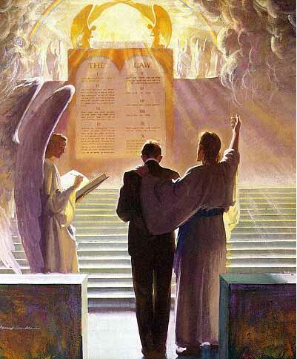
A Co-Intercessor
Romans 8:16, 26-27 “ The Spirit itself beareth witness with our spirit, that we are the children of God . . . Likewise the Spirit also helpeth our infirmities: for we know not what we should pray for as we ought: but the Spirit itself maketh intercession for us with groanings which cannot be uttered. And he that searcheth the hearts knoweth what is the mind of the Spirit, because he maketh intercession for the saints according to the will of God.

Slide 5

The Spirit Sent Christ!
Isaiah 48:16 “Come ye near unto me, hear ye this; I have not spoken in secret from the beginning; from the time that it was, there am I: and now the Lord GOD, and his Spirit, hath sent me.

Slide 6


The Holy Spirit Speaks
Acts 8:29 “Then the Spirit said unto Philip, Go near, and join thyself to this chariot.
Acts 13:2 “ As they ministered to the Lord, and fasted, the Holy Ghost said, Separate me Barnabas and Saul for the work whereunto I have called them.”
Acts 11:12 “And the Spirit bade me go with them, nothing doubting.”
1 Timothy 4:1 “Now the Spirit speaketh expressly, that in the latter times some shall depart from the faith, giving heed to seducing spirits, and doctrines of devils;

Slide 7
Other Scriptures Pointing to the Person, Godliness, or Personal attributes of the Holy Spirit
1 Cor. 12:11 Titus 3:5 2 Sam. 23:2 Acts 16:6
1 Cor. 2:10,11 1 Pet. 1:2 Acts 10:19 Ps. 139:7,8
Phil. 2:1 Eph. 3:16 Acts 21:11 John 14:16,17
2 Cor. 13:14 Eph. 4:30 Acts 28:25-26 Is. 40:13
Acts 5:3-4,9 Matt. 28:19-Baptize Heb. 3:7-8 Zech. 4:6
2 Pet. 1:21 2 Cor. 3:16-18 Rev. 14:13 Luke 1:35-Creator
1 Cor. 6:19 Rom. 8:11 Rev. 22:17 Heb. 9:8
Matt. 12:31-Blasphemy John 6:63 Acts 15:28 1 Pet. 1:12
John 15:26 1 John 5:6 Acts 20:28 Job 33:4
John 16:7 John 14:26 Acts 5:32 Ps. 104:30
John 16:9 Is. 63:10 Luke 12:12 Matt. 12:28
John 16:13 Rom. 15:30 Matt. 4:1 1 Cor. 12:4-6
2 Cor. 13:14

Slide 8
The Spirit of Prophecy Sheds Light
We need to realize that the Holy Spirit, who is as much a person as God is a person, is walking through these grounds.-- Manuscript 66, 1899. (From a talk to the students at the Avondale School.)
The Holy Spirit is a person, for He beareth witness with our spirits that we are the children of God. When this witness is borne, it carries with it its own evidence. At such times we believe and are sure that we are the children of God. . . . The Holy Spirit has a personality, else He could not bear witness to our spirits and with our spirits that we are the children of God. He must also be a divine person, else He could not search out the secrets which lie hidden in the mind of God. "For what man knoweth the things of a man, save the spirit of man which is in him? even so the things of God knoweth no man, but the Spirit of God."-- Manuscript 20, 1906

Slide 9
The prince of the power of evil can only be held in check by the power of God in the third person of the Godhead, the Holy Spirit.-- Special Testimonies, Series A, No. 10, p. 37. (1897)
The Comforter that Christ promised to send after He ascended to heaven, is the Spirit in all the fullness of the Godhead, making manifest the power of divine grace to all who receive and believe in Christ as a personal Saviour. There are three living persons of the heavenly trio; in the name of these three great powers --the Father, the Son, and the Holy Spirit--those who receive Christ by living faith are baptized, and these powers will co-operate with the obedient subjects of heaven in their efforts to live the new life in Christ.-- Special Testimonies, Series B, No. 7, pp. 62, 63. (1905)
When you gave yourself to Christ, you made a pledge in the presence of the Father, the Son, and the Holy Spirit—the three great personal Dignitaries of heaven. “Hold fast” to this pledge.– MS 92, 1901
Dignitary-An ecclesiastic who holds a dignity, or a benefice which gives him some pre-eminence over mere priests and canons, as a bishop, dean, archdeacon, prebendary, &c– 1828 Webster’s Dictionary

Slide 10
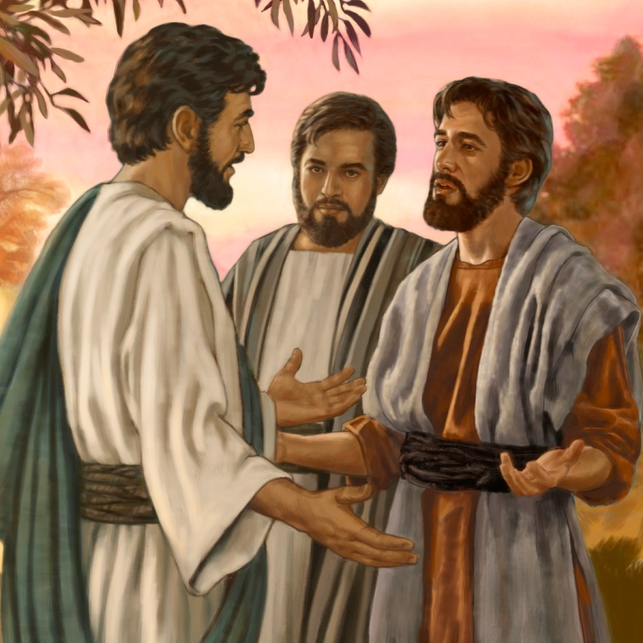
A Warning!
They were not to add to His words, or give a forced meaning to His utterances. They were not to put a mystical interpretation upon the plain teaching of the Scriptures, or draw from theological stores to build up some man-made theory. – RH, June 2, 1896

Slide 11
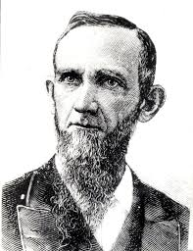
The Opposition
Dudley Canright-All trinitarian creeds make the Holy Ghost a person, equal in substance, power and eternity, and glory with the Father and the Son. Thus they claim three persons in the trinity, each one equal with both the others. If this be so, then the Holy Spirit is just as truly an individual, intelligent person as is the Father or the Son. But this we cannot believe. The Holy Spirit is not a person.” (D. M. Canright, Signs of the Times July 25th 1878, article ‘The Holy Spirit’)

Slide 12
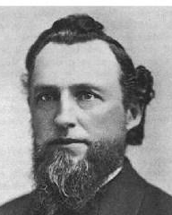
Inspired Pioneers?
Uriah Smith-The terms 'Holy Ghost,' are a harsh and repulsive translation. It should be 'Holy Spirit' (hagion pneuma) in every instance. This Spirit is the Spirit of God, and the Spirit of Christ; the Spirit being the same whether it is spoken of as pertaining to God or Christ. But respecting this Spirit, the Bible uses expressions which cannot be harmonized with the idea that it is a person like the Father and the Son. Rather it is shown to be a divine influence from them both, the medium which represents their presence and by which they have knowledge and power through all the universe, when not personally present.-- Review and Herald, Oct. 28th, 1890, ‘The Question Chair

Slide 13
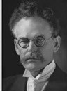
M.C. Wilcox-The Holy Spirit is the mighty energy of the Godhead, the life and power of God flowing out from Him to all parts of the universe, and thus making a living connection between His throne and all creation.-- (M. C. Wilcox, Questions And Answers, Pacific Press, 1911 p.181)

Slide 14
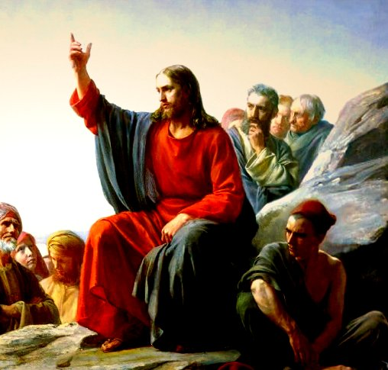
The Parable of the Comforter?
John 16:25-proverbs
John 14:16-18-Wanted to reveal the Father, he=Father
Rich man and Lazarus Parable-Abraham’s Bosom
John 14:22-Disciples say Jesus is coming
John 15:26-proceeds from the Father-Who is in the Sanctuary?

Slide 15
6. Spirit of truth, testify of Christ, therefore is Christ—If 3 are 1, then all symbols can apply to each
7. John 16:7-”I will send him unto you”—Christ could not send Spirit until he was glorified—Why then was He anointed with the Spirit at His baptism—was Christ’s ministry a farce? Stones into bread, come off the cross, legions
8. Spirit of a person and the person are the same thing right?
9. Holy Spirit as a person is a tradition, namely one from Rome—counterfeits of Satan
10. John 16:12-14-Not a new teacher—Christ is “truth” the “Spirit of truth” is the same Jesus Christ—NO TEACHER besides Christ—Son is glorified by the Father whose Spirit proceedeth from Him
11. John 16:26-27-All about the Father and Son of God-Sanctuary context
12. John 16:29-disciples said he speaks plain speech that He is the Son of God
13. This issue is NOT Christianity, not biblical-Become the 3rd Angel’s Message- Gal. 4:6—Is Christ omnipresent?
14. 1 John 2:1 “Comforter”—parakletos—is Jesus

Slide 16

Omnipresence Forfeited
Cumbered with humanity, Christ could not be in every place personally; therefore it was altogether for their advantage that he should leave them, go to his Father, and send the Holy Spirit to be his successor on earth. The Holy Spirit is himself, divested of the personality of humanity, and independent thereof. He would represent himself as present in all places by his Holy Spirit, as the Omnipresent. – Manuscript Releases, vol 14, p. 93

Slide 17
Thus Saith the Lord
Wherever hearts are open to receive the truth, Christ is ready to instruct them. He reveals to them the Father, and the worship acceptable to Him who reads the heart. For such He uses no parables. To them, as to the woman at the well, He says, "I that speak unto thee am He.“– DA, 194
The disciples had been with Christ, and could understand Him; to them He need not talk in parables. He corrected their errors, and made plain to them the right way of approaching the people. He opened more fully to them the precious treasures of divine truth.– DA, 361
But the multitudes were slow of hearing, and in the home at Bethany Christ found rest from the weary conflict of public life. Here He opened to an appreciative audience the volume of Providence. In these private interviews He unfolded to His hearers that which He did not attempt to tell to the mixed multitude. He needed not to speak to His friends in parables.– DA, 524
If this is a parable, why is it not outlined and explained by Ellen White in any writing? Not the Desire of Ages, Not Christ’s Object Lessons???

Slide 18
Truth or Tradition? Gospel or Distraction?
Holy Spirit is State of Not a Person the Dead Sabbath Sanctuary
-United Church of God
-Jehovah’s Witnesses
-Unitarian
-Christdelphians
-Interfaith Ecumenical “patheos”
-Dawn Bible Students
-neoArians
-Living Church of God
-Oneness Pentacostals
-Unity Church
-Rastafarian sects
-Mormons
-SDA sects
-Baptist sects
-SDA
-SD Baptists
-SD Church of God
-Sabbath Rest Advent
-House of Yahweh
-SDA
-SDA

Slide 19
Where then? Does this Doctrine Come From?
In order to understand the concept of person in God, we have to understand its foundation in the processions and relations within the inner life of God. And the Council of Florence, AD 1338-1445, can help us in this regard. . . The Son “proceeds” from the Father, and the Holy Spirit “proceeds from the Father and the Son.” These are the two processions in God. And these are foundational to the four relations that constitute the three persons in God. These are those four eternal relations in God:
1. The Father actively and eternally generates the Son, constituting the person of God, the Father.
2. The Son is passively generated of the Father, which constitutes the person of the Son.
3. The Father and the Son actively spirate the Holy Spirit in the one relation within the inner life of God that does not constitute a person. It does not do so because the Father and Son are already constituted as persons in relation to each other in the first two relations. This is why CCC 240 teaches, “[The Second Person of the Blessed Trinity] is Son only in relation to his Father.”
4. The Holy Spirit is passively spirated of the Father and the Son, constituting the person of the Holy Spirit. – Catholic Answers, June 20, 2014 (https://www.catholic.com/magazine/online-edition/explaining-the-trinity)

Slide 20
Don’t Forget Your ONLY Mission!
We are now living in the closing scenes of this world's history. Let men tremble with the sense of the responsibility of knowing the truth. The ends of the world are come. Proper consideration of these things will lead all to make an entire consecration of all that they have and are to their God. . . . The weighty obligation of warning a world of its coming doom is upon us. From every direction, far and near, calls are coming to us for help. The church, devotedly consecrated to the work, is to carry the message to the world: Come to the gospel feast; the supper is prepared, come. . . . Crowns, immortal crowns, are to be won. The kingdom of heaven is to be gained. A world, perishing in sin, is to be enlightened. The lost pearl is to be found. The lost sheep is to be brought back in safety to the fold. Who will join in the search? Who will bear the light to those who are wandering in the darkness of error? We should now feel the responsibility of laboring with intense earnestness to impart to others the truths that God has given for this time. We cannot be too much in earnest. . . . Now is the time for the last warning to be given. There is a special power in the presentation of the truth at the present time; but how long will it continue?--Only a little while. If there was ever a crisis, it is now. All are now deciding their eternal destiny. Men need to be aroused to realize the solemnity of the time, the nearness of the day when human probation shall be ended. Decided efforts should be made to bring the message for this time prominently before the people. The third angel is to go forth with great power. . . Evangelistic work, opening the Scriptures to others, warning men and women of what is coming upon the world, is to occupy more and still more of the time of God's servants. – Evangelism, p. 16,17

