Slide 1
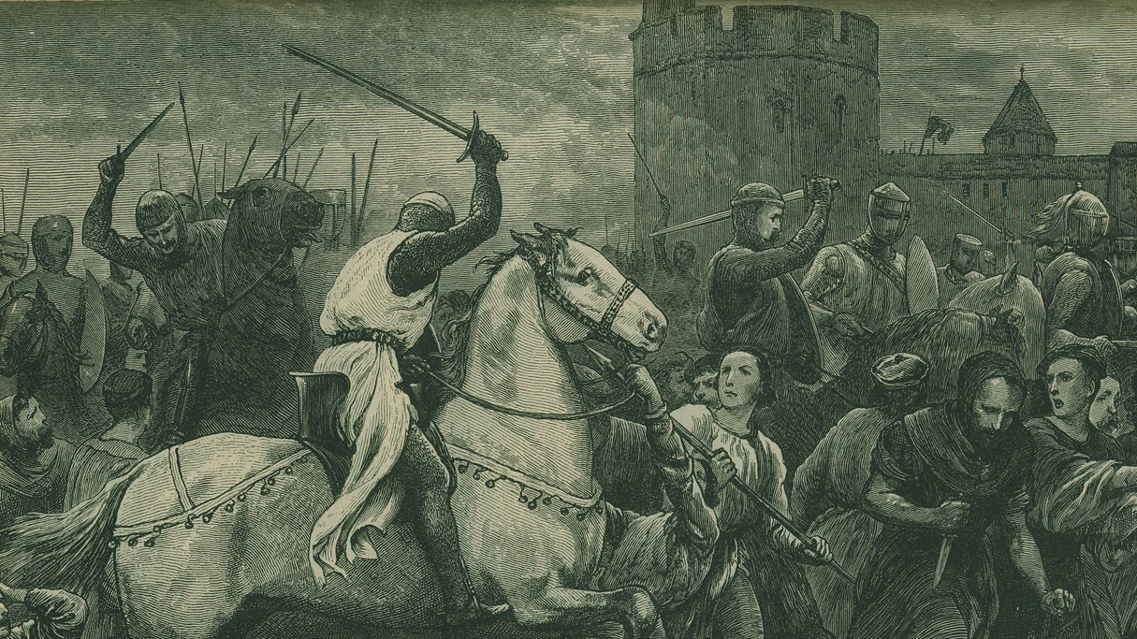
Remembering the Waldenses

Slide 2
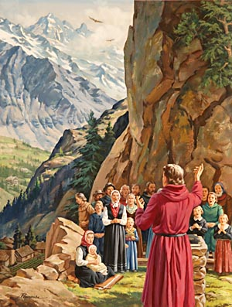
Who were they???
The Waldenses, the Vaudios, were true Bible-believing Christians who were persecuted greatly in the Middle-Ages by Rome, they held the Bible as their only rule of faith, renounced the heresies and pomp of Rome, and sought to share the Scriptures, which they had in their native tongue, with the lost sheep of God. They lived in the valleys of Northern Italy and Southern France—the Albigenses were also historically related to the Waldenses

Slide 3
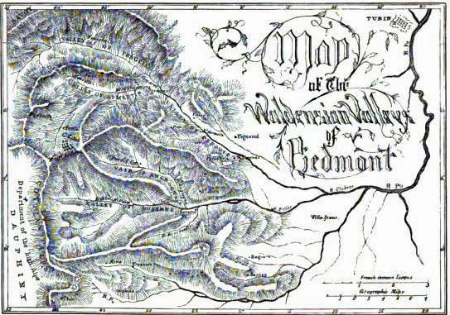

Slide 4
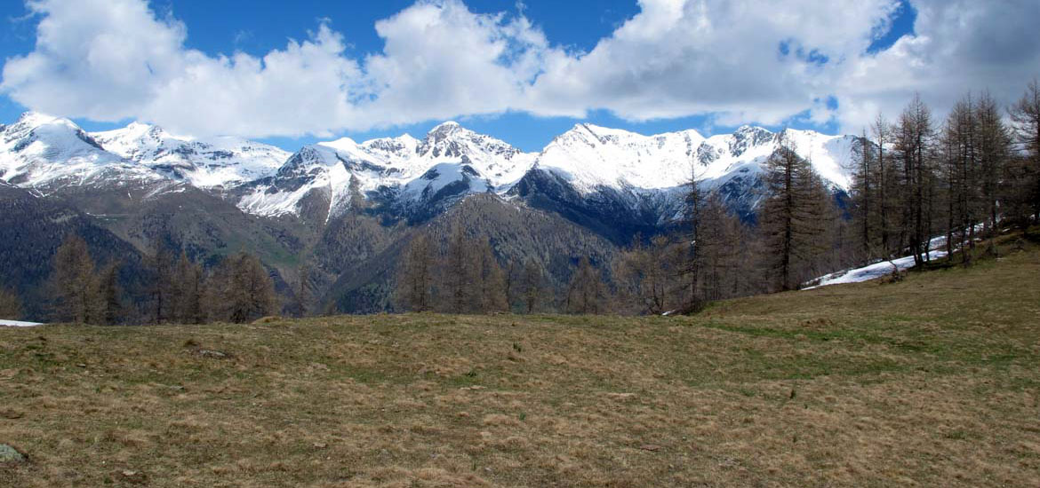

Slide 5
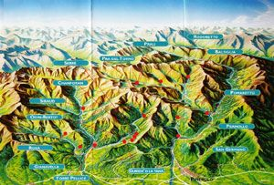
How long were they around???
“Behind the lofty bulwarks of the mountains—in all ages the refuge of the persecuted and oppressed—the Waldenses found a hiding place. Here the light of truth was kept burning amid the darkness of the Middle Ages. Here, for a thousand years, witnesses for the truth maintained the ancient faith.”—Great Controversy, p. 65-66

Slide 6
What History Today Teaches…
Early Roman Catholic and Waldensian sources are few and unreliable, and little is known with certainty about the reputed founder, Valdes (also called Peter Waldo, or Valdo). As a layman, Valdes preached (1170–76) in Lyon, France, but ecclesiastical authorities were disturbed by his lack of theological training and by his use of a non-Latin version of the Bible. Valdes attended the third Lateran Council (1179) in Rome and was confirmed in his vow of poverty by Pope Alexander III. Probably during this council Valdes made his Profession of Faith (which still survives); it is a statement of orthodox beliefs such as accused heretics were required to sign. Valdes, however, did not receive the ecclesiastical recognition that he sought. Undeterred, he and his followers (Pauperes, “Poor”) continued to preach; the archbishop of Lyon condemned him, and Pope Lucius III placed the Waldenses under ban with his bull Ad abolendam (1184), issued during the Synod of Verona.—Encyclopedia Britannica, Waldenses, https://www.britannica.com/topic/Waldenses

Slide 7
Come Again?
“Their traditions invariably point to an unbroken descent of from the earliest times, as regards to their religious belief. The Nobla Leycon, which dates from the 1100, goes to prove that the Waldenses of Piedmont did not owe their rise to Peter Waldo of Lyons, which did not appear till the later half of that century (1169). The Nobla Leycon, though a poem, is in reality a confession of faith, and could have been composed only after some considerable study of the system of Christianity, in contradistinction to the errors of Rome. How could a Church have arisen with such a document in her hands? Or how could these herdsmen and vine-dressers, shut up in their mountains, have detected the errors against which they bore testimony, and found their way to the truths of which they made open profession in times of darkness like these? If we grant that their religious beliefs were the heritage of former ages, handed down from an evangelical ancestry, all is plain; but if we maintain that they were the discovery of the men of those days, we assert what approaches almost a miracle. There greatest enemies, Claude Syssel of Turin (1517) and Reynerius the Inquisitor (1250), have admitted their antiquity, and stigmatised them as ‘the most dangerous of all heretics, because the most ancient.’”—History of the Waldenses, JA Wylie, p. 8-9

Slide 8
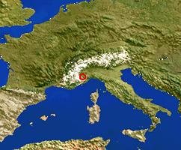
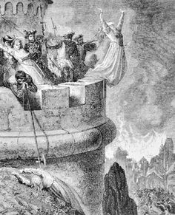
Amid the gloom that settled upon the earth during the long period of papal supremacy, the light of truth could not be wholly extinguished. In every age there were witnesses for God—men who cherished faith in Christ as the only mediator between God and man, who held the Bible as the only rule of life, and who hallowed the true Sabbath. How much the world owes to these men, posterity will never know. They were branded as heretics, their motives impugned, their characters maligned, their writings suppressed, misrepresented, or mutilated. Yet they stood firm, and from age to age maintained their faith in its purity, as a sacred heritage for the generations to come.—GC, p. 61

Slide 9
Misrepresented!!!
“The history of God's people during the ages of darkness that followed upon Rome's supremacy is written in heaven, but they have little place in human records. Few traces of their existence can be found, except in the accusations of their persecutors. It was the policy of Rome to obliterate every trace of dissent from her doctrines or decrees. Everything heretical, whether persons or writings, she sought to destroy. Expressions of doubt, or questions as to the authority of papal dogmas, were enough to forfeit the life of rich or poor, high or low. Rome endeavored also to destroy every record of her cruelty toward dissenters. Papal councils decreed that books and writings containing such records should be committed to the flames. Before the invention of printing, books were few in number, and in a form not favorable for preservation; therefore there was little to prevent the Romanists from carrying out their purpose.”—GC 61-62

Slide 10
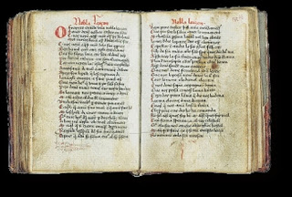
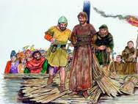
What did they believe?
“The Nobla Leycon sets forth with tolerable clearness the doctrine of the Trinity, the fall of man, the incarnation of the Son, the perpetual authority of the Decalogue as given by God, the need of Divine grace in order to [do] good works, the necessity of holiness, the institution of the ministry, the resurrection of the body, and the eternal bliss of heaven. This creed its professors exemplified in lives of evangelical virtue. The blamelessness of the Waldenses passed into proverb, so that one more than ordinarily exempt from the vices of his time was sure to be suspected of being a Vaudes.”—JA Wylie, p. 13

Slide 11
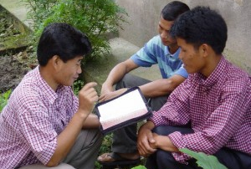
What did they Do For the Kingdom?
In the schools whither they went, they were not to make confidants of any. Their garments were so prepared as to conceal their greatest treasure—the precious manuscripts of the Scriptures. These, the fruit of months and years of toil, they carried with them, and whenever they could do so without exciting suspicion, they cautiously placed some portion in the way of those whose hearts seemed open to receive the truth. From their mother's knee the Waldensian youth had been trained with this purpose in view; they understood their work and faithfully performed it—GC 70

Slide 12
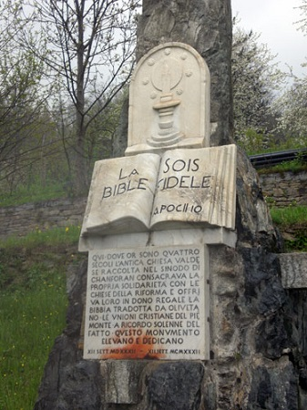
“They were an evangelistic as well as evangelical Church. It was an old law among them that all who took orders in their Church should, before being eligible to home charge, serve three years in the mission field. The youth on whose head the assembled barbes laid their hands saw in prospect not a rich benefice, but a possible martyrdom. . . They took care to carry with them . . . portions of the Word of God . . . When they saw a desire to possess it, they would freely make a gift of it where the means of purchase were absent. There was no kingdom of Southern and Central Europe to which these missionaries did not find their way.”—JA Wylie, History of the Waldenses, p. 16-17

Slide 13
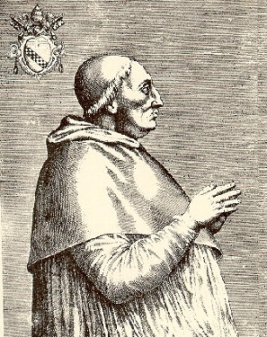
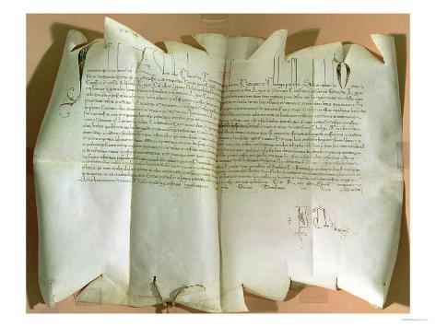
“The first step of the Pope was to issue a bull, denouncing as heretical those whom he delivered over to slaughter. This bull, after the manner of all such documents, was expressed in terms as sanctimonious as its spirit was inexorably cruel. It brings no charge against these men, as lawless, idle, dishonest, or disorderly; their fault was that they did not worship as Innocent worshipped, and that they practised a ‘simulated santity,’ which had the effect of seducing the sheep of the true fold, therefore he orders ‘that malicious and abominable sect of malignants,’ if they ‘refuse to abjure, to be crushed like venomous snakes.’”—JA Wylie, History of Waldenses, p. 24 quoting Pope Innocent VIII papal bull of 1487

Slide 14
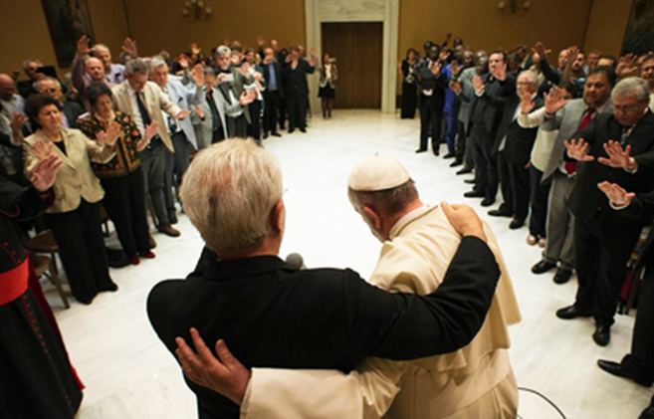
“Romanism is now regarded by Protestants with far greater favor than in former years. In those countries where Catholicism is not in the ascendancy, and the papists are taking a conciliatory course in order to gain influence, there is an increasing indifference concerning the doctrines that separate the reformed churches from the papal hierarchy; the opinion is gaining ground that, after all, we do not differ so widely upon vital points as has been supposed, and that a little concession on our part will bring us into a better understanding with Rome. The time was when Protestants placed a high value upon the liberty of conscience which had been so dearly purchased. They taught their children to abhor popery and held that to seek harmony with Rome would be disloyalty to God. But how widely different are the sentiments now expressed!”—GC, 563

Slide 15
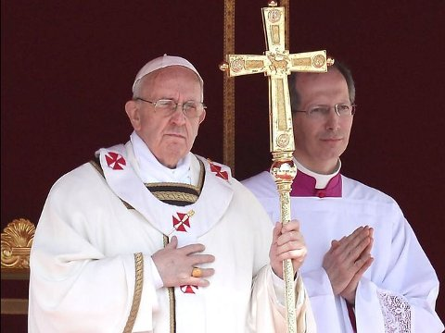
The Kingdom of Antichrist was Prophesied Thus
Dan. 7:25 “And he shall speak great words against the most High, and shall wear out the saints of the most High, and think to change times and laws: and they shall be given into his hand until a time and times and the dividing of time.”
John 16:2 “They shall put you out of the synagogues: yea, the time cometh, that whosoever killeth you will think that he doeth God service.”

Slide 16
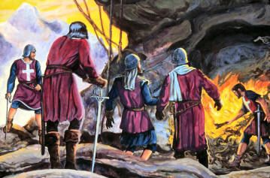
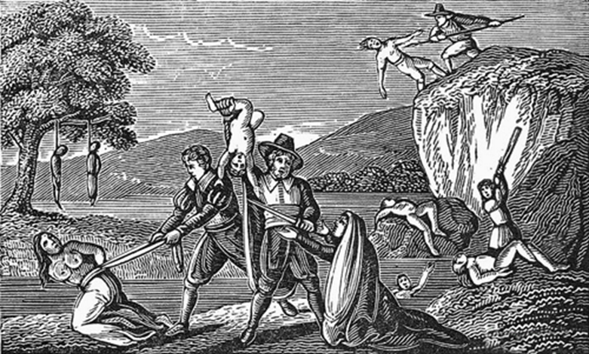
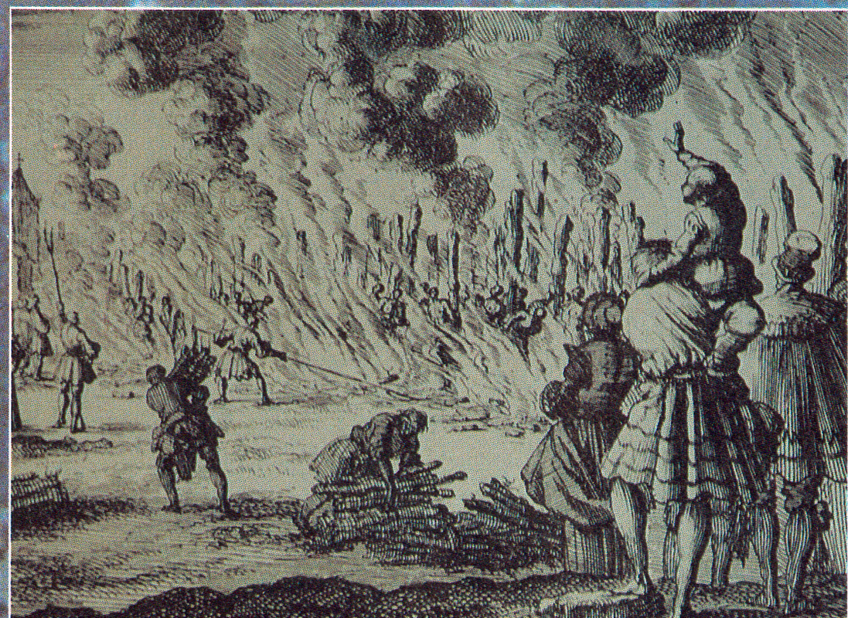
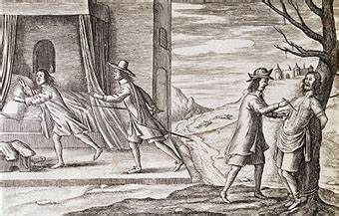

Slide 17
“Did not the Jew and Saracen live unmolested in their [Rome’s Jurisdiction] cities? Did they not permit the Israelite to build his synagogue, and the Moor to read his Koran, without annoyance or restraint? . . . They [the Waldenses] were prepared to die”Ibid., p. 58-59---Are we????

Slide 18
The Works Of Rome Laid Bare!
“Hugo Chiamps of Finestrelle had his entrails torn from his living body at Turin. Peter Geymarali of Bobbio, in like manner, had his entrails taken out at Lucerna, and fierce cat thrust in their place to torture him further; Maria Romano was buried alive at Rocco-patia; Magdalen Foulano underwent the same fate at San Giovanni; Susan Michelini was bound hand and foot, and left to perish in the cold and hunger at Saracena. Bartholomew Fache, gashed with sabres, had the wounds filled up with quicklime, and perished thus in agony at Fenile; Daniel Michelini had his tongue torn out at Bobbio for have praised God. James Baridari perished covered with sulphurous matches, which had been forced into his flesh under his nails, between the fingers, in the nostrils, in the lips, and over all his body, and then lighted. Daniel Revelli had his mouth filled with gunpowder, which, being lighted, blew his head to pieces. Maria Monnen, taken at Louisa, had the flesh cut from her cheek and chin bone, so that her jaw was left bare, and she was thus left to perish. Paul Garnier, was slowly sliced to pieces at Rora. Thomas Margueti was mutilated in an indescribable manner at Miraboco, and Susan Jaquin cut in bits at La Torre. Sara Rostagnol was slit open from the legs to the bosom, and so left to perish on the road between Eyral and Lucerna. Anne Charbonier was impaled and carried thus on a pike, as a standard, from San Giovanni to La Torre. Daniel Rambaud, at Paesano, had his nails torn off, then his fingers chopped off, then his feet and hands, then his arms and legs, with each successive refusal on his part to abjure the Gospel.”—JA Wylie, History of the Waldenses, p. 54

Slide 19
What Spirit is This???

Slide 20
The defenders of the papacy declare that the church has been maligned, and the Protestant world are inclined to accept the statement. Many urge that it is unjust to judge the church of today by the abominations and absurdities that marked her reign during the centuries of ignorance and darkness. They excuse her horrible cruelty as the result of the barbarism of the times and plead that the influence of modern civilization has changed her sentiments. Have these persons forgotten the claim of infallibility put forth for eight hundred years by this haughty power? So far from being relinquished, this claim was affirmed in the nineteenth century with greater positiveness than ever before. As Rome asserts that the "church never erred; nor will it, according to the Scriptures, ever err" (John L. von Mosheim, Institutes of Ecclesiastical History, book 3, century II, part 2, chapter 2, section 9, note 17), how can she renounce the principles which governed her course in past ages?”—GC 563-564

Slide 21
Rome Remembers… Do We?
“And let it be remembered, it is the boast of Rome that she never changes. The principles of Gregory VII and Innocent III are still the principles of the Roman Catholic Church. And had she but the power, she would put them in practice with as much vigor now as in past centuries. Protestants little know what they are doing when they propose to accept the aid of Rome in the work of Sunday exaltation. While they are bent upon the accomplishment of their purpose, Rome is aiming to re-establish her power, to recover her lost supremacy. Let the principle once be established in the United States that the church may employ or control the power of the state; that religious observances may be enforced by secular laws; in short, that the authority of church and state is to dominate the conscience, and the triumph of Rome in this country is assured. God's word has given warning of the impending danger; let this be unheeded, and the Protestant world will learn what the purposes of Rome really are, only when it is too late to escape the snare. She is silently growing into power. Her doctrines are exerting their influence in legislative halls, in the churches, and in the hearts of men. She is piling up her lofty and massive structures in the secret recesses of which her former persecutions will be repeated.—GC 581

Slide 22
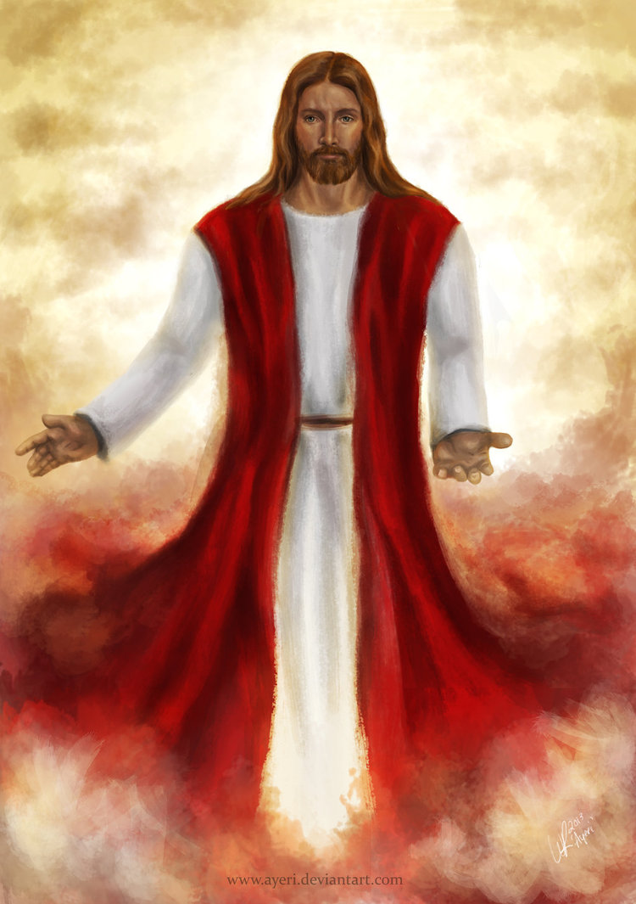
As for the Waldenses… Remember Them…
Matt. 5:11-12 “Blessed are ye, when men shall revile you, and persecute you, and shall say all manner of evil against you falsely, for my sake. Rejoice, and be exceeding glad: for great is your reward in heaven: for so persecuted they the prophets which were before you.”

