Slide 1
Romans 5:12-21, pt.10

Slide 2
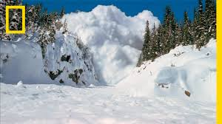
A Tough Passage Indeed
In all of Paul’s writings, this passage is considered one of the toughest to understand. Clearly, these verses fit into Peter’s comments, when he said, “And account that the longsuffering of our Lord is salvation; even as our beloved brother Paul also according to the wisdom given unto him hath written unto you; As also in all his epistles, speaking in them of these things; in which are some things hard to be understood, which they that are unlearned and unstable wrest, as they do also the other scriptures, unto their own destruction.” 2 Peter 3:15,16

Slide 3
Do Our Best!
In dealing with a difficult passage, the key is allowing the whole Bible to interpret to make it clear and this is what we will attempt to do. Here goes: “Wherefore, as by one man sin entered into the world, and death by sin; and so death passed upon all men, for that all have sinned: (For until the law sin was in the world: but sin is not imputed when there is no law. Nevertheless death reigned from Adam to Moses, even over them that had not sinned after the similitude of Adam's transgression, who is the figure of him that was to come.” Romans 5:12-14

Slide 4
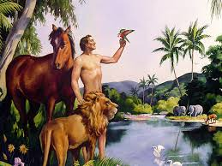
The Man Who Brought Sin
Adam brought sin into the world when he ate of the forbidden tree. As a result of Adam’s sin, physical and spiritual death rested upon all men. Because of Adam’s sin, we were all born with a carnal nature that chooses wrong and in imbibing the lusts of our nature we become sinners too. We were not responsible for Adam’s sin nor we were guilty of Adam’s sin, but we were condemned to dwell in a carnal nature that loves evil, and by following its dictates, we would sin and thus become guilty before God.

Slide 5
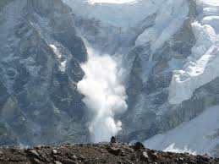
Condemned , but not guilty!
None of us were born guilty. We did not sin when Adam sinned. However, we were condemned to live our lives in a fallen nature that loves to do wrong. A prostitute has AIDS and is guilty of impurity. Her newborn inherits AIDS from the mother, condemned to that terrible life, but the child is not guilty of the mother’s mistakes!

Slide 6
The Law is Eternal
Many today want to tell us that the 100 commandments came into being at Sinai. That is not what Paul just said. Paul said sin is only imputed and known by the law. Since Adam sinned, the only way he would know that was because there was the law of God. As 1 Corinthians 15 says, “O death, where is thy sting? O grave, where is thy victory? The sting of death is sin; and the strength of sin is the law.” verses 55,56
That which gives sin an identity is the law. Adam only knew sin because there was law. The law existed in the garden otherwise Adam could not have known sin. The law of God condemned Lucifer in heaven when he sinned, and the law still reveals sin today!

Slide 7
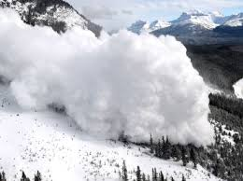
Adam was perfect in the garden. He had a perfect nature. He had no bent toward evil. Not so us. “Man was originally endowed with noble powers and a well-balanced mind. He was perfect in his being, and in harmony with God. His thoughts were pure, his aims holy. But through disobedience, his powers were perverted, and selfishness took the place of love. His nature became so weakened through transgression that it was impossible for him, in his own strength, to resist the power of evil. He was made captive by Satan, and would have remained so forever had not God specially interposed. It was the tempter's purpose to thwart the divine plan in man's creation, and fill the earth with woe and desolation. And he would point to all this evil as the result of God's work in creating man. In his sinless state, man held joyful communion with Him “in whom are hid all the treasures of wisdom and knowledge.” Colossians 2:3. But after his sin, he could no longer find joy in holiness.” SC, pg. 17

Slide 8
Jesus Redeems Adam’s Failure
“But not as the offence, so also is the free gift. For if through the offence of one many be dead, much more the grace of God, and the gift by grace, which is by one man, Jesus Christ, hath abounded unto many. And not as it was by one that sinned, so is the gift: for the judgment was by one to condemnation, but the free gift is of many offences unto justification. For if by one man's offence death reigned by one; much more they which receive abundance of grace and of the gift of righteousness shall reign in life by one, Jesus Christ.)” Romans 5:15-17

Slide 9
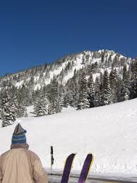
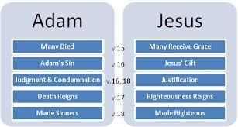
Death Through Adam; Life through Christ

Slide 10
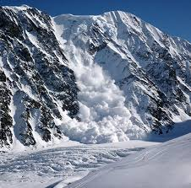
Adam’s Failure; Christ’s Victory
Whereas Adam failed, Jesus won the victory. Whereas Adam’s defeat brought death to the human family, Christ’s victory brought life into the reach of the human family. In order to escape from the depths of Adam’s woe, we must receive of the gift that Christ came to extend to the human family. Christ died for all at the cross, but that glorious victory only benefits us when we accept what He did for us personally.

Slide 11
Gifts are Free, we must partake
In order for any gift to benefit us, we must receive it as our own. If I leave my new bike under the Christmas tree, then the benefit of that new bike is of no avail to me. I must take the gift, open it, embrace it, and allow the blessing for which hit was given to be mine!!
“For by grace are ye saved through faith; and that not of yourselves: it is the gift of God: Not of works, lest any man should boast.” Ephesians 2:8,9

Slide 12
Christ Gains the Victory!
“Before his fall Adam was free from the results of the curse. When he was assailed by the tempter, none of the effects of sin were upon him. He was created perfect in thought and in action. But he yielded to sin, and fell from his high and holy estate. Christ, the second Adam, came in the likeness of sinful flesh. In man's behalf, He became subject to sorrow, to weariness, to hunger, and to thirst. He was subject to temptation, but He yielded not to sin. No taint of sin was upon Him. He declared, "I have kept My Father's commandments [in My earthly life]" (John 15:10). He had infinite power only because He was perfectly obedient to His Father's will. The second Adam stood the test of trial and temptation that He might become the Owner of all humanity.--Ms 99, 1903, pp. 3, 4. ("Christian Education in Our Schools," September 1, 1903.) This world is a vast missionary field. Christ is the greatest missionary the world has ever known. The wonderful love He manifested in our behalf is without a parallel. Willingly He passed over the ground where Adam fell, redeeming Adam's failure.”

Slide 13
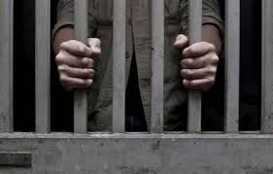
Condemned
“Therefore as by the offence of one judgment came upon all men to condemnation; even so by the righteousness of one the free gift came upon all men unto justification of life. For as by one man's disobedience many were made sinners, so by the obedience of one shall many be made righteous.” Romans 5:18,19

Slide 14
Original Sin???????
Adam’s sin brought the condemnation of a carnal nature to the human race. Possessing this nature does not make us guilty before God, just places us in a position where we chose readily to sin. Only One Person has ever lived a life of perfect righteousness and that was Jesus Christ. If we were born guilty of Adam’s failure, then Christ too would have been born guilty and hence, needed a Savior. The Augustinian idea of original sin says that man was born guilty. In order for Christ to escape this guilt, there had to be an Immaculate conception, Mary had to be free from original sin and thereby holy. Since the race is not born guilty of Adam’s sin, therefore, Christ did not have an immaculate birth nor was Mary holy. Christ died for all at the cross. It only benefits those who receive the free gift of His righteousness both declared AND GIVEN TO THE PENITENT BELIEVER!!

Slide 15
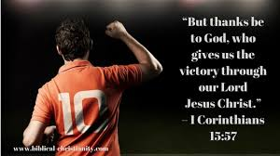
Christ came to enable people to become righteous. It was not just a legal matter. “
“There was in Him nothing that responded to Satan's sophistry. He did not consent to sin. Not even by a thought did He yield to temptation. So it may be with us. Christ's humanity was united with divinity; He was fitted for the conflict by the indwelling of the Holy Spirit. And He came to make us partakers of the divine nature. So long as we are united to Him by faith, sin has no more dominion over us. God reaches for the hand of faith in us to direct it to lay fast hold upon the divinity of Christ, that we may attain to perfection of character. And how this is accomplished, Christ has shown us. By what means did He overcome in the conflict with Satan? By the word of God. Only by the word could He resist temptation. “It is written,” He said. And unto us are given “exceeding great and precious promises: that by these ye might be partakers of the divine nature, having escaped the corruption that is in the world through lust.” 2 Peter 1:4 Desire of Ages, pg. 123

Slide 16
Abounding Grace!
“Moreover the law entered, that the offence might abound. But where sin abounded, grace did much more abound: That as sin hath reigned unto death, even so might grace reign through righteousness unto eternal life by Jesus Christ our Lord.” Romans 5:20,21

Slide 17
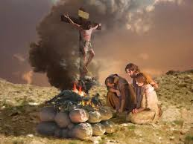
Since the law has always been, because without sin there is no law, and sin originated in heaven, then the law has always been in existence, pointing sin. Thanks be to God that as soon as there was sin in our world, there was a Savior. Immediately, Christ's grace was there to shield the guilty. Praise God! “And all that dwell upon the earth shall worship him, whose names are not written in the book of life of the Lamb slain from the foundation of the world.” Rev. 13:8

Slide 18
The Two Adam’s Meet!
“The two Adams are about to meet. The Son of God is standing with outstretched arms to receive the father of our race—the being whom He created, who sinned against his Maker, and for whose sin the marks of the crucifixion are borne upon the Savior's form. As Adam discerns the prints of the cruel nails, he does not fall upon the bosom of his Lord, but in humiliation casts himself at His feet, crying: “Worthy, worthy is the Lamb that was slain!” Tenderly the Savior lifts him up and bids him look once more upon the Eden home from which he has so long been exiled. After his expulsion from Eden, Adam's life on earth was filled with sorrow. Every dying leaf, every victim of sacrifice, every blight upon the fair face of nature, every stain upon man's purity, was a fresh reminder of his sin. Terrible was the agony of remorse as he beheld iniquity abounding, and, in answer to his warnings, met the reproaches cast upon himself as the cause of sin. With patient humility he bore, for nearly a thousand years, the penalty of transgression. Faithfully did he repent of his sin and trust in the merits of the promised Saviour, and he died in the hope of a resurrection. The Son of God redeemed man's failure and fall; and now, through the work of the atonement, Adam is reinstated in his first dominion.” GC. Pg. 647

