Slide 1
Francis Sacred Sunday, pt. 10
Prophecy Arise

Slide 2
Rapid Ones!
“The days in which we live are solemn and important. The Spirit of God is gradually but surely being withdrawn from the earth. Plagues and judgments are already falling upon the despisers of the grace of God. The calamities by land and sea, the unsettled state of society, the alarms of war, are portentous. They forecast approaching events of the greatest magnitude.
The agencies of evil are combining their forces and consolidating. They are strengthening for the last great crisis. Great changes are soon to take place in our world, and the final movements will be rapid ones.” Testimonies, volume 9, pg. 11

Slide 3
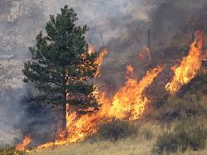
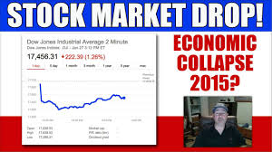

Slide 4
Francis’ Agenda!
Welcome immigrants :Maradiaga reiterated that Francis would have liked to enter the U.S. by crossing the border with Mexico to make a point about welcoming immigrants, not building walls to keep them out.
Protect the environment: Francis is going to publish a major teaching document on the environment ahead of his U.S. visit, and observers expect the encyclical to accept the reality of climate change and mankind’s role in it, and to call for action to address the dangers:

Slide 5
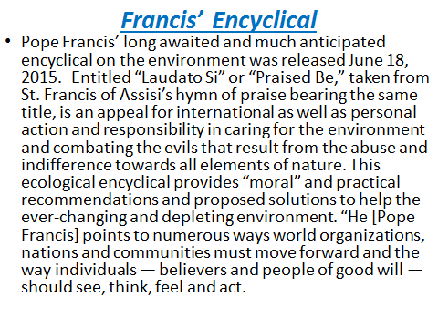

Slide 6
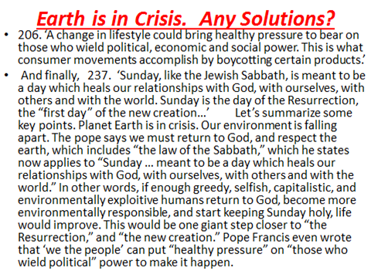

Slide 7
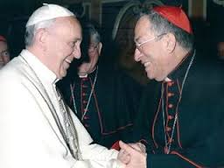
Maradiaga/Francis Concur
Hondurian Cardinal, Oscar Rodriguez Maradiaga said that Francis would discuss the protection of the environment when he comes to America!! In Francis’ encyclical ‘Praised Be’, Francis has made it clear that the way to save the environment is through keeping Sunday! This will definitely be part of his message to Congress, the President, and the Catholics of Philadelphia!

Slide 8
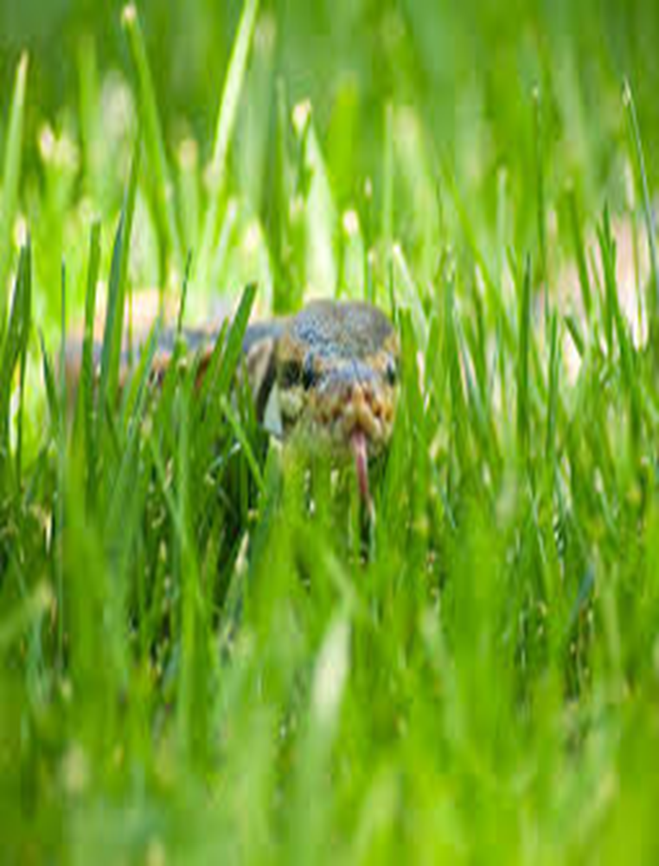
“And the ten horns out of this kingdom are ten kings that shall arise: and another shall rise after them; and he shall be diverse from the first, and he shall subdue three kings.
And he shall speak great words against the most High, and shall wear out the saints of the most High, and think to change times and laws: and they shall be given into his hand until a time and times and the dividing of time.” Daniel 7:24, 25

Slide 9
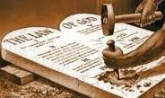
Man of Lawlessness
“Let no man deceive you by any means: for that day shall not come, except there come a falling away first, and that man of sin be revealed, the son of perdition; Who opposeth and exalteth himself above all that is called God, or that is worshipped; so that he as God sitteth in the temple of God, shewing himself that he is God. Remember ye not, that, when I was yet with you, I told you these things? And now ye know what withholdeth that he might be revealed in his time. For the mystery of iniquity doth already work:” 2 Thessalonians 2:3-7

Slide 10
Francis Recent Catechesis!
We begin now a series of catecheses on three facets of family life: celebration, work and prayer. Let us turn first to celebrations which, as we see from the Story of Creation, are the invention of God, who on the seventh day rested from his work. It is God himself who teaches us the importance of dedicating time to contemplating and enjoying the fruits of our labours, not only in our employment or profession, but through every action by which we as men and women cooperate in God’s creative work, even in times of difficulty. In the workplace too, we celebrate – a birthday, a marriage, a new baby, a farewell or a welcome. True moments of celebration make us pause from our work, because they remind us that we are made in the image and likeness of God, who is not a slave to work, but the Lord of work! And so we must never be slaves to work but rather its master…

Slide 11
Sunday Sacred!
…Yet we know that millions of men and women, even children, are slaves to work. The obsession with economic profit and technical efficiency puts the human rhythms of life at risk. Moments of rest, especially on Sunday, are sacred because in them we find God. The Sunday Eucharist brings to our celebrations every grace of Jesus Christ: his presence, his love and his sacrifice; his forming us into a community, and his way of being with us. Everything is transfigured by his grace: work, family, the joys and trials of each day, even our sufferings and death. May we always recognize the family as the privileged place to understand, guide and sustain the gifts which arise from our celebrations, especially the Sunday Eucharist.” Given by Francis, August 12, 2015

Slide 12
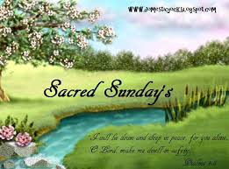
Sacred????
‘Moments of rest, especially on Sunday, are sacred because in them we find God. The Sunday Eucharist brings to our celebrations every grace of Jesus Christ: his presence, his love and his sacrifice; his forming us into a community, and his way of being with us.’

Slide 13
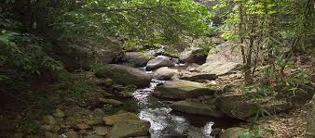
Saturday/Sabbath Sanctified
“ Thus the heavens and the earth were finished, and all the host of them. And on the seventh day God ended his work which he had made; and he rested on the seventh day from all his work which he had made. And God blessed the seventh day, and sanctified it: because that in it he had rested from all his work which God created and made.” Gen. 2:1-3

Slide 14
Satanic Delusion
“By the decree enforcing the institution of the papacy in violation of the law of God, our nation [the United States] will disconnect herself fully from righteousness. When Protestantism shall stretch her hand across the gulf to grasp the hand of the Roman power, when she shall reach over the abyss to clasp hands with spiritualism, when, under the influence of this threefold union, our country shall repudiate every principle of its Constitution as a Protestant and republican government, and shall make provision for the propagation of papal falsehoods and delusions, then we may know that the time has come for the marvelous working of Satan and that the end is near. Through the two great errors, the immortality of the soul and Sunday sacredness, Satan will bring the people under his deceptions. While the former lays the foundation of spiritualism, the latter creates a bond of sympathy with Rome. The Protestants of the United States will be foremost in stretching their hands across the gulf to grasp the hand of spiritualism; they will reach over the abyss to clasp hands with the Roman power; and under the influence of this threefold union, this country will follow in the steps of Rome in trampling on the rights of conscience. ..” Maranatha, pg. 191

Slide 15
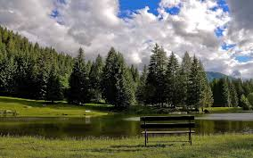
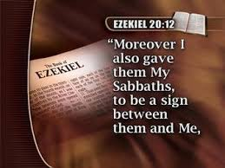

Slide 16
Unify
Protestant Leaders Declare Reunification of Churches Under the Holy See
Posted on July 9, 2015 VATICAN CITY – “Following more than five hundred years of separation, American and European Protestant leaders met with Pope Francis last week to finalize the reunification of the two churches under the Holy See. The historic agreement is the result of a year’s worth of unpublicized talks between Protestant leaders and the Vatican. Prominent American pastors Joel Osteen and Rick Warren, respectively, as well as Justin Welby, the Archbishop of Canterbury, were among the Protestant delegation that met with Pope Francis last week. Pastor Warren, founder of Saddleback Church in Lake Forest, California, spoke with members of the international press in St. Peter’s Square, saying, “Protestants, as a people, have a long history of heresy. The time for reconciliation is now in order to ensure a full and dogmatic transition into the folds of the Church...”

Slide 17
Papal Authority???
…Moments before meeting with reporters, the entire Protestant delegation, for the first time ever, entered the confessional to take part, individually, in the Sacrament of Penance. “It’s important that we participate in these sacred rituals before asking our congregation to do the same,” Pastor Osteen said, adding that his time in confession was “an immensely moving experience.” As Protestants around the world make the transition to Catholicism, many are wondering what, exactly, that means for them. “First and foremost we acknowledge the Pope’s infallibility with regard to universal moral declarations, the authority of Church magistrate, faith, and ex cathedra,” said Father Cliff Brogan, a former Protestant pastor who was the first of the delegation to be ordained as a priest at the Vatican. “Secondly, we participate in the sacrament of the Eucharist by accepting the actual body and blood of Christ, an event known as Transubstantiation, at the conclusion of the holy mass.”

Slide 18
Threefold Union!
“The Protestants of the United States will be foremost in stretching their hands across the gulf to grasp the hand of spiritualism; they will reach over the abyss to clasp hands with the Roman power; and under the influence of this threefold union, this country will follow in the steps of Rome in trampling on the rights of conscience. ..” Maranatha, pg. 191

Slide 19
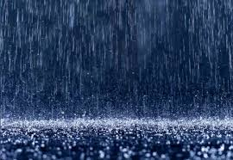
Time for Rain!
“And after these things I saw another angel come down from heaven, having great power; and the earth was lightened with his glory. And he cried mightily with a strong voice, saying, Babylon the great is fallen, is fallen, and is become the habitation of devils, and the hold of every foul spirit, and a cage of every unclean and hateful bird. For all nations have drunk of the wine of the wrath of her fornication, and the kings of the earth have committed fornication with her, and the merchants of the earth are waxed rich through the abundance of her delicacies. And I heard another voice from heaven, saying, Come out of her, my people, that ye be not partakers of her sins, and that ye receive not of her plagues.” Rev. 18:1-4

