Slide 1
Revelation 1
Pictures of Christ

Slide 2
A Revealing
Many claim that the book of Revelation can’t be understood. It is a closed book, they say. Revelation says something very different.
“The Revelation of Jesus Christ, which God gave unto him, to shew unto his servants things which must shortly come to pass; and he sent and signified [it] by his angel unto his servant John: Who bare record of the word of God, and of the testimony of Jesus Christ, and of all things that he saw. Blessed [is] he that readeth, and they that hear the words of this prophecy, and keep those things which are written therein: for the time [is] at hand.” Revelation 1:1-3

Slide 3
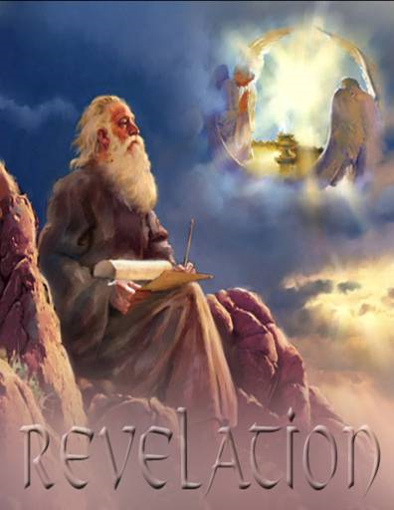
READ, HEAR, and KEEP
A blessing is pronounced upon those that :
1. read the book.
2. hear the things written in the book.
3. keep what is written in the book.
Obviously, those who claim it can’t be understood are speaking in their ignorance.

Slide 4
Greetings from Above
John sends salutations from heaven. He mentions three distinct Personages from whom the greetings come. “from him which is, and which was, and which is to come” “from the seven Spirits which are before his throne” “And from Jesus Christ, [who is] the faithful witness,”. Here we have very clear reference to the three Persons in the Godhead; the Father, the Holy Ghost, and from Jesus Christ.
“John to the seven churches which are in Asia: Grace [be] unto you, and peace, from him which is, and which was, and which is to come; and from the seven Spirits which are before his throne; And from Jesus Christ, [who is] the faithful witness, [and] the first begotten of the dead, and the prince of the kings of the earth. Unto him that loved us, and washed us from our sins in his own blood, And hath made us kings and priests unto God and his Father; to him [be] glory and dominion for ever and ever. Amen.” Revelation 1:4-6

Slide 5
Pictures of Christ Begin Here
“And from Jesus Christ, [who is] the faithful witness, [and] the first begotten of the dead, and the prince of the kings of the earth. Unto him that loved us, and washed us from our sins in his own blood…” Revelation 1:5
Christ’s exalted character in all its matchless charms and angles begins here in verse 5. The first picture reveals Christ as the only One faithful to reveal the character of God, the only One who kept all of God’s commandments, and the only One to testify to the greatness of God’s law and its holy precepts.

Slide 6
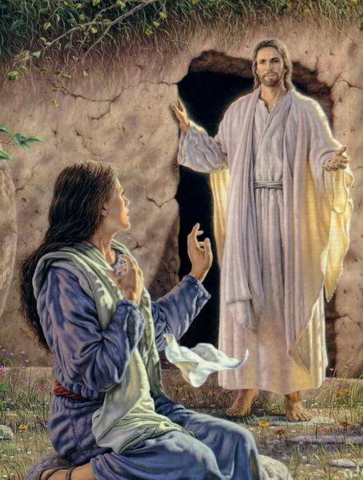
First Begotten of the Dead
The word for begotten, prototokos, means firstborn or pre eminent one. Christ wasn’t the first one to come from the grave; Moses, the widow’s son of Nain, Lazarus all came up before Christ, but Christ’s resurrection was the pre eminent resurrection that made all other resurrection’s possible. Without Christ’s resurrection, there would be no other. This word has nothing to do with Christ being created!

Slide 7

King of Kings and Redeemer
Christ is exalted as Master of all; He is the King above all kings. The reason He is thus because He went to the lowest place and in the universe when He died for our sins.
“And being found in fashion as a man, he humbled himself, and became obedient unto death, even the death of the cross. Wherefore God also hath highly exalted him, and given him a name which is above every name:” Philippians 2:8,9

Slide 8
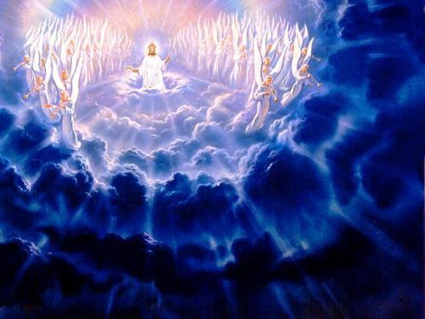
Every Eye Shall See Him!
“Behold, he cometh with clouds; and every eye shall see him, and they also which pierced him: and all kindreds of the earth shall wail because of him. Even so, Amen.” Revelation 1:7 This passage is very clear that:
1. When Christ returns, everyone alive will see Him. There is nothing secret about this event.
2. Those who killed Christ will be raised up in a special resurrection to see Christ return.

Slide 9
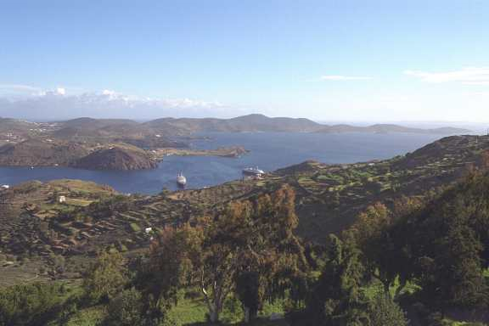
Patmos
“I am Alpha and Omega, the beginning and the ending, saith the Lord, which is, and which was, and which is to come, the Almighty. I John, who also am your brother, and companion in tribulation, and in the kingdom and patience of Jesus Christ, was in the isle that is called Patmos, for the word of God, and for the testimony of Jesus Christ.” Revelation 1:8,9

Slide 10
Exiled by Domitian
“John was cast into a caldron of boiling oil; but the Lord preserved the life of His faithful servant, even as He preserved the three Hebrews in the fiery furnace. As the words were spoken, Thus perish all who believe in that deceiver, Jesus Christ of Nazareth, John declared, My Master patiently submitted to all that Satan and his angels could devise to humiliate and torture Him. He gave His life to save the world. I am honored in being permitted to suffer for His sake. I am a weak, sinful man. Christ was holy, harmless, undefiled. He did no sin, neither was guile found in His mouth.
These words had their influence, and John was removed from the caldron by the very men who had cast him in.
Again the hand of persecution fell heavily upon the apostle. By the emperor's decree John was banished to the Isle of Patmos, condemned "for the word of God, and for the testimony of Jesus Christ." Revelation 1:9….
Patmos, a barren, rocky island in the Aegean Sea, had been chosen by the Roman government as a place of banishment for criminals; but to the servant of God this gloomy abode became the gate of heaven.” AA, pg. 570

Slide 11
The Lord’s Day
“And he said unto them, The sabbath was made for man, and not man for the sabbath: Therefore the Son of man is Lord also of the sabbath.” Mark 2:27,28
John, as one of the original twelve disciples, was aware of which day he meant when he referred to the Lord’s day. He clearly was stating the 7th day Sabbath, which is Saturday.
“I was in the Spirit on the Lord's day, and heard behind me a great voice, as of a trumpet, Saying, I am Alpha and Omega, the first and the last: and, What thou seest, write in a book, and send [it] unto the seven churches which are in Asia; unto Ephesus, and unto Smyrna, and unto Pergamos, and unto Thyatira, and unto Sardis, and unto Philadelphia, and unto Laodicea.” Revelation 1:10,11

Slide 12
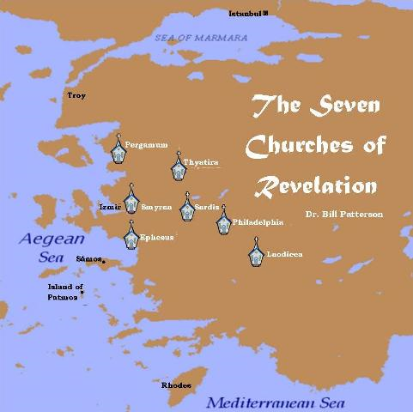
Write to the Churches
On the 7th day Sabbath, John is told to send messages to the 7 churches in Asia Minor. As you can see by the map, if a mail carrier were travelling there, the churches would follow a definite route for delivery as John was told in Revelation. The One who told John this is identified in the next verses.

Slide 13
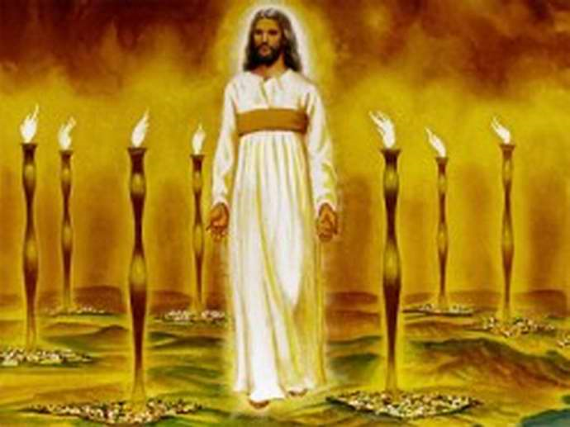
Christ in the Holy Place
And I turned to see the voice that spake with me. And being turned, I saw seven golden candlesticks; And in the midst of the seven candlesticks [one] like unto the Son of man, clothed with a garment down to the foot, and girt about the paps with a golden girdle. His head and [his] hairs [were] white like wool, as white as snow; and his eyes [were] as a flame of fire; And his feet like unto fine brass, as if they burned in a furnace; and his voice as the sound of many waters. And he had in his right hand seven stars: and out of his mouth went a sharp two-edged sword: and his countenance [was] as the sun shineth in his strength.” Revelation 1: 12-16

Slide 14
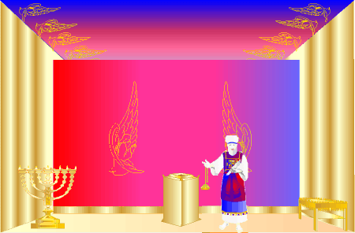
The Candlesticks
And thou shalt put the mercy seat upon the ark of the testimony in the most holy [place]. And thou shalt set the table without the vail, and the candlestick over against the table on the side of the tabernacle toward the south: and thou shalt put the table on the north side.” Ex. 26:34,35

Slide 15
High Priest in Heaven
With John, on Patmos, in 95 AD, comes the Lord Jesus Christ on the Sabbath day. John sees Christ in the midst of the candlesticks. This is a clear picture of Christ in the Holy Place of the Heavenly Sanctuary, ministering as our great High Priest.
“Seeing then that we have a great high priest, that is passed into the heavens, Jesus the Son of God, let us hold fast our profession. For we have not an high priest which cannot be touched with the feeling of our infirmities; but was in all points tempted like as we are, yet without sin. Let us therefore come boldly unto the throne of grace, that we may obtain mercy, and find grace to help in time of need.” Hebrews 4:14-16

Slide 16

Pictures of Christ
1. Faithful Witness (V. 5)
2. First begotten of the dead. (V. 5)
3. Redeemer (V. 6)
4. Coming King (V. 7)
5. Lord of the Sabbath (V. 10)
6. Great High Priest (V. 12,13)

Slide 17
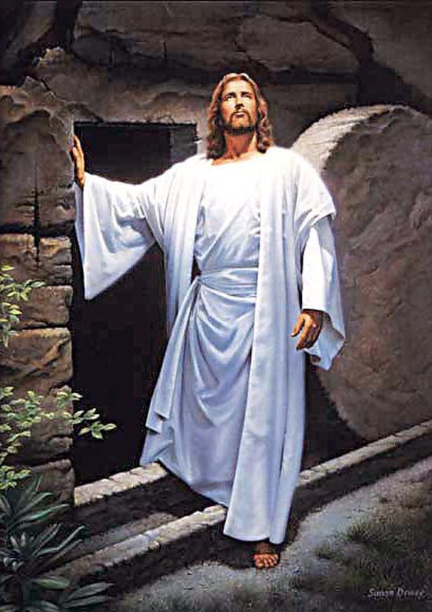
Conqueror of the Tomb
“And when I saw him, I fell at his feet as dead. And he laid his right hand upon me, saying unto me, Fear not; I am the first and the last: I am he that liveth, and was dead; and, behold, I am alive for evermore, Amen; and have the keys of hell and of death.” Revelation 1:17,18

Slide 18

Obstacles Surmounted
Christ assures John that no matter what is happening to the early church; persecution, trial, exile; no matter what, the risen Christ will see to it that truth triumphs. He comforts John with the words “Fear not” because Christ is at the helm. He holds the keys to everything and He will triumph and the faithful will triumph too.

Slide 19
Candlesticks, Angels, Churches
Christ’s church is to receive light from Him, through the power of the Holy Spirit (Zechariah 4:1-10), and then in turn, they are to share that light with the world. “Ye are the light of the world” Matthew 5:16.
Christ now shares messages with the seven churches which will be the focus of our next study.
“Write the things which thou hast seen, and the things which are, and the things which shall be hereafter; The mystery of the seven stars which thou sawest in my right hand, and the seven golden candlesticks. The seven stars are the angels of the seven churches: and the seven candlesticks which thou sawest are the seven churches.” Revelation 1:19,20

