Slide 1
Rueben “Unstable as Water”

Slide 2
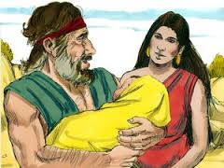
He had it All!
As the eldest child, Rueben had it all! He would receive the birthright blessings. This involved:
1. the priesthood of the family.
2. great material blessing would be his.
3. The Messiah of the world would come through his offspring.

Slide 3
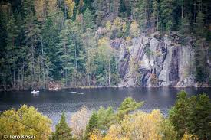
Trouble in the Home!
Into a home where his mother, Leah, was despised, and his aunt Rachel was loved and favored, Rueben grew up in surroundings that brought him the unenviable task of trying to bring his dad and mom together. Unfortunately, Rueben seemed so busy playing referee and never learning to take a stand himself, he grew up without a compass or ‘unstable as water’.

Slide 4
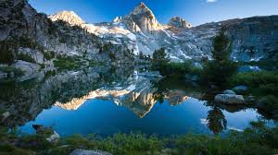
He Threw it Away
“And it came to pass, when Israel dwelt in that land, that Reuben went and lay with Bilhah his father's concubine: and Israel heard it. Now the sons of Jacob were twelve:” Gen. 35:29

Slide 5
Sad Life
For a moment of foolish self gratification, Rueben sold his birthright. This curse haunted him for sooo long. Jacob remembered it in his dying benediction, “Unstable as water, thou shalt not excel; because thou wentest up to thy father's bed; then defiledst thou it: he went up to my couch.” Genesis 49:4

Slide 6
Turning Point
“And they said one to another, Behold, this dreamer cometh. Come now therefore, and let us slay him, and cast him into some pit, and we will say, Some evil beast hath devoured him: and we shall see what will become of his dreams. And Reuben heard it, and he delivered him out of their hands; and said, Let us not kill him. And Reuben said unto them, Shed no blood, but cast him into this pit that is in the wilderness, and lay no hand upon him; that he might rid him out of their hands, to deliver him to his father again. And it came to pass, when Joseph was come unto his brethren, that they stript Joseph out of his coat, his coat of many colours that was on him; And they took him, and cast him into a pit: and the pit was empty, there was no water in it. And they sat down to eat bread: and they lifted up their eyes and looked, and, behold, a company of Ishmeelites came from Gilead with their camels bearing spicery and balm and myrrh, going to carry it down to Egypt. And Judah said unto his brethren, What profit is it if we slay our brother, and conceal his blood? Come, and let us sell him to the Ishmeelites, and let not our hand be upon him; for he is our brother and our flesh. And his brethren were content. Then there passed by Midianites merchantmen; and they drew and lifted up Joseph out of the pit, and sold Joseph to the Ishmeelites for twenty pieces of silver: and they brought Joseph into Egypt. And Reuben returned unto the pit; and, behold, Joseph was not in the pit; and he rent his clothes. And he returned unto his brethren, and said, The child is not; and I, whither shall I go?” Genesis 37:19-30

Slide 7
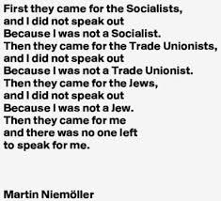
He Could Not Stand Up!
As the firstborn, Rueben could have delivered Joseph then and there, but he just would not stand for the right. Then, when he saw the pit empty, his only thoughts were of himself, not of his brother who still could have been delivered if Rueben had thought about it and acted!!!!

Slide 8
Oh, Rueben!
“They would have executed their purpose but for Reuben. He shrank from participating in the murder of his brother, and proposed that Joseph be cast alive into a pit, and left there to perish; secretly intending, however, to rescue him and return him to his father. Having persuaded all to consent to this plan, Reuben left the company, fearing that he might fail to control his feelings, and that his real intentions would be discovered.” PP, pg. 211
“Reuben returned to the pit, but Joseph was not there. In alarm and self-reproach he rent his garments, and sought his brothers, exclaiming, "The child is not; and I, whither shall I go?" Upon learning the fate of Joseph, and that it would now be impossible to recover him, Reuben was induced to unite with the rest in the attempt to conceal their guilt. Having killed a kid, they dipped Joseph's coat in its blood, and took it to their father, telling him that they had found it in the fields, and that they feared it was their brother's.” PP, pg. 212

Slide 9
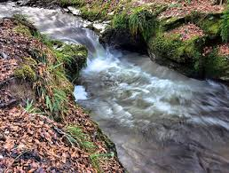
Crisis Foolishness!
For the next 22 years, Rueben refused to admit his folly to his grieving father. For 22 years, he listed to the wailing agonies that Rueben could have stopped, but his instability would not let him!!!! Just like water, Rueben took the path of least resistance, just like water.

Slide 10
Did it Again!
“And we said unto him, We are true men; we are no spies: We be twelve brethren, sons of our father; one is not, and the youngest is this day with our father in the land of Canaan. And the man, the lord of the country, said unto us, Hereby shall I know that ye are true men; leave one of your brethren here with me, and take food for the famine of your households, and be gone: And bring your youngest brother unto me: then shall I know that ye are no spies, but that ye are true men: so will I deliver you your brother, and ye shall traffick in the land. And it came to pass as they emptied their sacks, that, behold, every man's bundle of money was in his sack: and when both they and their father saw the bundles of money, they were afraid. And Jacob their father said unto them, Me have ye bereaved of my children: Joseph is not, and Simeon is not, and ye will take Benjamin away: all these things are against me. And Reuben spake unto his father, saying, Slay my two sons, if I bring him not to thee: deliver him into my hand, and I will bring him to thee again. And he said, My son shall not go down with you; for his brother is dead, and he is left alone: if mischief befall him by the way in the which ye go, then shall ye bring down my gray hairs with sorrow to the grave.” Gen. 42:31-38

Slide 11
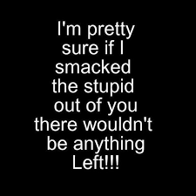
Go Figure
Famine and the possible loss of the only surviving son of Rachel left Jacob in a horrible quandary. What to do? Rueben’s advice, “Let me take Benjamin and if he doesn’t return, kill your two grandsons of mine as payment.” Are you kidding? What was Rueben thinking? He wasn’t thinking!!! That was to comfort his dad in this time of crisis. Unstable as water, Rueben would not excel!

Slide 12
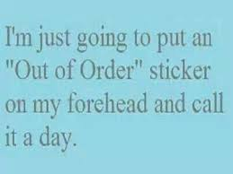
Rueben Had Lost it!
By now, Rueben had lost the respect of his dad, his brothers, and his own self-respect. He must have pondered deeply the depth of his degradation and came to some decisions. However, when the brothers went to meet the prime minister, Judah was clearly the leader of the brothers. Judah had drunk deeply of sin and selfish; he had repented as deeply and now stood head and shoulders above his brothers!!!

Slide 13
Rueben Started to change!
“Joseph was satisfied. He had seen in his brothers the fruits of true repentance. Upon hearing Judah's noble offer he gave orders that all but these men should withdraw; then, weeping aloud, he cried, "I am Joseph; doth my father yet live?“
His brothers stood motionless, dumb with fear and amazement.” PP, pg. 230

Slide 14
Change!
“And such were some of you: but ye are washed, but ye are sanctified, but ye are justified in the name of the Lord Jesus, and by the Spirit of our God.” 1 Cor. 6:11
“For behold this selfsame thing, that ye sorrowed after a godly sort, what carefulness it wrought in you, yea, what clearing of yourselves, yea, what indignation, yea, what fear, yea, what vehement desire, yea, what zeal, yea, what revenge! In all things ye have approved yourselves to be clear in this matter.” 2 Cor. 7:11

Slide 15
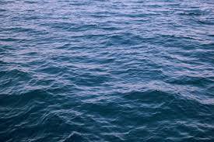
What Changed Rueben?
Jacob’s dying benediction told us that Rueben was unstable as water; he always did what was expedient, not what was right. He chose the path of least resistance; he never stood for anything! Water flows downward and Rueben’s choices flowed the same because it was easier!
Water can also do something else. It can thru the use of heat be used as steam to push things forward, to empower things to do what they can’t do on their own! Fire does this to water!

Slide 16
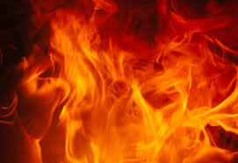
Fire Changes Things!
“Blessed be the God and Father of our Lord Jesus Christ, which according to his abundant mercy hath begotten us again unto a lively hope by the resurrection of Jesus Christ from the dead, To an inheritance incorruptible, and undefiled, and that fadeth not away, reserved in heaven for you,
Who are kept by the power of God through faith unto salvation ready to be revealed in the last time. Wherein ye greatly rejoice, though now for a season, if need be, ye are in heaviness through manifold temptations: That the trial of your faith, being much more precious than of gold that perisheth, though it be tried with fire, might be found unto praise and honour and glory at the appearing of Jesus Christ:” 1 Peter 1:3-7

Slide 17
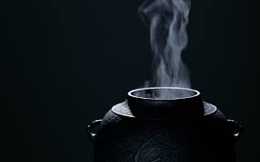
Laodicea Needs Fire Too
Heat enough water to produce enough steam and you can move just about anything. Rueben’s fickle instability was burned up in the furnace of affliction. “Because thou sayest, I am rich, and increased with goods, and have need of nothing; and knowest not that thou art wretched, and miserable, and poor, and blind, and naked: I counsel thee to buy of me gold tried in the fire, that thou mayest be rich; and white raiment, that thou mayest be clothed, and that the shame of thy nakedness do not appear; and anoint thine eyes with eyesalve, that thou mayest see.” Rev. 3:17, 18

Slide 18
The Refiner’s Fire
There burns a fire with sacred heat, White hot with holy flame, And all who dare pass through its blaze, Will not emerge the same , Some as bronze, and some as silver, Some as gold, then with great skill , All are hammered by their sufferings , On the anvil of His will
Chorus:
The Refiner’s fire, Has now become my souls desire, Purged and cleansed and purified, That the Lord be glorified, He is consuming my soul, Refining me, making me whole, No matter what I may lose , I choose the Refiner’s fire
I’m learning now to trust His touch, To crave the fire’s embrace , For though my past with sin was etched , His mercies did erase ,Each time His purging cleanses deeper , I’m not sure that I’ll survive, Yet the strength in growing weaker, Keeps my hungry soul alive

Slide 19
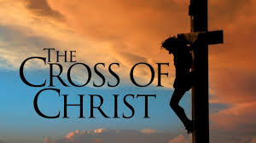
It would have been so easy to give up on so sorry a person as Rueben, BUT the Lord didn’t! Because of that amazing grace, Rueben will one day have his name emblazed on the city of the New Jerusalem! “And had a wall great and high, and had twelve gates, and at the gates twelve angels, and names written thereon, which are the names of the twelve tribes of the children of Israel:” Rev. 21:12

