Slide 1
Final Scenes, pt. 15
Peter’s Folly

Slide 2
A Thoughtful Hour
“It would be well for us to spend a thoughtful hour each day in contemplation of the life of Christ. We should take it point by point, and let the imagination grasp each scene, especially the closing ones. As we thus dwell upon His great sacrifice for us, our confidence in Him will be more constant, our love will be quickened, and we shall be more deeply imbued with His spirit. If we would be saved at last, we must learn the lesson of penitence and humiliation at the foot of the cross.” Desire of Ages, pg. 83

Slide 3
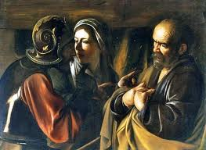
Peter
While Christ was facing the onslaught of Apostate Adventism, another twang of pain rocked His heart. Two disciples had followed Christ at a distance and were allowed entrance into the judgment hall of Caiaphas. They were John and Peter.

Slide 4
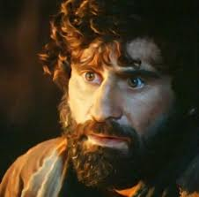
Who Was He?
1. He was married. (Matthew 8:14,15) ”And when Jesus was come into Peter's house, he saw his wife's mother laid, and sick of a fever. And he touched her hand, and the fever left her: and she arose, and ministered unto them. “
2. He owned his own shipping vessel. “And he entered into one of the ships, which was Simon's, and prayed him that he would thrust out a little from the land. And he sat down, and taught the people.” Luke 5:3

Slide 5
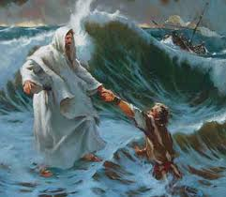
He’d Try Anything
3. He would try anything.
A) He rebuked God. “Then Peter took him, and began to rebuke him, saying, Be it far from thee, Lord: this shall not be unto thee.” Matt. 16:22
B) He walked on water. “And he said, Come. And when Peter was come down out of the ship, he walked on the water, to go to Jesus.” Matt. 14:29
C) He would fight to the death. “Then Simon Peter having a sword drew it, and smote the high priest's servant, and cut off his right ear. The servant's name was Malchus.” John 18:10

Slide 6
The Pebble
“Andrew sought to impart the joy that filled his heart. Going in search of his brother Simon, he cried, "We have found the Messias." Simon waited for no second bidding. He also had heard the preaching of John the Baptist, and he hastened to the Saviour. The eye of Christ rested upon him, reading his character and his life history. His impulsive nature, his loving, sympathetic heart, his ambition and self-confidence, the history of his fall, his repentance, his labors, and his martyr death,--the Saviour read it all, and He said, "Thou art Simon the son of Jona: thou shalt be called Cephas, which is by interpretation, A stone.“ DA, pg. 139

Slide 7
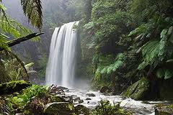
Always Flowing
4. He always had something to say. Some helpful.
A. “You are the Christ.”
B. “How many times should we forgive?”
Some not.
“And it came to pass, as they departed from him, Peter said unto Jesus, Master, it is good for us to be here: and let us make three tabernacles; one for thee, and one for Moses, and one for Elias: not knowing what he said.” Luke 9:33

Slide 8
His Problem
“Jesus read the character of His disciples. He knew how sorely their faith was to be tried. In this incident on the sea He desired to reveal to Peter his own weakness,--to show that his safety was in constant dependence upon divine power. Amid the storms of temptation he could walk safely only as in utter self-distrust he should rely upon the Saviour. It was on the point where he thought himself strong that Peter was weak; and not until he discerned his weakness could he realize his need of dependence upon Christ. Had he learned the lesson that Jesus sought to teach him in that experience on the sea, he would not have failed when the great test came upon him.” DA, pg. 382

Slide 9
Our Problem
“Day by day God instructs His children. By the circumstances of the daily life He is preparing them to act their part upon that wider stage to which His providence has appointed them. It is the issue of the daily test that determines their victory or defeat in life's great crisis.
Those who fail to realize their constant dependence upon God will be overcome by temptation. We may now suppose that our feet stand secure, and that we shall never be moved. We may say with confidence, "I know in whom I have believed; nothing can shake my faith in God and in His word." But Satan is planning to take advantage of our hereditary and cultivated traits of character, and to blind our eyes to our own necessities and defects. Only through realizing our own weakness and looking steadfastly unto Jesus can we walk securely.” DA, pg. 382

Slide 10
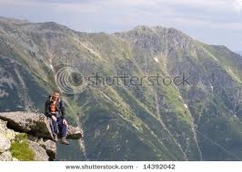
The Warning
“ And the Lord said, Simon, Simon, behold, Satan hath desired to have you, that he may sift you as wheat: But I have prayed for thee, that thy faith fail not: and when thou art converted, strengthen thy brethren. And he said unto him, Lord, I am ready to go with thee, both into prison, and to death. And he said, I tell thee, Peter, the cock shall not crow this day, before that thou shalt thrice deny that thou knowest me.” LK. 22:31,32

Slide 11
Not Interested
“When Peter said he would follow his Lord to prison and to death, he meant it, every word of it; but he did not know himself. Hidden in his heart were elements of evil that circumstances would fan into life. Unless he was made conscious of his danger, these would prove his eternal ruin. The Saviour saw in him a self-love and assurance that would overbear even his love for Christ. Much of infirmity, of unmortified sin, carelessness of spirit, unsanctified temper, heedlessness in entering into temptation, had been revealed in his experience. Christ's solemn warning was a call to heart searching. Peter needed to distrust himself, and to have a deeper faith in Christ. Had he in humility received the warning, he would have appealed to the Shepherd of the flock to keep His sheep.” DA, pg. 673

Slide 12
How About Us?!?!
“Because thou sayest, I am rich, and increased with goods, and have need of nothing; and knowest not that thou art wretched, and miserable, and poor, and blind, and naked: I counsel thee to buy of me gold tried in the fire, that thou mayest be rich; and white raiment, that thou mayest be clothed, and that the shame of thy nakedness do not appear; and anoint thine eyes with eyesalve, that thou mayest see. As many as I love, I rebuke and chasten: be zealous therefore, and repent.” Rev. 3:17-19

Slide 13
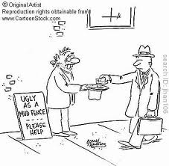
Our Greatest Need
We are God’s people. We go to church on the right day. We eat the right way. We give money to the church. We are pretty good people. Our greatest need is realizing how desperately we need Christ and His righteousness! “When Jesus heard it, he saith unto them, They that are whole have no need of the physician, but they that are sick: I came not to call the righteous, but sinners to repentance.” MK. 2:17

Slide 14
Peter Falls
”Now Peter sat without in the palace: and a damsel came unto him, saying, Thou also wast with Jesus of Galilee. But he denied before [them] all, saying, I know not what thou sayest. And when he was gone out into the porch, another maid saw him, and said unto them that were there, This fellow was also with Jesus of Nazareth. And again he denied with an oath, I do not know the man. And after a while came unto him they that stood by, and said to Peter, Surely thou also art one of them; for thy speech bewrayeth thee. Then began he to curse and to swear, saying, I know not the man. And immediately the cock crew. And Peter remembered the word of Jesus, which said unto him, Before the cock crow, thou shalt deny me thrice. And he went out, and wept bitterly.” Matt. 26:69-75

Slide 15
Christ’s Look
“While the degrading oaths were fresh upon Peter's lips, and the shrill crowing of the cock was still ringing in his ears, the Saviour turned from the frowning judges, and looked full upon His poor disciple. At the same time Peter's eyes were drawn to his Master. In that gentle countenance he read deep pity and sorrow, but there was no anger there. The sight of that pale, suffering face, those quivering lips, that look of compassion and forgiveness, pierced his heart like an arrow. Conscience was aroused. Memory was active. Peter called to mind his promise of a few short hours before that he would go with his Lord to prison and to death. He remembered his grief when the Saviour told him in the upper chamber that he would deny his Lord thrice that same night. Peter had just declared that he knew not Jesus, but he now realized with bitter grief how well his Lord knew him, and how accurately He had read his heart, the falseness of which was unknown even to himself. A tide of memories rushed over him. The Saviour's tender mercy, His kindness and long-suffering, His gentleness and patience toward His erring disciples,--all was remembered. ” DA, pgs. 712, 713

Slide 16
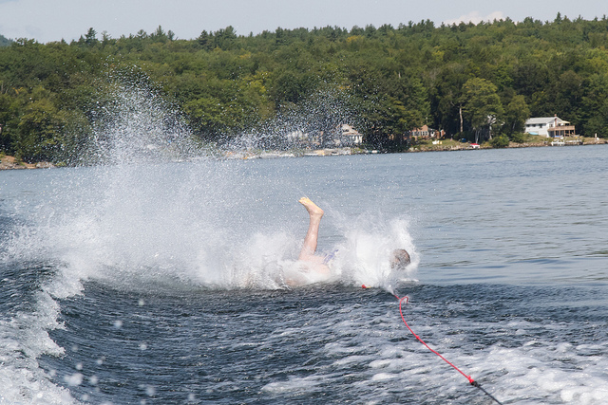
Down, But Not Out!
“And entering into the sepulcher, they saw a young man sitting on the right side, clothed in a long white garment; and they were affrighted. And he saith unto them, Be not affrighted: Ye seek Jesus of Nazareth, which was crucified: he is risen; he is not here: behold the place where they laid him. But go your way, tell his disciples and Peter that he goeth before you into Galilee: there shall ye see him, as he said unto you.” Mk. 16:5-7

Slide 17
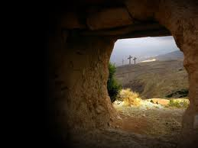
He Would Rise Again!
“But Peter, standing up with the eleven, lifted up his voice, and said unto them, Ye men of Judaea, and all [ye] that dwell at Jerusalem, be this known unto you, and hearken to my words:” Acts 2:14

