Slide 1
Church/State, pt. 7
Satan’s Final Assault

Slide 2
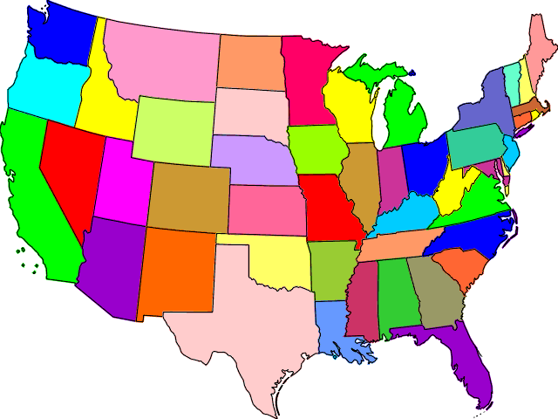
Two Horns Like a Lamb

Slide 3
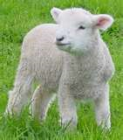
Republicanism and Protestantism
"And he had two horns like a lamb." The lamblike horns indicate youth, innocence, and gentleness, fitly representing the character of the United States when presented to the prophet as "coming up" in 1798. Among the Christian exiles who first fled to America and sought an asylum from royal oppression and priestly intolerance were many who determined to establish a government upon the broad foundation of civil and religious liberty. Their views found place in the Declaration of Independence, which sets forth the great truth that "all men are created equal" and endowed with the inalienable right to "life, liberty, and the pursuit of happiness." And the Constitution guarantees to the people the right of self-government, providing that representatives elected by the popular vote shall enact and administer the laws. Freedom of religious faith was also granted, every man being permitted to worship God according to the dictates of his conscience. Republicanism and Protestantism became the fundamental principles of the nation.” GC, pg. 441

Slide 4

Principles of Christ
The governmental principles of Jesus Christ would carry the day in the United States. There would be:
1. freedom to worship God as one chose.
2. the total separation of church and state.
3. the power of the government would rest with the people.

Slide 5
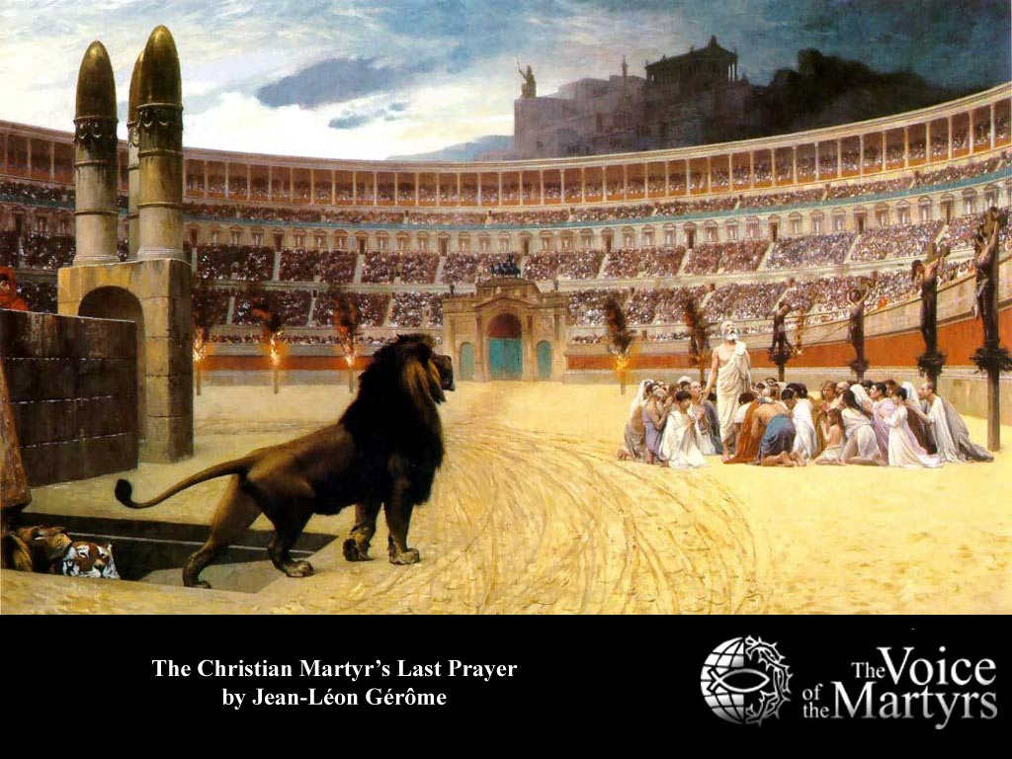
Wanted to Avoid This
“And he said unto them, Render therefore unto Caesar the things which be Caesar's, and unto God the things which be God's.” Luke 20:25
“He declared that since they were living under the protection of the Roman power, they should render to that power the support it claimed, so long as this did not conflict with a higher duty. But while peaceably subject to the laws of the land, they should at all times give their first allegiance to God…. “ DA, pg. 602

Slide 6

Not a Christian Government!
“Though Christianity flourished in the minds of the citizens and leaders of the new nation, neutrality in matters of religion had become official government doctrine. This philosophy appeared in the ‘Treaty of Peace and Friendship’ with Tripoli, executed November 4, 1796 during the administration of George Washington. This document declared that ‘the government of the United States of America is not, in any sense, founded on the Christian religion.” ‘Dateline Sunday, USA’ by Warren Johns, pg. 21

Slide 7
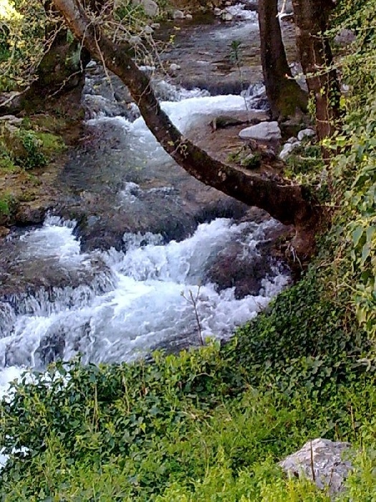
Freedom of religion for all
In founding a nation based on the principles of Christ, it would guarantee that no one would ever be forced to worship God a certain way. Everyone would be left free to choose their own religion. “Congress shall make no law respecting an establishment of religion, or prohibiting the free exercise thereof.“ the first amendment

Slide 8
Jefferson and separation
The concept of separation of church and state refers to the distance in the relationship between organized religion and the nation state. The term is an offshoot of the phrase, "wall of separation between church and state," as written in Thomas Jefferson's letter to the Danbury Baptists Association in 1802. The original text reads: "...I contemplate with sovereign reverence that act of the whole American people which declared that their legislature should 'make no law respecting an establishment of religion, or prohibiting the free exercise thereof,' thus building a wall of separation between Church & State.“ Wikipedia

Slide 9
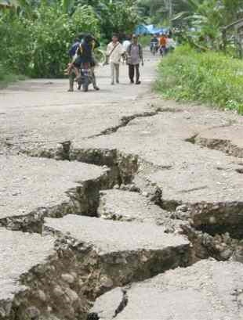
A Change Would Come
“And I beheld another beast coming up out of the earth; and he had two horns like a lamb, and he spake as a dragon. And he exerciseth all the power of the first beast before him, and causeth the earth and them which dwell therein to worship the first beast, whose deadly wound was healed.” Revelation 13:11,12

Slide 10
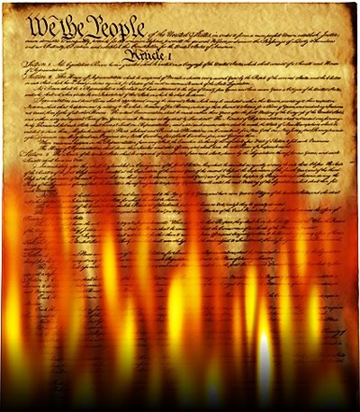
Constitution Destroyed
“The prediction that it will speak "as a dragon" and exercise "all the power of the first beast" plainly foretells a development of the spirit of intolerance and persecution that was manifested by the nations represented by the dragon and the leopard like beast. And the statement that the beast with two horns "causeth the earth and them which dwell therein to worship the first beast" indicates that the authority of this nation is to be exercised in enforcing some observance which shall be an act of homage to the papacy.
Such action would be directly contrary to the principles of this government, to the genius of its free institutions, to the direct and solemn avowals of the Declaration of Independence, and to the Constitution. The founders of the nation wisely sought to guard against the employment of secular power on the part of the church, with its inevitable result--intolerance and persecution.” GC, pg. 442

Slide 11
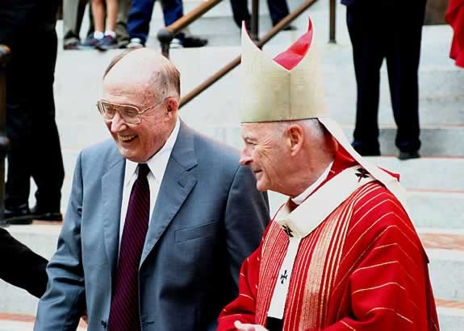
William Rehnquist, Chief Justice
“But the greatest injury of the 'wall' notion is its mischievous diversion of judges from the actual intentions of the drafters of the Bill of Rights. . . . The "wall of separation between church and state" is a metaphor based on bad history, a metaphor which has proved useless as a guide to judging. It should be frankly and explicitly abandoned.”… “It is impossible to build sound constitutional doctrine upon a mistaken understanding of constitutional history. . . . The establishment clause has been expressly freighted with Jefferson's misleading metaphor for nearly forty years. . . . There is simply no historical foundation for the proposition that the framers intended to build a wall of separation [between church and state]. .”

Slide 12
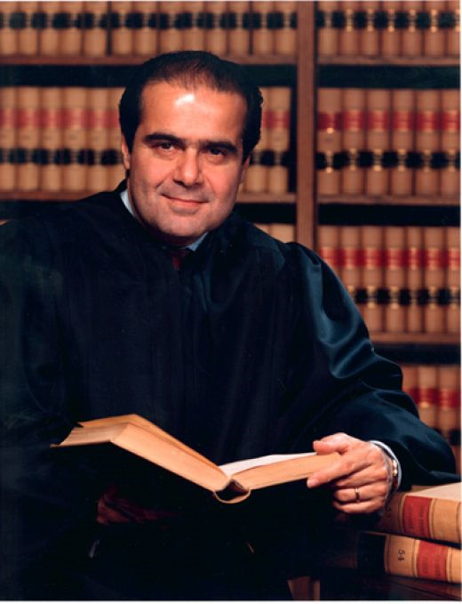
Antonin Scalia
Roman Catholic Antonin Scalia gave the majority opinion in a famous case back in 1990. Entitled ‘Smith vs. State of Oregon’, the case involved to two counselors that were of Indian background. In one of their religious rites as Indians, they would use a drug called peyote. The use of the drug did not effect their work skills in the least. The men were fired from their jobs for using peyote in a religious rite.

Slide 13
`Peyote and Smith’: the Decision
SECULAR and religious writers alike recognize a dramatic shift in the interpretation of the First Amendment of the Bill of Rights. The most significant ruling came in a case sometimes called "Smith versus the State of Oregon," alternatively the "Peyote case," handed down by the Supreme Court April 17 1990.
The case involved two American Indians who were drug counselors on an Indian reservation in the state of Oregon. The two counselors had admitted that they ingested peyote during a religious ceremony. The state of Oregon had argued that that act disqualified them as suitable counselors. The defendants claimed that because the ingestion of peyote was part of the ancient religious services of the Indians, its use in religious services was protected by the First Amendment to the Constitution.

Slide 14
Amazing! Speaking like a Dragon!
David Savage, of the Los Angeles Times, wrote,
In what was called a "radical departure" from previous rulings protecting religion, the Supreme Court Tuesday forcibly declared that it would no longer shield believers whose practices violate general laws… Religions that are out of the mainstream are most likely to be affected, because their unconventional practices and lack of political clout have led them to depend upon the courts for protection…But in a sweeping opinion, Justice Antonin Scalia went far beyond the case and declared that when religious rights clash with the government’s need for uniform rules, the court will side with the government…Even for lay members of the community, this decision dramatically eroded the protection given to those citizens who were members of churches not part of the popular or mainstream churches of America… We cannot afford the luxury "of striking down laws simply because they limit someone’s religious practice." Scalia said. He advised religious adherents to look to the political system, not to the courts for protection.” Los Angeles Times, April 18 1990

Slide 15
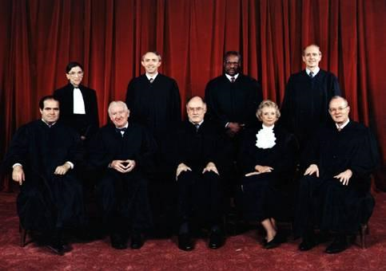
Concern and Praise
“The architects of the Bill of Rights sought to safeguard the rights of minorities through the First Amendment. It would not be going too far to suggest that Scalia’s opinion was a direct violation of the Constitution of the United States. We question how justices who had sworn to uphold the Constitution of the United States could have rendered such an opinion. We are even more surprised that the majority of the citizens of the nation, or alternatively the members of Congress, did not rise up more decidedly against such a decision. It would seem that only a minority of Congressional members held deep concerns about this ruling.” Sunday Law. net

Slide 16

Making America Christian: David Barton
His exhaustive research has rendered him an expert in historical and constitutional issues and he serves as a consultant to state and federal legislators, has participated in several cases at the Supreme Court, was involved in the development of the History/Social Studies standards for states such as Texas and California, and has helped produce history textbooks now used in schools across the nation.
A national news organization has described him as "America's historian," and Time Magazine called him "a hero to millions - including some powerful politicians. In fact, Time Magazine named him as one of America's 25 most influential evangelicals.

Slide 17
“The man behind the tape turned out to be David Barton, a fundamentalist activist who makes a living attacking separation of church and state. The video Barnett received is a shorter version of Barton's one hour documentary "America' s Godly Heritage." Both tapes in turn are based on Barton's 1989 book The Myth of Separation. Even though the book and videos are riddled with factual errors, half truths and distortions, they have become the weapons of choice for Religious Right activists in their ongoing war against separation of church and state. In recent months, Americans United members from around the country have discovered letters to the editor in their local newspapers repeating Barton's charges….Another incident that demonstrates the far reach of Barton's ideas occurred last year in Colorado during the state Republican Party convention. David S. Nelson, state director of the Colorado branch of the Christian Coalition distributed fliers asserting that "The Separation of Church and State is (1) Not a teaching of the founding fathers; (2) Not an historical teaching; (3) Not a teaching of law (except in recent years); (4) Not a biblical teaching." This language is lifted word for word.”

Slide 18
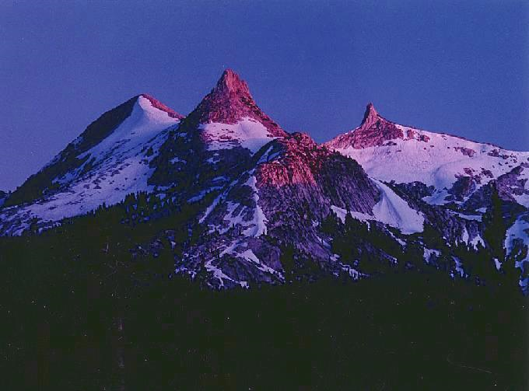
Making America a Christian Nation
Joining Mr. Beck for his American Revival event were… The third featured speaker at the event was none other than the star of the "Texas Textbook Massacre," Christian nationalist pseudo-historian David Barton. For those unfamiliar with Barton, he is the most popular of all the Christian nationalist history revisionists and a former vice-chair of the Texas Republican Party who was used by the GOP in recent elections to travel the country stumping for their "family values" candidates. He is very well connected with the far-right members of Congress. In 2005 Time Magazine named him one of the 25 most influential evangelicals in America. ” http://www.huffingtonpost.com/chris-rodda/david-barton-glenn-beck_b_521485.html

Slide 19
The End is Near!
“Heretofore those who presented the truths of the third angel's message have often been regarded as mere alarmists. Their predictions that religious intolerance would gain control in the United States, that church and state would unite to persecute those who keep the commandments of God, have been pronounced groundless and absurd. It has been confidently declared that this land could never become other than what it has been--the defender of religious freedom. But as the question of enforcing Sunday observance is widely agitated, the event so long doubted and disbelieved is seen to be approaching, and the third message will produce an effect which it could not have had before.” GC, pgs. 605,606

