Slide 1
What is the Difference Between Mormons, Jehovah’s Witnesses, and Seventh-day Adventists? pt 19

Slide 2
Some Omissions
KJV NIV Douay-Rheims
Omitted
Acts 8:37 “And Philip said: If thou believest with all thy heart, thou mayest. And he answering, said: I believe that Jesus Christ is the Son of God.”
Acts 8:37 “And Philip said, If thou believest with all thine heart, thou mayest. And he answered and said, I believe that Jesus Christ is the Son of God.”
NWT-Acts 8:37--Omitted
JST-Acts 8:37 “And Philip said, If thou believest with all thine heart, thou mayest. And he answered and said, I believe that Jesus Christ is the Son of God.”

Slide 3
Some Omissions
KJV NIV Douay-Rheims
Omitted
Matt. 17:21 “But this kind is not cast out but by prayer and fasting”
Matt. 17:21 “Howbeit this kind goeth not out but by prayer and fasting”
NWT-Matt. 17:21--Omitted
JST-Matt. 17:21 “Howbeit, this kind goeth not out but by prayer and fasting.”

Slide 4
Some Omissions
KJV NIV Douay-Rheims
Omitted
Matt. 18:11 “For the Son of man is come to save that which was lost.”
Matt. 18:11 “For the Son of man is come to save that which was lost.”
NWT-Matt. 18:11--Omitted
JST-Matt. 18:11 “For the Son of Man is come to save that which was lost and to call sinners to repentance; but these little ones have no need of repentance, and I will save them.”

Slide 5
Some Changes
KJV NIV Douay-Rheims
Is. 14:12 “How you have fallen from heaven, morning star, son of the dawn! You have been cast down to the earth, you who once laid low the nations!”
Is. 14:12 “How art thou fallen from heaven, O Lucifer, who didst rise in the morning? how art thou fallen to the earth, that didst wound the nations?”
Is. 14:12 “How art thou fallen from heaven, O Lucifer, son of the morning! how art thou cut down to the ground, which didst weaken the nations!”
NWT-Is. 14:12 “How you have fallen from heaven,O shining one, son of the dawn! How you have been cut down to the earth,You who vanquished nations!”
JST-Is. 14:12 “How art thou fallen from heaven, O Lucifer, son of the morning! How art thou cut down to the ground, which didst weaken the nations!”

Slide 6
Some Changes
KJV NIV Douay-Rheims
Matt. 6:13 “And lead us not into temptation, but deliver us from the evil one.”
Matt. 6:13 “And lead us not into temptation. But deliver us from evil. Amen”
Matt. 6:13 “And lead us not into temptation, but deliver us from evil: For thine is the kingdom, and the power, and the glory, for ever. Amen.”
NWT-Matt. 6:13 “And do not bring us into temptation, but deliver us from the wicked one”
JST-Matt. 6:13 “And forgive us our trespasses, as we forgive those who trespass against us.”

Slide 7
Some Changes
KJV NIV Douay-Rheims
Matt. 9:13 “But go and learn what this means: ‘I desire mercy, not sacrifice.’ For I have not come to call the righteous, but sinners.”
Matt. 9:13 “Go then and learn what this meaneth, I will have mercy and not sacrifice. For I am not come to call the just, but sinners”
Matt. 9:13 “But go ye and learn what that meaneth, I will have mercy, and not sacrifice: for I am not come to call the righteous, but sinners to repentance.”
NWT-Matt. 9:13 “Go, then, and learn what this means: ‘I want mercy, and not sacrifice.’ For I came to call, not righteous people, but sinners.”
JST-Matt. 9:14 (13) “But go ye and learn what this meaneth: I will have mercy and not sacrifice; for I am not come to call the righteous, but sinners to repentance.”

Slide 8
Some Changes
KJV NIV Douay-Rheims
Luke 5:32 “I have not come to call the righteous, but sinners to repentance.”
Luke 5:32 “I came not to call the just, but sinners to penance”
Luke 5:32 “I came not to call the righteous, but sinners to repentance.”
NWT-Luke 5:32 “I have come to call, not righteous people, but sinners to repentance”
JST-Luke 5:32 “I came not to call the righteous, but sinners to repentance.”

Slide 9
Some Changes
KJV NIV Douay-Rheims
Rev. 22:14 “Blessed are those who wash their robes, that they may have the right to the tree of life and may go through the gates into the city.”
Rev. 22:14 “Blessed are they that wash their robes in the blood of the Lamb: that they may have a right to the tree of life, and may enter in by the gates into the city”
Rev. 22:14 “Blessed are they that do his commandments, that they may have right to the tree of life, and may enter in through the gates into the city”
NWT-Rev. 22:14 “Happy are those who wash their robes, so that they may have authority to go to the trees of life and that they may gain entrance into the city through its gates”
JST-Rev. 22:14 “Blessed are they that do his commandments, that they may have right to the tree of life and may enter in through the gates into the city.”

Slide 10
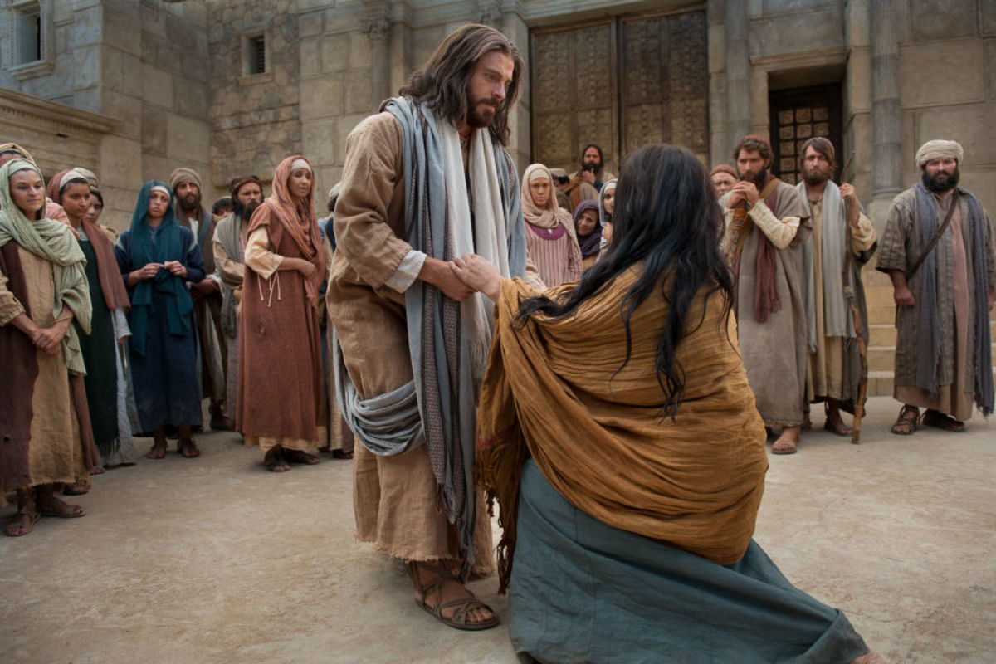
Other Major Omissions/Marginal Notes
The Modern Translations include marginal notes that which usually read as follows: “The most reliable manuscripts do not contain these verses”—You will most commonly find these notes in:
Mark 16:9-20—Which contains the resurrection of Jesus and His revealing Himself to His disciples, and His Ascension
Luke 22:43-44—Jesus strengthened by the angel and sweats drops of blood
John 7:53-8:11—The woman taken in adultery
1 John 5:7—The 3 that bear record in heaven
Most Scholars therefore and university students are taught to doubt these Bible passages or disregard them altogether, and many do.

Slide 11
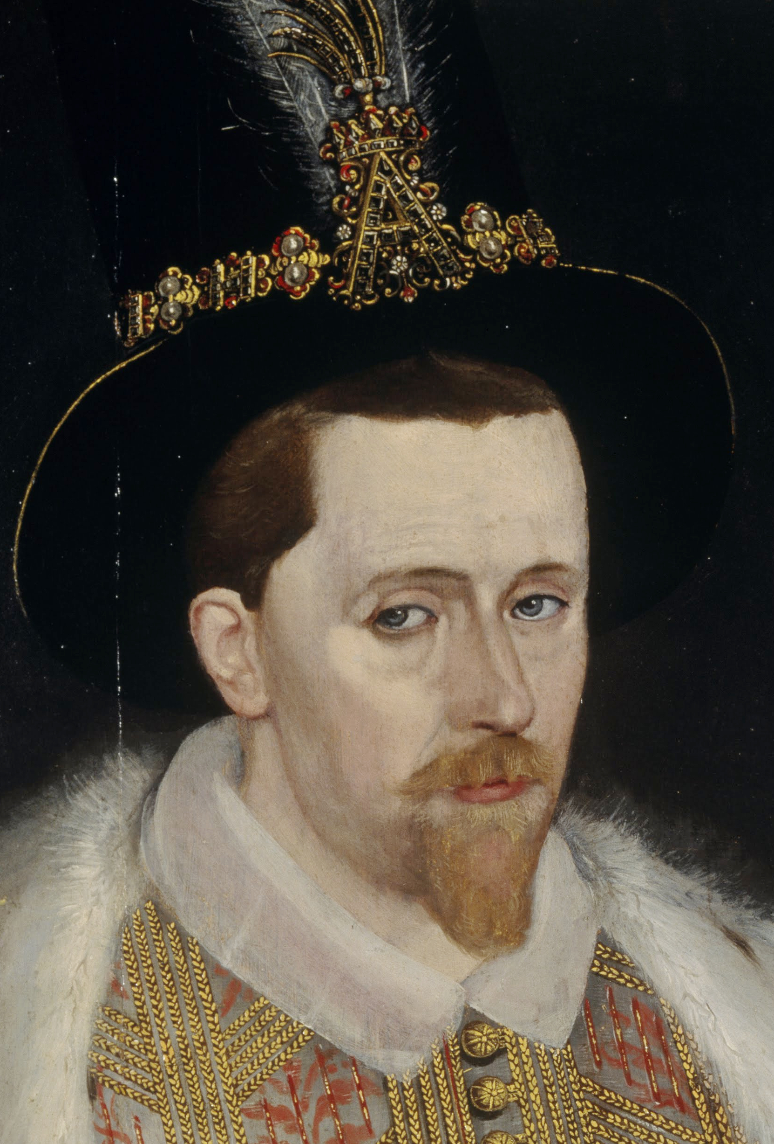
Short History of the Formation of the KJV
“After the life and death struggles with Spain, and the hard fought battle to save the English people from the Jesuit Bible of 1582, victorious Protestantism took stock of its situation and organized for the new era which had evidently dawned. A thousand ministers, it is said, sent in a petition, called the Millenary Petition, to King James who had now succeeded Elizabeth as sovereign. One author describes the petition as follows: “The petition craved reformation of sundry abuses in the worship, ministry, revenue, and discipline of the national Church... Among other of their demands, Dr. Reynolds, who was the chief speaker in their behalf, requested that there might be a new translation of the Bible, without note or comment.””—B.G. Wilkenson, Our Authorized Bible Vindicated, p. 49

Slide 12
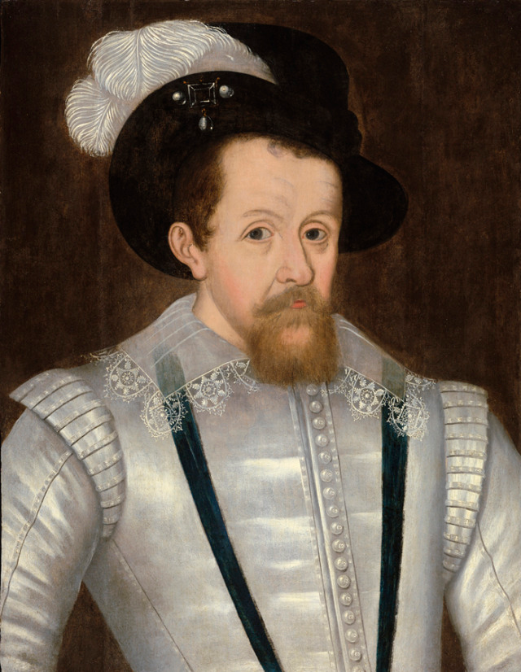
King James…
Believed in the Divine Right of Kings
Was the son of Mary Queen of Scotts—he was Scottish
Some biographers say that he was a closet Catholic
Believed that he was head of the church—did not believe in freedom of religion
Forced people to attend Anglican Churches and follow the agreed upon practices of religion—prayer books, powerful clergy, church-state together
Studied the Bible profusely as a young man, and hated both the Bishop’s Bibles for its errors and the Geneva Bible for its commentaries
Wanted a Bible that would unite the English Protestant people and ensure the domestic tranquility of his kingdom

Slide 13
The Work of Translation
“The forty-seven learned men appointed by King James to accomplish this important task were divided first into three companies: one worked at Cambridge, another at Oxford, and the third at Westminster. Each of these companies again split up into two. Thus, there were six companies working on six allotted portions of the Hebrew and Greek Bibles. Each member of each company worked individually on his task, then brought to each member of his committee the work he had accomplished. The committee all together went over that portion of the work translated. Thus, when one company had come together, and had agreed on what should stand, after having compared their work, as soon as they had completed any one of the sacred books, they sent it to each of the other companies to be critically reviewed. If a later company, upon reviewing the book, found anything doubtful or unsatisfactory, they noted such places, with their reasons, and sent it back to the company whence it came. If there should be a disagreement, the matter was finally arranged at a general meeting of the chief persons of all the companies at the end of the work. It can be seen by this method that each part of the work was carefully gone over at least fourteen times. It was further understood that if there was any special difficulty or obscurity, all the learned men of the land could be called upon by letter for their judgment. And finally each bishop kept the clergy of his diocese notified concerning the progress of the work, so that if any one felt constrained to send any particular observations, he was notified to do so.”—B.G. Wilkinson, Our Authorized Bible Vindicated, p. 54

Slide 14
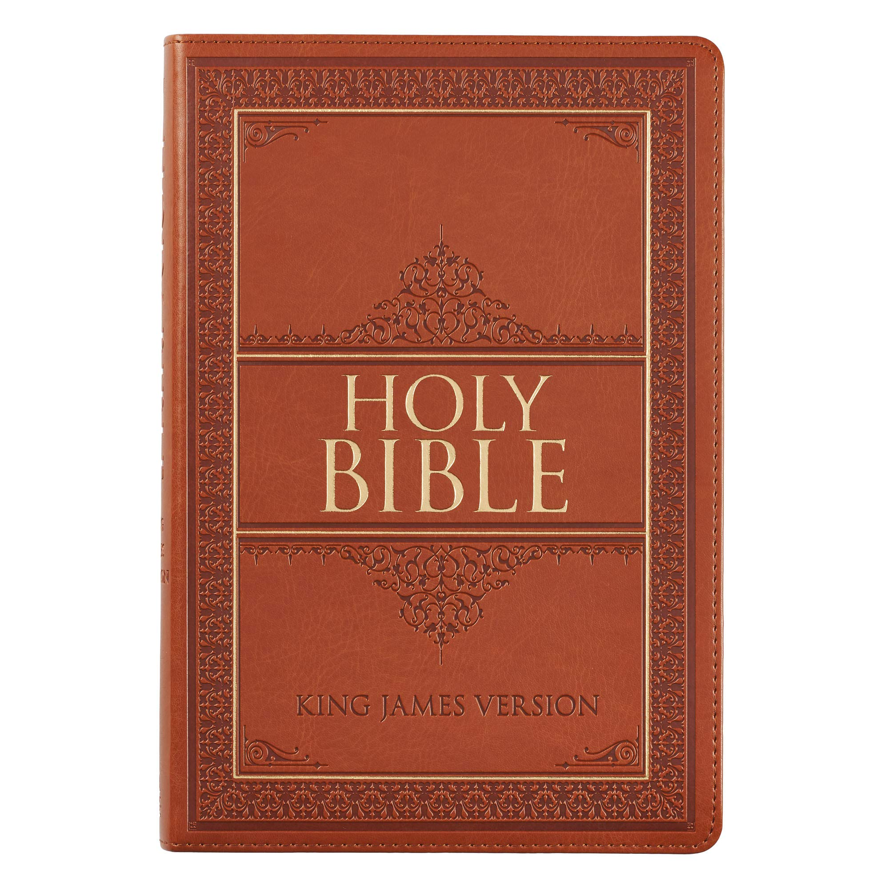
Sayings From KJV
Blind leading the Blind: Matt. 15:13-14
By the Skin of Your Teeth: Job 19:20
Broken Heart: Ps. 34:18
Can a Leopard Change his spots?: Jer. 13:23
Drop in a bucket: Is. 40:15
Fly in the Ointment: Ecc. 10:1
Go the Extra Mile: Matt. 5:41
Nothing but Skin and Bones: Job 19:19-20
The Powers that Be: Rom. 13:1
Put words in my mouth: 2 Sam. 14:3
Rise and Shine: Is. 60:1
The Root of the Matter: Job 19:28
See eye to eye: Is. 52:8
Sign of the Times: Matt. 16:3

Slide 15
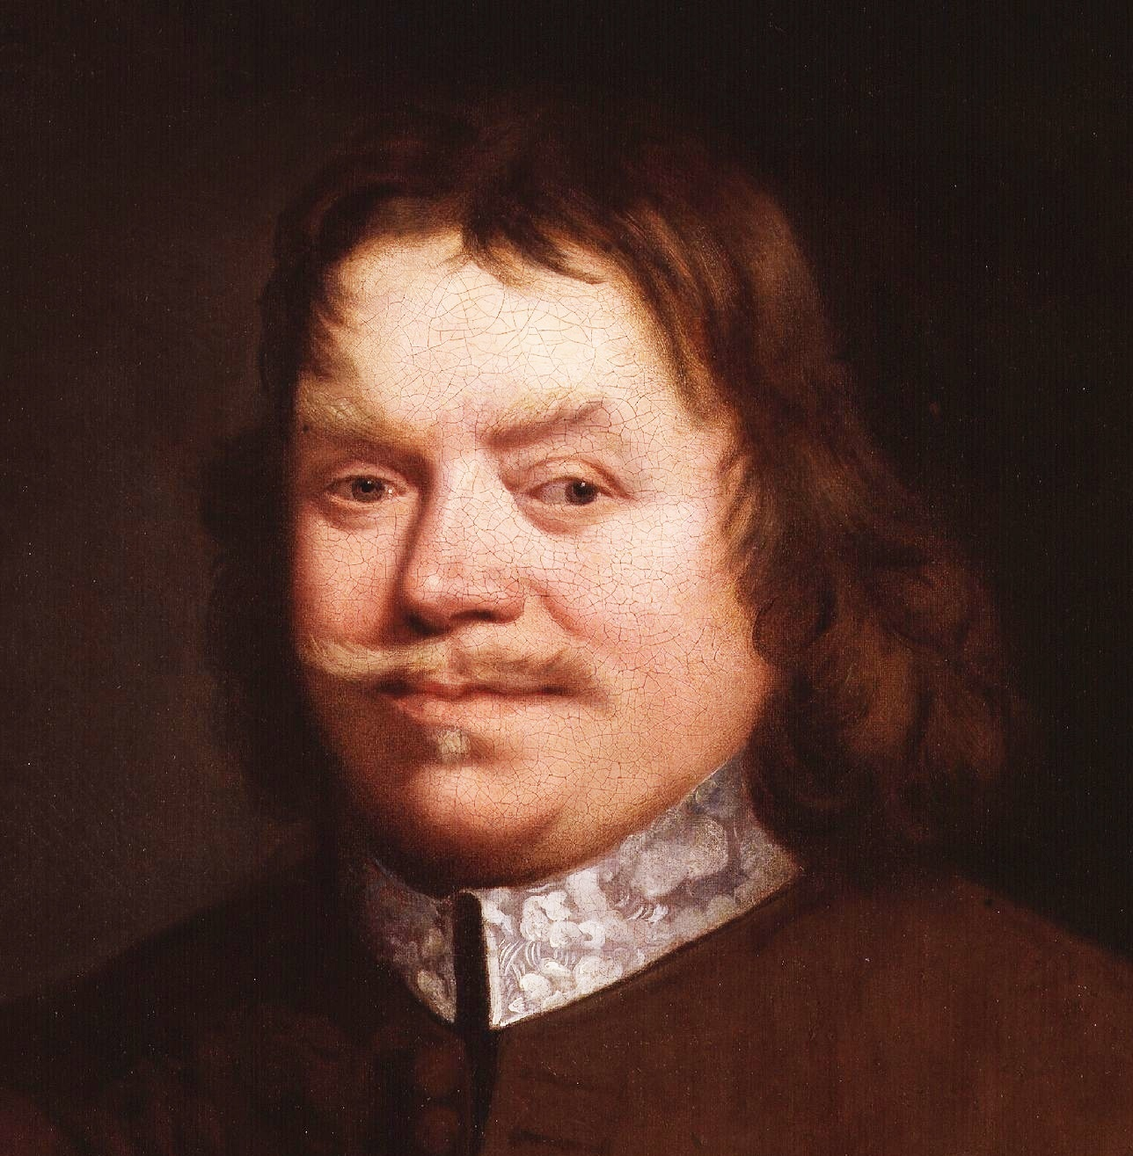
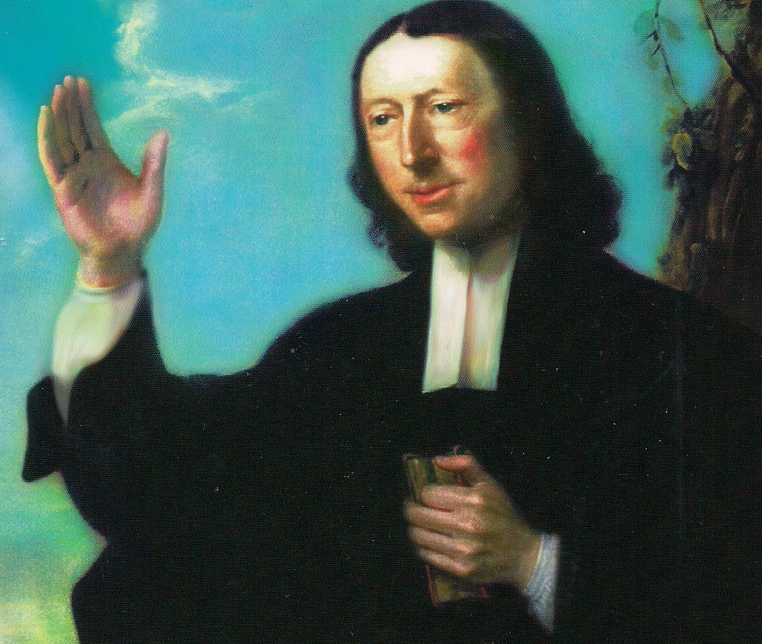
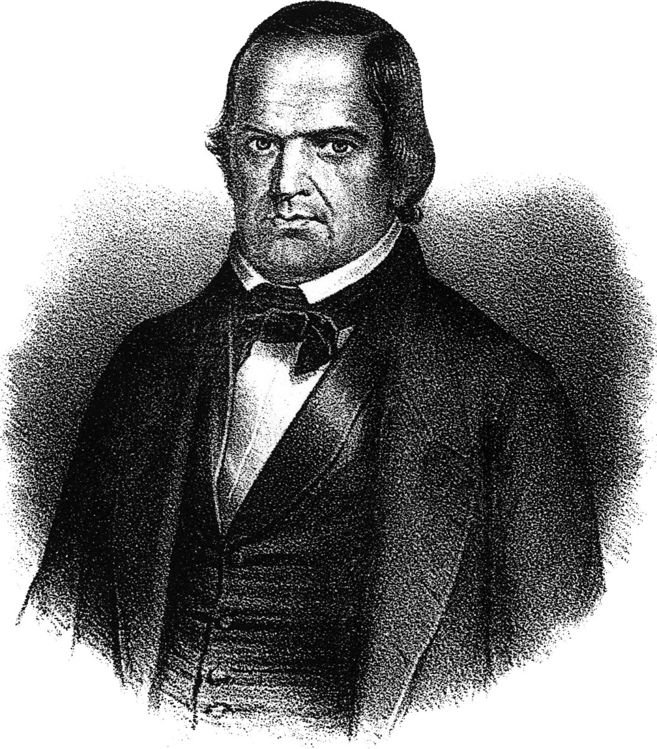
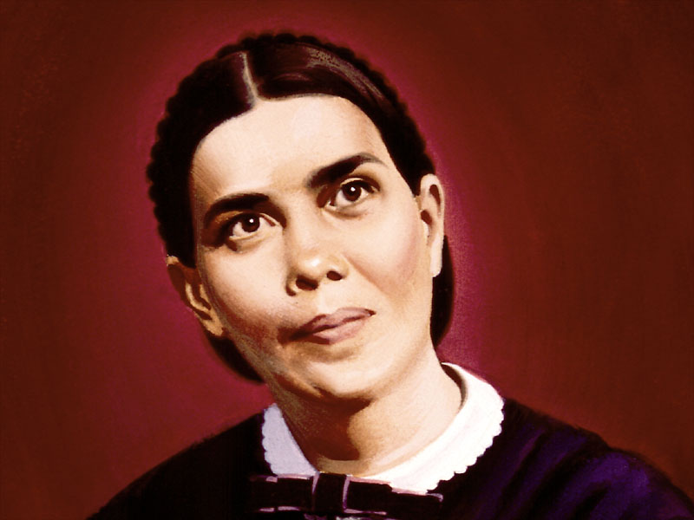
Results…
King James Bible helped to unite English Protestants in theologically understanding Popery and resisting Rome:
“Who will say that the uncommon beauty and marvelous English of the Protestant Bible is not one of the greatest strongholds of heresy in this country”—Faber (left Anglican Church for Catholicism), quoted in Eadie, The English Bible, vol II, p. 158
Helped to dismantle to remaining elements of Romanism in the English speaking world
This is the Bible of John Bunyan who spent 12 years in prison for his faith, and his resistance to forced prayers
This is the Bible of the Puritans, Oliver Cromwell, the Pilgrims (including Geneva) who came to the New World
This is the Bible of John Wesley and the Revivals in England and the establishment of Methodism
This is the Bible of Ellen White, Joseph Bates, Hiram Edson, James White, John Loughborough, William Miller and the 1844 movements and biblical rediscoveries

Slide 16
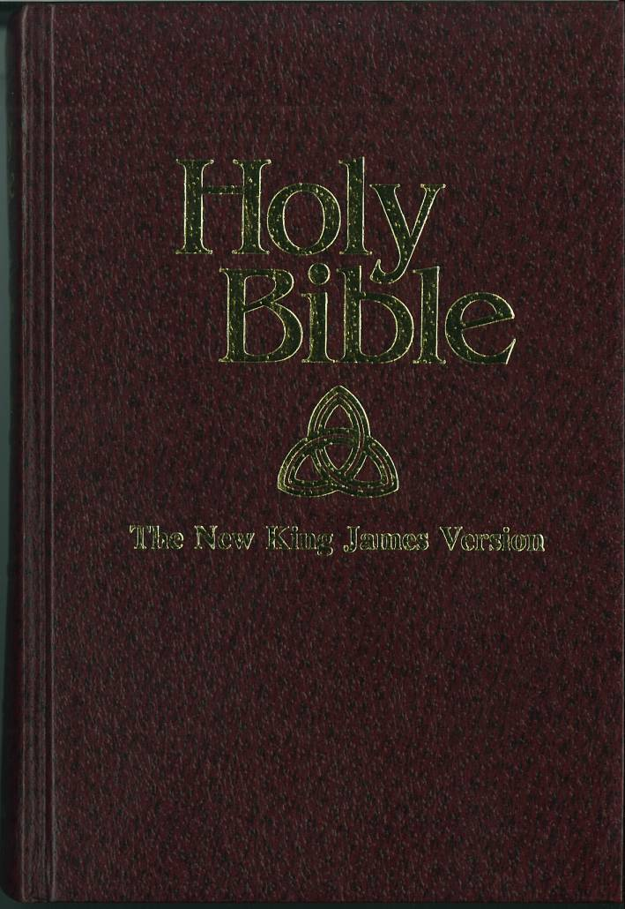
Beware the New King James Version
“KJV – The KJV Bible translation was created in the 1600’s. This translation completely excludes the Alexandrian Manuscripts and solely relies on the Textus Receptus. This translation is usually taken very literally, despite the obvious differences in use of language today. NKJV – This translation includes the Alexandrian Manuscripts in order to find more direct information as to the meaning of the original words. This translation was created in order to reflect better readability.”-Ashley Evans, Nov. 13, 2021, -https://biblereasons.com/kjv-vs-nkjv-bible/

Slide 17
D.A. Waite’s Work
“The NEW KING JAMES VERSION. As mentioned above, the computer analysis of the NEW KING JAMES VERSION shows a total of over 2,000 examples of addition, subtraction, and change from the KING JAMES BIBLE, and from the Hebrew in the Old Testament or Greek in the New Testament. . . I believe the NEW KING JAMES VERSION is probably the most dangerous of the new versions on the present market today because it is the foot in the door and the camel's nose in the tent to lead eventually to even more DYNAMIC EQUIVALENCY. By using the word, "KING JAMES VERSION" in its title, it lowers people's guard. People think that it is very similar to the KING JAMES VERSION, using the same technique and so on. This causes people to think, "Well, this is simply a NEW KING JAMES and there's nothing wrong in it." There are lots of things deceptive concerning it. We give thirteen examples where it adds words. It changes nouns to pronouns twenty-five times. It omits the subjunctive mood, etc. . . The diabolical nature of the NEW KING JAMES VERSION shows itself in their printing all the various readings of the Greek text in the footnotes. They print all sides and take their stand in favor of none of them. By so doing, they confuse the readers. The editors have made no decision as to what God's Words really are. If that isn't confusing, you think about it. They claim to use the Textus Receptus as a basis for translation, but it's not.” –DA Waite, Defending the King James Bible, p. 156

Slide 18
Some Changes
KJV NKJV NIV
Gen. 2:7 “And the LORD God formed man of the dust of the ground, and breathed into his nostrils the breath of life; and man became a living being”
Gen. 2:7 “Then the LORD God formed a man from the dust of the ground and breathed into his nostrils the breath of life, and the man became a living being.”
Gen. 2:7 “And the LORD God formed man of the dust of the ground, and breathed into his nostrils the breath of life; and man became a living soul.”
1599 Geneva _
Gen. 2:7 “The Lord God also made the man of the dust of the ground, and breathed in his face breath of life, and the man was a living soul.”
NWT-Gen. 2:7 “And Jehovah God went on to form the man out of dust from the ground and to blow into his nostrils the breath of life, and the man became a living person”
JST-Gen. 2:8 (7) “And I, the Lord God, formed man from the dust of the ground and breathed into his nostrils the breath of life; and man became a living soul--the first flesh upon the earth, the first man also.”

Slide 19
Some Changes
KJV NKJV NIV
Matt. 6:13 “And lead us not into temptation, but deliver us from evil: For thine is the kingdom, and the power, and the glory, for ever. Amen”
Matt. 6:13 “And do not lead us into temptation, But deliver us from the evil one. For Yours is the kingdom and the power and the glory forever. Amen.”
Matt. 6:13 “And lead us not into temptation, but deliver us from the evil one.”
1599 Geneva _
Matt. 6:13 “And lead us not into temptation, but deliver us from evil: for thine is the kingdom, and the power, and the glory for ever. Amen.”
NWT-Matt. 6:13 “And do not bring us into temptation, but deliver us from the wicked one”
JST-Matt. 6:14 (13) “And suffer us not to be led into temptation, but deliver us from evil.”

Slide 20
Some Changes
KJV NKJV NIV
Acts 3:26 “Unto you first God, having raised up his Son Jesus, sent him to bless you, in turning away every one of you from his iniquities.”
Acts 3:26 “To you first, God, having raised up His Servant Jesus, sent Him to bless you, in turning away every one of you from your iniquities.”
Acts 3:26 “When God raised up his servant, he sent him first to you to bless you by turning each of you from your wicked ways.”
1599 Geneva _
Acts 3:26 “First unto you hath God raised up his Son Jesus, and him he hath sent to bless you, in turning everyone of you from your iniquities”
NWT-Acts 3:26 “God, after raising up his Servant, sent him to you first to bless you by turning each one of you away from your wicked deeds.”
JST-Acts 3:26 “Unto you first, God, having raised up his Son Jesus, sent him to bless you, in turning away every one of you from his iniquities.”

Slide 21
Some Changes
KJV NKJV NIV
Acts 17:22 “Then Paul stood in the midst of Mars' hill, and said, Ye men of Athens, I perceive that in all things ye are too superstitious.”
Acts 17:22 “Then Paul stood in the midst of the Areopagus and said, “Men of Athens, I perceive that in all things you are very religious”
Acts 17:22 “Paul then stood up in the meeting of the Areopagus and said: “People of Athens! I see that in every way you are very religious”
1599 Geneva _
Acts 17:22 “Then Paul stood in the midst of Mars’ street, and said, Ye men of Athens, I perceive that in all things ye are too superstitious”
NWT-Acts 17:22 “Paul now stood in the midst of the Ar·e·opʹa·gus and said: ‘Men of Athens, I see that in all things you seem to be more given to the fear of the deities than others are’”
JST-Acts 17:22 “Then Paul stood in the midst of Mars' Hill and said, Ye men of Athens, I perceive that in all things ye are too superstitious.”

Slide 22
Some Changes
KJV NKJV NIV
1 Cor. 1:18 “For the preaching of the cross is to them that perish foolishness; but unto us which are saved it is the power of God.”
1 Cor. 1:18 “For the message of the cross is foolishness to those who are perishing, but to us who are being saved it is the power of God”
1 Cor. 1:18 “For the message of the cross is foolishness to those who are perishing, but to us who are being saved it is the power of God.”
1599 Geneva _
1 Cor. 1:18 “For that preaching of the cross is to them that perish, foolishness: but unto us, which are saved, it is the power of God”
NWT-1 Cor. 1:18 “For the speech about the torture stake is foolishness to those who are perishing, but to us who are being saved, it is God’s power”
JST-1 Cor. 1:18 “For the preaching of the cross is to them that perish, foolishness; but unto us which are saved, it is the power of God.”

Slide 23
Other Assaults
The word “Hell” is removed in 2 Sam. 22:6, Job 11:8, 26:6, Psalm 16:10, 18:5, 86:13, 116:3, Isaiah 5:14, 14:15, 28:15,18, 57:9, Jonah 2:2, Matt. 11:23, 16:18, Luke 10:15, 16:23, Acts 2:27, 31, Rev. 1:18, 6:8, 20:13,14—replaced with “Hades.” Also “grave” is removed in some places like 1 Cor. 15:55 “O Death, where is your sting? O Hades, where is your victory?”—more clear?
The word “repent” is taken it out 44 times! The NKJV makes it "much clearer“ by using “relent” or “remorseful” Matthew 21:32 “For John came to you in the way of righteousness, and you did not believe him; but tax collectors and harlots believed him; and when you saw it, you did not afterward relent and believe him”.
The term "new testament" is NOT in the NKJV at all (see Matt. 26:28, Mark 14:24, Luke 22:20, 1 Cor. 11:25, 2 Cor. 3:6, Heb. 9:15,) The NKJV replaces "new testament" with "new covenant" (these other translations agree with NKJV: NIV, NRSV, RSV, NASV).

Slide 24
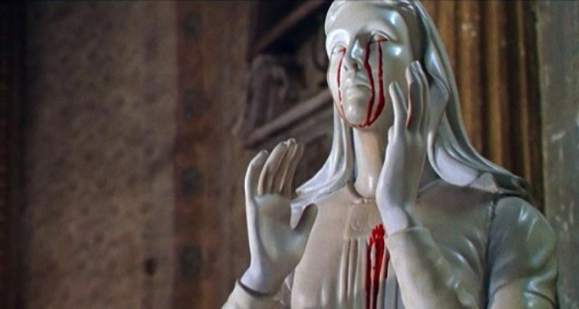
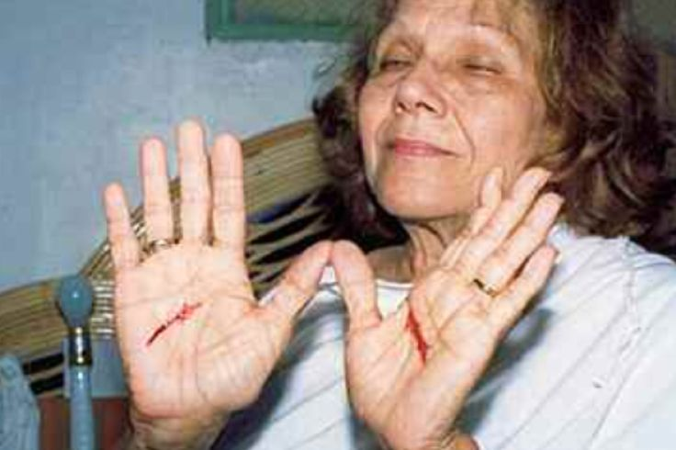
Study or Be Diligent?
The word "damned", "damnation" is NOT in the NKJV, They make it "much clearer" by replacing it with "condemn" (agreeing with NIV, RSV, NRSV, NASV). They make things “clearer” by removing the word “study” from 2 Tim. 2:15 (agreeing with modern translations) “Be diligent to present yourself approved to God, a worker who does not need to be ashamed, rightly dividing the word of truth.”

Slide 25
The Results….
The NKJV:
Has not united the English speaking world
Has had no revival movements of value, the world has plunged deeper into darkness with acceptance of it
Does not help readers be grounded in the faith through study but leaves them at the mercy of their pastors and priests
Does not dismantle Romanism but is aiding in the ecumenical movement
Ellen White would have rejected this Bible as she did the other translations

Slide 26
It Appears This Statement is True!
“God hath from the beginning chosen you to salvation,” the apostle Paul writes, “through sanctification of the Spirit and belief of the truth,” 2 Thessalonians 2:13. In this text the two agencies in the work of salvation are revealed—the divine influence, and the strong, living faith of those who follow Christ. It is through the sanctification of the Spirit and belief of the truth that we become laborers together with God. Christ waits for the co-operation of His church. He does not design to add a new element of efficiency to His word; He has done His great work in giving His inspiration to the word. The blood of Jesus Christ, the Holy Spirit, the divine word, are ours. The object of all this provision of heaven is before us—the salvation of the souls for whom Christ died; and it depends upon us to lay hold on the promises God has given, and become laborers together with Him. Divine and human agencies must co-operate in the work.”—Counsels to Parents, Teachers, and Students, p. 22

