Slide 1
Money, Money, Money
The Golden Rule

Slide 2
The Keys of This Blood
"In this timely and provocative new book, bestselling author Malachi Martin reveals the untold story behind the Vatican’s role in the collapse of the Iron Curtain, as well as the popes far-reaching assessment of the three-way contest now unfolding among the global powers the Soviet Union. . . the capitalist nations of the West, and the pope’s own universal Roman Church a winner-take-all race against time and each other to establish, maintain, and control the first one-world government that has ever existed on the face of the earth. . . And Martin reveals the pope’s own blueprint for a genuinely geopolitical structure: a one-world government that is both viable and humanly acceptable.“ front flap of book, Keys of This Blood, Malachi Martin, 1990

Slide 3
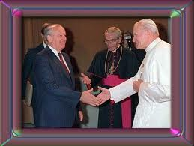
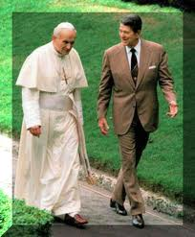
3 Way Race

Slide 4
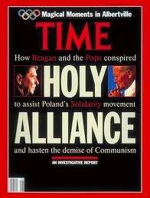
Superpowers Collide
Newsweek magazine reports, "As they watched the collapse of communism in Eastern Europe and Russia, China’s aging leadership became convinced that the man most responsible for the party’s fall from grace was none other than the pope himself. Internal party documents accused him of directing ‘reactionary and subversive’ forces against communists everywhere."

Slide 5
One Down, two to go?
The Soviet Union has disappeared. Still a country, it nevertheless wields little telling power/influence in our world today. Time magazine and the Chinese agree that the man who pulled the strings for its destruction was the Vatican!
That leaves America and the papacy. These are the two powers that Revelation 13 describes as calling the shots at the end of time. However, one of these two is in great danger today economically! The Capitalist West, as Malachi Martin declares, is struggling mightily today. Which one will rule the world in the days before us? Martin says only one will; the Bible says they will do it together with one of them calling the shots! Fasten your seat belts!!

Slide 6
Vatican Call for World Bank
“The Vatican called on Monday for the establishment of a “global public authority” and a “central world bank” to rule over financial institutions that have become outdated and often ineffective in dealing fairly with crises. The document from the Vatican’s Justice and Peace department should please the “Occupy Wall Street” demonstrators and similar movements around the world who have protested against the economic downturn.
“Towards Reforming the International Financial and Monetary Systems in the Context of a Global Public Authority,” was at times very specific, calling, for example, for taxation measures on financial transactions. “The economic and financial crisis which the world is going through calls everyone, individuals and peoples, to examine in depth the principles and the cultural and moral values at the basis of social coexistence,” it said.”
http://www.reuters.com/article/2011/10/24

Slide 7
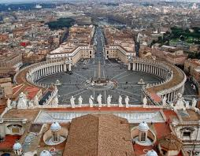
Vatican’s Call
This call came October 24 as the world’s financial fabric continues to unravel. The Vatican says that if something isn’t done, “If no solutions are found to the various forms of injustice, the negative effects that will follow on the social, political and economic level will be destined to create a climate of growing hostility and even violence, and ultimately undermine the very foundations of democratic institutions, even the ones considered most solid,” it said.

Slide 8
The Creator’s of Crisis
“And the merchants of the earth shall weep and mourn over her; for no man buyeth their merchandise any more: The merchandise of gold, and silver, and precious stones, and of pearls, and fine linen, and purple, and silk, and scarlet, and all thyine wood, and all manner vessels of ivory, and all manner vessels of most precious wood, and of brass, and iron, and marble, And cinnamon, and odours, and ointments, and frankincense, and wine, and oil, and fine flour, and wheat, and beasts, and sheep, and horses, and chariots, and slaves, and souls of men. And the fruits that thy soul lusted after are departed from thee, and all things which were dainty and goodly are departed from thee, and thou shalt find them no more at all. The merchants of these things, which were made rich by her, shall stand afar off for the fear of her torment, weeping and wailing, And saying, Alas, alas, that great city, that was clothed in fine linen, and purple, and scarlet, and decked with gold, and precious stones, and pearls!” Revelation 18:11-16

Slide 9
Malachi Martin
Several times Martin repeats Bill Moyers’s finding that "just about a dozen or fifteen individuals made day-by-day decisions that regulated the flow of capital and goods throughout the entire world." Keys of this Blood, p. 326

Slide 10
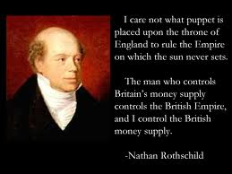
The Most Wealthy of All

Slide 11
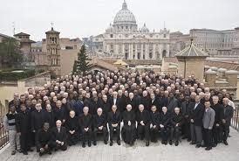
A Step Further
“Aware that the Rothschild’s are an important Jewish family, I looked them up in Encyclopedia Judaica and discovered that they bear the title 'Guardians of the Vatican Treasury.'... The appointment of Rothschild gave the black papacy absolute financial privacy and secrecy. Who would ever search a family of orthodox Jews for the key to the wealth of the Roman Catholic Church?” -- F. Tupper Saussy, Rulers of Evil, Harper-Collins, pp. 160,161.

Slide 12
Papacy Calls for Change
The Papacy is calling for change in the financial fabric of the world. They have created this financial crisis and now they are calling for its fixing. However, few realize that Rome has created the financial crisis in our world today. Now, they came forward with the solution to the world’s financial problems!! This is the Hegelian dialectic. It works simply this way: You want the world to accept something which you know will be difficult for them to accept. So, you create a problem or crisis and when it gets bad enough, you bring forward your solution that you had ready all along!!!

Slide 13
Wait a Minute
The problems are the Wall Street thieves. It is those Rockefeller’s- the Jewish International bankers!! It is Timothy Geithner, Ben Bernanke, and Fanny Mae and Freddie Mac!!
“The common people see and hear the big, noisy wheels of the Southern Confederacy’s cars: they call them Jeff Davis, Lee, Toombs, Beauregard, Semmes, etc., and they honestly think they are the motive power, the first cause of our troubles. But this is a mistake. The true motive power is secreted behind the thick walls of the Vatican, the colleges and schools of the Jesuits, the convents of the nuns and the confessional boxes of Rome. — 50 years in the Church of Rome, Charles Chiniquy, p. 305.

Slide 14
Call for Examination?
“The economic and financial crisis which the world is going through calls everyone, individuals and peoples, to examine in depth the principles and the cultural and moral values at the basis of social coexistence,” it said. Reuter’s News Service

Slide 15
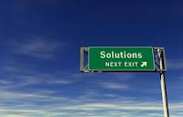
A Solution
“If no solutions are found to the various forms of injustice, the negative effects that will follow on the social, political and economic level will be destined to create a climate of growing hostility and even violence, and ultimately undermine the very foundations of democratic institutions, even the ones considered most solid,”

Slide 16
Return to Prosperity
“The class that have provoked the displeasure of Heaven will charge all their troubles upon those whose obedience to God's commandments is a perpetual reproof to transgressors. It will be declared that men are offending God by the violation of the Sunday sabbath; that this sin has brought calamities which will not cease until Sunday observance shall be strictly enforced; and that those who present the claims of the fourth commandment, thus destroying reverence for Sunday, are troublers of the people, preventing their restoration to divine favor and temporal prosperity…..

Slide 17
…Thus the accusation urged of old against the servant of God will be repeated and upon grounds equally well established: "And it came to pass, when Ahab saw Elijah, that Ahab said unto him, Art thou he that troubleth Israel? And he answered, I have not troubled Israel; but thou, and thy father's house, in that ye have forsaken the commandments of the Lord, and thou hast followed Baalim." 1 Kings 18:17, 18. As the wrath of the people shall be excited by false charges, they will pursue a course toward God's ambassadors very similar to that which apostate Israel pursued toward Elijah.” GC, pg. 590

Slide 18
Is This Revelation 13?!?
“ And he causeth all, both small and great, rich and poor, free and bond, to receive a mark in their right hand, or in their foreheads: And that no man might buy or sell, save he that had the mark, or the name of the beast, or the number of his name.” Revelation 13:16,17

Slide 19
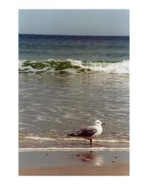
Who to Trust?
Can we trust those who pretend to be god? Can we trust those who claim to have thee answers and have failed so miserably so many times?
Man is untrustworthy. The Lord who reigns on high, who foretold our world 2,000 years ago thru John, is alone trustworthy!!! His word is true!!!

Slide 20
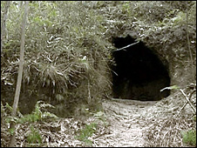
Papacy is doing their job!
What are we doing as the papacy parades thru the earth? What are we doing with the messages God has entrusted to us? Are we hiding in the caves of earth and saying nothing lest we might find consequences for ourselves? Goliath is in the valley: are we in the caves? It is past time to get to work!

