Slide 1
Against All Odds, pt. 3
Jehoshaphat

Slide 2
A Great Multitude!
“It came to pass after this also, that the children of Moab, and the children of Ammon, and with them other beside the Ammonites, came against Jehoshaphat to battle. Then there came some that told Jehoshaphat, saying, There cometh a great multitude against thee from beyond the sea on this side Syria; and, behold, they be in Hazazontamar, which is Engedi. And Jehoshaphat feared, and set himself to seek the LORD, and proclaimed a fast throughout all Judah. And Judah gathered themselves together, to ask help of the LORD: even out of all the cities of Judah they came to seek the LORD. And Jehoshaphat stood in the congregation of Judah and Jerusalem, in the house of the LORD, before the new court,” 2 Chronicles 20:1-5

Slide 3
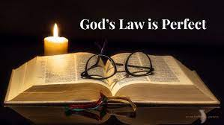
The Secret of his Success!
“To this wise provision for the spiritual needs of his subjects, Jehoshaphat owed much of his prosperity as a ruler. In obedience to God's law there is great gain. In conformity to the divine requirements there is a transforming power that brings peace and good will among men. If the teachings of God's word were made the controlling influence in the life of every man and woman, if mind and heart were brought under its restraining power, the evils that now exist in national and in social life would find no place. From every home would go forth an influence that would make men and women strong in spiritual insight and in moral power, and thus nations and individuals would be placed on vantage ground.” PK, pg. 192

Slide 4
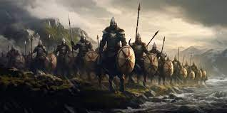
Judah Was Defenseless
“Toward the close of Jehoshaphat's reign the kingdom of Judah was invaded by an army before whose approach the inhabitants of the land had reason to tremble. “The children of Moab, and the children of Ammon, and with them other beside the Ammonites, came against Jehoshaphat to battle.” Tidings of this invasion reached the king through a messenger, who appeared with the startling word, “There cometh a great multitude against thee from beyond the sea on this side Syria: and, behold, they be in Hazazon-tamar, which is Engedi.” 2 Chronicles 20:1, 2. Jehoshaphat was a man of courage and valor. For years he had been strengthening his armies and his fortified cities. He was well prepared to meet almost any foe; yet in this crisis he put not his trust in the arm of flesh. Not by disciplined armies and fenced cities, but by a living faith in the God of Israel, could he hope to gain the victory over these heathen who boasted of their power to humble Judah in the eyes of the nations.” PK, pg. 198

Slide 5
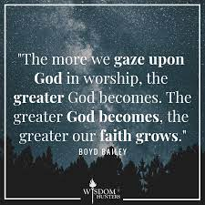
“And said, O LORD God of our fathers, art not thou God in heaven? and rulest not thou over all the kingdoms of the heathen? and in thine hand is there not power and might, so that none is able to withstand thee? Art not thou our God, who didst drive out the inhabitants of this land before thy people Israel, and gavest it to the seed of Abraham thy friend for ever? And they dwelt therein, and have built thee a sanctuary therein for thy name, saying, If, when evil cometh upon us, as the sword, judgment, or pestilence, or famine, we stand before this house, and in thy presence, (for thy name is in this house,) and cry unto thee in our affliction, then thou wilt hear and help. And now, behold, the children of Ammon and Moab and mount Seir, whom thou wouldest not let Israel invade, when they came out of the land of Egypt, but they turned from them, and destroyed them not; Behold, I say, how they reward us, to come to cast us out of thy possession, which thou hast given us to inherit.” 2 Chronicles 20:6-11

Slide 6
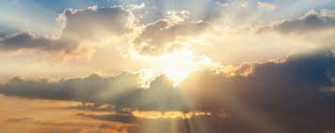
How Mighty You Are!!
1. Are You not King of the Universe?
2. Nothing can stand before You!
3. You are the One who drove out the heathen before us!!
4. How incredibly awesome You are!
5. Those You asked us not to harm are now trying to harm us!

Slide 7

We Are Helpless!!
“O our God, wilt thou not judge them? for we have no might against this great company that cometh against us; neither know we what to do: but our eyes are upon thee. And all Judah stood before the LORD, with their little ones, their wives, and their children.” 2 Chronicles 20:12,13

Slide 8
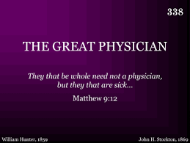
There is something so powerful when a person decides they need help from the Lord!
There is something so invincible as the person who realizes they need God’s help!!
There is nothing more hopeless than the person who thinks they can do things themselves!!
“To wait patiently, to trust when everything looks dark, is the lesson that the leaders in God's work need to learn. Heaven will not fail them in their day of adversity. Nothing is apparently more helpless, yet really more invincible, than the soul that feels its nothingness and relies wholly on God.” PK, pg. 174

Slide 9
Our Great Strength
“Then upon Jahaziel the son of Zechariah, the son of Benaiah, the son of Jeiel, the son of Mattaniah, a Levite of the sons of Asaph, came the Spirit of the LORD in the midst of the congregation; And he said, Hearken ye, all Judah, and ye inhabitants of Jerusalem, and thou king Jehoshaphat, Thus saith the LORD unto you, Be not afraid nor dismayed by reason of this great multitude; for the battle is not yours, but God’s. To morrow go ye down against them: behold, they come up by the cliff of Ziz; and ye shall find them at the end of the brook, before the wilderness of Jeruel. Ye shall not need to fight in this battle: set yourselves, stand ye still, and see the salvation of the LORD with you, O Judah and Jerusalem: fear not, nor be dismayed; to morrow go out against them: for the LORD will be with you.” 2 Chronicles 20:14-17

Slide 10
No Fear!!!
“True, there was no possibility of deliverance unless God Himself should interpose for their release; but having been brought into this position in obedience to the divine direction, Moses felt no fear of the consequences. His calm and assuring reply to the people was, “Fear ye not, stand still, and see the salvation of the Lord, which He will show to you today: for the Egyptians whom ye have seen today, ye shall see them again no more forever. The Lord shall fight for you, and ye shall hold your peace.” PP, Pg. 284

Slide 11
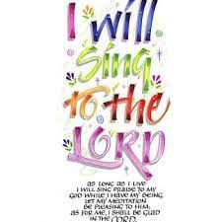
Praise the Lord!!!
“And when he had consulted with the people, he appointed singers unto the LORD, and that should praise the beauty of holiness, as they went out before the army, and to say, Praise the LORD; for his mercy endureth for ever. And when they began to sing and to praise, the LORD set ambushments against the children of Ammon, Moab, and mount Seir, which were come against Judah; and they were smitten. For the children of Ammon and Moab stood up against the inhabitants of mount Seir, utterly to slay and destroy them: and when they had made an end of the inhabitants of Seir, every one helped to destroy another.” 2 Chr. 20:21-23

Slide 12
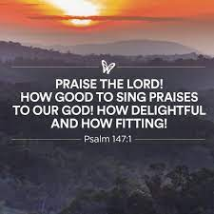
It has power to subdue rude and uncultivated natures; power to quicken thought and to awaken sympathy, to promote harmony of action, and to banish the gloom and foreboding that destroy courage and weaken effort.
It is one of the most effective means of impressing the heart with spiritual truth. How often to the soul hard-pressed and ready to despair, memory recalls some word of God's—the long-forgotten burden of a childhood song,—and temptations lose their power, life takes on new meaning and new purpose, and courage and gladness are imparted to other souls!
The value of song as a means of education should never be lost sight of. Let there be singing in the home, of songs that are sweet and pure, and there will be fewer words of censure and more of cheerfulness and hope and joy. Let there be singing in the school, and the pupils will be drawn closer to God, to their teachers, and to one another.” ED, pg. 168
song has wonderful power. It has power to subdue rude and uncultivated natures; power to quicken thought and to awaken sympathy, to promote harmony of action, and to banish the gloom and foreboding that destroy courage and weaken effort.
It is one of the most effective means of impressing the heart with spiritual truth. How often to the soul hard-pressed and ready to despair, memory recalls some word of God's—the long-forgotten burden of a childhood song,—and temptations lose their power, life takes on new meaning and new purpose, and courage and gladness are imparted to other souls!
Find out more today how to purchase a hardcover copy of Education.
The value of song as a means of education should never be lost sight of. Let there be singing in the home, of songs that are sweet and pure, and there will be fewer words of censure and more of cheerfulness and hope and joy. Let there be singing in the school, and the pupils will be drawn closer to God, to their teachers, and to one another.
song has wonderful power. It has power to subdue rude and uncultivated natures; power to quicken thought and to awaken sympathy, to promote harmony of action, and to banish the gloom and foreboding that destroy courage and weaken effort.
It is one of the most effective means of impressing the heart with spiritual truth. How often to the soul hard-pressed and ready to despair, memory recalls some word of God's—the long-forgotten burden of a childhood song,—and temptations lose their power, life takes on new meaning and new purpose, and courage and gladness are imparted to other souls!
Find out more today how to purchase a hardcover copy of Education.
The value of song as a means of education should never be lost sight of. Let there be singing in the home, of songs that are sweet and pure, and there will be fewer words of censure and more of cheerfulness and hope and joy. Let there be singing in the school, and the pupils will be drawn closer to God, to their teachers, and to one another.

Slide 13
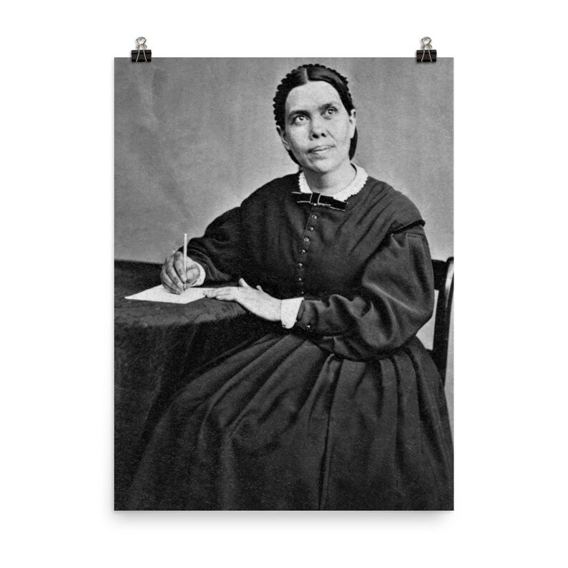
“And they rose early in the morning, and went forth into the wilderness of Tekoa: and as they went forth, Jehoshaphat stood and said, Hear me, O Judah, and ye inhabitants of Jerusalem; Believe in the LORD your God, so shall ye be established; believe his prophets, so shall ye prosper.” 2 Chron. 20:20

Slide 14
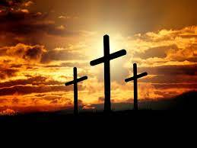
If Christ Were Here Today!!
Jehoshaphat stated a Hebrew parallelism!
Believe in the Lord
Believe His prophets
So shall ye be established
So shall ye prosper
By how we treat the Lord’s appointed messenger reveals how we feel about Christ!! Rejecting the Lord’s messenger is an assault on the Lord!!

