Slide 1
Revelation, chapter 7
Two Groups

Slide 2
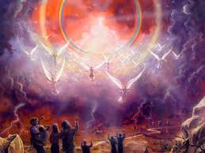
The Question
Rev. 6 ended with a question. “For the great day of his wrath is come; and who shall be able to stand?” verse 17
Not too surprisingly, Rev. 7 answers the question. When Christ comes, who will be standing?

Slide 3
A Brief Interim
“And after these things I saw four angels standing on the four corners of the earth, holding the four winds of the earth, that the wind should not blow on the earth, nor on the sea, nor on any tree. And I saw another angel ascending from the east, having the seal of the living God: and he cried with a loud voice to the four angels, to whom it was given to hurt the earth and the sea, Saying, Hurt not the earth, neither the sea, nor the trees, till we have sealed the servants of our God in their foreheads.” Rev. 7:1-3

Slide 4
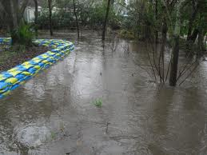
Holding it Back!
The angels:
1. hold back world-wide strife.
2. told to wait till God’s people are sealed.
3. an angel comes from the east with God’s seal. (Dan. 11:44)

Slide 5
The SOP Speaks
“We are standing upon the threshold of great and solemn events. Prophecies are fulfilling. Strange, eventful history is being recorded in the books of heaven. Everything in our world is in agitation. There are wars and rumors of wars. The nations are angry, and the time of the dead has come, that they should be judged. Events are changing to bring about the day of God, which hasteth greatly. Only a moment of time, as it were, yet remains. But while already nation is rising against nation, and kingdom against kingdom, there is not now a general engagement. As yet the four winds are held until the servants of God shall be sealed in their foreheads. Then the powers of earth will marshal their forces for the last great battle.
Satan is busily laying his plans for the last mighty conflict, when all will take sides.” 6 Testimonies, pg. 14

Slide 6
“The nations are now getting angry, but when our High Priest has finished His work in the sanctuary, He will stand up, put on the garments of vengeance, and then the seven last plagues will be poured out. I saw that the four angels would hold the four winds until Jesus' work was done in the sanctuary, and then will come the seven last plagues. These plagues enraged the wicked against the righteous; they thought that we had brought the judgments of God upon them, and that if they could rid the earth of us, the plagues would then be stayed. A decree went forth to slay the saints, which caused them to cry day and night for deliverance. This was the time of Jacob's trouble. Then all the saints cried out with anguish of spirit, and were delivered by the voice of God. The 144,000 triumphed. Their faces were lighted up with the glory of God.

Slide 7
… Then I was shown a company who were howling in agony. On their garments was written in large characters, "Thou art weighed in the balance, and found wanting." I asked who this company were. The angel said, "These are they who have once kept the Sabbath and have given it up." I heard them cry with a loud voice, "We have believed in Thy coming, and taught it with energy." And while they were speaking, their eyes would fall upon their garments and see the writing, and then they would wail aloud.” Early Writings, pgs. 36,37

Slide 8
Seals Authenticate a document
Seals contain three things:
1. Person’s name
2. Person’s title
3. Person’s area of authority.
In order for a document to be legal and binding, it must contain the seal thereby making authentic the document. Without it, the document is void.

Slide 9
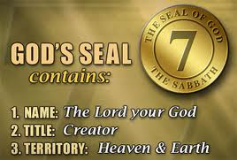
God’s Seal
“Bind up the testimony, seal the law among my disciples.” Isaiah 8:16
The Sabbath contains the seal of God. It is the only commandment that contains all 3 parts of a seal. It points to God as Creator and Sanctifier.
“It points to Him as both the Creator and the Sanctifier. It declares that He who created all things in heaven and in earth, and by whom all things hold together, is the head of the church, and that by His power we are reconciled to God.” DA, pg. 288

Slide 10
The Ones Standing
Rev. 7:4-8 “And I heard the number of them which were sealed: and there were sealed an hundred and forty and four thousand of all the tribes of the children of Israel. Of the tribe of Juda were sealed twelve thousand. Of the tribe of Reuben were sealed twelve thousand. Of the tribe of Gad were sealed twelve thousand. Of the tribe of Aser were sealed twelve thousand. Of the tribe of Nepthalim were sealed twelve thousand. Of the tribe of Manasses were sealed twelve thousand. Of the tribe of Simeon were sealed twelve thousand. Of the tribe of Levi were sealed twelve thousand. Of the tribe of Issachar were sealed twelve thousand. Of the tribe of Zabulon were sealed twelve thousand. Of the tribe of Joseph were sealed twelve thousand. Of the tribe of Benjamin were sealed twelve thousand.”

Slide 11
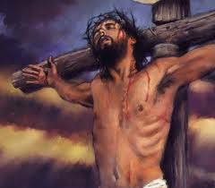
The Greatness of Christ
Christ took, immoral, incestual, cowardly, political, hypocritical, murdererous, wicked men and transformed them by His Amazing Grace! ‘Worthy, worthy is the Lamb that was slain’!! He placed them at the head of the most illustrious people who ever lived! Redeemed!

Slide 12
Summary
1. They have the seal of God which is the Sabbath. (Exodus 20:8-11)
2. They receive this as a sign of Christ’s creative/redeeming power. (Genesis 2:1-3, Ezekiel 20:12)
3. They are spiritual Jews. They follow Christ as did Abraham. (Galatians 3:26-29, Romans 2:28,29)

Slide 13
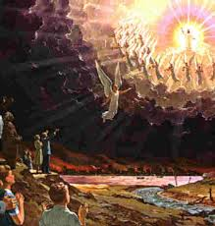
Standing When Christ Comes
144,00 in number, (EW, pg. 15) having never died, having gone thru the 7 last plagues, lived in the sight of God without a mediator, will go to heaven without ever dying. “And they sung as it were a new song before the throne, and before the four beasts, and the elders: and no man could learn that song but the hundred and forty and four thousand, which were redeemed from the earth.” Rev. 14:3

Slide 14
Clear Enough!
“Others rashly denied the light behind them and said that it was not God that had led them out so far. The light behind them went out, leaving their feet in perfect darkness, and they stumbled and lost sight of the mark and of Jesus, and fell off the path down into the dark and wicked world below. Soon we heard the voice of God like many waters, which gave us the day and hour of Jesus' coming. The living saints, 144,000 in number, knew and understood the voice, while the wicked thought it was thunder and an earthquake. When God spoke the time, He poured upon us the Holy Ghost, and our faces began to light up and shine with the glory of God, as Moses' did when he came down from Mount Sinai.” EW, pg. 15

Slide 15
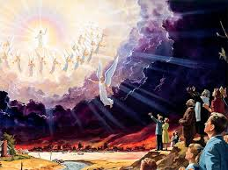
Answering the Call
Revelation 6 ended with the question, “For the great day of his wrath is come; and who shall be able to stand?” verse 17 The answer has now been made very clear; those who will be standing when Christ comes will be the 144,000!

Slide 16
Clarification
The special resurrection people
The 144,000
1. They never die.
2. They go thru the 7 last plagues.
3. They are given the latter rain to help them go thru the last plagues.
1. They die in the faith of the 3rd angels message.
2. They are resurrected toward the end of the plagues.
3. Some of them have received the latter rain, but they are martyred before the plagues start.

Slide 17
Beyond the 144,000
“After this I beheld, and, lo, a great multitude, which no man could number, of all nations, and kindreds, and people, and tongues, stood before the throne, and before the Lamb, clothed with white robes, and palms in their hands; And cried with a loud voice, saying, Salvation to our God which sitteth upon the throne, and unto the Lamb. And all the angels stood round about the throne, and about the elders and the four beasts, and fell before the throne on their faces, and worshipped God, Saying, Amen: Blessing, and glory, and wisdom, and thanksgiving, and honour, and power, and might, be unto our God for ever and ever. Amen. And one of the elders answered, saying unto me, What are these which are arrayed in white robes? and whence came they? And I said unto him, Sir, thou knowest. And he said to me, These are they which came out of great tribulation, and have washed their robes, and made them white in the blood of the Lamb. Therefore are they before the throne of God, and serve him day and night in his temple: and he that sitteth on the throne shall dwell among them. They shall hunger no more, neither thirst any more; neither shall the sun light on them, nor any heat. For the Lamb which is in the midst of the throne shall feed them, and shall lead them unto living fountains of waters: and God shall wipe away all tears from their eyes.” Rev. 7:9-17

Slide 18
Identified
“Nearest the throne are those who were once zealous in the cause of Satan, but who, plucked as brands from the burning, have followed their Savior with deep, intense devotion. Next are those who perfected Christian characters in the midst of falsehood and infidelity, those who honored the law of God when the Christian world declared it void, and the millions, of all ages, who were martyred for their faith. And beyond is the "great multitude, which no man could number, of all nations, and kindreds, and people, and tongues, . . . before the throne, and before the Lamb, clothed with white robes, and palms in their hands." Revelation 7:9. Their warfare is ended, their victory won. They have run the race and reached the prize. The palm branch in their hands is a symbol of their triumph, the white robe an emblem of the spotless righteousness of Christ which now is theirs.” GC, pg. 665

Slide 19
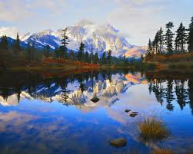
The Moses People
The great multitude;
1. those who died believing and following Christ.
2. those who come forth from the grave around Christ’s coming.
3. they rise to meet Christ in the air.
Praise be to God!

