Slide 1
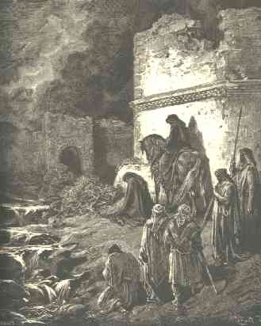
The Analysis
“And I went out by night by the gate of the valley, even before the dragon well, and to the dung port, and viewed the walls of Jerusalem, which were broken down, and the gates thereof were consumed with fire. Then I went on to the gate of the fountain, and to the king's pool: but there was no place for the beast that was under me to pass. Then went I up in the night by the brook, and viewed the wall, and turned back, and entered by the gate of the valley, and so returned.” Nehemiah 2:13-15

Slide 2
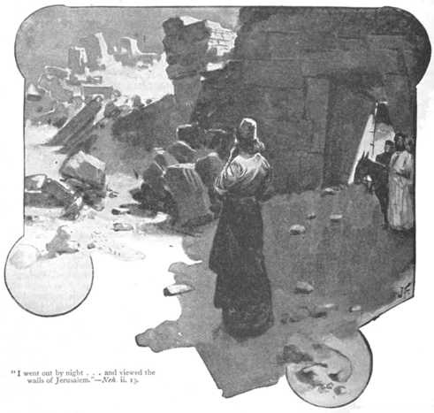
The Helpers
“Then said I unto them, Ye see the distress that we are in, how Jerusalem lieth waste, and the gates thereof are burned with fire: come, and let us build up the wall of Jerusalem, that we be no more a reproach. Then I told them of the hand of my God which was good upon me; as also the king's words that he had spoken unto me. And they said, Let us rise up and build. So they strengthened their hands for this good work.”
Nehemiah 2:17,18

Slide 3
The Slothful
“And next unto them the Tekoites repaired; but their nobles put not their necks to the work of their Lord.” Nehemiah 2:5
“majority of the princes and rulers of Israel came up nobly to their duty, and these faithful men have honorable mention in the book of God. There were a few, the Tekoite nobles, who "put not their necks to the work of their Lord." The memory of these slothful servants is branded with shame and has been handed down as a warning to all future generations. In every religious movement there are some who, while they cannot deny that the cause is God's, still hold themselves aloof, refusing to make any effort to help. It were well for such ones to remember the record kept on high--that book in which there are no omissions, no mistakes, and out of which they will be judged. There every neglected opportunity to do service for God is recorded; and there, too, every deed of faith and love is held in everlasting remembrance. “ PK, pgs. 638,639

Slide 4
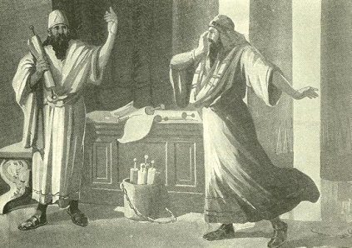
The Enemies
“When Sanballat the Horonite, and Tobiah the servant, the Ammonite, heard of it, it grieved them exceedingly that there was come a man to seek the welfare of the children of Israel.”… “they laughed us to scorn, and despised us, and said, What is this thing that ye do? will ye rebel against the king? Then answered I them, and said unto them, The God of heaven, he will prosper us; therefore we his servants will arise and build: but ye have no portion, nor right, nor memorial, in Jerusalem.” Nehemiah 2:10,19,20

Slide 5
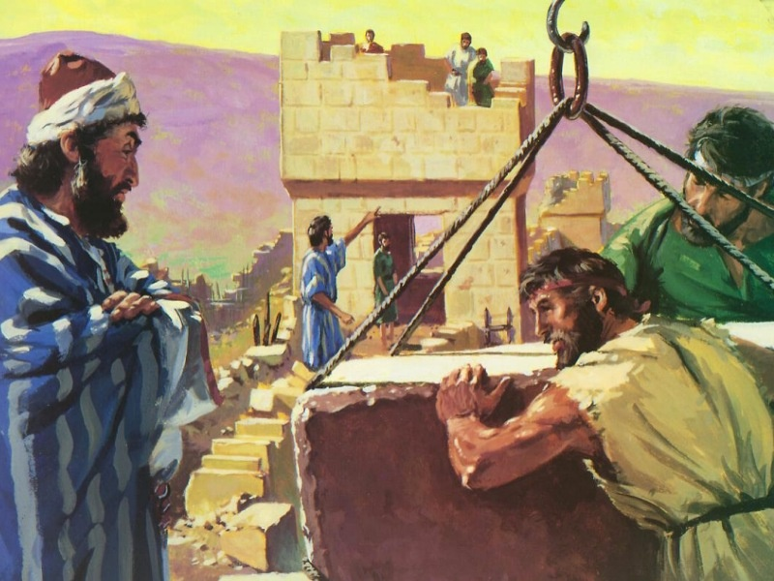
The Builders and Repairers
Nehemiah chapter 3 is all about doing the work of restoring the wall around Jerusalem. 37 times or so, the chapter refers to repairs and 7 or so to building the wall. They had a job to do and were doing it!!

Slide 6
The Assault
But it came to pass, that when Sanballat heard that we builded the wall, he was wroth, and took great indignation, and mocked the Jews. And he spake before his brethren and the army of Samaria, and said, What do these feeble Jews? will they fortify themselves? will they sacrifice? will they make an end in a day? will they revive the stones out of the heaps of the rubbish which are burned? Now Tobiah the Ammonite was by him, and he said, Even that which they build, if a fox go up, he shall even break down their stone wall. Hear, O our God; for we are despised: and turn their reproach upon

Slide 7
…their own head, and give them for a prey in the land of captivity: And cover not their iniquity, and let not their sin be blotted out from before thee: for they have provoked thee to anger before the builders. So built we the wall; and all the wall was joined together unto the half thereof: for the people had a mind to work. But it came to pass, that when Sanballat, and Tobiah, and the Arabians, and the Ammonites, and the Ashdodites, heard that the walls of Jerusalem were made up, and that the breaches began to be stopped, then they were very wroth, And conspired all of them together to come and to fight against Jerusalem, and to hinder it.” Nehemiah 4:1-8

Slide 8
The Attack
“But the restoration of the defenses of Jerusalem did not go forward unhindered. Satan was working to stir up opposition and bring discouragement. Sanballat, Tobiah, and Geshem, his principal agents in this movement, now set themselves to hinder the work of rebuilding. They endeavored to cause division among the workmen. They ridiculed the efforts of the builders, declaring the enterprise an impossibility and predicting failure.…

Slide 9
They were compelled to guard continually against the plots of their adversaries, who, professing friendliness, sought in various ways to cause confusion and perplexity, and to arouse distrust. They endeavored to destroy the courage of the Jews; they formed conspiracies to draw Nehemiah into their toils; and falsehearted Jews were found ready to aid the treacherous undertaking.” PK, pgs. 641,642

Slide 10
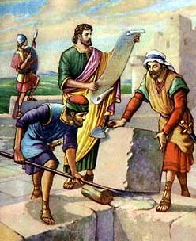
The Paralysis of Fear
“Therefore set I in the lower places behind the wall, and on the higher places, I even set the people after their families with their swords, their spears, and their bows. And I looked, and rose up, and said unto the nobles, and to the rulers, and to the rest of the people, Be not ye afraid of them: remember the Lord, which is great and terrible, and fight for your brethren, your sons, and your daughters, your wives, and your houses.” Nehemiah 4:13,14

Slide 11
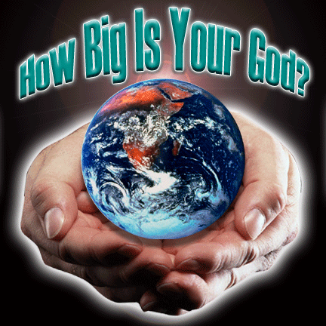
The Banishment of Fear
“…remember the Lord, which is great and terrible…” “Fear thou not; for I am with thee: be not dismayed; for I am thy God: I will strengthen thee; yea, I will help thee; yea, I will uphold thee with the right hand of my righteousness.” “For I the LORD thy God will hold thy right hand, saying unto thee, Fear not; I will help thee.” Isaiah 41:10,13

Slide 12
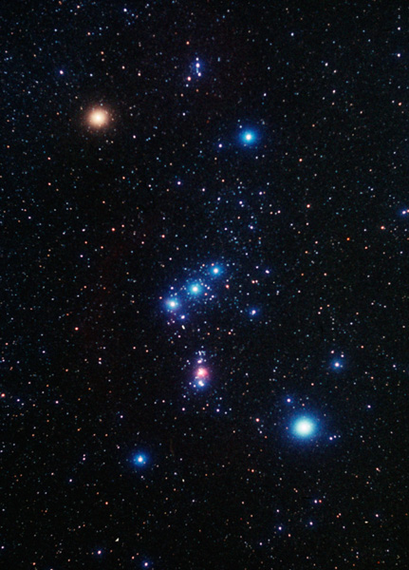
Orion
“When I consider thy heavens, the work of thy fingers, the moon and the stars, which thou hast ordained; What is man, that thou art mindful of him? and the son of man, that thou visitest him?” Psalm 8:3,4

Slide 13
The Distractions
“Now it came to pass, when Sanballat, and Tobiah, and Geshem the Arabian, and the rest of our enemies, heard that I had builded the wall, and that there was no breach left therein; (though at that time I had not set up the doors upon the gates;) That Sanballat and Geshem sent unto me, saying, Come, let us meet together in some one of the villages in the plain of Ono. But they thought to do me mischief. And I sent messengers unto them, saying, I am doing a great work, so that I cannot come down: why should the work cease, whilst I leave it, and come down to you? Yet they sent unto me four times after this sort; and I answered them after the same manner. Then sent Sanballat his servant unto me in like manner the fifth time with an open letter in his hand;

Slide 14
Wherein was written, It is reported among the heathen, and Gashmu saith it, that thou and the Jews think to rebel: for which cause thou buildest the wall, that thou mayest be their king, according to these words. And thou hast also appointed prophets to preach of thee at Jerusalem, saying, There is a king in Judah: and now shall it be reported to the king according to these words. Come now therefore, and let us take counsel together. Then I sent unto him, saying, There are no such things done as thou sayest, but thou feignest them out of thine own heart. For they all made us afraid, saying, Their hands shall be weakened from the work, that it be not done. Now therefore, O God, strengthen my hands. Afterward I came unto the house of Shemaiah the son of Delaiah the son of Mehetabeel, who was shut up; and he said, Let us meet together in the house of God, within the temple, and let us shut the doors of the temple: for they will come to slay thee; yea, in the night will they come to slay thee.” Nehemiah 6:1-10

Slide 15
The Conspiracy
“Sanballat and his confederates dared not make open war upon the Jews; but with increasing malice they continued their secret efforts to discourage, perplex, and injure them. The wall about Jerusalem was rapidly approaching completion. When it should be finished and its gates set up, these enemies of Israel could not hope to force an entrance into the city. They were the more eager, therefore, to stop the work without further delay. At last they devised a plan by which they hoped to draw Nehemiah from his station, and while they had him in their power, to kill or imprison him.
Pretending to desire a compromise of the opposing parties, they sought a conference with Nehemiah, and invited him to meet them in a village on the plain on Ono.” PK, pg.653

Slide 16
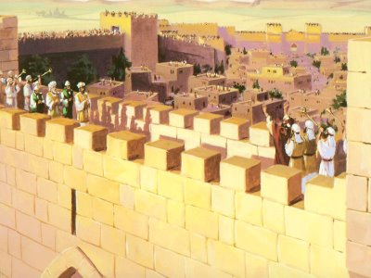
The Victory
“So the wall was finished in the twenty and fifth day of the month Elul, in fifty and two days. “ Nehemiah 6:15 The work was completed; God’s people were now safe within the wall of Jerusalem!!!

Slide 17
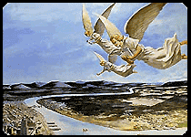
The Work/Wall Today
“These three angels represent the people who accept the light of God's messages, and go forth as His agents to sound the warning throughout the length and breadth of the earth. Christ declared to His followers, "Ye are the light of the world." To every soul that accepts Jesus, the cross of Calvary speaks: "Behold the worth of the soul. 'Go ye into all the world, and preach the Gospel to every creature.'" Nothing is to be permitted to hinder this work. It is the all-important work for this time, and it is to be far-reaching as eternity. “{ST, January 25, 1910 par. 5}

Slide 18
The Cleaver
“In this day, God has called His church, as He called ancient Israel, to stand as a light in the earth. By the mighty cleaver of truth,--the messages of the first, second, and third angels,--He has separated a people from the churches and from the world, to bring them into a sacred nearness to Himself. He has made them the depositories of His law, and has committed to them the great truths of prophecy for this time. Like the holy oracles committed to ancient Israel, these are a sacred trust to be communicated to the world. “ST, January 25, 1910 par. 11

Slide 19

This/ Not This

Slide 20
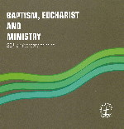
Ecumenical Union Since 1982

Slide 21
The Messages
1. The sum and substance of the messages is total submission to Jesus Christ that leads to honoring all of His commandments.
2. The investigative judgment began in 1844.
3. True worship vs. false worship is the marquee issue in these messages.
A. True worship is honoring God’s commandments/ false worship is honoring man-made traditions.

Slide 22
Continued
B. The commandment that reveals God as the Creator/Sanctifier is the 7th day Sabbath, or Saturday.
C. The tradition of the beast is the Sunday tradition which represents rebellion/doing things our way, against God.
4. Maintaining solid health keeps our minds clear to discern God’s voice and truth and to detect and resist lies/evil.

Slide 23
Unheard Today -Politically Incorrect!
5. Babylon! falls around 1844. She represents the apostate Protestant churches that rejected the Sabbath and held onto her traditions.
6. The beast is the papacy. Her image is the fallen, apostate Protestant churches. Her mark is Sunday keeping. This is rebellion against God. The result of rejecting God’s truth will be receiving the wrath of God………..

Slide 24
A Mass Mailing to Oregon
4. Priest and pastors in Southern Oregon speak out against mass mailings of Secret Terrorists, calling it hate literature.
5. Pseudo Adventist pastors denounce Secret Terrorists as ‘not in harmony with Adventist teachings’.
Most Adventists today refuse to give the 2nd and 3rd Angels messages because they are not politically correct. Will we build the wall or not?

Slide 25
Building a Wall
“We need Nehemiahs in 1884, who shall arouse the people to see how far they are from God through their transgressions. It is time for the whole Christian world to search the Scriptures for themselves; for in the all pulpits through our land the law of God is made void by precept and example. The papal power has thought to change the law of God by instituting a Sabbath for the world and the Christian church; and this spurious Sabbath is exalted and revered, while the Sabbath of Jehovah is trampled beneath unholy feet. But will the Lord degrade his law to meet the standard of men? Will he accept a man-made institution in place of the Sabbath which he has sanctified and blessed? No; the convenience or profit of men is not to supersede the claims of God; for he is a jealous God. He does not alter his precepts to gratify the desires of the ambitious or the covetous. "Thus saith the Lord" should be sufficient to settle all controversy……………”

Slide 26
The End Result of Rejecting the 2nd and 3rd Angels Messages
“The Lord has a controversy with his professed people in these last days. In this controversy men in responsible positions will take a course directly opposite to that pursued by Nehemiah. They will not only ignore and despise the Sabbath themselves, but they will try to keep it from others by burying it beneath the rubbish of custom and tradition. In churches and in large gatherings in the open air, ministers will urge upon the people the necessity of keeping the first day of the week. There are calamities on sea and land: and these calamities will increase, one disaster following close upon another; and the little band of conscientious Sabbath-keepers will be pointed out as the ones who are bringing the wrath of God upon the world by their disregard of Sunday.” RH, March 18, 1884 par. 8

Slide 27
Restorers of the Breach
“And they that shall be of thee shall build the old waste places: thou shalt raise up the foundations of many generations; and thou shalt be called, The repairer of the breach, The restorer of paths to dwell in. If thou turn away thy foot from the sabbath, from doing thy pleasure on my holy day; and call the sabbath a delight, the holy of the LORD, honourable; and shalt honour him, not doing thine own ways, nor finding thine own pleasure, nor speaking thine own words: Then shalt thou delight thyself in the LORD; and I will cause thee to ride upon the high places of the earth, and feed thee with the heritage of Jacob thy father: for the mouth of the LORD hath spoken it.” Isaiah 58:12-14

