Slide 1
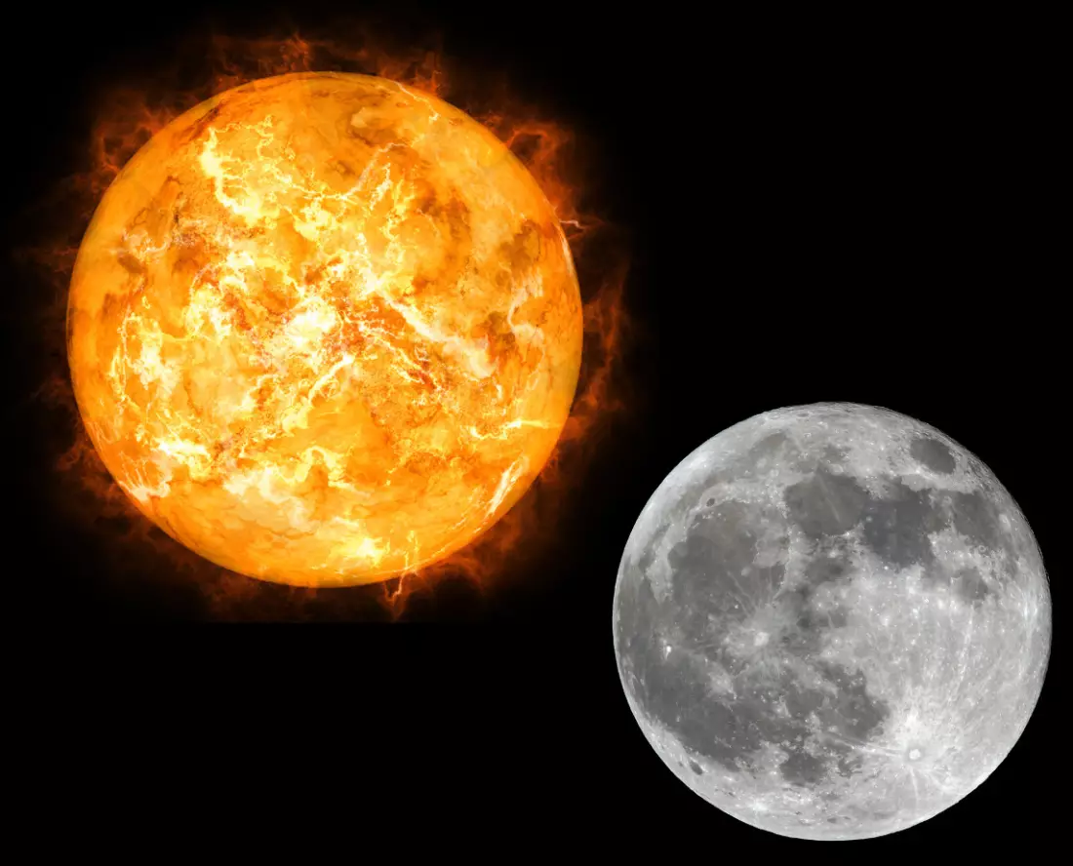
Old Testament Prophecy Meets New Testament Fulfilment
Isaiah 53:10-12 “Yet it pleased the Lord to bruise him; he hath put him to grief: when thou shalt make his soul an offering for sin, he shall see his seed, he shall prolong his days, and the pleasure of the Lord shall prosper in his hand. He shall see of the travail of his soul, and shall be satisfied: by his knowledge shall my righteous servant justify many; for he shall bear their iniquities. Therefore will I divide him a portion with the great, and he shall divide the spoil with the strong; because he hath poured out his soul unto death: and he was numbered with the transgressors; and he bare the sin of many, and made intercession for the transgressors.”
Luke 22:43-44 “Saying, Father, if thou be willing, remove this cup from me: nevertheless not my will, but thine, be done. And there appeared an angel unto him from heaven, strengthening him. And being in an agony he prayed more earnestly: and his sweat was as it were great drops of blood falling down to the ground.”

Slide 2
Frankincense: Memorial and Merits of Christ
Exodus 30:34-36 “And the Lord said unto Moses, Take unto thee sweet spices, stacte, and onycha, and galbanum; these sweet spices with pure frankincense: of each shall there be a like weight: And thou shalt make it a perfume, a confection after the art of the apothecary, tempered together, pure and holy: And thou shalt beat some of it very small, and put of it before the testimony in the tabernacle of the congregation, where I will meet with thee: it shall be unto you most holy.”
All incense from earthly tabernacles must be moist with the cleansing drops of the blood of Christ. He holds before the Father the censer of His own merits, in which there is no taint of earthly corruption. He gathers into this censer the prayers, the praise, and the confessions of His people, and with these He puts His own spotless righteousness. Then, perfumed with the merits of Christ’s propitiation, the incense comes up before God wholly and entirely acceptable. Then gracious answers are returned—Selected Messages 1, p. 344

Slide 3
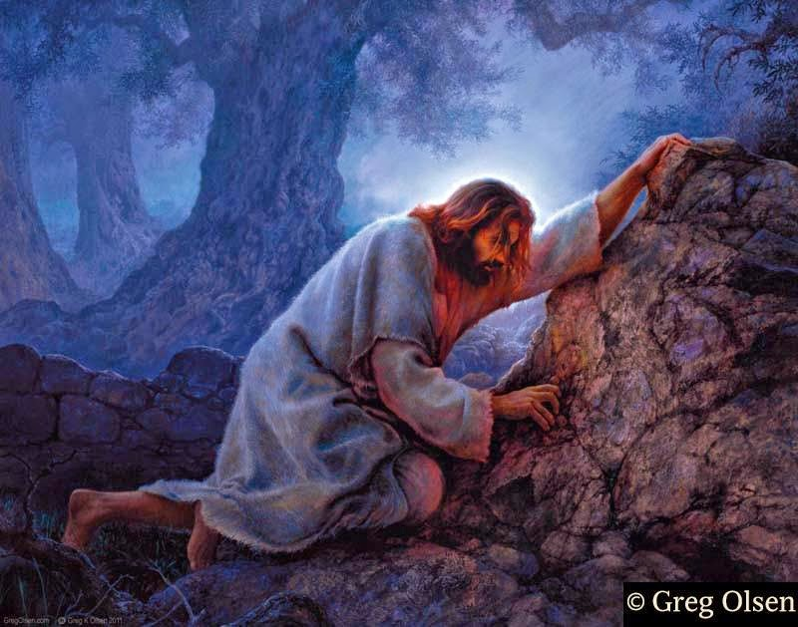
Now We Know…. Sort Of…

Slide 4
The Oil and Merits Were Stripped from Him
“Could mortals view the amazement and sorrow of the angels as they watched in silent grief the Father separating His beams of light, love, and glory, from His Son, they would better understand how offensive is sin in His sight, As the Son of God in the Garden of Gethsemane bowed in the attitude of prayer, the agony of His Spirit forced from His pores sweat like great drops of blood. It was here that the horror of great darkness surrounded Him. The sins of the world were upon Him, He was suffering in man’s stead, as a transgressor of His Father’s law. Here was the scene of temptation. The divine light of God was receding from His vision, and He was passing into the hands of the powers of darkness. In the agony of His soul He lay prostrate on the cold earth, He was realizing His Father’s frown. The cup of suffering Christ had taken from the lips of guilty man, and proposed to drink it Himself, and, in its place, give to man the cup of blessing. The wrath that would have fallen upon man, was now falling upon Christ—Sufferings of Christ, p. 17-18

Slide 5
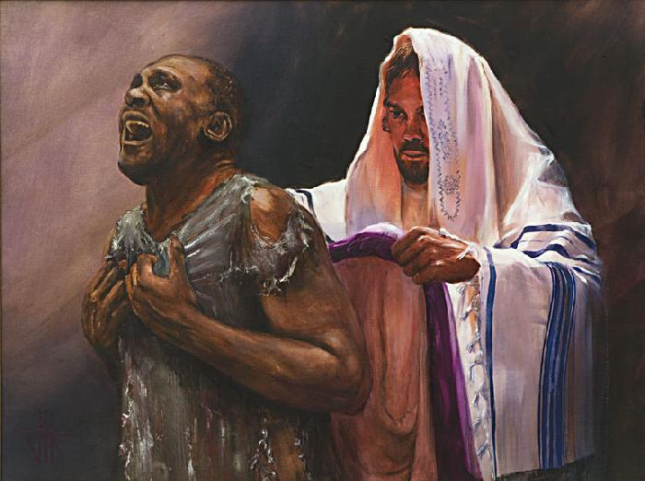
As We Deserved!
“Christ was treated as we deserve, that we might be treated as He deserves. He was condemned for our sins, in which He had no share, that we might be justified by His righteousness, in which we had no share. He suffered the death which was ours, that we might receive the life which was His. ‘With His stripes we are healed”—Desire of Ages, p. 25

Slide 6
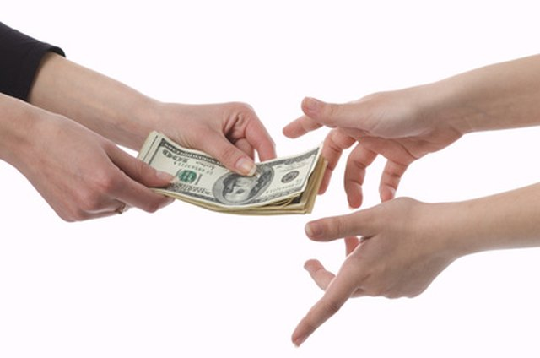
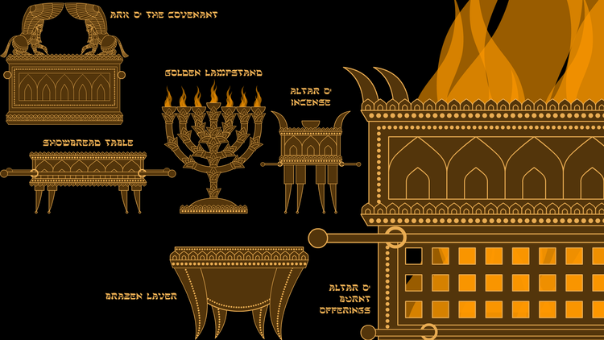
Going Deeper…
Lev. 5:15-16 “If a soul commit a trespass, and sin through ignorance, in the holy things of the Lord; then he shall bring for his trespass unto the Lord a ram without blemish out of the flocks, with thy estimation by shekels of silver, after the shekel of the sanctuary, for a trespass offering. And he shall make amends for the harm that he hath done in the holy thing, and shall add the fifth part thereto, and give it unto the priest: and the priest shall make an atonement for him with the ram of the trespass offering, and it shall be forgiven him.”

Slide 7
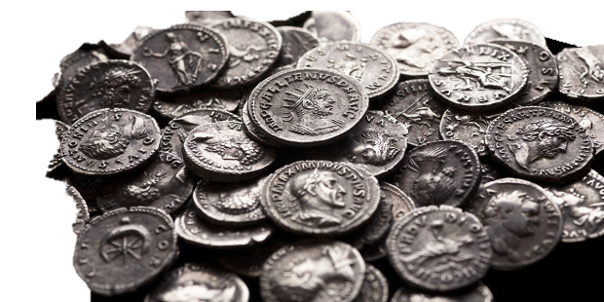
Silver=Redemption Money
Ex. 30:12-16 “When thou takest the sum of the children of Israel after their number, then shall they give every man a ransom for his soul unto the Lord, when thou numberest them; that there be no plague among them, when thou numberest them. This they shall give, every one that passeth among them that are numbered, half a shekel after the shekel of the sanctuary: (a shekel is twenty gerahs: [1/2 oz. or 11 g]) an half shekel shall be the offering of the Lord. Every one that passeth among them that are numbered, from twenty years old and above, shall give an offering unto the Lord. The rich shall not give more, and the poor shall not give less than half a shekel, when they give an offering unto
the Lord, to make an atonement for your souls. And
thou shalt take the atonement money of the
children of Israel, and shalt appoint it for the service
of the tabernacle of the congregation; that it may be
a memorial unto the children of Israel before the
Lord, to make an atonement for your souls.”

Slide 8
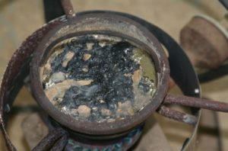
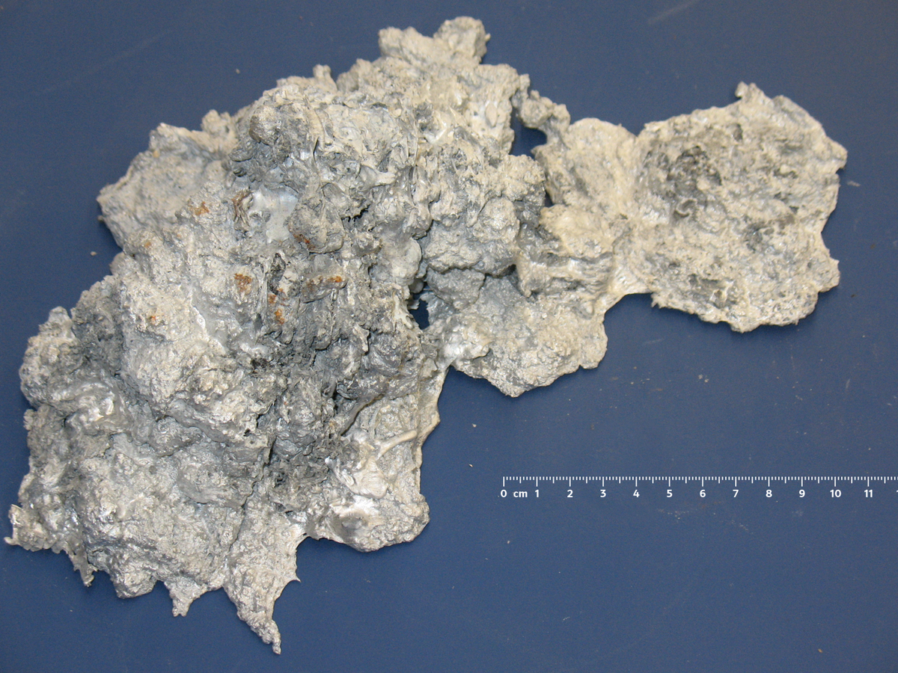
Bad Silver=Disobedience and uncleanness
Jer. 6:27-30 “I have set thee for a tower and a fortress among my people, that thou mayest know and try their way. They are all grievous revolters, walking with slanders: they are brass and iron; they are all corrupters. The bellows are burned, the lead is consumed of the fire; the founder melteth in vain: for the wicked are not plucked away. Reprobate silver shall men call them, because the Lord hath rejected them.”
Good Silver=Obedience and Purity
Prov. 25:4 “Take away the dross from the silver, and there shall come forth a vessel for the finer.”

Slide 9
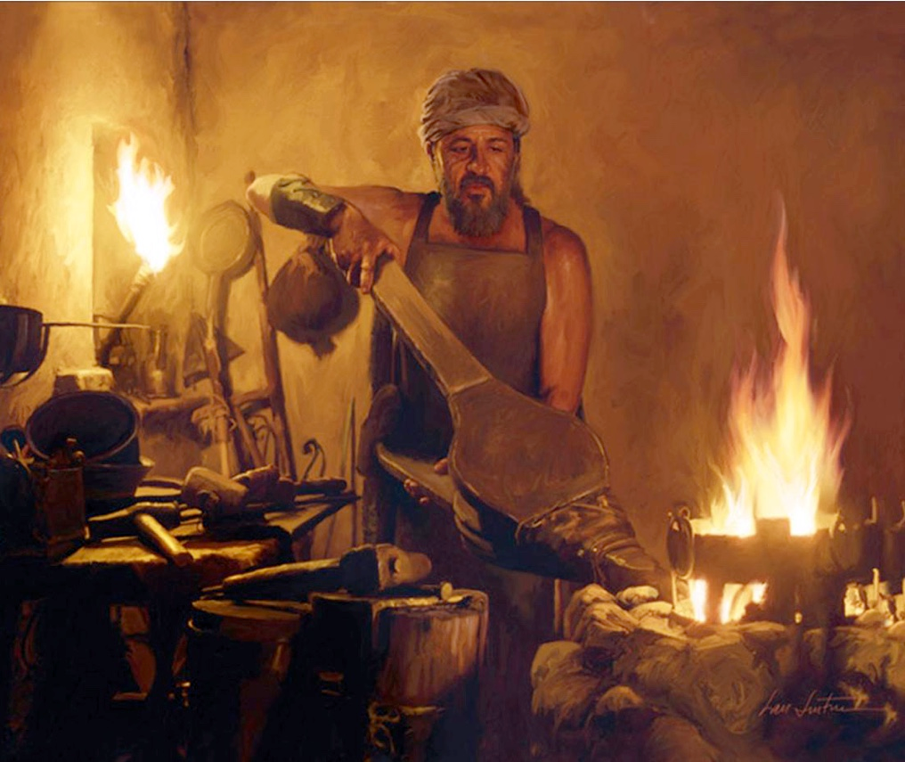
Mal. 3:3 “And he shall sit as a refiner and purifier of silver: and he shall purify the sons of Levi, and purge them as gold and silver, that they may offer unto the LORD an offering in righteousness.”

Slide 10
Adding 20% to our offering restorations!
Lev. 6:2-7 “If a soul sin, and commit a trespass against the Lord, and lie unto his neighbour in that which was delivered him to keep, or in fellowship, or in a thing taken away by violence, or hath deceived his neighbour; Or have found that which was lost, and lieth concerning it, and sweareth falsely; in any of all these that a man doeth, sinning therein: Then it shall be, because he hath sinned, and is guilty, that he shall restore that which he took violently away, or the thing which he hath deceitfully gotten, or that which was delivered him to keep, or the lost thing which he found, Or all that about which he hath sworn falsely; he shall even restore it in the principal, and shall add the fifth part more thereto, and give it unto him to whom it appertaineth, in the day of his trespass offering. And he shall bring his trespass offering unto the Lord, a ram without blemish out of the flock, with thy estimation, for a trespass offering, unto the priest: And the priest shall make an atonement for him before the Lord: and it shall be forgiven him for any thing of all that he hath done in trespassing therein.”

Slide 11
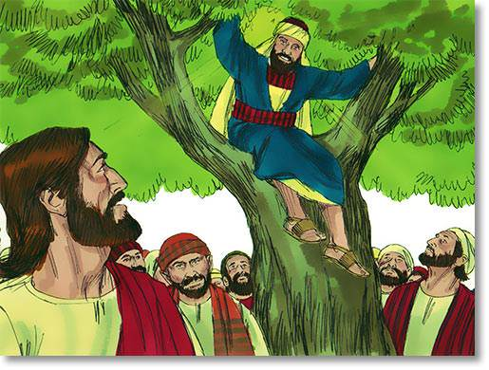
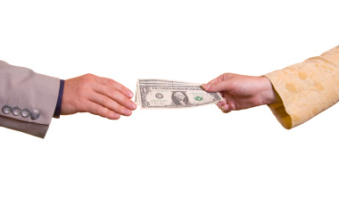
A Biblical Example?
Luke 19:5-9 “And when Jesus came to the place, he looked up, and saw him, and said unto him, Zacchaeus, make haste, and come down; for to day I must abide at thy house. And he made haste, and came down, and received him joyfully. And when they saw it, they all murmured, saying, That he was gone to be guest with a man that is a sinner. And Zacchaeus stood, and said unto the Lord: Behold, Lord, the half of my goods I give to the poor; and if I have taken any thing from any man by false accusation, I restore him fourfold. And Jesus said unto him, This day is salvation come to this house, forsomuch as he also is a son of Abraham.”

