Slide 1
“I Will Not Let YOU Go!!”

Slide 2
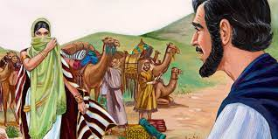
The Consummate Negotiator
He knew how to manipulate situations toward his best interests. He had learned this from his mother, Rebecca. From the get go, Rebecca had told Isaac that the angel had told her, “And the LORD said unto her, Two nations are in thy womb, and two manner of people shall be separated from thy bowels; and the one people shall be stronger than the other people; and the elder shall serve the younger. And when her days to be delivered were fulfilled, behold, there were twins in her womb. And the first came out red, all over like an hairy garment; and they called his name Esau. And after that came his brother out, and his hand took hold on Esau's heel; and his name was called Jacob: and Isaac was threescore years old when she bare them.” Genesis 25:23-26

Slide 3
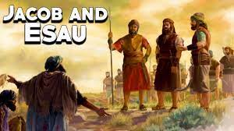
Isaac Just Didn’t Get it!
Isaac was not convinced of this. He felt that Esau should and would get the birthright in spite of the angel's words!
Rebecca tried to help her husband, but he was downright stubborn. “Rebekah remembered the words of the angel, and she read with clearer insight than did her husband the character of their sons. She was convinced that the heritage of divine promise was intended for Jacob. She repeated to Isaac the angel's words; but the father's affections were centered upon the elder son, and he was unshaken in his purpose.” PP, pg. 178

Slide 4
The Indulgent Father!
“Esau grew up loving self-gratification and centering all his interest in the present. Impatient of restraint, he delighted in the wild freedom of the chase, and early chose the life of a hunter. Yet he was the father's favorite. The quiet, peace-loving shepherd was attracted by the daring and vigor of this elder son, who fearlessly ranged over mountain and desert, returning home with game for his father and with exciting accounts of his adventurous life. Jacob, thoughtful, diligent, and care-taking, ever thinking more of the future than the present, was content to dwell at home, occupied in the care of the flocks and the tillage of the soil. His patient perseverance, thrift, and foresight were valued by the mother. His affections were deep and strong, and his gentle, unremitting attentions added far more to her happiness than did the boisterous and occasional kindnesses of Esau. To Rebekah, Jacob was the dearer son.” PP, pg. 177

Slide 5
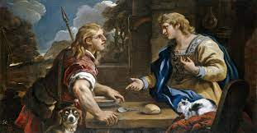
Jacob Would Negotiate
“And Jacob sod pottage: and Esau came from the field, and he was faint: And Esau said to Jacob, Feed me, I pray thee, with that same red pottage; for I am faint: therefore was his name called Edom. And Jacob said, Sell me this day thy birthright. And Esau said, Behold, I am at the point to die: and what profit shall this birthright do to me? And Jacob said, Swear to me this day; and he sware unto him: and he sold his birthright unto Jacob. Then Jacob gave Esau bread and pottage of lentils; and he did eat and drink, and rose up, and went his way: thus Esau despised his birthright.” Genesis 25:29-34

Slide 6
Esau Gave it Away!
“And for a dish of red pottage he parted with his birthright, and confirmed the transaction by an oath. A short time at most would have secured him food in his father's tents, but to satisfy the desire of the moment he carelessly bartered the glorious heritage that God Himself had promised to his fathers. His whole interest was in the present. He was ready to sacrifice the heavenly to the earthly, to exchange a future good for a momentary indulgence.
“Thus Esau despised his birthright.” In disposing of it he felt a sense of relief. Now his way was unobstructed; he could do as he liked. For this wild pleasure, miscalled freedom, how many are still selling their birthright to an inheritance pure and undefiled, eternal in the heavens! Ever subject to mere outward and earthly attractions, Esau took two wives of the daughters of Heth. They were worshipers of false gods, and their idolatry was a bitter grief to Isaac and Rebekah. Esau had violated one of the conditions of the covenant, which forbade intermarriage between the chosen people and the heathen; yet Isaac was still unshaken in his determination to bestow upon him the birthright. The reasoning of Rebekah, Jacob's strong desire for the blessing, and Esau's indifference to its obligations had no effect to change the father's purpose.” PP, pg. 179

Slide 7
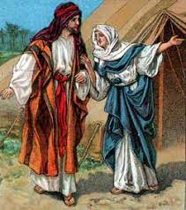
Rebecca and Jacob’s Strategy
“And Rebekah spake unto Jacob her son, saying, Behold, I heard thy father speak unto Esau thy brother, saying, Bring me venison, and make me savoury meat, that I may eat, and bless thee before the LORD before my death. Now therefore, my son, obey my voice according to that which I command thee. Go now to the flock, and fetch me from thence two good kids of the goats; and I will make them savoury meat for thy father, such as he loveth: And thou shalt bring it to thy father, that he may eat, and that he may bless thee before his death. And Jacob said to Rebekah his mother, Behold, Esau my brother is a hairy man, and I am a smooth man: My father peradventure will feel me, and I shall seem to him as a deceiver; and I shall bring a curse upon me, and not a blessing. And his mother said unto him, Upon me be thy curse, my son: only obey my voice, and go fetch me them.” Genesis 27:6-13

Slide 8
Never Saw him Again!!!
“Rebekah divined his purpose. She was confident that it was contrary to what God had revealed as His will. Isaac was in danger of incurring the divine displeasure and of debarring his younger son from the position to which God had called him. She had in vain tried the effect of reasoning with Isaac, and she determined to resort to stratagem…. Jacob and Rebekah succeeded in their purpose, but they gained only trouble and sorrow by their deception. God had declared that Jacob should receive the birthright, and His word would have been fulfilled in His own time had they waited in faith for Him to work for them. But like many who now profess to be children of God, they were unwilling to leave the matter in His hands. Rebekah bitterly repented the wrong counsel she had given her son; it was the means of separating him from her, and she never saw his face again. From the hour when he received the birthright, Jacob was weighed down with self-condemnation. He had sinned against his father, his brother, his own soul, and against God. In one short hour he had made work for a lifelong repentance. This scene was vivid before him in after years, when the wicked course of his sons oppressed his soul.” PP, pg. 180

Slide 9
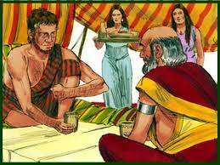
Time to Play with Laban!
“And Jacob loved Rachel; and said, I will serve thee seven years for Rachel thy younger daughter. And Laban said, It is better that I give her to thee, than that I should give her to another man: abide with me. And Jacob served seven years for Rachel; and they seemed unto him but a few days, for the love he had to her. And Jacob said unto Laban, Give me my wife, for my days are fulfilled, that I may go in unto her. And Laban gathered together all the men of the place, and made a feast. And it came to pass in the evening, that he took Leah his daughter, and brought her to him; and he went in unto her. And Laban gave unto his daughter Leah Zilpah his maid for an handmaid. And it came to pass, that in the morning, behold, it was Leah: and he said to Laban, What is this thou hast done unto me? did not I serve with thee for Rachel? wherefore then hast thou beguiled me?” Genesis 29:18-25

Slide 10
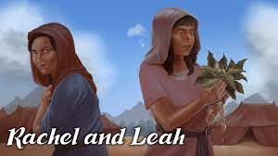
Leah, not Rachel
“But the selfish and grasping Laban, desiring to retain so valuable a helper, practiced a cruel deception in substituting Leah for Rachel. The fact that Leah herself was a party to the cheat, caused Jacob to feel that he could not love her. His indignant rebuke to Laban was met with the offer of Rachel for another seven years’ service. But the father insisted that Leah should not be discarded, since this would bring disgrace upon the family. Jacob was thus placed in a most painful and trying position; he finally decided to retain Leah and marry Rachel. Rachel was ever the one best loved; but his preference for her excited envy and jealousy, and his life was embittered by the rivalry between the sister-wives.” pp, PG. 189

Slide 11
Jacob’s Strategy Wins
“And Laban said unto him, I pray thee, if I have found favour in thine eyes, tarry: for I have learned by experience that the LORD hath blessed me for thy sake. And he said, Appoint me thy wages, and I will give it. And he said unto him, Thou knowest how I have served thee, and how thy cattle was with me. For it was little which thou hadst before I came, and it is now increased unto a multitude; and the LORD hath blessed thee since my coming: and now when shall I provide for mine own house also? And he said, What shall I give thee? And Jacob said, Thou shalt not give me any thing: if thou wilt do this thing for me, I will again feed and keep thy flock: I will pass through all thy flock to day, removing from thence all the speckled and spotted cattle, and all the brown cattle among the sheep, and the spotted and speckled among the goats: and of such shall be my hire. So shall my righteousness answer for me in time to come, when it shall come for my hire before thy face: every one that is not speckled and spotted among the goats, and brown among the sheep, that shall be counted stolen with me.” Genesis 30:27-33

Slide 12
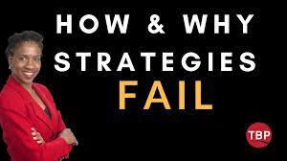
When Strategy Failed!
“And he commanded them, saying, Thus shall ye speak unto my lord Esau; Thy servant Jacob saith thus, I have sojourned with Laban, and stayed there until now: And I have oxen, and asses, flocks, and menservants, and women servants: and I have sent to tell my lord, that I may find grace in thy sight. And the messengers returned to Jacob, saying, We came to thy brother Esau, and also he cometh to meet thee, and four hundred men with him. Then Jacob was greatly afraid and distressed: and he divided the people that was with him, and the flocks, and herds, and the camels, into two bands; And said, If Esau come to the one company, and smite it, then the other company which is left shall escape.” Genesis 32:4-8

Slide 13
“But the servants returned with the tidings that Esau was approaching with four hundred men, and no response was sent to the friendly message. It appeared certain that he was coming to seek revenge. Terror pervaded the camp. “Jacob was greatly afraid and distressed.” He could not go back, and he feared to advance. His company, unarmed and defenseless, were wholly unprepared for a hostile encounter. He accordingly divided them into two bands, so that if one should be attacked, the other might have an opportunity to escape. He sent from his vast flocks generous presents to Esau, with a friendly message. He did all in his power to atone for the wrong to his brother and to avert the threatened danger, and then in humiliation and repentance he pleaded for divine protection: Thou “saidst unto me, Return unto thy country, and to thy kindred, and I will deal well with thee: I am not worthy of the least of all the mercies, and of all the truth, which Thou hast showed unto Thy servant; for with my staff I passed over this Jordan; and now I am become two bands. Deliver me, I pray Thee, from the hand of my brother, from the hand of Esau: for I fear him, lest he will come and smite me, and the mother with the children.” PP, pg. 196

Slide 14
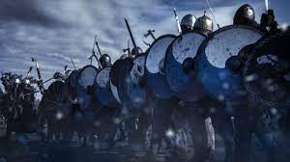
Strategy and Self dependence Wouldn’t Work
“Jesus read the character of His disciples. He knew how sorely their faith was to be tried. In this incident on the sea He desired to reveal to Peter his own weakness,—to show that his safety was in constant dependence upon divine power. Amid the storms of temptation he could walk safely only as in utter self-distrust he should rely upon the Saviour. It was on the point where he thought himself strong that Peter was weak; and not until he discerned his weakness could he realize his need of dependence upon Christ. Had he learned the lesson that Jesus sought to teach him in that experience on the sea, he would not have failed when the great test came upon him. Day by day God instructs His children. By the circumstances of the daily life He is preparing them to act their part upon that wider stage to which His providence has appointed them. It is the issue of the daily test that determines their victory or defeat in life's great crisis.” DA, pg. 382

Slide 15
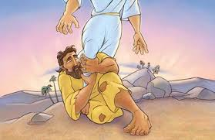
I Will Not Let Thee Go!
“The patriarch was now disabled and suffering the keenest pain, but he would not loosen his hold. All penitent and broken, he clung to the Angel; “he wept, and made supplication” (Hosea 12:4), pleading for a blessing. He must have the assurance that his sin was pardoned. Physical pain was not sufficient to divert his mind from this object. His determination grew stronger, his faith more earnest and persevering, until the very last. The Angel tried to release Himself; He urged, “Let Me go, for the day breaketh;” but Jacob answered, “I will not let Thee go, except Thou bless me.” Had this been a boastful, presumptuous confidence, Jacob would have been instantly destroyed; but his was the assurance of one who confesses his own unworthiness, yet trusts the faithfulness of a covenant-keeping God. Jacob “had power over the Angel, and prevailed.” Hosea 12:4. Through humiliation, repentance, and self-surrender, this sinful, erring mortal prevailed with the Majesty of heaven. He had fastened his trembling grasp upon the promises of God, and the heart of Infinite Love could not turn away the sinner's plea.” PP, pgs. 196,197

Slide 16
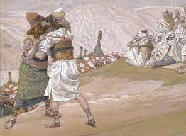
Victory!
“At sight of that crippled sufferer, “Esau ran to meet him, and embraced him, and fell on his neck, and kissed him: and they wept.” As they looked upon the scene, even the hearts of Esau's rude soldiers were touched. Notwithstanding he had told them of his dream, they could not account for the change that had come over their captain. Though they beheld the patriarch's infirmity, they little thought that this his weakness had been made his strength. In his night of anguish beside the Jabbok, when destruction seemed just before him, Jacob had been taught how vain is the help of man, how groundless is all trust in human power. He saw that his only help must come from Him against whom he had so grievously sinned. Helpless and unworthy, he pleaded God's promise of mercy to the repentant sinner. That promise was his assurance that God would pardon and accept him. Sooner might heaven and earth pass than that word could fail; and it was this that sustained him through that fearful conflict.” PP, pg. 198

