Slide 1
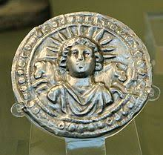
Sun Worship
“During the later periods of Roman history, sun worship gained in importance and ultimately led to what has been called a “solar monotheism.” Nearly all the gods of the period were possessed of solar qualities, and both Christ and Mithra acquired the traits of solar deities. The feast of Sol Invictus (Unconquered Sun) on December 25 was celebrated with great joy, and eventually this date was taken over by the Christians as Christmas, the birthday of Christ.”—Encyclopedia Britannica, “Sun Worship”, https://www.britannica.com/topic/sun-worship

Slide 2
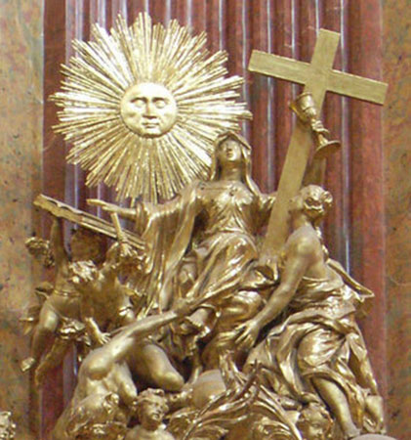
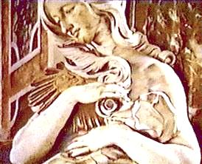

Slide 3
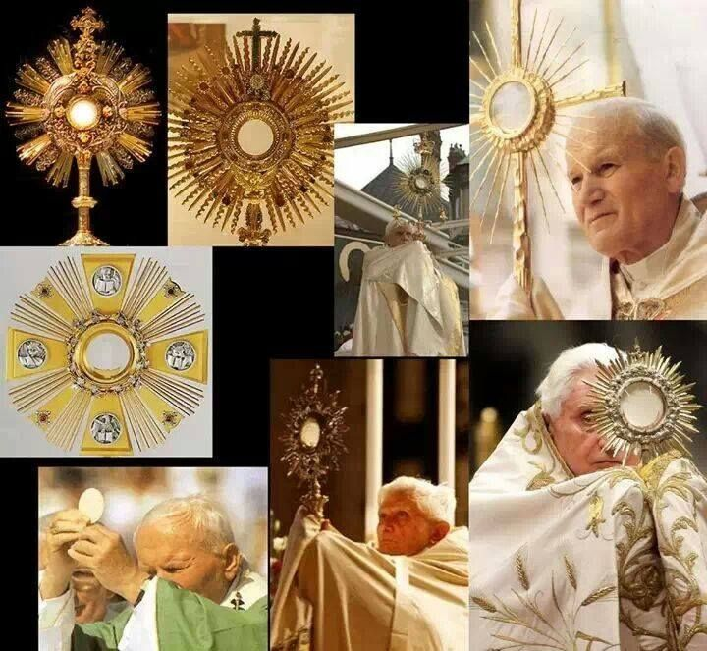
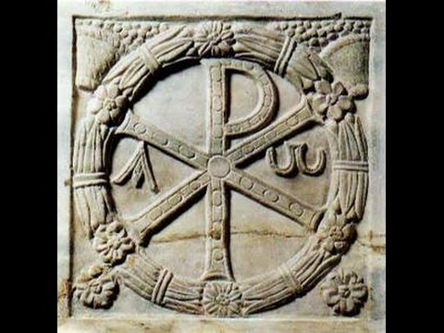
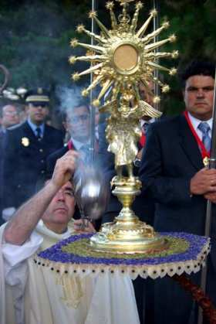
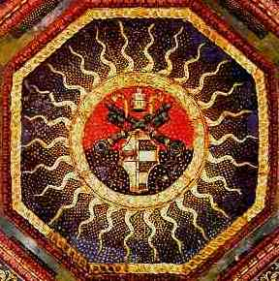

Slide 4
This is NOT a Duck!!

Slide 6
Ancient Roman Empire Catholic Church
Celibate priesthood of Mithra (Semiramis origin) Celibate priests
Civil and religious power Spiritual/Temporal Authority
Conquered then adopted religious customs adopted pagan rites
Authority in priesthood/men/teachers/philosophy tradition equal with Scripture
Sunday worship day Sabbath changed to Sunday
Festivals to pagan gods same dates/festivals now Christianized
Hades Doctrine of Hell
Emperor infallible Pope infallible
Persecuted Christians Persecuted/killed Protestants
Paranoid massacres/terrorism (Nero) St Bartholomew's Day Massacre
Imperial Order Papal Bull
Opposing Emperors (2-3 at one times sometimes) Antipope
Mystics and witchcraft Desert fathers
Emperor was god on earth or became a god after death “Lord God the Pope”

Slide 7
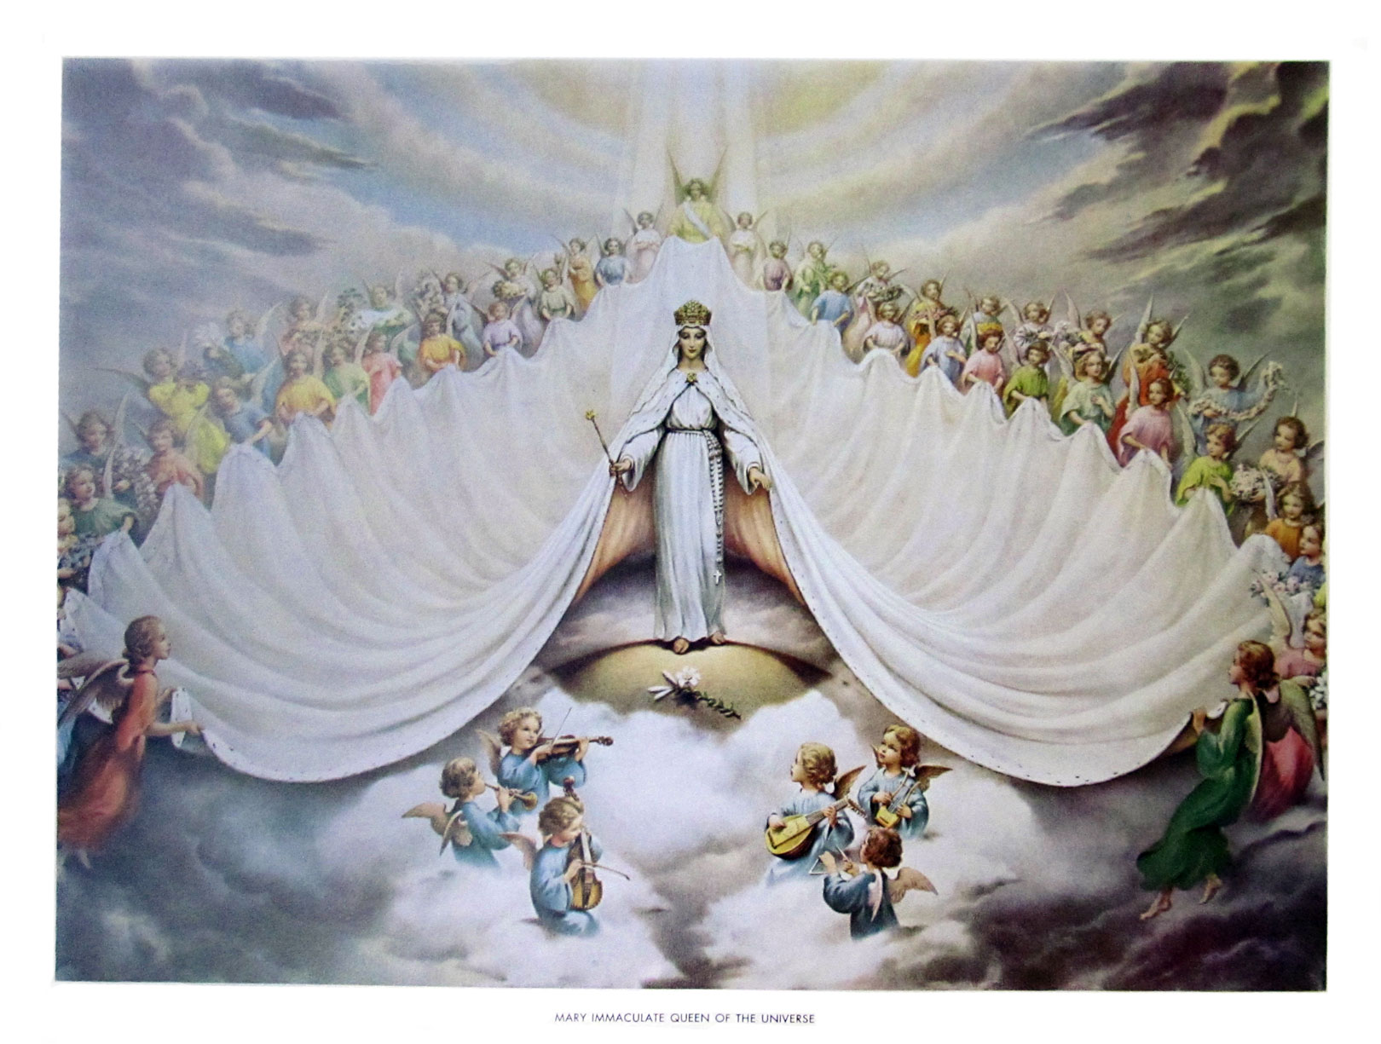
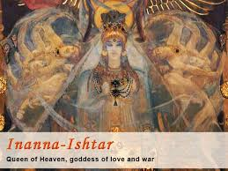
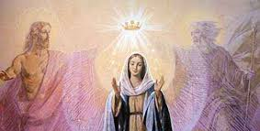
Jer. 7:18 “The children gather wood, and the fathers kindle the fire, and the women knead their dough, to make cakes to the queen of heaven, and to pour out drink offerings unto other gods, that they may provoke me to anger.”
Mary Immaculate Queen of the Universe

Slide 8
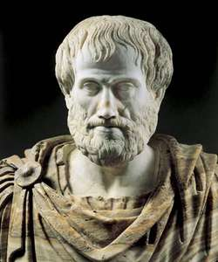
“The missionary history of the Church [Catholic] clearly shows her adaptability to all races, all continents, all nations. In her liturgy and her art, in her tradition and the forming of her doctrine, naturally enough she includes Jewish elements, but also elements that are of pagan origin. In certain respects, she has copied her organization from that of the Roman Empire, has preserved and made fruitful the philosophical intuitions of Socrates, Plato and Aristotle, borrowed from both Barbarians and the Byzantine Roman Empire—but always remains herself, thoroughly digesting all elements drawn from external sources...In her laws, her ceremonies, her festivals and her devotions, she makes use of local customs after purifying them and ‘baptizing’ them.”—Twentieth Century Encyclopedia of Catholicism

Slide 9
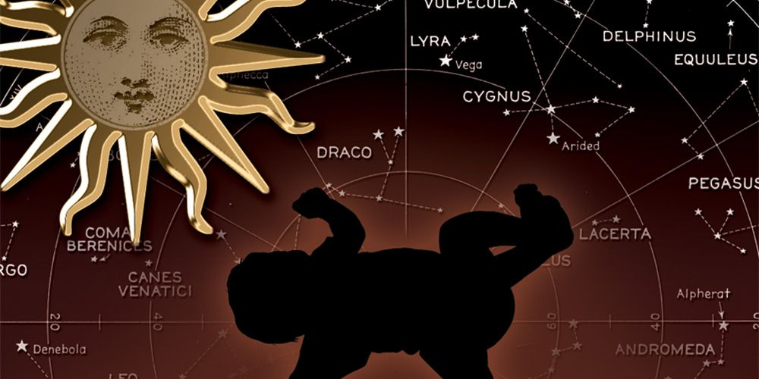

Slide 10
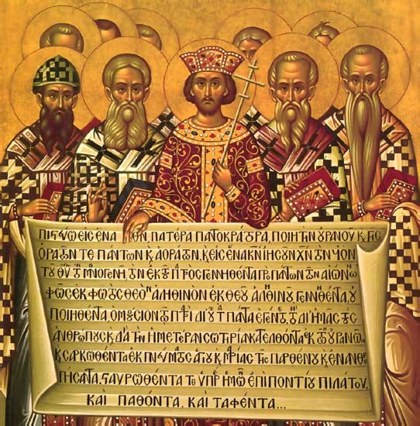
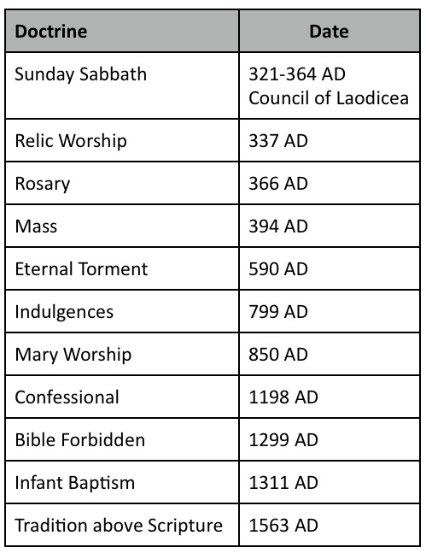
Edict of Milan (313 AD), signed by Constantine legalizes Christianity. Over the years, decades, and centuries, paganism gets absorbed into the fledgling faith.

