Slide 1
Three Wavy Lines/the Lord’s Supper

Slide 2
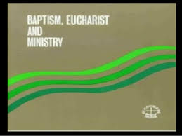

Slide 4
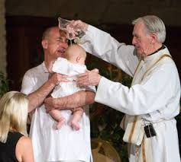
Lima, Peru/January 1982
Lima, Peru, January, 1982. All churches voted to unite together on three beliefs that centered around baptism, the Eucharist, and ministry. Baptism and the Eucharist were what divided Christendom in the 16th, 17th, and 18th centuries. With this agreement, all churches said it did not matter how a person was baptized; sprinkling, while still babies, immersion; all are fine! Many people died during the Reformation who refused to accept baby baptisms and sprinkling!

Slide 5
The List of Churches

Slide 6
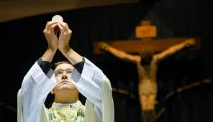
All Agreed on the Eucharist!
How one felt about the Eucharist; whether the priest recreates the Creator in the bread, or Christ is present in the bread by the words (Luther’s consubstantiation), or that the service is purely symbolic; we can believe whatever we want and be united!! How far would we go with this?

Slide 7
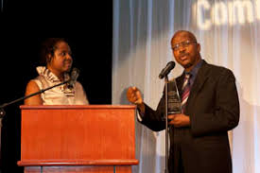
The Review:28 Years Ago
May 2, 1991: No wonder in this issue of the Adventist Review, Roy Adams could declare: “And we could go on if space permitted – to mention the WCC’s… accentuation of the Holy Spirit and the Eucharist. All of these emphases fit into the ambit of the three angels’ messages.”
(The Third Angel’s Message warns that if anyone worships the beast, he will receive the wrath of God poured out without mixture in the seven last plagues. What is the center piece of Catholic worship?–it is the Eucharist.

Slide 8
The Eucharist is in the 3rd Angels’ Message???
“But they also have erred through wine, and through strong drink are out of the way; the priest and the prophet have erred through strong drink, they are swallowed up of wine, they are out of the way through strong drink; they err in vision, they stumble in judgment. For all tables are full of vomit and filthiness, so that there is no place clean. Whom shall he teach knowledge? and whom shall he make to understand doctrine? them that are weaned from the milk, and drawn from the breasts. For precept must be upon precept, precept upon precept; line upon line, line upon line; here a little, and there a little: For with stammering lips and another tongue will he speak to this people.” Isaiah 28:7-11

Slide 9
We owe ALL to Him!
“The ordinances that point to our Lord's humiliation and suffering are regarded too much as a form. They were instituted for a purpose. Our senses need to be quickened to lay hold of the mystery of godliness. It is the privilege of all to comprehend, far more than we do, the expiatory sufferings of Christ. “As Moses lifted up the serpent in the wilderness,” even so has the Son of man been lifted up, “that whosoever believeth in Him should not perish, but have eternal life.” John 3:14, 15. To the cross of Calvary, bearing a dying Savior, we must look. Our eternal interests demand that we show faith in Christ. Our Lord has said, “Except ye eat the flesh of the Son of man, and drink His blood, ye have no life in you.... For My flesh is meat indeed, and My blood is drink indeed.” John 6:53-55. This is true of our physical nature. To the death of Christ we owe even this earthly life. The bread we eat is the purchase of His broken body. The water we drink is bought by His spilled blood. Never one, saint or sinner, eats his daily food, but he is nourished by the body and the blood of Christ. The cross of Calvary is stamped on every loaf. It is reflected in every water spring. All this Christ has taught in appointing the emblems of His great sacrifice. The light shining from that Communion service in the upper chamber makes sacred the provisions for our daily life. The family board becomes as the table of the Lord, and every meal a sacrament….

Slide 10
Symbols!
“And how much more are Christ's words true of our spiritual nature. He declares, “Whoso eateth My flesh, and drinketh My blood, hath eternal life.” It is by receiving the life for us poured out on Calvary's cross, that we can live the life of holiness. And this life we receive by receiving His word, by doing those things which He has commanded. Thus we become one with Him. “He that eateth My flesh,” He says, “and drinketh My blood, dwelleth in Me, and I in him. As the living Father hath sent Me, and I live by the Father: so he that eateth Me, even he shall live by Me.” John 6:54, 56, 57. To the holy Communion this scripture in a special sense applies. As faith contemplates our Lord's great sacrifice, the soul assimilates the spiritual life of Christ. That soul will receive spiritual strength from every Communion. The service forms a living connection by which the believer is bound up with Christ, and thus bound up with the Father. In a special sense it forms a connection between dependent human beings and God.
As we receive the bread and wine symbolizing Christ's broken body and spilled blood, we in imagination join in the scene of Communion in the upper chamber. We seem to be passing through the garden consecrated by the agony of Him who bore the sins of the world. We witness the struggle by which our reconciliation with God was obtained. Christ is set forth crucified among us.” DA, pgs. 660, 661

