Slide 1
They Did Not Know Yet!
Giants Square Off!

Slide 2
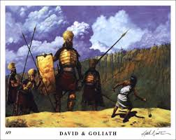

Slide 3
Monstrous
“And there went out a champion out of the camp of the Philistines, named Goliath, of Gath, whose height was six cubits and a span. And he had an helmet of brass upon his head, and he was armed with a coat of mail; and the weight of the coat was five thousand shekels of brass. And he had greaves of brass upon his legs, and a target of brass between his shoulders. And the staff of his spear was like a weaver's beam; and his spear's head weighed six hundred shekels of iron: and one bearing a shield went before him. And he stood and cried unto the armies of Israel, and said unto them, Why are ye come out to set your battle in array? am not I a Philistine, and ye servants to Saul? choose you a man for you, and let him come down to me.” 1 Sam. 17:4-8

Slide 4
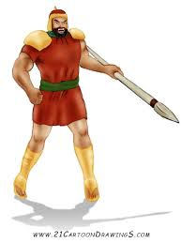
He Let People Know It!
“Goliath, the champion of the Philistines, came forth, and with insulting language defied Israel and challenged them to provide a man from their ranks who would meet him in single combat.” PP, pg. 645
He taunted them and let them know he was powerful!

Slide 5
Running Scared!
“And he stood and cried unto the armies of Israel, and said unto them, Why are ye come out to set your battle in array? am not I a Philistine, and ye servants to Saul? choose you a man for you, and let him come down to me. If he be able to fight with me, and to kill me, then will we be your servants: but if I prevail against him, and kill him, then shall ye be our servants, and serve us. And the Philistine said, I defy the armies of Israel this day; give me a man, that we may fight together. When Saul and all Israel heard those words of the Philistine, they were dismayed, and greatly afraid…. And the Philistine drew near morning and evening, and presented himself forty days.” ! Sam. 17:8-11, 16

Slide 6
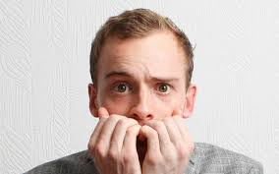
No Giants in Israel!
“The armies of Israel were depressed. Their courage failed. They said one to another, "Have ye seen this man that is come up? surely to defy Israel is he come up.” PP, pg. 645
They were not trusting in the Lord, claiming His promises. They were looking to themselves, depending on their own feebleness!

Slide 7
Along Came ANOTHER Giant!
“And Jesse said unto David his son, Take now for thy brethren an ephah of this parched corn, and these ten loaves, and run to the camp to thy brethren; And carry these ten cheeses unto the captain of their thousand, and look how thy brethren fare, and take their pledge. Now Saul, and they, and all the men of Israel, were in the valley of Elah, fighting with the Philistines. And David rose up early in the morning, and left the sheep with a keeper, and took, and went, as Jesse had commanded him; and he came to the trench, as the host was going forth to the fight, and shouted for the battle. For Israel and the Philistines had put the battle in array, army against army. And David left his carriage in the hand of the keeper of the carriage, and ran into the army, and came and saluted his brethren.” 1 Samuel 17:17-22

Slide 8
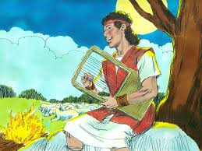
A Powerful Young Man!
“ I will lift up mine eyes unto the hills, from whence cometh my help. My help cometh from the LORD, which made heaven and earth. He will not suffer thy foot to be moved: he that keepeth thee will not slumber. Behold, he that keepeth Israel shall neither slumber nor sleep. The LORD is thy keeper: the LORD is thy shade upon thy right hand.” Ps. 121:1-4

Slide 9
Gaining Strength Each Day!
“God was teaching David lessons of trust. As Moses was trained for his work, so the Lord was fitting the son of Jesse to become the guide of His chosen people. In his watchcare for his flocks, he was gaining an appreciation of the care that the Great Shepherd has for the sheep of His pasture.
The lonely hills and the wild ravines where David wandered with his flocks were the lurking place of beasts of prey. Not infrequently the lion from the thickets by the Jordan, or the bear from his lair among the hills, came, fierce with hunger, to attack the flocks. According to the custom of his time, David was armed only with his sling and shepherd's staff; yet he early gave proof of his strength and courage in protecting his charge.” PP, pg. 644

Slide 10
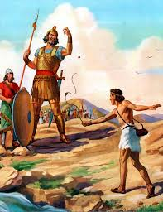
Afraid, but Not Fearful!
The monster was humungous. He was apparently invincible. His very size would cause one to take notice. David saw this, but knew that the LORD was bigger than all monsters! HE was bigger than all ferocious animals!!

Slide 11
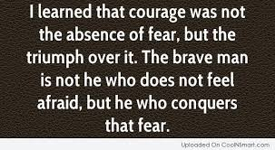

Slide 12
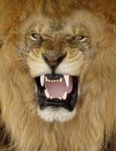
“And David said unto Saul, Thy servant kept his father's sheep, and there came a lion, and a bear, and took a lamb out of the flock: And I went out after him, and smote him, and delivered it out of his mouth: and when he arose against me, I caught him by his beard, and smote him, and slew him. Thy servant slew both the lion and the bear: and this uncircumcised Philistine shall be as one of them, seeing he hath defied the armies of the living God.” 1 Sam. 17:34-36

Slide 13
The Confrontation
“ And the Philistine said unto David, Am I a dog, that thou comest to me with staves? And the Philistine cursed David by his gods. And the Philistine said to David, Come to me, and I will give thy flesh unto the fowls of the air, and to the beasts of the field. Then said David to the Philistine, Thou comest to me with a sword, and with a spear, and with a shield: but I come to thee in the name of the LORD of hosts, the God of the armies of Israel, whom thou hast defied. This day will the LORD deliver thee into mine hand; and I will smite thee, and take thine head from thee; and I will give the carcases of the host of the Philistines this day unto the fowls of the air, and to the wild beasts of the earth; that all the earth may know that there is a God in Israel. And all this assembly shall know that the LORD saveth not with sword and spear: for the battle is the LORD'S, and he will give you into our hands.” 1 Samuel 17:43-47

Slide 14
David was ready to confront the giant because he had confronted other giants and had seen them fall before the power of God. The giants of greed, lust, anger had all fallen before the power of God and he knew this one would fall too! “David said moreover, The LORD that delivered me out of the paw of the lion, and out of the paw of the bear, he will deliver me out of the hand of this Philistine.” v. 37

Slide 15
The Lord of Hosts
The commander of the armies of the universe was taking the field of conflict.
Joshua- “And it came to pass, when Joshua was by Jericho, that he lifted up his eyes and looked, and, behold, there stood a man over against him with his sword drawn in his hand: and Joshua went unto him, and said unto him, Art thou for us, or for our adversaries? And he said, Nay; but as captain of the host of the LORD am I now come.” Josh 5:13-15
Zerrubabel- “Then he answered and spake unto me, saying, This is the word of the LORD unto Zerubbabel, saying, Not by might, nor by power, but by my spirit, saith the LORD of hosts. Who art thou, O great mountain? before Zerubbabel thou shalt become a plain: and he shall bring forth the headstone thereof with shoutings, crying, Grace, grace unto it.” Zechariah 4:6,7
Luther- A Mighty Fortress

Slide 16
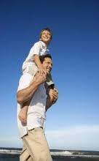
“Cast thy burden upon the LORD, and he shall sustain thee: he shall never suffer the righteous to be moved.” Ps. 55:22
“Casting all your care upon him; for he careth for you.” 1 Peter 5:7

Slide 17
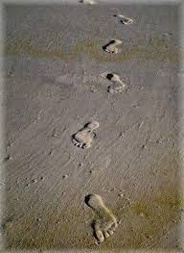
In the toughest times; when it seems like everything is against us, then it is that there is only a single set of footprints in the sand for the Lord is carrying us thru!!

Slide 18

Heaven’s Limitless Power
“I saw the latter rain is coming suddenly, as the midnight cry and with ten times the power.” Ellen White letter, Spalding-Megan Collection, pages 3,4
How powerful was the midnight cry?
“In the parable of Matthew 25 the time of waiting and slumber is followed by the coming of the bridegroom. This was in accordance with the arguments just presented, both from prophecy and from the types. They carried strong conviction of their truthfulness; and the "midnight cry" was heralded by thousands of believers.
Like a tidal wave the movement swept over the land. From city to city, from village to village, and into remote country places it went, until the waiting people of God were fully aroused.” GC, pg. 400

