Slide 1
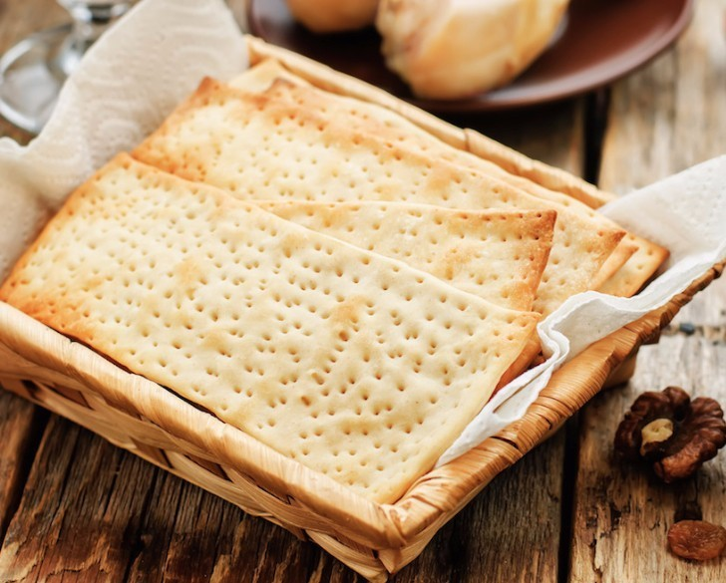
The Sanctuary pt 47: The Feast of Unleavened Bread and the Wave Sheaf

Slide 2
Recap of the Passover
In the last 3 part series on Passover, we learned what took place on the Passover, what it meant to the ancient Israelites, what it means for us today, and it’s prophetic fulfillment in earth’s historythese were some of the highlights:
Passover represented God’s deliverance of His people from Egyptian Bondage, the sacrificial blood of the Lamb was the identifying characteristic between the saved and the condemned. The same truth is spiritually applied today—Christ is the Passover Lamb, the Deliverer from the bondage of sin and unbelief
The Passover Lamb was selected about 3-1/2 days before the Passover, just as Christ was selected as the Lamb, when He was baptized 3-1/2 years (day-year principle) before Calvary
None of the Passover Lambs limbs were broken, He was cooked whole, head to hoof, and spread open over an open fire in a cross like position, just as was Jesus: no bones were broken and His arms were spread wide to take the spiritual fires of Judgment on behalf of us
Passover and the other feasts are not necessary to be physically kept anymore. We now study their spiritual meanings, apply their fruitful lessons and decipher their prophetic fulfillments
Passover was literally replaced with the Communion service—both point to the death of the sacrificial Lamb and Deliverance/Redemption brought on by that act.

Slide 3
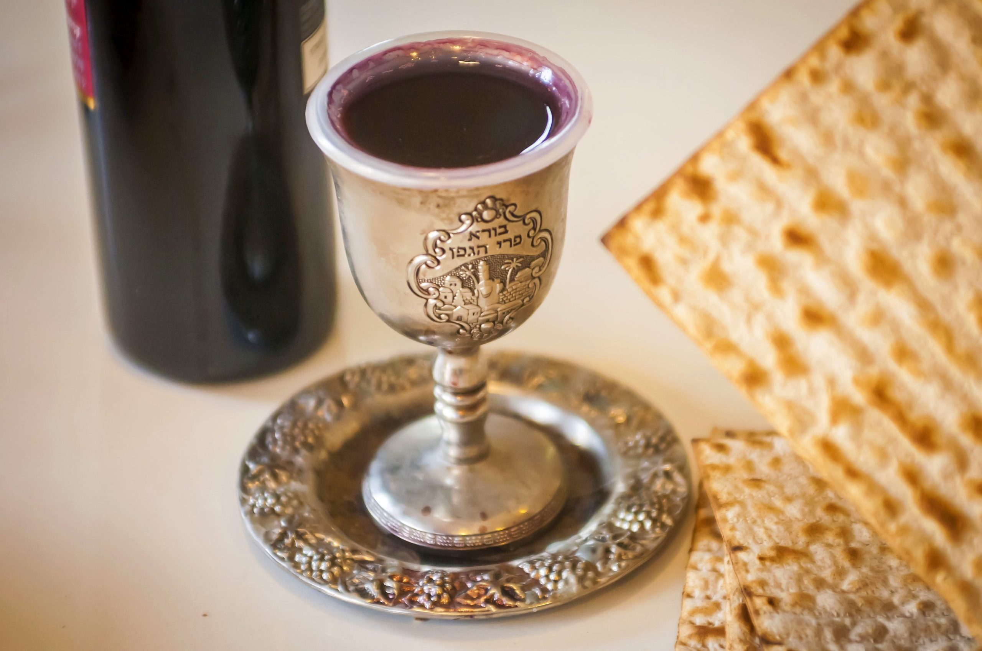
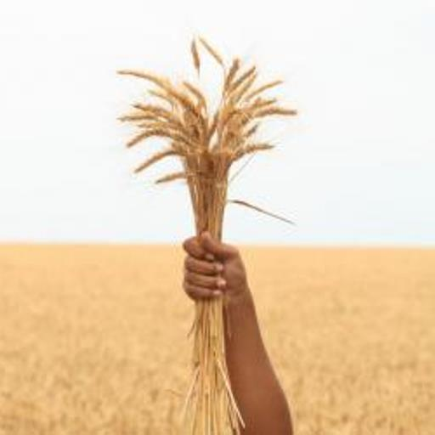
A Follow-up to Passover
The Feast of Unleavened Bread was really a continuation of Passover, and many times the two separate feasts could be identified interchangeably. Example:
Matt. 26:17-19 “Now the first day of the feast of unleavened bread the disciples came to Jesus, saying unto him, Where wilt thou that we prepare for thee to eat the passover? And he said, Go into the city to such a man, and say unto him, The Master saith, My time is at hand; I will keep the passover at thy house with my disciples. And the disciples did as Jesus had appointed them; and they made ready the passover.”
The Feast of Unleavened Bread was a week long feast, where all Israel would only eat of unleavened bread, the 1st day was a holy convocation, or sabbath, while the second day marked the beginning of the spring harvest with the “Wave Sheaf” offering or Firstfruits

Slide 4
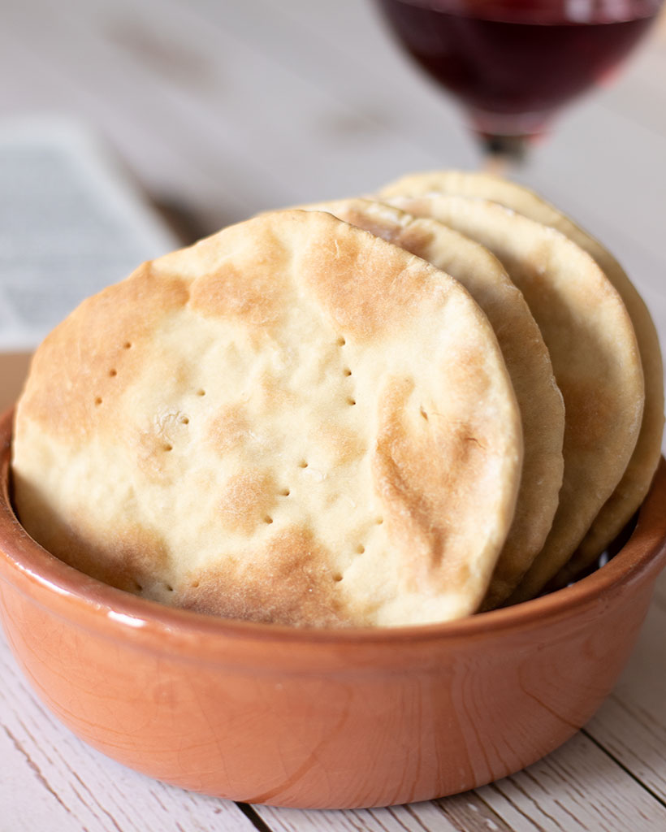
What We Aim to Learn
What Actually Happened During the Feast of Unleavened Bread and Firstfruits
What it meant to the ancient Israelites-literally and spiritually—and what it means for us today
What is the prophetic fulfillment of these feasts

Slide 5
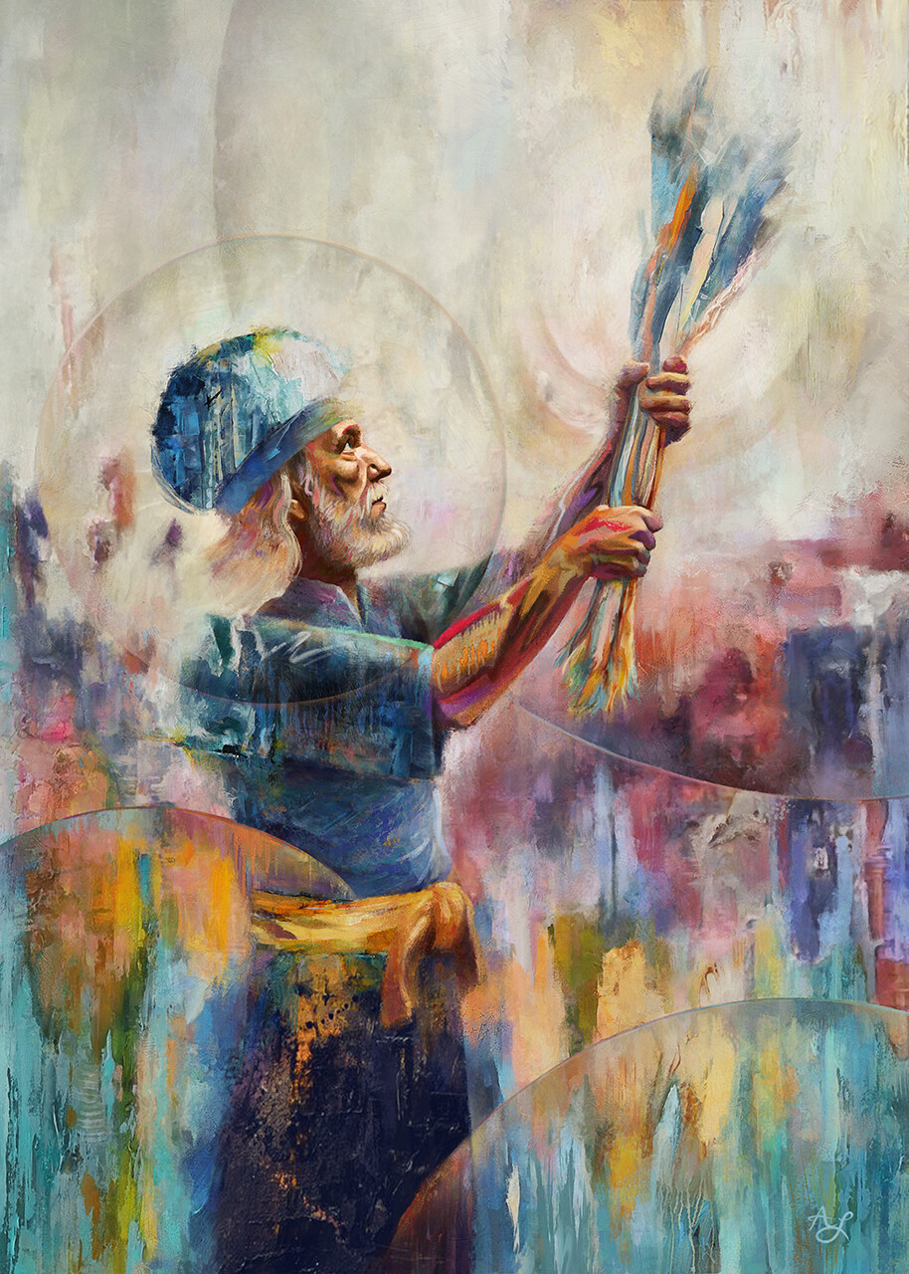
Mrs. White Sets the Stage
“The Passover was followed by the seven day's feast of unleavened bread. The first and the seventh day were days of holy convocation, when no servile work was to be performed. On the second day of the feast, the first fruits of the year's harvest were presented before God. Barley was the earliest grain in Palestine, and at the opening of the feast it was beginning to ripen. A sheaf of this grain was waved by the priest before the altar of God, as an acknowledgment that all was His. Not until this ceremony had been performed was the harvest to be gathered.” PP, 539

Slide 6
The Feast of Unleavened Bread, First Mention
Ex. 12:15-20 “Seven days shall ye eat unleavened bread; even the first day ye shall put away leaven out of your houses: for whosoever eateth leavened bread from the first day until the seventh day, that soul shall be cut off from Israel. And in the first day there shall be an holy convocation, and in the seventh day there shall be an holy convocation to you; no manner of work shall be done in them, save that which every man must eat, that only may be done of you. And ye shall observe the feast of unleavened bread; for in this selfsame day have I brought your armies out of the land of Egypt: therefore shall ye observe this day in your generations by an ordinance for ever. In the first month, on the fourteenth day of the month at even, ye shall eat unleavened bread, until the one and twentieth day of the month at even. Seven days shall there be no leaven found in your houses: for whosoever eateth that which is leavened, even that soul shall be cut off from the congregation of Israel, whether he be a stranger, or born in the land. Ye shall eat nothing leavened; in all your habitations shall ye eat unleavened bread.”

Slide 7
The Feast of Unleavened Bread in Numbers
Num. 28:16-25 “And in the fourteenth day of the first month is the passover of the Lord. And in the fifteenth day of this month is the feast: seven days shall unleavened bread be eaten. In the first day shall be an holy convocation; ye shall do no manner of servile work therein: But ye shall offer a sacrifice made by fire for a burnt offering unto the Lord; two young bullocks, and one ram, and seven lambs of the first year: they shall be unto you without blemish: And their meat offering shall be of flour mingled with oil: three tenth deals shall ye offer for a bullock, and two tenth deals for a ram; A several tenth deal shalt thou offer for every lamb, throughout the seven lambs: And one goat for a sin offering, to make an atonement for you. Ye shall offer these beside the burnt offering in the morning, which is for a continual burnt offering. After this manner ye shall offer daily, throughout the seven days, the meat of the sacrifice made by fire, of a sweet savour unto the Lord: it shall be offered beside the continual burnt offering, and his drink offering. And on the seventh day ye shall have an holy convocation; ye shall do no servile work.”

Slide 8
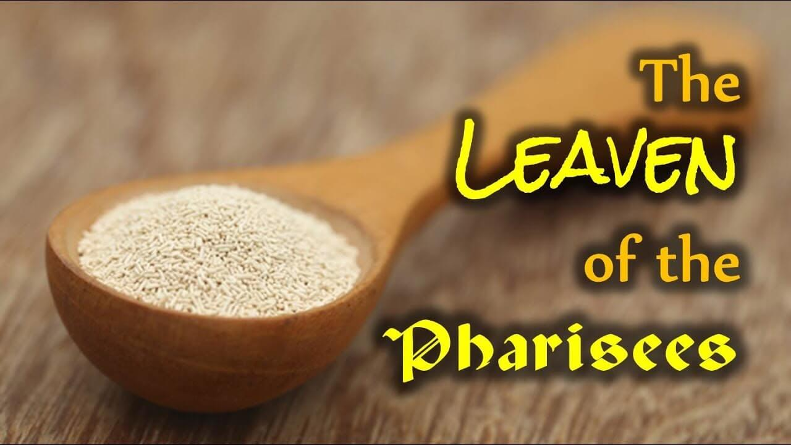
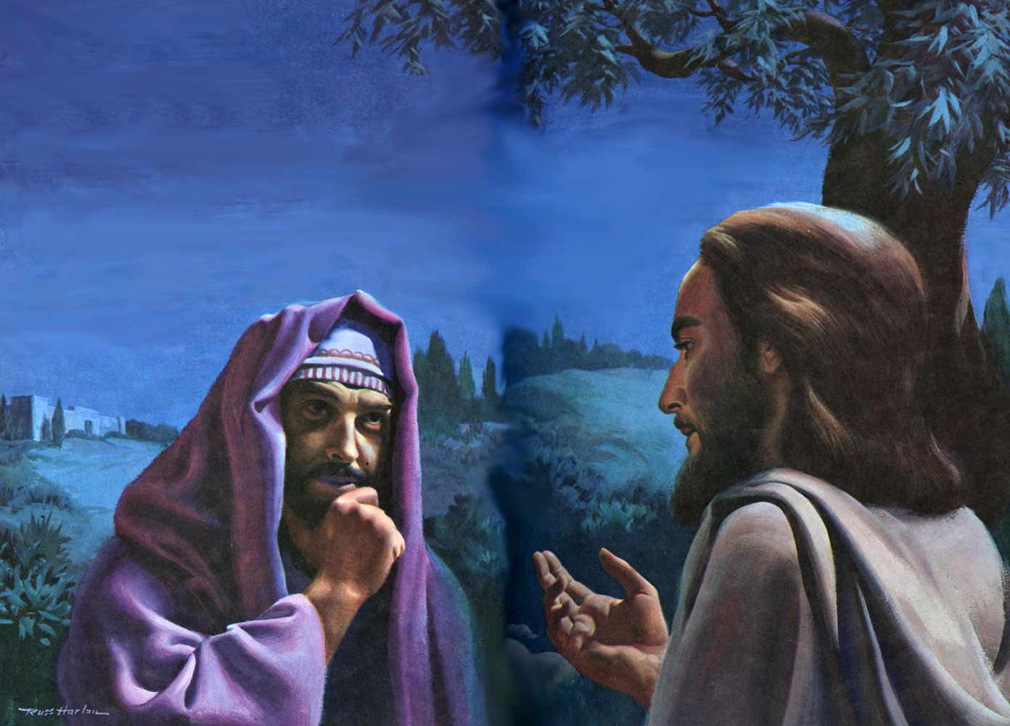
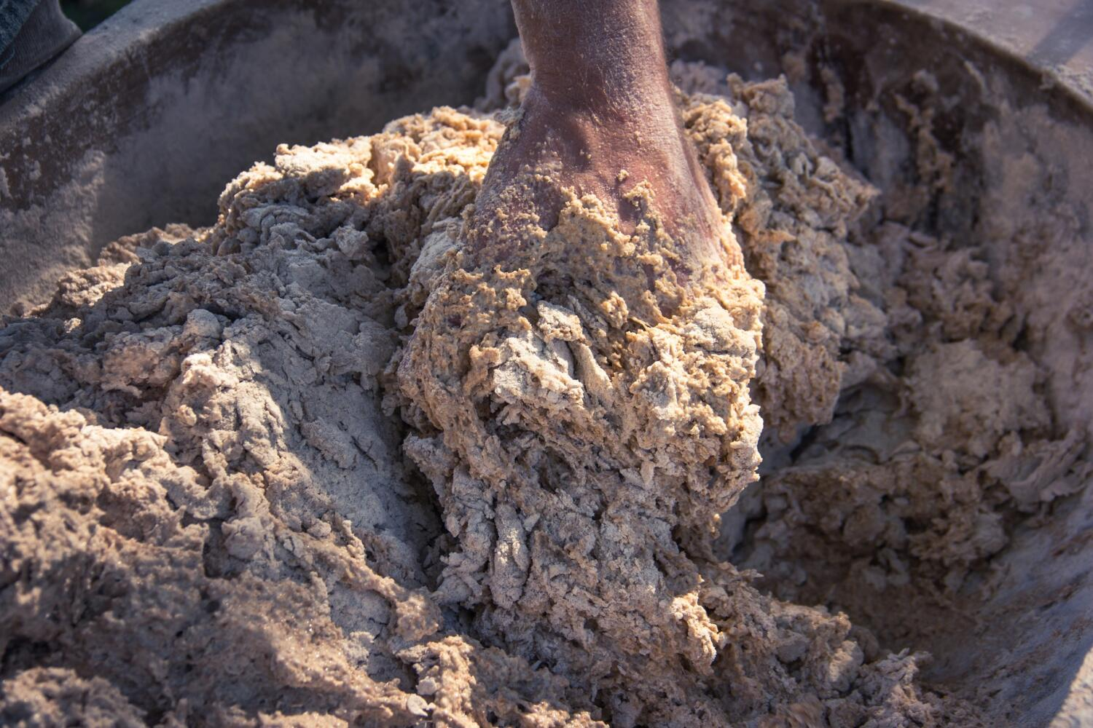
Eaten with Unleavened Bread?
Leaven=sin/sinful traits of character/bad doctrine or policy
Matt. 6:11-12 “ How is it that ye do not understand that I spake it not to you concerning bread, that ye should beware of the leaven of the Pharisees and of the Sadducees? Then understood they how that he bade them not beware of the leaven of bread, but of the doctrine of the Pharisees and of the Sadducees.”
“The use of unleavened bread also was significant. It was expressly enjoined in the law of the Passover, and as strictly observed by the Jews in their practice, that no leaven should be found in their houses during the feast. In like manner the leaven of sin must be put away from all who would receive life and nourishment from Christ. So Paul writes to the Corinthian church, ‘Purge out therefore the old leaven, that ye may be a new lump. . . . For even Christ our Passover is sacrificed for us: therefore let us keep the feast, not with old leaven, neither with the leaven of malice and wickedness; but with the unleavened bread of sincerity and truth.’ 1 Corinthians 5:7, 8.” PP, 278

Slide 9
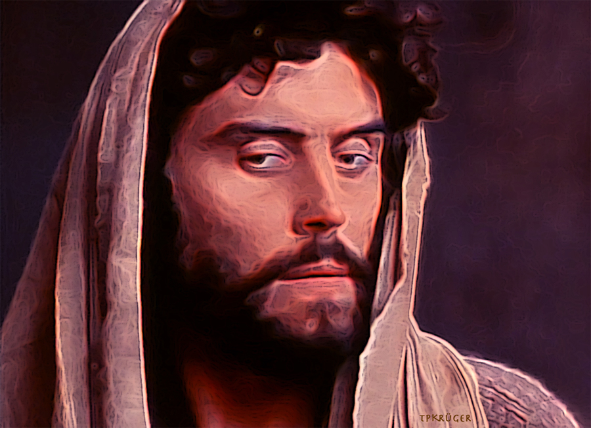
Leaven of Judas…
“If Judas were only received as a counselor, he thought, he could suggest many plans for the advantage of the little church. His principles and methods would differ somewhat from Christ's, but in these things he thought himself wiser than Christ. In all that Christ said to His disciples, there was something with which, in heart, Judas disagreed. Under his influence the leaven of disaffection was fast doing its work” DA, 719-720

Slide 10
Leaven of Hypocrisy
“Hypocrisy is like leaven or yeast. Leaven may be hidden in the flour, and its presence is not known until it produces its effect. By insinuating itself, it soon pervades the whole mass. Hypocrisy works secretly, and if indulged, it will fill the mind with pride and vanity. There are deceptions practiced now similar to those practiced by the Pharisees. When the Saviour gave this caution, it was to warn all who believe in Him to be on guard. Watch against imbibing this spirit, and becoming like those who tried to ensnare the Saviour.” MS 43, 1896

Slide 11
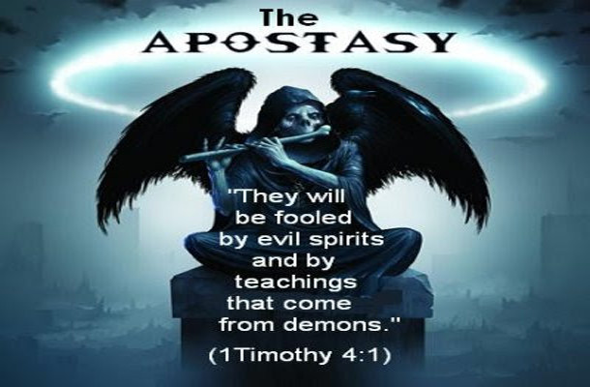
Leaven of Apostasy
“The man of sin was to arise, and do his work of exaltation and blasphemy, before the brethren could look for the coming of Christ. That great event was to be preceded by a falling away. There would be revealed a form of Antichrist, and the leaven of apostasy was to work with increasing power to the end of time.” RH July 31, 1888

Slide 12
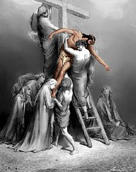
The Holy Convocation
The Feast of Unleavened Bread began with a holy convocation or sabbath. Why? Let’s look at the fulfillment:
Luke 23:52-56 “This man went unto Pilate, and begged the body of Jesus. And he took it down, and wrapped it in linen, and laid it in a sepulchre that was hewn in stone, wherein never man before was laid. And that day was the preparation, and the sabbath drew on. And the women also, which came with him from Galilee, followed after, and beheld the sepulchre, and how his body was laid. And they returned, and prepared spices and ointments; and rested the sabbath day according to the commandment.”

Slide 13
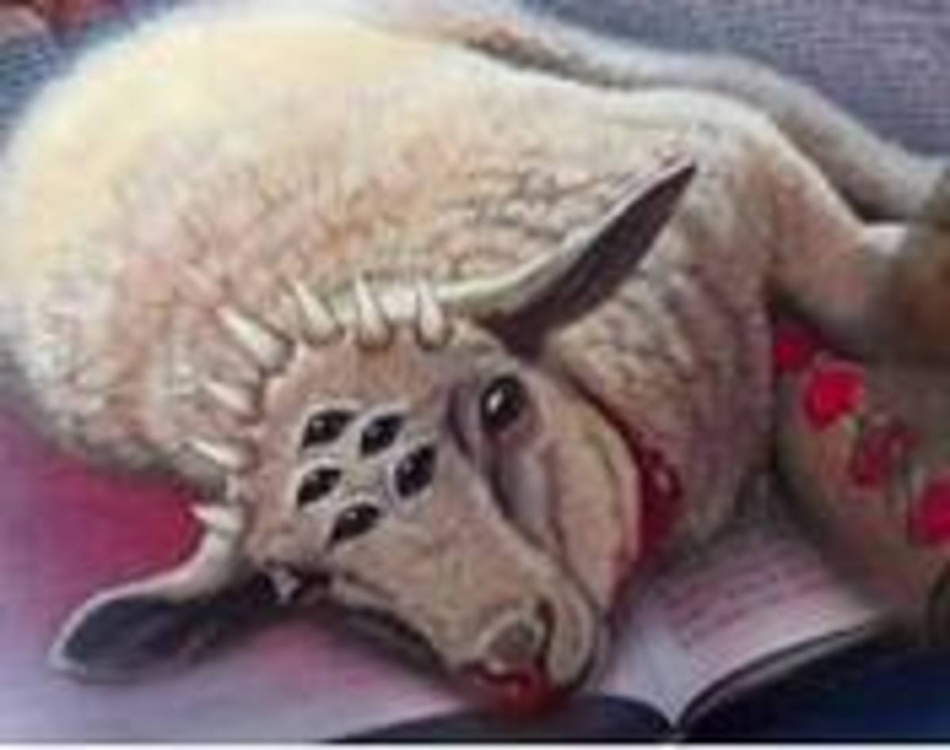
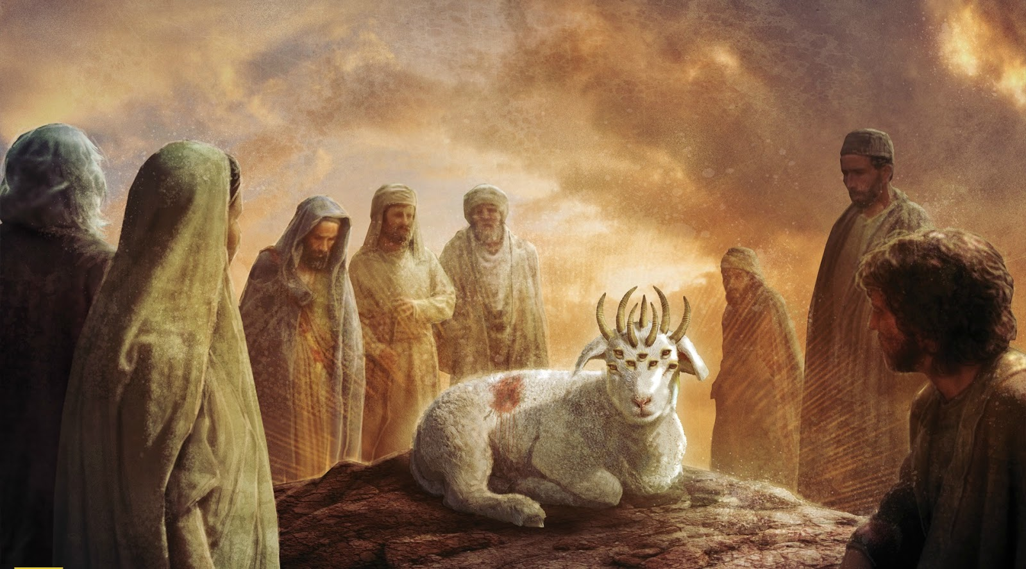
Why 7 Days?
In the Scriptures, the number 7 is much more than just a period or number. It is symbolic of perfection. In Revelation alone there are 7 Church Time Period segments (Rev. 2-3), 7 Spirits of God representing the Holy Spirit (Rev. 1:4), 7 horns and 7 eyes upon the Lamb:
Rev. 5:6 “And I beheld, and, lo, in the midst of the throne and of the four beasts, and in the midst of the elders, stood a Lamb as it had been slain, having seven horns and seven eyes, which are the seven Spirits of God sent forth into all the earth.”

Slide 14
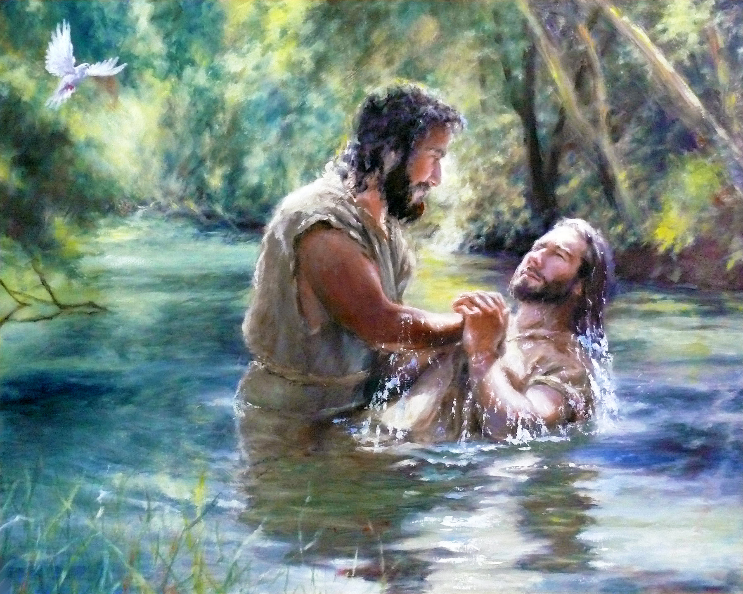
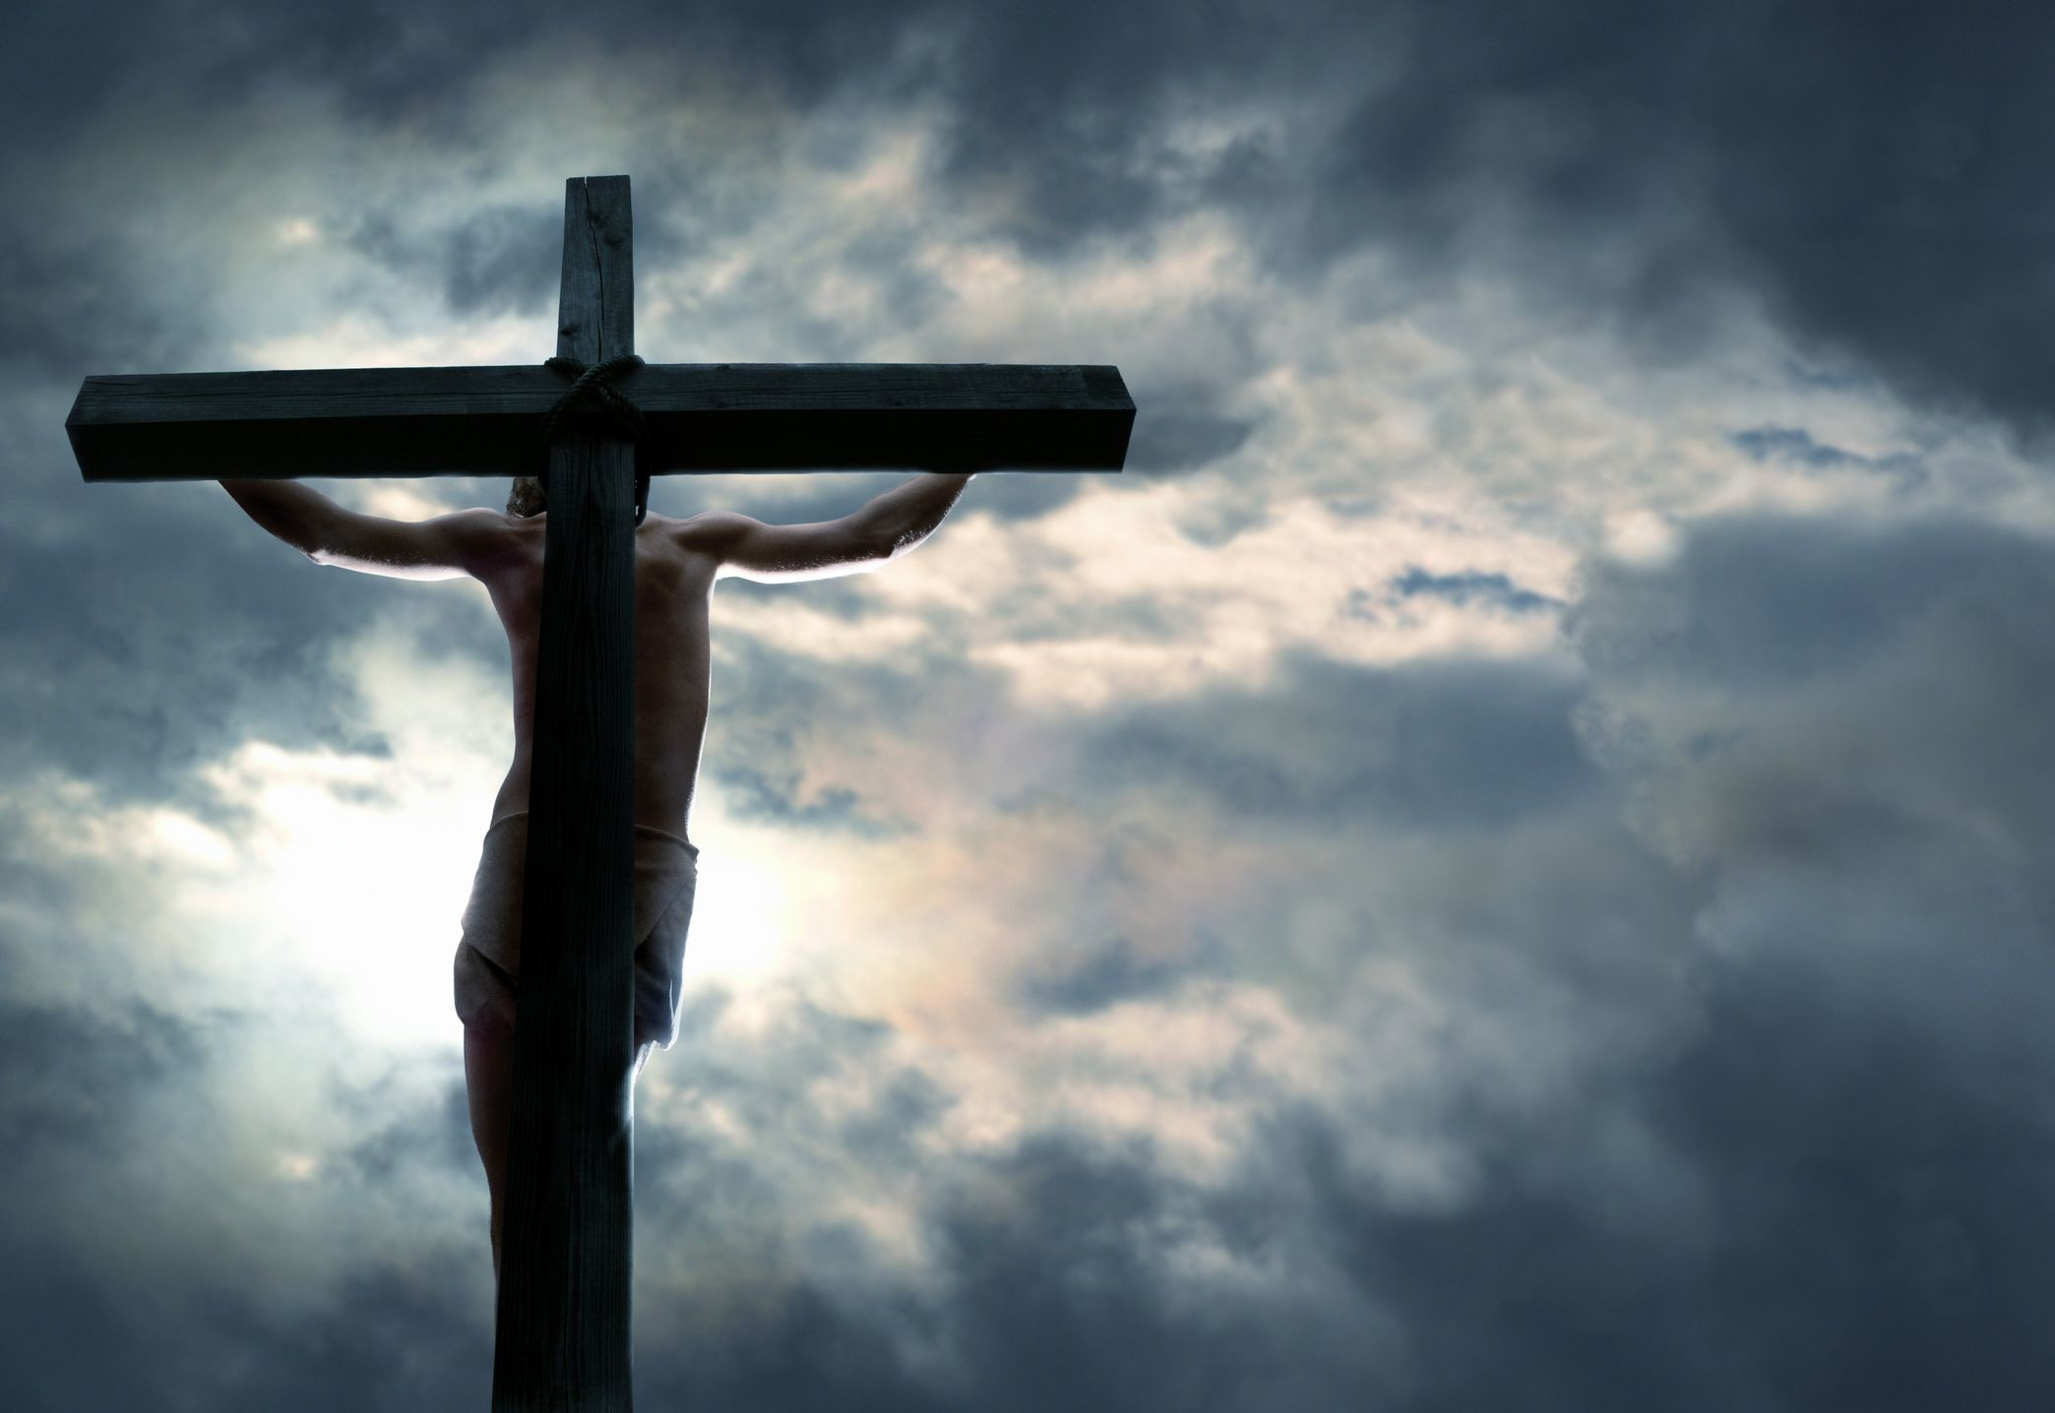
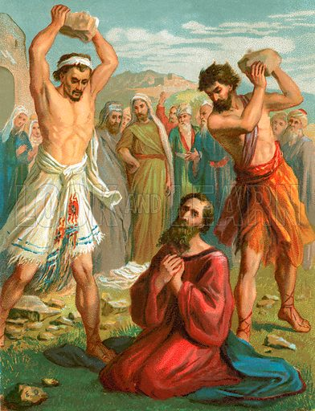
7 Days 7 Years?
Daniel 9:25-27 “Know therefore and understand, that from the going forth of the commandment to restore and to build Jerusalem unto the Messiah the Prince shall be seven weeks, and threescore and two weeks: the street shall be built again, and the wall, even in troublous times. And after threescore and two weeks shall Messiah be cut off, but not for himself: and the people of the prince that shall come shall destroy the city and the sanctuary; and the end thereof shall be with a flood, and unto the end of the war desolations are determined. And he shall confirm the covenant with many for one week: and in the midst of the week he shall cause the sacrifice and the oblation to cease, and for the overspreading of abominations he shall make it desolate, even until the consummation, and that determined shall be poured upon the desolate.”
27 AD
31 AD
34 AD

Slide 15
Comparison
Feast Day:
Pointed to the Deliverance and Exodus out of Egypt (Deliverance)
It began with a sabbath
Unleavened Bread only
Was 7 days long
Christ’s Day:
Pointed to the Deliverance and Exodus out of Bondage of Sin
It began with the Sabbath
Jesus is the Unleavened Bread
7 days was coupled by two Sabbaths, and the True Unleavened Bread Confirmed the Covenant for a total of 7 years

Slide 16
Feast of Unleavened Bread and Firstfruits in Leviticus
Lev. 23:5-14 “In the fourteenth day of the first month at even is the Lord's passover. And on the fifteenth day of the same month is the feast of unleavened bread unto the Lord: seven days ye must eat unleavened bread. In the first day ye shall have an holy convocation: ye shall do no servile work therein. But ye shall offer an offering made by fire unto the Lord seven days: in the seventh day is an holy convocation: ye shall do no servile work therein. And the Lord spake unto Moses, saying, Speak unto the children of Israel, and say unto them, When ye be come into the land which I give unto you, and shall reap the harvest thereof, then ye shall bring a sheaf of the firstfruits of your harvest unto the priest: And he shall wave the sheaf before the Lord, to be accepted for you: on the morrow after the sabbath the priest shall wave it. And ye shall offer that day when ye wave the sheaf an he lamb without blemish of the first year for a burnt offering unto the Lord. And the meat offering thereof shall be two tenth deals of fine flour mingled with oil, an offering made by fire unto the Lord for a sweet savour: and the drink offering thereof shall be of wine, the fourth part of an hin. And ye shall eat neither bread, nor parched corn, nor green ears, until the selfsame day that ye have brought an offering unto your God: it shall be a statute for ever throughout your generations in all your dwellings.

Slide 17
Ellen White Explains the Wave Sheaf
“The Passover was followed by the seven days' feast of unleavened bread. On the second day of the feast, the first fruits of the year's harvest, a sheaf of barley, was presented before the Lord. All the ceremonies of the feast were types of the work of Christ. The deliverance of Israel from Egypt was an object lesson of redemption, which the Passover was intended to keep in memory. The slain lamb, the unleavened bread, the sheaf of first fruits, represented the Saviour.” DA, 77

Slide 18
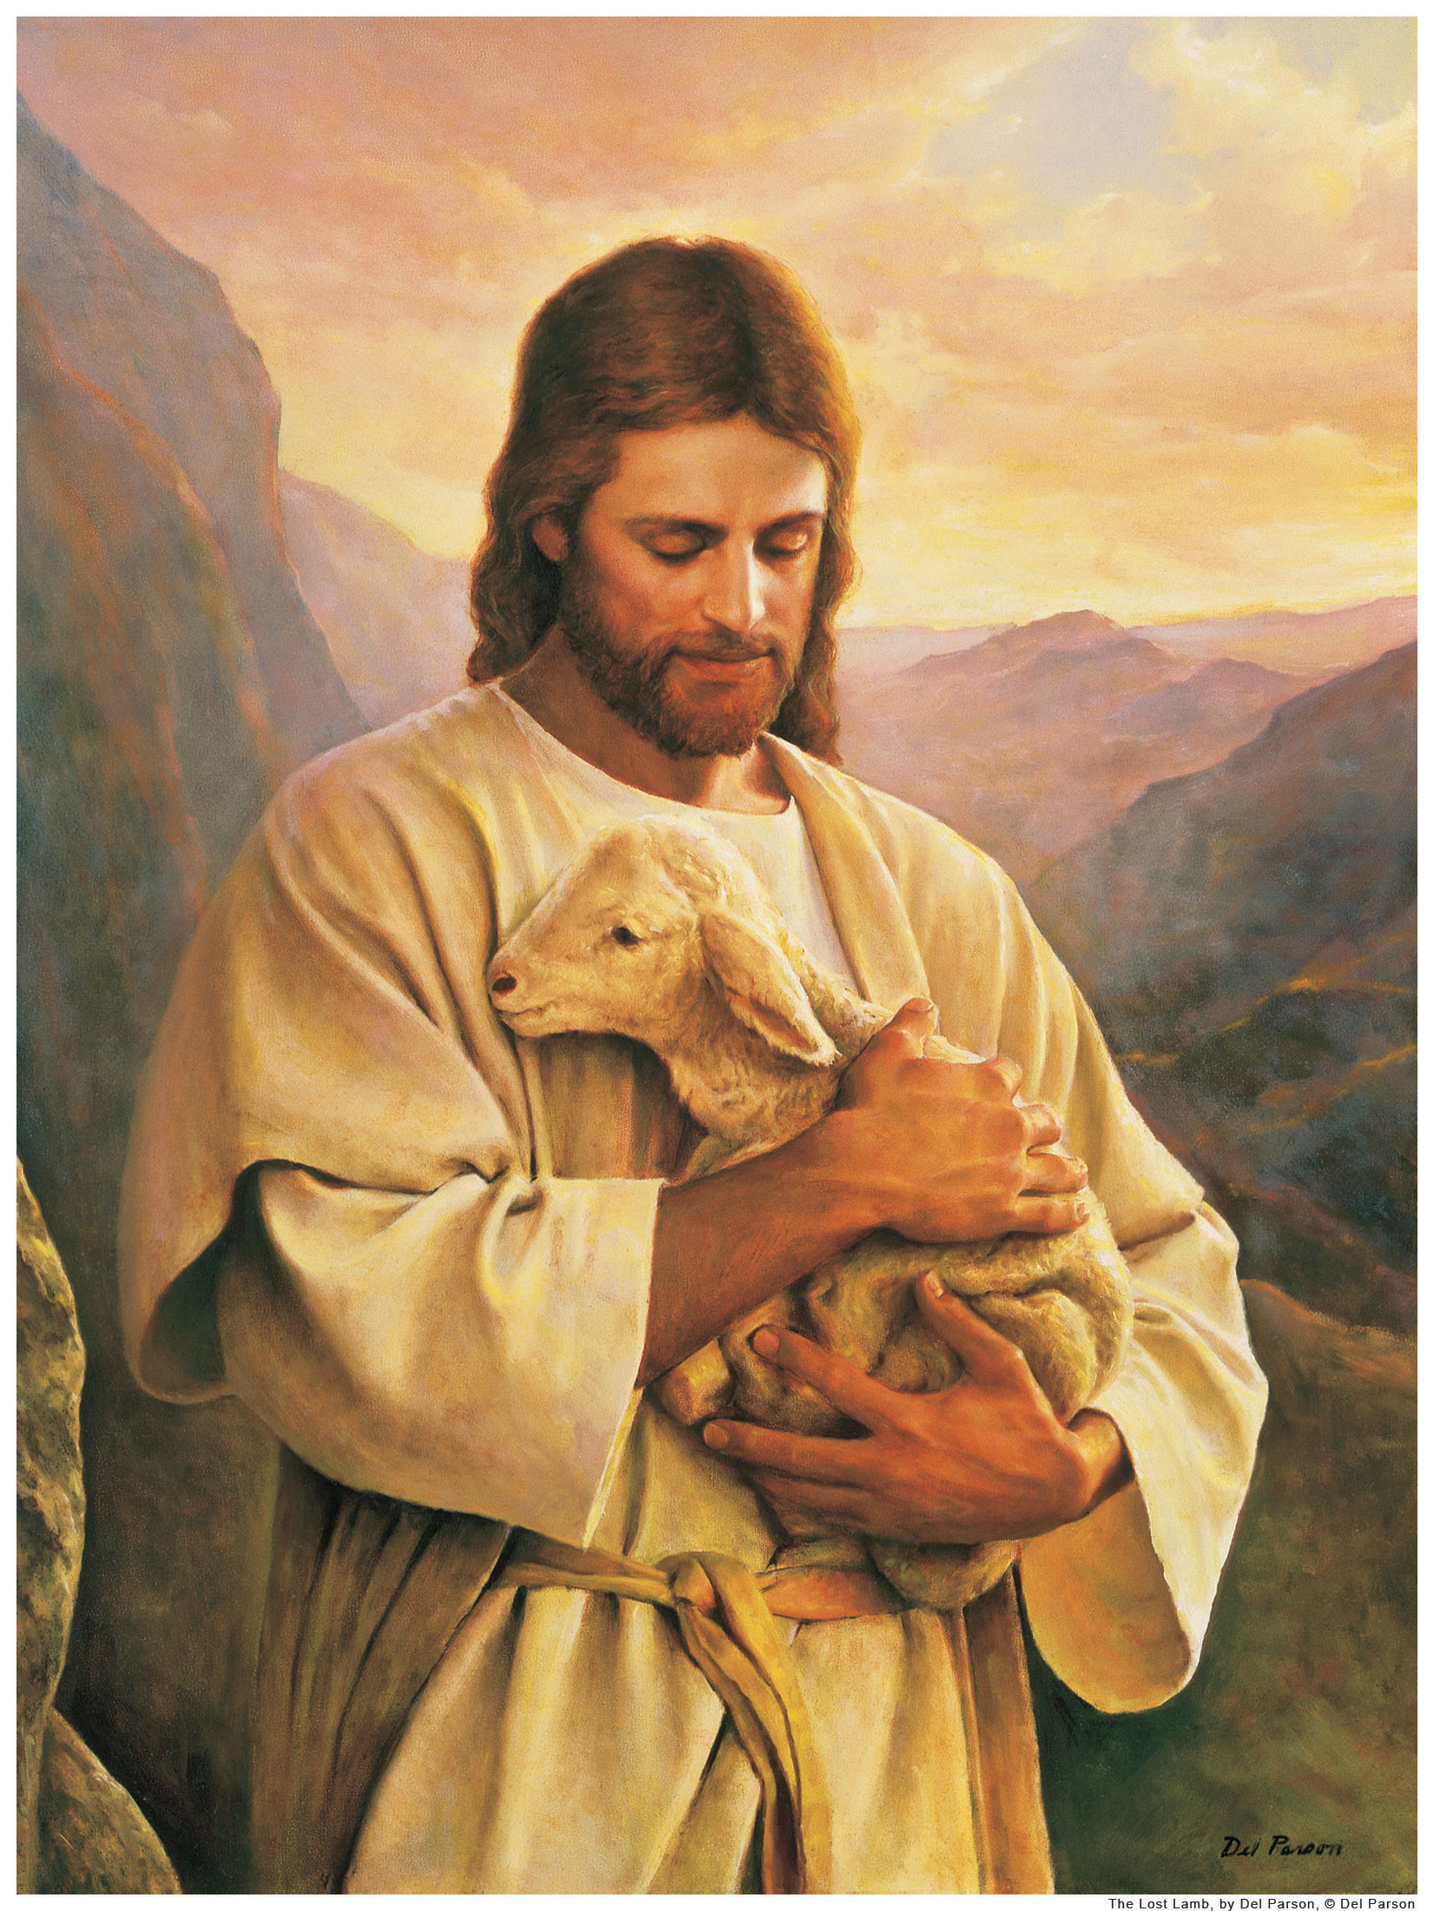
Who Are/Is the FirstFruits???
1 Cor. 15:20-23 “But now is Christ risen from the dead, and become the firstfruits of them that slept. For since by man came death, by man came also the resurrection of the dead. For as in Adam all die, even so in Christ shall all be made alive. But every man in his own order: Christ the firstfruits; afterward they that are Christ's at his coming.”

Slide 19
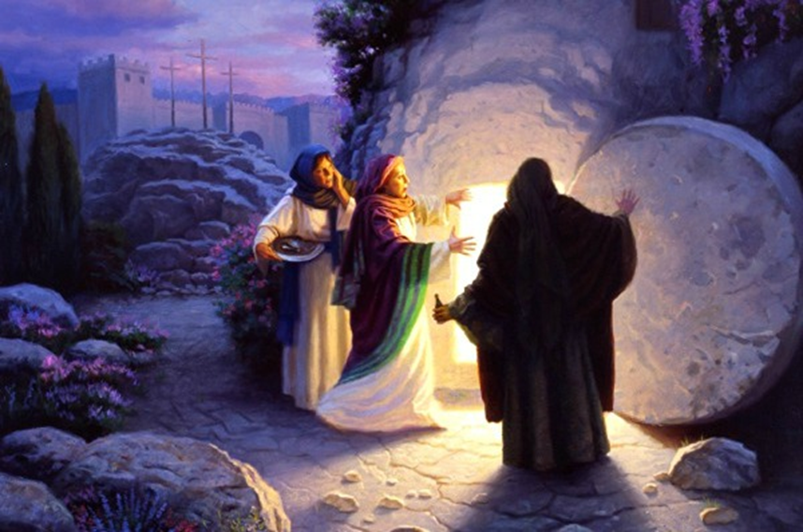
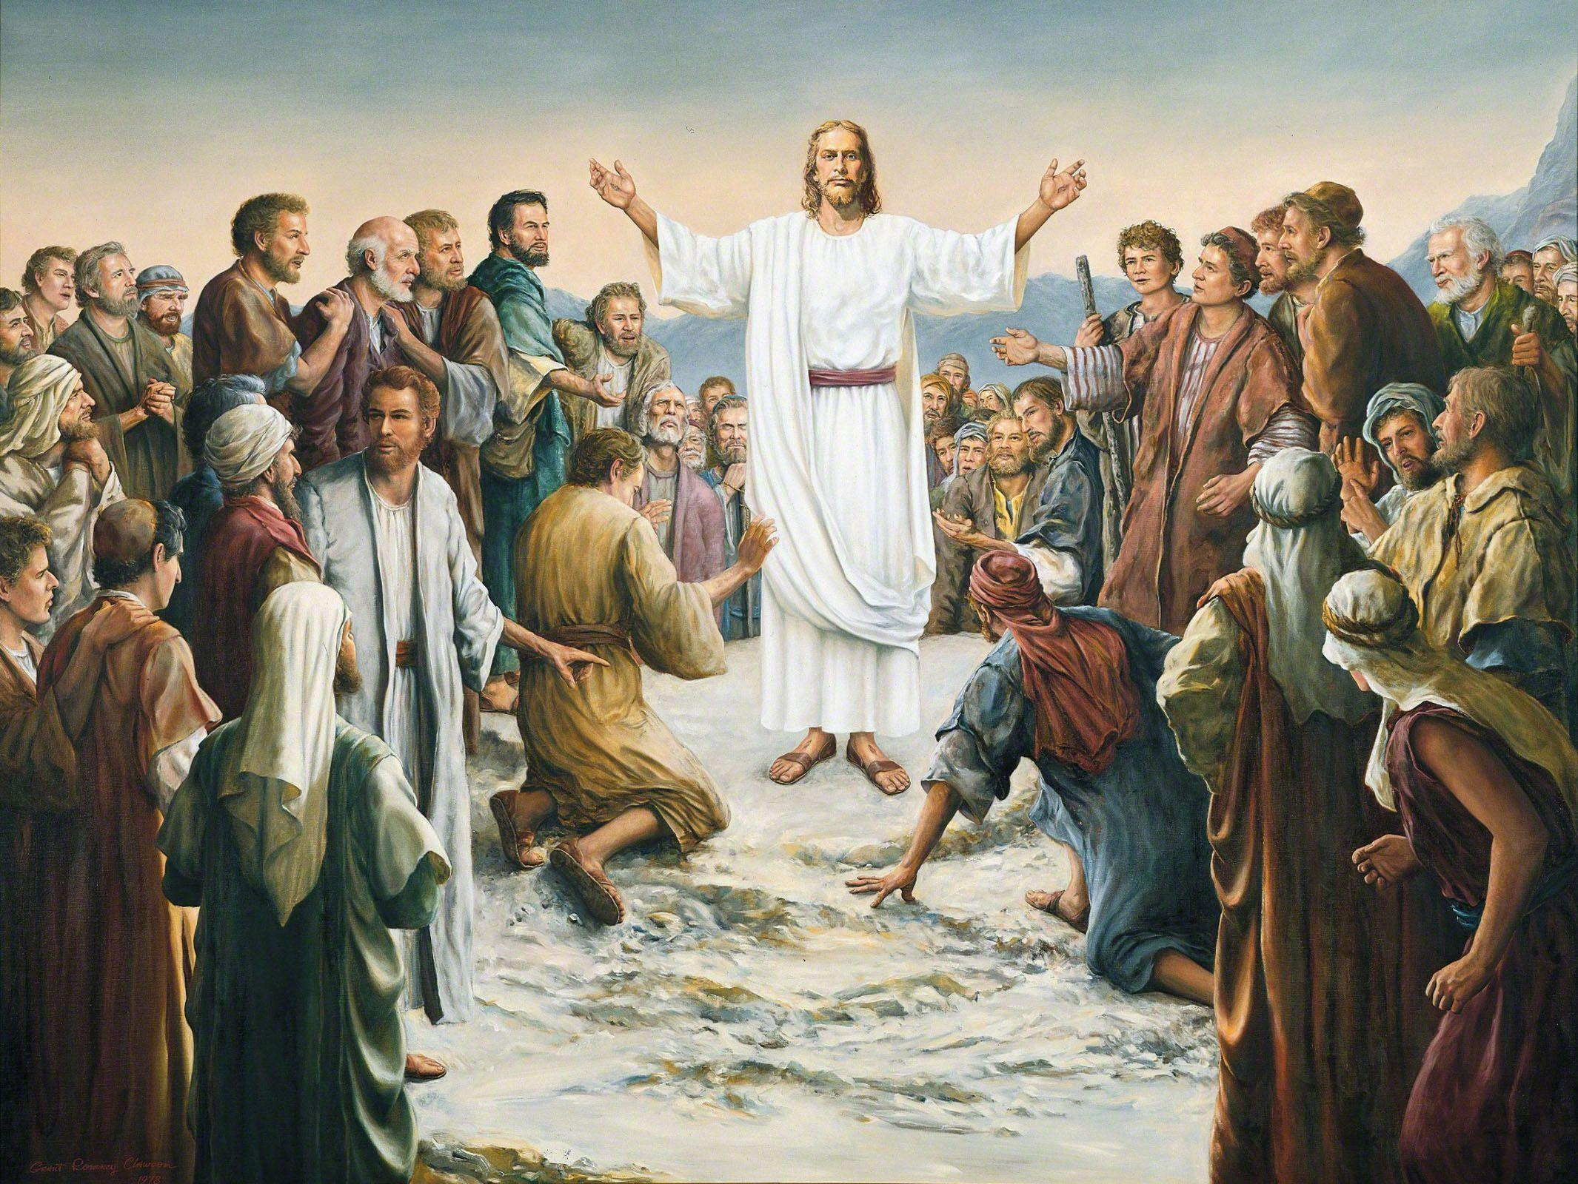
Other “Firstfruits” Accepted by the Lord!
John 20:17 “Jesus saith unto her, Touch me not; for I am not yet ascended to my Father: but go to my brethren, and say unto them, I ascend unto my Father, and your Father; and to my God, and your God.”
Matt. 27:52-53 “And the graves were opened; and many bodies of the saints which slept arose, And came out of the graves after his resurrection, and went into the holy city, and appeared unto many.”

Slide 20
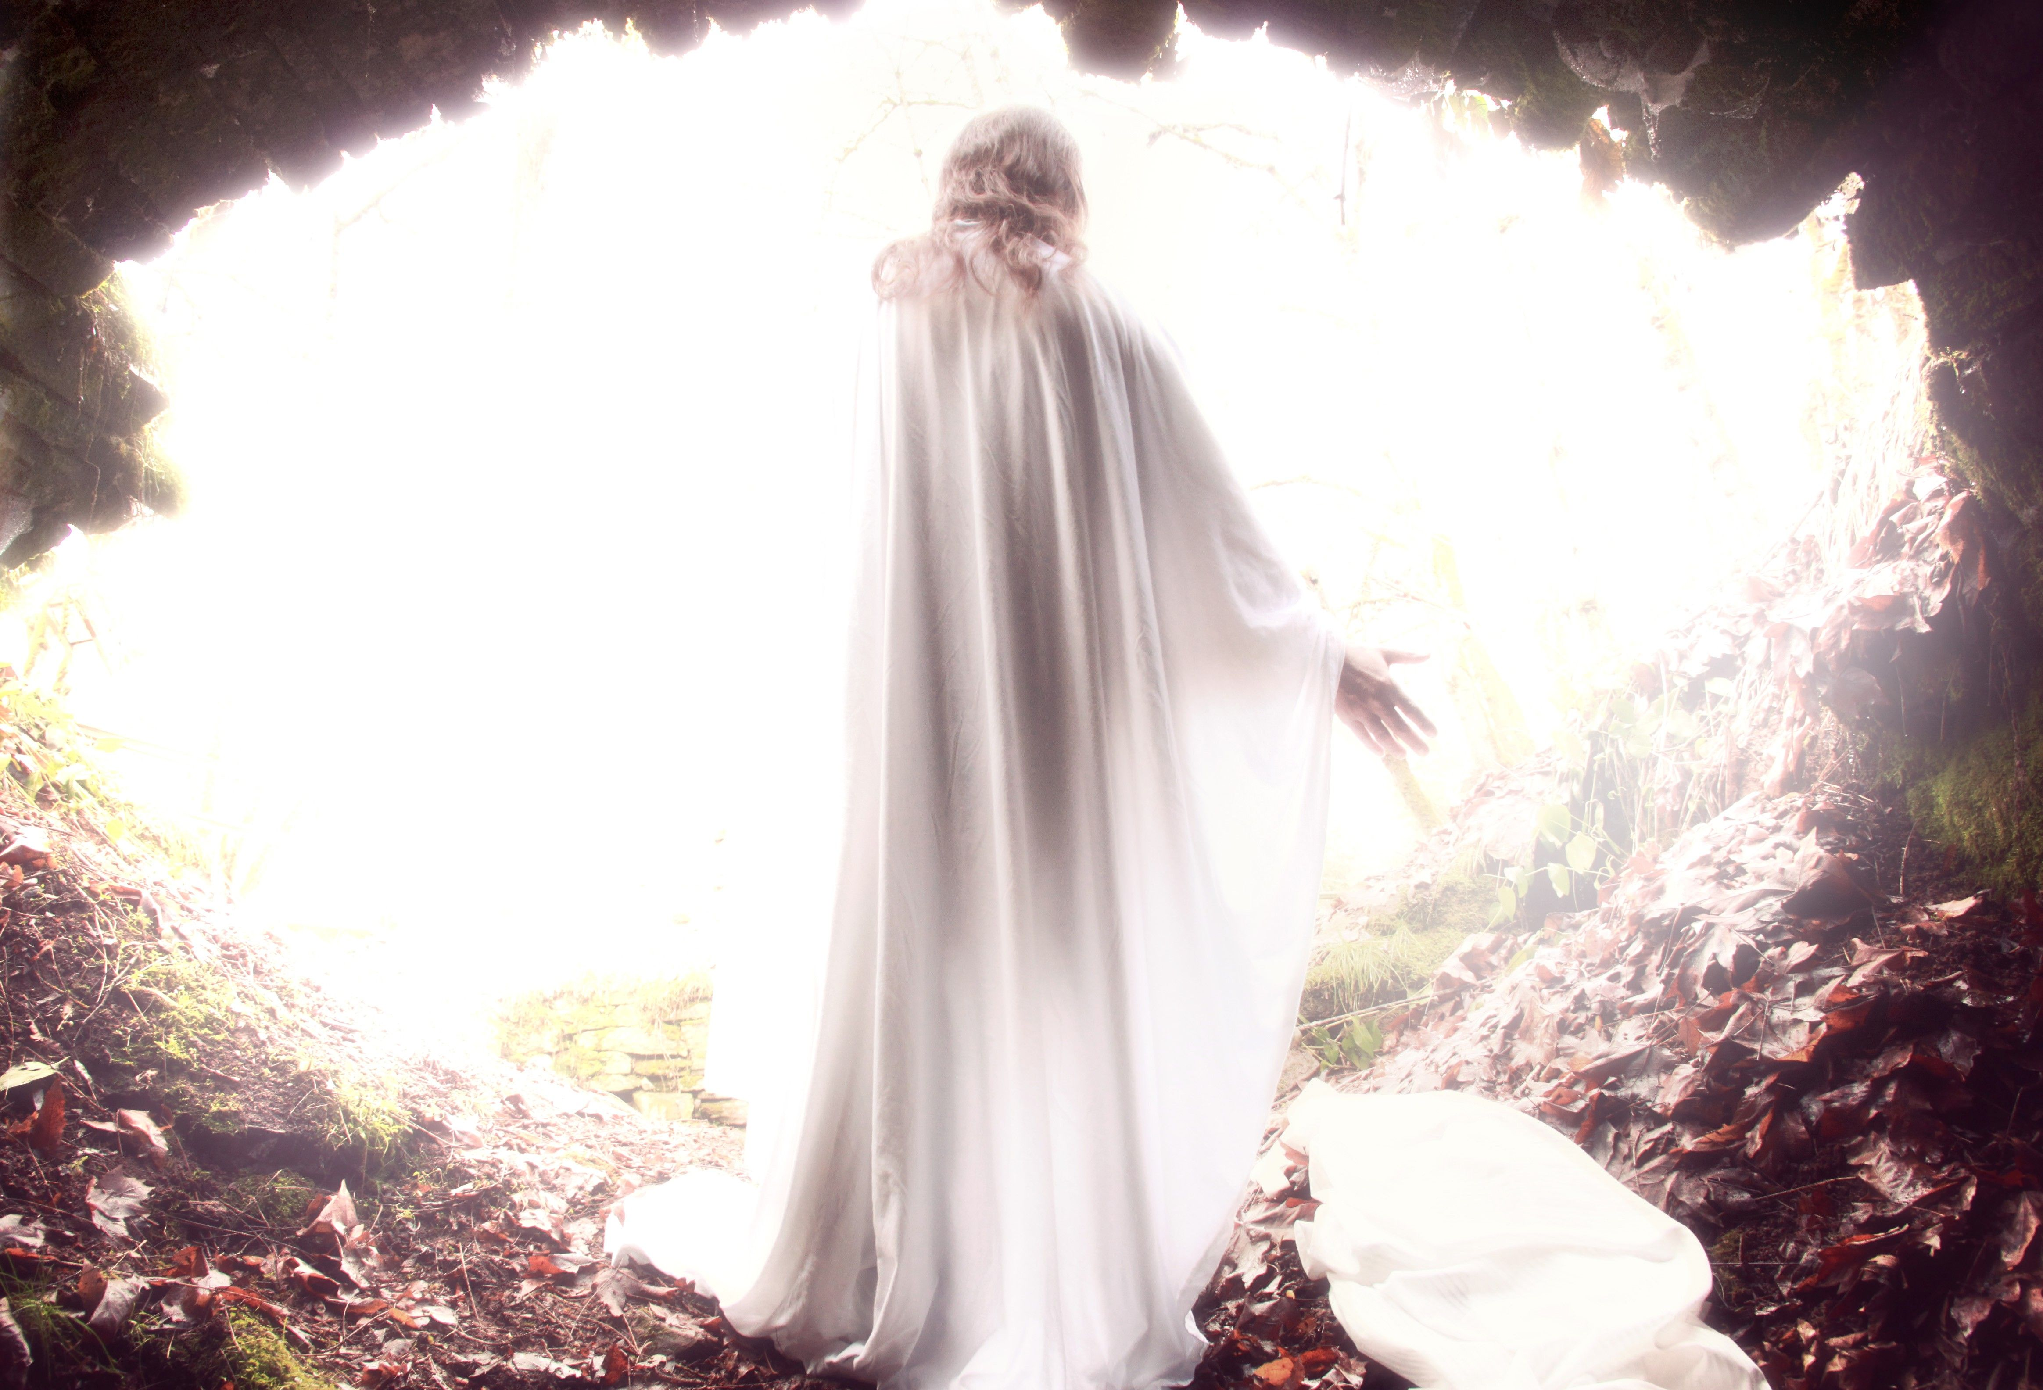
Ellen White Further Explains
“Christ arose from the dead as the first fruits of those that slept. He was the antitype of the wave sheaf, and His resurrection took place on the very day when the wave sheaf was to be presented before the Lord. For more than a thousand years this symbolic ceremony had been performed. From the harvest fields the first heads of ripened grain were gathered, and when the people went up to Jerusalem to the Passover, the sheaf of first fruits was waved as a thank offering before the Lord. Not until this was presented could the sickle be put to the grain, and it be gathered into sheaves. The sheaf dedicated to God represented the harvest. So Christ the first fruits represented the great spiritual harvest to be gathered for the kingdom of God. His resurrection is the type and pledge of the resurrection of all the righteous dead.” DA 785-786

Slide 21
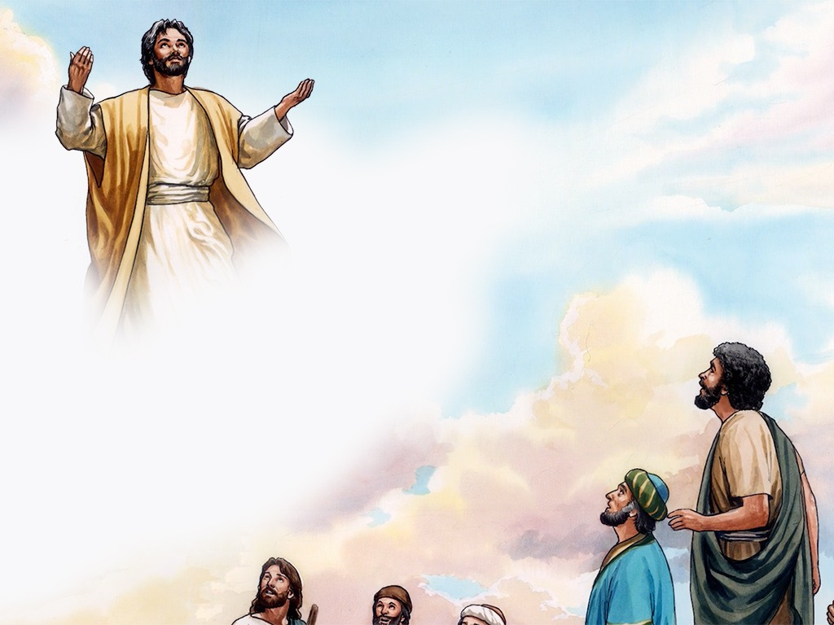
“As Christ arose, He brought from the grave a multitude of captives. The earthquake at His death had rent open their graves, and when He arose, they came forth with Him. They were those who had been co-laborers with God, and who at the cost of their lives had borne testimony to the truth. Now they were to be witnesses for Him who had raised them from the dead. During His ministry, Jesus had raised the dead to life. He had raised the son of the widow of Nain, and the ruler's daughter and Lazarus. But these were not clothed with immortality. After they were raised, they were still subject to death. But those who came forth from the grave at Christ's resurrection were raised to everlasting life. They ascended with Him as trophies of His victory over death and the grave. These, said Christ, are no longer the captives of Satan; I have redeemed them. I have brought them from the grave as the first fruits of My power, to be with Me where I am, nevermore to see death or experience sorrow.” DA, 786

Slide 22
Fulfilled Exactly On Time!
“These types were fulfilled, not only as to the event, but as to the time. On the fourteenth day of the first Jewish month, the very day and month on which for fifteen long centuries the Passover lamb had been slain, Christ, having eaten the Passover with His disciples, instituted that feast which was to commemorate His own death as "the Lamb of God, which taketh away the sin of the world." That same night He was taken by wicked hands to be crucified and slain. And as the antitype of the wave sheaf our Lord was raised from the dead on the third day, "the first fruits of them that slept," a sample of all the resurrected just, whose "vile body" shall be changed, and "fashioned like unto His glorious body." Verse 20; Philippians 3:21.” GC, 399

Slide 23
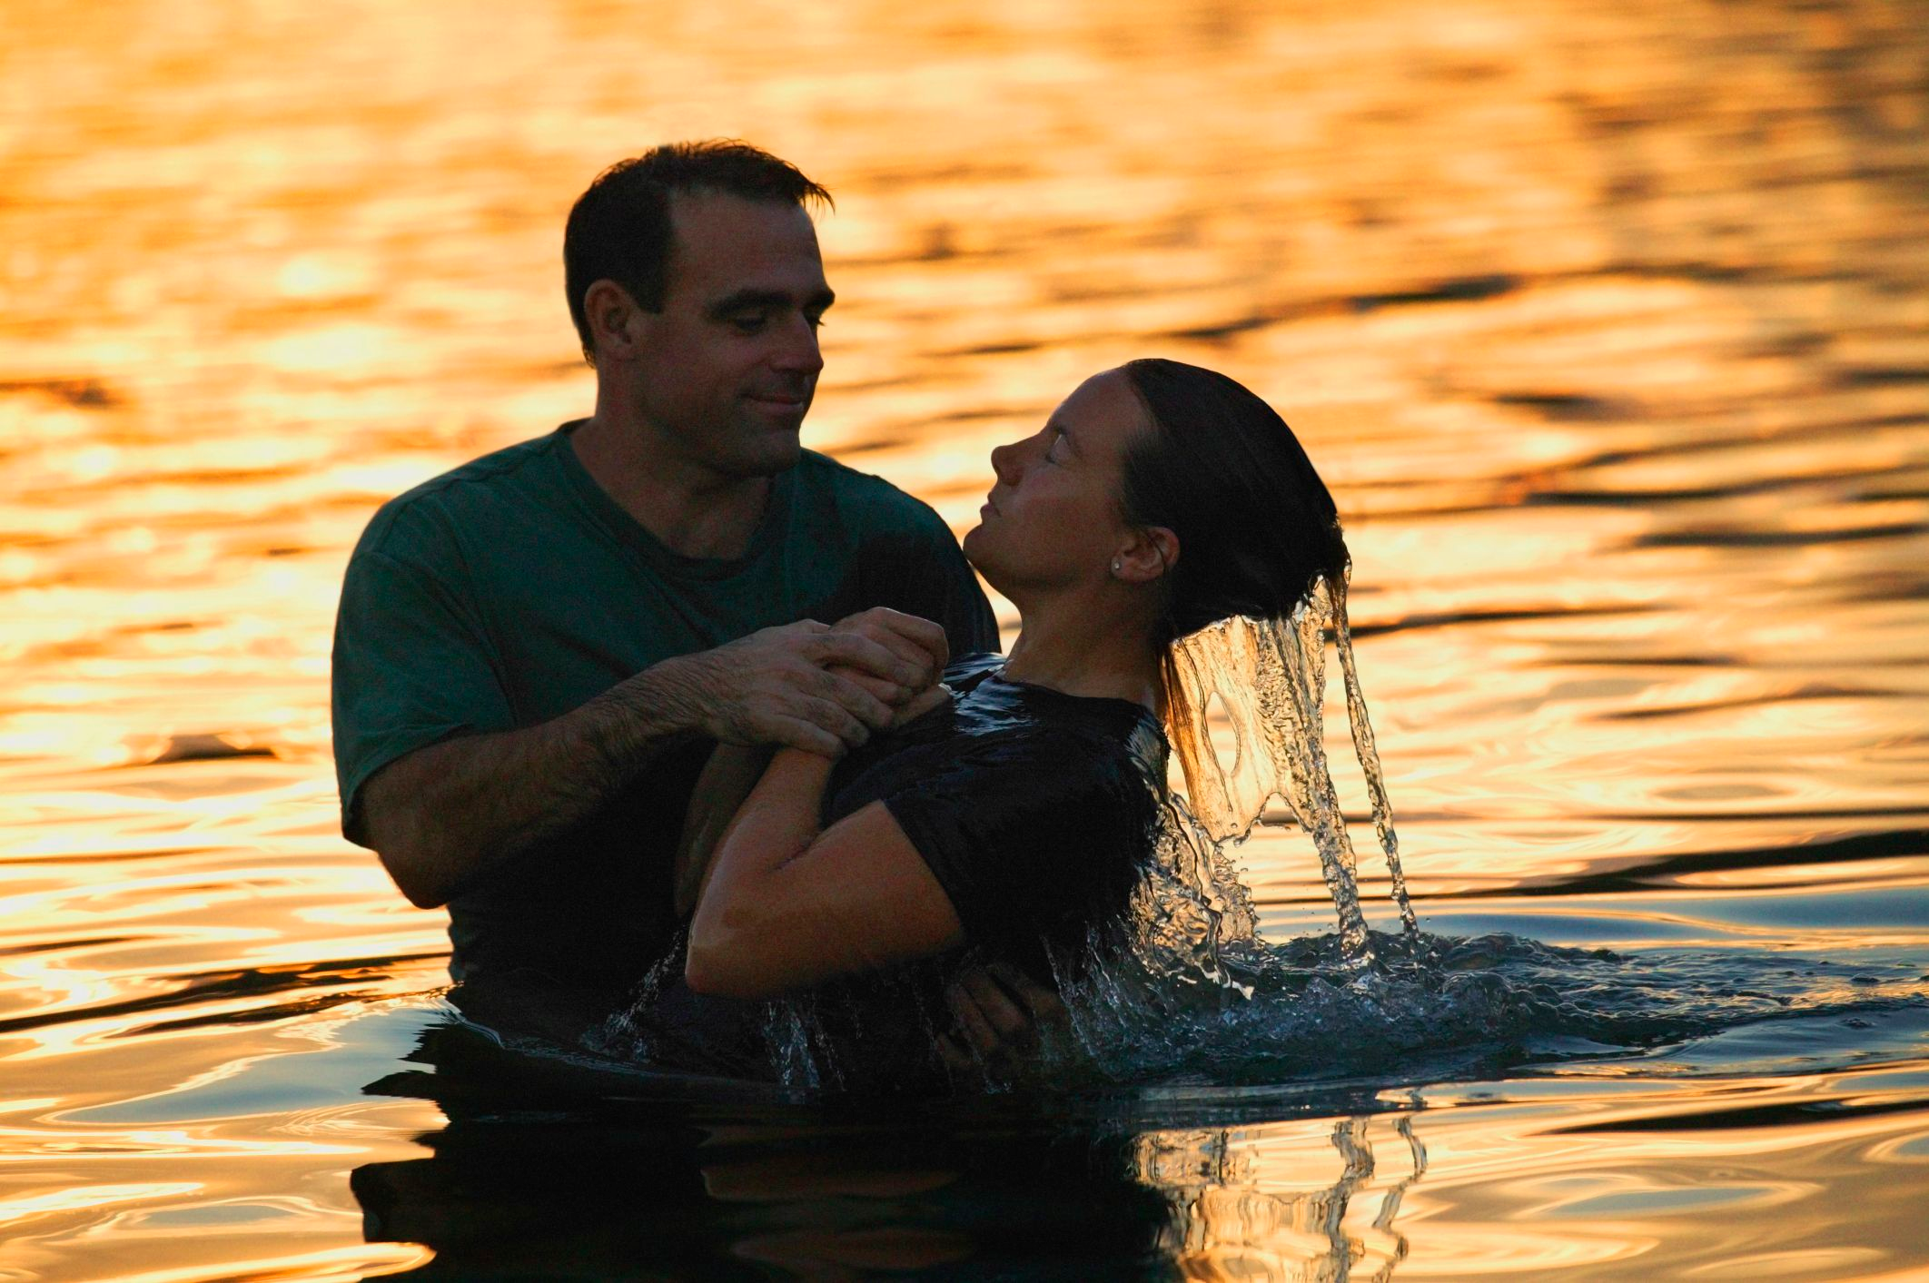
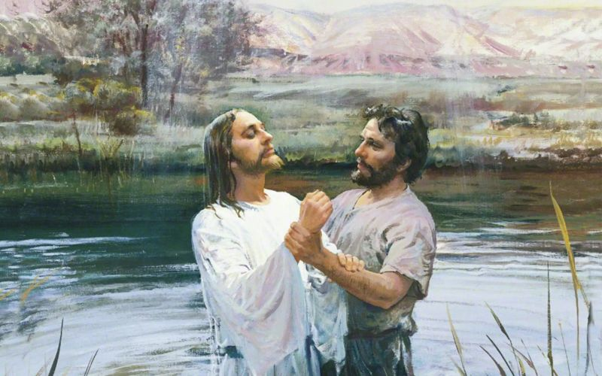
What Replaced This Ceremony?
Rom. 6:4-10 “Therefore we are buried with him by baptism into death: that like as Christ was raised up from the dead by the glory of the Father, even so we also should walk in newness of life. For if we have been planted together in the likeness of his death, we shall be also in the likeness of his resurrection: Knowing this, that our old man is crucified with him, that the body of sin might be destroyed, that henceforth we should not serve sin. For he that is dead is freed from sin. Now if we be dead with Christ, we believe that we shall also live with him: Knowing that Christ being raised from the dead dieth no more; death hath no more dominion over him. For in that he died, he died unto sin once: but in that he liveth, he liveth unto God.”

Slide 24
Comparison
Feast Day:
Pointed to total dependence on God for everything
It was an offering to be “accepted by the Lord”
Is called and represents the “firstfruits”
It happened the day after the holy convocation of the Feast of Unleavened Bread
Christ’s Day:
The Wave Sheaf is Christ—total dependence on God for everything!
Jesus was the offering that was accepted by the Father on behalf of man
Jesus is the firstfruits, as well as the 144,000 and the resurrected in Christ’s day
Christ Resurrected on exactly the same day as this Wave Sheaf Offering!

