Slide 1
The Godhead
What we Believe

Slide 2
Let Us Hear the Conclusion…
I am instructed to say, The sentiments of those who are searching for advanced scientific ideas are not to be trusted. Such representations as the following are made: “The Father is as the light invisible: the Son is as the light embodied; the Spirit is the light shed abroad.” “The Father is like the dew, invisible vapor; the Son is like the dew gathered in beauteous form; the Spirit is like the dew fallen to the seat of life.” Another representation: “The Father is like the invisible vapor; the Son is like the leaden cloud; the Spirit is rain fallen and working in refreshing power.”
All these spiritualistic representations are simply nothingness. They are imperfect, untrue. They weaken and diminish the Majesty which no earthly likeness can be compared to. God cannot be compared with the things His hands have made. These are mere earthly things, suffering under the curse of God because of the sins of man. The Father cannot be described by the things of earth. The Father is all the fullness of the Godhead bodily, and is invisible to mortal sight.
The Son is all the fullness of the Godhead manifested. The Word of God declares Him to be “the express image of His person.” “God so loved the world, that He gave His only-begotten Son, that whosoever believeth in Him should not perish, but have

Slide 3
everlasting life.” Here is shown the personality of the Father. The Comforter that Christ promised to send after He ascended to heaven, is the Spirit in all the fullness of the Godhead, making manifest the power of divine grace to all who receive and believe in Christ as a personal Saviour. There are three living persons of the heavenly trio; in the name of these three great powers—the Father, the Son, and the Holy Spirit—those who receive Christ by living faith are baptized, and these powers will co-operate with the obedient subjects of heaven in their efforts to live the new life in Christ.—Special Testimonies, Series B, No. 7, pp. 62, 63. (1905).

Slide 4
Controversy
Controversy flies around so many different teachings today. Here are a few:
1. the feast days.
2. the sacred name.
3. the original writings.
4. God doesn’t kill.
5. reapply Daniel 12.
6. the Godhead/trinity
7. the church is Babylon
8. The Wednesday crucifixion
9. health and dress reform

Slide 5

The issue of the Godhead
The one we will look at in this study has to do with the Godhead. There is a truth to the Godhead that is amazing and beautiful. Three Beings can be so perfectly united in every way that they are considered to be ONE! Others say that Christ was created at some point in time, and that the Holy Spirit is really the spirit that comes from Christ and God. Well, let us take a look at this!

Slide 6
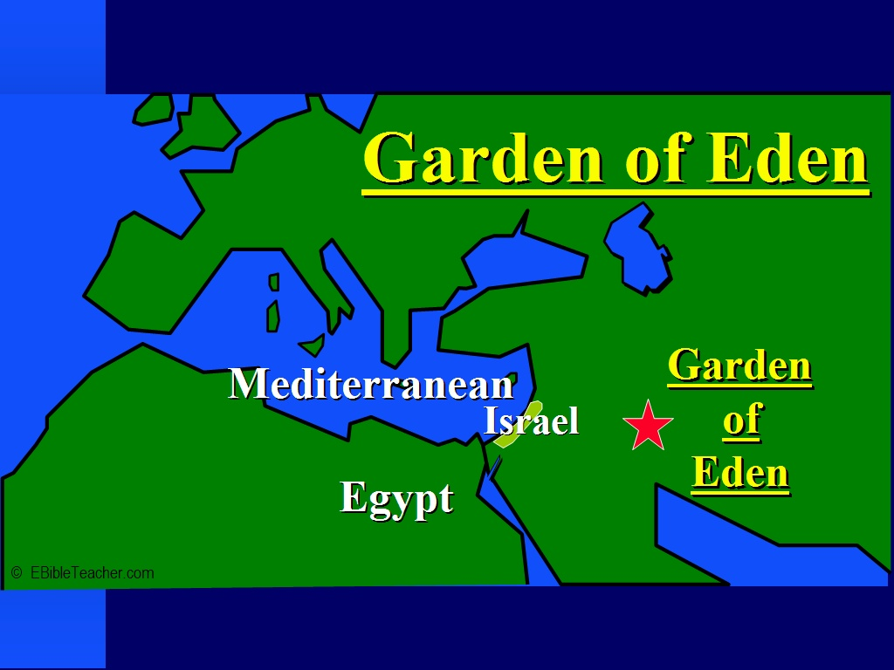
In the Beginning
Genesis chapter 1 provides us with some valuable insights into the Godhead. Throughout this chapter, the name used for God is Elohim. This word means the Mighty Covenant Maker, the One who always keeps His promises. The word Elohim is also PLURAL. The King James Bible translates Elohim as ‘God’. So, in actuality, Genesis1 should read, “In the beginning, Gods created the heavens and the earth.” Genesis 1:1 Immediately, the Holy Spirit is alerting us to the fact that the divine being called God has more than one being within that name. This is amazing!

Slide 7

Further Insight
While the very name of Elohim alerts us to the fact that there is more than one personage in the Godhead, we are further confronted with this obvious truth in Genesis 1:26 where the Bible says, “And God said, Let us make man in our image, after our likeness:” Both pronouns that refer back to God are plural. The only way that this can be so is if the noun to which the pronouns refer is also plural and as we have already seen, the word for God is plural! Awesome!

Slide 8

Clarification
As a finite, feeble, and weak human being, who has had to suffer with 6,000 years of debilitation in the human family, it is impossible for any of us to grasp this idea. Nevertheless, the Bible is clear right in Genesis 1; there are a plural number of beings that comprise the Godhead that are in such harmony that they call themselves ONE! “For my thoughts are not your thoughts, neither are your ways my ways, saith the LORD. For as the heavens are higher than the earth, so are my ways higher than your ways, and my thoughts than your thoughts.” Isaiah 55:8,9
For this reason, we must accept this by faith because the Bible says it is so because this is incomprehensible for our little, pea brains!

Slide 9

How Many Beings?
The Bible is very clear that there are 3 Persons in the Godhead. The Bible speaks of the Father, the Son, and the Holy Spirit. Each one of them is eternal, equal, and totally committed to doing everything possible to aid us as we walk through this world.
“There are three living persons of the heavenly trio; in the name of these three great powers--the Father, the Son, and the Holy Spirit--those who receive Christ by living faith are baptized, and these powers will co-operate with the obedient subjects of heaven in their efforts to live the new life in Christ.-- Evangelism, p. 615.

Slide 10
My Bible Says there is ONE! You Say Three!
“Hear, O Israel: The LORD our God is one LORD: And thou shalt love the LORD thy God with all thine heart, and with all thy soul, and with all thy might.” Deuteronomy 6:4,5
Amazingly, the word for one in this verse is echad. Wherever it is used, it always refers to two or more elements that comprise a single entity. Let me cite some examples. In Genesis 1:5, it is talking about the first day of creation and it says, “And God called the light Day, and the darkness he called Night. And the evening and the morning were the first day.” The literal translation for the last part is, ‘It was evening and it was morning, day one.” The word for ‘first’ or ‘one’ in that passage is echad. In this passage, we have two elements; the evening and the morning; and these two elements form a single unit.
Likewise, in Deuteronomy 6:4,5, the word echad is used to describe God or Elohim. He is one! Echad confronts us with eternal truth that there are multiple Persons in the Godhead!

Slide 11

I’m not Convinced!
Well, here is another example. In Genesis 2:24, the Bible says, “Therefore shall a man leave his father and his mother, and shall cleave unto his wife: and they shall be one flesh.” Two personages in this case, Adam and Eve, joining together to become one flesh. The word there for one is; you guessed it; echad.
There is another word in the Bible that also translates as one. That word is yachid. This Hebrew word is used 12 times in the Bible and means a unique, solitary one. Now get this, it NEVER is used in reference to the Godhead!!

Slide 12
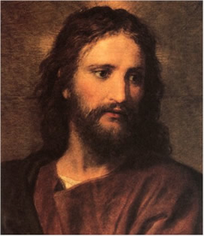
The Rest of the Story
Most people have no trouble with the Father being an Eternal Being and a member of the Godhead, However, when it comes to Christ and the Holy Spirit, people can become very adamant and even angry. Let us then proceed to look at the other members of the Godhead; the Son and the Holy Spirit!

Slide 13
Inspirational Support
Isaiah 9:6 “For unto us a child is born, unto us a son is given: and the government shall be upon his shoulder: and his name shall be called Wonderful, Counselor, The mighty God, The everlasting Father, The Prince of Peace.”
John 1:1-4 “In the beginning was the Word, and the Word was with God, and the Word was God. The same was in the beginning with God. All things were made by him; and without him was not any thing made that was made. In him was life; and the life was the light of men.”
John 8:56-58 “Your father Abraham rejoiced to see my day: and he saw it, and was glad. Then said the Jews unto him, Thou art not yet fifty years old, and hast thou seen Abraham? Jesus said unto them, Verily, verily, I say unto you, Before Abraham was, I am.”
Micah 5:2 “But thou, Bethlehem Ephratah, though thou be little among the thousands of Judah, yet out of thee shall he come forth unto me that is to be ruler in Israel; whose goings forth have been from of old, from everlasting.”

Slide 14

From the Pen of Prophecy
“With solemn dignity Jesus answered, "Verily, verily, I say unto you, Before Abraham was, I Am." Silence fell upon the vast assembly. The name of God, given to Moses to express the idea of the eternal presence, had been claimed as His own by this Galilean Rabbi. He had announced Himself to be the self-existent One, He who had been promised to Israel, "whose goings forth have been from of old, from the days of eternity." Micah 5:2, margin. “ DA, pgs. 469, 470 “The Lord Jesus Christ, the divine Son of God, existed from eternity, a distinct person,--The Review and Herald, April 5, 1906, p. 8.

Slide 15
Peter and Ananias and the Holy Spirit
“But a certain man named Ananias, with Sapphira his wife, sold a possession, And kept back part of the price, his wife also being privy to it, and brought a certain part, and laid it at the apostles' feet. But Peter said, Ananias, why hath Satan filled thine heart to lie to the Holy Ghost, and to keep back part of the price of the land? Whiles it remained, was it not thine own? and after it was sold, was it not in thine own power? why hast thou conceived this thing in thine heart? thou hast not lied unto men, but unto God.” Acts 5:1-4

Slide 16
EGW and the Holy Spirit
“Evil had been accumulating for centuries, and could only be restrained and resisted by the mighty power of the Holy Spirit, the third person of the Godhead, who would come with no modified energy, but in the fullness of divine power. Another spirit must be met, for the essence of evil was working in all ways, and the submission of man to this satanic captivity was amazing.” UL 51
“Christ determined that when He ascended from this earth He would bestow a gift on those who had believed on Him and those who should believe on Him. What gift could He bestow rich enough to signalize and grace His ascension to the mediatorial throne? It must be worthy of His greatness and His royalty. He determined to give His representative, the third person of the Godhead. This gift could not be excelled.” (ST, December 1, 1898)

Slide 17
Some Things are a Mystery!
“How much more shall the blood of Christ, who through the eternal Spirit offered himself without spot to God, purge your conscience from dead works to serve the living God?” Hebrews 9:14
“Howbeit when he, the Spirit of truth, is come, he will guide you into all truth: for he shall not speak of himself; but whatsoever he shall hear, that shall he speak: and he will shew you things to come.” John 16:13
“It is not essential for us to be able to define just what the Holy Spirit is. Christ tells us that the Spirit is the Comforter, "the Spirit of truth, which proceedeth from the Father." It is plainly declared regarding the Holy Spirit that, in His work of guiding men into all truth, "He shall not speak of Himself." John 15:26; 16:13. The nature of the Holy Spirit is a mystery. Men cannot explain it, because the Lord has not revealed it to them. Men having fanciful views may bring together passages of Scripture and put a human construction on them, but the acceptance of these views will not strengthen the church. Regarding such mysteries, which are too deep for human understanding, silence is golden.
The office of the Holy Spirit is distinctly specified in the words of Christ: "When He is come, He will reprove the world of sin, and of righteousness, and of judgment." John 16:8. It is the Holy Spirit that convicts of sin.” AA, pgs. 51,52

Slide 18
How About the Pioneers?
Several early pioneers in Adventism believed that Jesus Christ was a created being and that the Holy Spirit came forth from the Father and the Son. They believed as Arius, an early church father believed. Several have tried to place Ellen White in that category and that simply is not true. We follow what the Bible and SOP said. As long as the pioneers followed Inspiration, then they were fine, but on some things they didn’t and the doctrine of the 3 Person Godhead is one of them!

Slide 19

The Trinity
1. The word is not in Scripture.
2. It was adopted by the papists in some of the early church councils.
3. There is nothing in the natural world that can illustrate the Godhead.

