Slide 1
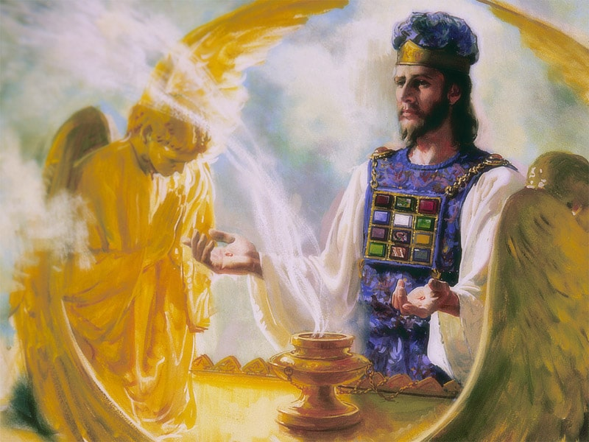
The Sanctuary pt 63: The Day of Atonement 10: The Pre-Advent Judgment

Slide 2
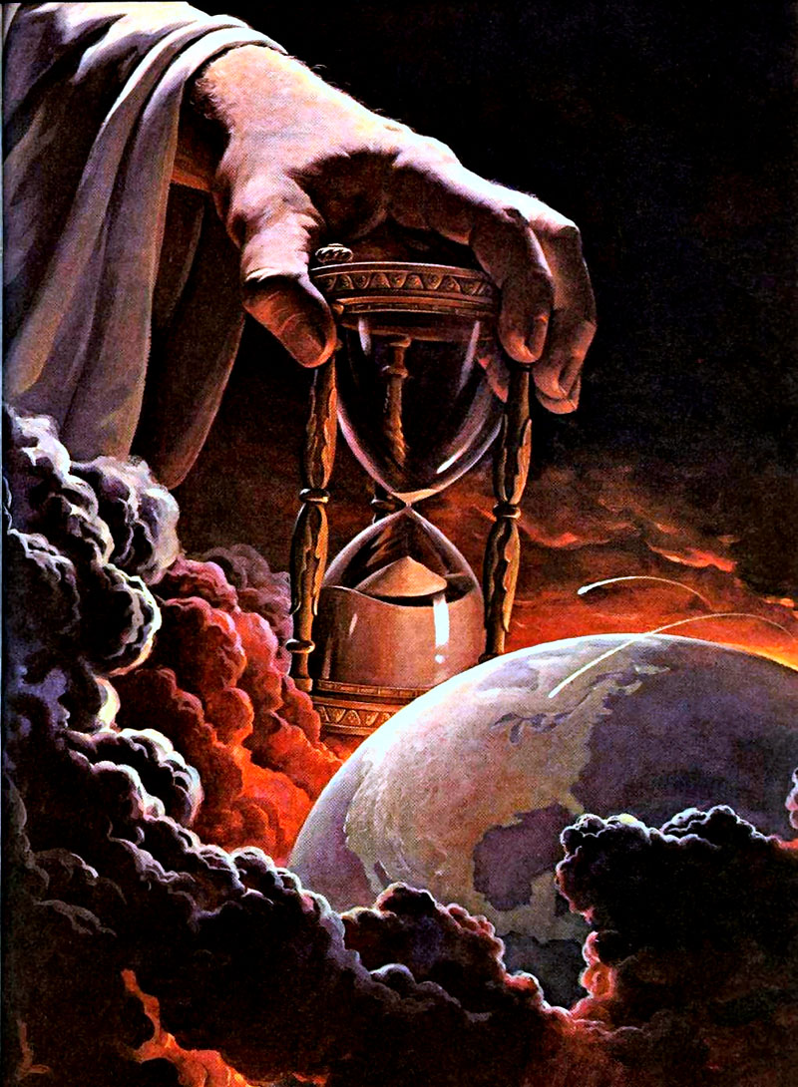
Who is in the Lamb’s Book of Life?
“Christ says of the overcomer, “I will not blot out his name out of the book of life.” The names of all those who have once given themselves to God are written in the book of life, and their characters are now passing in review before him. Angels of God are weighing moral worth. They are watching the development of character in those now living, to see if their names can be retained in the book of life. A probation is granted us in which to wash our robes of character and make them white in the blood of the Lamb. Who is doing this work? Who is separating from himself sin and selfishness? “Ye are dead,” says the apostle Paul of the true followers of Christ, “and your life is hid with Christ in God.” When we are alive to God, we are dead to self. May God help us to die to self. Whose names will not be blotted out of the book of life? Only the names of those who have loved God with all the powers of their being, and their neighbors as themselves.”—{Historical Sketches of the Foreign Missions of Seventh-day Adventists, p. 138}

Slide 3
The Books of Works
“In the case of each individual there is a process going forward which is far more wonderful than that which transfers the features to the polished plate of the artist. The art of the photographer merely imprints the likeness on perishable substance; but in the life-record the character is faithfully delineated, and this record, however dark, can never be effaced except by the blood of the atoning Sacrifice. Angels of God are taking a daguerreotype of the character just as accurately as the artist takes the likeness of the human features; and . . . it is from this that we are to be judged! When the Judgment shall sit, and the books shall be opened, there will be many astonishing disclosures. Men will not then appear as they appear to the human eyes and finite judgments. Secret sins will then be laid open to the view of all. Motives and intentions which have been hidden in the dark chambers of the heart will be revealed. All will appear as a real life-picture.”—Maranatha, 340

Slide 4
The Recorder Angel
“During the time of trouble, the position of God's people will be similar to the position of Joshua. They will not be ignorant of the work going on in heaven in their behalf. They will realize that sin is recorded against their names, but they will also know that the sins of all who repent and lay hold of the merits of Christ will be canceled. Jesus says: "He that overcometh, the same shall be clothed in white raiment; and I will not blot out his name out of the book of life, but I will confess his name before my Father, and before his angels." The judgment of the dead has been going on, and soon the judgment will begin upon the living, and every case will be decided. It will be known whose names are retained upon the book of life, and whose are blotted out. Every day the angels of God keep a record of the transactions of men, and these records stand open to the eyes of angels, and Christ, and God. Those who have manifested true repentance for sin, and by living faith in Christ are obedient to God's commandments, will have their names retained in the book of life, and they will be confessed before the Father and before the holy angels. Jesus will say, "They are mine; I have purchased them with my own blood." {ST, June 2, 1890}

Slide 5
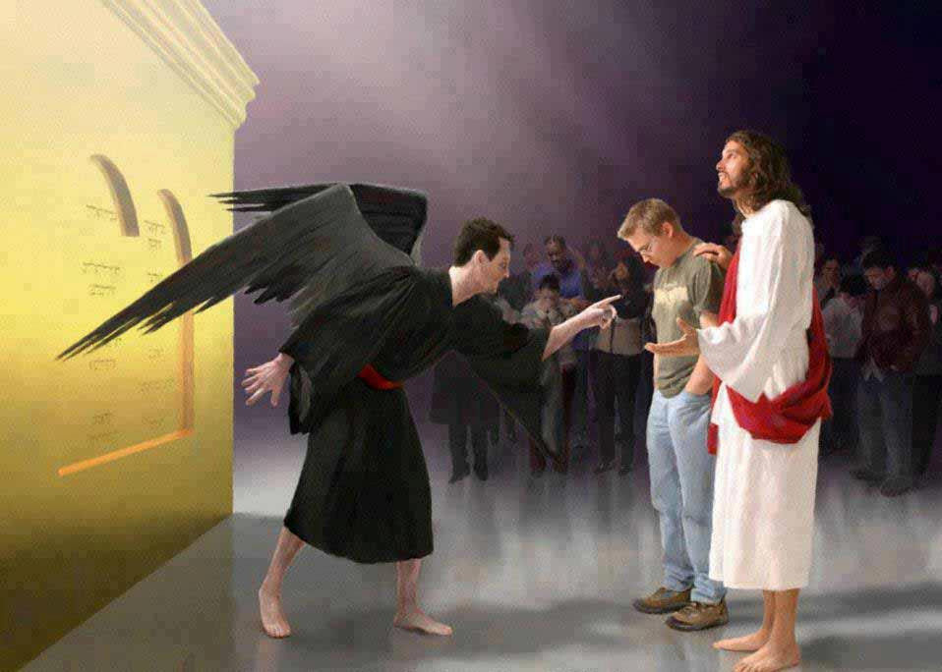
What the Tribunal Looks Like…
Zech. 3:1-4 “And he shewed me Joshua the high priest standing before the angel of the Lord, and Satan standing at his right hand to resist him. And the Lord said unto Satan, The Lord rebuke thee, O Satan; even the Lord that hath chosen Jerusalem rebuke thee: is not this a brand plucked out of the fire? Now Joshua was clothed with filthy garments, and stood before the angel. And he answered and spake unto those that stood before him, saying, Take away the filthy garments from him. And unto him he said, Behold, I have caused thine iniquity to pass from thee, and I will clothe thee with change of raiment.

Slide 6
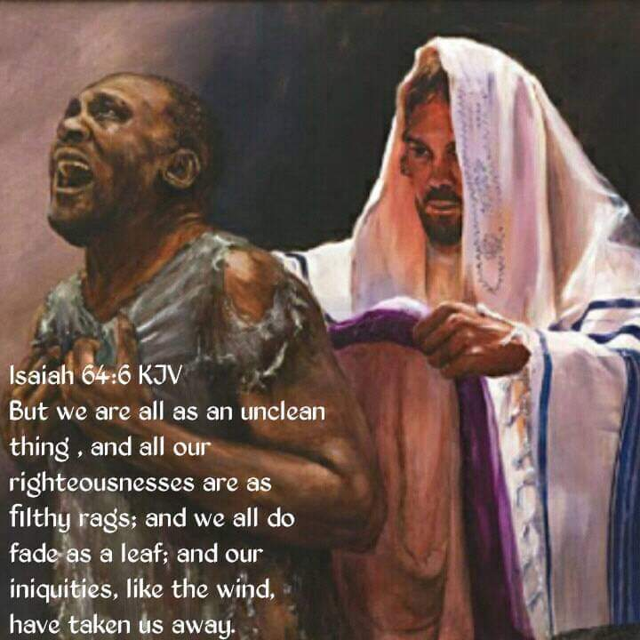
Filthy Rags vs Christ’s Righteousness
“The parable of the wedding garment opens before us a lesson of the highest consequence. By the marriage is represented the union of humanity with divinity; the wedding garment represents the character which all must possess who shall be accounted fit guests for the wedding.”—COB, 307

Slide 7
Satan’s Book Accuses Us in Heaven
Rev. 12:10-11 “And I heard a loud voice saying in heaven, Now is come salvation, and strength, and the kingdom of our God, and the power of his Christ: for the accuser of our brethren is cast down, which accused them before our God day and night. And they overcame him by the blood of the Lamb, and by the word of their testimony; and they loved not their lives unto the death.”

Slide 8
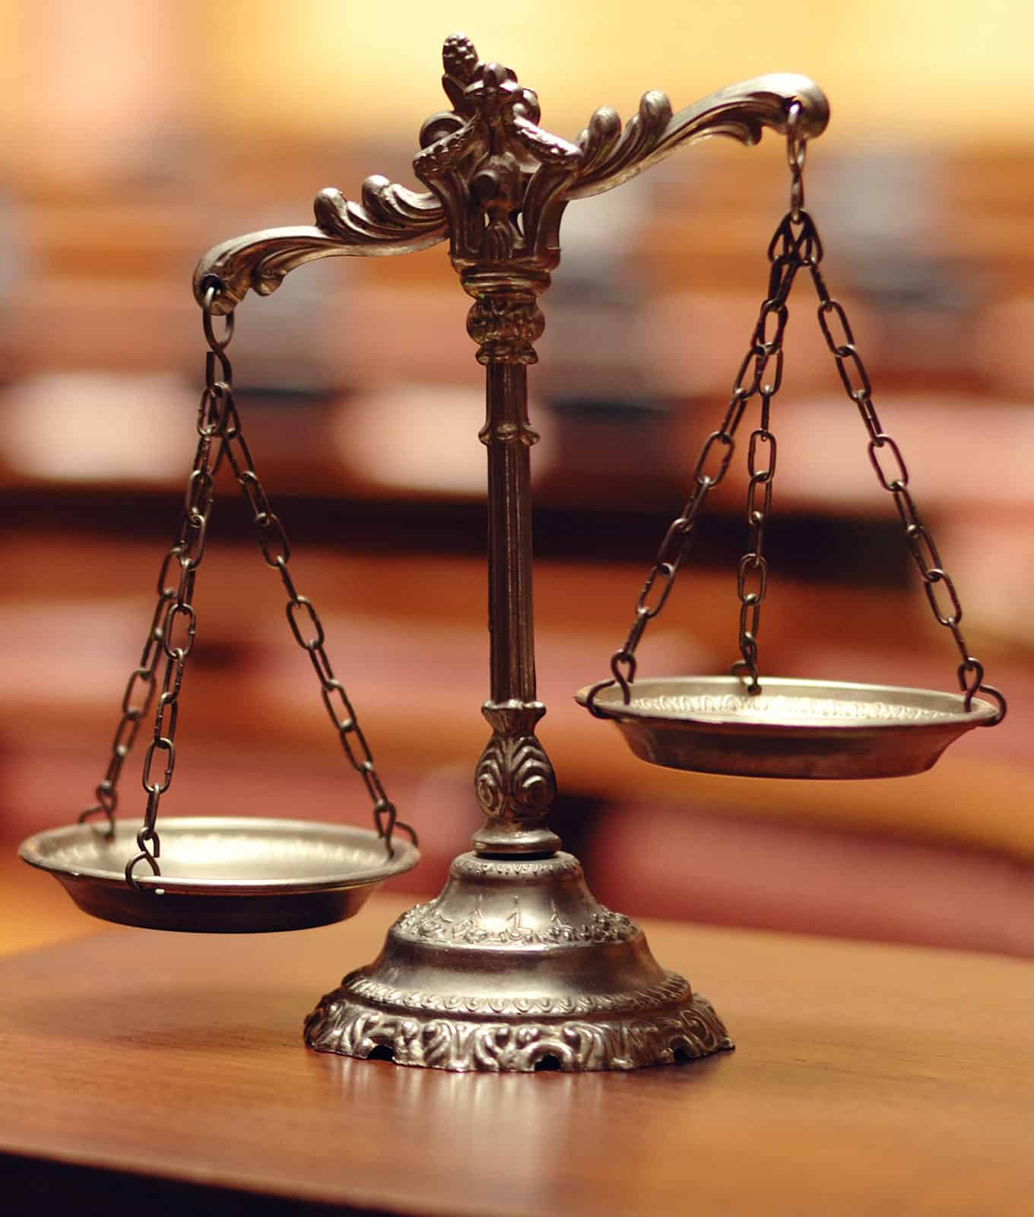
Your Book Stands, or You Stand!
Rev. 20:12-14 “And I saw the dead, small and great, stand before God; and the books were opened: and another book was opened, which is the book of life: and the dead were judged out of those things which were written in the books, according to their works. And the sea gave up the dead which were in it; and death and hell delivered up the dead which were in them: and they were judged every man according to their works. And death and hell were cast into the lake of fire. This is the second death.

Slide 9
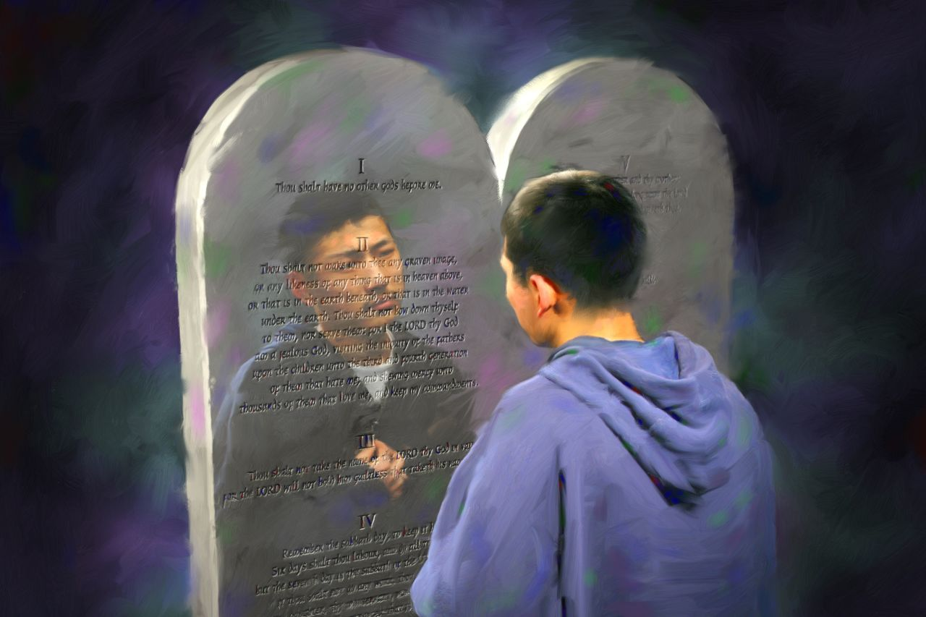
What Will Be Judged By???
James 2:10-12 “For whosoever shall keep the whole law, and yet offend in one point, he is guilty of all. For he that said, Do not commit adultery, said also, Do not kill. Now if thou commit no adultery, yet if thou kill, thou art become a transgressor of the law. So speak ye, and so do, as they that shall be judged by the law of liberty.”

Slide 10
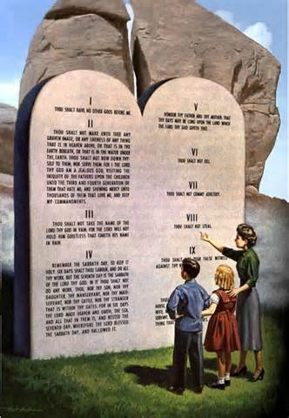
Christ’s Character is the Law???
“Turning away from the law of God, trampling the commandments under their feet, men cannot know God; for the law of God is a transcript of his character. Failing to understand the law of God, they also fail to know the human agent who discerns the attributes of the character of God revealed in his law. This is why men are filled with prejudice against the truth of God, why they are inspired with the spirit of the great adversary of God and of his children. This is why they bear false reports, fabricating lies, and loving the lies that are prepared for their using. This is why they make such decided efforts to turn away the people from the law of God; for they have not seen him, neither known him.” RH, March 9, 1897

Slide 11
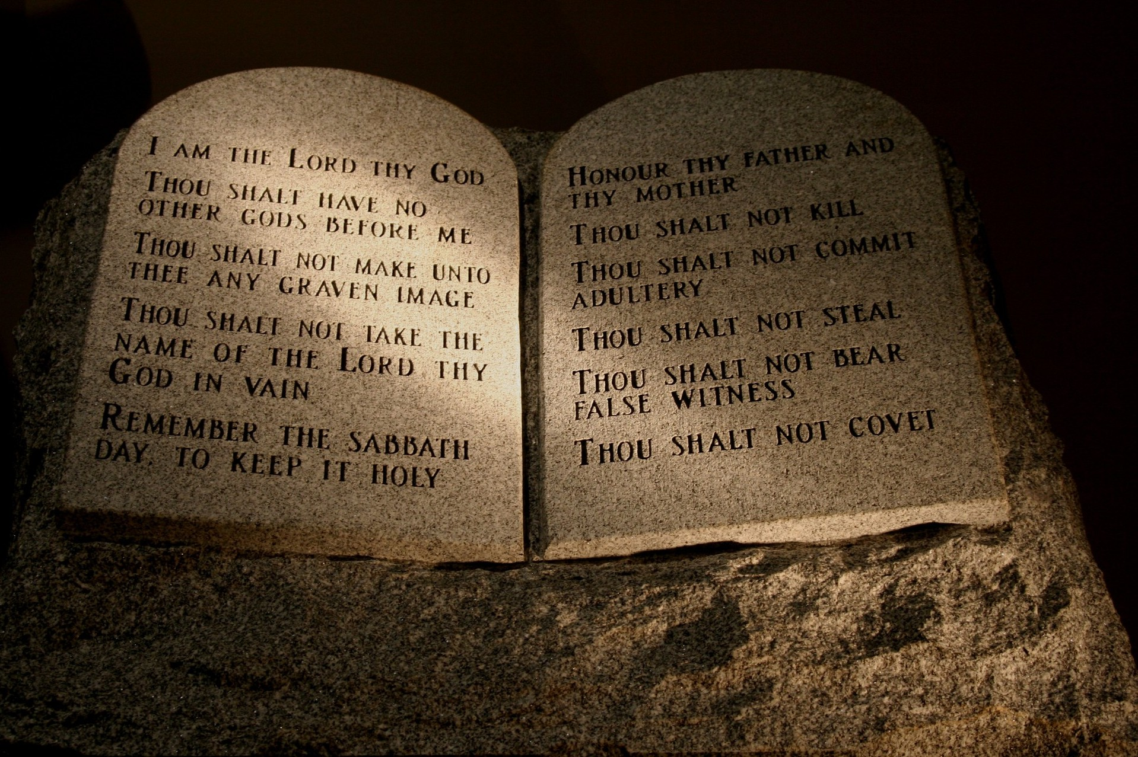
Ecclesiastes
Ecc. 12:13-14 “Let us hear the conclusion of the whole matter: Fear God, and keep his commandments: for this is the whole duty of man. For God shall bring every work into judgment, with every secret thing, whether it be good, or whether it be evil.”

Slide 12
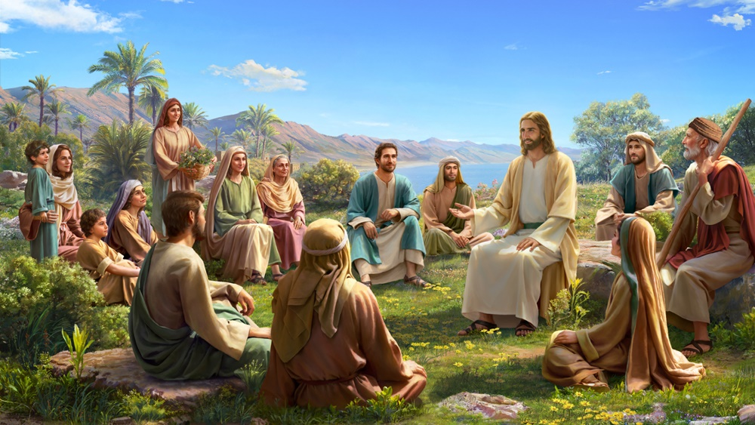
In Thought and Deed!
Matt. 5:27-28 “Ye have heard that it was said by them of old time, Thou shalt not commit adultery: But I say unto you, That whosoever looketh on a woman to lust after her hath committed adultery with her already in his heart.”
Job 31:1 “I made a covenant with mine eyes; why then should I think upon a maid?”

Slide 13
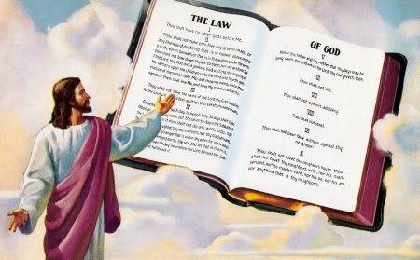
Judged By Your Words Too
Matt. 12:36-37 “But I say unto you, That every idle word that men shall speak, they shall give account thereof in the day of judgment. For by thy words thou shalt be justified, and by thy words thou shalt be condemned.”

Slide 14
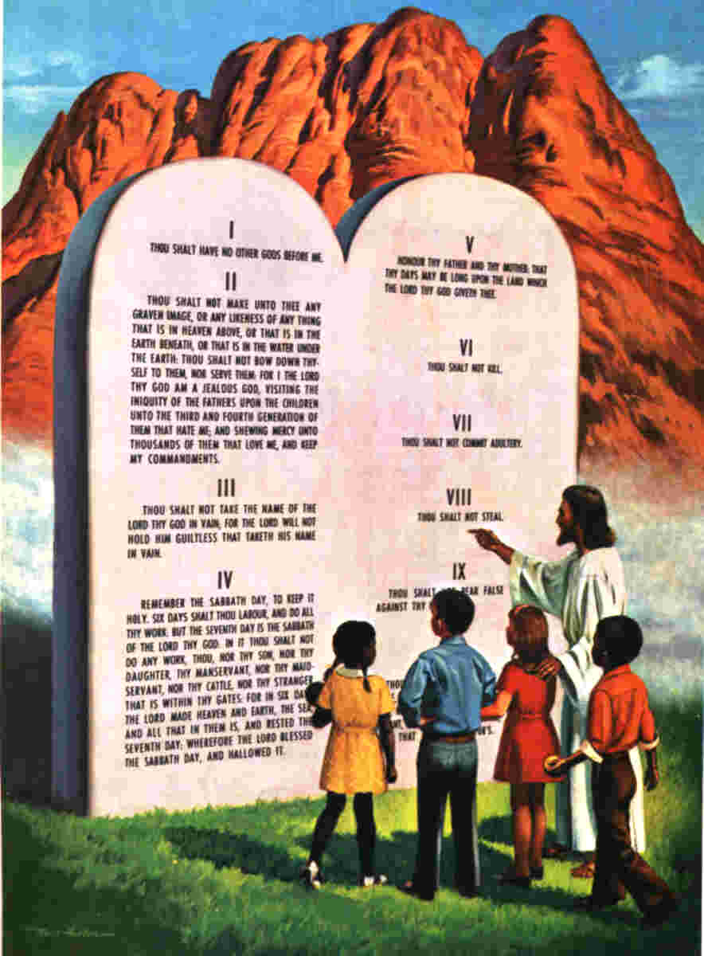
You Will By Judged in the Way You Judge Others
Matt. 7:2 “For with what judgment ye judge, ye shall be judged: and with what measure ye mete, it shall be measured to you again.”

Slide 15
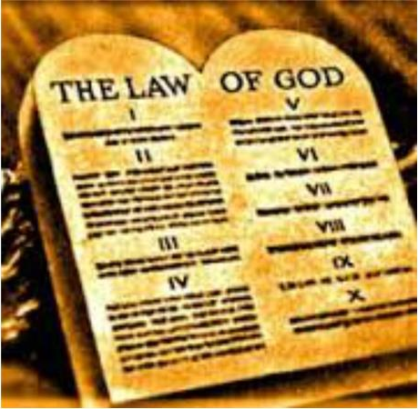
Mrs. White Sheds Some Light on Judgment Scene
“Every man's work passes in review before God and is registered for faithfulness or unfaithfulness. Opposite each name in the books of heaven is entered with terrible exactness every wrong word, every selfish act, every unfulfilled duty, and every secret sin, with every artful dissembling. Heaven-sent warnings or reproofs neglected, wasted moments, unimproved opportunities, the influence exerted for good or for evil, with its far-reaching results, all are chronicled by the recording angel. The law of God is the standard by which the characters and the lives of men will be tested in the judgment.” GC, 482

Slide 16
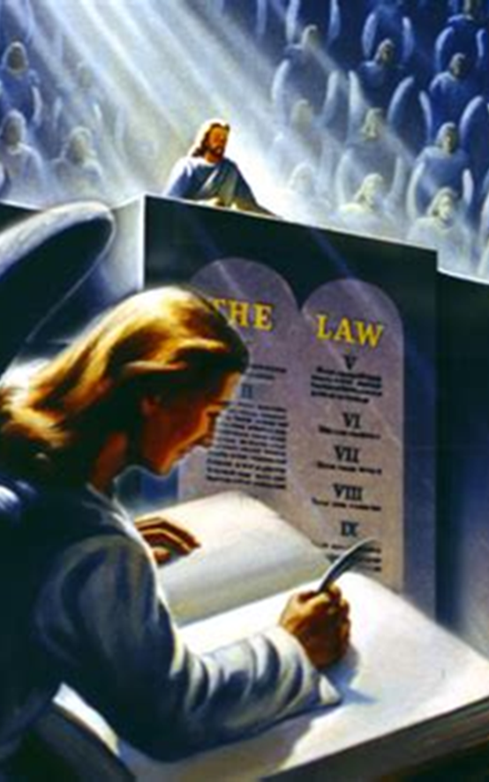
Judgment Began With Righteous Dead?
“As the books of record are opened in the judgment, the lives of all who have believed on Jesus come in review before God. Beginning with those who first lived upon the earth, our Advocate presents the cases of each successive generation, and closes with the living. Every name is mentioned, every case closely investigated. Names are accepted, names rejected. When any have sins remaining upon the books of record, unrepented of and unforgiven, their names will be blotted out of the book of life, and the record of their good deeds will be erased from the book of God's remembrance.” GC, 483

Slide 17
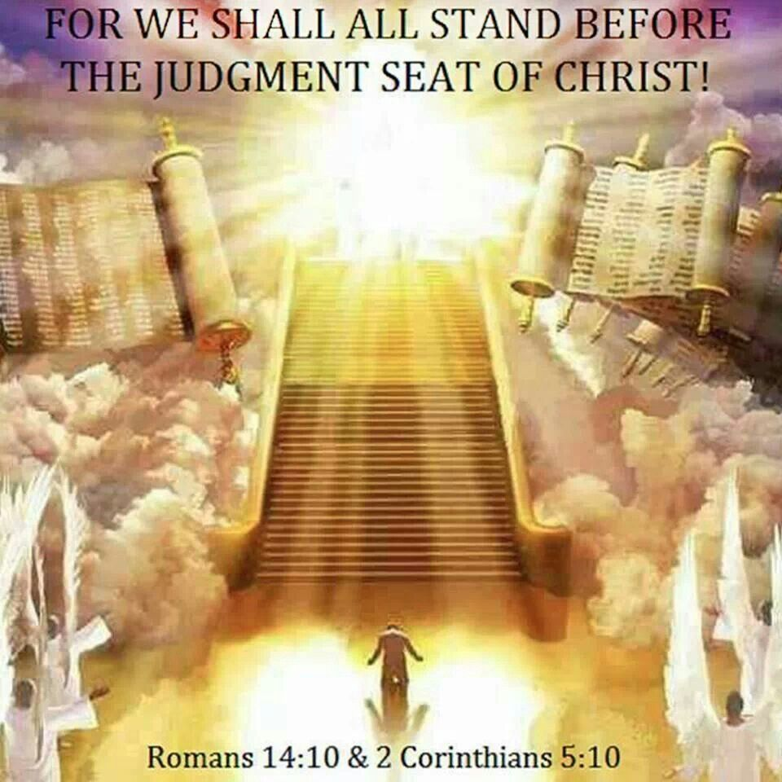
Righteous Dead then Righteous Living
“Every case had been decided for life or death. While Jesus had been ministering in the sanctuary, the judgment had been going on for the righteous dead, and then for the righteous living. Christ had received His kingdom, having made the atonement for His people and blotted out their sins. The subjects of the kingdom were made up. The marriage of the Lamb was consummated. And the kingdom, and the greatness of the kingdom under the whole heaven, was given to Jesus and the heirs of salvation, and Jesus was to reign as King of kings and Lord of lords.” {EW 280.1}

Slide 18
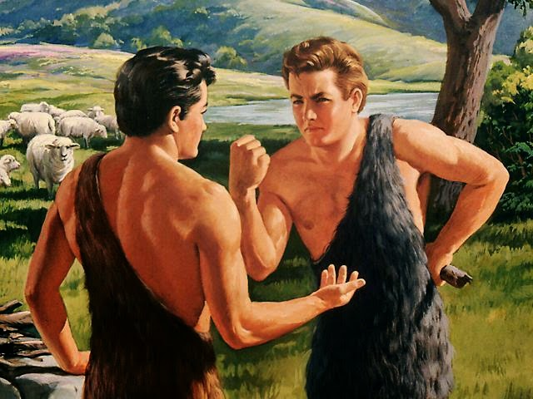
Began with Abel?
“A few graves were opened at the resurrection of Christ; but at His second coming all the precious dead, from righteous Abel to the last saint that dies, shall awake to glorious, immortal life.”—ST April 22, 1913

Slide 19
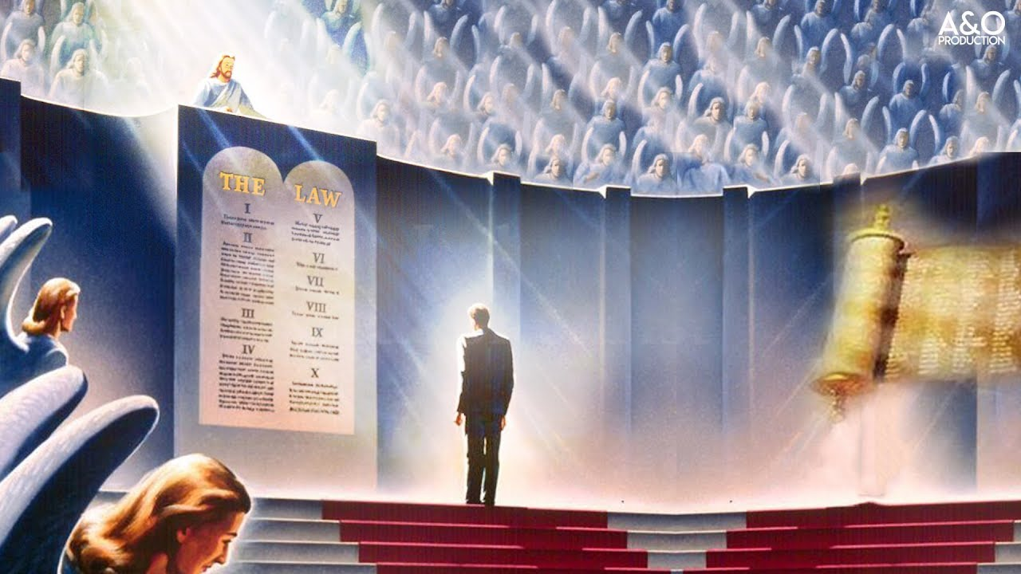
Judgment of the Living Begins At the House of God
1 Pet. 4:17-18 “For the time is come that judgment must begin at the house of God: and if it first begin at us, what shall the end be of them that obey not the gospel of God? And if the righteous scarcely be saved, where shall the ungodly and the sinner appear?”

Slide 20
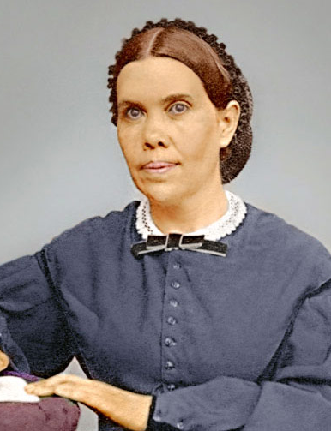
Mrs. White Elaborates
“Solemn are the scenes connected with the closing work of the atonement. Momentous are the interests involved therein. The judgment is now passing in the sanctuary above. For many years this work has been in progress. Soon--none know how soon--it will pass to the cases of the living. In the awful presence of God our lives are to come up in review. At this time above all others it behooves every soul to heed the Saviour's admonition: "Watch and pray: for ye know not when the time is." Mark 13:33. "If therefore thou shalt not watch, I will come on thee as a thief, and thou shalt not know what hour I will come upon thee." Revelation 3:3.” {GC 490.1}

Slide 21
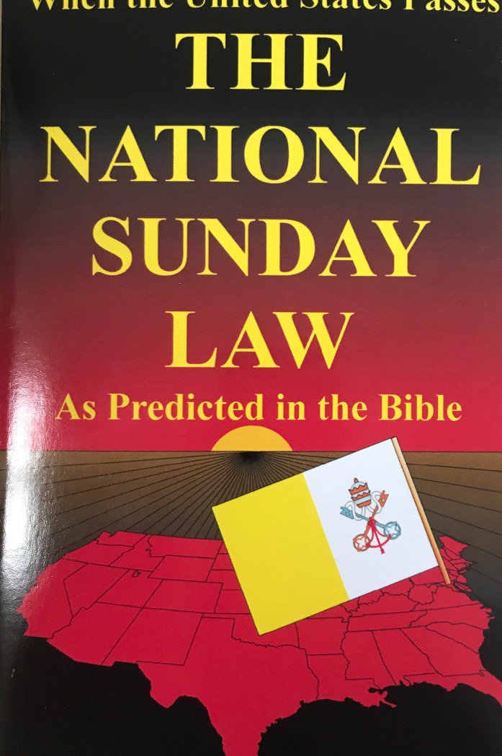
When Does Judgment of the Living Begin???
“The image of the beast will be formed before probation closes; for it is to be the great test for the people of God, by which their eternal destiny will be decided.... This is the test that the people of God must have before they are sealed. All who prove their loyalty to God by observing His law, and refusing to accept a spurious sabbath, will rank under the banner of the Lord God Jehovah, and will receive the seal of the living God. Those who yield the truth of heavenly origin, and accept the Sunday sabbath, will receive the mark of the beast.”—Maranatha p. 164

Slide 22
When is Probation Closed?
“The same angel who visited Sodom is sounding the note of warning, "Escape for thy life." The bottles of God's wrath cannot be poured out to destroy the wicked and their works until all the people of God have been judged, and the cases of the living as well as the dead are decided. And even after the saints are sealed with the seal of the living God, His elect will have trials individually. Personal afflictions will come; but the furnace is closely watched by an eye that will not suffer the gold to be consumed. The indelible mark of God is upon them. God can plead that His own name is written there. The Lord has shut them in. Their destination is inscribed--"God, New Jerusalem." They are God's property, His possession. Will this seal be put upon the impure in mind, the fornicator, the adulterer, the man who covets his neighbor's wife? Let your souls answer the question, Does my character correspond to the qualifications essential that I may receive a passport to the mansions Christ has prepared for those who are fitted for them? Holiness must be inwrought in our character.” {TM 446.2}

Slide 23
Another Quote
“As Jesus moved out of the most holy place, I heard the tinkling of the bells upon His garment; and as He left, a cloud of darkness covered the inhabitants of the earth. There was then no mediator between guilty man and an offended God. While Jesus had been standing between God and guilty man, a restraint was upon the people; but when He stepped out from between man and the Father, the restraint was removed and Satan had entire control of the finally impenitent. It was impossible for the plagues to be poured out while Jesus officiated in the sanctuary; but as His work there is finished, and His intercession closes, there is nothing to stay the wrath of God, and it breaks with fury upon the shelterless head of the guilty sinner, who has slighted salvation and hated reproof. In that fearful time, after the close of Jesus' mediation, the saints were living in the sight of a holy God without an intercessor. Every case was decided, every jewel numbered. Jesus tarried a moment in the outer apartment of the heavenly sanctuary, and the sins which had been confessed while He was in the most holy place were placed upon Satan, the originator of sin, who must suffer their punishment” EW, 280-281

Slide 24
Probation Closes Unnoticed
“When the work of the investigative judgment closes, the destiny of all will have been decided for life or death. Probation is ended a short time before the appearing of the Lord in the clouds of heaven. Christ in the Revelation, looking forward to that time, declares: "He that is unjust, let him be unjust still: and he which is filthy, let him be filthy still: and he that is righteous let him be righteous still: and he that is holy, let him be holy still. And, behold, I come quickly; and My reward is with Me, to give every man according as his work shall be." Revelation 22:11, 12. The righteous and the wicked will still be living upon the earth in their mortal state--men will be planting and building, eating and drinking, all unconscious that the final, irrevocable decision has been pronounced in the sanctuary above. Before the Flood, after Noah entered the ark, God shut him in and shut the ungodly out; but for seven days the people, knowing not that their doom was fixed, continued their careless, pleasure-loving life and mocked the warnings of impending judgment. "So," says the Saviour, "shall also the coming of the Son of man be." Matthew 24:39. Silently, unnoticed as the midnight thief, will come the decisive hour which marks the fixing of every man's destiny, the final withdrawal of mercy's offer to guilty men.”—GC, 490-491

Slide 25
